Slide 1
Stock Market prediction using various Machine Learning models
Mithas Kumar (181IT227)
Prasad Jagtap (181IT134)
K Keerthana (181IT221)
Yash Parakh (181IT253)

Slide 2
Problem Statement
Implementing a model for stock market prediction to help the investors in fast changing stock market using machine learning approach.
Feature extraction from financial data is one of the most important problems in market prediction domain for which many approaches have been suggested. Among other modern tools, convolutional neural networks (CNN) have recently been applied for automatic feature selection and market prediction, which is used in our base paper.

Slide 3
Objectives
The ultimate goal of our application is to serve retail investors as a third party investment tool that uses machine learning to help them navigate in the fast-changing stock market
The project aims to introduce and democratize the latest machine learning technologies for retail investors.
Aim of project is to serve supplementary quantitative tool for investors to see the market at a different perspective with the help of technology.

Slide 4
DATASET
The data set in consideration is a combination of the world news and stock price shifts available on Kaggle.
There are 25 columns of top news headlines for each day in the data frame.
Data ranges from 2008 to 2016 and the data from 2000 to 2008 was scrapped from Yahoo finance.
Labels are based on the Dow Jones Industrial Average stock index.
Class 1→ the stock price increased.
Class 0→ the stock price stayed the same or decreased.

Slide 5
Data Wrangling
The data has a lot of stopwords. (Words like a, the, you doesn’t help in predicting a stock!)
Convert all the words to lowercase.
Remove punctuation marks and numbers.
Combine all the top 25 News headline into one single list of words per day.

Slide 6
Words → Vectors
CountVectorizer helps to tokenize and determine the frequency of the words.
Then fit_transform is applied on the above object to obtain a sparse matrix of word counts.

Slide 7
LSTM
Long Short-Term Memory (LSTM) networks are a type of recurrent neural network capable of learning order dependence in sequence prediction problems.
LSTM can learn to bridge minimal time lags in excess of 1000 discrete time steps by enforcing constant error flow within special units, called cells.
The two technical problems overcome by LSTMs are vanishing gradients and exploding gradients, both related to how the network is trained.
The key to the LSTM solution to the technical problems was the specific internal structure of the units used in the model.

Slide 8
Random Forest
Random Forest consists of a collection or ensemble of simple tree predictors, each capable of producing a response when presented with a set of predictor values.
The RF algorithm grows n decision trees as the weak classifier, each provides different kind of classification, and then merge all the trees into a forest.
Unlike decision tree or K-NN method, RF don’t have to take the cross validation.

Slide 9
Naïve Bayes
This model provides a family of probabilistic classifiers that are based on the Bayes theorem with strong independence characteristics within its feature vectors.
P(A/B) = P(B/A)P(A) /P(B) where A and B are events and P(B) ≠ 0.
● P(A) and P(B) are the probabilities of observing A and B without regard to each other.
● P(A | B), a conditional probability, is the probability of observing event A given that B is true.

Slide 10
Support Vector Machine
Given labeled training data, the algorithm outputs an optimal hyperplane which categorizes new examples.
SVM is a margin-based classification method. It discriminates the data by a separating hyperplane and it’s margin.
We have only 2 classes and 25 features in each data, we can get low testing error if the training error is also small. Therefore it is suitable for classifying our data set. In addition, the kernel method is also taken into our SVM model to sparse the data which cannot be distinguished in original space.

Slide 11
Logistic Regression
It is a statistical method for analyzing a dataset in which there are one or more independent variables that determine an outcome.
Logistic Regression is widely used in classification and data analysis. It is appropriate when the response take only one of two values, that is, there are only two classes for the dependent variables. Therefore it is also appropriate to our data set.
Using this we are able to connect the relation between the specific words that appear frequently, and identify what tendency the headline (our data set) has, so that can predict the price of the stock in the next day.

Slide 12
Methodology
Collecting the data (TTM stock 2015 - 2020)
Preprocessing the data (Train and Test)
Create a stacked LSTM model, train it
Predict the test data and plot the output
Predict the future 10 days stock and plot the output

Slide 13
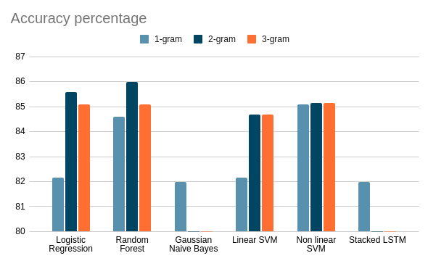
Result and Analysis

Slide 14
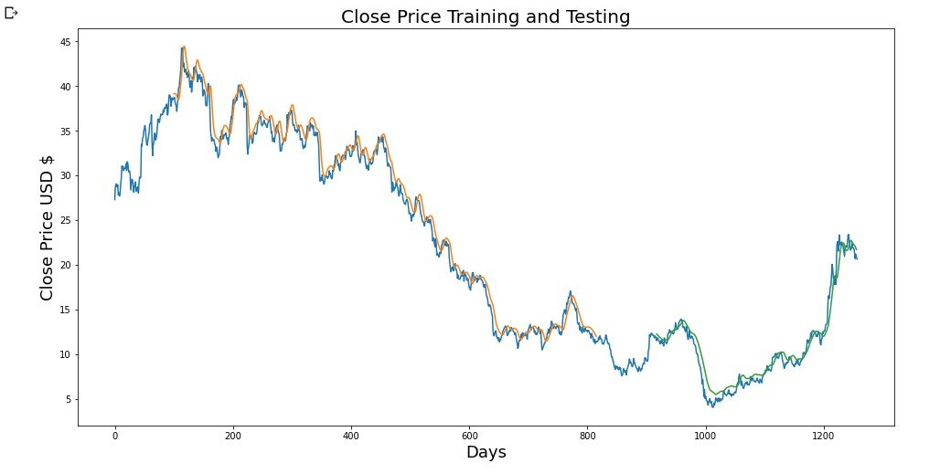

Slide 15
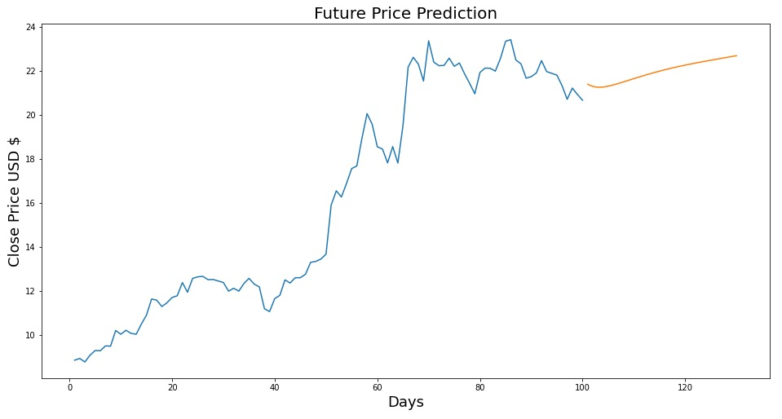

Slide 16
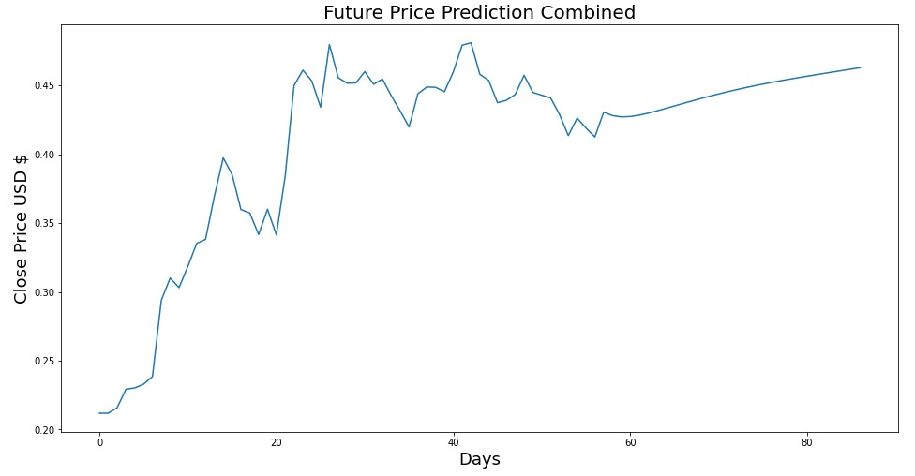

Slide 17
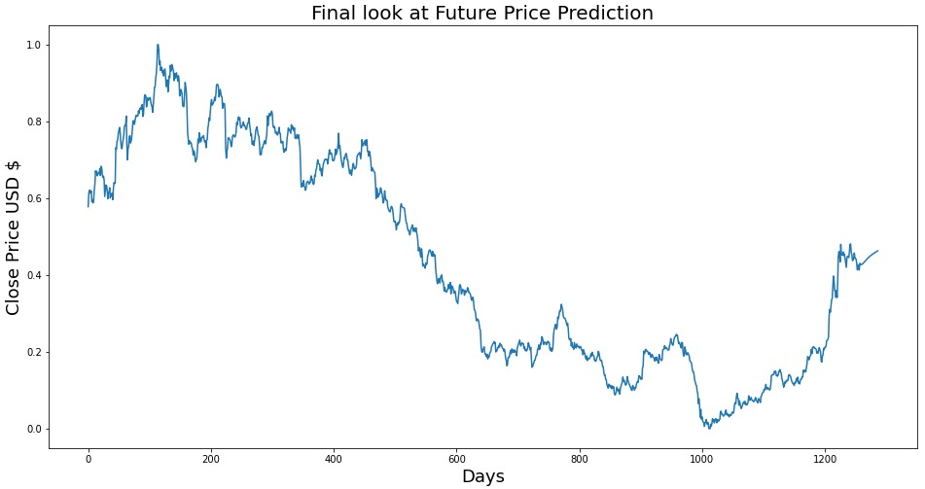

Slide 18
Conclusion
Random forests had highest accuracy on the a bi-gram model as shown in the chart. The prediction accuracy was 85.97%.
Using Natural Language Processing techniques, we were able to accurately predict the stock market trends 85% of the time.
Using Stacked LSTM model we got the accuracy of 82%.
In conclusion NLP techniques fairs better in comparison to Trend prediction

