Slide 1
VRSU on Datalogger

Slide 2
Use Cases
Signal Light Violation
Log Red Light violation
Log Amber light crossing
Vehicle Speed
Log Speed Limit Violation
Log Excess speed wrt to known Speed Limit
Log special zone information (WZ, School etc.,)
Have to confirm if we get data
Consider hours of the day for special zones like schools
Driving environment
Traffic conditions
Locations
Future Possibilities
Wrong Side Driving - Potentially on Highways
Driver Behavior (under identified conditions)
Move over compliance (Approaching Emergency Vehicle)
Pedestrian crossing (in vehicle path)
Vehicle passing VRU
Railway crossing

Slide 3
Potential sources
VDOT
MAP, SPaT, WZ data, Speed Limits
HAAS
Work Zones, Emergency Vehicles
Google Maps, Waze, Here Maps
Speed Limits
https://notraffic.tech/how-it-works/ (to be explored)

Slide 4
VDOT Cloud Data Analysis
3/5/2024

Slide 5
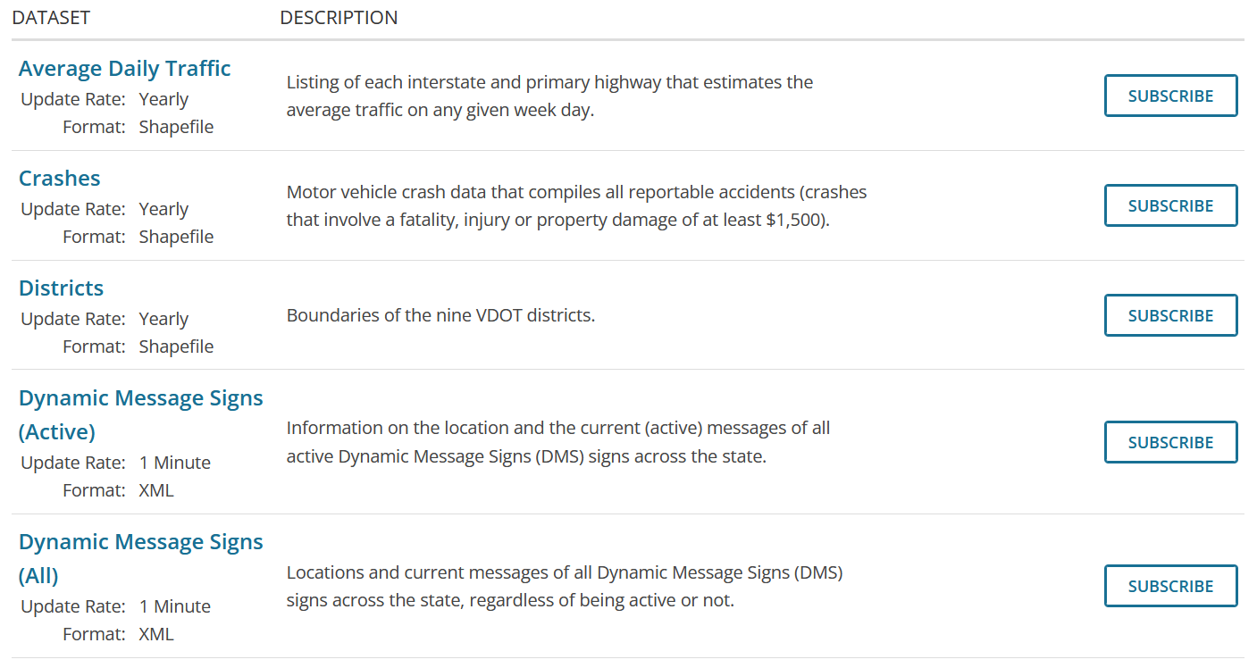
Types of Datasets Available
VDOT has many datasets that you can subscribe to.
You will need a different API Key to subscribe to different Datasets
The types of Datasets are:

Slide 6
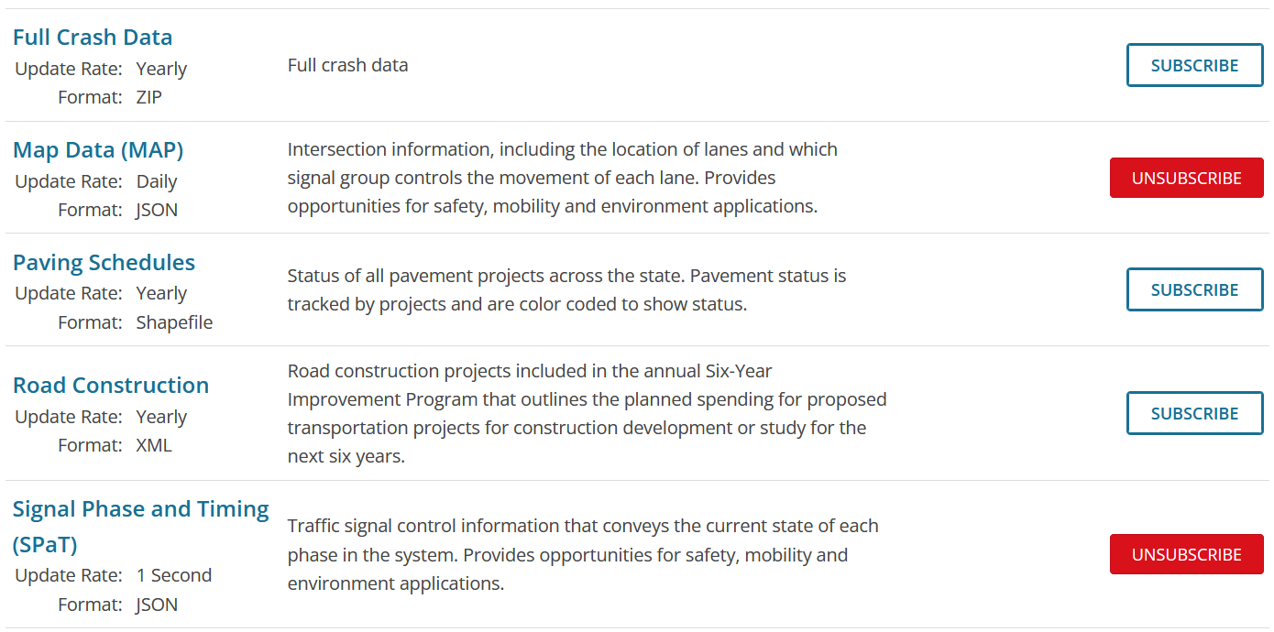
Types of Datasets Available

Slide 7
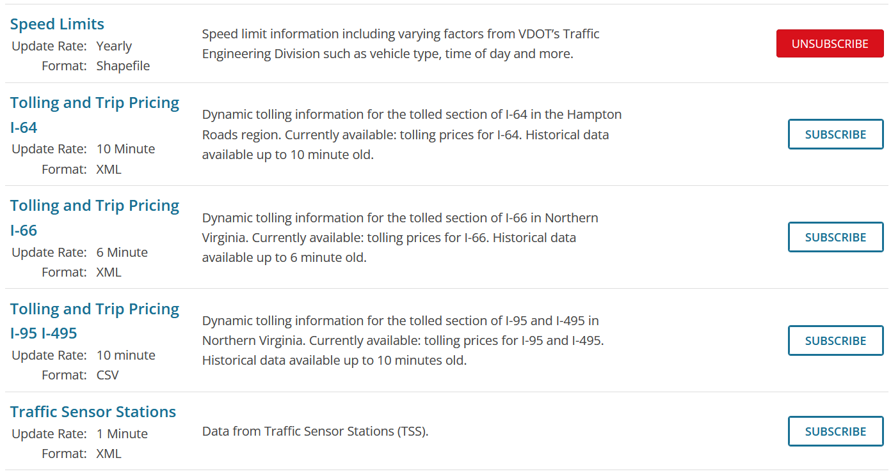
Types of Datasets Available

Slide 8
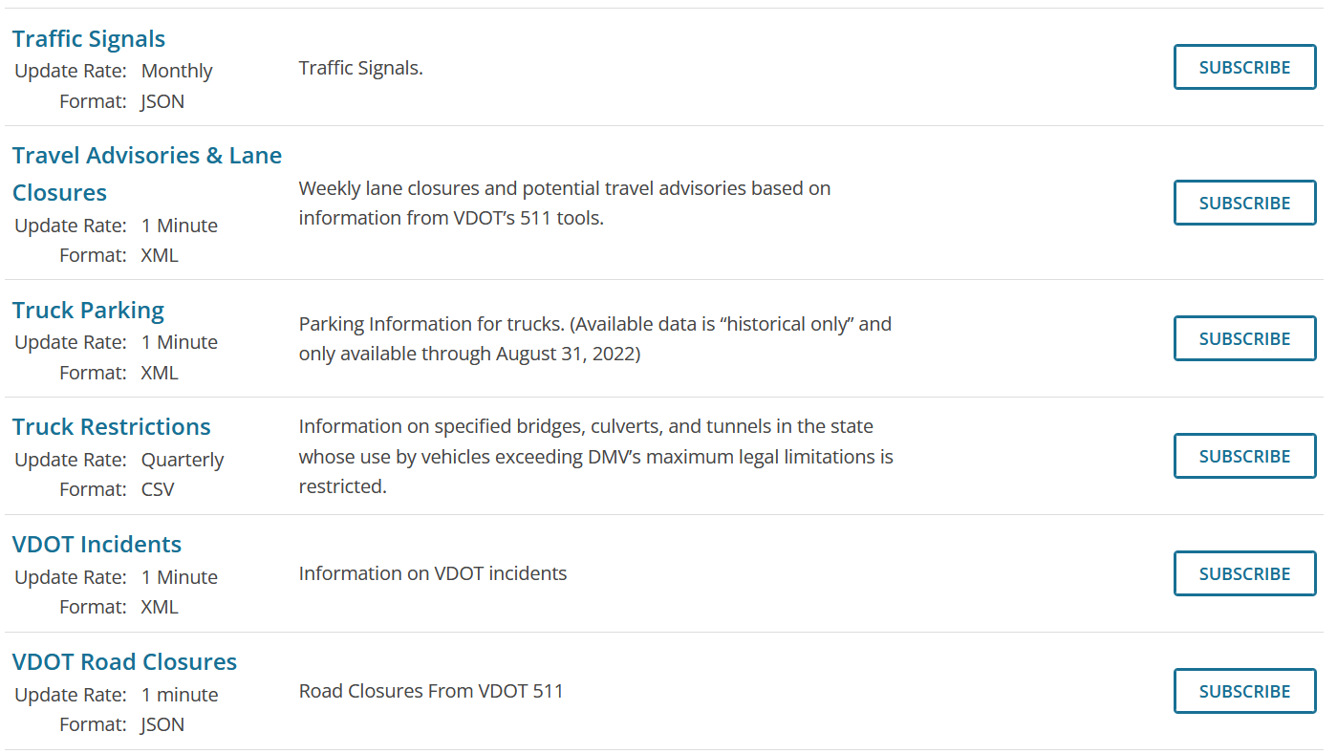
Types of Datasets Available

Slide 9
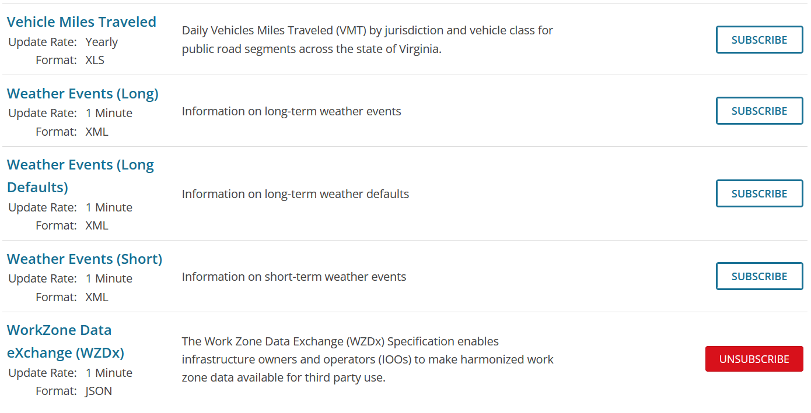
Types of Datasets Available

Slide 10
What was evaluated
MAP Dataset
SPaT Dataset
Speed Limit Dataset
WZDx (Work Zone Data eXchange) Dataset

Slide 11
MAP Dataset
I was able to receive MAP Messages from 24 different intersections in the Virginia State
MAP Messages received from 24 Intersections: [115, 116, 117, 118, 119, 120, 121, 122, 127, 128, 130, 133, 135, 136, 137, 152, 153, 154, 156, 157, 158, 159, 167, 173]

Slide 12
SPaT Dataset
There are 2 ways you can subscribe to this data
Give all SPaT Messages from the last 1 to 120 seconds from server
Give last 1 to 120 SPaT Messages from server
Unique SPaT Messages received from 1 Intersections over last 1 Seconds: [127]
Unique SPaT Messages received from 2 Intersections over last 2 Seconds: [127, 156]
Unique SPaT Messages received from 5 Intersections over last 5 Seconds: [127, 135, 137, 153, 156]
Unique SPaT Messages received from 7 Intersections over last 10 Seconds: [127, 128, 133, 135, 137, 153, 156]
Unique SPaT Messages received from 15 Intersections over last 120 Seconds: [117, 120, 127, 128, 133, 135, 136, 137, 152, 153, 154, 156, 157, 158, 159]
I can see there 6 out of 24 Intersections, there is no SPaT Data coming through.

Slide 13
Darby Interface
I was able to write a quick code which subscribe to this data and feed it into our vRSU Darby Server.
With this code active, I tried to simulate my android tablet as if is driving in Virginia in an active intersection.
The Android App is able to pick up the MAP and the SPaT but for reason it is not showing the actual SPaT Timing on the App. Debugging going on...

Slide 14
WZDx Dataset
WZDx is the standardized way for DOTs to create and share WorkZone information
The format here is JSON.
DOTs that use this format currently:
Colorado Department of Transportation
Florida Department of Transportation
Iowa Department of Transportation
Maricopa County (Arizona) Department of Transportation
Maryland Department of Transportation
Massachusetts Department of Transportation
Metropolitan Transportation Commission (California)
Minnesota Department of Transportation
Missouri Department of Transportation
National Park Service – Mojave National Preserve
North Carolina Department of Transportation
Oklahoma Department of Transportation
Texas Department of Transportation
Utah Department of Transportation
Virginia Department of Transportation
Wisconsin Department of Transportation

Slide 15
WZDx Dataset
This API is giving me the WorkZones in Virginia.
Amount of Workzones I get back from server is different on different days. This means this data feed is live and active.
Number of WorkZones received through WZDx are: 512
As part of this data there is an optional field "reduced_speed_limit_kph" which tells the speed limit restriction in that work zone.
I parsed all the 512 data points. None of them have this optional field populated.

Slide 16
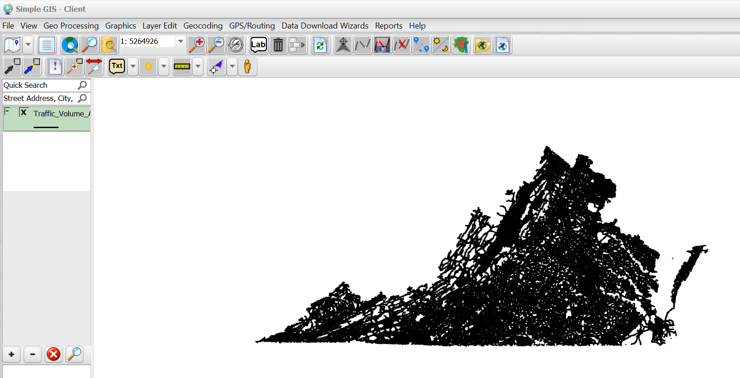
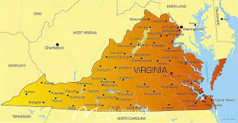
Speed Limit Dataset
This API is giving me a shapefile.
A shapefile is a geometric represenation of all the roadways in the state of virginia.
We need some paid software to open this file.
Used a trial version. Able to see all roadways. But I do not see "speed limit" data point in any of the roadways.

