Slide 1
S
R3 · TALENTAP MEGA HACKATHON 2026
Selectra
A shopping assistant that doesn't lie: every price, stock status and spec is read from the catalogue.
Team dino · Team ID 1086
AI understands · code verifies · catalogue decides
Notes:
One line: shopping chatbots invent prices; Selectra cannot state a price or fact that isn't in the catalogue.

Slide 2
PROBLEM OVERVIEW
Shopping chatbots invent prices, products and policies
■ A made-up price is a legal and trust problem for a retailer.
■ We get a fixed catalogue of 5,000 products and a 30-section store policy.
■ Shoppers type short, misspelt Hinglish: “herbiqe ultraflex trimer kitne ka h”
■ Every question needs one action: answer, clarify (which product?) or refuse.
HOW THE COMPETITION SCORES EACH QUESTION
action × (0.4 + 0.3·grounded + 0.3·helpful)
− 3 × hallucinated_prices
−3
0.73
1.0
per price not copied from the catalogue
organisers' baseline on dev
perfect question score
TEST QUESTION MIX (150)
45%
20%
15%
12%
Answerable 45% · Clarify 20% · Not sold 15% · Unanswerable 8% · Policy 12%
Selectra · R3 grounded shopping assistant
2
Notes:
One wrong price costs 3 points on that question, more than three perfect answers earn. So the design goal is: never let a model write a fact.

Slide 3
ARCHITECTURE
How a question flows through the system
INPUT
CODE
AI
CODE
AI
Shopper message
Name spell-check
LLM interpretation
Code checks
Similarity search ×2
“herbiqe astraair facewash kitne ka”
51 brands, 963 product lines
Hinglish → JSON search plan
numbers · colours · values
raw text + LLM phrase
English, Hinglish, typos
Hints only; text never rewritten
Only real sub-categories and fields allowed
Drops numbers the shopper never typed
A bad rewrite can't hide a product
2 × 5,000 similarity scores
CODE
CODE
CODE
CODE
OUTPUT
Rank fusion
Category grounding
Evidence ledger
Decision
Web app + Debug
Σ 1 / (60 + rank)
named product line wins
verified · contradicted · unknown
answer · clarify · refuse
cards, details, full trace
Combines both rankings by position
LLM guess dropped if searches disagree
Missing ≠ false; exact colour match
Rules, not the model, pick the action
Every value read from the record
Blue boxes are AI. Everything else is plain code, so every fact on screen can be traced to a field in a product record.
Selectra · R3 grounded shopping assistant
3
Notes:
Walk left to right. Only the blue boxes involve models. The LLM is called once per question.

Slide 4
TECH STACK
Small, local and open-licence
1
Interface
NiceGUI web app
Search tab
Debug tab
Terminal search tool
LLM call per question
question / results
≈ 3,000 / 120
Pydantic schema checks
RapidFuzz name matching
NumPy search + rank fusion
Evidence ledger
tokens in / out per question
Pipeline · Python 3.13
1.5 – 2.5 s
plan, vectors
per question on a healthy server
AI models · Ollama, local GPU
Qwen3.5-9B Instruct (LLM)
qwen3-embedding 0.6B (1,024-d)
≈ 1 ms
search over 5,000 products
records, vectors
catalogue.jsonl · 5,000 products
policy.md · 30 sections
cached vectors · 20 MB
0
Data
paid APIs or fact-checking LLM calls
Selectra · R3 grounded shopping assistant
4
Notes:
No vector database and no reranker: 5,000 products fit in 20 MB and search takes a millisecond. All models are open-licence and run locally.

Slide 5
ROLE OF AI
AI understands the question. It never states a fact.
AI
Understand
Find
LLM turns Hinglish and typos into a search plan: product type, brand, budget, fields asked about
Embedding model finds similar products for both the raw text and the LLM's phrase
plan
candidates
CODE
Check the plan
Verify
Decide
State facts
Drops invented numbers and values the catalogue never uses
Each condition vs the product record: verified, contradicted, unknown
Rules pick answer, clarify or refuse
Prices and specs copied from the record, with product ID
REAL EXAMPLE FROM TESTING
“cheapest nike shoes” → LLM wrote a budget of ₹0 that nobody typed → code dropped it → “We don't carry Nike” + cheapest shoes we do sell
Selectra · R3 grounded shopping assistant
5
Notes:
AI is used where language is messy: understanding and finding. Everything that could become a false claim is code reading the catalogue. The Nike example is a real bug the code check caught.

Slide 6
HOW IT DECIDES
Rules choose answer, clarify or refuse
Policy question?
No store sub-category and no catalogue brand?
Brand named that we don't carry?
Any product with no contradicted condition?
Lookup with ≥ 2 matches that differ in what was asked?
Top products with evidence
answer
no
no
no
yes
no
yes
yes
yes
no
yes
Policy answer with § citation
“We don't sell this”
Notice “We don't carry Nike”, then search other brands
No match: closest shown, mismatches marked
Ask “Which one do you mean?”
answer · next phase
refuse
continue
refuse
clarify
Checked left to right. Before the fourth question, every condition is checked on every candidate. Blue labels are the competition action each branch maps to.
Selectra · R3 grounded shopping assistant
6
Notes:
The model never picks the action. That makes refusals and clarifications predictable and explainable.

Slide 7
SOLUTION COMPLETENESS
Complete pipeline, scored with the official evaluator
DONE
Hinglish and typo understanding
OFFICIAL EVALUATE.PY, 40 DEV QUESTIONS
DONE
Hybrid search with category grounding
1.000
DONE
Evidence ledger: verified / contradicted / unknown
dev score (organisers' baseline: 0.73)
DONE
Refuses things we don't sell or carry
0
DONE
Asks which one when variants differ
hallucinated prices
DONE
Policy answers citing § sections
100%
DONE
Multi-turn memory (budget, colour carry over)
correct action: answer, clarify or refuse
DONE
Submission file for all 150 test questions
DONE
0.51 → 0.89
Web app with full Debug trace
first result correct on descriptive Hinglish (probe set)
NEXT
Code backstop for material words
Selectra · R3 grounded shopping assistant
7
Notes:
The full pipeline runs end to end and writes the submission file. Dev score 1.000 with the official scorer. Be honest: we fixed two rules after looking at dev failures and dev has only 40 questions, so expect the hidden test score to be lower.

Slide 8
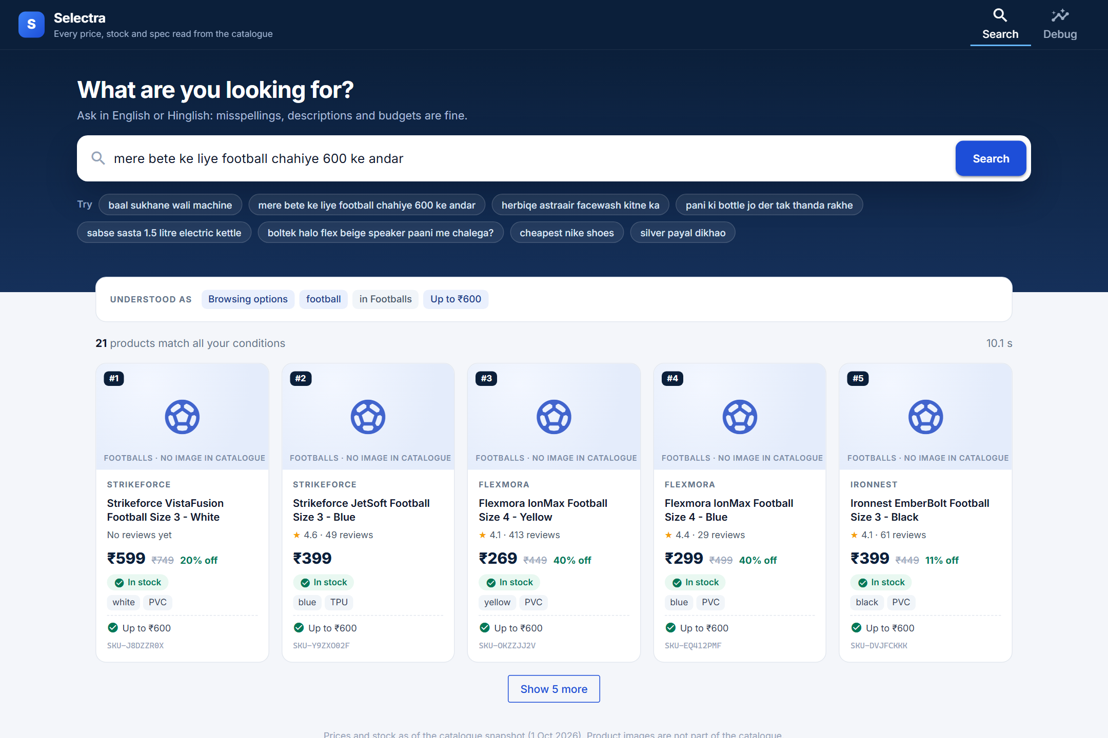
DEMO
Search: understood, filtered and verified
■ “Understood as” shows the plan in plain words.
■ Budget applied by code: 21 footballs, all ≤ ₹600, each with a ✓.
■ Real price, MRP, discount and stock from the record.
■ No images in the catalogue, so none are invented.
Selectra · R3 grounded shopping assistant
8
Notes:
Query: 'mere bete ke liye football chahiye 600 ke andar'.

Slide 9
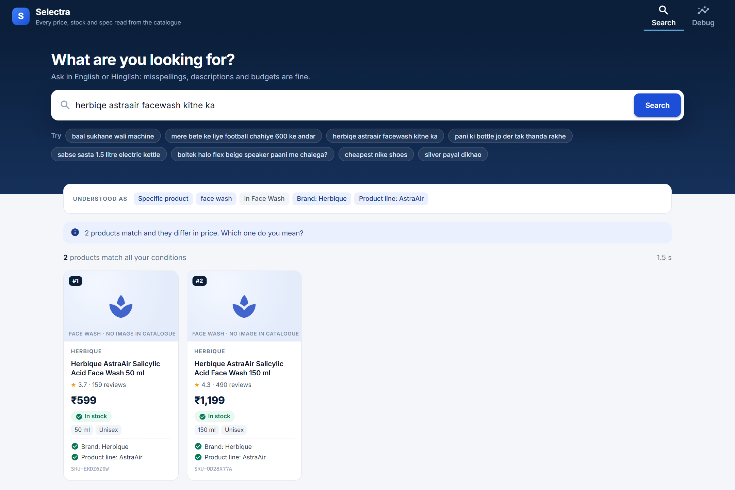
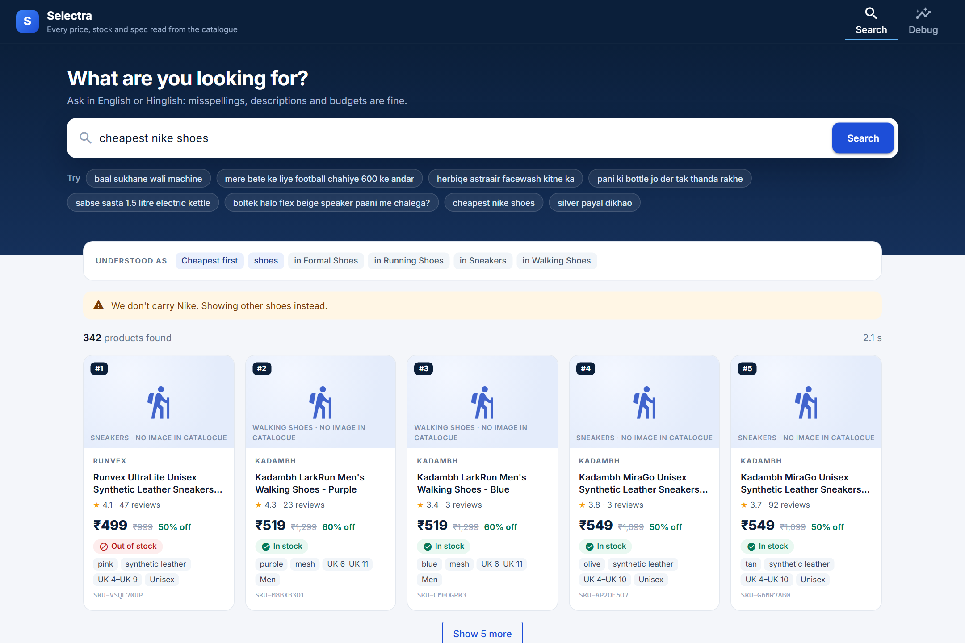
DEMO
It asks, or says no, instead of guessing
Clarify. Two AstraAir face washes match and their prices differ, so it asks which one.
Refuse the brand. Nike isn't in the catalogue. It says so, then shows shoes we do sell.
Selectra · R3 grounded shopping assistant
9
Notes:
If there is time, also type 'silver payal dikhao' live: it returns 'We don't sell this'.

Slide 10
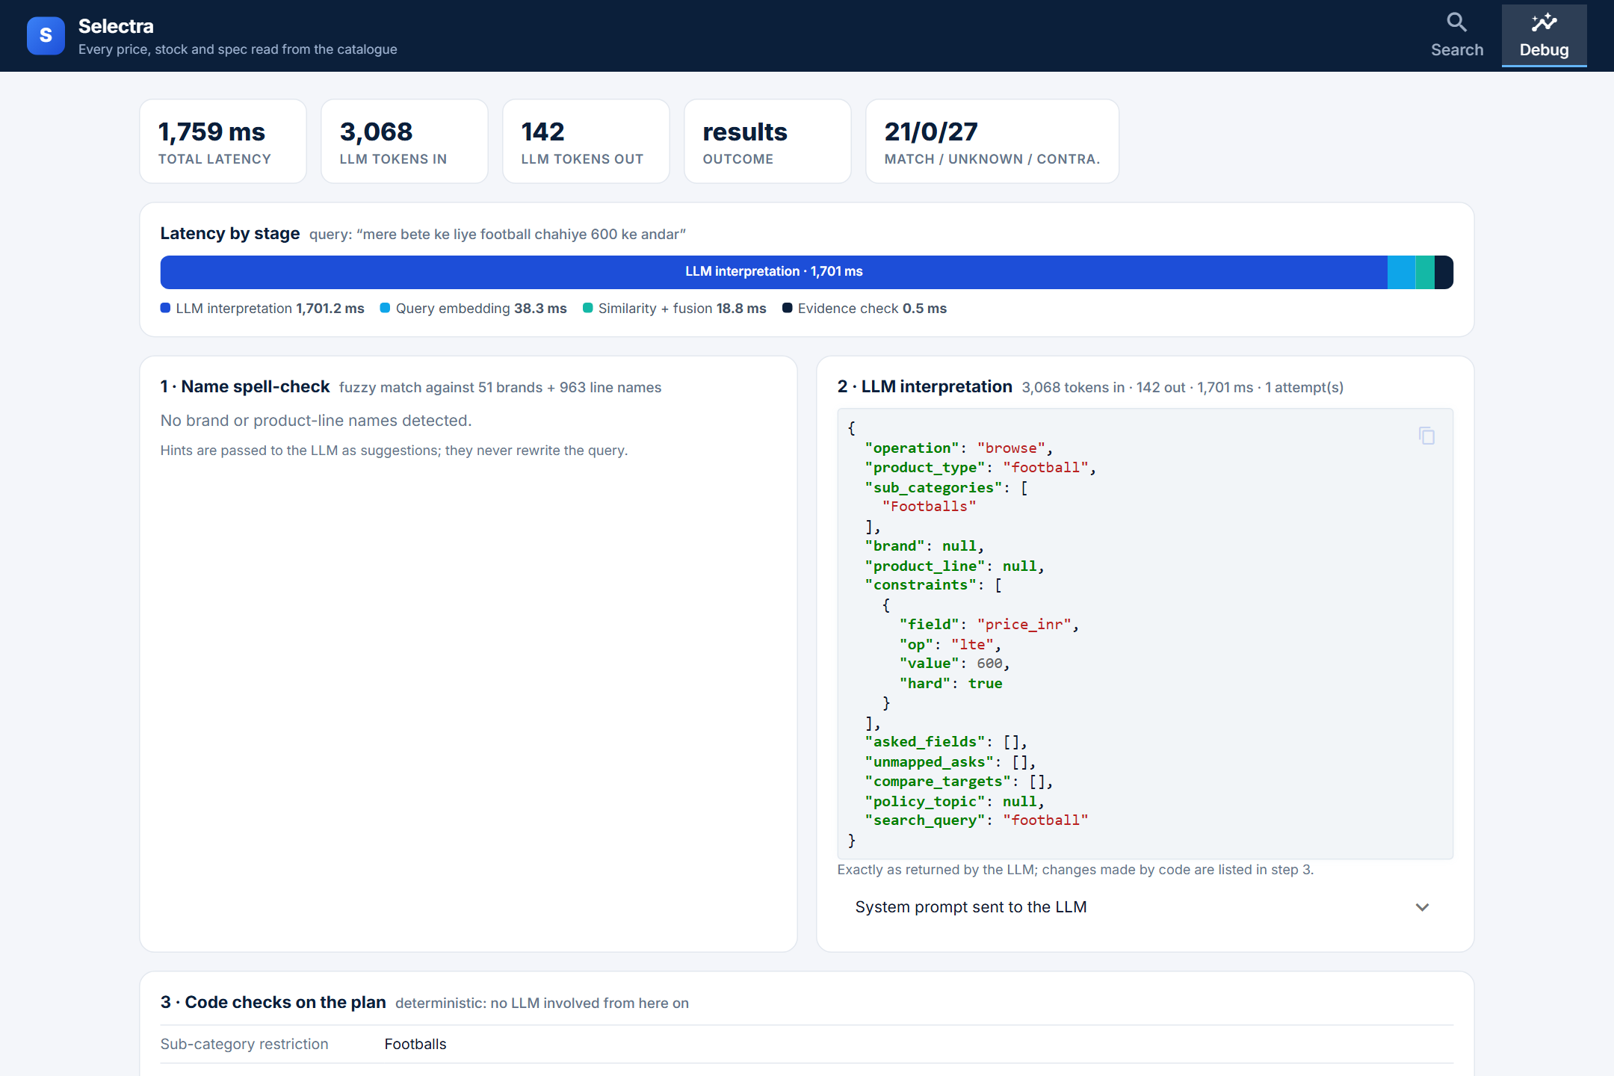
DEMO
Debug: every step is visible
■ Latency per stage and LLM tokens per question.
■ The LLM's plan exactly as returned.
■ What code dropped, added or restricted, and why.
■ Evidence per product: field, value, source, status.
Selectra · R3 grounded shopping assistant
10
Notes:
This is how a judge can check any answer: open Debug and trace each fact to its catalogue field.

Slide 11
AI understands.
Code verifies.
The catalogue decides.
Selectra · Team dino (1086) · Thank you. Questions?
Notes:
Offer to run any question the judges type, live.

