Slide 1


A
PS-020
IP
ROUTING
×
SRv6
Local SRv6 Path Steering and
Measured Failure Recovery
6G & Future Networks · AIORI Hackathon 3
Team: [NODEX]
Presenter(s): [MITHI KHOBRAGADE-khobragademithil45@gmail.com
SHARAD KALMANI- sharadkalamani3@gmail.com ]

Slide 2
A
Abstract & Problem Description
Objective
• Build a five-router virtual testbed.
• Compare explicit SRv6 steering with hop-by-hop IPv6 routing.
• Use the same controlled link failure for both.
The challenge
What will be tested
Evidence required
• Traditional IP routing forwards packets hop by hop.
• SRv6 can steer packets through an ordered list of SIDs.
• Test two explicit SRv6 paths.
• Trigger one controlled link failure.
• Switch to a configured backup policy.
• Capture packets and repeat trials.
• Measure packet loss and recovery time.
• Analyze SRv6 header overhead.
PS-020 · Local SRv6 Path Steering and Measured Failure Recovery
2 / 11

Slide 3
Background
Ordinary IPv6 routing
Segment Routing over IPv6
• Routers use IPv6 routing tables to select the next hop.
• Backup behavior depends on routing and failover configuration.
• SRv6 uses Segment Identifiers (SIDs).
• SIDs represent segments or behaviors and guide packets through configured waypoints.
Failure and recovery
Why compare them?
• A link failure can cause packet loss.
• Recovery depends on failure detection and route or policy switching.
• Keep topology, endpoints, traffic and failure conditions the same.
• Compare packet behavior and recovery fairly.
Key terms: SID list = ordered segment instructions · SRH = Segment Routing Header · repair delay = time from failure handling to restored forwarding.
PS-020 · Local SRv6 Path Steering and Measured Failure Recovery
3 / 11

Slide 4
Literature Review
RFC 8402
Segment Routing Architecture (2018)
RFC 8754
IPv6 Segment Routing Header (2020)
RFC 8986
SRv6 Network Programming (2021)
Purpose: Defines the Segment Routing architecture and source routing using ordered segments.
Contribution: A packet carries its intended path, so routers need no per-path state.
Relevance: Basis for comparing conventional IPv6 routing with SRv6 path steering.
Limitation: Architecture only; no measurements for your five-router topology or recovery script.
Purpose: Specifies the SRH format and processing rules for an SRv6 segment list.
Contribution: Defines fields such as Segments Left and Last Entry.
Relevance: Used to inspect packets in Wireshark and check header overhead.
Limitation: Does not set a recovery policy or recovery time.
Purpose: Defines SRv6 endpoint behaviors for Segment Identifiers (SIDs).
Contribution: Behaviors such as End and End.X let a router process a SID and keep forwarding.
Relevance: Main reference for implementing SIDs on the routers.
Limitation: No automatic failure detection; does not prove a backup policy activates.
PS-020 · Local SRv6 Path Steering and Measured Failure Recovery
4 / 11

Slide 5
Proposed Solution
01 Build topology
02 IPv6 baseline
03 SRv6 policy
• Build a five-router topology.
• Verify IPv6 connectivity and two viable paths.
• Configure ordinary hop-by-hop IPv6 routing.
• Verify reachability.
• Configure SIDs.
• Set up two explicit paths on an SRv6-capable platform.
04 Controlled failure
05 Capture & measure
06 Repeat & compare
• Shut down the selected link.
• Run the detection and backup-switch script.
• Capture packets and count loss.
• Measure interruption and repair time.
• Inspect SRH overhead.
• Repeat identical trials.
• Summarize measured results without assuming a winner.
Fairness controls: same source/destination, topology, packet size/rate, failure link, and trial duration for both cases.
PS-020 · Local SRv6 Path Steering and Measured Failure Recovery
5 / 11

Slide 6
Solution Optimization
Optimization focus: make the comparison repeatable, observable and fair.
Aspect | Baseline / initial setup | Improved experiment design
Path selection | IPv6 routes selected by routing tables | Explicit SID lists for SRv6 path steering
Failure handling | Record the configured IPv6 recovery behavior | Scripted switch to a preconfigured SRv6 backup policy
Measurements | Single ping test may miss short events | Timestamped repeated probes + packet captures
Verification | Reachability alone does not prove the path | Inspect SRv6 packet header and confirm SID traversal
Reliability | One run can be noisy | Repeat trials; report mean/range and exact setup
6 / 11

Slide 7
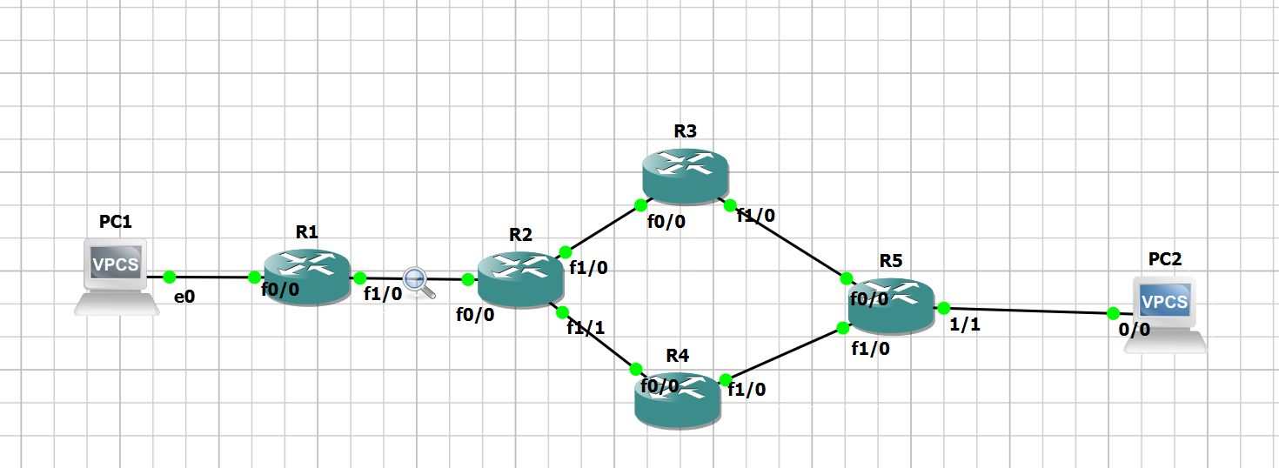
Solution Architecture & Design
Path A
R2
Traffic source
Traffic sink
Host A
R1
R4
R5
Host B
R3
Path B
IPv6/SRv6 routing + packet capture
PS-020 · Local SRv6 Path Steering and Measured Failure Recovery
7 / 11

Slide 8
Data Flow
1. Configure network
Five routers, IPv6 addresses, endpoints
2. Select experiment
A: IPv6 routing, B: SRv6 steering
3. Generate traffic
Continuous ping, source to destination
4. Record baseline
Loss, latency, path, packet headers
5. Trigger link failure
Disable R3–R5 at a recorded time
6. Recover
IPv6: routing reconverges. SRv6: script switches to backup via R4
7. Capture and analyze
PCAPs, logs, timestamps, ping results, Python, CSV
8. Compare results
Loss, recovery time, path, header overhead
Packet path
R3
R3–R5 down
Primary: R1, R2, R3, R5
R1
R2
R5
Backup: R1, R2, R4, R5
Failed link: R3–R5
R4
PS-020 · Local SRv6 Path Steering and Measured Failure Recovery
8 / 11

Slide 9
Deployment Timeline
PHASE 1
Platform & topology
• Select an SRv6-capable image; build the five-router topology; verify IPv6 reachability.
PHASE 2
IPv6 baseline
• Configure ordinary IPv6 routes; record baseline traffic and failure behavior.
PHASE 3
SRv6 configuration
• Configure SIDs and two explicit paths; validate packet captures.
PHASE 4
Failure automation
• Trigger a controlled link-down event; script the backup-policy switch.
PHASE 5
Measurement
• Repeat trials; measure packet loss, interruption, detection/repair delay and overhead.
PHASE 6
Deliverables
• Analyze results; prepare the report, demonstration and private GitHub repository.
PS-020 · Local SRv6 Path Steering and Measured Failure Recovery
9 / 11

Slide 10
Bibliography
[1] F. Clad et al., “Segment Routing Header (SRH) for IPv6,” RFC 8754, Internet Engineering Task Force, March 2020.
https://www.rfc-editor.org/rfc/rfc8754.html
[2] PS-020: “Local SRv6 Path Steering and Measured Failure Recovery,” AIORI Hackathon 3 problem statement, supplied project brief.
[3] Official reference: IPv6 architecture — RFC 8200
[4 ] David Lebrun and the Linux SRv6 implementation
https://segmentv-routing.org/index.php/implementation/configuration
PS-020 · Local SRv6 Path Steering and Measured Failure Recovery
10 / 11

Slide 11
THANK YOU
Questions & Discussion
PS-020 · Local SRv6 Path Steering and Measured Failure Recovery
AIORI Hackathon 3 · 6G & Future Networks
Thank you for your attention!

