Slide 1
CAPSTONE PROJECT REVIEW
ALMS
Agentic Legacy Modernization System
Migrating Python monoliths into deployable FastAPI microservices—entirely on a local laptop, at zero API cost.
B.Tech Capstone – Computer Science & Business Systems

Slide 2




THE PROBLEM
Monolith-to-Microservice Migration Is Slow, Manual, and Risky
Boundary identification is the hardest part
Migrations take months, not days
Deciding where to split a monolith is repeatedly flagged as the single hardest sub-problem in the literature.
Teams manually trace coupling, redesign data ownership, and rewrite request handling by hand.
Existing AI tools assume a GPU + cloud budget
Sending proprietary code to a third-party API isn’t always an option
Fine-tuned embedding methods need GPU training; agentic pipelines call hosted models like Claude/Cursor per step.
Students, small teams, and regulated organizations often simply cannot use cloud-hosted LLMs on their codebase.
02

Slide 3





THE SOLUTION
What ALMS Does
A multi-agent pipeline that takes a legacy Python monolith and produces a running, containerised microservice stack — five stages, one continuous flow.
1
2
3
4
5
Analyze
Design
Generate
Test
Deploy
Parse the monolith’s AST into a call graph
Cluster the graph into service boundaries
Write FastAPI code for each service
Generate pytest suites automatically
Package as Docker containers behind a gateway
03

Slide 4

DESIGN PHILOSOPHY
Keep Everything Deterministic Out of the LLM
The model is only asked to do the one transformation it’s actually good at. Everything else — boundaries, validation, data contracts — is handled by ordinary, checkable code.
Deterministic — no model in the loop
LLM — only where it’s genuinely needed
•
AST-based dependency graph extraction
•
Writing the FastAPI service code from source modules
•
Filtering out builtin / stdlib noise before clustering
•
Generating pytest test suites for each service
•
Louvain community detection (seed-fixed → reproducible)
•
Optionally refining bounded-context descriptions
•
​​py_compile gate with bounded auto-retry on generated code
•
Grounded throughout by a local retrieval (RAG) knowledge base
•
Pydantic schema validation of every inter-agent message
•
No model is ever used to judge another model’s output
04

Slide 5


HOW IT WORKS
End-to-End Pipeline
Legacy
Monolith
Analyzer
(AST + graph)
Architect
(Louvain)
Refactor
+ py_compile
Test-Gen
(pytest)
Deployable
Stack
↻ retry on compile fail (max 3 attempts)
Human-in-the-loop review gates after Analysis, after Boundary Proposal, and after Test Generation — approve, reject with feedback, or stop.
Local Retrieval-Augmented Generation (RAG)
Every LLM stage is grounded in a local knowledge base (ChromaDB + nomic-embed-text) of FastAPI, DDD, refactoring, and security patterns — compensating for what a small local model doesn’t reliably know.
Orchestrated with LangGraph
A stateful graph fans out one parallel branch per proposed service, each running its own compile-retry loop, then merges results back with a name-keyed reducer.
05

Slide 6




UNDER THE HOOD
Technology Stack
LangGraph
Ollama + Qwen
ChromaDB
Stateful orchestration, fan-out & retry cycles
Local LLM runtime — no cloud inference
Local vector store for RAG retrieval
python-louvain
Docker Compose
pytest + hypothesis
Community detection for service boundaries
Containerised, portable deployment
Generated & property-based testing
06

Slide 7



WHY IT MATTERS
Fully Local — No Cost, No Cloud, No Compromise
$0
100%
0
0
API cost — every run is free
Offline — no network call at any stage
GPUs required — runs on a CPU-only laptop
Lines of source code ever leave the machine
Prior automated pipelines pick one: reach a deployable result by depending on hosted, commercial-scale models (Cursor, Claude Code) and cloud inference — or stay local and stop at a class-to-service partition, never producing a running artifact. ALMS combines a full decompose → generate → test → deploy pipeline with a fully local, offline execution model — a combination no prior system in our review offers.
07

Slide 8
RESULTS
Case Study: A 1,578-Line Flask Monolith
Full pipeline run — analysis through containerised deployment — on a 6-module e-commerce Flask app (users, orders, payments).
4 of 4
1,120
56% / 61%
3 of 4
proposed services compiled cleanly (0 needing manual fixes)
test cases auto-generated across 570 files
reduction in graph nodes / edges from deterministic filtering
containers booted successfully behind a working API gateway
Evaluated with qwen3-coder:30b (Mixture-of-Experts, ~3.3B active parameters/token) served locally via Ollama, with weights larger than host RAM paged from disk — a single unattended run completed end-to-end in one pass, at zero API cost.
Feasibility study on a single codebase — not a benchmark claim. See Limitations.
08

Slide 9
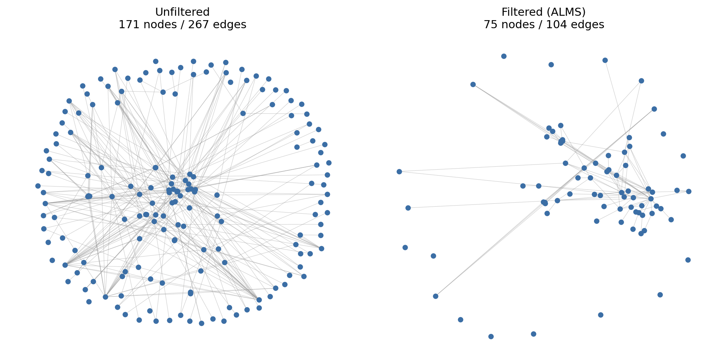
RESULTS
Deterministic Filtering Before Any Model Sees the Graph
Removing calls to Python builtins, stdlib methods, and local variables — before Louvain clustering ever runs — keeps the boundary-selection graph small and architecturally meaningful.
171 → 75
267 → 104
6 → 2
nodes (−56.1%)
edges (−61.0%)
coupling hotspots
09

Slide 10

WHAT WE LEARNED
Where It Fell Short — and Why That’s Useful
One service never booted
Application Core Service — leftover routing/glue code with no owned data — got clustered into its own “service” anyway. A hub module with no domain needs a different rule.
Test generation isn’t compile-gated
Only 58.2% of the 570 generated test files are valid Python (truncated output). Code generation, which does have a compile-retry loop, passes 100%.
Services duplicate each other’s data
Order and Payment services both regenerated /users and /products CRUD logic — declared ownership isn’t yet enforced at generation time.
Each of these directly motivates a concrete next step — see Future Work.
10

Slide 11
OUR PROCESS
The 8-Week Build
1
2
3
4
Topic finalized
Mentor approval
Dev setup
Model chosen
Literature review; scope & feasibility confirmed
Roadmap drafted; resources procured
Env + repo structure; agent architecture defined; model shortlist
Qwen2.5-Coder 7B selected; agent prompts drafted
5
6
7
8
Analyzer + Architect
Refactoring agent
Full integration
Scaled up
Both agents implemented; migration methodology researched
Code-gen agent built; RAG + knowledge base started
Test agent + LangGraph wiring; first end-to-end run (non-optimal)
“Layering” technique enables upgrade to Qwen3-Coder 30B
11

Slide 12
STATUS
What We’ve Built So Far
Analyzer agent — AST parsing & dependency graph
Architect agent — Louvain-based boundary proposal
Refactoring agent — FastAPI code generation
Test-Gen agent — pytest + hypothesis suites
RAG knowledge base — ChromaDB + local embeddings
LangGraph orchestration — fan-out, retry, HITL gates
py_compile validation gate with bounded retry
Docker Compose deployment + Nginx API gateway
Full end-to-end run completed on a sample monolith
12

Slide 13


LOOKING AHEAD
Conclusion & Future Work
A disciplined deterministic/LLM split lets a local model — even a 30B-class one — carry a full migration pipeline through to a mostly-bootable, containerised output, at zero cloud cost, on hardware a single developer already owns.
Extend the py_compile-style retry gate to Test-Gen output
Enforce declared data ownership to stop cross-service duplication
Scale evaluation to 10–30 repositories with ablation studies
Wire shadow-testing to the live container stack for real parity checks
13

Slide 14
THANK YOU
Questions & Discussion
ALMS — Agentic Legacy Modernization System

