Slide 1
CineConnect
A Hybrid Movie Recommendation Tool
SPL-1
Mid-Term Presentation
Preparing By: MITHILA PAUL(Roll:1633)
Supervised By: Prof. Dr. B.M. Mainul Hossain

Slide 2
Why is this problem important?
01
02
03
Users struggle to discover relevant movies according to their own preference
Most recommendation systems are black-box or based on what others liked.
Aim to design a lightweight, offline, file-based recommendation engine prioritizing users’ choice.
1

Slide 3
What is CineConnect
A Console Based Web Application
User view their previous rated movies
Checks if the user’s personal ratings already exists or not
Can rate a movie by searching its name
Keep the record!
View My Ratings
Rate A Movie
Get Recommendation
Join/Create A Community
Register/Login
Program Runs CBF & Matrix-Factorization to get the best movies according to user’s choice
User can create or get access to a commenting file ,based on movie preference
2

Slide 4
Files to be used
Processed Master File Containing Movies and Their Metadata(title, director, genre, cast)
Second Master File Containing Sparse table of User(IDs) and their Rated Movie(IDs) and Ratings
Users Personal File Containing Their Ratings
Community File Based On Movie Preference To Leave Users’ comments/messages
3

Slide 5
Functions to be used
Content-Based Filtering (CBF)
Compares user preference vector with movie feature vectors
Uses cosine similarity
Matrix Factorization
Predicts missing ratings from user-movie interactions
Cold Start Strategy
Predicts missing ratings from user-movie interactions
4

Slide 6
Current Progress
Dataset preprocessing (tags generation)
TF-IDF vectorization of movies
Rating system with movie ID + title
Minimal Cold-Start strategy
Content-based similarity computation
Personalized recommendations working
5

Slide 7
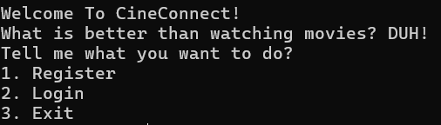

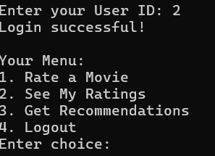
System In Action
6

Slide 8
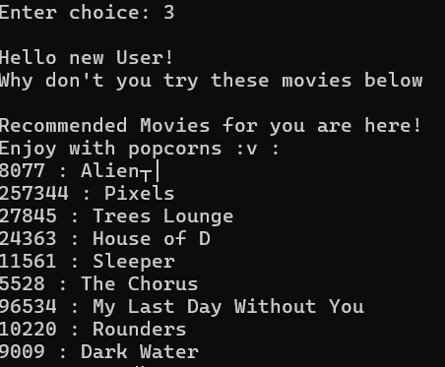
System In Action
The Cold Start
7

Slide 9
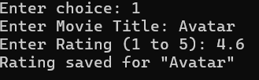
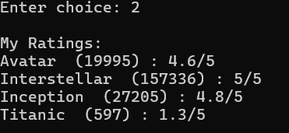
System In Action
Ratings
8

Slide 10
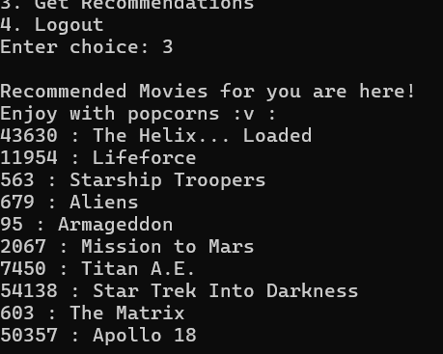
System In Action
CBF Recommendation
9

Slide 11
What remains to be implemented
Matrix Factorization for better prediction of unseen movies
Improved cold-start strategy
Hybrid model: CBF + Matrix Factorization
Community Idea
UID/MID | M001 | M002
U001 | 4 | ?
U002 | 5 | 4
10

Slide 12
Thank You

