Slide 1
CineConnect A Hybrid Movie Recommendation System
Course: Software Project Lab-1
Submitted by: Mithila Paul
Exam Roll: 245439
Supervised by: Professor BM Mainul Hossain

Slide 2

Project Overview
Dataset Foundation:
Built on two master datasets:
Movie dataset with 4,802 movies and metadata
Ratings dataset with ~53,000 ratings from 610+ users
System Design:
Hybrid Recommendation pipeline combining multiple algorithms and integrates user behavior, content features and relational data.
Core Functionality: Supports personalized recommendations based on user interaction. Handles Cold-start and sparse data scenarios
Processing Pipeline: Data preprocessing-> feature extraction -> hybrid scoring -> recommendation
Fast in-memory processing with scalable architecture.

Slide 3
Key Features
Hybrid Recommendation Engine | Combines Content-based, Collaborative Filtering, Matrix Factorization and Graph Propagation
Adaptive Scoring System | Dynamically adjusts weights based on user data
Cold-Start Handling | Genre onboarding + trending fallback
Search & Input Handling | Supports movie genre, actor, director, and fuzzy search
Smart Trend-Aware Recommendations | Uses Bayesian average and popularity scaling
Interactive User Interface | Enables rating, search, and real-time recommendations

Slide 4
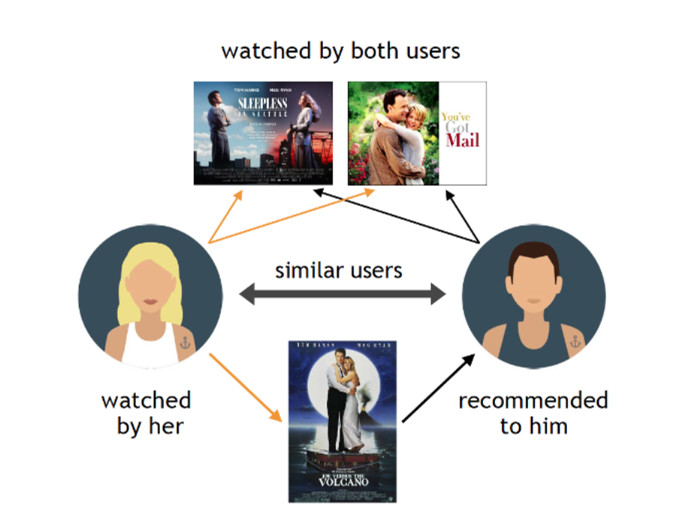
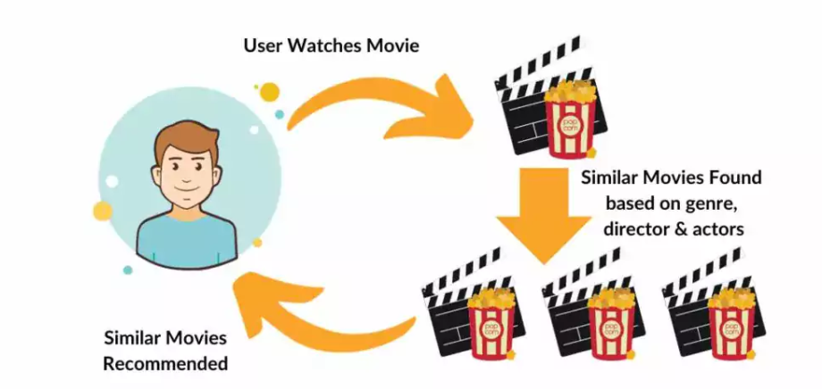
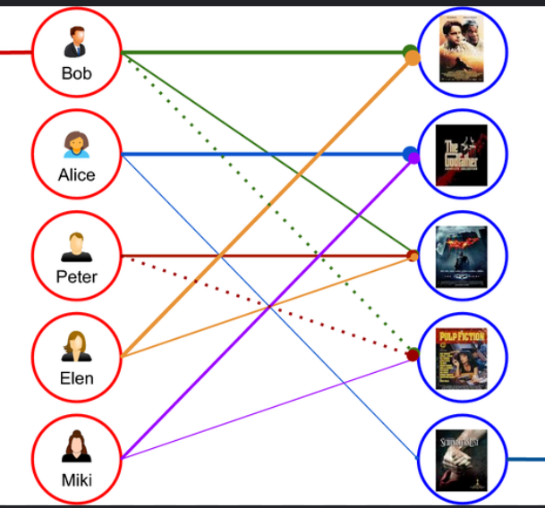
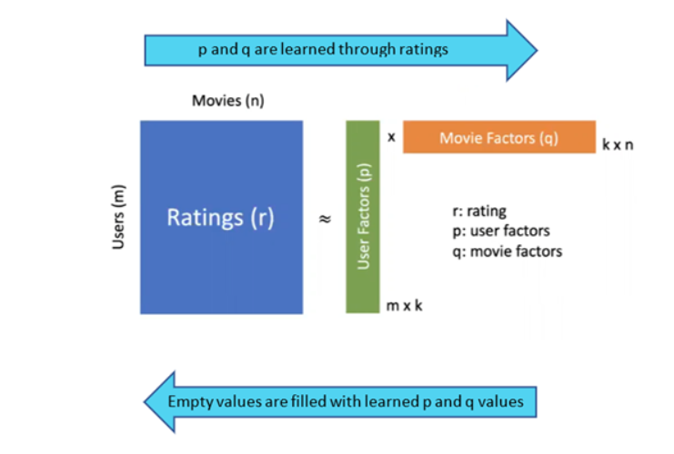
Algorithms
WHY?
Supporting Algorithms
TF-IDF → text vectorization
Edit Distance → fuzzy search
Jaccard similarity → topic matching
New User / Few Ratings | CBF (primary) Query similarity Genre matching
Moderate Ratings | Hybrid (balanced)
Many Ratings(20+) | collaborative and latent models become more reliable
user watches niche movies(Cf Fails) | MF -> learns latent taste GP ->indirect connections CBF -> content similarity
User wants something different CBF fails) | CF -> similar users may suggest Romance MF -> latent features capture hidden taste GP -> indirect discovery
Recommendation Algorithms
CBF → cosine similarity + TF-IDF
CF → Pearson similarity
MF → SGD + latent vectors
GP → graph propagation
Statistical Methods
RMSE → model evaluation
Bayesian Average → fair ratings
Log scaling → popularity

Slide 5
Architecture Flow
Search Type Selection (Genre / Actor / Plot / Query)
Candidate Filtering
Feature Processing (TF-IDF / Tokens / Topics)
User Input
Ranking & Top Recommendations
Hybrid Scoring
Recommendation Models (CBF | CF | MF | GP)

Slide 6
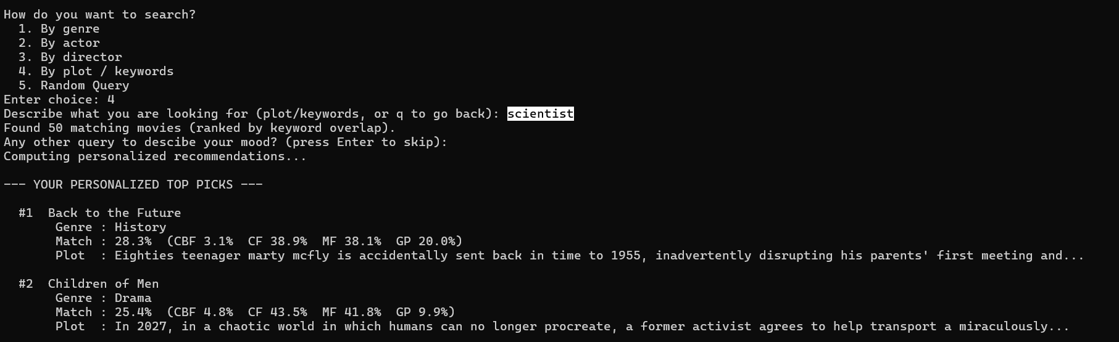
Demo Output (by plot/keywords)

Slide 7

Intelligent Recommendation Features
Cold Start Onboarding
Trending Statistics
New User ↓ No History
All Ratings ↓ Avg Rating
Genre Selection ↓ Seed Ratings
Bayesian Avg ↓ Log Scaling
User Profile ↓ Hybrid System
Trending Score ↓ Top Movies

Slide 8

Future Scope
Web/Mobile Interface (Convert console system into a full UI-based application)
Deep Learning Models (Use neural networks for better personalization)
Real-Time Updates (Continuously update recommendations with new rating)
Larger & Dynamic Datasets (Integrate live movie databases (APIs))
Social & Context Features (Include mood, time, and user interactions)

Slide 9
THANK YOU
I recommend watching more movies

