Slide 1


TransMatcher
Deep Image Matching Through Transformers for Generalizable Person Re-identification
Kelechi Otu
Mithila Sivakumar

Slide 2
Outline
Introduction
Experiments
Implementation
Specs
Results
Discussion
Summary

Slide 3
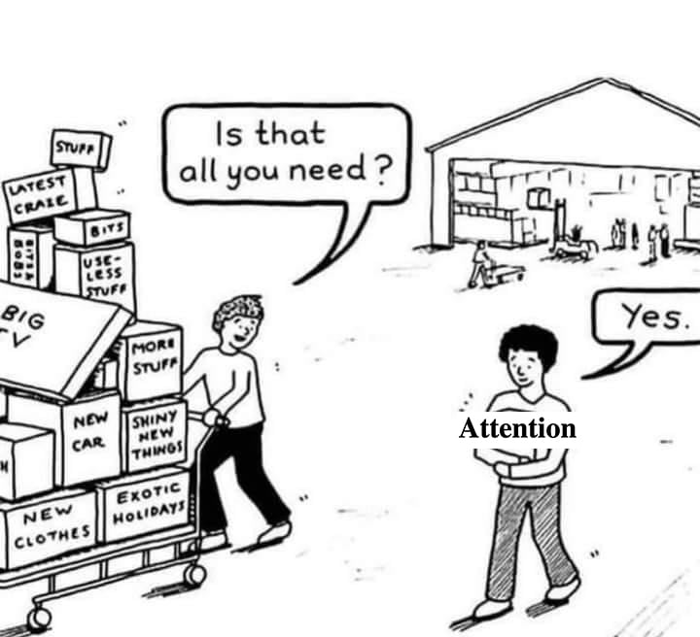
Introduction
Transformers have been gaining significant attention for feature representation learning
Problem of image matching and metric learning, given a pair of images
Propose a simplified decoder which keeps only the query-key similarity computation
6 % and 5% performance gains in Rank-1 and mAP

Slide 4
Experiments
We proposed to reproduce two experiments
The first experiment
Train on Market-1501 dataset
Test on CUHK03-np test set
The second experiment
Train on RandPerson subset dataset
Test on Market-1501 and CUHK03-np test sets

Slide 5
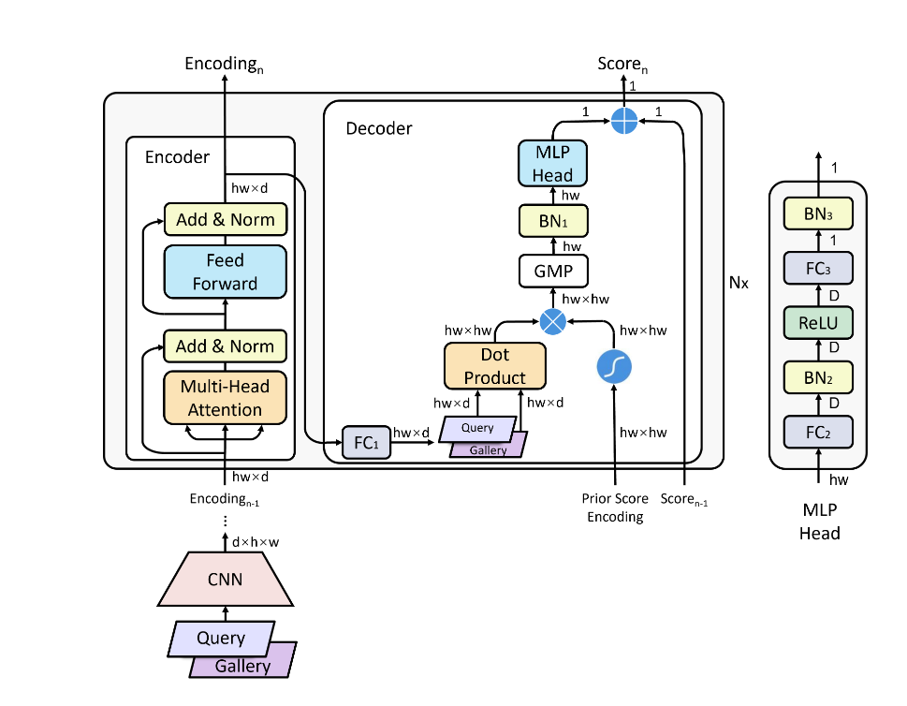
Implementation
Resnet50-ibn-b as backbone
3x3 neck convolution layer
Query and Gallery encodings
TransformerEncoderLayer from pytorch
Custom Decoder
GMP layer from QAConv-GS
MLP head 1 and 2
Binary cross entropy loss from pytorch (QAConv-GS)
Prior score encoding – learnable weights

Slide 6
Specs
The input image is resized to 384 × 128
The batch size is set to 64
K=4 for the GS sampler (QAConv-GS)
SGD optimizer
learning rate of 0.0005 for the backbone network
0.005 for newly added layers
decayed by 0.1 after 10 epochs
15 epochs are trained in total – Market dataset
Reused dataloaders, train and test loop from QAConv-GS and modified them

Slide 7
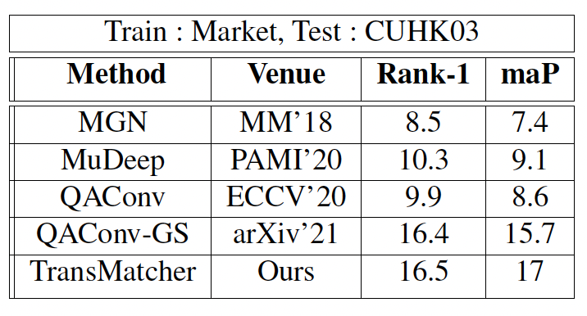
Results

Slide 8
Discussion
Unsuccessful in reproducing the results
Ours : 16.5% Rank-1 and 17% mAP
Theirs : 22% Rank-1 and 21% mAP
QAConv-GS code was difficult to understand
No Comments or Instructions
Missing information in the paper
Prior score embedding initialization missing
Nestrov momentum for SGD
RandPerson training unsuccessful
Machine constraints

Slide 9
Summary
Implemented TransMatcher custom decoder
Trained the model on Market-1501 dataset. Tested on CUHK03-np dataset
Rank-1 and mAP 6% and 4% less than what is reported in the paper
It is not easy to reproduce the results in deep learning space
Papers are vague and miss tiny but important implementation details

Slide 10

Thank You

