Slide 1

Low-Latency EOG-Based Early Intent Detection for Eye Movements
Biomedical Signal Processing & Machine Learning
Technical Project Presentation

Slide 2
Why Detect Eye Movement Before It Finishes?
The Latency Problem
The EOG Advantage
Optical tracking: camera delay + computation + waiting for saccade completion = 300+ ms
Conventional systems register command only after eye settles (200–400 ms)
Detect saccade onset electrically, not optically
Predict direction within 20–100 ms of movement start
Immune to occlusion, lighting, and head movement

Slide 3
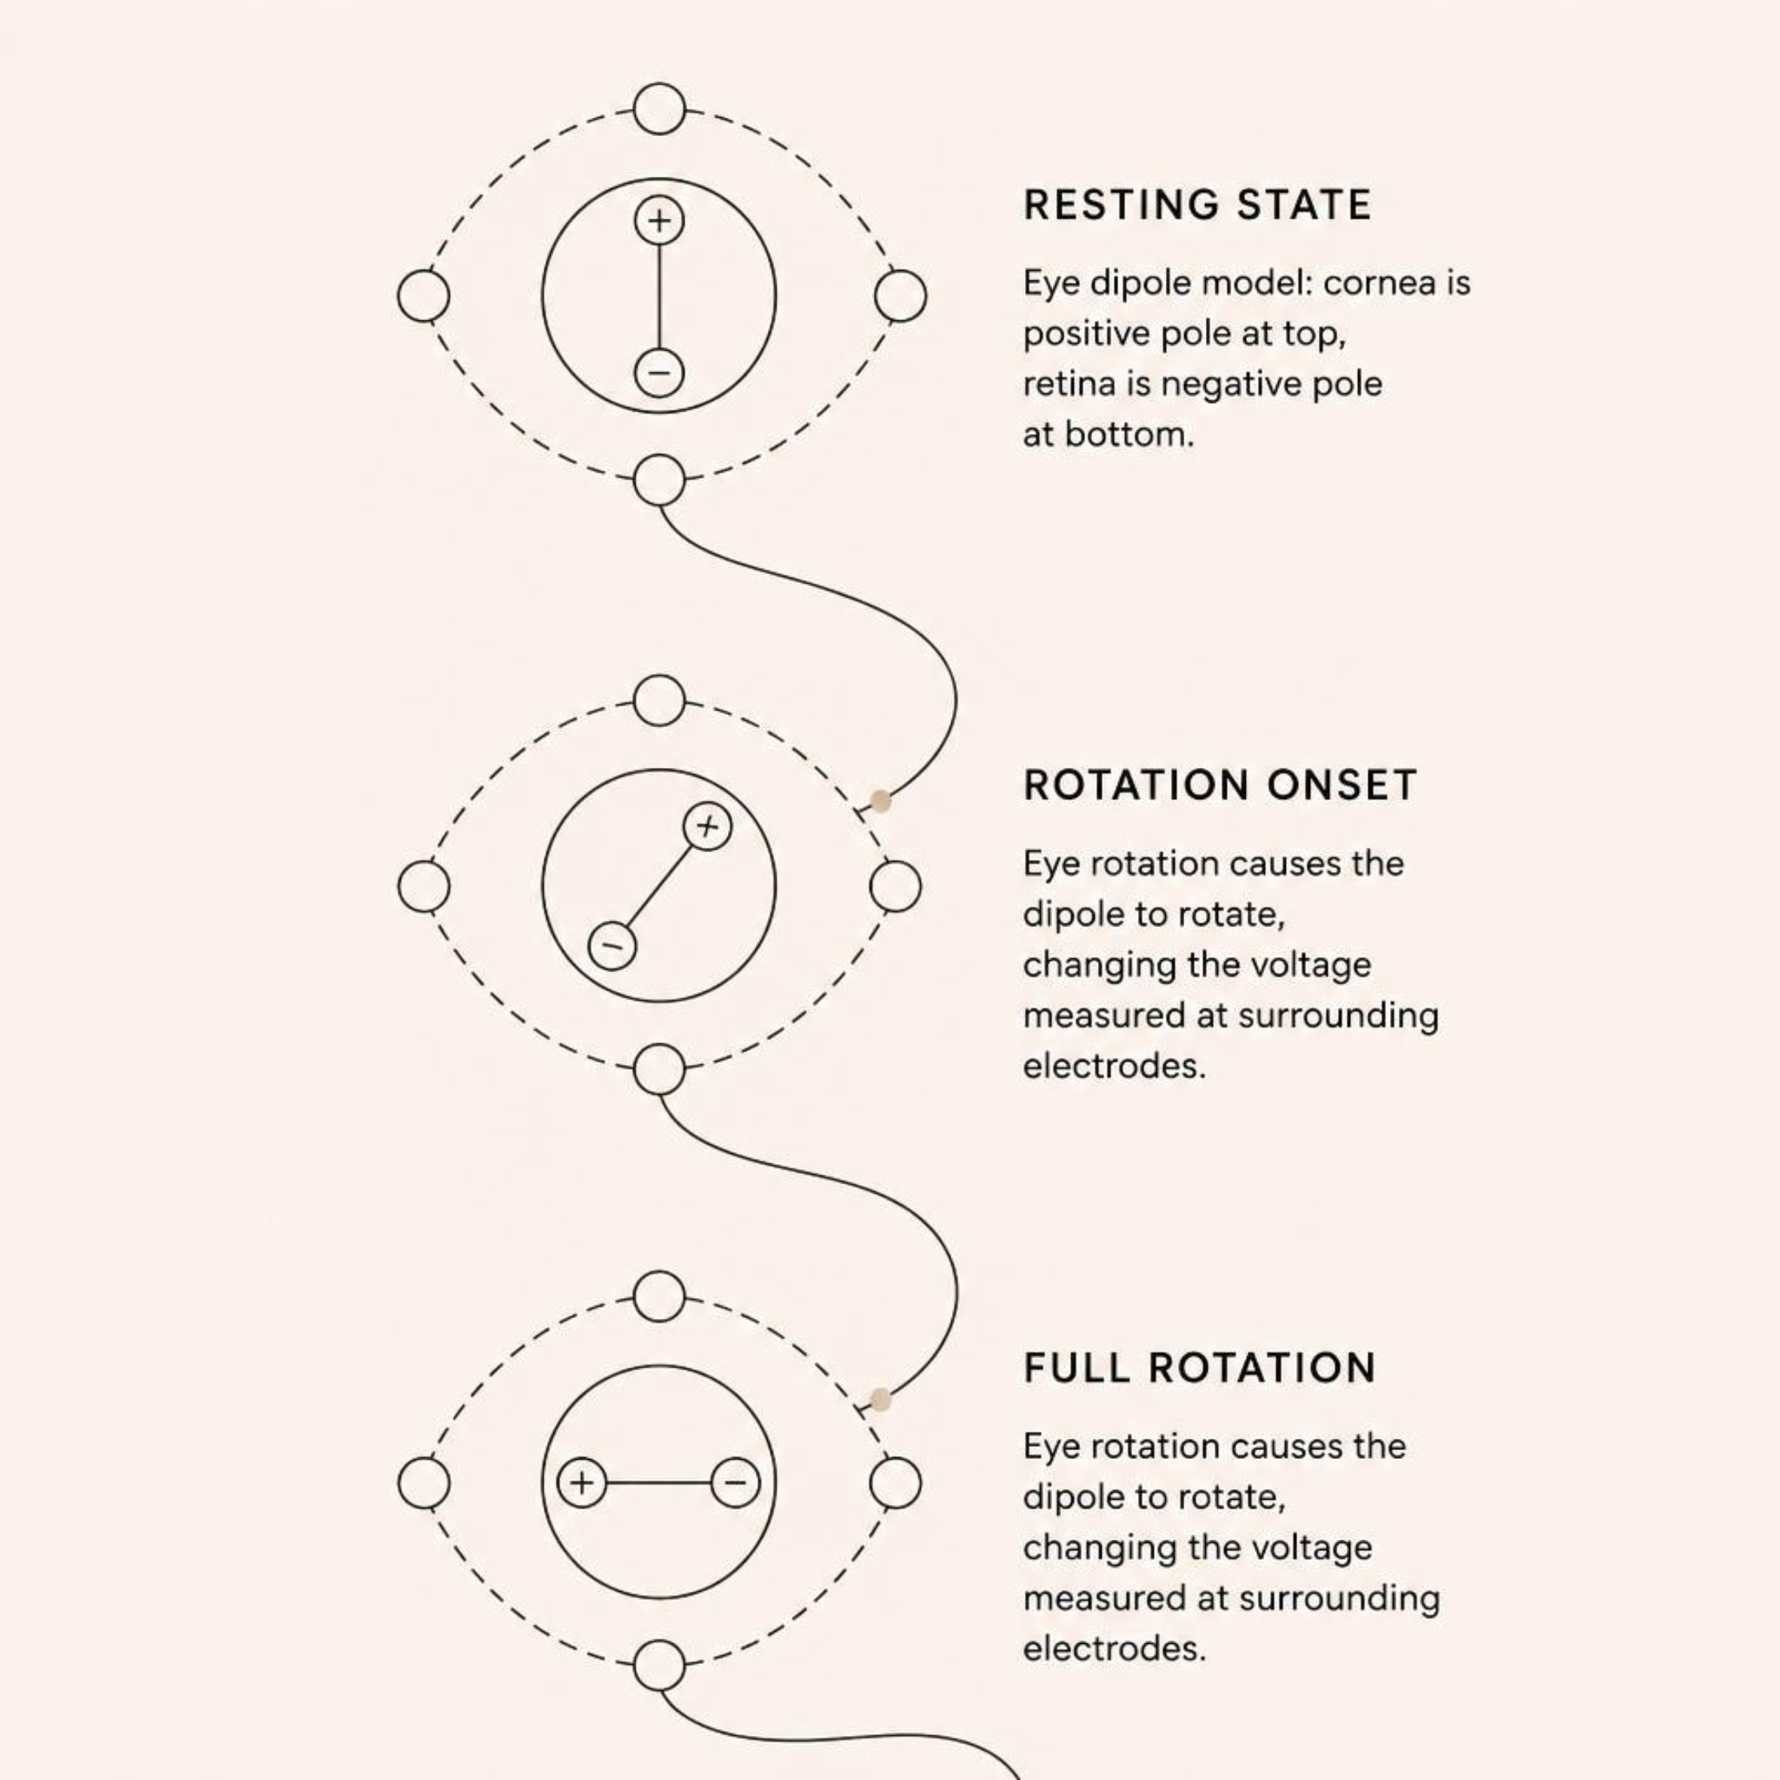
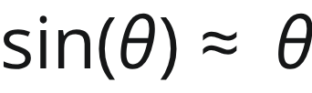
How Does EOG Detect Eye Movement?
The Eye as an Electrical Dipole
Cornea: positive pole (~0.4–1.0 mV)
Retina: negative pole
Eye rotation → dipole rotates → electrode potentials change
Voltage–Angle Relationship
For small angles: — voltage is approximately proportional to eye rotation.

Slide 4
Dataset & 16-Channel EOG Configuration
Dataset Overview
14
4032
Subjects
Total Trials
S1–S14
288 per subject
36
256
Target Directions
Hz Sampling
12° eccentricity
16 EOG channels
Why 16 Channels?
Standard 2-Channel EOG
16-Channel Isotropic Montage
Poor oblique-angle resolution, vulnerable to EMG artifacts
Full 2D voltage-gradient map, 360° directional coverage

Slide 5

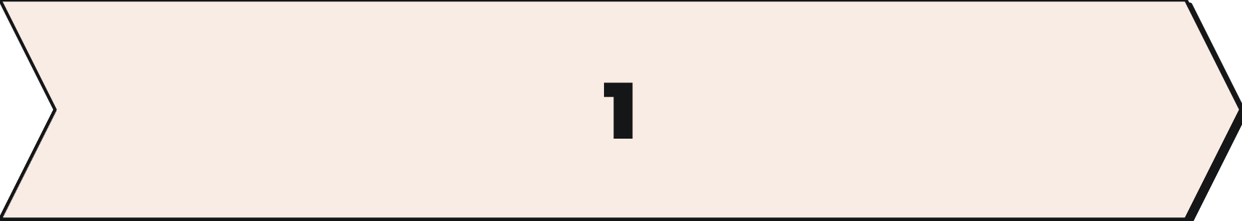


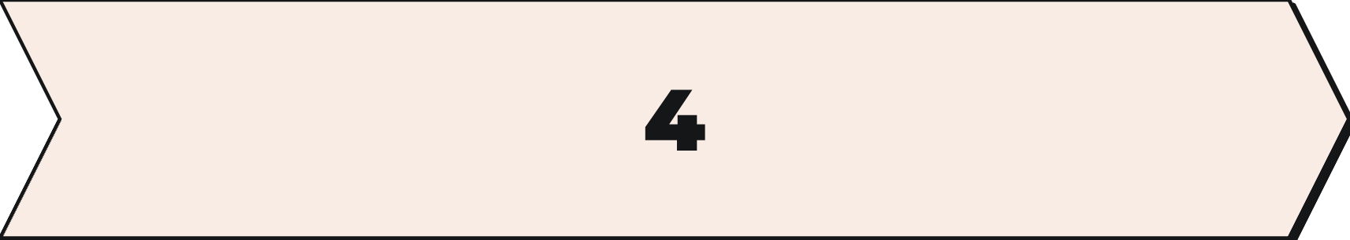
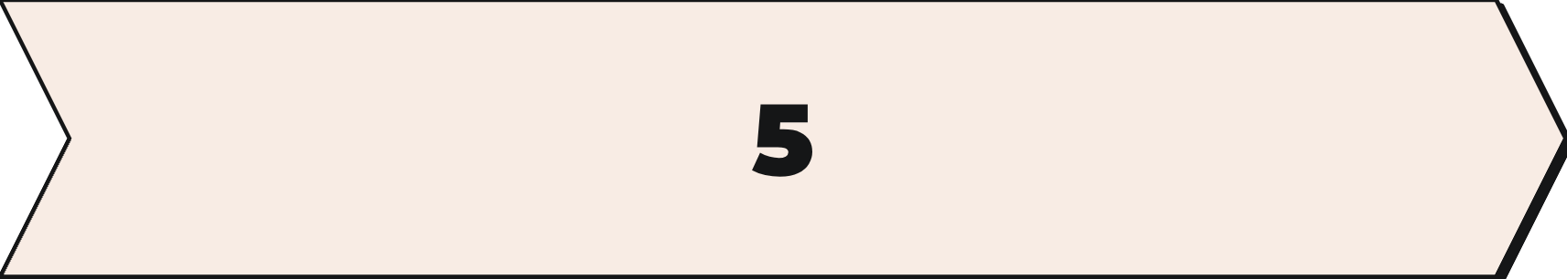
Signal Processing Pipeline
Strict Causality: No future samples used — valid for real-time deployment.
Raw EOG
Baseline Centering
High-Pass Filter
16 channels acquired
First 25 samples ≈ 97.6 ms
0.1 Hz causal drift suppression
Z-Score Norm
Onset Detection
Training-fold statistics only
→ Window → Features → Class
Baseline correction:

Slide 6

Finding Saccade Onset
Six-Step Detection
MAD Threshold Formula
1
Select 4 highest-variance channels
Early Window Sizes at 256 Hz
2
Spatial RMS aggregation
Window | Samples
20 ms | 6 samples
100 ms | 26 samples
200 ms | 52 samples
3
3-sample causal smoothing
4
Forward derivative calculation
5
MAD adaptive threshold
Target cue onset ≠ saccade onset — 150–250 ms neural delay separates them.
6
3-sample persistence check

Slide 7
Feature Engineering: 210 Dimensions
Per-Channel Features × 16
Spatial Features × 2
Normalized index of channel with maximum voltage shift
Magnitude of maximum shift
Amplitude / Statistical
16 × 13 + 2 = 210
Voltage displacement, mean, std dev, min, max, peak-to-peak
Total feature dimensions per trial window
Temporal / Derivative
Regression slope, mean derivative, max positive/negative derivative
Energy / Integral
Derivative energy, signal energy, area under curve

Slide 8
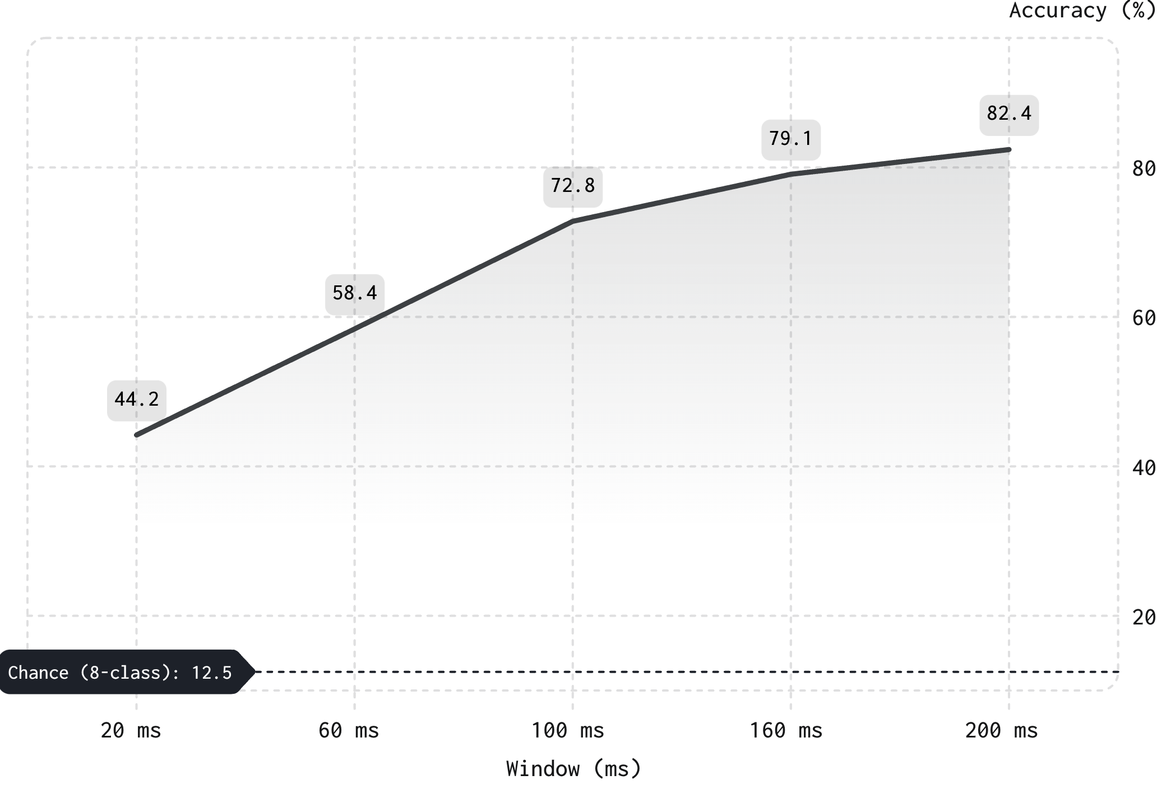

Can Direction Be Predicted from 20 ms?
8-Class Octant Accuracy vs. Window Duration
Classification Schemes
Scheme | Chance
4-class cardinal | 25.0%
8-class octant | 12.5%
36-class fine radial | 2.78%
Models
L2-regularized logistic regression
One-vs-rest linear SVM
Key Finding: Directional information is present in the first 20 ms. Errors concentrate in adjacent octants.

Slide 9
Software Architecture & Verification
System Stack
Frontend
Backend
React + TypeScript
Python FastAPI
Modules
Overview, Dataset Explorer, Signal Processing
Early Window Lab, Experiments, Data Quality
Methodology, About / Milestones
Testing & Verification
27
5.22s
pytest Tests
Execution Time
100% pass rate
Full test suite
Coverage
API, dataset loader, feature extractor
Onset detector, preprocessor
Trial segmenter, window generator

Slide 10
Conclusion & Future Work
Key Findings
Future Directions
1
EOG encodes directional intent within the earliest part of a saccade
1D-TCN + ST-CNN
Causal dilated residuals & spatial modeling
2
8-class decoding reaches 44.2% accuracy at 20 ms window
Continuous Angular Regression
0°–360° prediction
3
Accuracy scales to 82.4% at 200 ms — all causally processed
Cross-Subject Adaptation
DANN, Riemannian alignment
Wearable Configuration
4–6 channel electrode setup
Goal: Reduce latency while preserving causal, real-time operation.

