Slide 1

Python
if condition and looping( patterns )

Slide 2
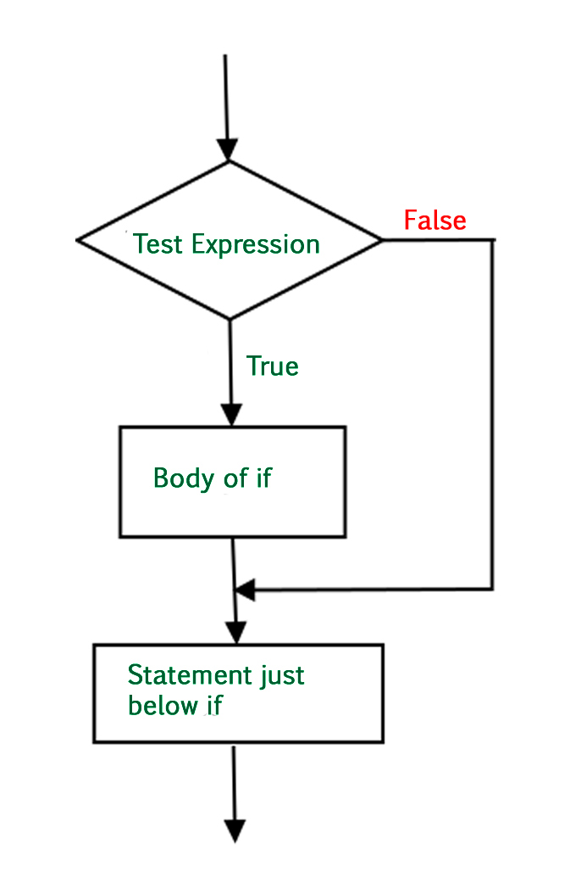
If-else Statements
An "if-else" condition is a fundamental concept in programming used to make decisions based on whether a specific condition is true or false. It's a way to execute different blocks of code based on varying conditions.
Flowchart of If Statement:
Let’s look at the flow of code in the Python If statements.

Slide 3
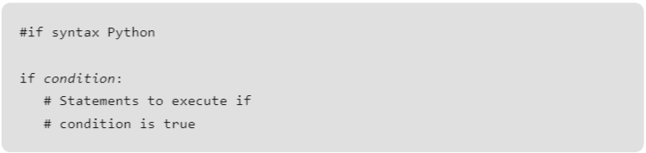
What is an If-Else Condition?
A decision-making structure in programming: If-else conditions allow the program to make decisions and execute specific code blocks based on whether certain conditions are met
Executes different code blocks based on a condition: Depending on whether the condition evaluates to true or false, the program will execute different parts of the code.
Syantax:

Slide 4
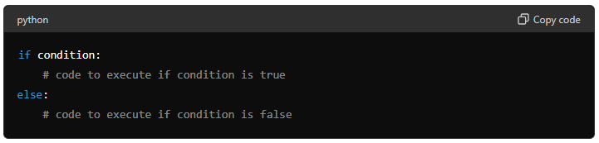
If-Else Structure
if condition: Checks the condition.The if statement evaluates a condition (a logical expression).
-If the condition is true, the block of code immediately following the if statement is executed.
# code to execute if condition is true: Executes if condition is true.
-This is the block of code that runs if the condition in the if statement is true. It is indented to show that it belongs to the if statement.
else: Executes if condition is false.
-The else statement follows the if statement and provides an alternative block of code to run if the if condition is false.
# code to execute if condition is false:
-Code to run when the condition is false.This is the block of code that runs if the condition in the if statement is false. It is indented to show that it belongs to the else statement.
Example: if condition:
# code to execute if condition is true
else:
# code to execute if condition is false

Slide 5
Understanding Nested Elif Conditions
This presentation will explore nested elif conditions, a more advanced concept in programming used for complex decision-making. By understanding nested elif conditions, you can handle multiple scenarios in your code efficiently.
A decision-making structure for multiple conditions: Nested elif conditions allow you to check several conditions in sequence.
Executes different code blocks based on multiple conditions: The program evaluates conditions one by one until it finds a true condition or reaches the end.

Slide 6
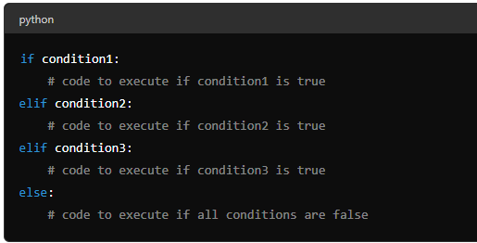
Nested Elif Structure
if condition1: Checks the first condition.
If the first condition is true, the block of code immediately following the if statement is executed.
elif condition2: Checks the second condition if the first is false.
If the first condition is false and the second condition is true, the block of
code following the elif statement is executed.
elif condition3: Checks the third condition if the second is false.
This process continues for as many elif statements as needed.
else: Executes if all conditions are false.
If none of the conditions are true, the block
of code following the else statement is executed.

Slide 7
What is a For Loop?
This presentation will introduce the concepts of "for" loops and "if-else" conditions, both of which are fundamental for controlling the flow of a program and making decisions based on conditions.
A loop that iterates over a sequence: Executes a block of code multiple times, once for each item in a sequence.
Used to automate repetitive tasks: Simplifies the process of performing repetitive actions.
A "for" loop is used to iterate over a sequence (like a list, tuple, dictionary, set, or string) and execute a block of code for each item in that sequence. It is particularly useful for automating tasks that involve repetition.

Slide 8
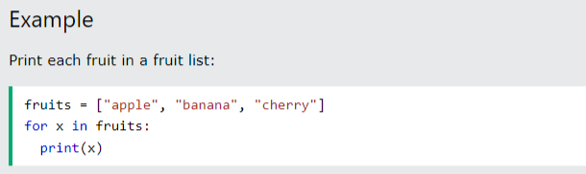
For Loop Structure
for item in sequence: Iterates over each item in the sequence.
-The "for" statement creates a loop that iterates over each element in the sequence (e.g., list, range).
# code to execute for each item: The block of code to run for each item in the sequence.
-This code block runs once for each item in the sequence.
Explanation of Example Code:
-The "for" loop iterates over each element in the sequence.
-For each iteration, the code block indented under the "for"
statemen is executed.

Slide 9
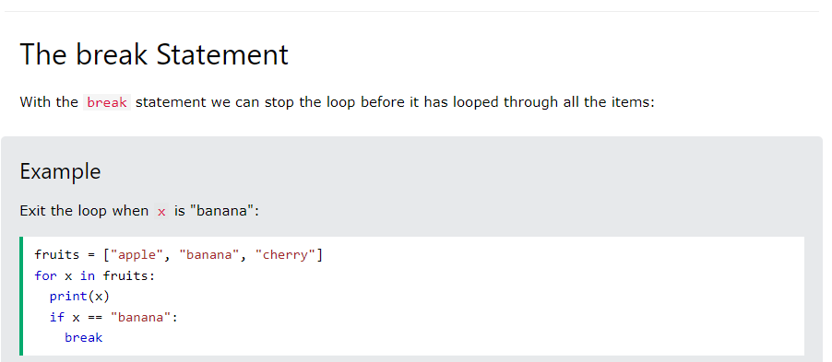
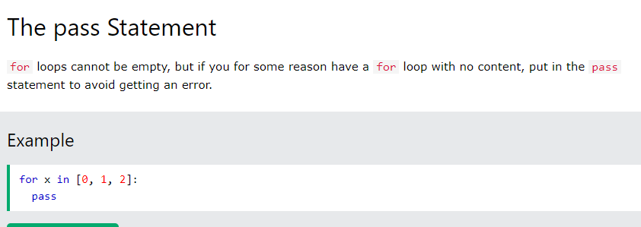
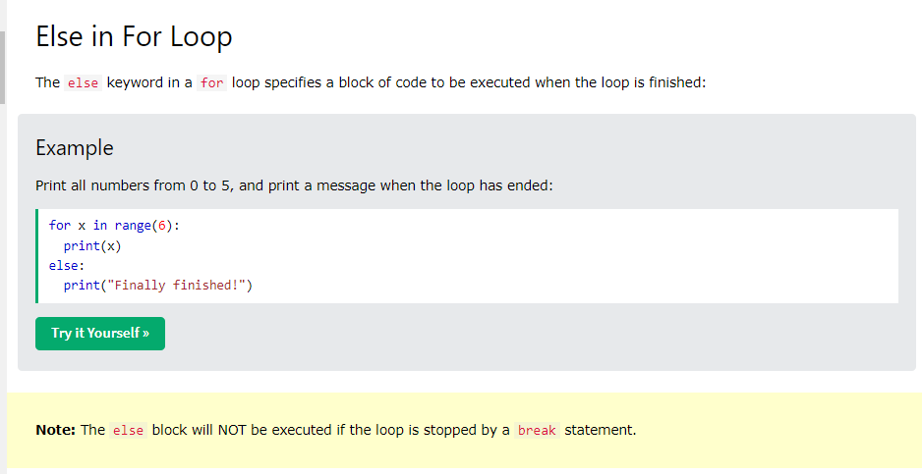
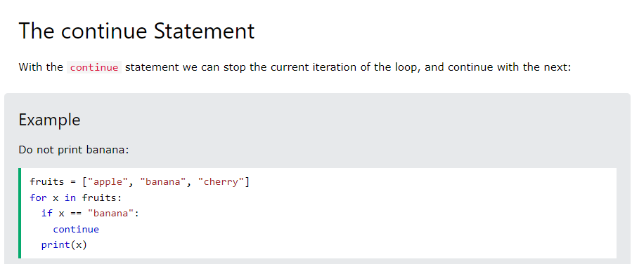
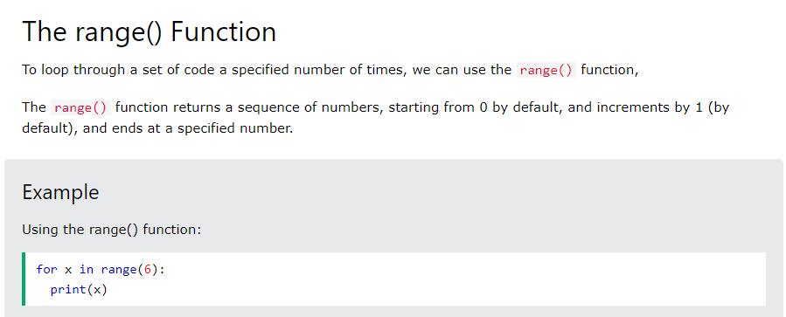

Slide 10
pattern
In Python, we commonly use multiple for loops, and sometimes while loops, too, to print the various patterns. Here, the first outer loop prints the number of rows, and the inner loop prints the number of columns of the pattern. Most pattern programs are variations of each other and work on the same logic.
We will be covering the following pattern programs today:
Simple * Pattern Pyramid
Simple Number Pyramid
Simple Alphabet Pyramid

Slide 11
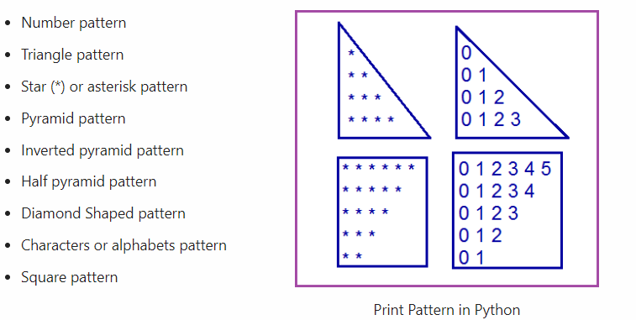
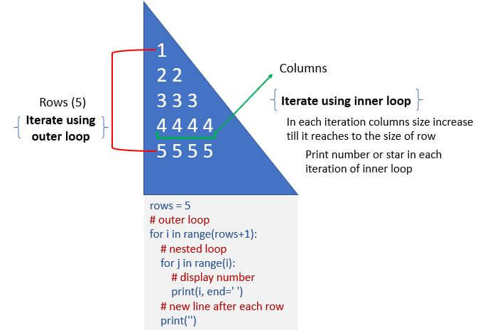
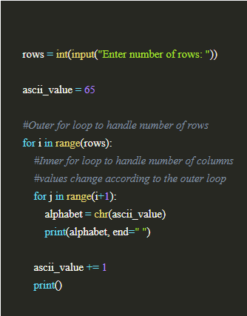
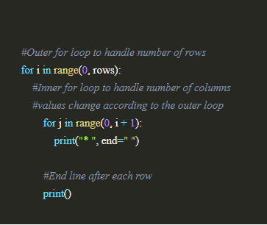
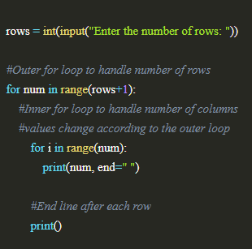
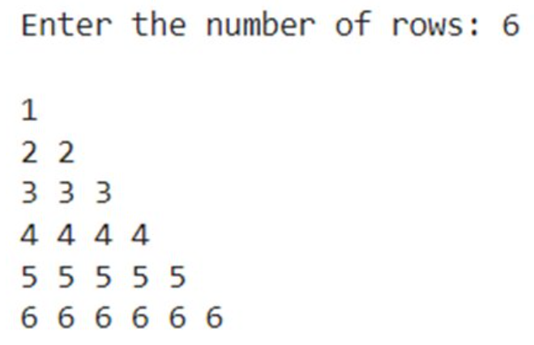
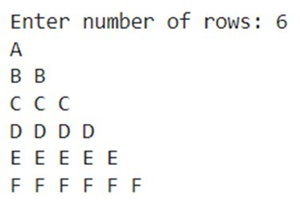
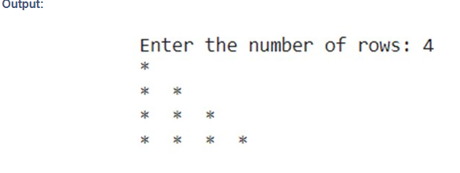
Simple Pyramid
2.Simple number pattern
3.Simple Alphabet Pyramid
1.Simple * pattern pyramid

Slide 12
