Slide 1

INNOTRACK INTERNSHIP PROGRAM - 2026
Name – Mithilesh K
Project Name – CartSense – Customer Purchase & Churn Predictor
Theme –AI-Powered Customer Analytics & churn predictor
VH NO – VH13675

Slide 2
CartSense – Customer Purchase & Churn Predictor
INTRODUCTION
CartSense – Customer Purchase & Churn Predictor is an AI-powered web application that helps businesses predict customer behavior. It analyzes customer details and predicts whether a customer is likely to continue purchasing or churn. The application also helps manage customer records and view prediction history. It is designed with a simple and easy-to-use interface. The main goal of this project is to improve customer retention and support better business decisions.

Slide 3
Idea
CartSense is an AI-powered web application that helps businesses analyze customer behavior and predict whether a customer is likely to continue purchasing or churn.
The idea is to enable businesses to identify at-risk customers early and improve customer retention.
solution:
The system allows users to enter customer details, processes the data using a Machine Learning model, and predicts the customer's churn status.
It also stores customer records, displays prediction results, and provides a dashboard for managing customer information efficiently.
Uniqueness:
AI-based customer churn
prediction using Machine Learning.
Simple, user-friendly, and responsive interface.
Customer record management with prediction history.
Analytics dashboard for better business insights.
Designed as an affordable and easy-to-use solution for small businesses and startups.

Slide 4
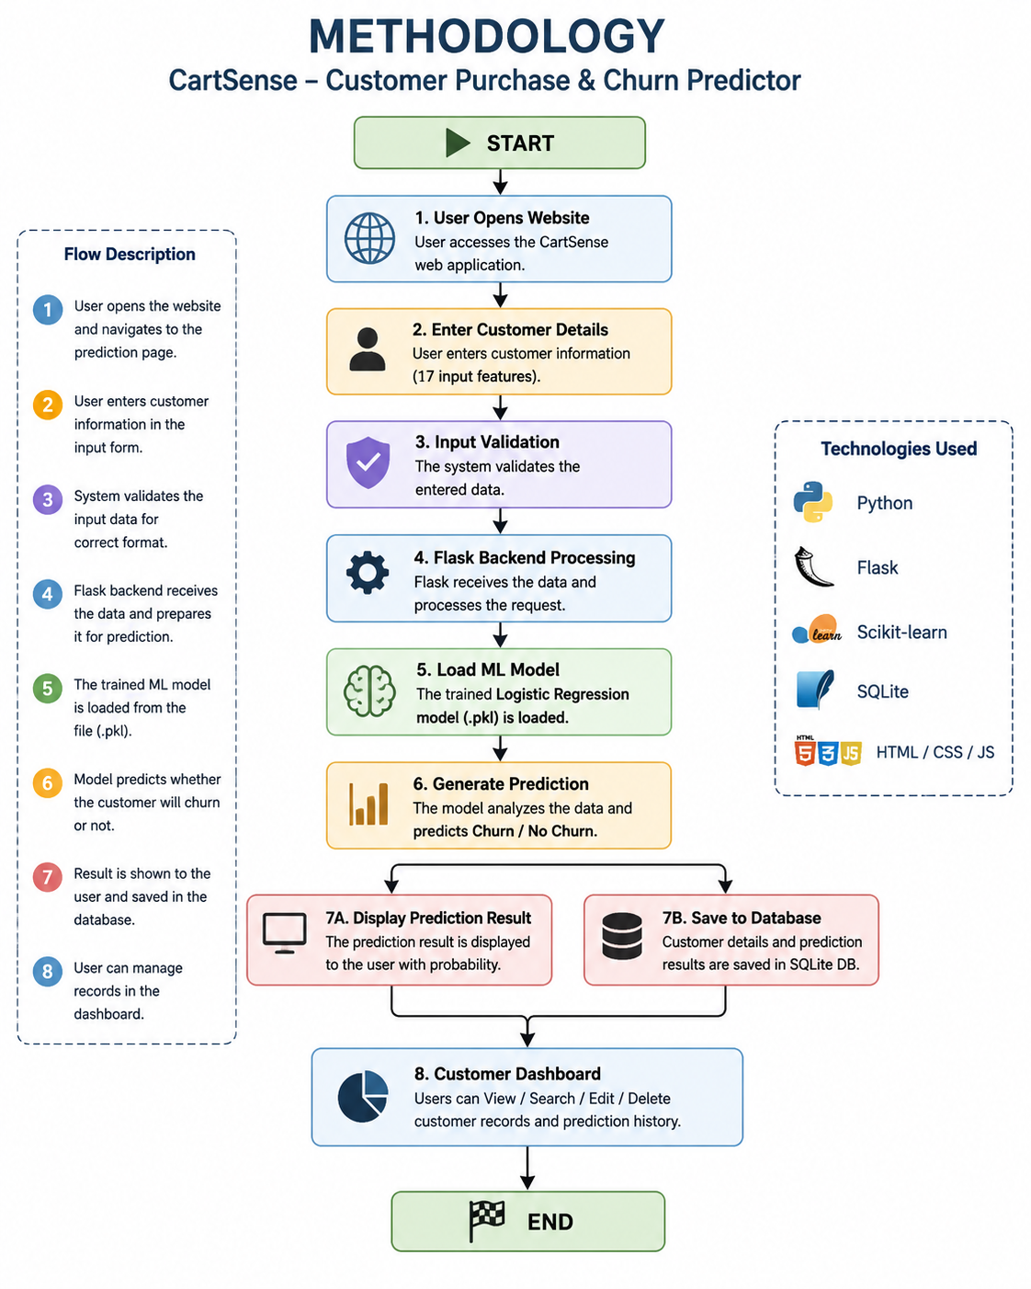
TECHNICAL APPROACH
Technologies to be Used:
Frontend – HTML, CSS3, JavaScript
Backend – Python, Flask
Database – SQLite
Tools – Visual Studio Code,git,github,google collab
ML – Logistic Regression,Numpy,Pandas,Joblib
Methodology:
The user enters customer details through the web application, and the input data is validated and processed. The Logistic Regression model analyzes the processed data, predicts whether the customer is likely to churn or continue purchasing, and displays the result while storing the record in the SQLite database.
METHODOLOGY IMAGE

Slide 5
FEASIBILITY AND VIABILITY
The project is technically feasible as it is built using open-source technologies such as Python, Flask, SQLite, and a Logistic Regression Machine Learning model.
The system is easy to develop, deploy, maintain, and can run efficiently on standard hardware without requiring high-end infrastructure.
It provides a cost-effective solution for businesses to analyze customer behavior and predict customer churn.
The application helps organizations improve customer retention, reduce customer loss, and make data-driven business decisions.
The platform features a simple and user-friendly interface, making it suitable for both technical and non-technical users.
The system can be deployed on cloud platforms, making it accessible anytime and anywhere through a web browser.

Slide 6
CHALLENGES FACED
Understanding the Machine Learning model and integrating the trained .pkl file with the Flask application.
Designing a responsive and user-friendly UI/UX for better user experience.
Connecting the frontend, backend, and database to ensure smooth data flow.
Handling input validation and preventing errors during prediction.
Managing customer records with Create, Read, Update, and Delete (CRUD) operations.
Testing the complete prediction workflow and fixing integration bugs.
Preparing the project for deployment by configuring the required files (requirements.txt, Procfile, and runtime.txt).
Organizing the project structure to make it professional, scalable, and easy to maintain.

Slide 7
FUTURE ENHANCEMENTS
Integrate advanced Machine Learning and Deep Learning models to improve prediction accuracy.
Add real-time customer analytics and interactive dashboards with charts and reports.
Implement secure user authentication and role-based access control (Admin, Manager, Employee).
Integrate email and SMS notifications to alert businesses about high-risk customers.
Support cloud databases (MySQL/PostgreSQL) and deploy the application on cloud platforms for better scalability.
Develop a mobile application for Android and iOS to enable access from anywhere.
Add customer segmentation and personalized retention recommendations based on AI.
Connect with CRM and ERP systems through APIs for seamless business integration.
Enable real-time data synchronization and automated report generation.

Slide 8
IMPACT AND BENEFITS
Helps businesses identify customers who are likely to churn at an early stage. Improves customer retention by supporting timely engagement and retention strategies.
Enables data-driven decision-making through AI-based customer behavior analysis.
Reduces customer loss and helps increase customer loyalty and business growth.
Saves time by automating the customer analysis and prediction process. Provides a simple, user-friendly interface for efficient customer record management.
Stores prediction history, making it easier to track customer trends over time. Cost-effective solution suitable for small businesses, startups, and growing organizations.

Slide 9
CONCLUSION
CartSense – Customer Purchase & Churn Predictor is an AI-powered web application that helps businesses analyze customer behavior and predict customer churn. By combining Machine Learning with a user-friendly web interface, the system supports better customer management and data-driven decision-making. It improves customer retention, reduces business losses, and provides an efficient platform for managing customer information. With future enhancements, CartSense has the potential to become a scalable and valuable solution for organizations of all sizes.

Slide 10
THANK YOU

