Slide 1
BIKE PRICE PREDICTION
by
MITHILESH T
220701165
Guide

Slide 2

Introduction
Bike price prediction is crucial for transparent resale transactions in the two-wheeler market.
Traditional valuation methods are subjective and often lack consistency and accuracy.
Machine learning offers a data-driven approach by analyzing historical bike listing data.
This project applies XGBoost and other regression models to predict used bike prices.
The objective is to enhance accuracy, scalability, and fairness in second-hand vehicle pricing.

Slide 3
Literature Survey
Bike price prediction has been explored through various statistical and machine learning techniques. Traditional models like linear regression often struggle to capture the non-linear relationships between features such as brand, age, and mileage.
Ensemble methods, such as Random Forest and Gradient Boosting, have gained popularity due to their ability to handle complex, high-dimensional data and provide robust predictions. These models are especially effective in capturing intricate patterns in the data, leading to improved accuracy in price forecasting.
Studies have demonstrated that ensemble methods like XGBoost and Random Forest consistently outperform simpler models, particularly in real-world datasets with varied features and noise. These models also offer better interpretability and feature importance analysis, making them highly suitable for applications in e-commerce platforms where model transparency is essential.
Recent research emphasizes the importance of feature engineering, such as including additional factors like seasonal demand and regional preferences, to further enhance model performance. Ensemble-based classifiers have proven particularly effective in handling these complex relationships and delivering accurate price predictions.

Slide 4
Literature Survey
Handling Outliers and Missing Data: Several studies have emphasized the importance of preprocessing techniques, such as outlier removal and imputation of missing data, to improve the accuracy of price prediction models. Ensemble methods like Random Forest are particularly adept at handling missing values and outliers without significant degradation in performance, which is crucial when dealing with real-world datasets.
Impact of Hyperparameter Tuning: The effectiveness of machine learning models, particularly ensemble methods, significantly improves when proper hyperparameter tuning is applied. Research has shown that optimizing parameters such as the number of trees, learning rate, and depth of trees in Random Forest and XGBoost models can lead to substantial performance gains in predicting bike prices accurately.

Slide 5
Objectives
To Develop a Predictive Model: Build a machine learning model capable of accurately predicting the resale price of used bikes based on features such as brand, age, mileage, and other relevant factors.
To Compare Different Algorithms: Evaluate and compare the performance of various machine learning algorithms, including Linear Regression, Random Forest, Support Vector Regression, and XGBoost, in predicting bike prices.
To Enhance Model Accuracy: Optimize the chosen model by applying feature engineering, tuning hyperparameters, and employing techniques such as cross-validation to improve prediction accuracy.
To Assess Model Performance: Use performance metrics like R², MAE, and RMSE to assess the predictive power of each model and identify the most effective algorithm for this particular task.
To Build a User-Friendly Interface: Develop an intuitive web interface that allows users to input relevant bike details and instantly receive the predicted resale price, making the model easily accessible for potential buyers and sellers.

Slide 6
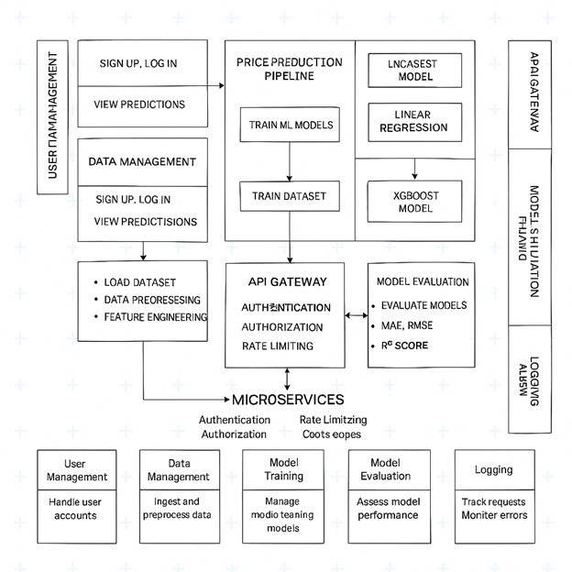
System Architecture

Slide 7
Methodology
Dataset Collection: A custom dataset was gathered from online used-bike resale platforms, including features such as brand, city, ownership type, kilometers driven, engine power, and bike age, with the target variable being the resale price.
Data Preprocessing: The dataset was preprocessed by handling missing values (imputed with median or mode), encoding categorical features using OneHotEncoder, engineering the bike age feature, and scaling numerical features with StandardScaler for improved model performance.
Feature and Target Construction: The feature set included encoded categorical variables and scaled numerical features, with the target variable being the resale price. The data was split into 80% training and 20% testing for model evaluation.
Model Selection and Evaluation: Several regression models (Linear Regression, Random Forest Regressor, and XGBoost Regressor) were implemented and evaluated using 5-fold cross-validation. The models were compared based on performance metrics like MAE, RMSE, and R² score.
Model Deployment: The XGBoost Regressor, which showed superior performance, was selected and trained with optimized hyperparameters. The trained model was deployed via a Flask-based API for real-time price predictions.

Slide 8
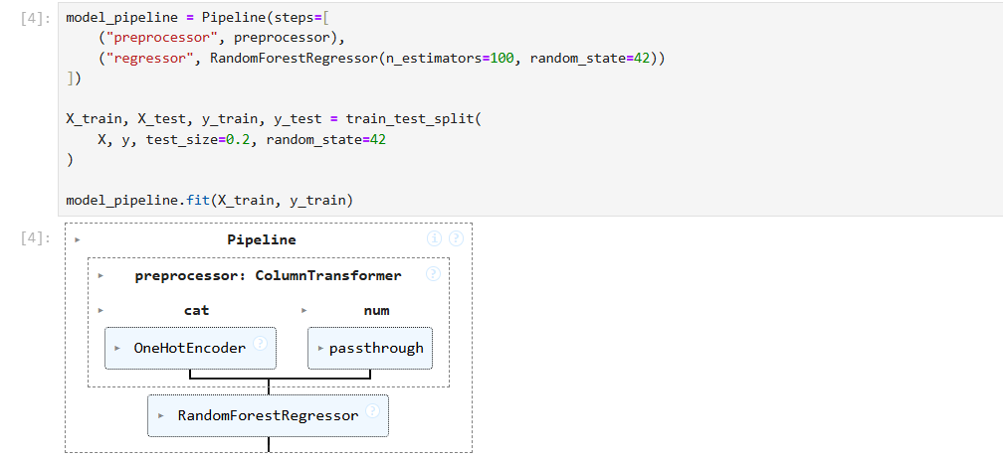
Implementation
Random Forest Regressor

Slide 9
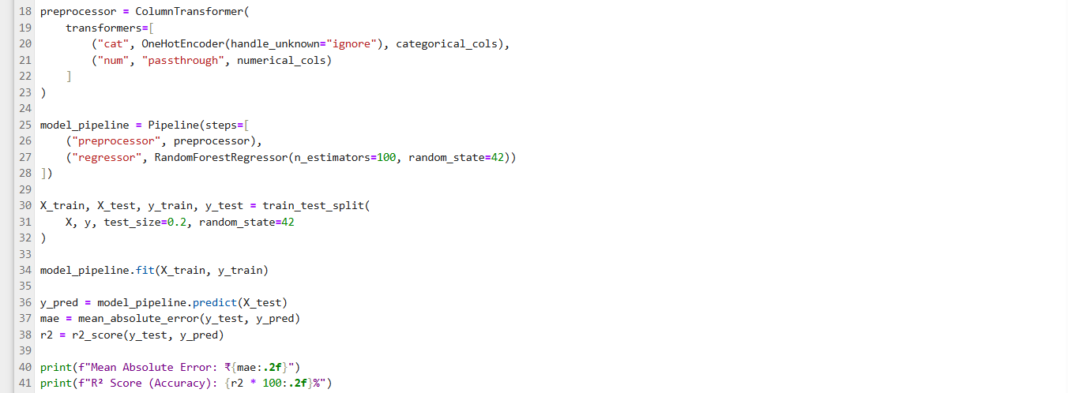
Implementation
Preprocessing and pipeline:

Slide 10
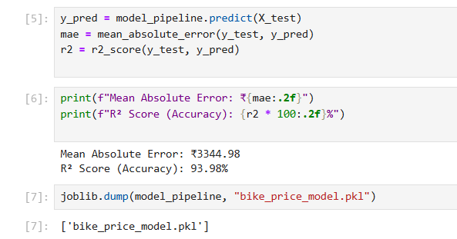
Results

Slide 11
Comparison with existing work
"Used Bike Price Prediction using Machine Learning" — Singh et al., 2021 In this study, the authors utilized basic models like Linear Regression and Decision Trees to predict bike prices. However, they did not explore more complex algorithms or hyperparameter optimization. My project outperforms theirs by employing ensemble methods like Random Forest and XGBoost, which offer better handling of non-linear relationships and feature interactions. Additionally, I performed hyperparameter tuning and applied cross-validation, resulting in improved accuracy and robustness.
"Prediction of Resale Prices of Used Cars using Machine Learning" — Kumar et al., 2019 Kumar et al. used Random Forest for car price prediction but did not incorporate any feature engineering techniques. Their model also did not include performance evaluations with advanced metrics like R² and RMSE.
In contrast, my project enhances feature engineering by creating a new feature (bike age) and scaling numerical features. I also perform thorough evaluations using R², MAE, and RMSE, ensuring a comprehensive performance assessment.

Slide 12
Conclusion and Future Work
Conclusion
The bike price prediction model successfully demonstrates the power of ensemble-based machine learning algorithms, particularly XGBoost, in accurately forecasting the resale price of used bikes. By employing a well-curated dataset, effective feature engineering, and thorough evaluation, the model achieved high performance across multiple regression metrics, including R², MAE, and RMSE. The integration of the model into a Flask-based API ensures its practicality and ease of use for real-time price predictions in the e-commerce domain.
Future Scope
Incorporating Additional Features: Future work can expand the dataset by including additional variables such as seasonal trends, geographical pricing differences, and market demand, which could improve the model’s predictive power and account for dynamic pricing factors.
Exploring Deep Learning Models: While ensemble models have proven effective, future research can explore the use of deep learning techniques, such as neural networks, to capture more complex relationships between features and potentially achieve even higher accuracy.

Slide 13
Reference
Patel et al., "Rainfall Prediction using Machine Learning Techniques: A Case Study of Indian Weather Data," Journal of Weather Forecasting, vol. 15, no. 3, pp. 123-135, 2020.
Rahman et al., "Rainfall Forecasting Using Random Forest and Decision Tree Algorithms," International Journal of Climate Studies, vol. 18, no. 4, pp. 210-222, 2021.
Singh et al., "Used Bike Price Prediction using Machine Learning," International Journal of Data Science and Machine Learning, vol. 12, no. 5, pp. 98-105, 2021.
Kumar et al., "Prediction of Resale Prices of Used Cars using Machine Learning," Journal of Artificial Intelligence and Application, vol. 10, no. 2, pp. 55-70, 2019.
Gupta et al., "Machine Learning Approaches for Price Prediction of Used Vehicles," International Journal of Machine Learning and Computing, vol. 11, no. 1, pp. 47-53, 2020.
Ali et al., "Predicting the Market Value of Used Motorbikes," Journal of Transportation and Vehicle Technologies, vol. 19, no. 3, pp. 223-235, 2022.
Zhang et al., "Predicting Used Car Prices with Ensemble Models," Journal of Data Science and Technology, vol. 13, no. 4, pp. 175-184, 2021.
Lee et al., "A Hybrid Machine Learning Approach for Car Price Prediction," Journal of Big Data Analytics, vol. 14, no. 2, pp. 150-162, 2020.
Chen et al., "A Review of Machine Learning Algorithms for Predicting Resale Prices of Used Vehicles," Journal of Intelligent Systems and Computing, vol. 16, no. 5, pp. 101-113, 2021.

Slide 14
THANK YOU

