Slide 1
Hillary Clinton’s Emails
Boying Xu

Slide 2
Background
During her time as the United States Secretary of State, Hillary Clinton used personal email accounts to conduct Secretary of State affairs, which caused a lot of controversy throughout 2015.
A number of Freedom of Information lawsuits were filed.
On Monday, August 31, the State Department released nearly 7,000 pages of Clinton's heavily redacted emails.

Slide 3
Goals
I want to answer the following questions:
Which countries were of great concern?
What topics did the State Department care most?
Who were the close links to Hillary Clinton regarding email exchanges?

Slide 4
Data
Data Source: Kaggle Competition
4 Data Sets:
Emails
Persons
Aliases
EmailReceivers

Slide 5
Approach
Mapping of countries that were mentioned most frequently
Text Mining of email contents
Network Analysis

Slide 6
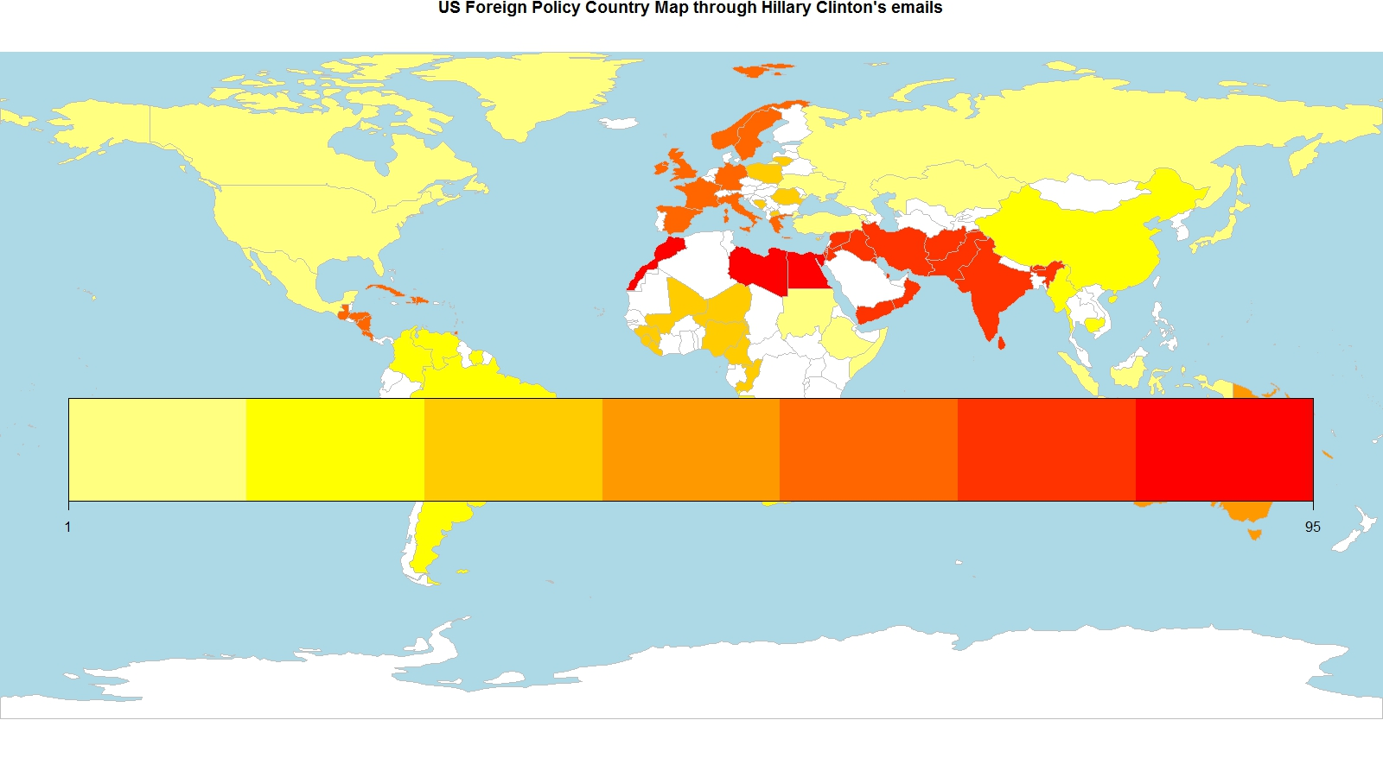
World Map

Slide 7
World Map
The previous slide shows the world map on which the countries mentioned in Hillary Clinton’s emails.
The color varied from pale yellow to crimson, the darker the country, the more frequently mentioned in the emails.

Slide 8
Text Mining
Convert all the uppercase letters to lowercase letters
Convert all the documents to plain texts
Remove punctuations, numbers, stop-words and some other meaningless words from the texts
Transform the documents to term matrix
Word cloud of emails filtered by “terror”
Find out the most frequent terms associated with key words
Find out topics with great importance using topic modeling and K-Means

Slide 9
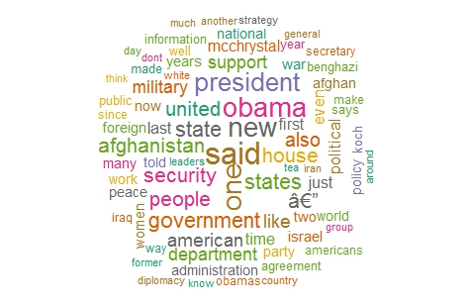
Word Cloud——Terror
This word cloud picture reveals the most frequent words in the emails which contains the term “terror”. The size of a word reflects its importance. Some city and country names were mentioned frequently, such as Benghazi, Afghanistan, Iran and Israel.

Slide 10
Social Network Analysis
Make email sender and recipient names vertices, and each email exchange an edge
Used igraph package in R to draw the graph and analyze the network

Slide 11
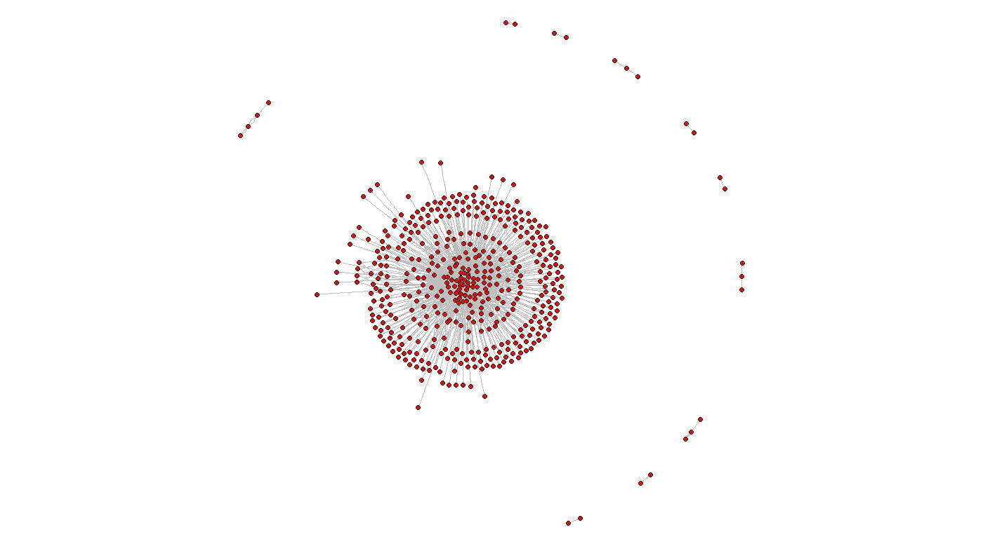
Social Network Analysis——Email Graph

Slide 12
Social Network Analysis——Email Graph
The email graph in the previous slide indicates the social network of Hillary Clinton through emails
468 vertices
Hillary Clinton had 467 email contacts
23 cliques
There are 23 subnetworks in which all the people were connected to each other, making them a close group

Slide 13
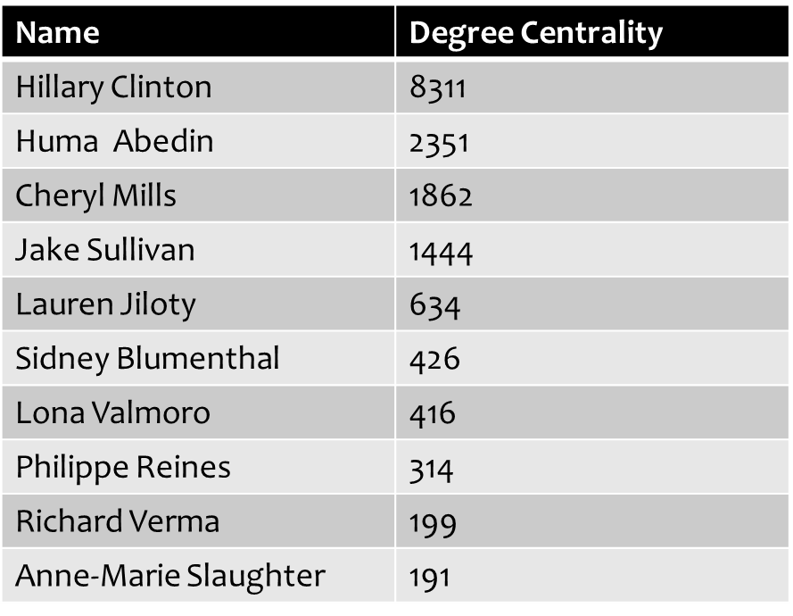
Social Network Analysis——Email Graph
Degree Centrality
Centrality indicates the importance of a node, and degree centrality for each person was simply identical to the number of their emails.

Slide 14
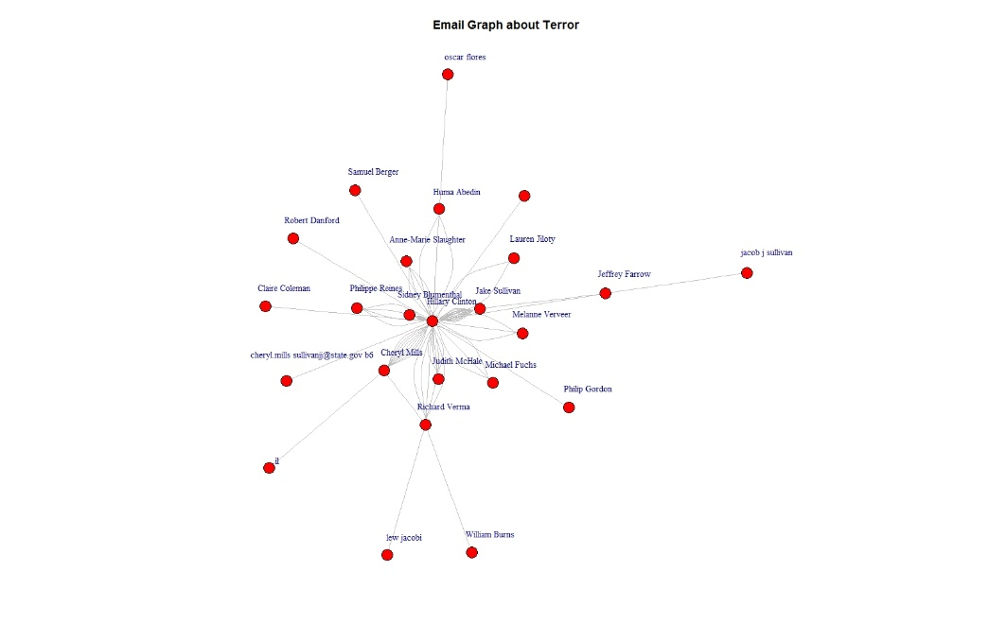
Social Network Analysis ——Email Graph About Terror

Slide 15
Social Network Analysis ——Email Graph About Terror
Sidney Blumenthal
Jake Sullivan
The graph in the previous slide shows who were exchanging ideas about terrorism with Hillary Clinton.
The number of edges between two people indicates the number of emails in which they were discussing about terrorism.
Apparently Sidney Blumenthal, a journalist and former aide to Hillary Clinton, and Jake Sullivan, an American policymaker and the top foreign policy advisor to Hillary Clinton, had the most edges among all the nodes in this network.

Slide 16
Findings
Most of the people exchanging emails with Hillary Clinton were working for her, this have been shown from the frequency bar charts and the network measurements.
Using terror as the key words, I found the people who were discussing about it and the most relevant words, like Obama, president, diplomacy, Mcchrystal, security, military and a couple of countries.

