Slide 1

PAAVAI ENGINEERING COLLEGE
Agroguard – Crop Protection using AI to detect and deter animals
Done by:
1. Kamil S - 622121104043
2. Kirubasankar K - 622121104048
3. Mithin R C - 622121104059
Faculty guide:
Rajkumar D V AP/CSE

Slide 2
CONTENTS
Abstract
Literature review
Disadvantage of Base Paper
Advantages of Proposed system
Requirement gathering
Methodology: Proposed system
Component used
Data collection
System architecture and
Development and implementation
Demonstration of Project

Slide 3
ABSTRACT
Agroguard – Crop Protection Using AI Agroguard is a smart system designed to protect crops from wild animals using AI and buzzersound technology. The system uses AI-powered cameras to detect animals and buzzersonic frequencies to safely repel them. When an animal is detected, it triggers deterrents and sends real-time alerts to farmers and officials via SMS communication. The system also tracks animal movements using camera and sensors to help manage wildlife. Powered by solar energy, Agroguard offers an eco-friendly and cost-effective solution for crop protection while reducing human-wildlife conflict.

Slide 4
LITERATURE REVIEW
Name of Author | Title | Disadvantages | Solutions
Dhillipan J, Vijayalakshmi N, Surya .S, Shanmugam D. B (2020) | A Secure Wild Animals Alert System for Preventing the Farming Land using IoT | False Positives & Negatives: The system might incorrectly classify non-animal movements (like wind-blown objects) or fail to detect certain animals. | Improved Image Processing Algorithms: Enhance machine learning models to reduce false detections.
Gupta. A, M. Joshi (2022) | Implementation of a Wild Animal Intrusion Detection Model Based on Internet of Things | Continuous operation of sensors and communication devices may lead to excessive power consumption, making the system unsustainable in remote areas. | Implement power-saving modes (e.g., sleep-wake mechanisms) to reduce energy consumption when no activity is detected.

Slide 5
LITERATURE REVIEW
Name of Author | Title | Disadvantages | Solutions
Bharathan K, Suganthi J (2022) | Animal detection and prevention in Agri field using iot | Limited Animal Response – Some animals may adapt to the sound deterrents, reducing the system’s effectiveness. | By training the modules for high accuracy and the system sends immediate alerts to mobile devices, ensuring quick response times from farmers.
Pukale, D. D., Dudhane, K., Dawghat, S., Deshmukh, A., & Deshmukh, S. (2023). | Wild Animal Detection and Identification Using Deep Learning. International Journal of Creative Research Thoughts | High Initial Cost: The cost of setting up AI-based detection and prevention systems might be high for small-scale farmers. | Provide cost-effective versions with modular components, allowing farmers to expand their system as needed.

Slide 6
DISADVANTAGES OF BASE PAPER
False Alarms – The system may misidentify objects (e.g., people, birds) and trigger unnecessary alerts.
Limited Animal Response – Some animals may adapt to the sound deterrents, reducing the system’s effectiveness.
Weather Dependency – Cameras and sensors may be affected by fog, rain, or poor lighting, reducing accuracy.
Power and Network Dependency – The system requires constant power and internet connectivity, which might not be available in rural areas.
Initial Setup Complexity – Farmers may require technical knowledge to install and maintain the system.

Slide 7
ADVANTAGES OF PROPOSED SYSTEM
Non-invasive: AgroGuard uses buzzersound to repel animals without harming them, providing an ethical solution to animal control.
Real-time alerts: The system sends immediate alerts to mobile devices, ensuring quick response times from farmers.
24/7 protection: The system operates around the clock, providing continuous monitoring of agricultural fields even during the night or in remote areas.
Cost-effective: Once installed, the system requires minimal maintenance and reduces the need for costly animal control methods, such as fencing or hiring guards.
Scalable: AgroGuard can be adapted for use in small-scale farms or large agricultural operations, making it a versatile tool for a variety of farming environments.

Slide 8



Methodology: Proposed Approach
Data Collection
Gather animal movement data using camera and sensors. Deploy sensors around agricultural areas.
AI Model Development
Train an AI model to predict animal incursions. Customize buzzersound frequencies for specific species.
System Deployment
Install buzzersound devices on field perimeters. Connect the system to a community alert network.

Slide 9
COMPONENTS USED
LCD Display : A 16x2 LCD (likely an HD44780 module), used for displaying information like sensor data, alerts, etc.
Buzzer : For audio alerts or notifications.
Arduino UNO : The central microcontroller controlling the entire system.
Web camera : The web cam is for Capturing images/video

Slide 10
COMPONENTS USED
GSM Module : For sending SMS alerts or receiving remote commands. Likely a SIM800/900 series.
Power Supply Section :Step-down Transformer: Converts AC mains to low-voltage AC.Rectifier and Voltage Regulator Circuit: Converts AC to DC and regulates it (probably to 5V or 12V).
Interfacing Board : It is a basic sensor interface board.

Slide 11
TECHNOLOGIES USED
PYTHON :
If it detects something (like A person’s face or movement):
save the image
send A signal to arduino (via serial)
send an alert (SMS, email, etc.)

Slide 12
TECHNOLOGIES USED
ARDUINO IDE :
Write Code (Sketches)
Compile Code
Upload Code
Serial Monitor

Slide 13
DEVELOPMENT AND IMPLEMENTATION
1.Arduino Function : Hardware control and communication
LCD display
Buzzer
GSM alerts
Sending alerts via Serial to laptop
2. Webcam (Laptop - Python) Function: Image capture
Accessing webcam
Capturing frames when triggered
Saving snapshots

Slide 14
DEVELOPMENT AND IMPLEMENTATION
3. Detection (Laptop – Python) Function: Detect faces, objects, or motion
Face/object/motion detection using OpenCV
Triggers alerts or events
Passes information to logging & alert modules
4. Serial Communication Function: Data exchange between Arduino and Laptop
Reading signals from Arduino
5. Alert Function: Notify users
Send SMS via GSM (Arduino)

Slide 15
FUTURE ENHANCEMENT
Sound Recognition Integration
Cloud Storage and Remote Access
Night Vision Support
Motion Zone Configuration
Power Backup and Reliability
IoT Integration
Email Alert Functionality
AI-Based Behavior Analysis

Slide 16
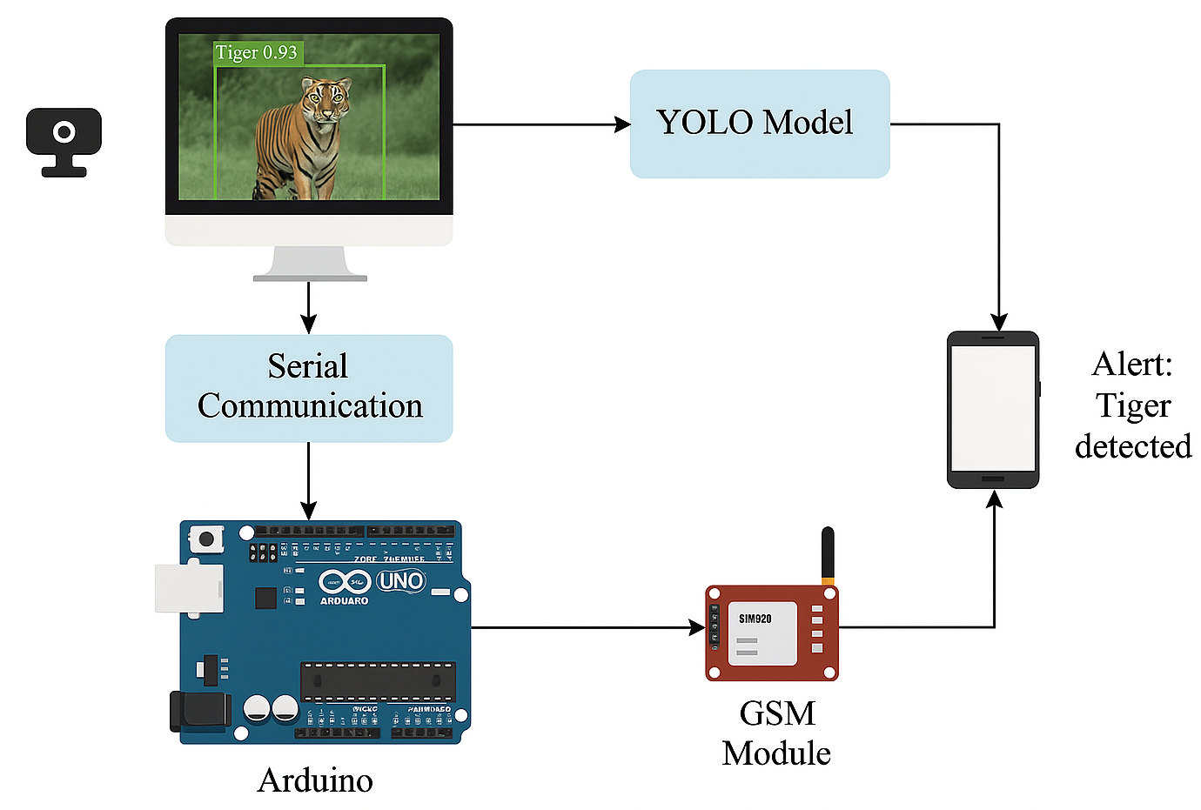
SYSTEM ARCHITECTURE

Slide 17
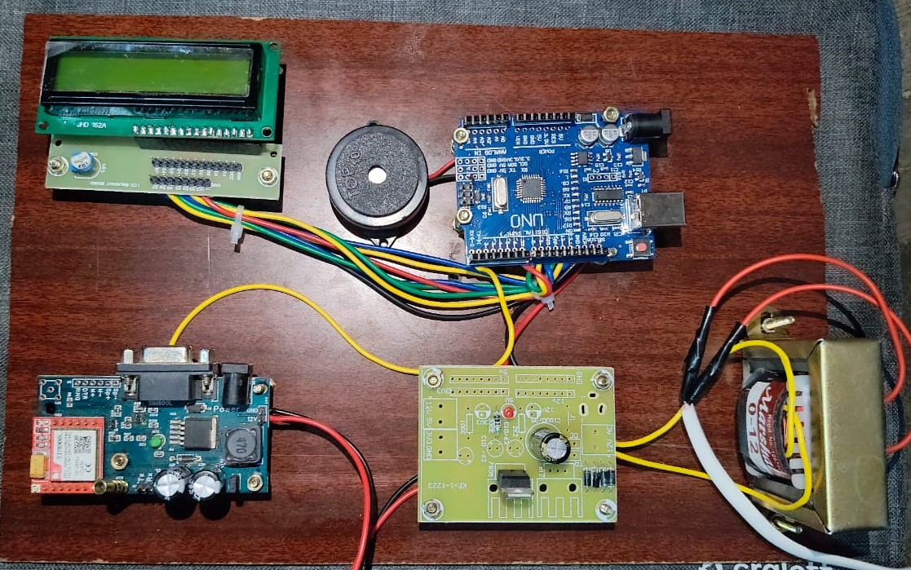
HARDWARE COMPONENTS

Slide 18
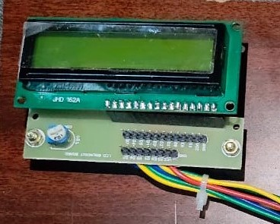
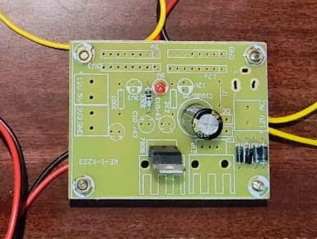
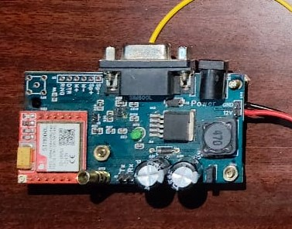
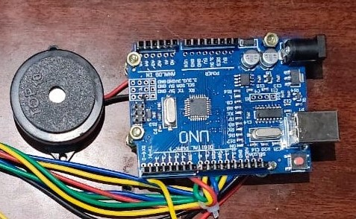
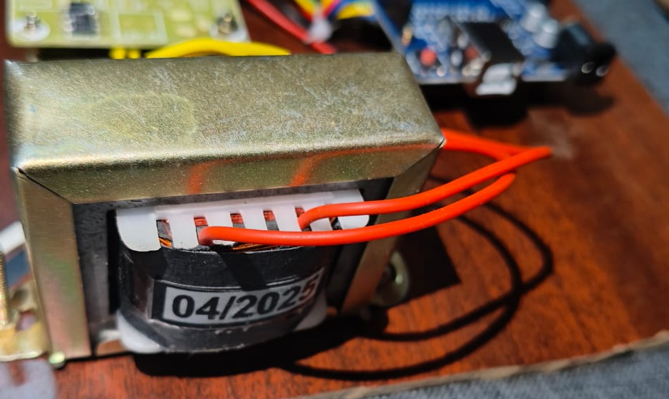
LCD Display
Interfacing board
GSM module
Buzzer & Arduino UNO
Step-down transformer

Slide 19
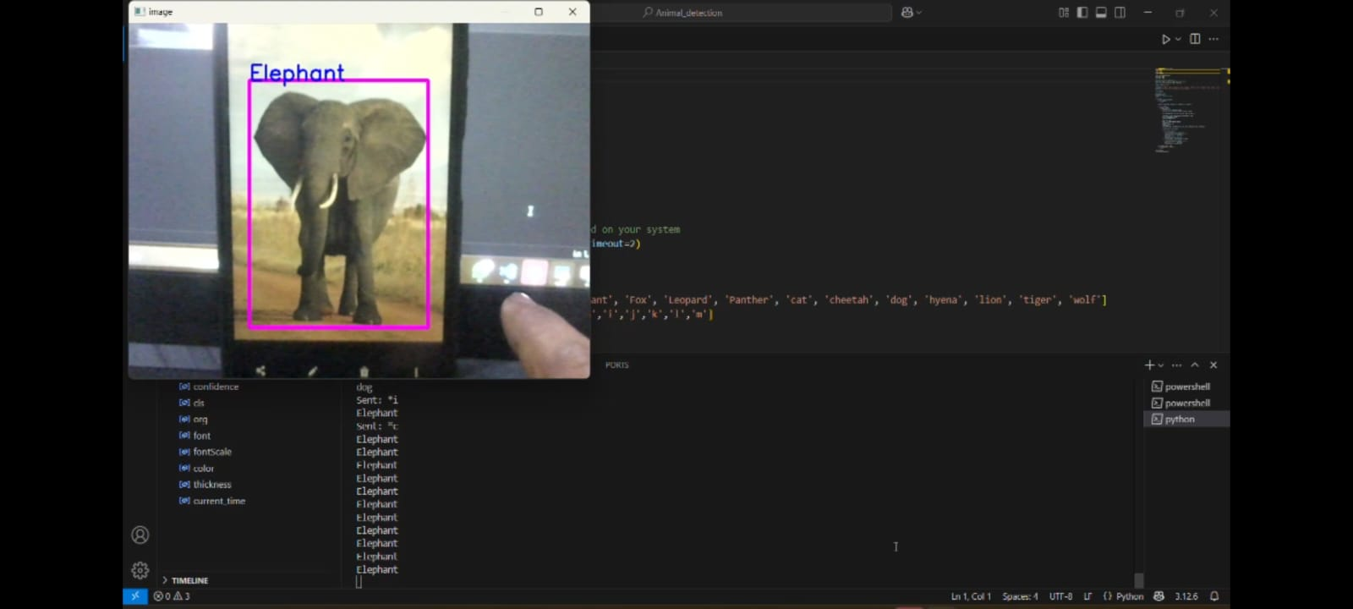
SCREENSHOTS

Slide 20
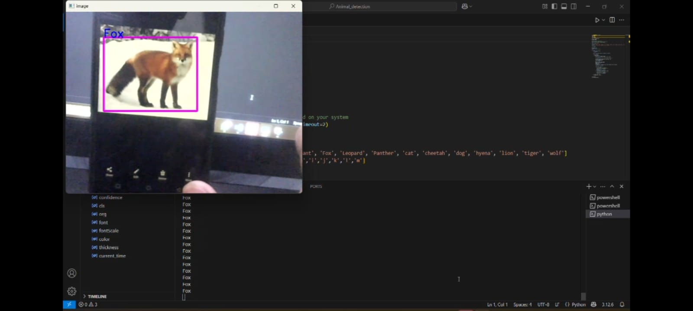

Slide 21
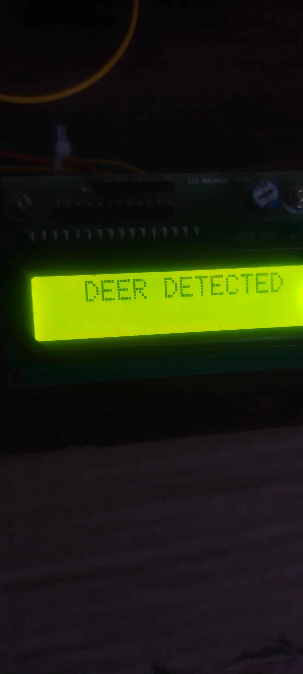
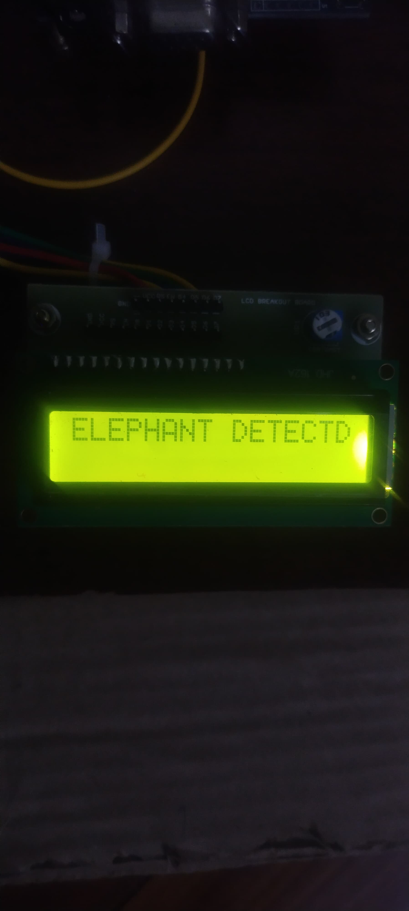
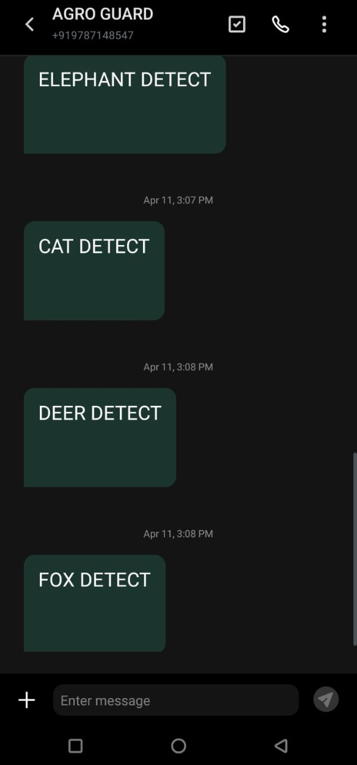

Slide 22
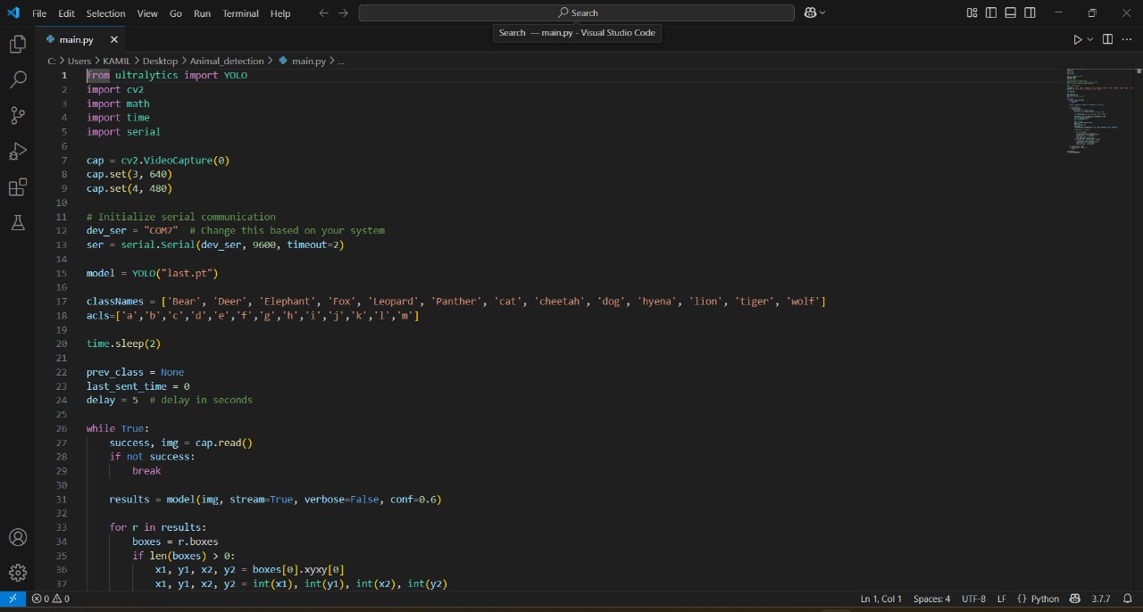

Slide 23
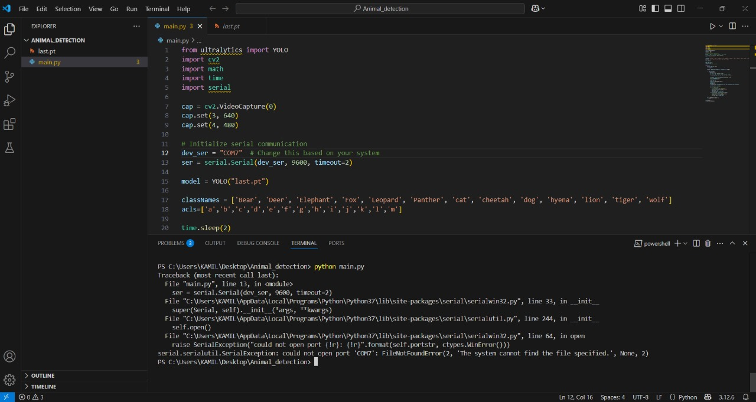
CODE

Slide 24
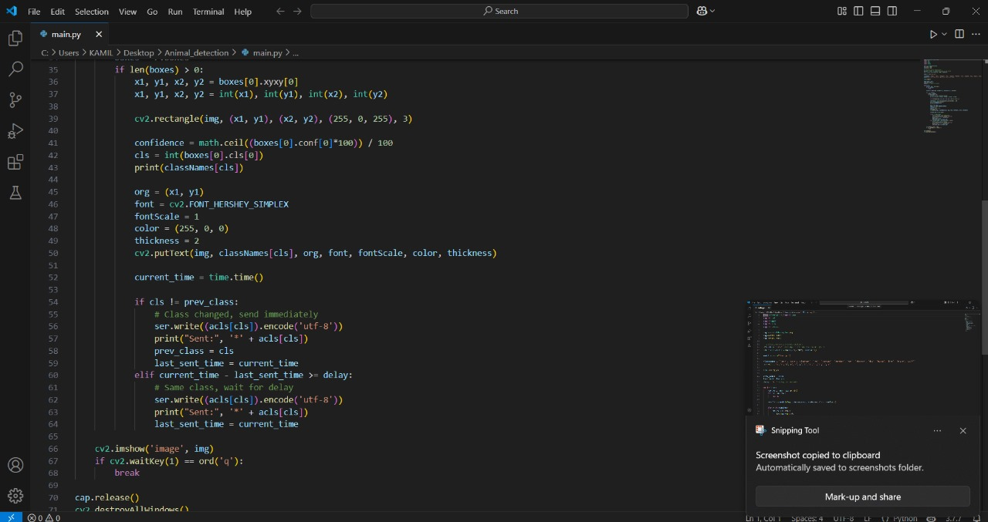

Slide 25
CONCLUSION
Innovative Crop Protection: AgroGuard combines AI and buzzersound technology to provide an effective, ethical solution for preventing animal intrusions into agricultural fields.
Cost-Effective and Scalable: The system reduces the need for expensive and labor-intensive animal control methods, making it suitable for both small and large-scale farms.
24/7 Autonomous Monitoring: With its round-the-clock, automated operation, AgroGuard ensures continuous crop security without the need for manual intervention.
Environmentally Friendly: By using non-harmful buzzersonic sound waves, AgroGuard protects crops without damaging animals or the environment, contributing to sustainable farming.
Data-Driven Insights: The system offers valuable analytics on animal patterns and crop health, enabling farmers to make informed decisions and improve overall farm management.

Slide 26

THANK YOU

