Slide 1

PAAVAI ENGINEERING COLLEGE
Community Service App - LinkUp
Done by:
1. Kamil S - 622121104043
2. Kirubasankar K - 622121104048
3. Mithin R C - 622121104059
Faculty guide:
Rajkumar D V AP/CSE

Slide 2
CONTENTS
Abstract.
Objective.
Literature review.
Existing system.
Proposed system.
Modulation description.
Requirements gathering.
Data collection.
References.

Slide 3
Abstract
Due to fast developments in the technology, the smart phones are proved to be an vital source of communication and now have grown to be an imperative part of our everyday lives. Now a days in India, human beings are facing the problems in finding and hiring nearby profession experts to avail repairing job and maintenance services for their properties and offices. Because of unavailability of such kind of system, new people coming to city are also dealing with predicament of discovering terrific work in their vicinity. To overcome this problem, it’s immensely necessary to provide a platform in order to make a bridge of the communication gap between the technical employees and end-users which can provide an convenient and understandable interface for both the usage of the cutting-edge developments of technology. To get the great of smart phones, this work proposes an android utility or application for the android smart phones. Android app can be a terrific begin in this context in India. It is an android app that can communicate with the consumer and experts possessing different technical skills. The app presently has only four classes of professionals i.e. Painter, Electricians, Mechanics, Plumbers but it is expandable.

Slide 4
OBJECTIVES
The linkup app facilitates seamless connections between customers and service providers.
Users can book services at their convenience, regardless of location.
Intelligent algorithms play a key role in efficiently matching users with suitable Labour.
By tailoring matches based on specific needs, linkup ensures a better overall experience.
Users receive services from professionals who precisely meet their requirements.

Slide 5
LITERATURE REVIEW
Name of Author | Title | Disadvantages | Solutions
Choudhury. L, A. Singh (2023) | Enhancing Urban Service Delivery through Mobile Technology. | Accessibility issues in urban areas; inefficiencies in service delivery. | Implement technology-driven solutions for real-time updates and tracking features.
Gupta. A, M. Joshi (2020) | The Role of Mobile Apps in Enhancing Daily Life Services. | Poor design and navigation hinder user satisfaction. | Emphasize user-centric design principles; improve real-time service matching.
Hendrik Santoso Sugiarto, Ee-Peng Lim, Ngak-Leng Sim (2019) | On Analysing Supply and Demand in Labor Markets: Framework, Model and System. | Limited applicability outside Singapore; potential biases in data interpretation. | Development of a Wage Dashboard for actionable insights; continuous updates to model based on new data.

Slide 6
Name of Author | Title | Disadvantages | Solutions
Jianan Zhang, Shuoyi Zhu (2021) | Research on the Transfer of Rural Labor Force under the Construction of Intelligent Society. | Low education levels; urban-rural labour market divides; social issues like left-behind children. | Enhance rural education; guide orderly labour migration; unify labour markets; leverage technology for better communication.
Kumar. S, R. Sharma (2019) | Mobile Service Platforms: Challenges and Opportunities. | User trust issues; lack of localized content; interface complexity. | Develop localized applications tailored to cultural contexts; improve user interface design.
Mehta. P, R. Verma (2022) | User-Centric Design in Mobile Service Applications. | Complicated interfaces lead to low user retention. | Focus on simplicity and clarity in app design; incorporate feedback mechanisms.

Slide 7
Name of Author | Title | Disadvantages | Solutions
Patel. N, K. Desai (2021) | Digital Platforms and Employment in Emerging Economies. | Challenges in securing consistent work for freelancers; reliability issues on platforms. | Establish transparent channels for service providers; enhance trust mechanisms within platforms.
Vivek Kumar Sehgal et al. (2013) | Job Portal - A Web Application for Geographically Distributed Multiple Clients. | Knowledge gaps among job seekers regarding industry needs. | Design online recruitment systems that capture job requirements effectively.
Yashi Jain, Aneesha Jaykumar, Ateeba Jawaid, Prof. Silviya D’monte (2022) | Job Portal: Finding Best Job and Best Candidate. | Inefficient communication between job seekers and recruiters; lack of real-time updates. | Create a centralized job portal with chat features and notifications for better interaction.
Zaijin Lin, He Chen (2012) | Labor Structure, Wage and Efficiency of Economic Growth. | Mismatched industrial structures; declining low-end labour opportunities. | Adapt industrial strategies to align with labour market changes; focus on education and training for high-end labour.

Slide 8
EXISTING SYSTEM
In the existing system, there is no application for home service. The Worker details are shared only for
manual process.
There is no booking option and view service man for the android application.
This results in increased inefficiency and may not cover all the details.
All process can be either booking by calling to the worker or direct visit.
There is no option to book the worker.

Slide 9
Proposed system
Objective: Develop a user-friendly android application for home-related services.
Minimize Manual Interaction: The goal is to reduce manual effort in requesting services.
User Registration: Registered users can log in and request service employees based on their location.
Service Listing: The app displays registered home-related service employees in the user’s area.
Request Process: Users select a service employee and make service requests.
Employee Interaction: Service employees can accept or reject user requests.

Slide 10
MODULE DISCRIPTION
CUSTOMER PROFILE
LABOUR PROFILE
FLEXIBILITY AND CONVENIENCE
Customers can hire Labour for various services on a user-friendly platform. They can also provide reviews and ratings for Labour services.
Labour profiles are verified to prevent spam and fraud. Labours can be hired for different tasks and services across various fields.
The app offers a one-on-one hiring approach without brokerage. It supports individual and multi-hiring options for users.

Slide 11
REQUIREMENTS GATHERING
1
CUSTOMER NEEDS
Customers require a convenient, reliable, and user-friendly platform to access a wide range of professional services on-demand.
2
LABOUR NEEDS
Labours seek a platform that provides them with visibility, flexible scheduling, and the ability to grow their customer base.
3
INTEGRATIVE APPROACH
The app must seamlessly cater labours to the needs of both customers and, fostering a mutually beneficial ecosystem.

Slide 12
TOOLS REQUIRED
40%
30%
30%
FRONTEND (FLUTTER)
DATABASE (SQL)
BACKEND (DJANGO)
The frontend developed in Flutter accounts for 40% of the architecture, providing a smooth user interface that works consistently across devices. This ensures an engaging experience for all users.
The SQL-based database constitutes 30% of the architecture, providing reliable data storage and fast retrieval capabilities. This is essential for handling numerous transactions smoothly.
The backend built with Django makes up 30% of the architecture, managing data interactions and business logic effectively. Django's robust framework aids in rapid development and high security.

Slide 13
Frontend Development with Flutter
1
User Interface Design
Flutter's intuitive UI framework allowed for creating a user-friendly and visually appealing interface with a consistent look and feel across all devices.
2
Interactive Elements
Flutter's widget library enabled us to implement interactive elements such as buttons, sliders, and menus, providing a responsive and engaging user experience.
3
Performance Optimization
Flutter's efficient rendering engine ensures smooth performance and fast load times, even on low-powered devices.

Slide 14



Backend Integration with Python Django
API Development
Django's REST framework facilitated the creation of a robust API for seamless communication between the frontend and backend.
Data Processing
Python's data manipulation capabilities were used to process and manage user data, service details, and transaction information.
Security Measures
Django's built-in security features ensured data integrity and user privacy by implementing robust authentication and authorization measures.

Slide 15



SYSTEM ARCHITECTURE DESIGN
MICROSERVICES
The LinkUp app will be built on a microservices-based architecture, allowing for scalability and independent component deployment.
CLOUD INFRASTRUCTURE
The system will leverage cloud-based services for storage, computing power, and seamless integration of various components.
API-DRIVEN INTEGRATION
Well-defined APIs will enable efficient communication between the frontend, backend, and external services, ensuring a flexible and modular system.

Slide 16
Flow chart
Open app
Login page
New registration
Data base
User login
Recruiter login
Applied
Applied
Notification
Notification
Rating
Rating
Review
Review
Log out

Slide 17
Algorithms and Techniques Used
1
Federal Algorithm
2
Pricing
LinkUp utilizes a federal algorithm that considers factors such as location, skillset, availability, and customer preferences to connect users efficiently.
The app dynamically calculates service pricing based on factors like job complexity, time required, and market demand, ensuring fair and competitive pricing.
Verified Labour profiles
4
Review System
3
To maintain the platform’s intergrity, each labour profile undergoes a verification process to ensure genuine service providers.
In LinkUp both labours and customer can provide reviews and rating for each other.

Slide 18
Data Collection and Management
User Data
Service Data
Transaction Data
LinkUp collects user data, including location, skills, availability, service preferences, and pricing information, to create detailed profiles.
Data on service types, descriptions, pricing, availability, and customer ratings is gathered and organized for efficient matching and service management.
LinkUp captures and stores data on all transactions, including service bookings, pricing, and feedback, to provide a comprehensive history and facilitate analysis.

Slide 19
Streamlined Booking Workflow
1
Service Search
Users can search for services based on location, type, and keywords.
2
Service Selection
Customers can view detailed information about services, including provider profiles and reviews.
3
Booking Confirmation
Once a service is selected, users can choose a date and time for the booking, provide necessary details, and make payment.
4
Communication and Updates
The app facilitates communication between customers and service providers, providing real-time updates on booking status and any changes.

Slide 20
Customer Review and Feedback System
2-Way Rating System
Review Submission
Customers can rate service providers based on their experience, providing valuable feedback for other users. Also, service provider can give feedback about their customer.
Users can submit detailed reviews and comments, sharing their experiences and insights with the community.
Feedback Analysis
LinkUp aggregates customer reviews and feedback to identify areas for improvement and enhance the quality of services.

Slide 21
Secure and Scalable Infrastructure
Data Encryption
Sensitive user data is encrypted both in transit and at rest, ensuring maximum security.
Scalable Architecture
LinkUp's infrastructure is designed to scale seamlessly to handle increasing user traffic and data volumes.

Slide 22
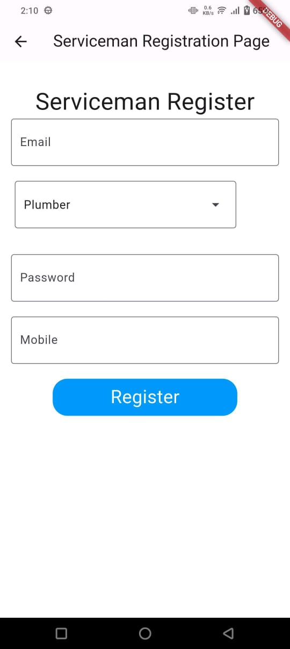
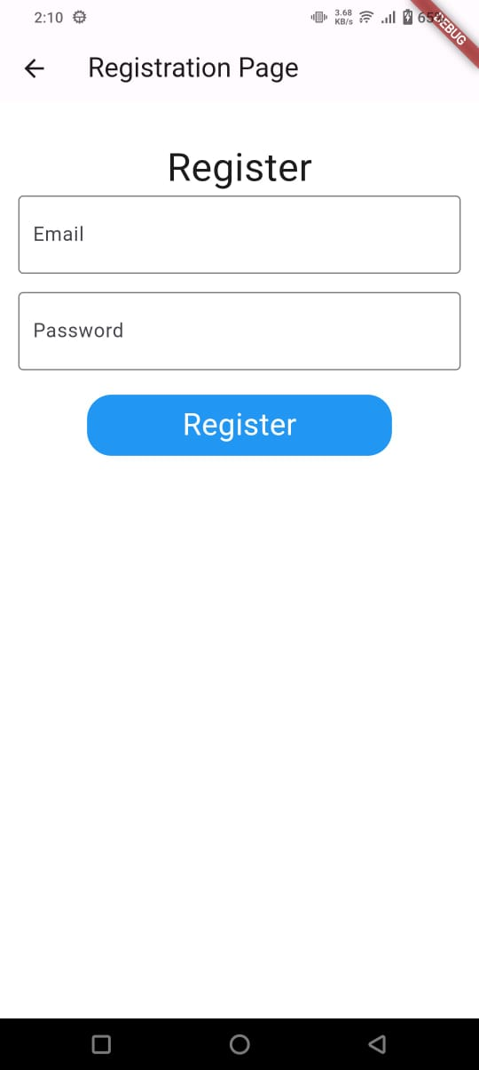
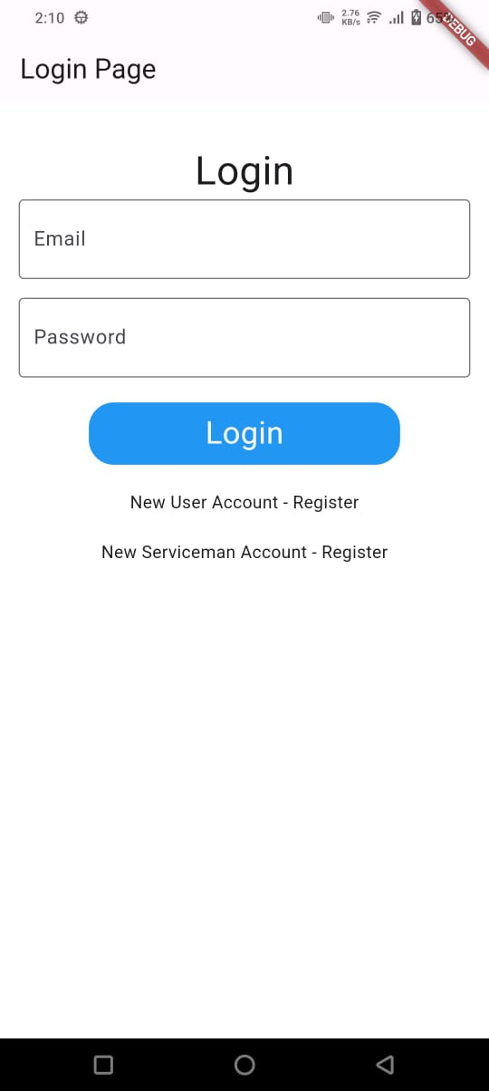

Slide 23
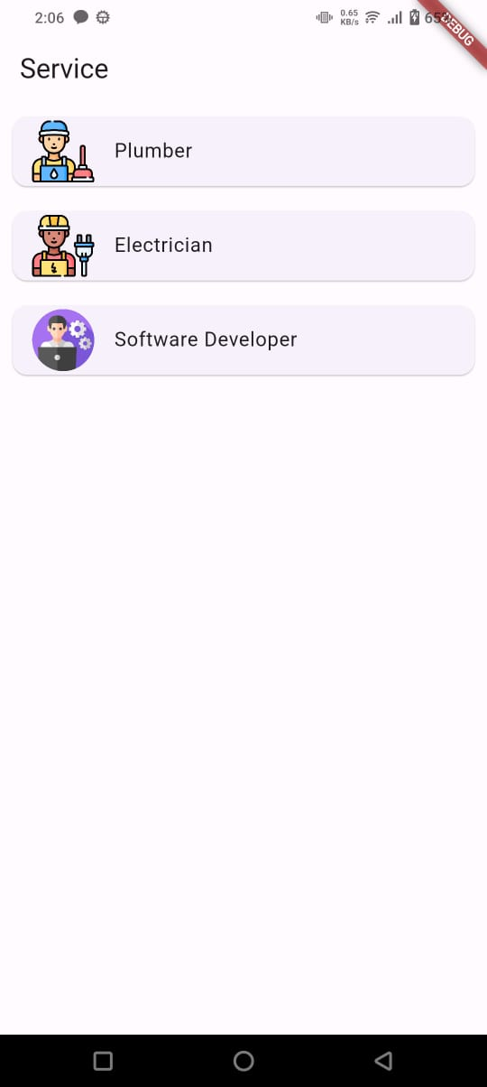
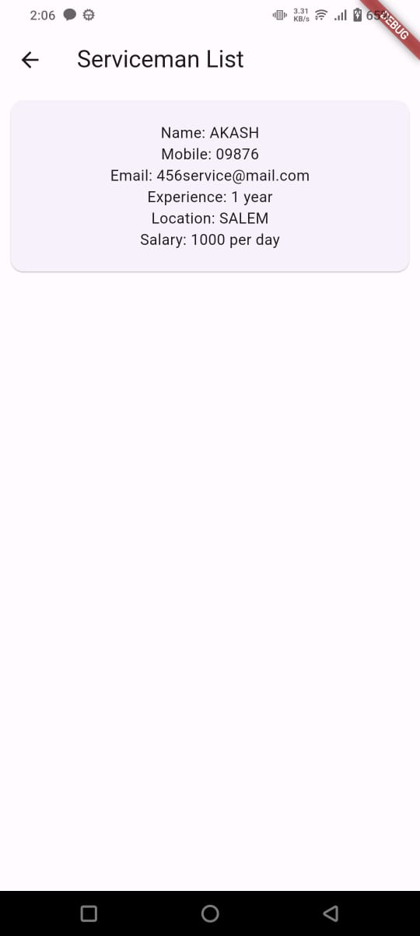
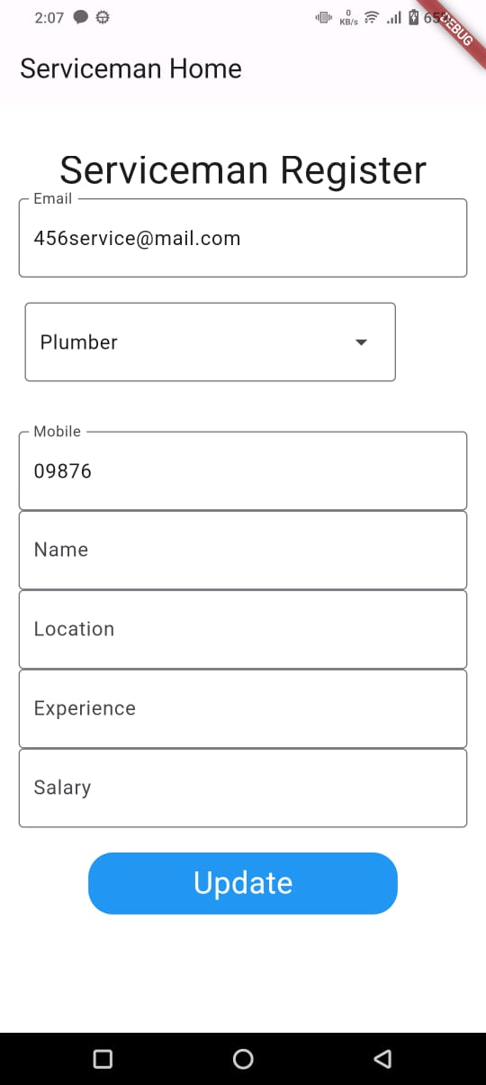

Slide 24
REFERENCE
[1] Hendrik Santoso Sugiarto, Ee-Peng Lim, Ngak-Leng Sim (2019) On Analysing Supply and Demand in Labor Markets: Framework, Model and System. IEEE International Conference on Data Science and Advanced Analytics (DSAA).
[2] Zaijin Lin, He Chen (2012) Labor Structure, Wage and Efficiency of Economic Growth. 4th International Conference on Intelligent Human-Machine Systems and Cybernetics.
[3] Jianan, Zhang, Shuoyi, Zhu (2021) Research on the Transfer of Rural Labor Force under the Construction of Intelligent Society. International Conference on Public Management and Intelligent Society (PMIS).
[4] Yashi Jain, Aneesha Jaykumar, Ateeba Jawaid, Prof. Silviya D’monte (2022) job portal: finding best job and best candidate. International Research Journal of Engineering and Technology (IRJET).
[5] S. Kumar, R. Sharma (2019) Mobile Service Platforms: Challenges and Opportunities.
[6] A. Gupta, M. Joshi (2020) The Role of Mobile Apps in Enhancing Daily Life Services.

Slide 25
[7] N. Patel, K. Desai (2021) Digital Platforms and Employment in Emerging Economies.
[8] P. Mehta, R. Verma (2022) User-Centric Design in Mobile Service Applications.
[9] L. Choudhury, A. Singh (2023) Enhancing Urban Service Delivery through Mobile Technology.
[10] Vivek Kumar Sehgal, Akshay Jagtiani, Meha Shah, Anupriya Sharma, Arpit Jaiswal, Dhananjay Mehta (2013) Job Portal - A Web Application for Geographically Distributed Multiple Clients.
[11] Pradeep Kant (2015) Android App for Household Services, IEEE Conference on Computer and Information Technology. ISSN-245-228, ISO125:162, Vol no-25.
[12] Kamal Dharani, Sania Bhatti, Amirita Dewani (2011) Renovate -It: A geo-based technical professional hiring system for repairing and maintenance services .
[13] Cunlu Zhang ,Yimeei Guo (2012) A Knowledge Management System Solution Based on ASP Platform for Domestic Appliance Repair.

