Slide 1
Online News , commerce and social-network web site
Name: Sunirmal Mallick Mithon
ID : 143-35-800 Section : “B”

Slide 2
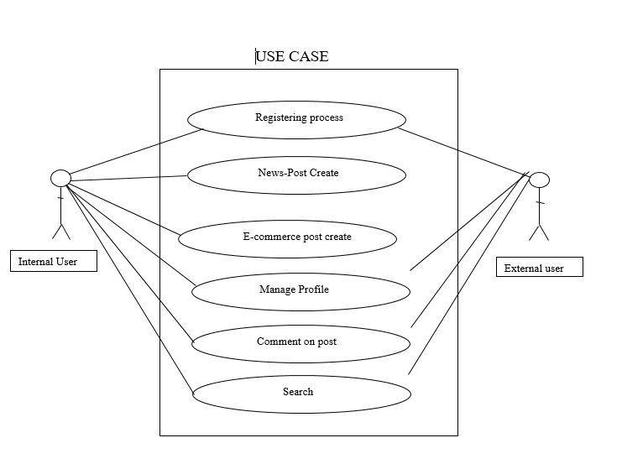
Use Case

Slide 3
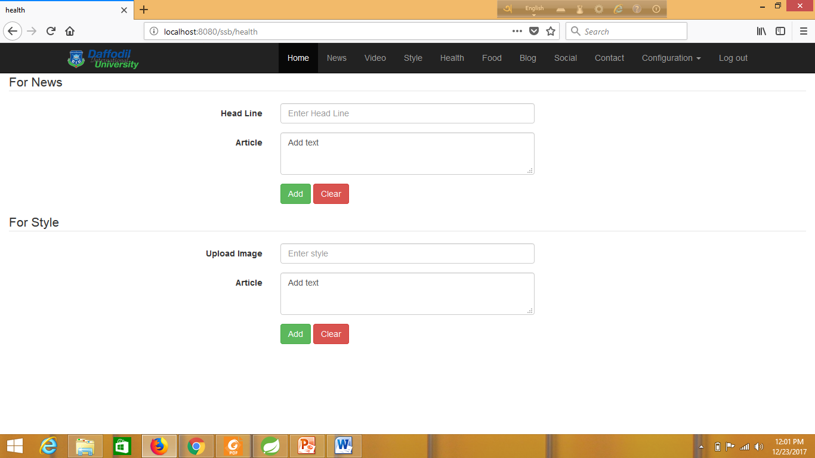
Admin Page:

Slide 4
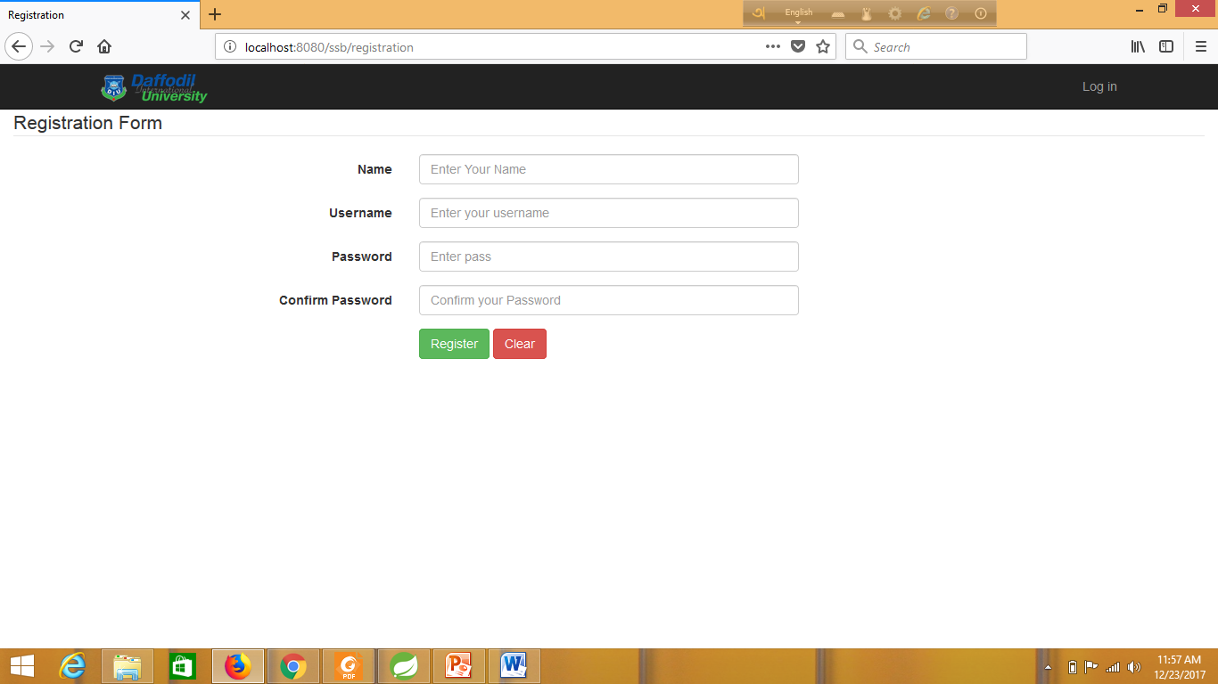
Registation Page:

Slide 5
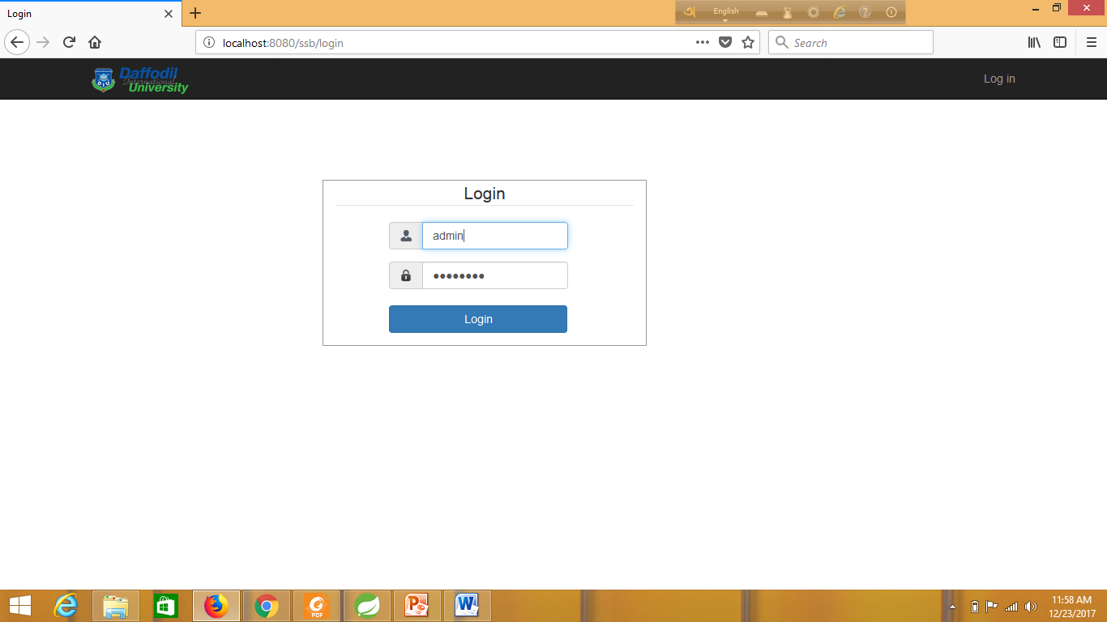
Login Page:

Slide 6
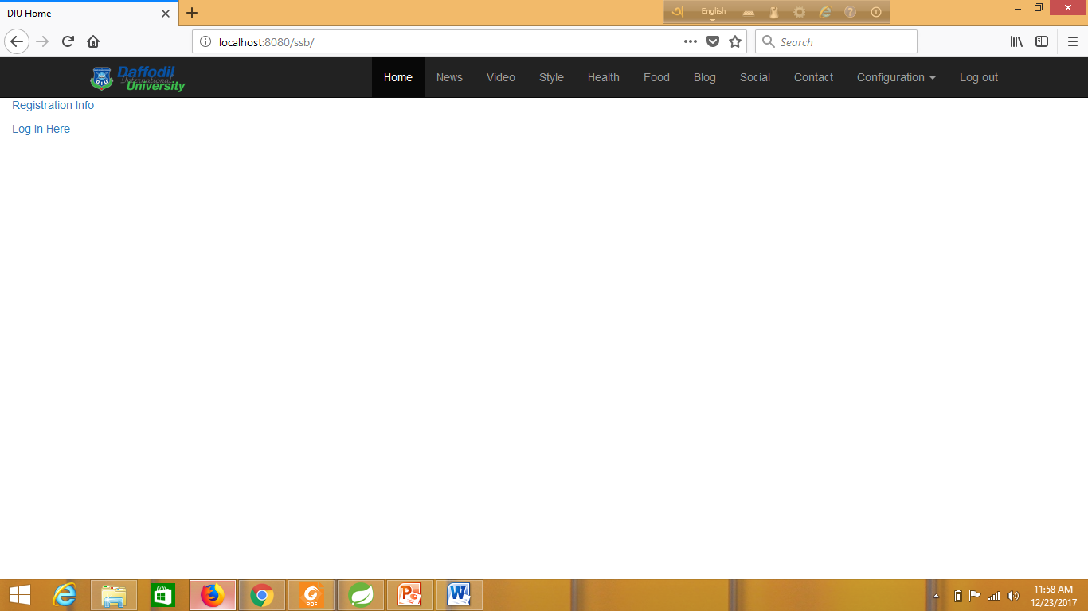
Home Page:

Slide 7
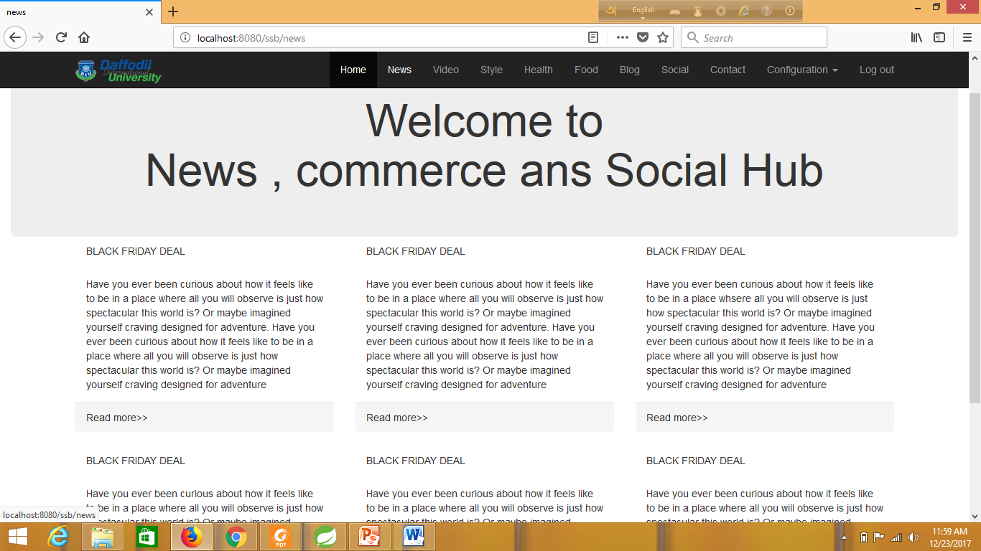
News Page:

Slide 8
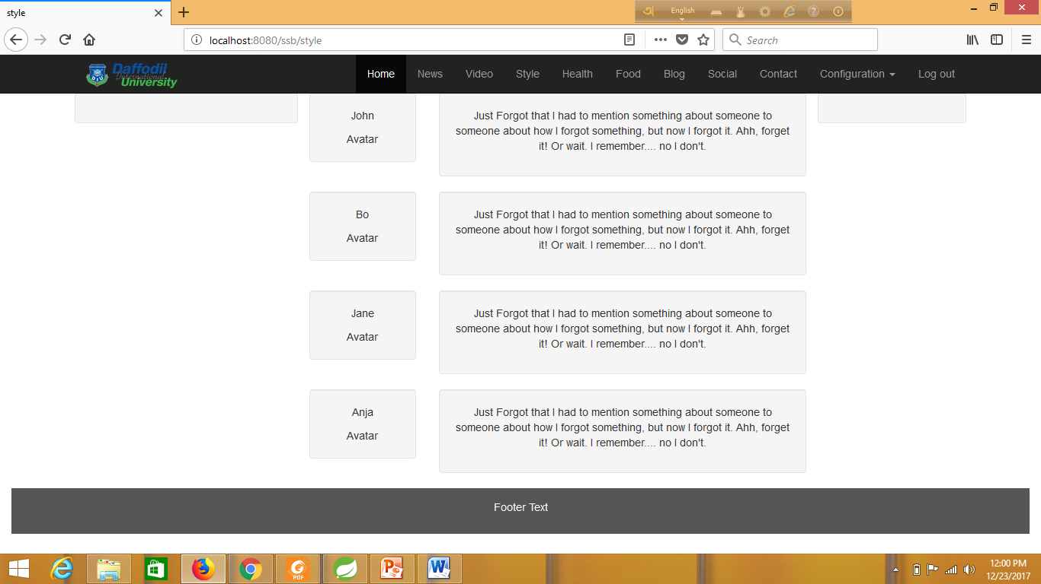
E-commerce(Style) Page:

Slide 9
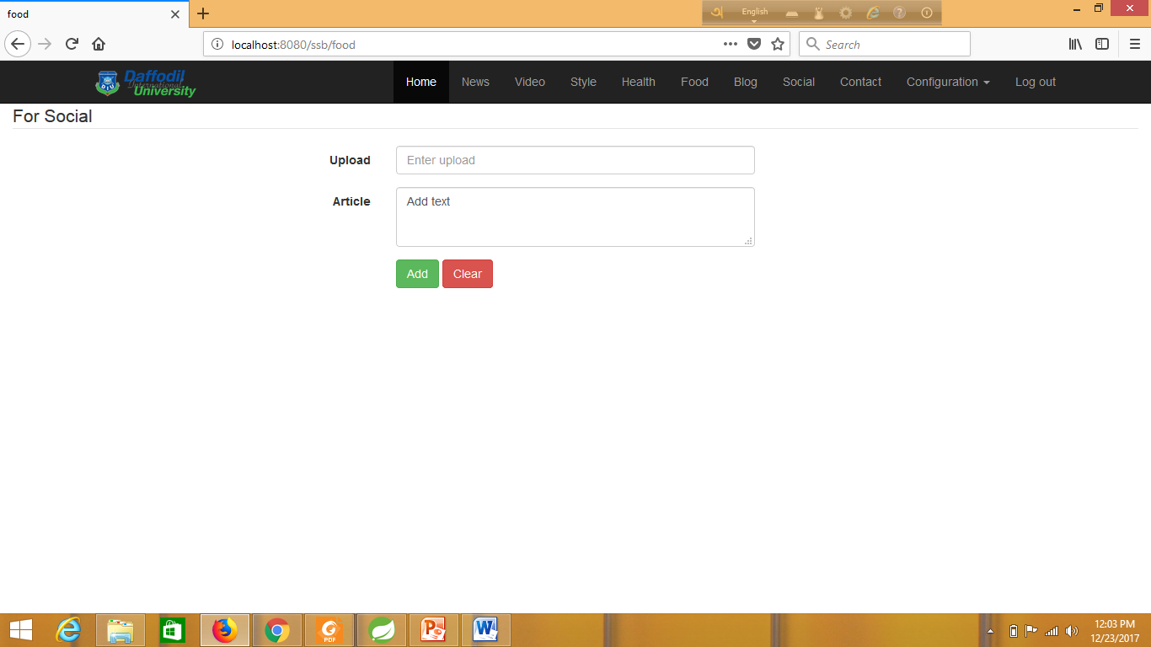
Social upload Page:

Slide 10
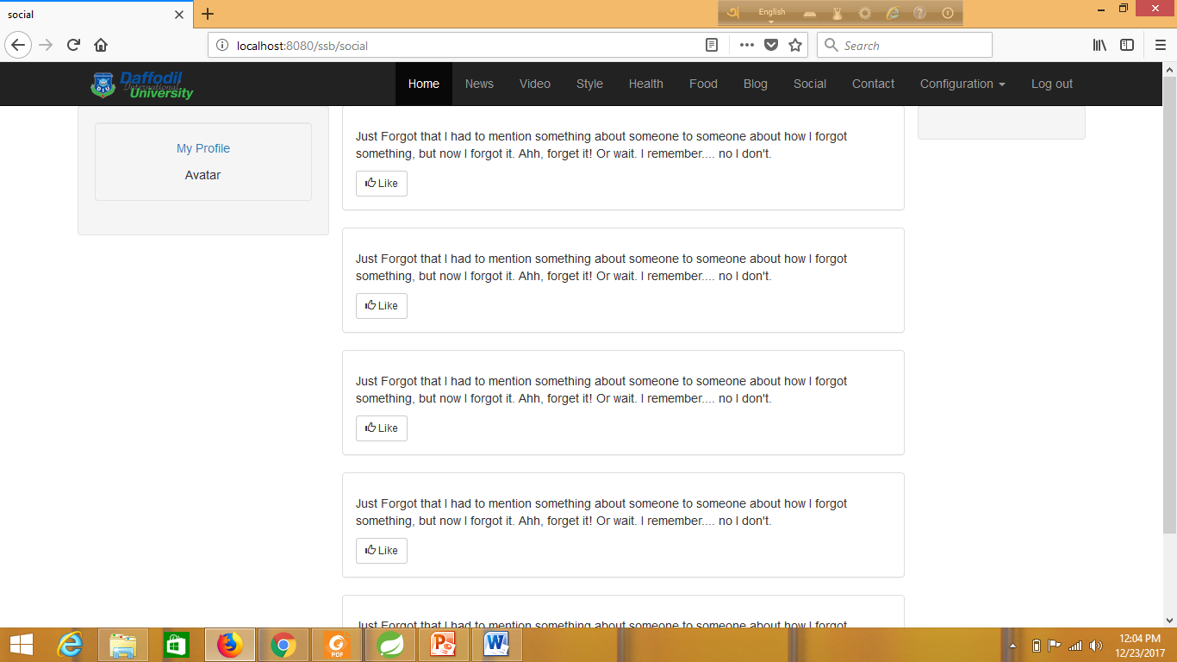
Social Page:

Slide 11
Thank You
Sir

