Slide 1



NEWTECH PRECISION DATABASE PROJECT
-SRM CONNECTS

Slide 2
ABSTRACT
This project needs to store the employee database with their salary,accommodation and daily uses (usage of canteen)
A Database is created and named as Employee which consists of module. They are follows
1.Login table
2.Employee Index page
3.Admin page
These tables are further explained in the following presentation.In this Employee database the employee can view their day to day expenditures and salary . The admin can have the complete data of each and every employee and can generate reports.The admin will be controlled by both SRM CONNECTS and NEWTECH PRECISION Admin Team.

Slide 3
LOGIN TABLE
The user and admin can login through Login page . We will be providing a username and password for both user and admin.
EMPLOYEE TABLE
In this table the employee can view their dashboard including salary,employee id , expenditures,HRA
This page fetches and gives result to employee on their expenditures which will be calculated to the salary and salary will reduced on their expenditures.

Slide 4
ADMIN TABLE
The admin table contains entire details of the employee and will generate the report of all employees with employee ID,salary with HRA,PF amount
The admin can enter the expenditure done by the employee and can enter or reduce the salary as per their expenditures.

Slide 5
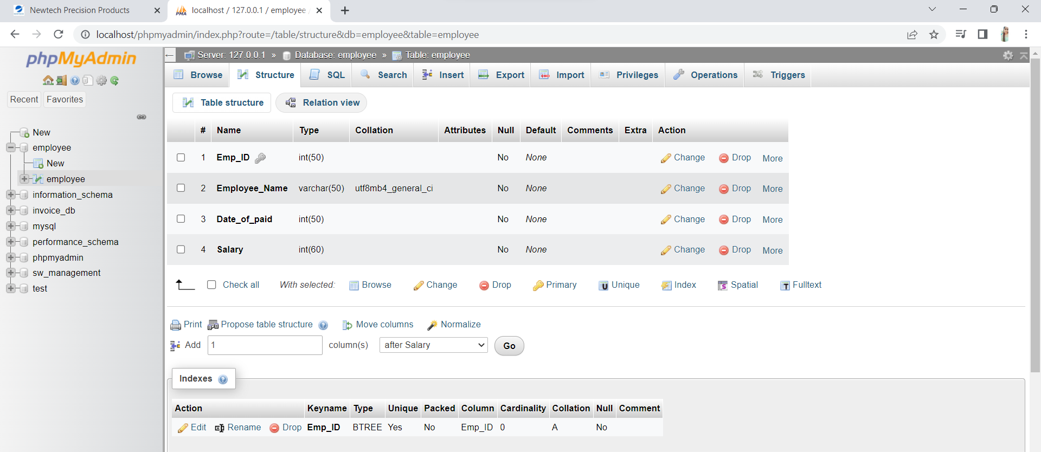
SAMPLE TABLE

Slide 6
THANK YOU

