Slide 1
Money Matters: A Personal Finance Management App
Presented by:
Madhumithra N
Anushree T
Navaneedha D
Gowtham B
Program: Naan Mudhalvan

Slide 2
Problem Statement
Managing personal finances can be challenging for individuals due to a lack of tools and financial literacy.
Statistics:
"A budget is telling your money where to go instead of wondering where it went."

Slide 3
Objectives
Simplify Budgeting
Provide users with an intuitive platform to set, manage, and track budgets effortlessly.
Track Expenses and Income
Enable users to log their financial transactions and categorize them for better visibility.
Financial Goal Planning
Allow users to set short-term and long-term financial goals and monitor their progress.
Provide Analytical Insights
Offer visual tools such as charts and reports to help users analyze spending patterns and make informed decisions.
Increase Financial Awareness
Educate users about their spending habits, encouraging responsible financial management.
Secure Data Storage
Ensure user data privacy and provide secure storage for financial records.

Slide 4
Features
Expense and Income Tracker
Budget Management
Financial Goal Planner
Visual Analytics and Reports
Secure Login and Data Privacy

Slide 5
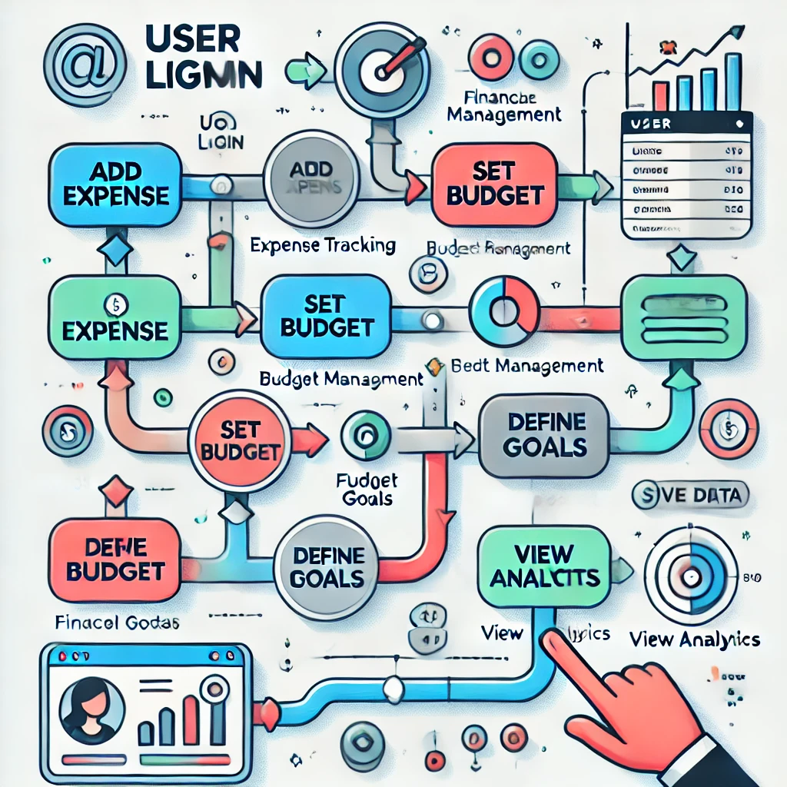
System Architecture

Slide 6
Technology Stack
- Frontend: React Native/Ionic
- Backend: Firebase/Node.js
- Database: Firestore/SQLite
- Deployment: Play Store/ App Store

Slide 7
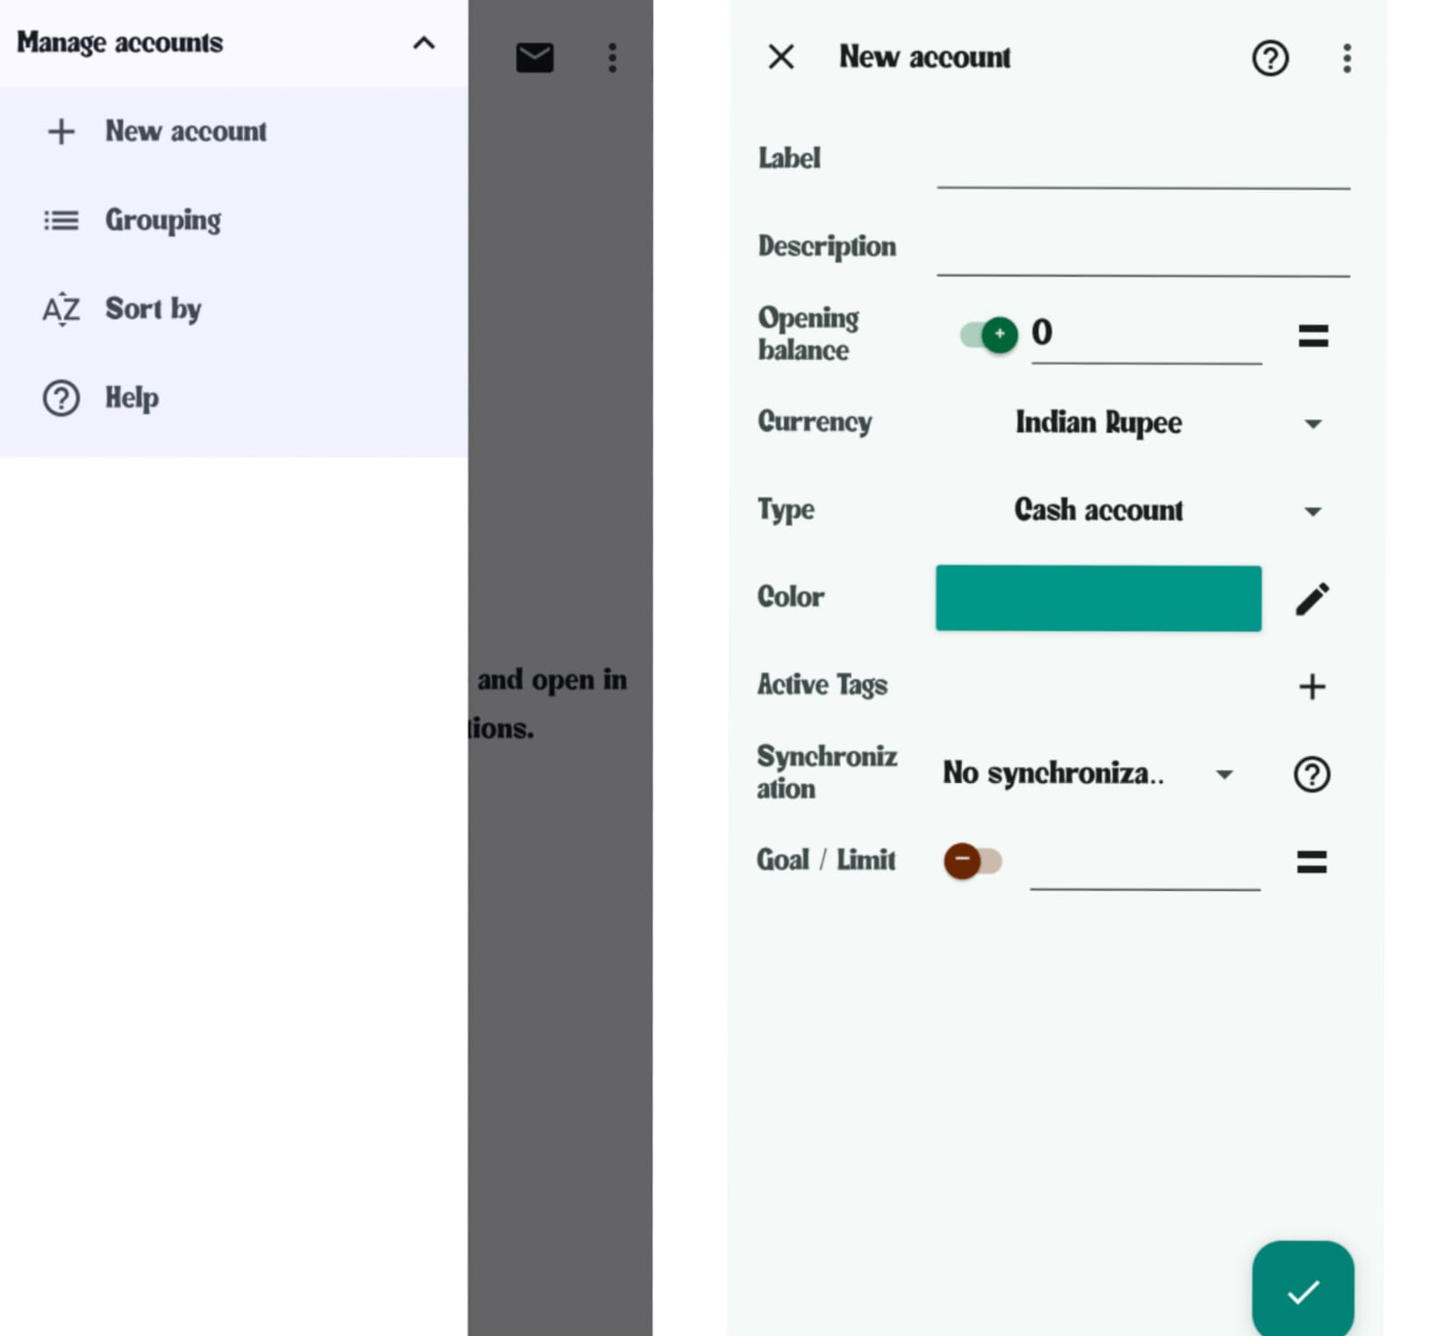
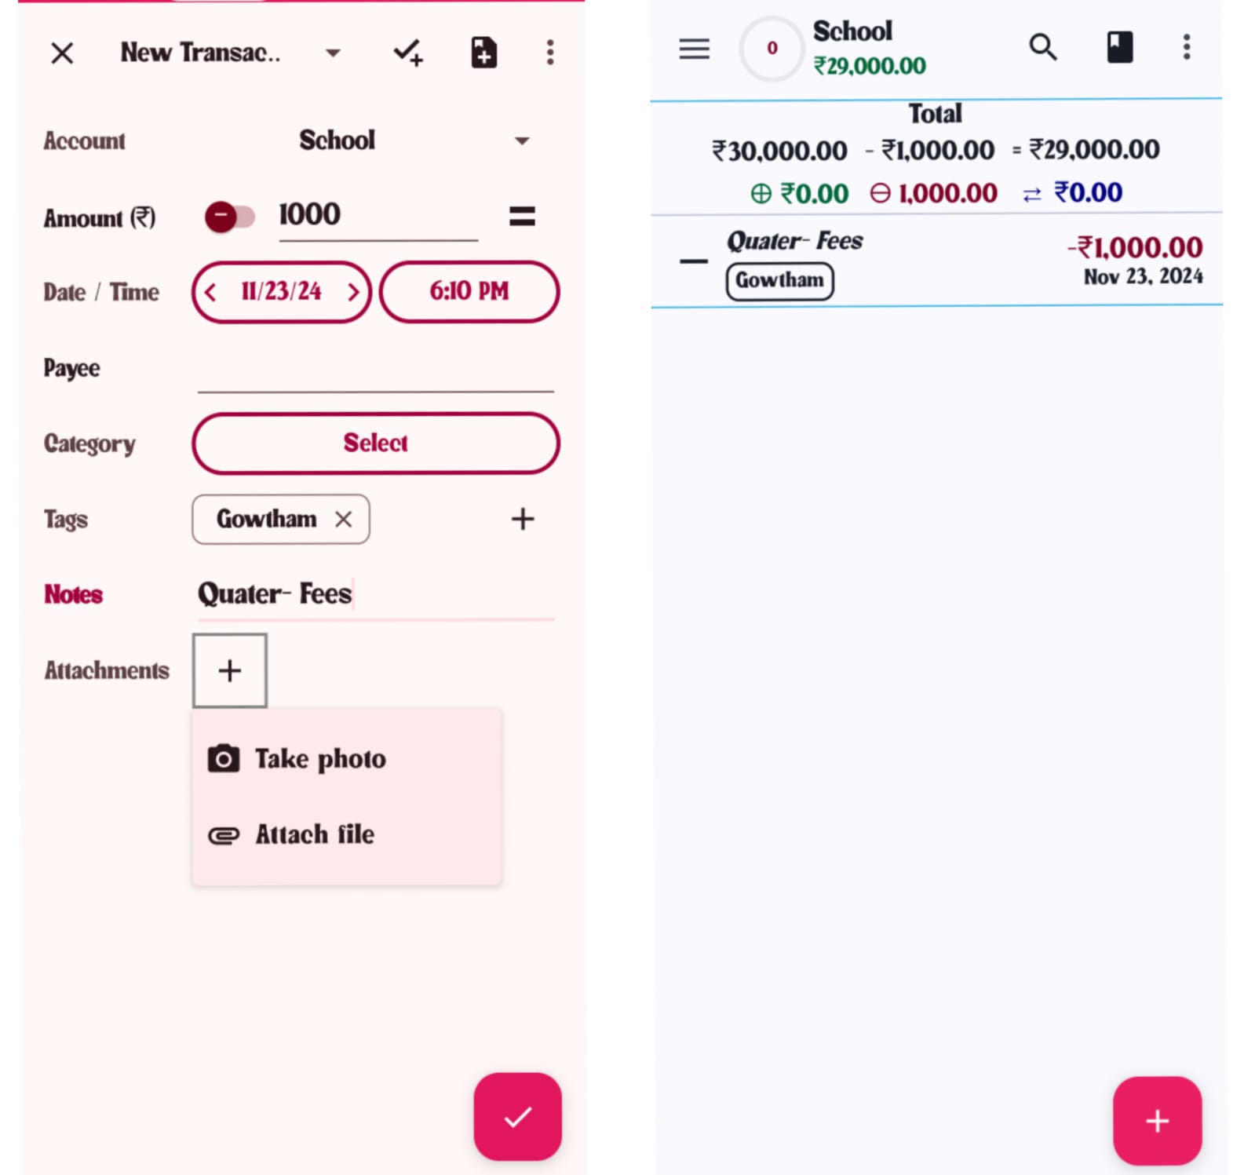
User Interface (UI)

Slide 8
Code Implementation
Snippet 1: User Authentication
// Example Login Code
firebaseAuth.signInWithEmailAndPassword(email, password)
.addOnCompleteListener(task -> {
if (task.isSuccessful()) {
Log.d("Login", "Success");
} else {
Log.d("Login", "Failed: " + task.getException().getMessage());
}
});
Snippet 2: Expense Entry Form
public void addExpense(String category, double amount) {
Map<String, Object> expense = new HashMap<>();
expense.put("category", category);
expense.put("amount", amount);
db.collection("expenses").add(expense)
.addOnSuccessListener(docRef -> Log.d("Expense", "Added"))
.addOnFailureListener(e -> Log.d("Expense", "Error: " + e.getMessage()));
}

Slide 9
Code implementation
AndroidMainFest.xml
<?xml version="1.0" encoding="utf-8"?> <manifest xmlns:android="http://schemas.android.com/apk/res/android" xmlns:dist="http://schemas.android.com/apk/distribution" xmlns:tools="http://schemas.android.com/tools"> <uses-permission android:name="android.permission.AUTHENTICATE_ACCOUNTS" android:maxSdkVersion="22" /> <application tools:ignore="MissingApplicationIcon"> <activity android:name=".activity.DropboxSetup" /> <activity android:name="com.dropbox.core.android.AuthActivity" android:configChanges="orientation|keyboard" android:launchMode="singleTask" android:exported="true"> <intent-filter> <data android:scheme="db-09ctg08r5gnsh5c" /> <action android:name="android.intent.action.VIEW" /> <category android:name="android.intent.category.BROWSABLE" /> <category android:name="android.intent.category.DEFAULT" /> </intent-filter> </activity> </application> <dist:module dist:instant="false" dist:title="@string/title_dropbox"> <dist:delivery> <dist:on-demand /> </dist:dfusing dist:include="true" /> </dist:module> </manifest>elivery> <dist:

Slide 10
Code implementation
Build.gradle[Project: MyExpense]:
import org.jetbrains.kotlin.gradle.tasks.KotlinCompile plugins { alias libs.plugins.android.application apply false alias libs.plugins.android.library apply false alias libs.plugins.android.dynamic.feature apply false alias libs.plugins.jetbrains.kotlin.android apply false alias libs.plugins.ksp apply false alias libs.plugins.compose.compiler apply false } ext { resConfig = ['en', 'en-rGB', 'ar', 'bg', 'ca', 'cs', 'da', 'de', 'de-rDE', 'el', 'es', 'eu', 'fr', 'fr-rCA', 'hr', 'hu', 'it', 'iw', 'ja', 'km', 'kn', 'ko', 'ms', 'nl', 'pl', 'pt-rBR', 'pt-rPT', 'ro', 'ru', 'si', 'ta', 'te', 'tr', 'uk', 'ur', 'vi', 'zh-rCN', 'zh-rHK', 'zh-rTW'] versionCode = 764 versionName = '3.9.0.1' compileSdkVersion = 35 minSdkVersion = 21 targetSdkVersion = 34 } subprojects { tasks.withType(KotlinCompile).configureEach { kotlinOptions { if (project.findProperty("composeCompilerReports") == "true") { freeCompilerArgs += [ "-P", "plugin:androidx.compose.compiler.plugins.kotlin:reportsDestination=" + project.buildDir.absolutePath + "/compose_compiler" ] } } } }

Slide 11
Conclusion
In conclusion, "Money Matters" is designed to simplify personal finance management by providing a user-friendly platform for tracking expenses, managing budgets, and setting financial goals. The app empowers users to take control of their finances, make informed decisions, and work towards achieving their financial objectives. With future enhancements like AI-driven financial insights and integration with banking services, the app has the potential to become an indispensable tool for personal finance management. Take the first step towards better financial health with "Money Matters"!

Slide 12
Thank You

