Slide 1

Amazon Co-Purchase Network Analysis
Team monsteRs: Chen Chen, Mithra Chintha, Samyuktha Kavitha Anand, Anuj Kumar, Mihir Sanghvi

Slide 2
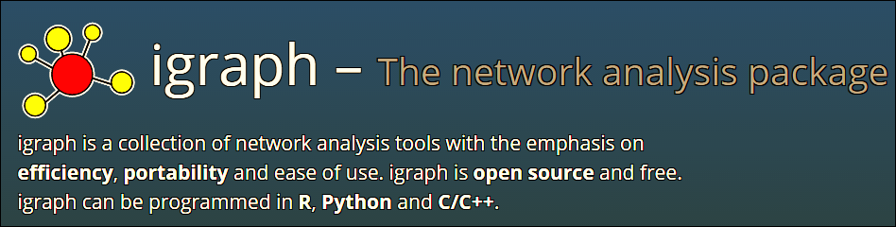
Exploring igraph

Slide 3
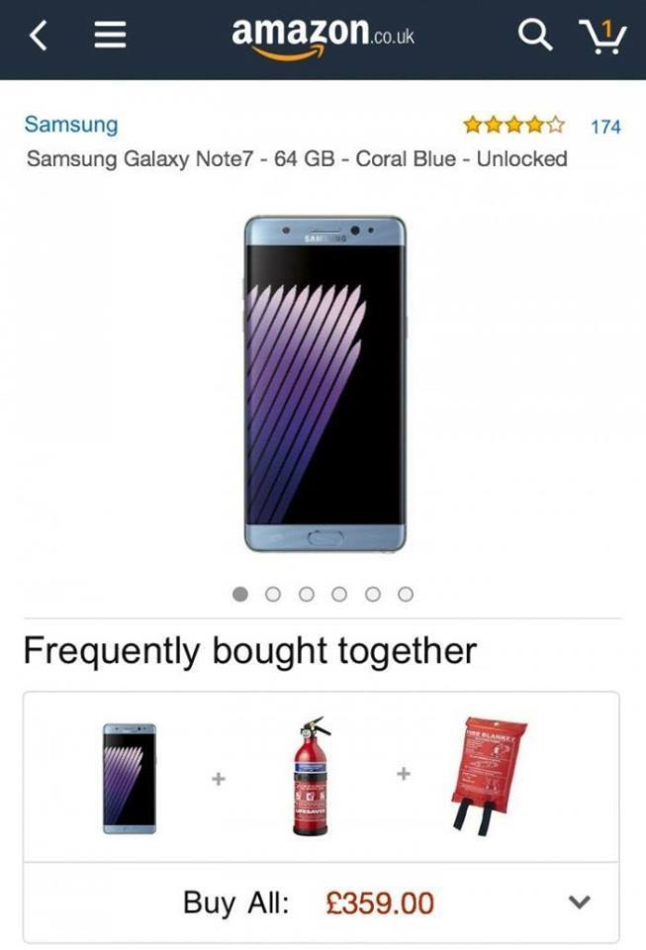

Co-Purchase Network
Product 1
Product 2
Product 4
Product 3
Notes:
Amazon product co-purchasing network from June 1 2003

Slide 4
3 Phase Approach
Data Prep
Create Edge List
Create Network
Create Network Graph (Step-1)
Insights
Identify up-selling opportunities
Create vertex attributes list
Create Communities (Step-2)
(Step 3, 4, 5)
(Step-0)

Slide 5
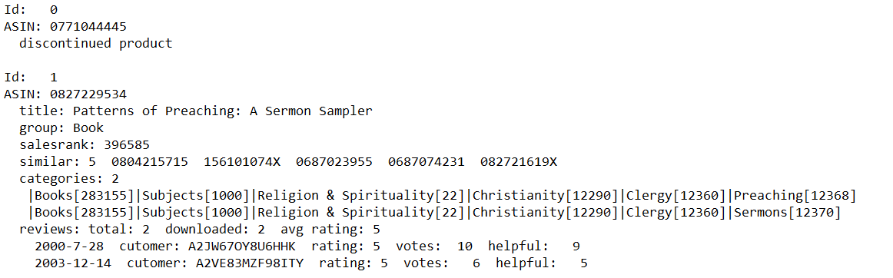
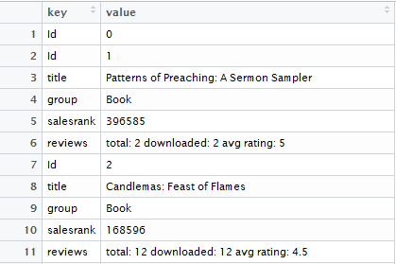
Data Preparation
Packages Used:
data.table: Used read.table function
sqldf: Used sqldf function to write sql queries in R
tidyr: Used ‘separate’ function to divide the column with delimiter “:”

Slide 6

Packages Used:
foreach: Used foreach for faster loops
**Converted data.frame to matrix as the access values based on the index in matrix is faster
**Uploading data to csv file every time the data reaches 20000

Slide 7

Packages Used:
tidyr: Used ‘separate’ function to divide the column with delimiter “:”

Slide 8
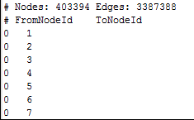
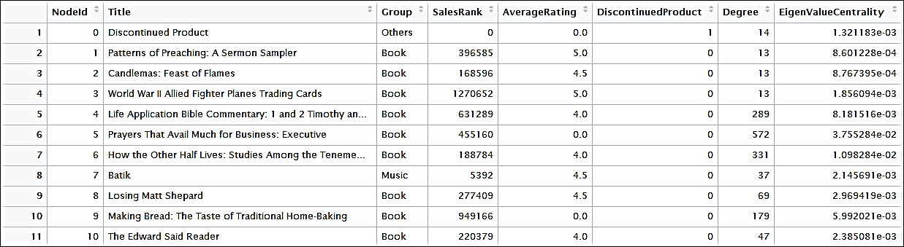
Get common data from both files and create a final edge list and vertex attributes list

Slide 9
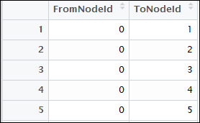
Data Preparation Output
Vertex Attributes
Edge List

Slide 10

Creating Network Graph
Edge List
Vertex Attributes
Network Graph

Slide 11
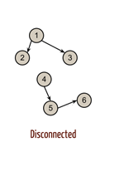
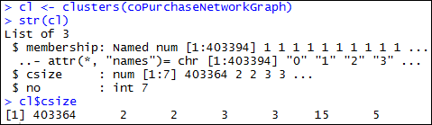
Network Diagnostics
Is the network globally connected ?
Checking for connected components
Notes:
one giant connected component (403364 nodes) and 6 other components with very few nodes

Slide 12
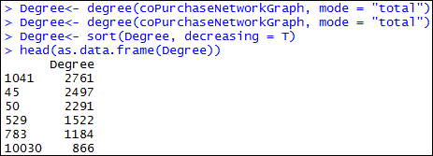
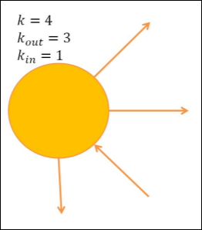
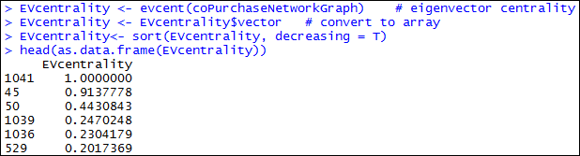
Degree : number of direct neighbors
Network Diagnostics
Eigenvector Centrality:
Node Importance
(based on importance of its neighbors)

Slide 13
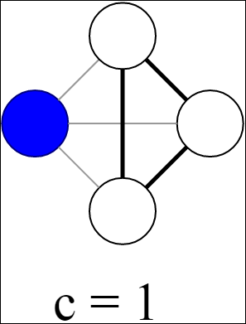
Network Diagnostics
Local Clustering Coefficient: (Transitivity)
Measures the probability that the adjacent vertices of a vertex are connected,
Quantifies how close its neighbors are to being a clique (complete graph)
The average clustering coefficient of the whole graph is simply the average of the node’s local clustering coefficients

Slide 14
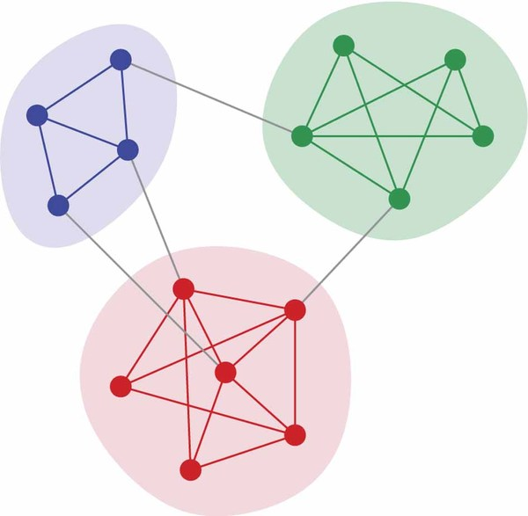
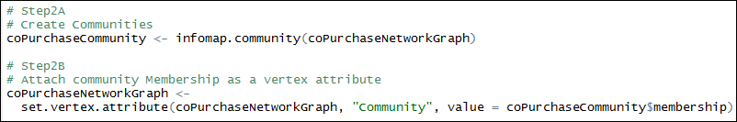
Creating and Analyzing Communities

Slide 15
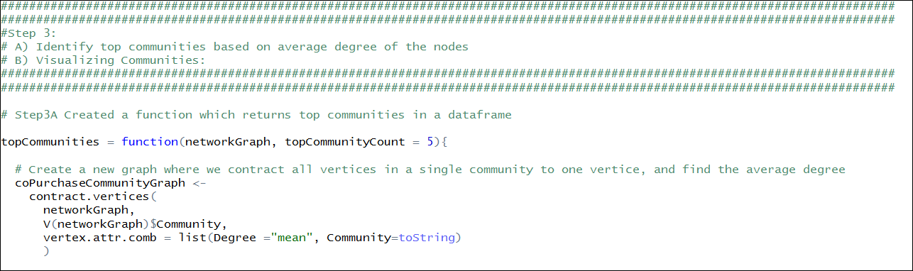

Slide 16
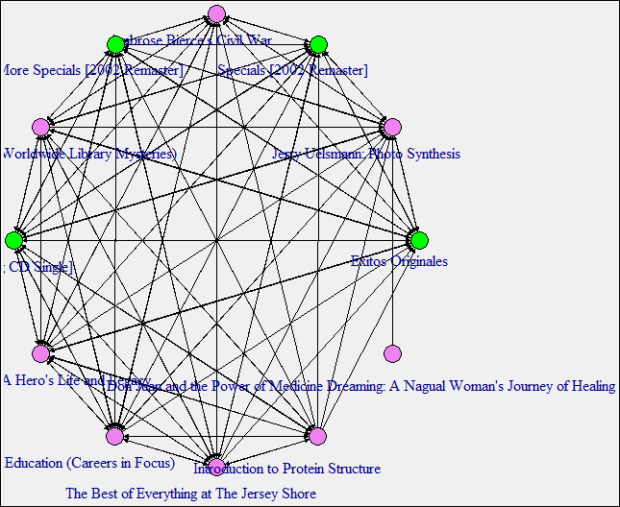
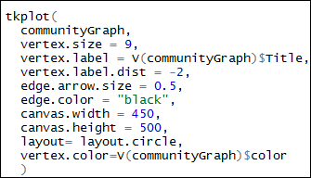

Slide 17
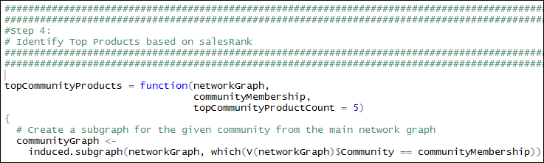

Slide 18
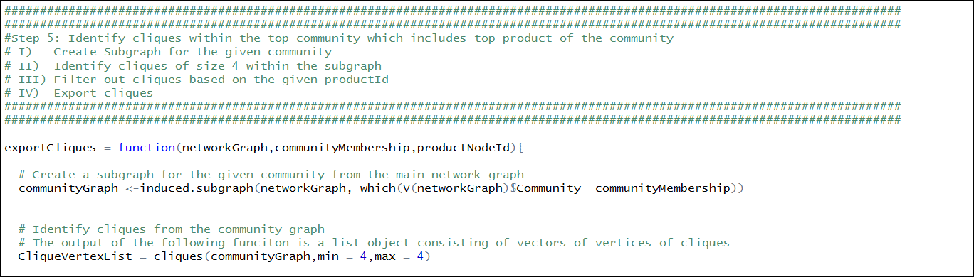
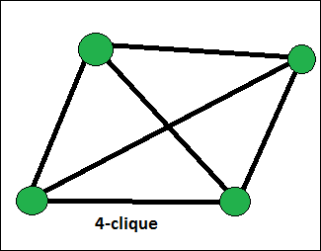
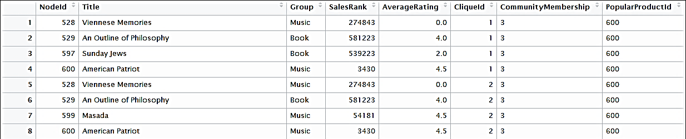
Output:

Slide 19
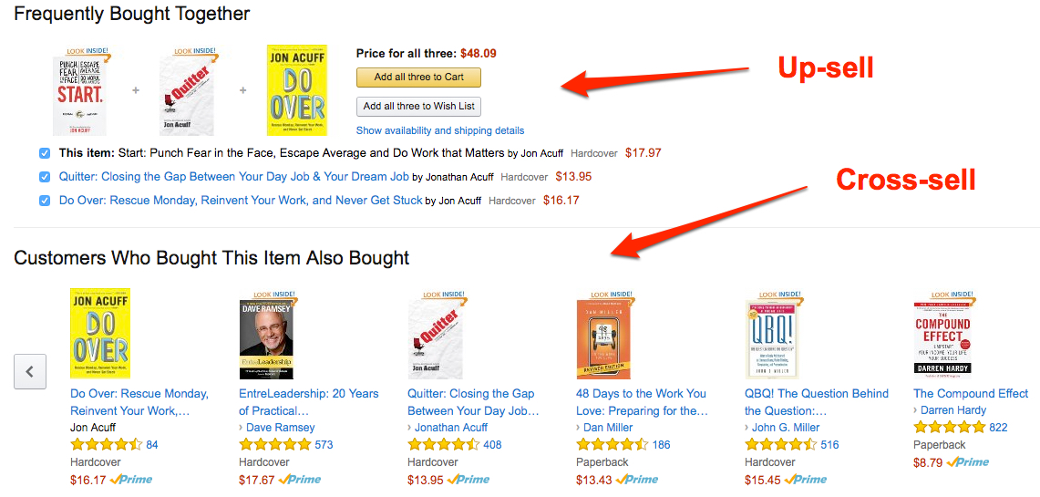
Insights

Slide 20
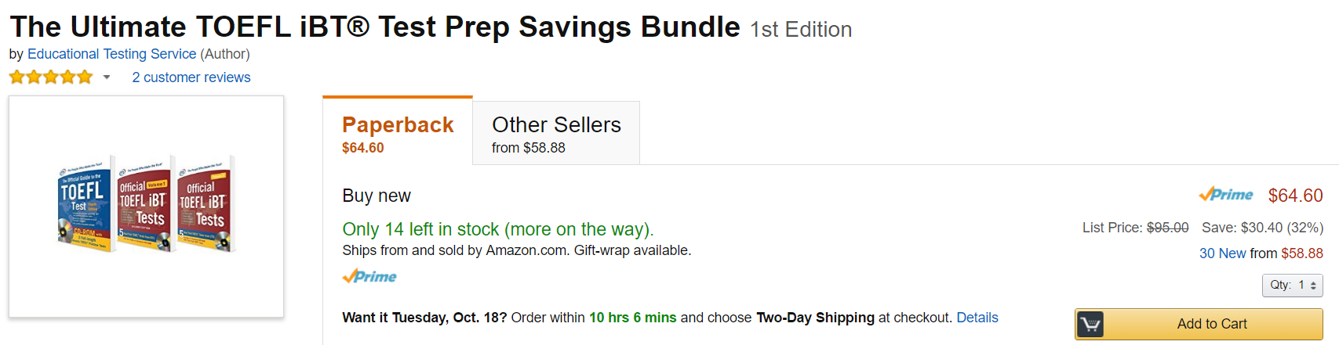
Upselling Campaign Design

Slide 21


Slide 22

Appendix
Notes:
To play the video, view in presentation mode…

Slide 23
Appendix
Notes:
To play the video, view in presentation mode…

