Slide 1

Department of Computer Science and Engineering
CLOUD COMPUTING
Installation of Google App Engine & Creation of Hello World Web Application
Supervisor
Mrs. ThivaPriya
CLOUD COMPUTING LAB — EXPERIMENT 03

Slide 2
CONTENTS
Experiment Aim
Google App Engine & Tools
Install Google Plugin for Eclipse
Create Web Application Project
Hello World Project Structure
Run the Application Locally
Deploy to Google App Engine
Verify Web Application
Result & Key Takeaways

Slide 3
EXPERIMENT AIM
Ex. No: 03 — Google App Engine
AIM
To install Google App Engine and create a Hello World web application using Python/Java.
WHAT WE WILL ACHIEVE
• Install the Google Plugin for Eclipse.
• Configure the Google App Engine Java SDK.
• Create a new Web Application Project.
• Generate a sample Hello World application.
• Run the application locally.
• Deploy the application to Google App Engine.
• Verify the deployed web application.
3

Slide 4
GOOGLE APP ENGINE & TOOLS
FLOW
LAB ENVIRONMENT
ECLIPSE
1. Eclipse IDE — used to create and manage the web application project.
2. Google Plugin for Eclipse — provides App Engine development and deployment support.
3. Google App Engine Java SDK — provides the App Engine development environment.
4. Web Application Project — contains source code, configuration and web resources.
5. Local Development Server — used to test the application before deployment.
GOOGLE PLUGIN
APP ENGINE SDK
WEB APP
LOCAL SERVER
GOOGLE APP ENGINE
4

Slide 5
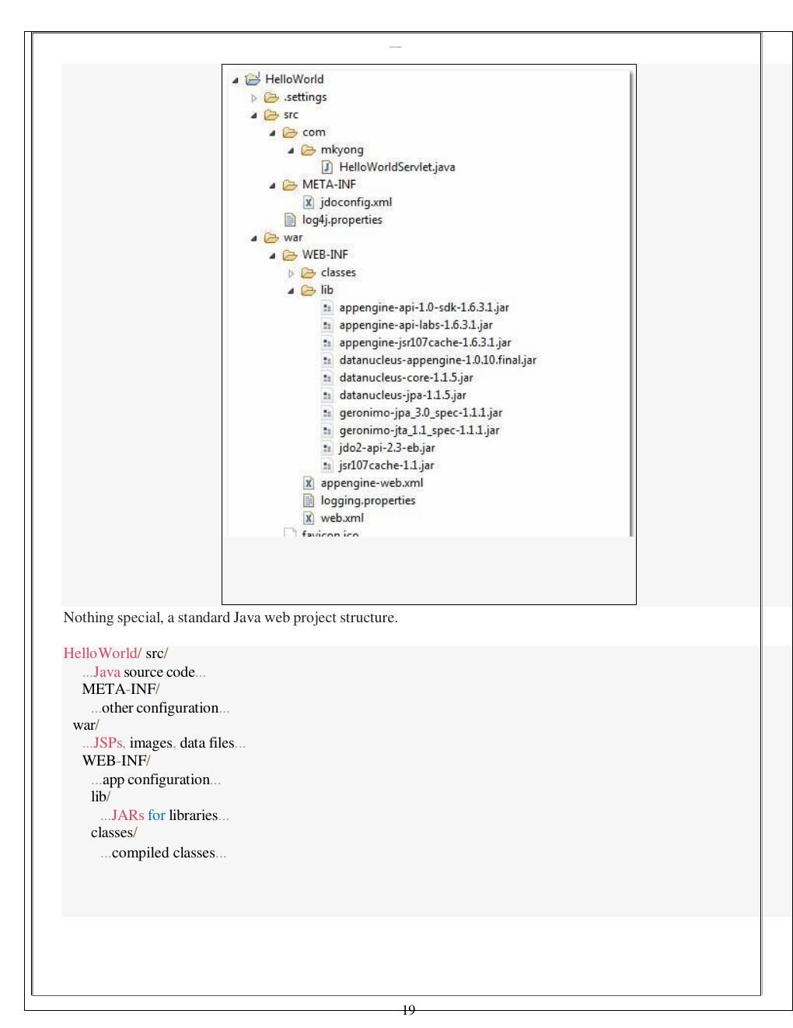
INSTALL GOOGLE APP ENGINE TOOLS
STEP-BY-STEP PROCEDURE
1. Install Google Plugin for Eclipse along with the Google App Engine Java SDK.
2. If the SDK is not installed with the plugin, download and extract it separately.
3. Launch Eclipse and access the Google tools from the toolbar.
4. Select “New Web Application Project…”.
5. Deselect Google Web Toolkit if not required and configure the Google App Engine Java SDK.
6. Complete the project setup.
CHECKPOINT ✓ Google App Engine development
tools are configured.
5

Slide 6
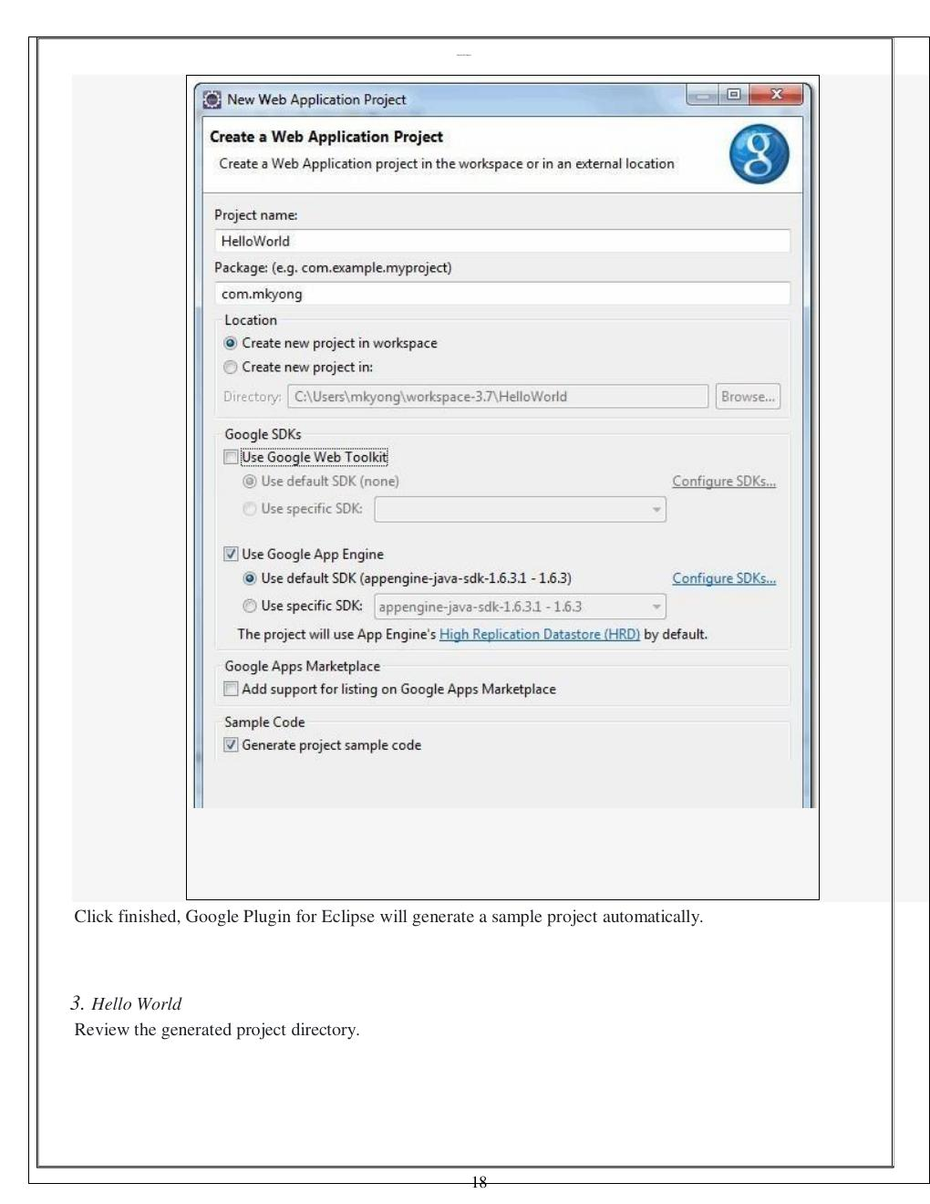
CREATE HELLO WORLD PROJECT
CREATE A WEB APPLICATION
1. From the Eclipse Google menu, select New Web Application Project.
2. Enter the project name and package details.
3. Select/configure the Google App Engine SDK.
4. Click Finish to generate the sample project.
Eclipse automatically generates the sample Hello World project.
PROJECT: HelloWorld
6

Slide 7
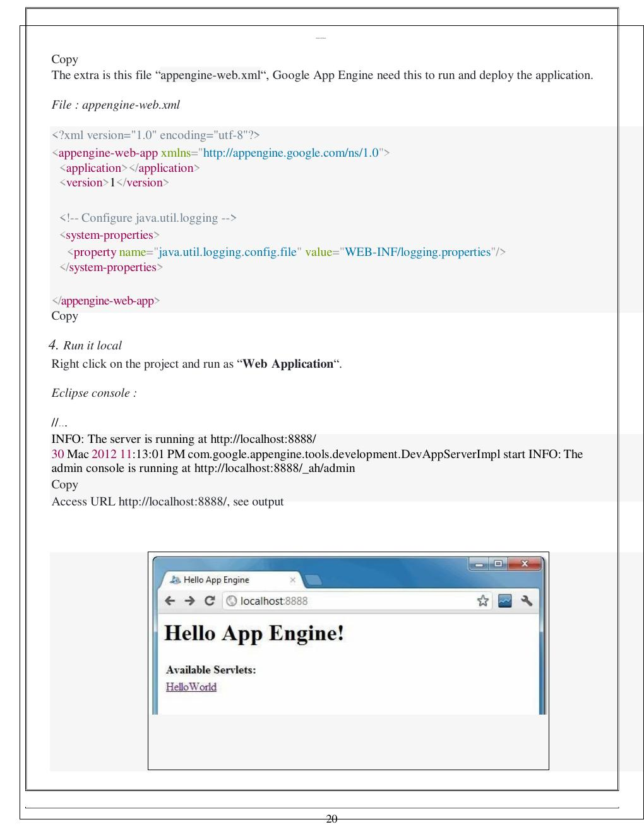
HELLO WORLD PROJECT STRUCTURE
PROJECT STRUCTURE
HelloWorld/
├── src/ → Java source code
├── META-INF/ → configuration files
├── war/ → JSPs, images and web data
├── WEB-INF/ → application configuration
├── lib/ → JAR libraries
└── classes/ → compiled classes
IMPORTANT FILE
appengine-web.xml
This configuration file is required by Google App Engine to run and deploy the application.
7

Slide 8
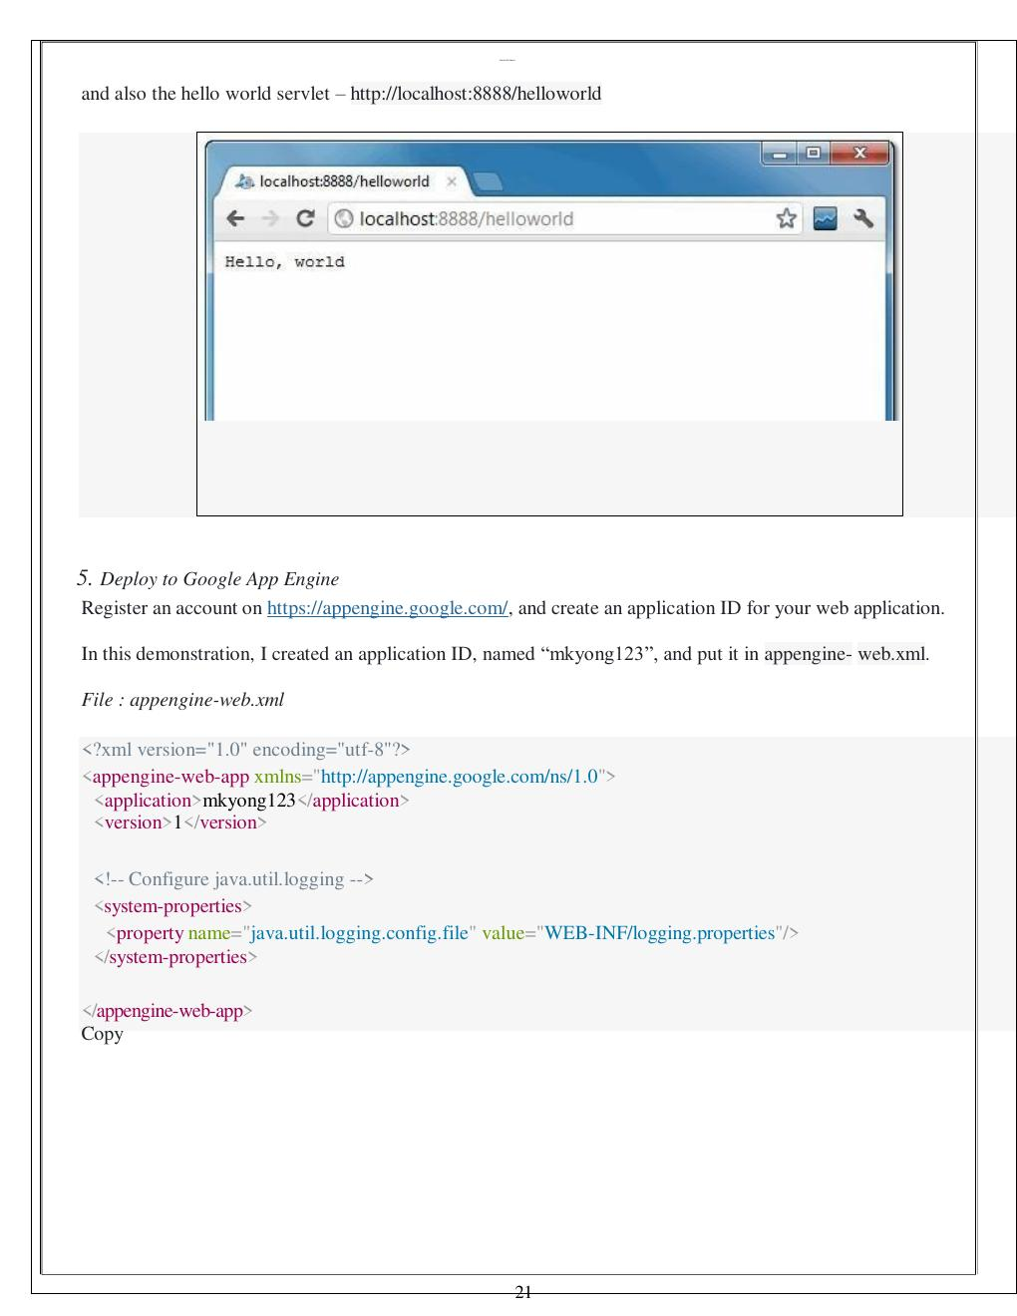
RUN, DEPLOY & VERIFY
RUN THE APPLICATION LOCALLY
Right-click the project → Run As → Web Application
Local server:
http://localhost:8888/
Hello World servlet:
http://localhost:8888/helloworld
DEPLOY TO GOOGLE APP ENGINE
1. Register/sign in to Google App Engine.
2. Create an application ID.
3. Add the ID to appengine-web.xml.
4. Select Deploy to App Engine.
5. Sign in and click Deploy.
8

Slide 9
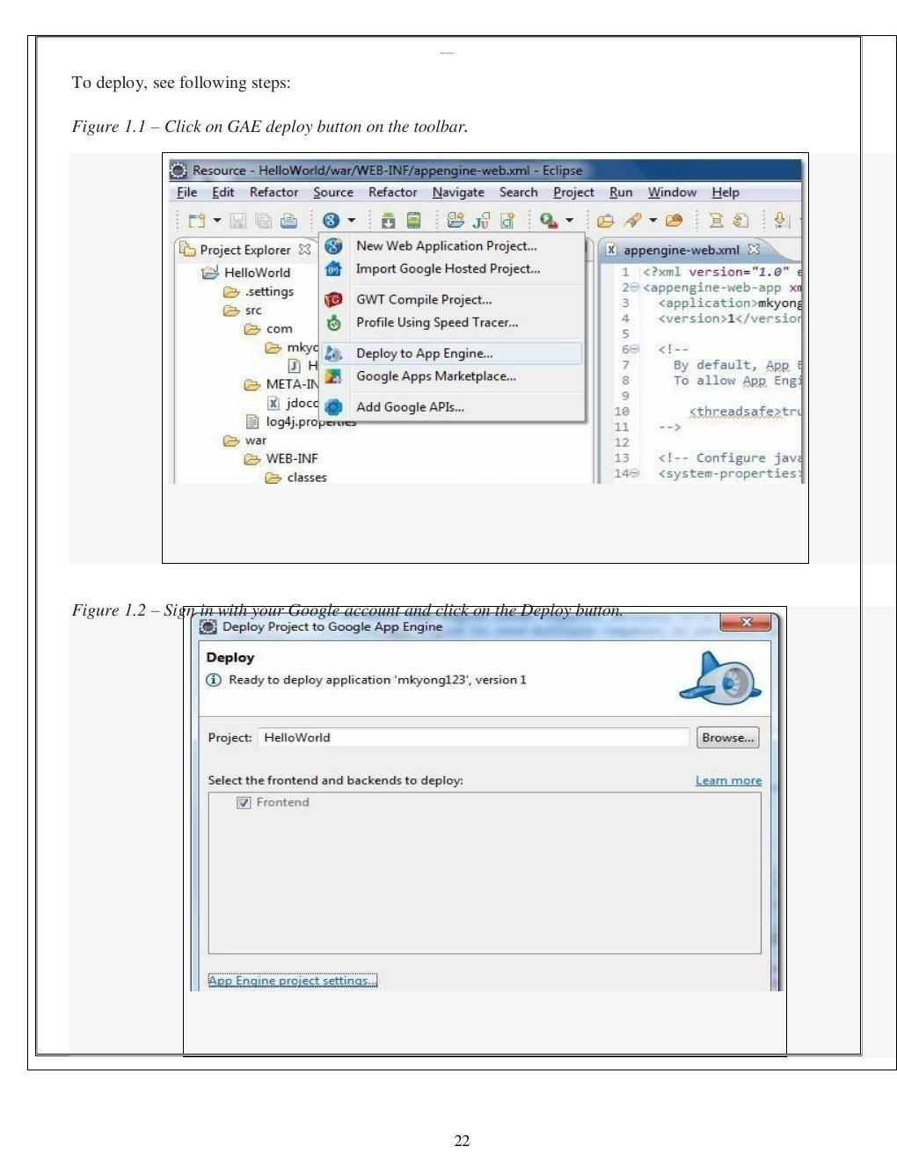
RESULT & KEY TAKEAWAYS
RESULT
Thus, Google App Engine was installed successfully and a Hello World web application was developed and deployed using the Google App Engine environment.
KEY TAKEAWAYS
• Google App Engine provides a platform for hosting web applications.
• Eclipse with the Google Plugin is used to create the web application.
• The App Engine SDK provides the development environment.
• The project contains source code and configuration files.
• The application can be tested locally before deployment.
• The completed application can be deployed to Google App Engine.
QUICK CHECK
What is the purpose of appengine-web.xml?
Answer: It contains configuration required by Google App Engine to run and deploy the application.
9

