Slide 1

Department of Computer Science and Engineering
CLOUD COMPUTING LAB
EXPERIMENT 05
Simulate a Cloud Scenario Using CloudSim
CloudSim setup • Eclipse • Project configuration • Execution
Aim: Simulate a cloud scenario using CloudSim and run a scheduling algorithm that is not present in CloudSim.

Slide 2
CONTENTS
CONTENTS
01
Aim & Tools
02
Download Eclipse & CloudSim
Click the navigation arrows to move through the experiment.
Click the navigation arrows to move through the experiment.
03
Create the CloudSim Project
04
Add External JAR
Click the navigation arrows to move through the experiment.
Click the navigation arrows to move through the experiment.
05
Configure & Build
06
Run CloudSimExample1
Click the navigation arrows to move through the experiment.
Click the navigation arrows to move through the experiment.
07
Output & Result
08
Interactive Workflow
Click the navigation arrows to move through the experiment.
Click the navigation arrows to move through the experiment.
Source: Cloud Computing Lab Manual — Experiment No. 5
‹
›

Slide 3
AIM & EXPERIMENT OVERVIEW
◎
AIM
⚙
CORE TOOLS
To simulate a cloud scenario using CloudSim and run a scheduling algorithm that is not present in CloudSim.
Eclipse IDE • CloudSim 3.0.3 • Apache Commons Math 3.x • Java
↓
INPUT
✓
CONFIGURE
▶
EXECUTE
Download the required packages and source files.
Create a Java project and attach the CloudSim source + external JAR.
Run CloudSimExample1 and observe the Eclipse console output.
Experiment flow: Download → Import → Configure → Build → Run → Verify
‹
›

Slide 4
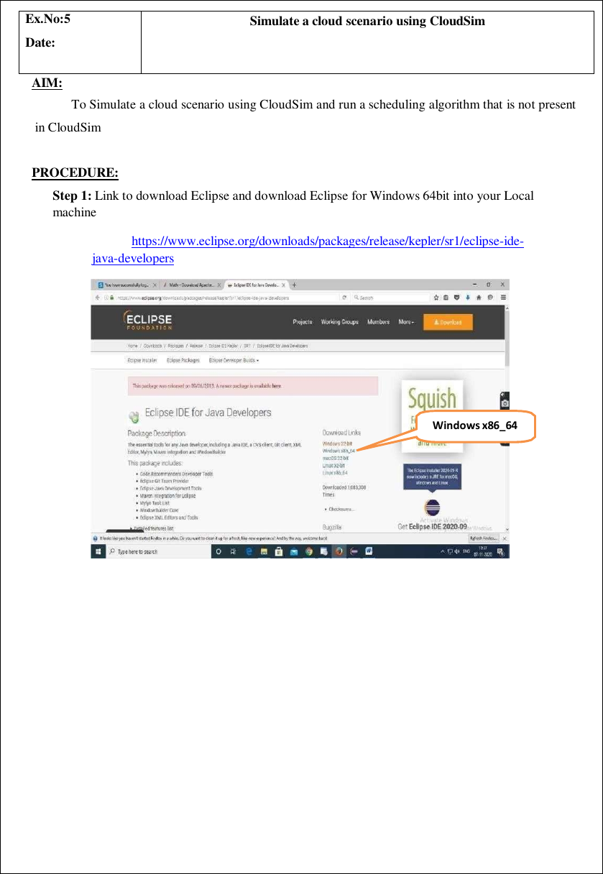
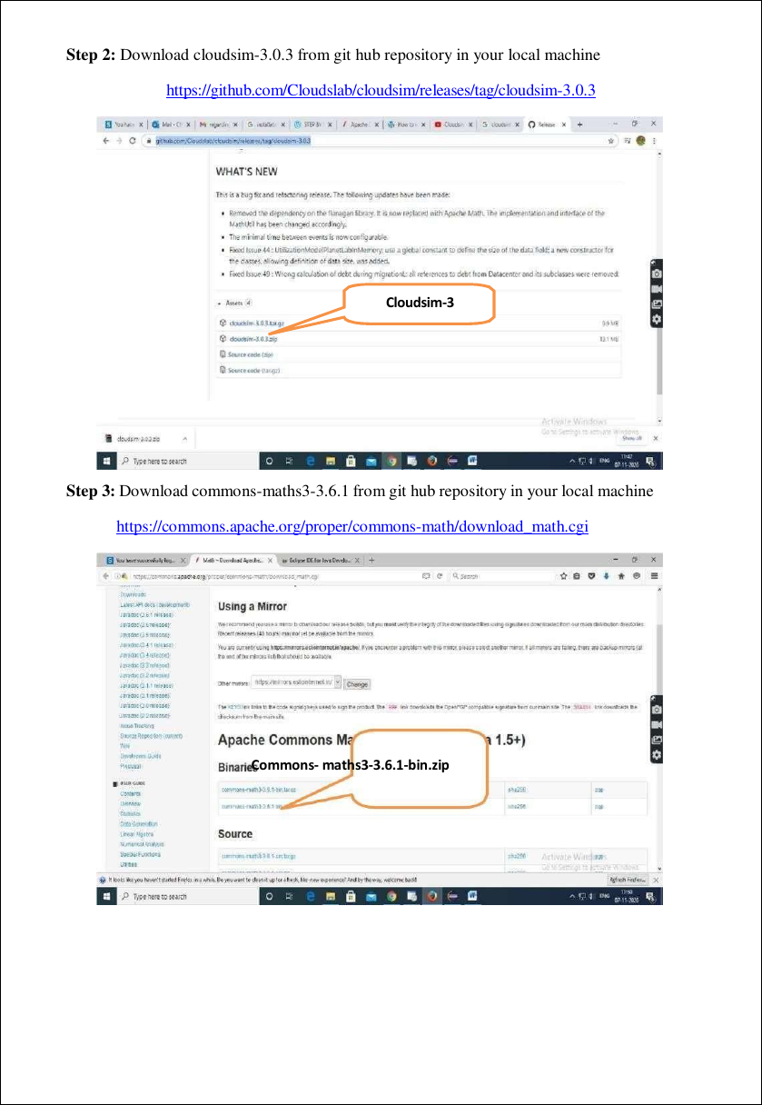
DOWNLOAD THE REQUIRED TOOLS
Eclipse for Windows x86_64
CloudSim + Commons Math downloads
✓
QUICK CHECK
Keep Eclipse, cloudsim-3.0.3 and commons-math3-3.6.1 extracted on the local machine before starting the project setup.
Lab-manual sequence: Step 1 → Eclipse • Step 2 → CloudSim • Step 3 → Commons Math
‹
›

Slide 5
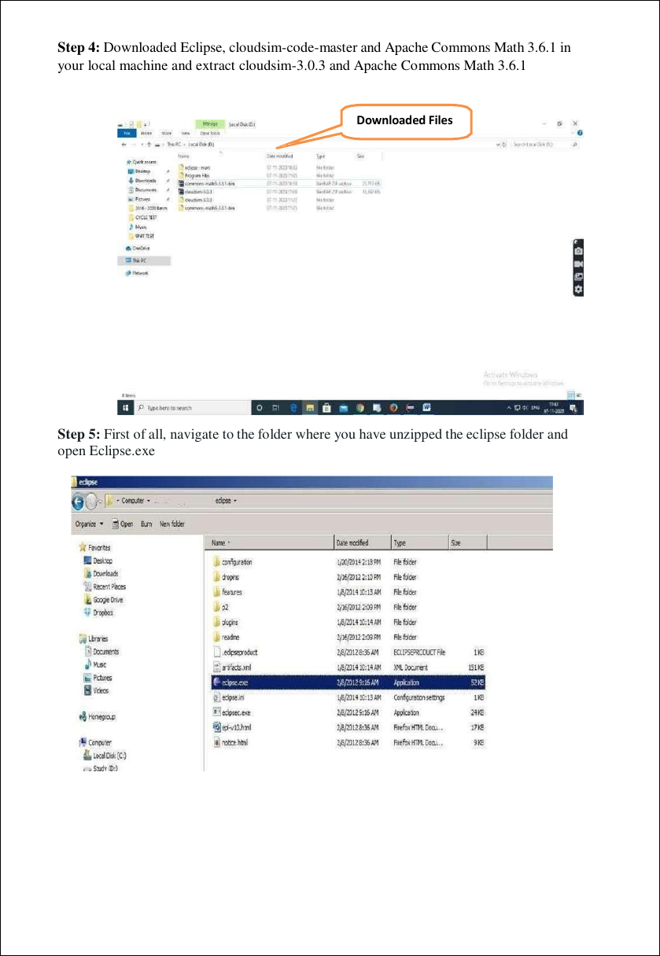
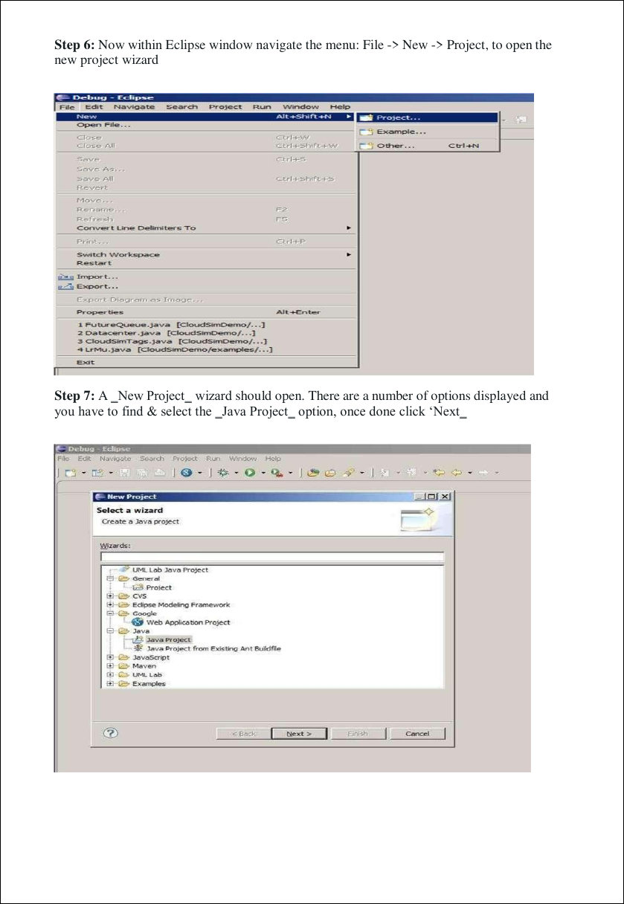
CREATE THE CLOUDSIM PROJECT
Eclipse → File → New → Project
Choose Java Project
06
STEP 6
07
STEP 7
08
STEP 8
Open Eclipse and choose File → New → Project.
Select Java Project and click Next.
Set the project name to CloudSim and point to the extracted source.
‹
›

Slide 6
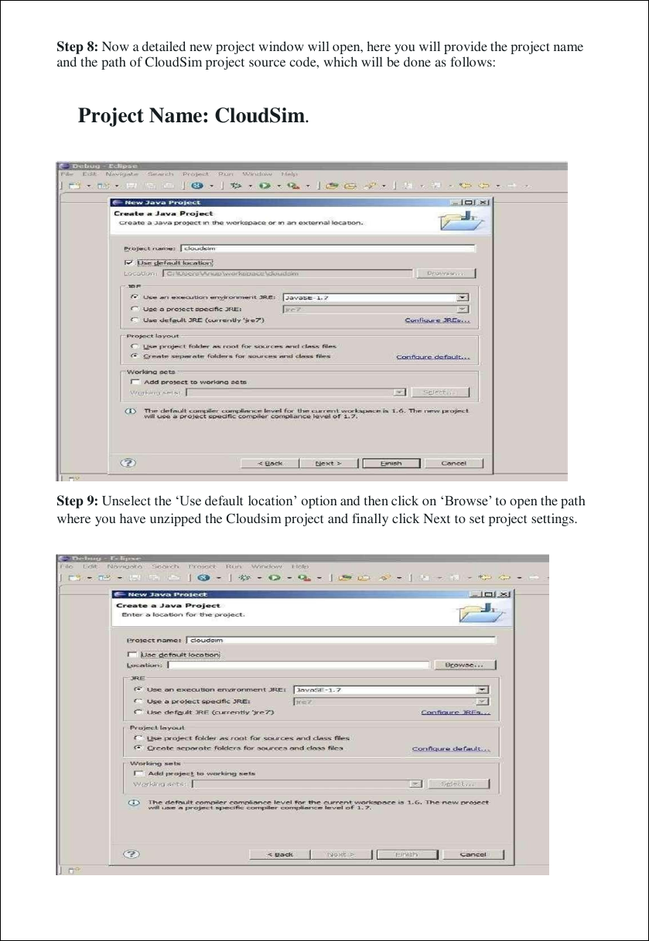
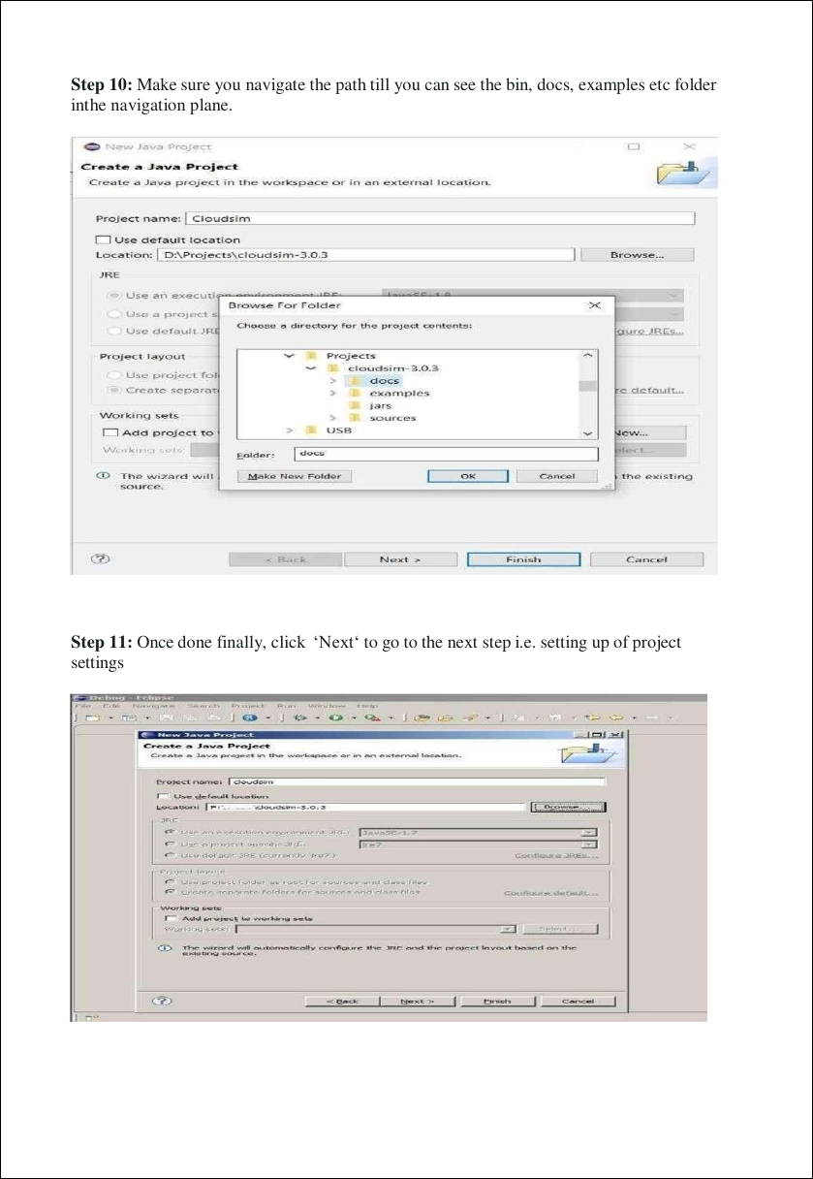
SET THE PROJECT LOCATION & SOURCE
Select CloudSim source location
Project settings / source path
✓
KEY POINT
⌕
VERIFY
Unselect “Use default location” and browse to the folder where CloudSim was extracted.
Continue until the project structure shows folders such as bin, docs and examples.
‹
›

Slide 7
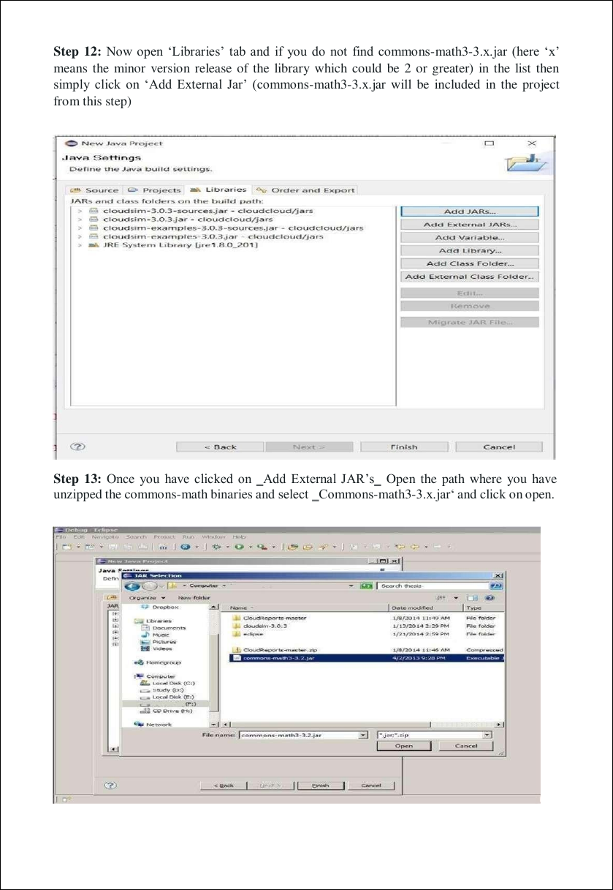
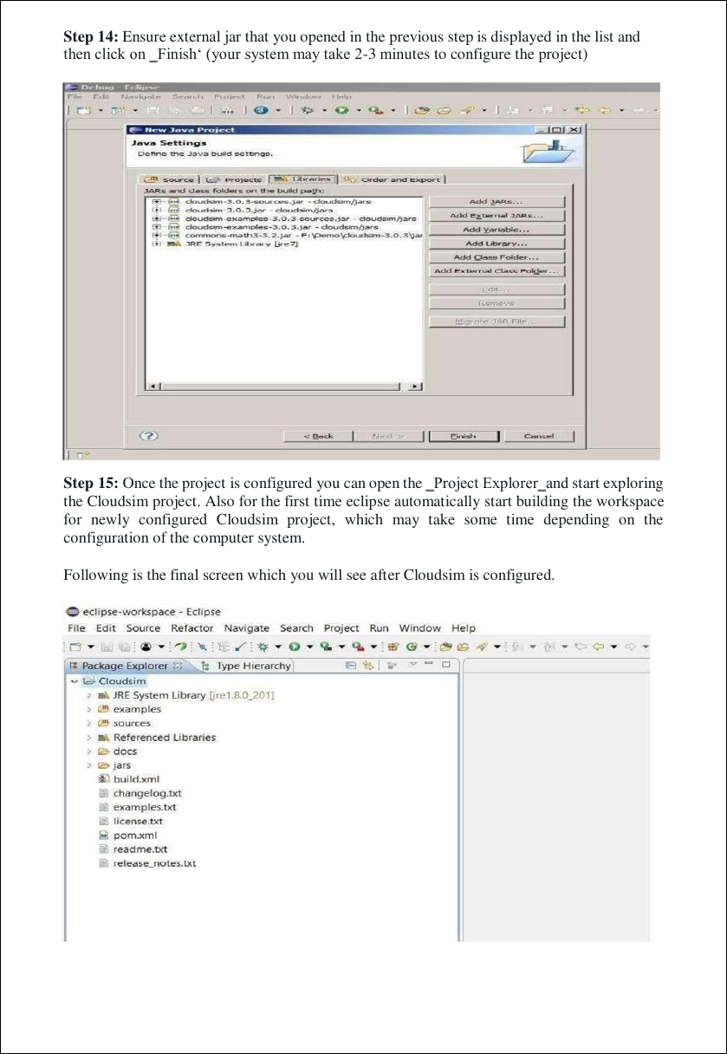
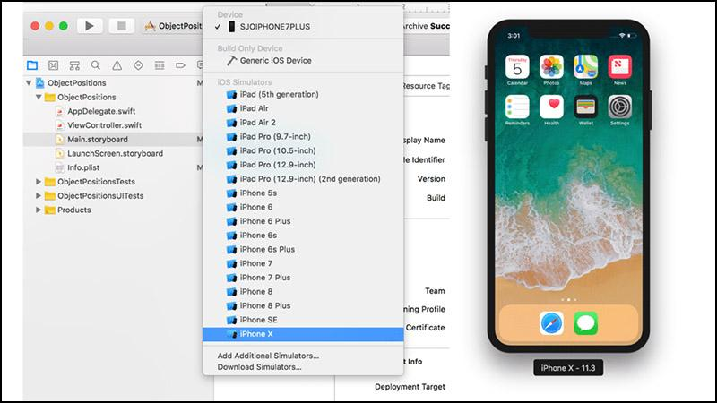
ADD EXTERNAL JAR & CONFIGURE
Libraries → Add External JARs
Select commons-math3-3.x.jar
12
STEP 12
13
STEP 13
✓
STEP 14–15
Open the Libraries tab and choose Add External JARs if needed.
Browse to the Commons Math binary and select the JAR.
Confirm the JAR, click Finish, then let Eclipse build the project.
‹
›

Slide 8
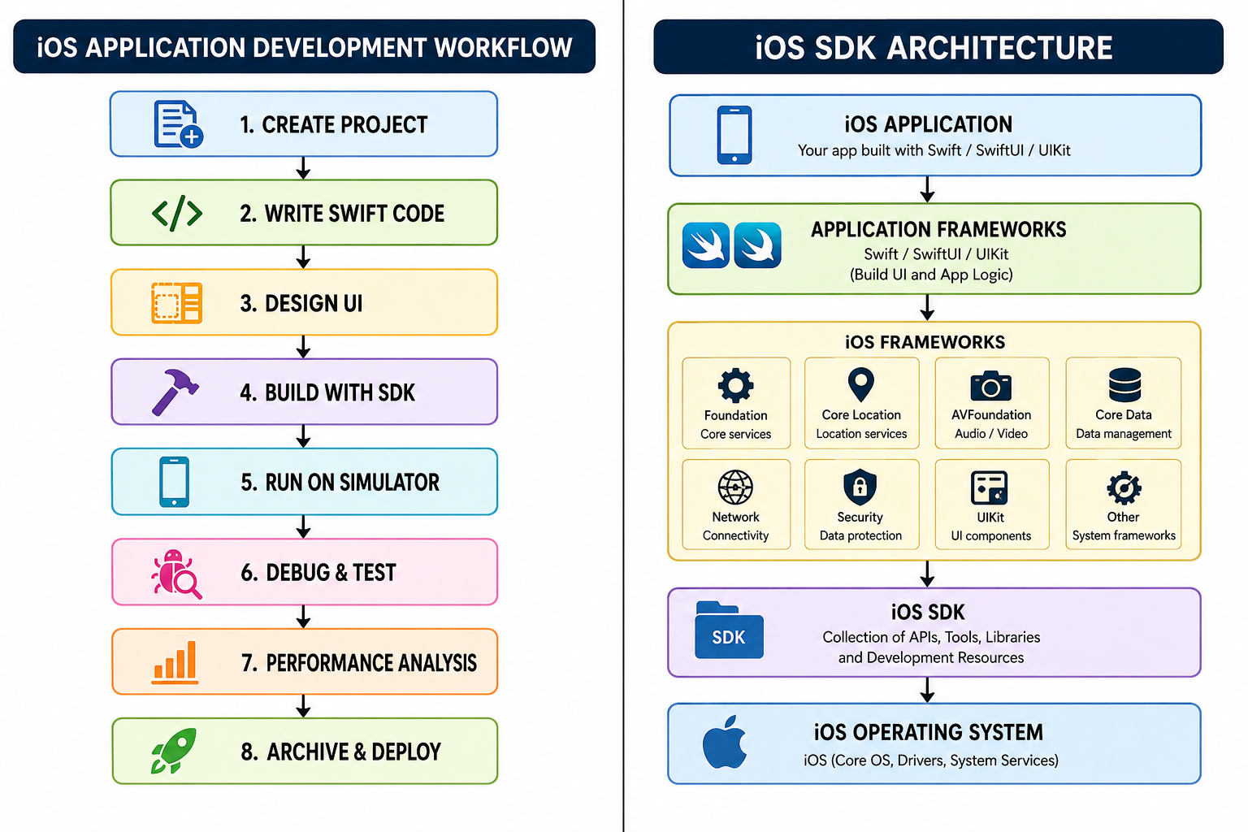
INTERACTIVE CLOUDSIM LAB WORKFLOW
01
Download
02
Extract
03
Create
Eclipse + CloudSim
CloudSim + Commons Math
Java project: CloudSim
04
Browse
05
Add JAR
06
Finish
Select extracted source
commons-math3-3.x.jar
Build & configure
07
Open
08
Run
09
Verify
CloudSimExample1.java
Run → Run / Ctrl+F11
Read console output
RUN: CloudsimExample1.java → Run / Ctrl+F11 → Eclipse Console Output
‹
›

Slide 9
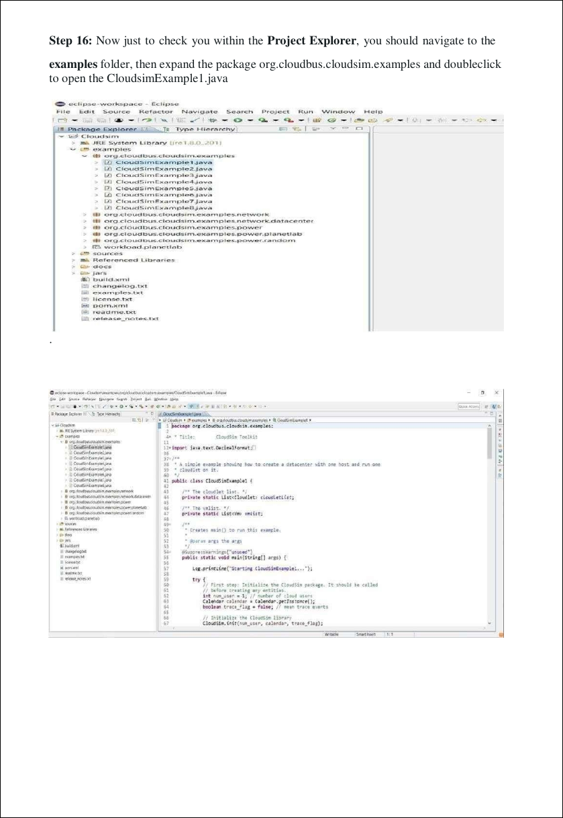
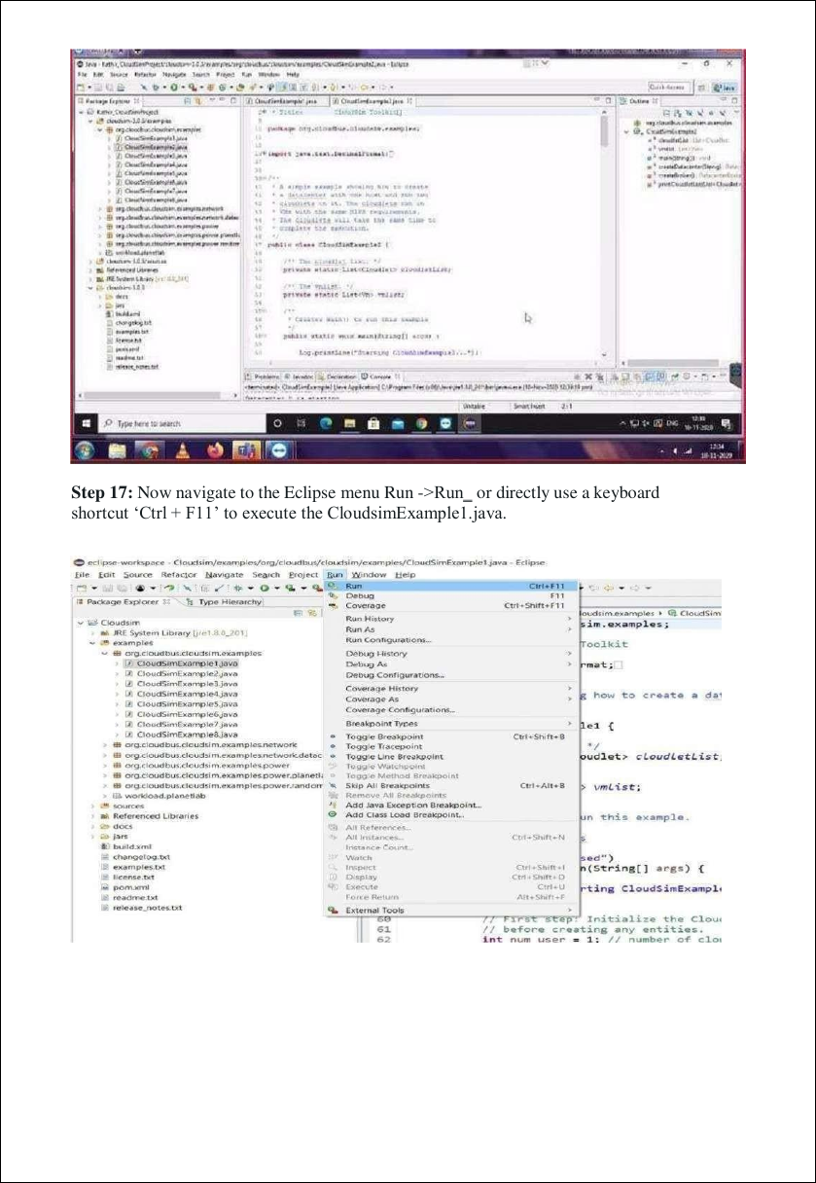
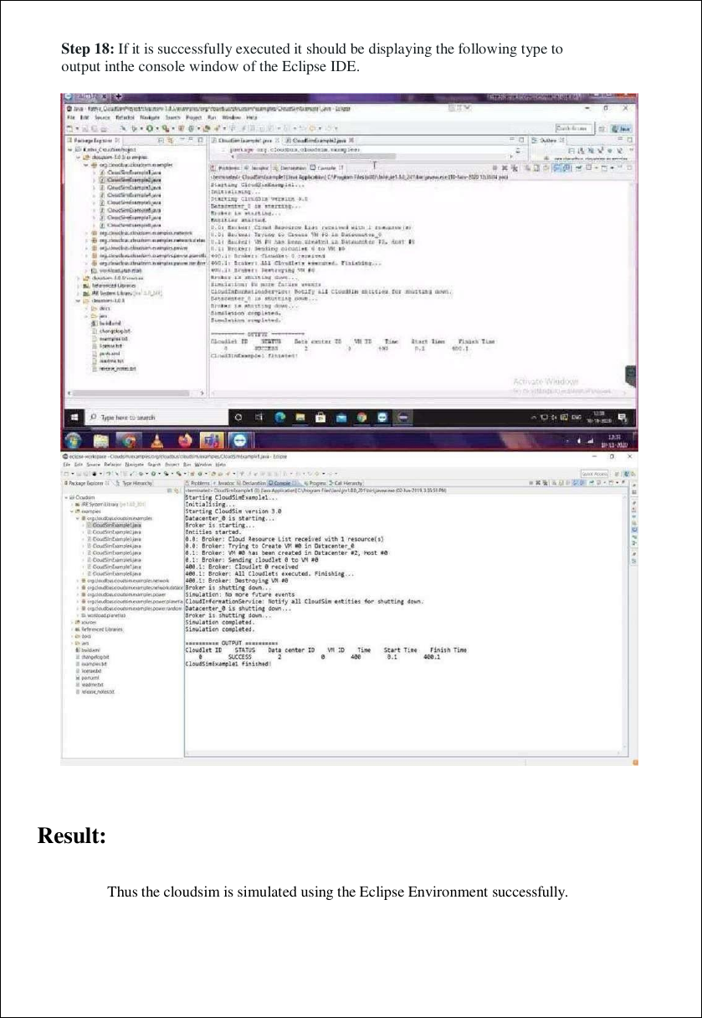
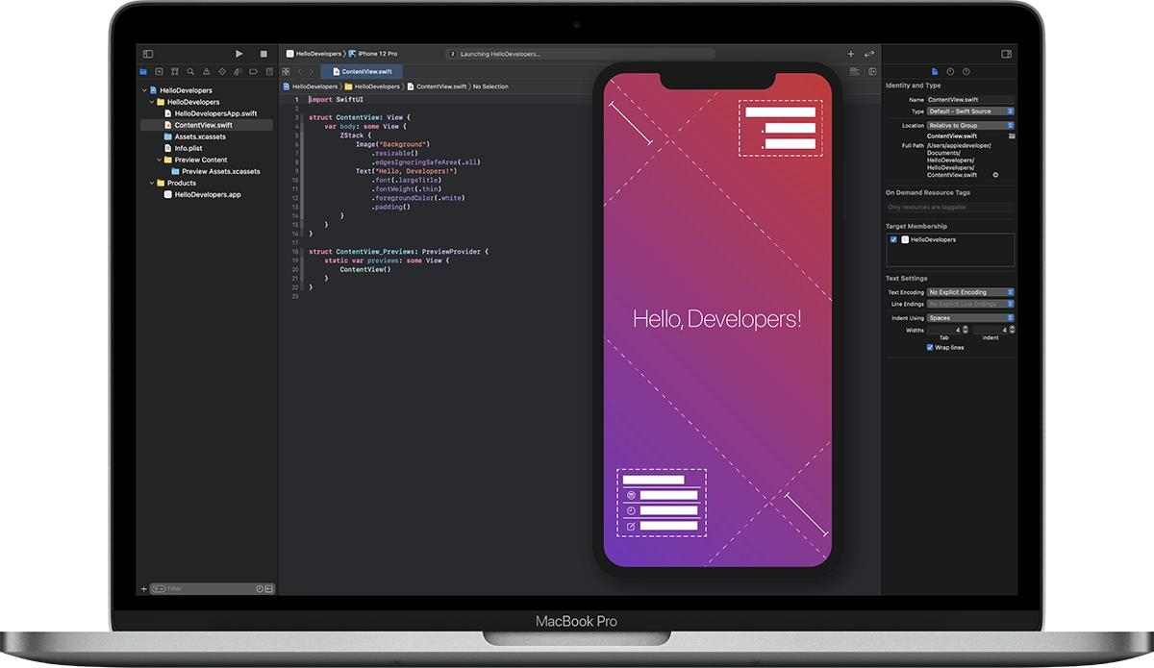
EXECUTION, OUTPUT & RESULT
CloudSim project structure
Open & run CloudSimExample1
✓
RESULT
Thus, the CloudSim scenario is simulated using the Eclipse environment successfully.
Eclipse console execution
Final check: Project builds → Example opens → Run completes → Console displays the simulation output
‹

