Slide 1


Department of Computer Science and Engineering
CLOUD COMPUTING
6.Find a procedure to transfer the files from one virtual machine to another virtual machine.

Slide 2
Aim:
To find a procedure to transfer files from one virtual machine to another virtual machine.
Tool Used: Oracle VirtualBox
Experiment: Virtual Machine File Transfer

Slide 3
Methods of File Transfer
THREE METHODS
Copy & Paste / Drag & Drop
Transfer files directly between host and guest.
Supports Host → Guest and Guest → Host.
USB Drive
Transfer files using a physical USB device.
USB access must be enabled in VirtualBox.
Network / Shared Folder
Create a shared folder accessible by the virtual machine.
Useful for transferring multiple files regularly.

Slide 4
Copy & Paste / Drag & Drop
Procedure:
Start the virtual machine.
Open VirtualBox → Devices.
Select Drag and Drop.
Choose:
Host to Guest
Guest to Host
Bidirectional
Disabled
Select Bidirectional for easy two-way transfer.
Drag the required file between the systems.

Slide 5
Transfer Using USB Drive
Procedure:
Install the VirtualBox Extension Pack.
Connect the USB drive to the computer.
Open VirtualBox → File → Preferences.
Select Extensions → +.
Select and install the Extension Pack.
Open VM Settings → USB.
Enable USB access.
Attach the USB device to the virtual machine.
Copy the required files.

Slide 6
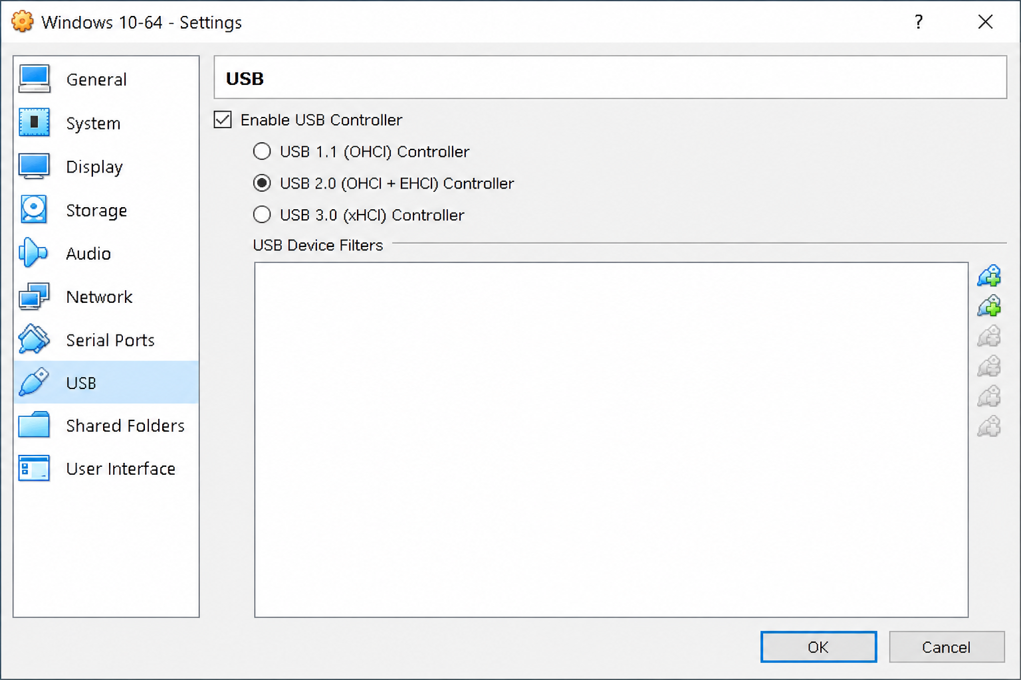

Slide 7
Shared Folder Method
Procedure:
Install VirtualBox Guest Additions.
Select Devices → Shared Folders → Shared Folder Settings.
Click + Add Shared Folder.
Select the folder path from the host system.
Enter a folder name.
Enable:
☑ Auto-mount
☑ Make Permanent
7. Click OK.
8. Open the shared folder inside the VM.
9. Copy/paste the required files.

Slide 8
