Slide 1
Learning neural Question Answering Systems for Low resource Langauges
Notes:
Welcome
Topic: learning a neural question answering system that can transfer knowledge learned from resource-rich languages to relatively resource-poor languages
Breakdown:
1. Problem statement: what is question answering
2. Neural question answering and the challenges for resource-poor languages
3. Proposed approaches to solve the problem
4. Experiment design
5. Experiment Results
6. Conclusions

Slide 2
What’s Question Answering
General Sense:
Information retrieval: web queries, smart assistants, etc.
Natural language understanding: Reading comprehension test
Combinations: Jeopardy! etc.
Narrower Definition:
Document + Question + Answer → Model
Model (Document, Question) → Answer
Notes:
“Question answering” can be understood in many different senses
…
But here we are interested in a specific form of QA (simple reading comprehension)

Slide 3
What’s Question Answering
( @entity3 ) the @entity2 military claims to have shot down a @entity5 drone , state media reported tuesday . " @entity2 air defense systems shot down a @entity5 @entity9 ( unmanned aerial vehicle ) north of @entity11 , " the state - run @entity6 said . the @entity5 military lost contact with a mq - 1 predator drone over @entity2 , a @entity5 official said tuesday …
@placeholder 's military claims it shot down a @entity5 drone north of @entity11
Teaching Machines to Read and Comprehend, Hermann et al., NIPS 2015
( @entity18) – Un hombre fue detenido por su presunta participación en un tiroteo en el que murieron tres personas durante una reunión, en una pequeña ciudad del estado de @entity8, en la costa oeste de @entity5, dijeron las autoridades.
En el tiroteo -registrado en @entity11, a unos 45 kilómetros al norte de @entity13- también resultó herida una persona.
@entity0, …
El tiroteo se registró en el poblado de @placeholder
Notes:
One example of a well-formulated QA problem is like this one purposed in Hermann et al. 2015 paper.
Story + answer format
Look for the best word in the story corresponding to the placeholder token
Named entities are replaced in this example. Reason – force the system to learn basic reasoning instead of simple collocations

Slide 4
Neural QA Systems
Memory Networks (Weston et al. 2015)
Effective on simple logical statements
N2NMenNet, DMN, etc.
Attentive Reader (Hermann et al. 2015)
News article reading comprehension
Neural Turing Machines (Graves et al. 2014), Differentiable Neural Computers (Graves et al. 2016)
Various tasks (logic statements, graph reasoning, etc.)
Notes:
In recent years, many developments involving applying neural network-based systems to QA problems. Here are some notable examples.
Memory network model uses an external memory module and attention-based memory access to effectively solve simple logical deduction problems
Extensions such as N2NMemNet, Dynamic MN etc.
Attentive Reader achieves reasonable results on news article QA problems
NTM/DNC able to handle a variety of tasks

Slide 5
The Research Question
Large amount of data is needed to train a neural QA system
380K Q&A pairs in the CNN news dataset (machine-generated)
120K Q&A pairs in the Maluuba NewsQA dataset (human-annotated)
100,000+ Q&A pairs in SQUAD dataset
Such large datasets (especially human-annotated ones) are difficult to compile
But the data doesn’t exist for many languages
Even for relatively widely-spoken languages like French, Spanish or Chinese
How to solve this problem?
Notes:
Thst is all good, however…
As with most neural networks, training a neural network-based QA system requires a large amount of training data, some of which are rather difficult to come by…
Here are some of the datasets used in previously mentioned research or current research
Especially difficult if data have to be human-annotated
Current status: relative abundance of datasets for English, but much less available data for other languages
Challenging for developing systems on new languages for which we cannot easily obtain high-quality high-volume datasets

Slide 6
The IDEA
Transfer Learning
Transfer the learned knowledge from a resource rich language (like English) to a resource poor language (like Spanish)
Jointly learn the QA models for Engilsh & Spanish
Learn abstract knowledge which can be transferred across languages
Notes:
We wish to use the knowledge learned by models trained on English data to help models to be trained on other languages.
Even though the questions and answers are in different languages, the model may learn either some form of generic linguistic knowledge and exploit the similarity between two languages, or learn some task-specific but language-indepdent knowledge such as how to perform context matching.
Generally two basic approaches to tranfer learning: fine-tuning or joint training
This can be achieved in two ways:
1. sequential transfer learning
2. Joint learning (simultaneous)

Slide 7
Our Architecture
Approach 1 – Direct Transfer
Train a model in Language 1, then fine-tune the model on a smaller dataset of Language 2
Assuming that some aspect of the model can be shared
To boost performance, we use aligned word embeddings
Lang1
Embedding1
Model
Answer
Fine-tune
Lang2
Embedding2
Model
Answer
Notes:
Here we propose two network architectures for the transfer learning problem. One based on direct tranfer learning and another only joint learning.
In this first approach we attempt to build a model in Lang 1 first, then fine-tune the parameters using training examples of Lang 2
Here we wish to exploit the fact that despite the training examples are from different languages, some common linguistic features and task-related knowledge can be shared between the old and new training examples
Aligned word embeddings – discuss later

Slide 8
Our Architecture
Story Representations
Word
Word
Word
Word
Question Representation
RNN
RNN
RNN
RNN
RNN
RNN
RNN
RNN
Story
Question
Word
Word
Word
Word
Word
Word
Word
Word
Based on Hermann et al. (2015) and Chen et al. (2016)
Notes:
Start with story and question words
Convert to embeddings
Run through bidirectional RNNs respectively to obtain a context-depedent representation of words in the story and a summary representation of the question

Slide 9
Our Architecture
Answer
Story Representations
Word
Word
Word
Word
Attended Word(s)
Representation
Att
Att
Att
Att
Similarity
Story Representations
Word
Word
Word
Word
Question Representation
Based on Hermann et al. (2015) and Chen et al. (2016)
Notes:
We calculate a similarity measure between the question representation and the (contextual) representation of each word in the story and define that as the attention for each word
Sum of contextual story word representations weighted by attentions as the attended word(s) representation
Encodes what word or words are focused on by the network
Answerer network to map the attended word represenation to an answer token id

Slide 10
( @entity3 ) the @entity2 military claims to have shot down a @entity5 drone , state media reported tuesday . " @entity2 air defense systems shot down a @entity5 @entity9 ( unmanned aerial vehicle ) north of @entity11 , " the state - run @entity6 said . the @entity5 military lost contact...
@placeholder 's military claims it shot down a @entity5 drone north of @entity11
Match Context
( @entity3 ) the @entity2 military claims to have shot down a @entity5 drone , state media reported tuesday . " @entity2 air defense systems shot down a @entity5 @entity9 ( unmanned aerial vehicle ) north of @entity11 , " the state - run @entity6 said . the @entity5 military lost contact...
Attend to key word
( @entity3 ) the @entity2 military claims to have shot down a @entity5 drone , state media reported tuesday . " @entity2 air defense systems shot down a @entity5 @entity9 ( unmanned aerial vehicle ) north of @entity11 , " the state - run @entity6 said . the @entity5 military lost contact...
Notes:
Example of how the network works
First step – calculate representations of words and question
Second – use similarity measure to compare the question vs story and match possible context(s) that contains the answer
Third – Use the weighed sum to find the word that is most likely to be the answer
Last – recovery: Repr → ID

Slide 11
Our Architecture
Embedding Alignment
Artetxe et al. (2016)
tormenta
king
state
state
state
Orthogonal
transformantion
estato
cat
gato
cat
cat
storm
storm
storm
Rey
Notes:
Now we talk about how we perform transfer learning.
The procedure of context matching and entity mapping are not inherently language dependent and can be shared
However the word vectors are always language-dependent
Fortunately, it is possible to map the word embeddings of two different languages into the same space such that the distance between similar words in two languages are mimimised
Word embeddings are learned from some form of collocation data and they encode syntactical and semantical information using the relative distance and position of word vectors
Assuming two languages are not too different and the corpus on which the embeddings are trained on are similar, they should have similar relative layout of equivalent words in the embedded space
Like two maps we can align them (via orthogonal tf)

Slide 12
Our Architecture
Embedding Alignment
Embedding Vectors of L1
a 0.32, 0.41, -0.55, …
the 0.02, -0.92, 0.33, ...
Keyword Alignment:
ions iones
iridium iridio
iris iris
irisated irisado
iron hierro
ironic irónico
Embedding Vectors of L1
la 0.76, 0.39, -0.63, …
el 0.12, -0.92, 0.43, ...
P
X
Y
Minimise distance for
all aligned words
Notes:
Here we will talk about the alignment procedure. Suppose we have embedding vectors of Lang 1 and Lang 2, along with a list of words that are roughly equivalent in two aligned documents of these two languages
We find an optimal orthogonal transformation P such that the distance between aligned words in two languages are minimised
Strengths:
1. Similar words will generally be closer together
2. Does not impact monolingual information
Limitations:
1. Alignment not perfect – multiple meanings, perfect equivalence might not exist
2. out-of-dictionary words are not guaranteed to be mapped close to similar words in the other language

Slide 13
Our Architecture
Approach 2 – Joint Training
Simultaneously train the model on both languages
Challenge: different optimal weights for each language. Model might learn a bad “average” model
Proposed solution: use adversarial training to force the model to learn language-independent features
Lang1
Embedding1
Model
Answer
Lang2
Embedding2
Notes:
Differece: instead of training sequentially, we train two models together, mixing the training examples
Difficulties:
1. “average” model
2. “overwhelmed” by majority language
Solution: adversarial training (discuss next)

Slide 14
Our Architecture
Lang1
Embedding1
Model
Representations
Answer
Lang2
Embedding2
This should not depend on the source language
Penalise language-dependency:
Discriminator
Network
Prediction of
source language
Representations
This should not be accurate
Notes:
Model for two languages, from which a representation for the attended word is learned, which is used to predict the answer
We wish to learn a representation that does not depend on a specific source language and thus encodes language-agnostgic knowledge about the problem
We can achieve this by adding a penalty term to punish the network for learning language-dependent representations (but no such function exist out of the box)
But we have to train the penalty term ourselves through a discriminator network

Slide 15
Language
Prediction
Dis Loss
Discriminator
Network
Story Vectors
Training
Example
Language
Story
Attention Weights
RNN
Question
Answer
Attended Word
Answerer Network
Question Vector
Prediction
Ans Loss

Slide 16
Training the Architecture
Embedding Alignment Objective:
Adversarial Training Objective
$\underset{P}{argmin}\sum_{i}{\left\|X_{i}P−Y_{i}\right\|}$
For all aligned words
$\underset{Θ_{A},−Θ_{D}}{argmin}\left[−logP\left(A | Θ_{A}\right)+logP\left(L | Θ_{A},Θ_{D}\right)\right]$
Follow the negative
gradient of theta_D so
that we minimise discrim.
network loss wrt to it
Mimimise answerer
network loss
Maximise discriminator
Network loss

Slide 17
Experiments
Datasets used:
English QA data
https://github.com/deepmind/rc-data/ (Hermann et al., NIPS 2015)
380298 training QA pairs, 3924 dev and test QA pairs
Spanish QA data
Collected from www.elmondo.es and CNN Spanish (via cached links on Wayback Machine)
Processed by Google Natural Language API (named entity recognition)
69289 training QA pairs, 3839 dev and test QA pairs

Slide 18
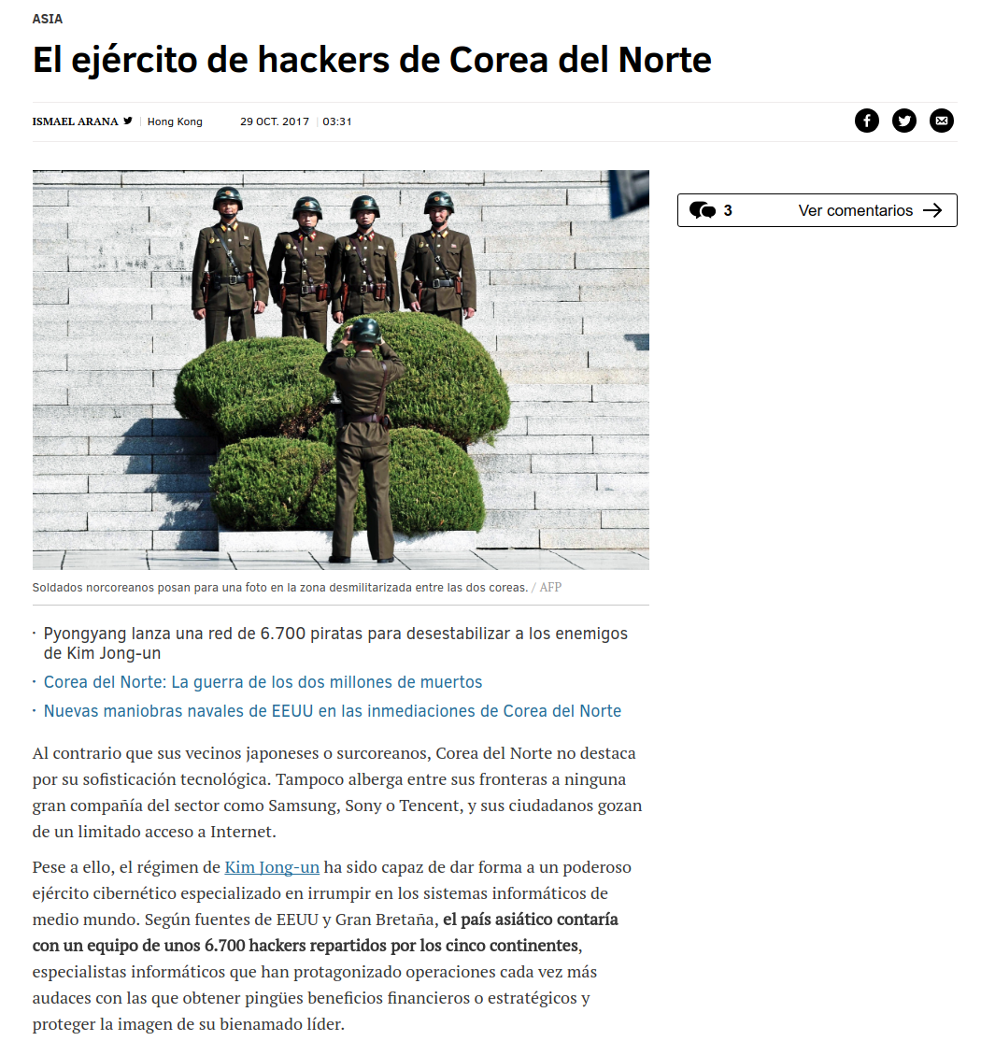
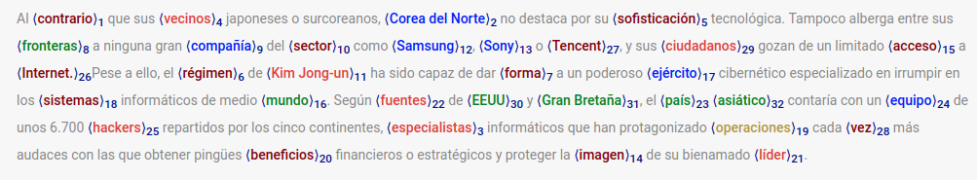
Question Candidates
Google Natural
Language API
Story
Named entities:
Replace with @entityX
Question key word
(answer):
@placeholder
Entity Replacement
Story
Question 1
Answer 1
Question 2
Answer 2

Slide 19
Experiments
Embeddings used:
FastText by Facebook
https://github.com/facebookresearch/fastText/blob/master/pretrained-vectors.md (P. Bojanowski, E. Grave, A. Joulin, T. Mikolov, Enriching Word Vectors with Subword Information)
300 dimension word vectors trained on Wikipedia text.
Word Alignment Dictionary
http://opus.lingfil.uu.se/OpenSubtitles2012.php (Jörg Tiedemann, 2012, Parallel Data, Tools and Interfaces in OPUS. In Proceedings of the 8th International Conference on Language Resources and Evaluation (LREC 2012))
Open Subtitles dataset
Word alignment Algorithm
Artetxe et al. 2016

Slide 20
Results
 | En. | Es. | En. → Es. (no training) | En. → Es. (training)
Individual Embeddings | 0.65666 | 0.42089 | 0.21908 | 0.54538
Mapped Embeddings | 0.66291 | 0.41596 | 0.26405 | 0.56622
Joint Training | 0.63226 | 0.51001 | - | -
Adversarial Training | 0.66979 | 0.5133 | - | (0.51714)
Notes:
Points:
1. using mapped embeddings do not significantly degradate monolingual performance
2. Best result on English monolingual performance is actually from using adversarial training (surprising)
3. Using fine-tuning transfer learning has significant beneficial impact on Spanish performance
4. Using mapped embeddings can further improve tranfer learning performance on Spanish data
5. Joint learning / Adversarial learning does not seem to perform better for Spanish data than fine-tuning + mapped embeddings

Slide 21
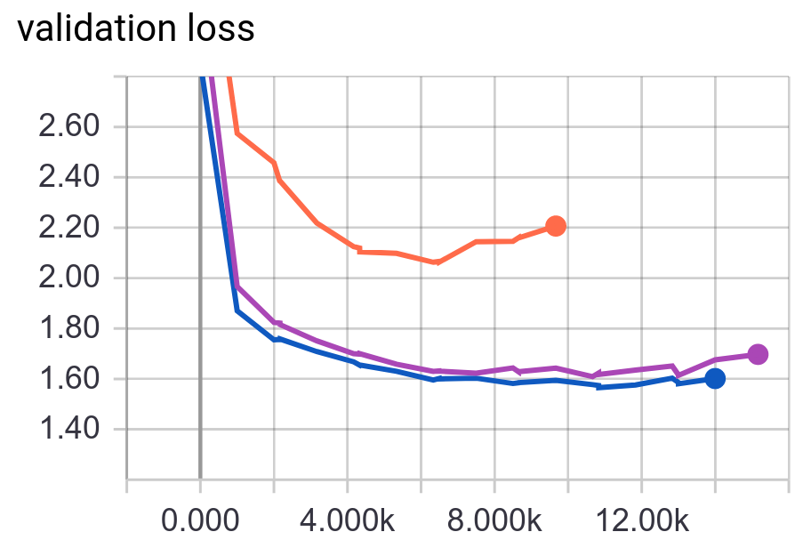
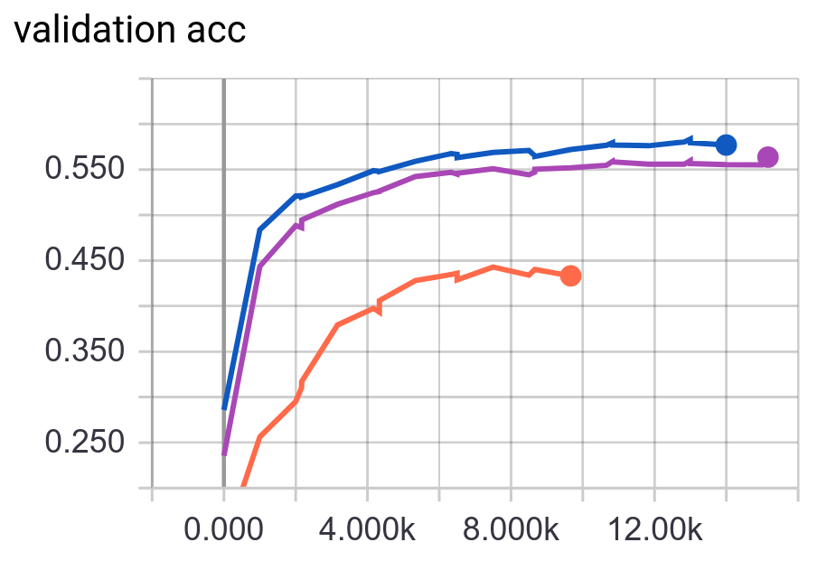
Analysis
Spanish Only
En→Es Original
Fine-tuning
En→Es Mapped
Fine-tuning
1. The spanish dataset alone is not large enough to learn the context matching and entity mapping task
2. Initialising training on the Spanish dataset with the model training on the English dataset helps accelerate training and improve accuracy on the Spanish dataset
3. Using aligned embeddings instead of individual embeddings slightly improves Spanish dataset performance

Slide 22
Analysis
Using mapped embeddings do not degradate monolingual performance while enhancing cross-lingual tranfer performance
Using adversarial training improves performance for both languages individually
The improvement on Spanish dataset is not as significant as using mapped embeddings + fine-tuning
Issues: data size of En:Es is 5:1, model adapts to En data much better
More layers might be needed to learn more useful language-independent features
Surprisingly, the performance on English dataset is better than without adversarial training
It is likely that joint training and adversarial training provides some extra information while also acting as a form of regularisation

Slide 23
Analysis
Why is adversarial training not as effective for Spanish dataset?
Model is “overwhelmed” by English data
But “supersampling” Spanish data does not improve performance while introducing overfitting
This particular task involves mainly context matching, which is already language-independent to some degree
Plus “token variable” (@entityX) representations are already shared
Attention mechanism is trained to focus on these token words
Adversarial training does not contribute much to the language-independence of answer representation

Slide 24
Conclusions
Cross-lingual knowledge transfer between QA models is possible
Fine-tuning is effective when the task itself is not highly language-dependent
Aligned embeddings generated with a limited dictionary can potentially improve cross-lingual tranfer learning performances
Joint learning and language-independent represenation learning through adversarial training is promising, but not necessarily better than fine-tuning

Slide 25
Future Work
Evaluate cross-lingual tranfer learning performance on QA tasks without entity replacement (i.e. more language-dependent)
Use adversarial learning to fine-tune word embeddings
Explore different options to represent “variables” (such as @entityX or @placeholder in this problem) within a text
Evaluate transfer learning on bilingual (mixed) texts

