Slide 1
FMCG: FAST MOVING CONSUMER GOODS

Slide 2
WHAT IS FMCG?
FMCG (Fast-Moving Consumer Goods) refers to everyday consumer products that are sold quickly and at relatively low prices. These products are used frequently and purchased regularly by consumers, such as food and beverages, personal care items, household cleaning products, and basic healthcare items. FMCG goods have a high demand, short shelf life, and strong distribution networks to ensure wide availability.

Slide 3
TODAY’S AGENDA
Group Details
Summary of the Project
KPI List
Excel Dashboard
Power BI Dashboard
Tableau Dashboard
SQL Script
Suggestions
Key Take Away

Slide 4
GROUP MEMBER DETAILS
Sanika Bhagwan Chavan
Vaishnavi Narayan Jibbanwad
Mithun N
Bhagyalaxmi Ainapur
Sanjib Kumar Bhuyan

Slide 5
SUMMARY OF THE PROJECT
Analyzed FMCG sales data to understand overall sales performance and revenue trends.
Identified top-selling and fast-moving products based on revenue and quantity sold.
Evaluated store-level and product-level performance to compare sales contribution.
Studied customer demand and purchasing patterns across different time periods.
Calculated key KPIs such as total sales, total revenue, average sales, and product contribution %.
Generated insights to support better inventory planning, stock optimization, and business decision-making.

Slide 6
KPI LIST
Store-level Sales Performance
Top 10 Products By Revenue
SKU Contribution %
Total Sales Revenue
Total Quantity Sold
Gross Profit
Gross Margin %
Channel Contribution
Category Contribution By Quantity
GST Contribution To Total GST By State
Payment Method

Slide 7
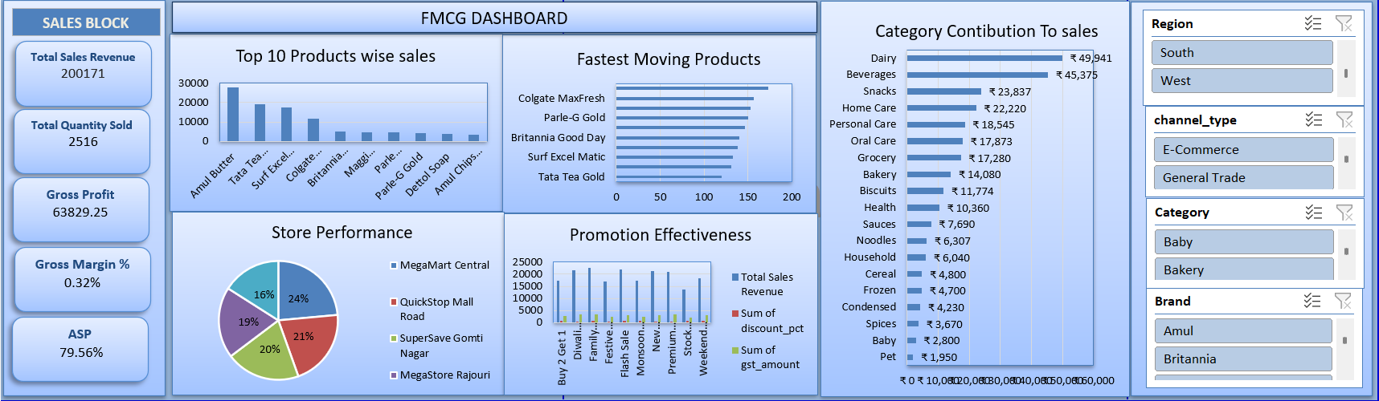
Excel DAshboaRd

Slide 8
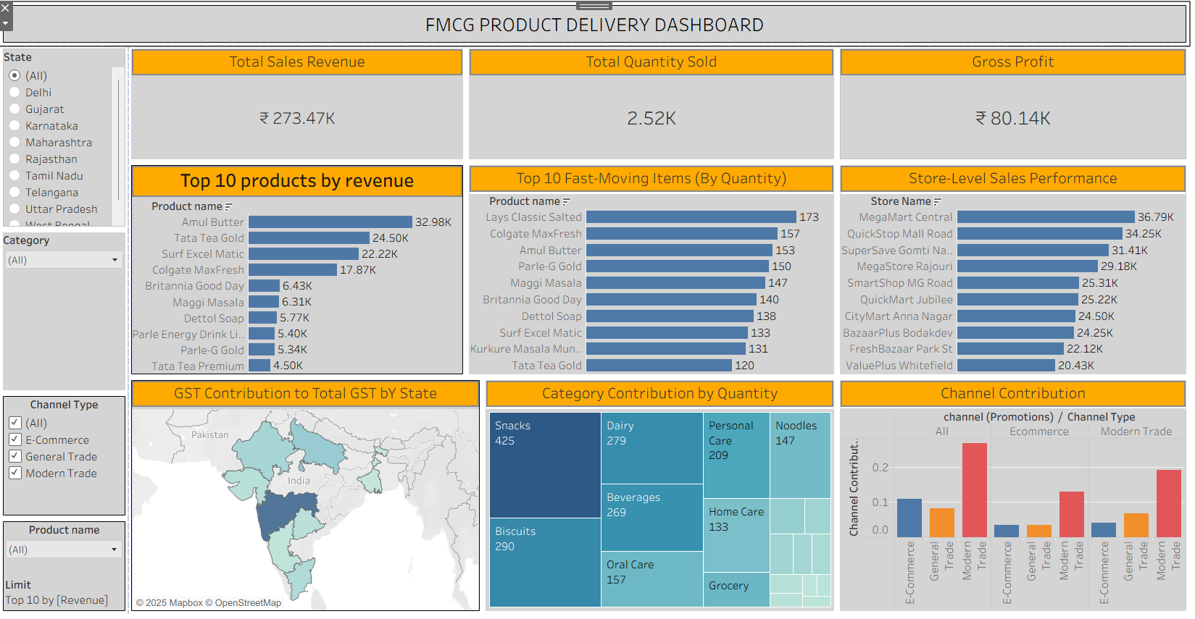
Tableau dashboard

Slide 9
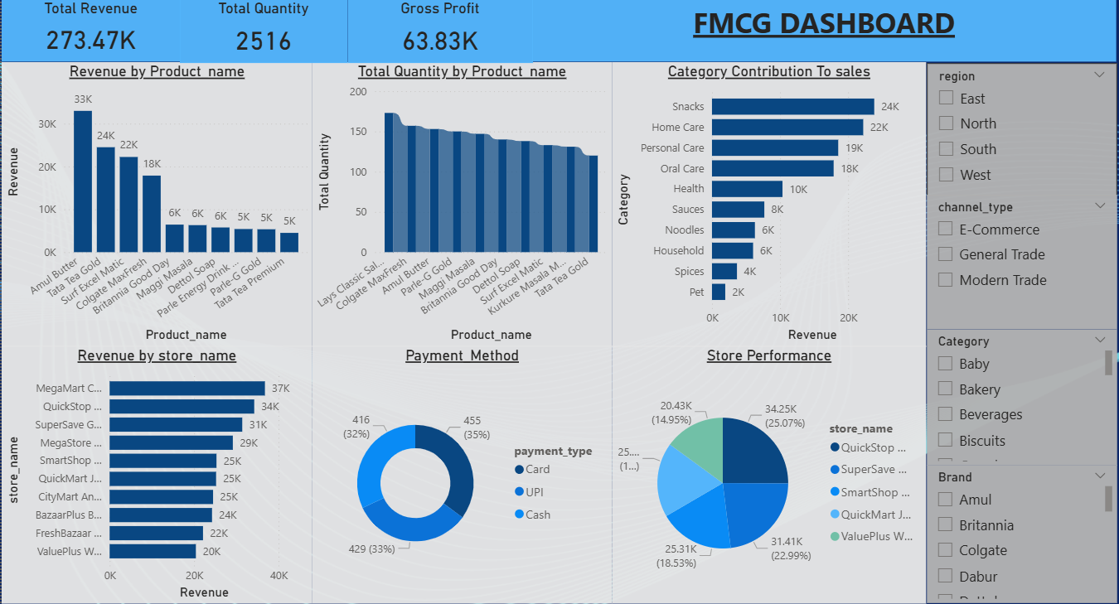
POWER-BI DASHBOARD

Slide 10
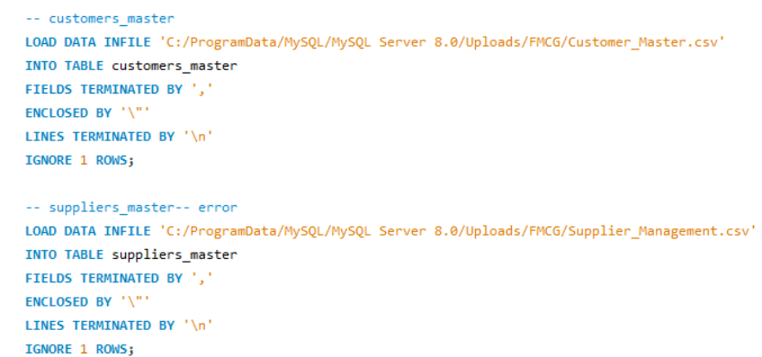
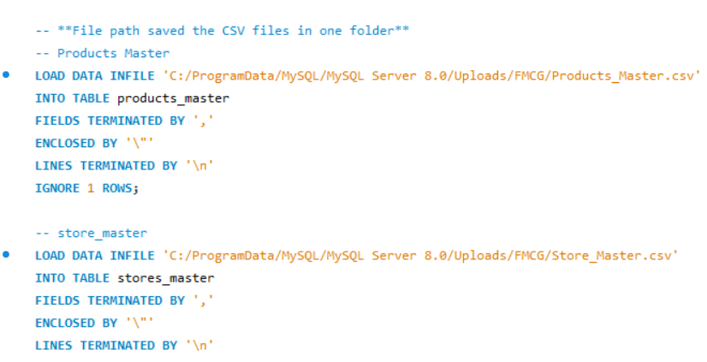
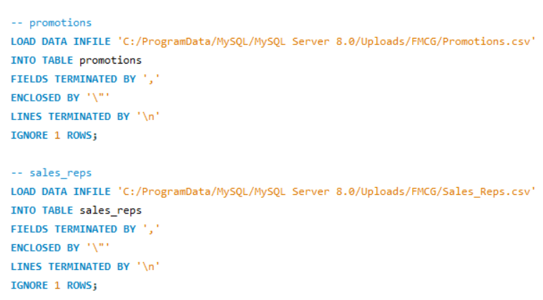
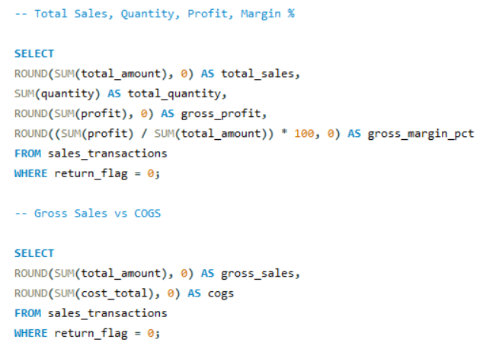
MY SQL SCRIPT FILE

Slide 11
KEY TAKEAWAY
The key takeaways of this FMCG Sales Analysis project are that fast-moving products contribute the most to overall revenue and require strong inventory control, a limited number of top products generate a major share of sales, store-level performance differs and needs location-specific strategies, demand patterns and seasonal trends are crucial for accurate forecasting and promotions, and data-driven KPIs help businesses improve stock management, sales efficiency, and overall decision-making in the FMCG sector.

Slide 12
Thank you

