Slide 1




A medley of medleys
Soutrik BANERJEE
27th Aug, 2013
E
P
A
R

Slide 2
SINPHONIE.pt
70 students (asthmatics (40) or controls (30)) were selected
Outcomes_{(binary)} (reported by parent questionnaire):
18 recent symptoms (hand itch, face rash, headache, runny nose, ... <3 months)
15 ISAAC symptoms (ever wheeze, ever itchy rash, ever nasal allergy, ...)
16 Exposures (measured in their houses using pumps or passive sampling for 7 days and averaged):
VOCs (mainly aromatic, & terpenoids & halogenated), aldehydes, total biological count, total fungal count, (& PMs excluded in this analysis due to missing data)
We select a case example – runny or blocked nose (<3 months) vs. exposures (standardised scores)

Slide 3
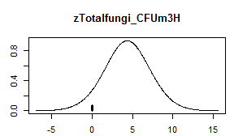
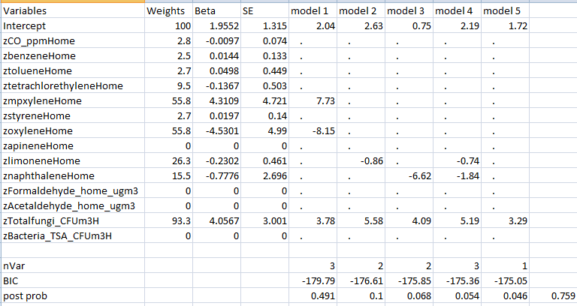
Tot. fungi = 30%

Slide 4
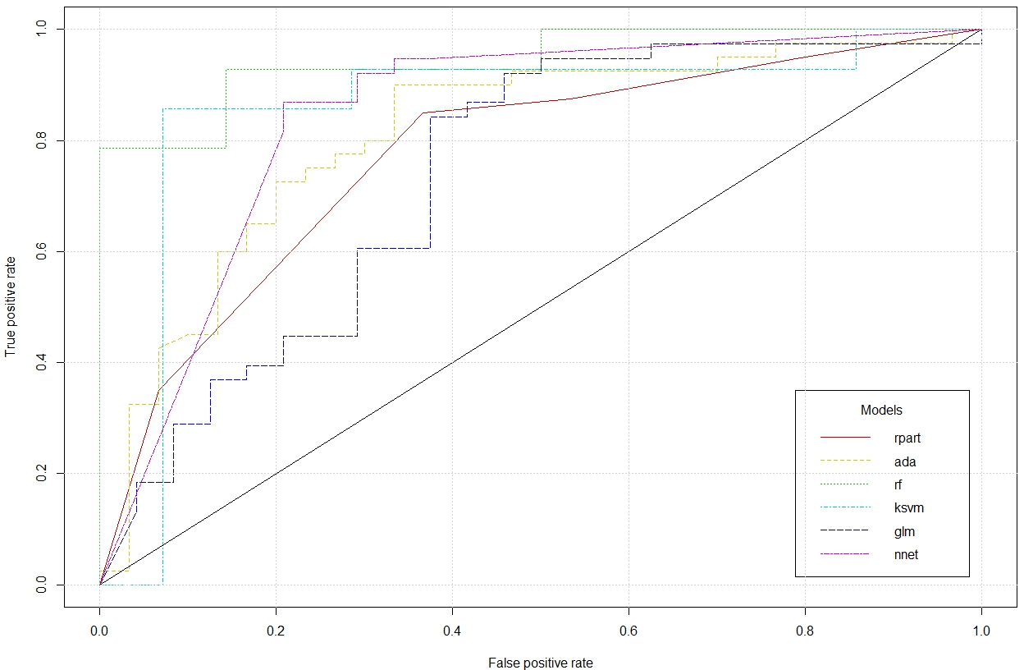
Comparison between the performance of some ensemble methods: asthmatic (y/n)

Slide 5
SINPHONIE – meta-analysis

Slide 6
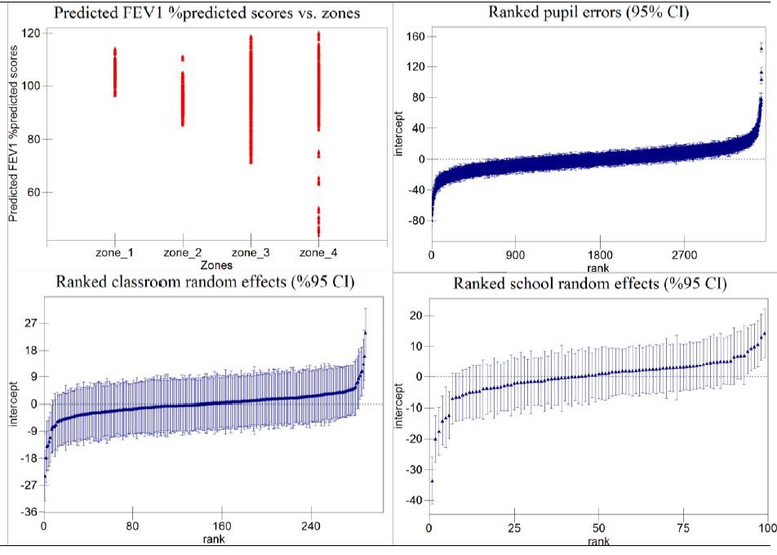
Multilevel analysis

Slide 7
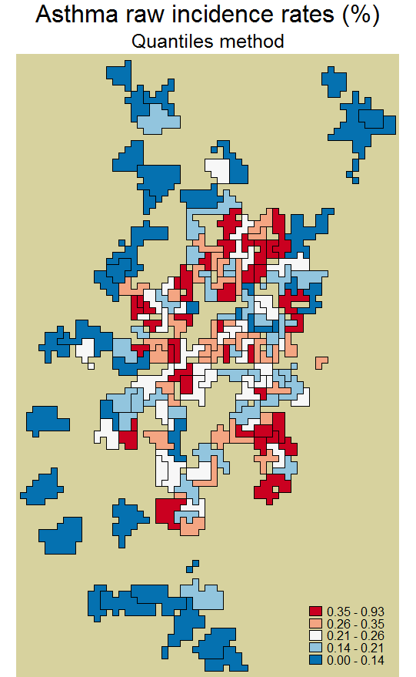
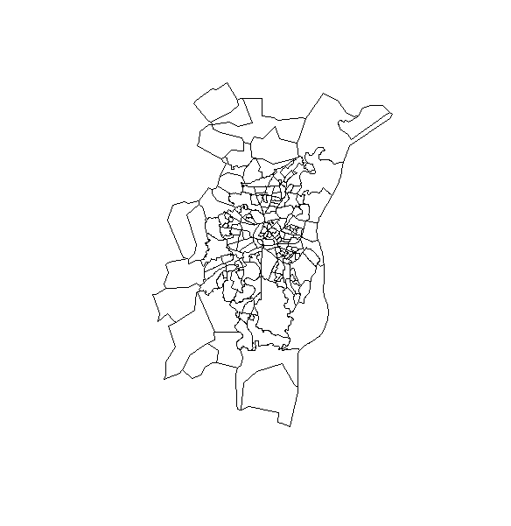
PAISARC+
Air pollution
Asthma attacks
Confounder? Effect modifier?
Deprivation

Slide 8

Let’s plug-in our estimates
I ≈ 0.70
I = 0.21
NO₂
RR = 1.31
CO
Air pollution
Asthma attack ‘calls’
PM
Benzene
RR = 0.92
Unknown agent
p < 0.01
RR = 1.47
Deprivation
Latent factors mediated
I ≈ 0.30*
The interaction model explained 40% of total variability (mainly spatial), but still 60% variability (mainly unstructured) was not explained → standard errors of the estimates

Slide 9
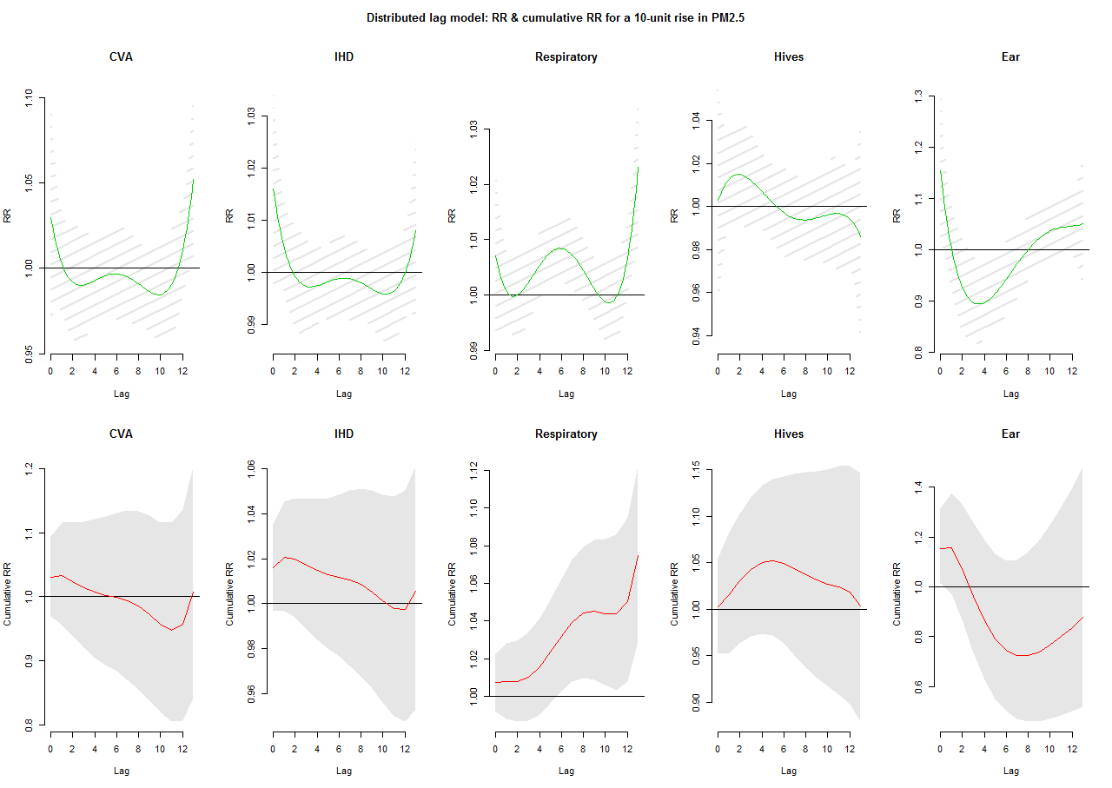
BAPHE – time-series analysis

