Slide 1

Master TES
UE3 Méthodes en Epidémiologie Environnementales
Introduction à la gestion et à l’analyse des données avec R
Soutrik Banerjee
Isabella Annesi-Maesano
INSERM U707
Équipe "Épidémiologie des Maladies Allergiques et Respiratoires" (EPAR)
Novembre 2013

Slide 2
Useful information (1)
CRAN website to download R-base or individual packages (e.g., ‘Rcmdr’ for R-commander); check for updates
Created by Ross Ihaka (NZ) & Robert Gentleman in the ‘90s
3rd generation language (3GL) (Sas® / Stata® are 4GL)
Opensource, GNU licensed & very similar to the commercially available S+ software:
  Works with OS like Windows®, Linux, Unix, Mac-OS®
Comparing with Sas® software:
  Sas® is case-insensitive; whereas R (also S+®, WinBUGS, Matlab® & Stata®) is case-sensitive
  Sas® works by I/O (= capable of loading huge data), R uses RAM (= limited by RAM space)
Novembre 2013
M2 TES – UE3

Slide 3
Useful information (2)
‘Package’ means ‘Library’
Type these commands in the console:
  install.packages("lattice") → redirected to a choice of downloadable sites
  library(lattice)
R functions → some are general, some are package-specific
Assignment operators (R):
  <- or ->
  =
Assignment operators (S+):
  _
  =
Windows:
  Console – press “ctrl + L” in the console will clear the console (use ↑ / ↓ keys to see commands’ history)
    Commands, outputs, error logs – all appear at the console
  Script editor
  Graphic output (appears on running a command)
Novembre 2013
M2 TES – UE3

Slide 4

Useful information (3)
Run a command:
  Select → click RUN icon from the SCRIPT editor
  Select → press “ctrl + R” from the SCRIPT editor
  Write command directly on the CONSOLE and press ENTER or RETURN key
R-calculator:
  sqrt(36)
  8^2
  pi
  log(2) [gives natural logarithm; log() is an R-function, 2 is the argument]
  log10(2) [gives logarithm to base 10]
  , rounded to 2 decimal places, is given as
  round((10.3+pi^2)/(pi*(log(5^3)-2)), 2) = 2.67
Novembre 2013
M2 TES – UE3
Notes:
Inverse of log() is exp().

Slide 5
Useful information (4)
Load R-stored data:
  data(cars)
  cars # head(cars); tail(cars)
R-help:
  help(mean) or ?mean # help on function mean; compare ??mean
  help(package = “MASS”) or help.search("HSAUR") # help on package MASS or HSAUR
  help(cars) or ?cars # help on cars data; compare with ??cars
List of R-objects (OOPS):
  ls() or objects()
Change and view your working directory:
  setwd(“C:/Users/u707-10299/Documents”) or setwd(“C:\\Users\\u707-10299\\Documents”)
  getwd()
Novembre 2013
M2 TES – UE3
Notes:
OOPS = Object-Oriented Programming System.
Everything is stored as “objects” in R; data, array, a single value, matrix, ....

Slide 6
Useful information (5)
R-operators:
  Assignment (<-, ->, =, (_ in S-plus))
  Arithmetic (+, -, *, /, ^ or **, %% (= modulus), %/% (= integer division))
  Logical (returns the value – TRUE or FALSE):
    &, |, !
    ==, <, <=, >, >=, !=
    is.na(x), isTRUE(x), na.rm, na.omit
  Special:
    %in%, %any%
    $, @
    [ ], { }, ( )
    ~ (in a formula), ? (for help), : (for a sequence of integers)
    : or * (interaction symbol)
Novembre 2013
M2 TES – UE3
Notes:
x %% y = modulus (x mod y) 5%%2 is 1.
x %/% y = integer division 5%/%2 is 2.

Slide 7
Useful information (6)
R-variable types:
  Numeric or float (2.61, pi, -5.623, 0.00)
  Character or string (“a”, “c”, “New”, “XYZ”)
  Integer (5, -10, 0)
  Logical (TRUE, FALSE)
  Factor (“1”, “B”, “C3”)
  Missing (NA)
Novembre 2013
M2 TES – UE3

Slide 8
Load datasets
One can load tab delimited, .csv, .txt, ... formats:
acti.w <- read.table("C:\\Users\\u707-10299\\Documents\\ActiWide.txt", header = TRUE, sep = "")
acti.w
acti.m <- read.table("C:/Users/u707-10299/Documents/ActiMedian.txt", header = T, sep = ""); acti.m
?read.csv() # help on reading a comma separated file
# rm(acti.w) # remove acti.w object
# rm(list = ls()) # remove all active objects !!!
Novembre 2013
M2 TES – UE3
Notes:
Dot used in naming objects in R, but in Sas® or Stata® an underscore is preferable.

Slide 9
Explore data frames (1)
Determine dimensions:
  > dim(acti.m) # no. of rows, no. of columns
  [1] 21 5
  > length(acti.m)
  [1] 5 # no. of variables in a DATA FRAME
Determine properties:
  class(acti.m); summary(acti.m); str(acti.m)
  print(acti.m)[1:5, ]
  row.names(acti.m) or rownames(acti.m)
  names(acti.m) or colnames(acti.m)
Select an element:
  acti.m[19, 4]
Novembre 2013
M2 TES – UE3

Slide 10
Explore data frames (2)
Select row(s):
  acti.m[2:4, ]; acti.m[c(2, 4), ]
Select column(s):
  acti.m[, 4]
  acti.m$Median.act # ‘$’ = CONTENT of an object
  attach(acti.m); Median.act
  detach(acti.m); Median.act
Convert into a matrix:
  acti.m.mat <- as.matrix(acti.m)
  class(acti.m.mat); acti.m.mat
  colnames(acti.m.mat)
  dim(acti.m.mat) # no. of rows, no. of columns
  length(acti.m.mat) # no. of rows x columns of a MATRIX
Novembre 2013
M2 TES – UE3

Slide 11
Explore data frames (3)
Select column(s) (in a matrix):
  acti.m.mat[, 4] # but, NOT ‘$’ sign for matrices
  This gives you a vector (or array of numbers), just as before with data frames
Type stored value of a constant (e.g., π):
  pi
Novembre 2013
M2 TES – UE3

Slide 12
Explore vectors (1)
Some simple functions:
d = c(3 ,4 ,7); d
length(d) # !!! no. of elements of a VECTOR
max(d); min(d)
range(d); mean(d); median(d);
var(d); sd(d); sd(d)^2
Generate vectors:
e = seq(from = 1, to = 3, by = 0.5); e
e = seq(1, 3, 0.5); e
f = rep(NA, 6); f
a <- c(1, 2, 3, NA, 6); a
Create a null vector:
x = c(); x
Novembre 2013
M2 TES – UE3

Slide 13
Explore vectors (2)
More functions:
is.na(a) # logical function
mean(a)
mean(a, na.rm = TRUE)
sum(a)
sum(a, na.rm = TRUE)
Count no. of missing elements:
sum(is.na(a)); sum(is.na(f))
Sorting:
g <- c(2, 6, 7, 4, 5, 2, 9, 3, 6, 4, 3)
sort(g, decreasing = TRUE)
unique(g)
duplicated(g); sum(duplicated(g)) # logical function
Novembre 2013
M2 TES – UE3
Notes:
Compare with sum(g), sum(unique(g))

Slide 14
Explore vectors (3)
Subsetting:
d == 3 # logical function
d != 3 # logical function
d > 3 # logical function
d[d > 3] # conditional subsetting
which(d == 3) # WHICH element no. has the value = 3
d[-2] # without the 2nd element of the vector
a[-c(3:5)] # without 3rd, 4th and 5th element
Novembre 2013
M2 TES – UE3

Slide 15
Explore matrices (1)
Operations:
mat <- matrix(c(10:15), nrow = 3, ncol = 2); mat # bycol is default
mat1 <- matrix(c(10:15), nrow = 3, ncol = 2, byrow = TRUE); mat1
mat + mat1
mat - mat1
mat / mat1 # by element division
mat * mat1 # by element multiplication
mat %*% t(mat1)# matrix multiplication, t() = transpose of matrix
ncol(mat); nrow(mat)
Novembre 2013
M2 TES – UE3

Slide 16
Explore matrices (2)
More operations:
v <- c(5, 7, 12, -6)
(1) as.matrix(v)
(2) v.mat <- matrix(v, nrow = 2, ncol = 2, byrow = TRUE); v.mat
1/v.mat # by element inverse
solve(v.mat) # inverse of a matrix only for a square matrix
Extract / impute elements:
mat[c(1, 3), 2]
mat[3, 2] <- 999; mat # try NA instead of 999
Combine vectors (or matrices) to form a matrix:
mat2 <- rbind(d,d); mat2 # by row bind
mat3 <- cbind(d,d); mat3 # by column bind
Novembre 2013
M2 TES – UE3

Slide 17
Explore matrices (3)
Missing data:
h = matrix(c(NA, 3, 1, NA, 7, -8), nrow = 3, ncol = 2, byrow = TRUE); h
is.na(h) # logical function
Count no. of missing elements:
sum(is.na(h))
which(is.na(h)) # WHICH element(s) no. are missing -> element(s) no. = by rows x columns (i.e., ‘length’) of a MATRIX (default is by column)
Novembre 2013
M2 TES – UE3

Slide 18
Quick data management tips
Loop (example):
For (iterative):
    for (i in 1:10) {x = i^2
    print(x)
    }
While (conditional)
Functions:
Inbuilt – sum(), ifelse(), with(), seq(), apply(), sample(), subset(), ...
User-defined
Merge 2 datasets:
names(acti.m)[names(acti.m) == "patid"] <- "Patid"
newdat = merge(acti.m, acti.w, by = "Patid")
Novembre 2013
M2 TES – UE3

Slide 19
Exercise (1)
Combien de variables contient le data.frame acti.w ?
Afficher les premières 3 lignes de acti.w.
Quelle est la moyenne de la variable ‘Median.act’ du data.frame acti.m arrondi à 2 places après le virgule ?
Créer un data.frame à partir de acti.w, qui ne contient que les déments (Group = 1).
Novembre 2013
M2 TES – UE3
Notes:
length(acti.w) = 13 or dim(acti.w)[2].
acti.w[c(1:3), ].
round(mean(acti.m$Median.act), 2) = 16.41.
acti.w.grp1 <- subset(acti.w, Group == 1).

Slide 20
Correlation
Pearson correlation (= parametric):
cor(acti.m$GDS, acti.m$Median.act)
Check normality assumptions:
shapiro.test(acti.m$GDS) # ok
shapiro.test(acti.m$Median.act) # not ok !
Correlation test:
cor.test(acti.m$GDS, acti.m$Median.act)
Correlation matrix:
round(cor(acti.w[, c(3:10)]), 1) # correlation matrix
Novembre 2013
M2 TES – UE3

Slide 21
Plot 2 variables
(1) Y ~ X:
plot(acti.m$Median.act ~ acti.m$GDS, main = "Comparison between median activity (min.) and depression", xlab = "Geriatric Depression Scale", ylab = "Median Activity")
(2) X, Y:
plot(acti.m$GDS, acti.m$Median.act, main = "Comparison between median activity (min.) and depression", xlab = "Geriatric Depression Scale", ylab = "Median Activity")
Add a regression line to the plot:
abline(a = 39.765, b = -1.679) # default parameters: a = intercept, b = slope
Novembre 2013
M2 TES – UE3

Slide 22
Histogram & boxplot
par(mfrow = c(1, 2)) # to insert many images into one
Histogram:
hist(acti.m$Median.act, main = "Histogram", xlim = c(0, 80), xlab = "Median activity (min.)", br = 10, col = "green")
Boxplot:
boxplot(acti.m$Median.act, main = "Boxplot - median activity (min.)", ylab = "Median activity")
Boxplot, by group:
boxplot(acti.m$Median.act ~ acti.m$MMS.bin, main = "Boxplot - median activity (min.) by group", ylab = "Median activity", xlab = "0 = Normal, 1 = Demented")
Can we do a t-test = Student’s test (or ANOVA test) here ?
Novembre 2013
M2 TES – UE3

Slide 23
Scatterplot matrix & linear regression
pairs(acti.w[, c(3:10)], main = "Scatterplot of activity for 8 nights", pch = 16)
pairs(log(acti.w[, c(3:10)]), main = "Scatterplot of log-activity for 8 nights", pch = 16)
Linear regression:
reduced.model <- lm(acti.m$Median.act ~ acti.m$GDS); summary(reduced.model)
par(mfrow = c(2, 2)); plot(reduced.model)
full.model <- lm(acti.m$Median.act ~ acti.m$Waterlow.bin + acti.m$GDS + acti.m$MMS.bin + acti.m$MMS.bin:acti.m$GDS); summary(full.model)
par(mfrow = c(2, 2)); plot(full.model)
anova(reduced.model, full.model) # compare 2 models
Novembre 2013
M2 TES – UE3

Slide 24
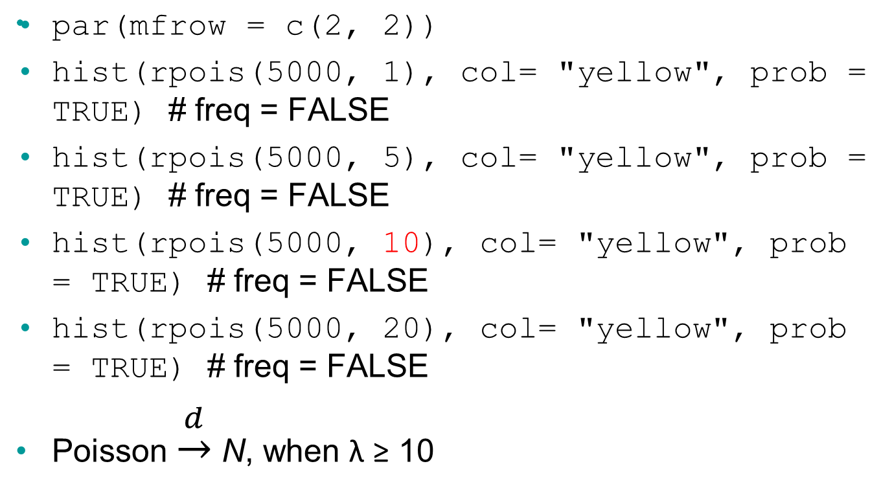
Simulate Poisson distributions
Novembre 2013
M2 TES – UE3

Slide 25
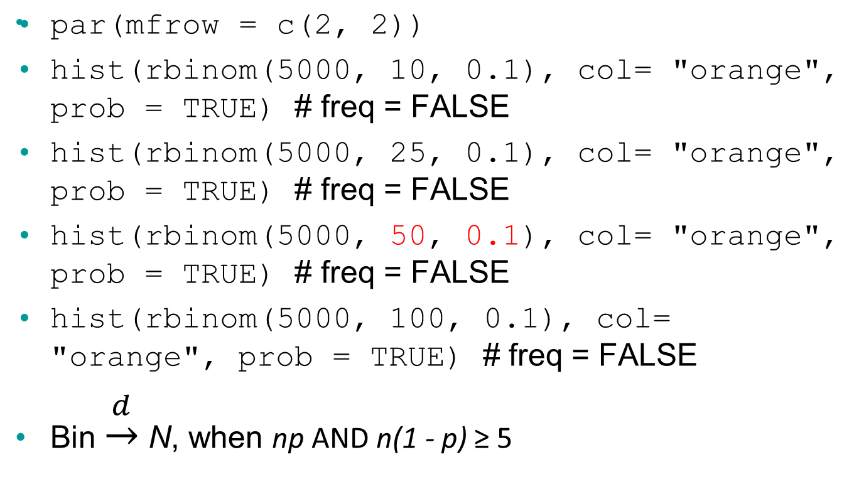
Simulate binomial distributions
Novembre 2013
M2 TES – UE3

Slide 26
Simulate (standardised) Normal distributions
par(mfrow = c(2, 2))
hist(rnorm(30, 0, 1), col= "red", prob = TRUE) # freq = FALSE
hist(rnorm(50, 0, 1), col= "red", prob = TRUE) # freq = FALSE
hist(rnorm(200, 0, 1), col= "red", prob = TRUE) # freq = FALSE
hist(rnorm(1000, 0, 1), col= "red", prob = TRUE) # freq = FALSE
Novembre 2013
M2 TES – UE3

Slide 27
Formal checking of our assumptions (1)
Generate Normally distributed random no.:
n0 <- rnorm(15, 0, 1)
n1 <- rnorm(30, 0, 1)
n2 <- rnorm(50, 0, 1)
n3 <- rnorm(200, 0, 1)
n4 <- rnorm(1000, 0, 1)
Normality tests:
shapiro.test(n0)
shapiro.test(n1)
shapiro.test(n2)
shapiro.test(n3)
shapiro.test(n4)
Q-Q Normal probability plot (Quantile-Quantile Normal probability plot):
par(mfrow = c(2, 3))
qqnorm(n0)
qqnorm(n1)
qqnorm(n2)
qqnorm(n3)
qqnorm(n4)
Novembre 2013
M2 TES – UE3

Slide 28
Formal checking of our assumptions (2)
par(mfrow = c(2, 2))
hist(n0, prob = TRUE)
plot(density(n0))
qqnorm(n0)
plot(ecdf(n0))
shapiro.test(n0)
...
Novembre 2013
M2 TES – UE3

Slide 29
Simulate t (Student’s) distributions
par(mfrow = c(2, 2))
hist(rt(5000, df = 5), col= "blue", prob = TRUE, xlim = c(-8, 8)) # freq = FALSE
hist(rt(5000, df = 10), col= "blue", prob = TRUE, xlim = c(-8, 8)) # freq = FALSE
hist(rt(5000, df = 30), col= "blue", prob = TRUE, xlim = c(-8, 8)) # freq = FALSE
hist(rt(5000, df = 100), col= "blue", prob = TRUE, xlim = c(-8, 8)) # freq = FALSE
Novembre 2013
M2 TES – UE3
Notes:
Student: William G. Gosset, worked in een Browerij.

Slide 30
Example of the impact of small sample size (d.f.) on t-test
a = c(12, 13) # a sample of 2 observations
b = c(14, 16) # a sample of 2 observations
t.test(a, b)
c = c(30, 32) # a sample of 2 observations
t.test(a, c)
Novembre 2013
M2 TES – UE3

Slide 31
Categorical data
tableau <- c("yes", "no", "yes", "yes", "no")
table(tableau)
scanned <- scan()
10 10 20 10 30 20 10 40 # press enter/return key
barplot(scanned) # not useful
barplot(table(scanned)) # = histogram
pie(table(scanned))
Novembre 2013
M2 TES – UE3

Slide 32
Contingency table
gel <- scan(what = "character")
a b a b b b a a b a b a b # press enter/return key
infection <- scan(what = "character")
n n n y n n y n n n y y n # press enter/return key
tableau2 <- table(gel, infection); tableau2
round(prop.table(tableau2), 2) # cell proportions
round(prop.table(tableau2, 1), 2) # row proportions
round(prop.table(tableau2, 2), 2) # column proportions
fisher.test(tableau2); chisq.test(tableau2) # warning !
Novembre 2013
M2 TES – UE3

Slide 33
Exercise (2)
Combien de patients déments (Group = 1) sont fragiles (Waterlow.bin = 1) ?
Quel % de patients chez les déments sont fragiles ?
Y a-t-il une différence significative entre les % des patients fragiles chez les déments par rapport aux patients fragiles chez les non-déments ?
Novembre 2013
M2 TES – UE3
Notes:
table(acti.w$Group, acti.w$Waterlow.bin) = 10 (48% du total).
round(prop.table(table(acti.w$Group, acti.w$Waterlow.bin), 1), 2) = 62% (% de ligne), alors que tous le non-déments sont fragiles.
fisher.test(acti.m$MMS.bin, acti.m$Waterlow.bin) = p = 0.262 → le test est donc non-significatif; car le test du chi² n’est pas peut-être valable ici; # fisher.test(table(acti.m$MMS.bin, acti.m$Waterlow.bin)).

Slide 34
Inference on proportions
One sample proportion:
prop.test(17, 50) # parametric
prop.test(17, 50, p = 0.45) # parametric, comparison to a given proportion
Two sample proportions:
exposed = c(83, 80)
not.exposed = c(86, 93)
prop.test(exposed, not.exposed) # parametric
fisher.test(exposed, not.exposed) # non-parametric
Novembre 2013
M2 TES – UE3

Slide 35
Inference on means (1)
One sample mean:
shapiro.test(cars$speed) # check Normality assumptions
t.test(cars$speed)
t.test(cars$speed, mu = 16.95) # parametric, comparison to a given mean
wilcox.test(cars$speed, mu = 16.95) # non-parametric, comparison to a given mean
shapiro.test(cars$dist) # check Normality assumptions
wilcox.test(cars$dist, mu = 50) # non-parametric, comparison to a given mean; no t-test allowed here (cf. *)
Novembre 2013
M2 TES – UE3
Notes:
* t.test(cars$dist, mu = 50).

Slide 36
Inference on means (2)
Two sample means:
Test homogeneity of variance = heteroscedasticity !
var(subset((acti.m$Median.act), acti.m$MMS.bin == 1))
shapiro.test(subset((acti.m$Median.act), acti.m$MMS.bin == 1)) # check Normality assumptions
var(subset((acti.m$Median.act), acti.m$MMS.bin == 0))
shapiro.test(subset((acti.m$Median.act), acti.m$MMS.bin == 0)) # check Normality assumptions
t.test(acti.m$Median.act ~ acti.m$MMS.bin) # for example only, but in reality, not allowed
wilcox.test(acti.m$Median.act ~ acti.m$MMS.bin)
Novembre 2013
M2 TES – UE3
Notes:
Alternative format in the next slide.

Slide 37
Inference on means (3)
Paired t-test (parametric):
a <- scan()
3 6 2 5 5 7 7 4 7 6 # press enter now
b <- scan()
4 8 4 3 6 9 6 6 9 10 # press enter now
diff <- a – b
shapiro.test(diff) # check Normality assumption of the DIFFRENCE
t.test(a, b) # by default: paired = FALSE
t.test(a, b, paired = TRUE) # no ~ here ! parametric
t.test(diff)
wilcox.test(a, b, paired = TRUE) # non-parametric
Novembre 2013
M2 TES – UE3
Notes:
Paired t-test or Wilcoxon sign ranked test.
(Tests pour les données appariées).

Slide 38
R-commander (by John Fox)
First load dependencies:
library(tcltk); library(car); library(MASS); library(nnet); library(survival); library(splines)
Then:
library(scatterplot3d)
library(Rcmdr)
Demonstration:
Novembre 2013
M2 TES – UE3

Slide 39
Save your work !
Save all objects:
save.image("TES2011.TP.RData") # saved in working directory
load("TES2011.TP.RData") # load from working directory
Save datasets:
write.table(acti.m, file = "ActiMedian.txt")
write.csv(acti.m, file = "ActiMedian.csv")
Save all commands:
savehistory(file = "commands.r")
Run all commands from a scripts file:
source("commands.r")
Novembre 2013
M2 TES – UE3

Slide 40
Free resources
Open source software:
  Epi InfoTM (CDC-USA), EpiData (Denmark) – for data entry software
  StaTable (distribution, statistic, degrees of freedom)
Websites:
  BiostaTGV (Jussieu), OpenEpi / Kevin Sullivan’s home page – online different kinds of simple tests and useful information
Online books:
  Trick: “Use R! PDF …” in Google to find R books, tutorials free on the net
Novembre 2013
M2 TES – UE3

