Slide 1
Welcome
1
02/01/2018

Slide 2
Presentation by
Name here
University of Asia Pacific
02/01/2018

Slide 3
SQLITE
SQLite Open Source DATABASE
Ref: www.google.com
www.stackoverflow.com
Android developer
www.youtube.com

Slide 4
After this presentation we will able to understand.
What is SQLite?
What is SQLiteOpenHelper?
How to CREATE SQLite Database?
How to INSERT Data into SQLite Database?
How to READ from SQLite Database?
How to UPDATE Data into Database?
How to DELETE Data from Database?
Use of SQLite Database in real Life?

Slide 5

What is DATABASE?

Slide 6
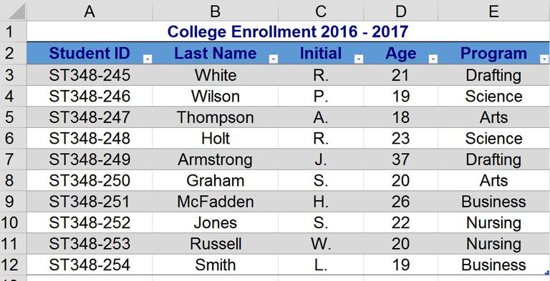
Database
A DATABASE consists of many tables. Table hold data in rows/column Also called records/fields.

Slide 7
SQLITE Database
SQLite is open source SQL database that stores data to a text file on a device. Android comes in with built in SQLite database implementation. SQLite supports all the relational database features.

Slide 8
SQLiteOpenHelper
A helper class to manage database.
SqliteOpenHelper
Super(parameters)
OnCreate
OnUpgrade()
Create a helper object to create, open, and manage a database.
Called when the database is created for the first time.
Called when the database needs to be upgrade.

Slide 9
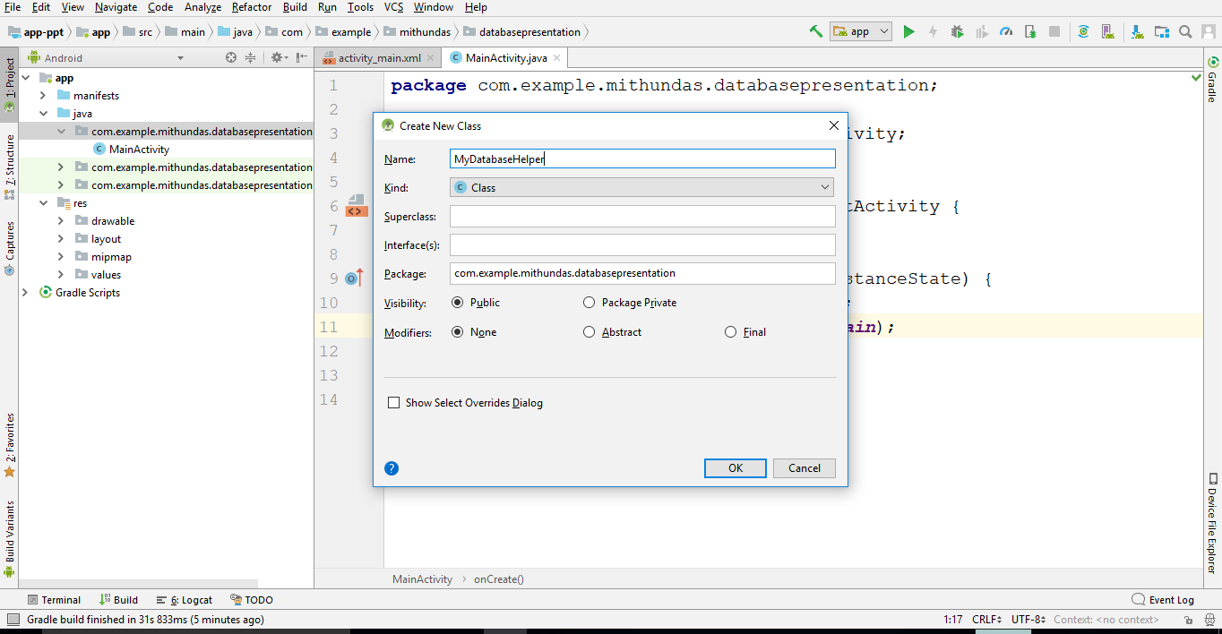
CREATE SQLite Database
1st step

Slide 10
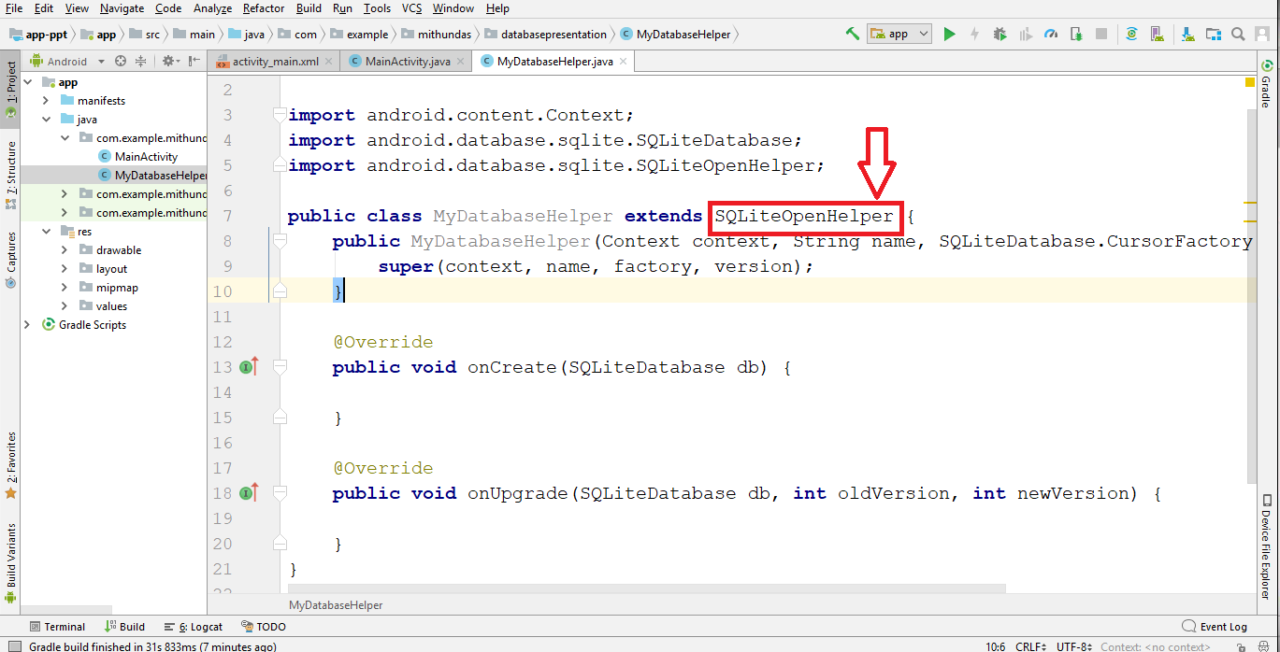
CREATE SQLite Database
2nd step
After Created class now we extends SQLiteOpenHelper class .

Slide 11
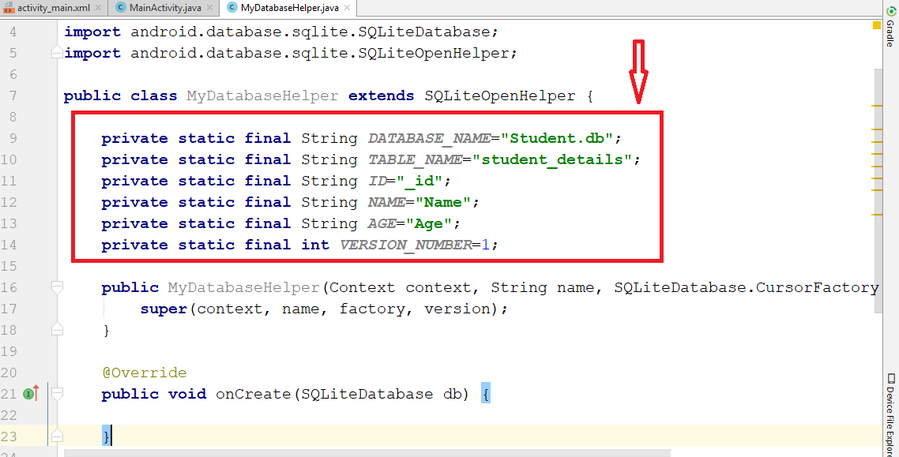
CREATE SQLite Database
3rd step
Now we declare DATABASE_NAME,TABLE_NAME , ROWS and database version number.

Slide 12
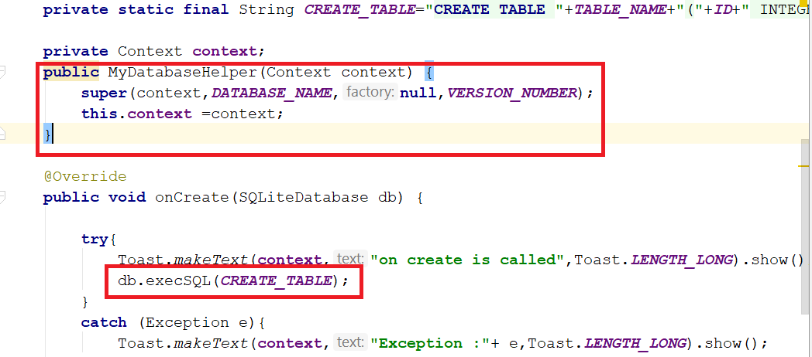
CREATE SQLite Database
4th step
.
private static final String CREATE_TABLE="CREATE TABLE "+TABLE_NAME+"("+ID+" INTEGER PRIMARY KEY AUTOINCREMENT,"+NAME+" VARCHAR(255),"+AGE+" INTEGER);";

Slide 13
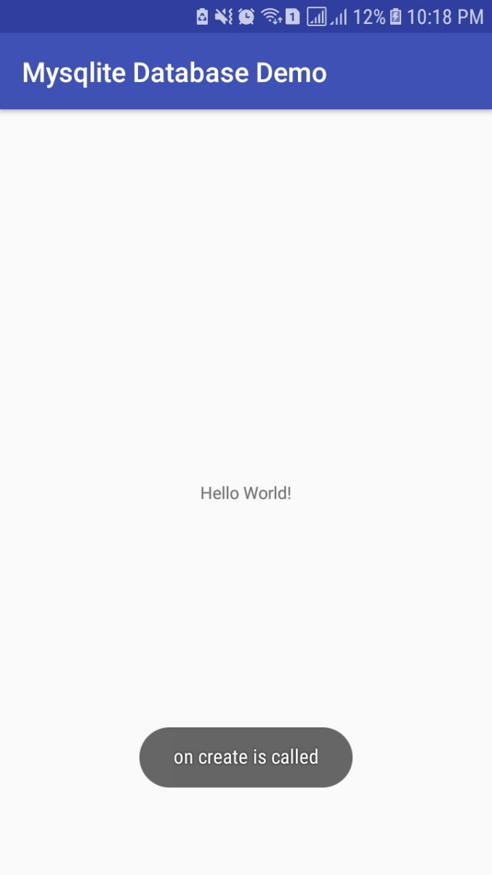
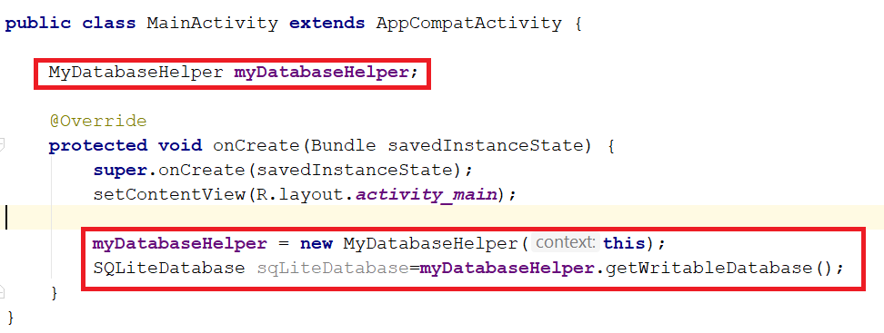
CREATE SQLite Database
5th step
First create object for MyDatabaseHelper and run android application.

Slide 14
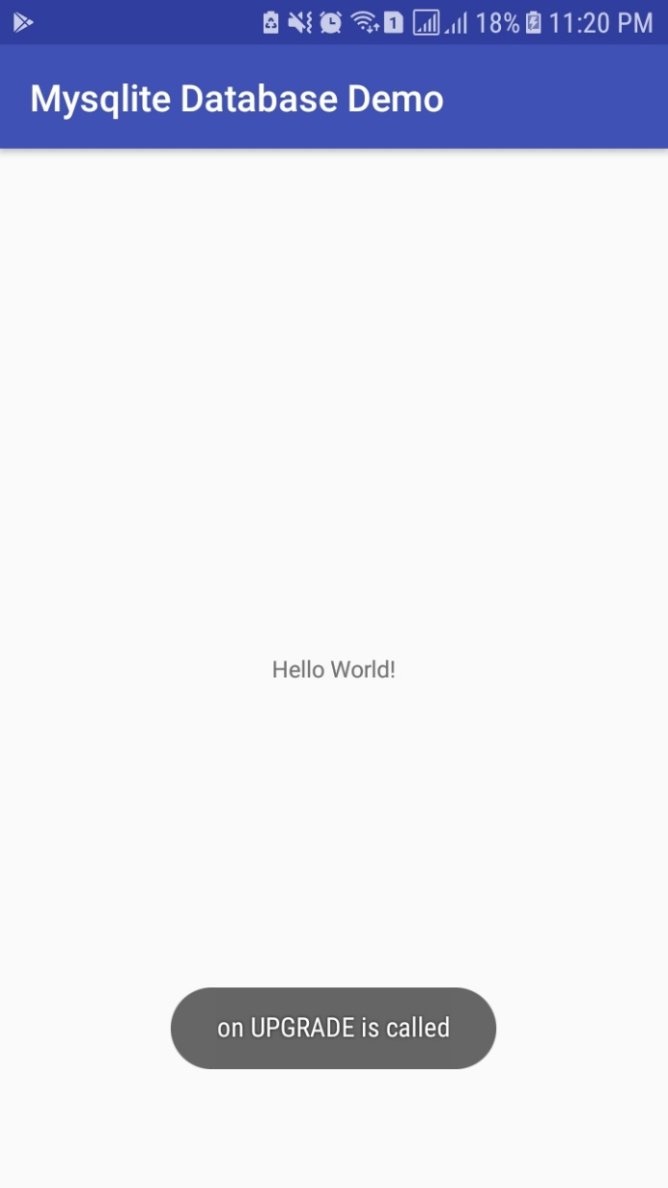
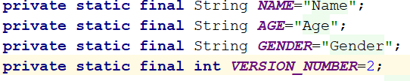
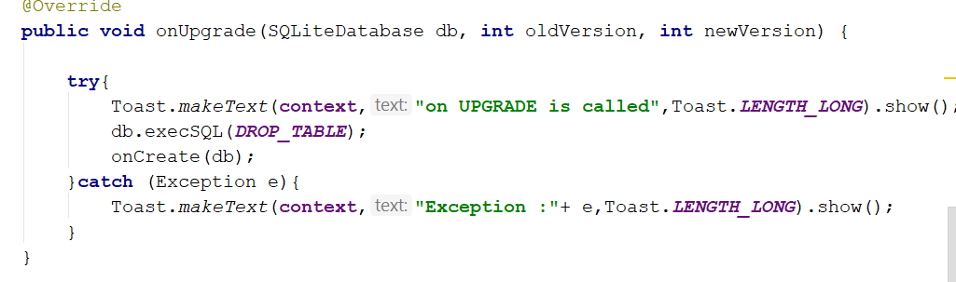
UPGRADE SQLite Database
First add column name and change version number
Then write drop table command.

Slide 15
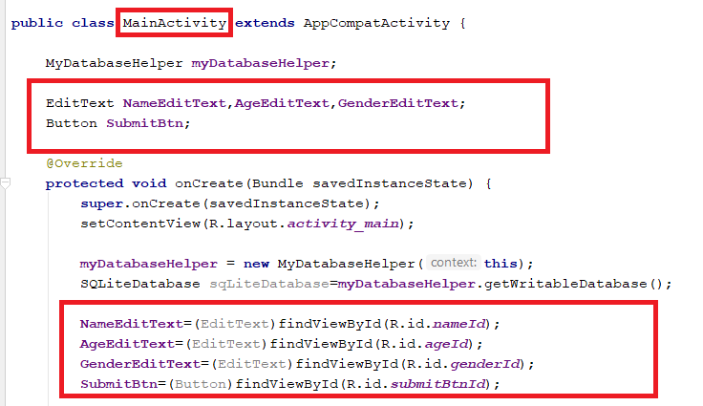
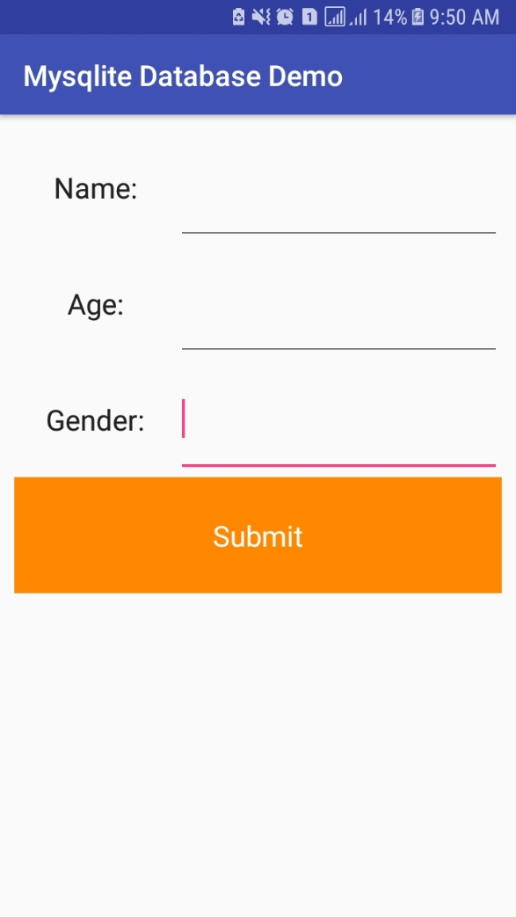
INSERT SQLite Database
First we design our application as per required what we want.
Then find all of the item in MainActivity.

Slide 16
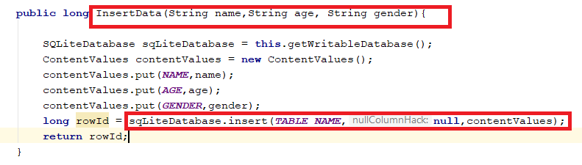
INSERT SQLite Database
Then we write a method for INSERTION in the SQLite Database inside the MyDatabaseHelper class.
In this case we have 3 parameter name, age and gender.

Slide 17
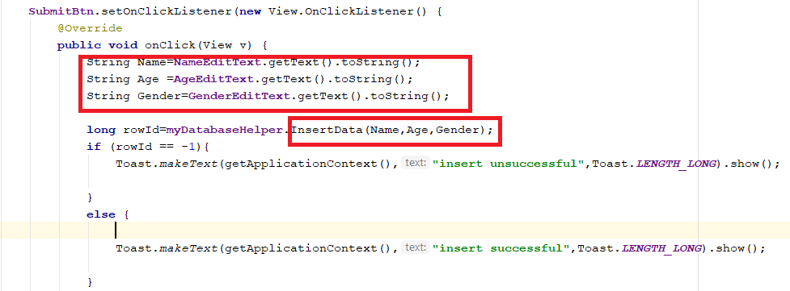
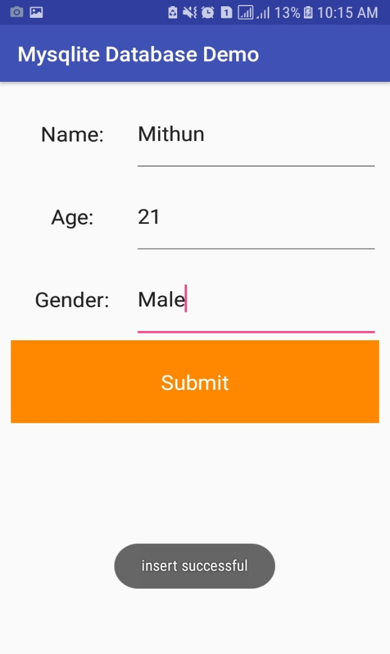
INSERT SQLite Database
Then Call InsertData method from the MainActivity. If it is insert successfully then system give me a successfully Toast.

Slide 18
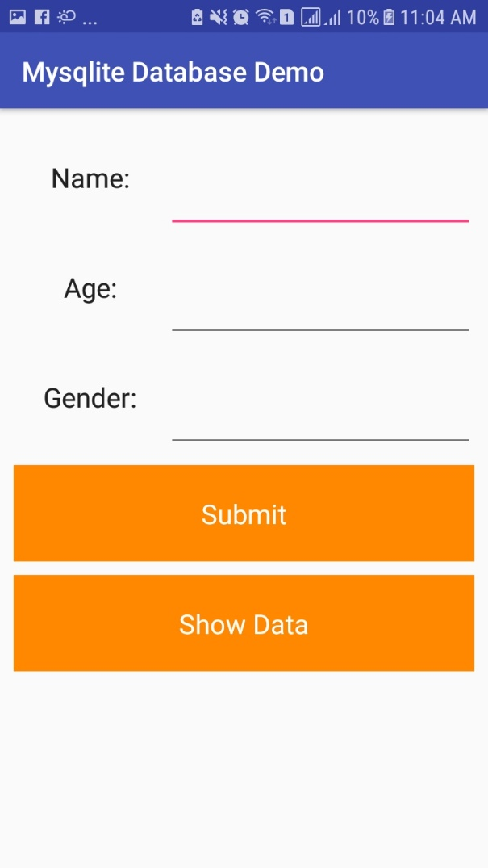

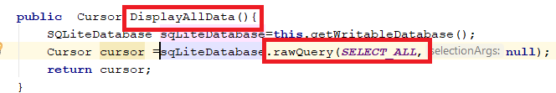
READ SQLite Data
First add a button for showing all data.
Inside the MyDatabaseHelper class write a query for select all data and create a method for display all data.

Slide 19
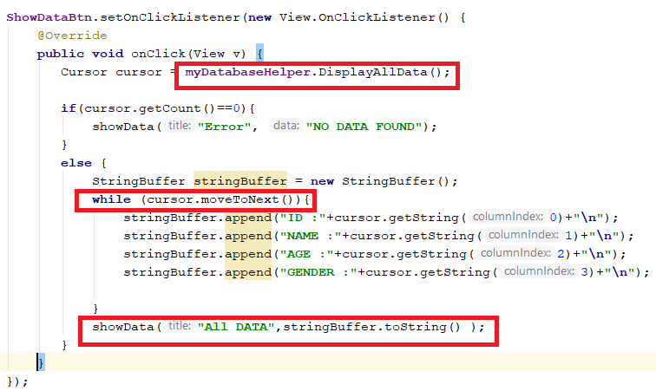
READ SQLite Data
Then call DisplayAllData method from the MainActivity and do all necessary thing which is given below.

Slide 20
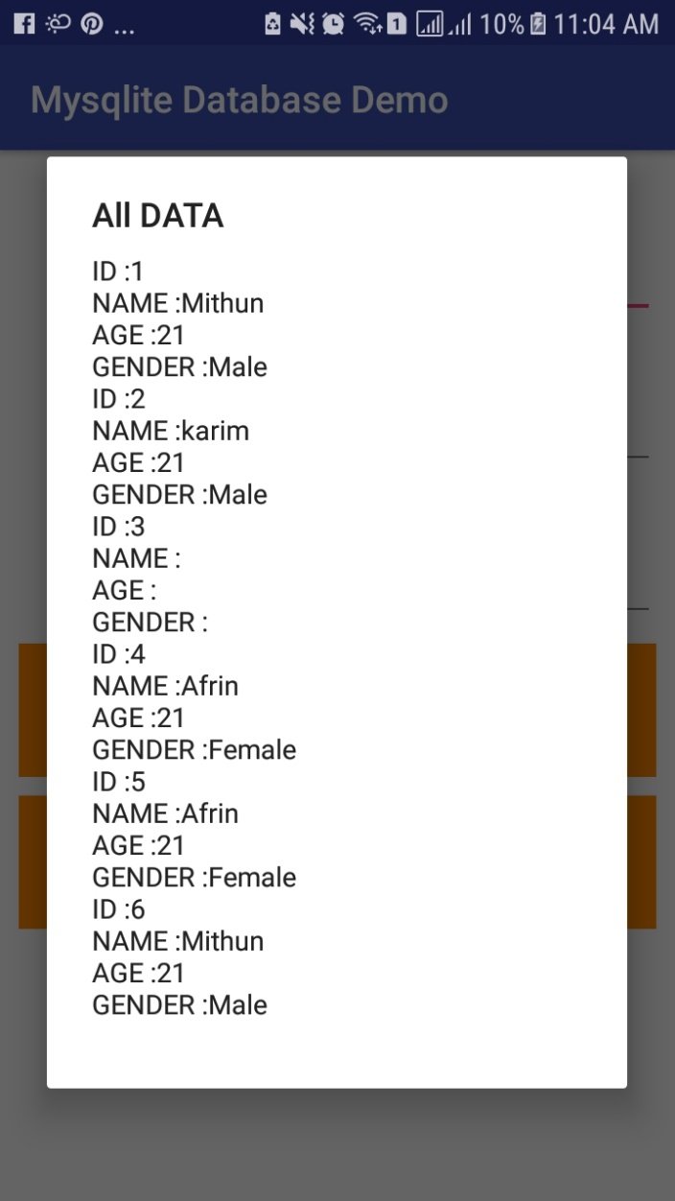
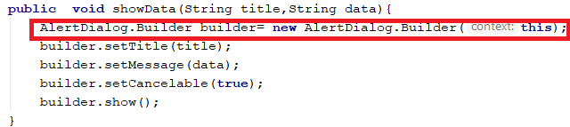
READ SQLite Data
In my case I am using AlertDialogeBuilder for showing my all data.
Run your application and hit show Data button.

Slide 21
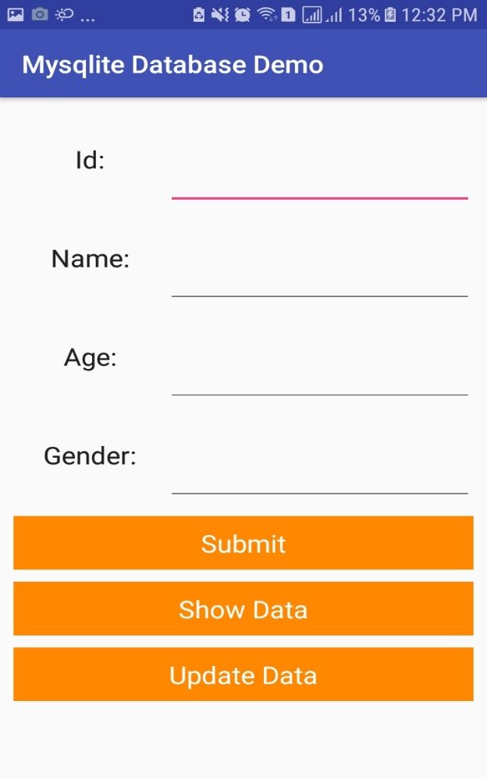
UPDATE SQLite Data
First add a EditText and add a Button for Updating Data.
For Updating data we use a column which is unique in this case id is unique.

Slide 22
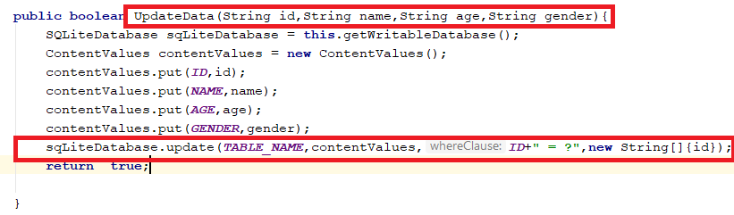
UPDATE SQLite Data
Then we create a method inside the MyDatabaseHelper class for updating data like as we use UpdateData .In this case four parameter is used which is id , name , age and gender.
In this method we use update method which is to help us for updating data. This is build in method in android studio ide.

Slide 23
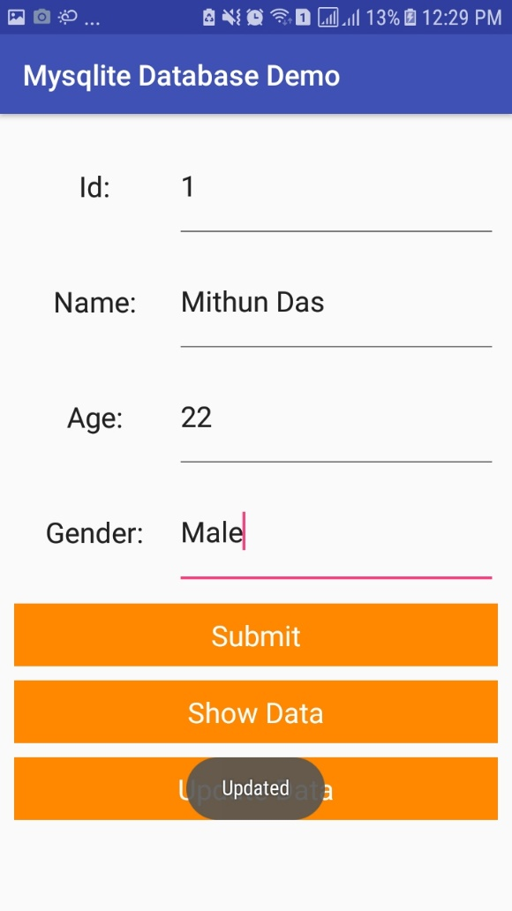
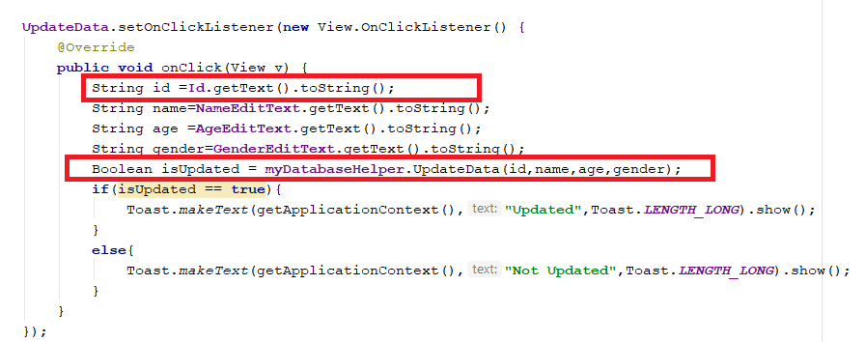
UPDATE SQLite Data
Then call this method inside the MainActivity class and run your app.

Slide 24
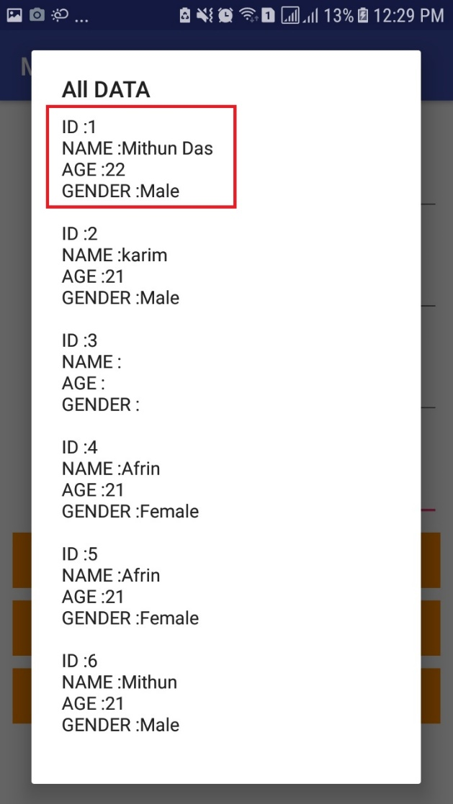
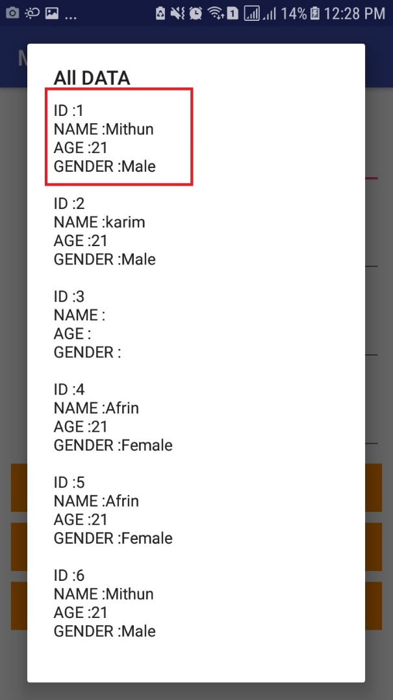
UPDATE SQLite Data
Before Updated
After Updated

Slide 25
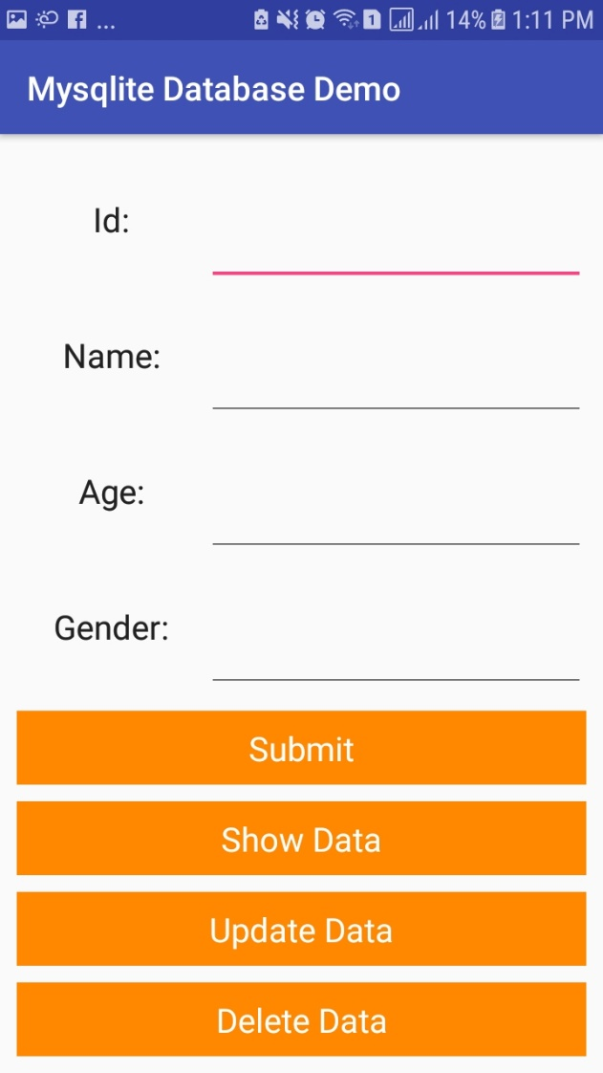
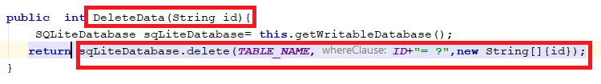
DELETE SQLite Data
First add delete button and inside the MyDatabaseHelper Class create DeleteData method for deleting data we use delete method which is already build in android.

Slide 26
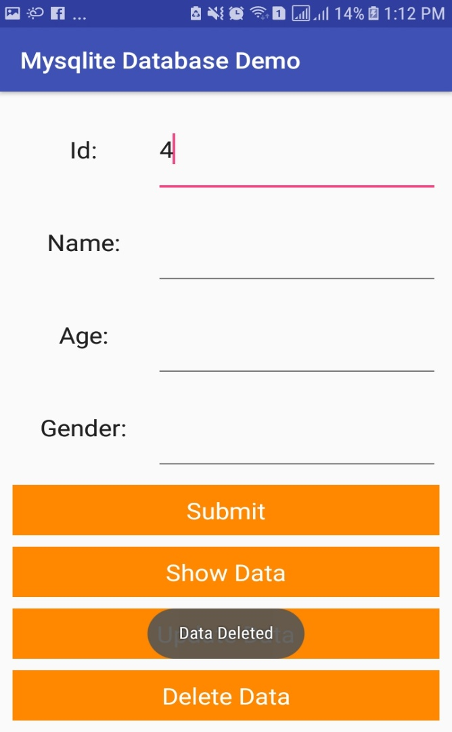
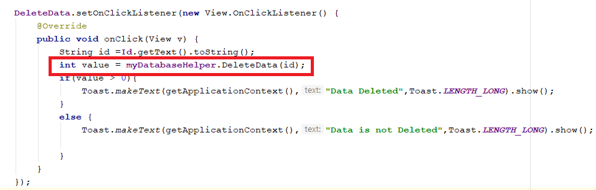
DELETE SQLite Data
Now its time to call delete method from the MainActivity class. If it is successfully deleted then it return a integer value which is greater then 0.

Slide 27
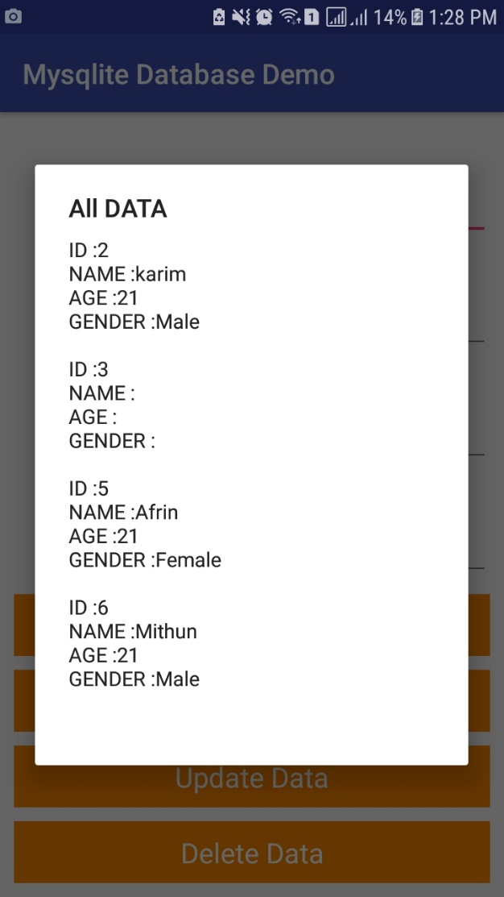
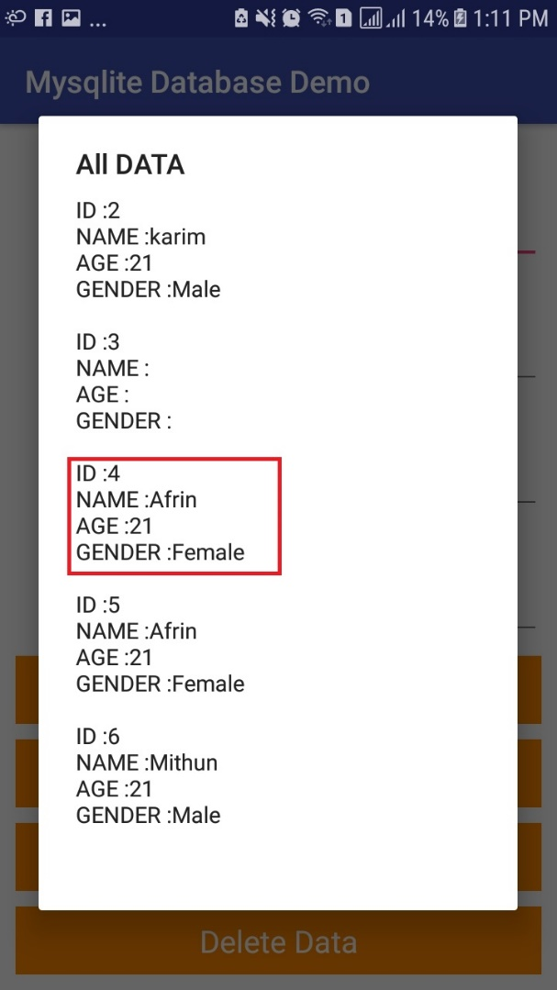
DELETE SQLite Data
Before deleted
After delete

Slide 28







Now lets see some example

Slide 29


Slide 30


