Slide 1
Cotton leaf disease detection using
Image Processing
Team Members Group No: 39
Project Advisor : Dr.S.Padmavathi / Assistant Professor / CSE
S.No | Reg.No | Name of the Student | Section
1 | CB.EN.U4CSE15013 | K .Chetan Sai | A
2 | CB.EN.U4CSE15022 | K .Anush Reddy | A
3 | CB.EN.U4CSE15034 | P.Mithun Chandhra | A
4 | CB.EN.U4CSE15035 | P.Satya Anirudh | A
Date:12/04/2019
Group No:39

Slide 2
Content
Introduction
Motivation
Problem Definition
Conclusion of Literature Survey
Challenges and Approaches
Results
Conclusion
References
Publications
Date: 12/04/2019
Group No:39

Slide 3
Introduction
Cotton is one of the most important fiber crops in our country that provide basic raw materials for textile industry.
Detection of plant diseases at earlier stage is necessary to reduce both the crop and economic loss.
About 80 % of diseases on the cotton plant is on its leaves.
Date: 12/04/2019
Group No:39

Slide 4
Contd…
The major diseases related to cotton leaves are Myrothecium Leaf Spot, Alterneria Leaf Spot, Leaf Crumple, Cercospora Leaf Spot and are common to all the major cultivated species.
The leaf images are captured using cameras and processed to extract features that will help in identification of diseases.
Various Machine learning algorithms have emerged to increase the accuracy of the system.
Date: 12/04/2019
Group No:39

Slide 5
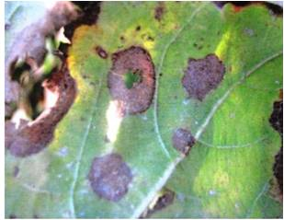
Cotton leaf diseases
Disease Name | Symptoms | Images
Myrothecium Leaf Spot | Reddish spots of 0.5 mm-1cm diameter may appear near the margins of the leaves. The affected portions fall off leaving irregular shot holes in the leaves.
Date: 12/04/2019
Group No:39

Slide 6
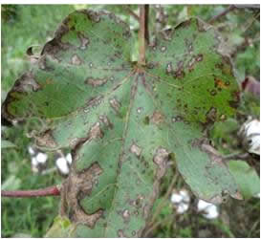
Cotton leaf diseases
Disease Name | Symptoms | Images
Alterneria Leaf Spot | Small, plate to brown, irregular or round spots, may appear on the leaves. Each spot has a central lesion surrounded by concentric rings. Several spots coalesce together to form blighted areas.
Date:12/04/2019
Group No:39

Slide 7
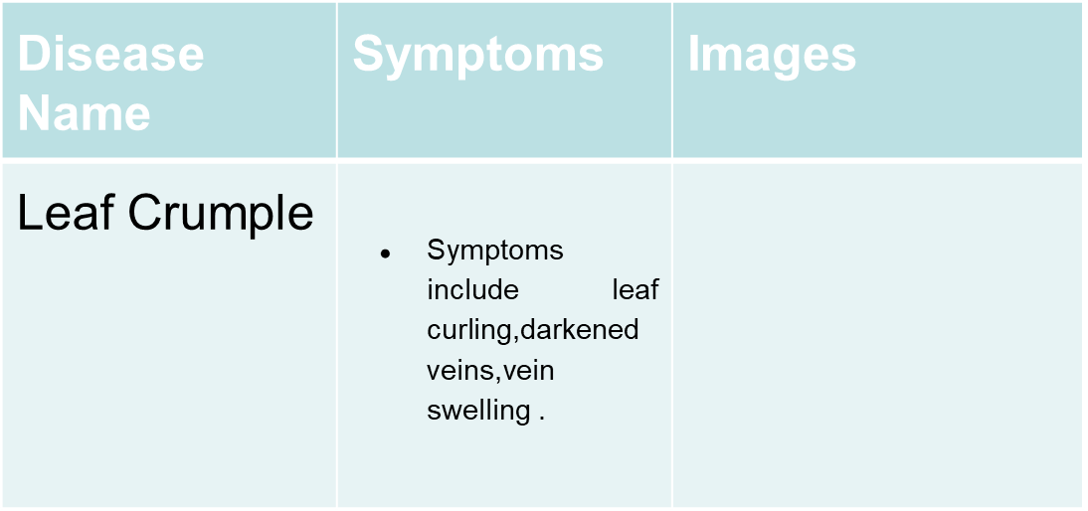
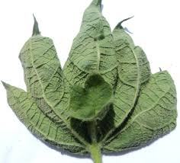
Cotton leaf diseases
Date: 12/04/2019
Group No:39

Slide 8
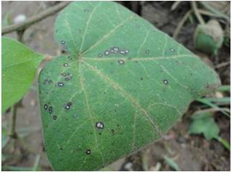
Cotton leaf diseases
Disease Name | Symptoms | Images
Cercospora Leaf Spot | Round or irregular greyish spots Dark brown or blackish borders appear on older leaves
Date: 12/04/2019
Group No:39

Slide 9
Motivation
Agriculture plays a vital role in India, where more than 50% of population depends on it and accounts for 18 % of India's gross domestic product.
Cotton is one of the major crop in our country , and nearly
80 % of diseases on the cotton plant are on its leaves.
Early detection of these diseases allow better disease control without using pesticides.
Date: 12/04/2019
Group No:39

Slide 10
Problem Definition
The intention of this project is to provide an efficient detection method that would take an image of cotton leaf as input and then provides the output with classified disease.
This system will be implemented for the four cotton diseases mentioned above.
Date: 12/04/2019
Group No:39

Slide 11
Conclusion of Literature Survey
No. | Techniques Used | Advantages | Disadvantages
[1] | K-Means Clustering(for Image Segmentation) Deep Learning Algorithm(for Image Classification) | Improved accuracy with the help of K mean clustering Algorithm | They have not specified about what diseases they are mainly concentrating in cotton plant.
[2] | Histogram equilization K- Means clustering(for Segmentation) Otsu's methodology ANN Back propagation algorithm(for classification) | The loss to the product is been avoided by detecting the disease at initial stage. | It takes more time to get the results.
[3] | K-mean clustering (for Segmentation) SVM Classifier(for Classification) | we can classify the disease easily and the computation is fast. | The proposed system is limited to just 3 diseases only.It can classify only 3 diseases.
[4] | Otsu's method K-mean clustering (for Segmentation) | It utilizes GSM to send message to our mobiles | It is limited to main diseases only .
Date: 12/04/2019
Group No: 39

Slide 12
No. | Techniques Used | Advantages | Disadvantages
[5] | Contrast enhancement, Converting RGB to HSI, SVM Classifier(for Classification) | The user can know the affected area of leaf in percentage by identifying the disease properly. | The proposed system is not applicable to all cotton diseases.
[6] | Scaling process(for Resizing the Image) Canny detection(for Edge detection) SVM-GA classifier(for classification using SVM) | They are comparing the accuracy for all the exisiting classifiers and their proposed classifier for several cotton diseases. | As they are using Genetic Algorithms for classification the proposed system may take time to calculate Accuracy.
[7] | Hue saturation value(HSV) back propagation neural network(BPNN) | This paper will give information about the possible diseases and the treatment to provide. | It is a slow process.
[8] | OTSU Thresholding method(for segmentation) Color Co-Occurence method (for Feature Extraction) Multi SVM(for Classification) | The proposed method has high recognition accuracy | This method works on only few leaf diseases.
Date: 12/04/2019
Group No: 39

Slide 13
No. | Techniques Used | Advantages | Disadvantages
[9] | Histogram equalization K-mean clustering (for Segmentation) Neural network for final classification | Classification of diseases can be done easily and the accuracy is also high. | The proposed system is not applicable to all cotton diseases.
[10] | Spatial FCM clustering (for Segmentation) Spatial PNN classifier(for Classification) | It yields regions more homogeneous than those of other methods.It reduces the spurious blobs. | Time Complexity is very high in FCM technique when compared to K-means Clustering.
[11] | K-mean clustering with Discrete Wavelet Transform (for Segmentation) Neural Network technique PCA (for Classification) | This classifier gives an accuracy of 97%. | It is still a theory and it is need to be implemented in real-time.
[12] | feature extraction techniques SVM for segmentation | They are comparing the accuracy for all the existing classifiers and their proposed classifier for several cotton diseases. | They are classifying only leaf spot diseases.
Date: 12/04/2019
Group No:39

Slide 14
Challenges
Detection of different shaped leaves.
Extraction of color features for different varieties of cotton.
Detecting the disease even when the leaves are crumpled and differentiating from crumpled disease.
Proper lighting conditions for getting proper image.
Date: 12/04/2019
Group No:39

Slide 15
Approaches
Leaf disease detection is done by using image processing techniques like
Preprocessing
Segmentation
Feature extraction
Classification of disease
Date: 12/04/2019
Group No:39

Slide 16
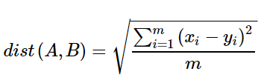
Classification Methods
KNN Classifier:
In KNN classifier, Euclidean distance is used to find the distance between the points in the data.
Let A and B are represented by feature vectors A = (x1, x2, . …xm) and B = (y1, y2, …, ym), where m is the dimensionality of the feature space. To calculate the distance between A and B, the normalized Euclidean metric is generally used by
Date: 12/04/2019
Group No: 39

Slide 17

Bayes Classifier:
In Bayes classifier positerior probabilities are calculated and classified accordingly. Posterior probability can be calculated by
P(Ci|X) is the posterior probability of class Ci conditioned on X.
P(X|Ci) is the posterior probability of X conditioned on class Ci.
P(X) is the prior probability of X.
Date: 12/04/2019
Group No: 39

Slide 18

Decision Tree Classifier:
The decision tree algorithm tries to solve the problem, by using tree representation. Each internal node of the tree corresponds to an attribute, and each leaf node corresponds to a class label. Information gain is calculated by
D is the data. pi is the nonzero probability that an arbitrary tuple in D belongs to class Ci.
Date: 12/04/2019
Group No: 39

Slide 19
Results
The dataset of this project contains 18 images for each disease (4 diseases).
Cotton leaf image is taken as input and it is checked whether the given image contains spots by considering the threshold range of h-part as [0.08, 0.12] and I-part as [0.16, 0.33] of HSI image.
Date: 12/04/2019
Group No: 39

Slide 20
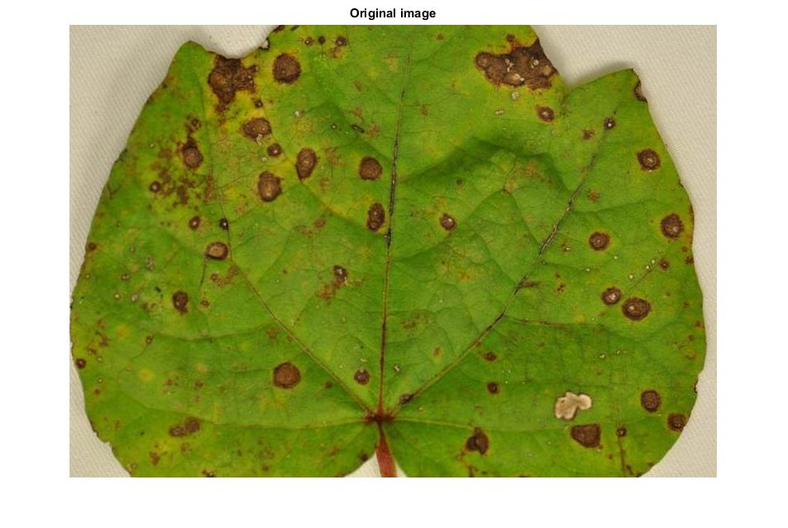
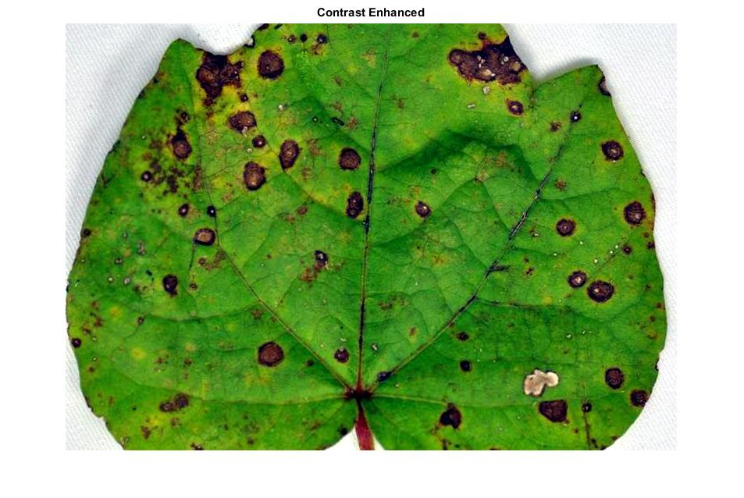
Results of cercospora leaf spot disease.
Original image Constrast enhanced image
Date: 12/04/2019
Group No: 39

Slide 21

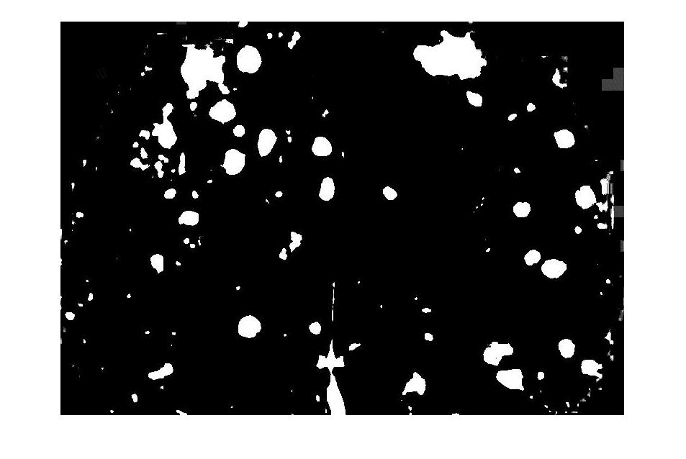
LAB converted image ‘A’ part of LAB image
Date:12/04/2019
Group No: 39

Slide 22

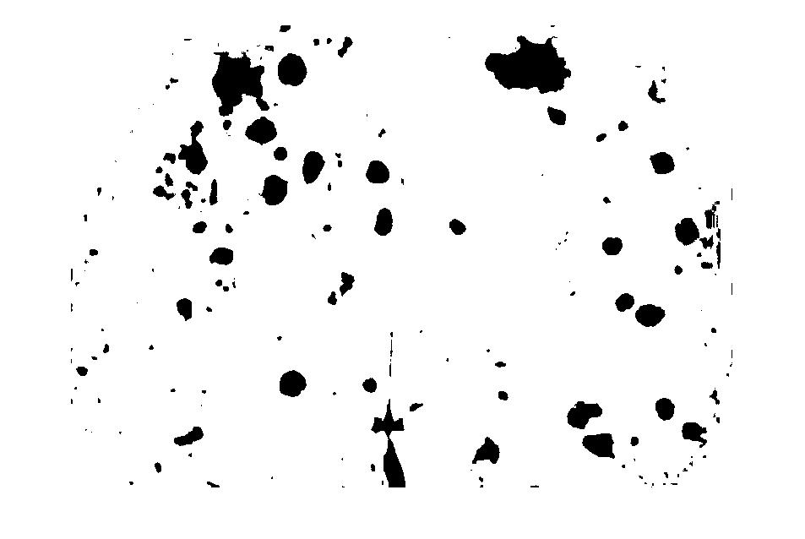
BW image of extracted image. Complement of bwimage
Date: 12/04/2019
Group No: 39

Slide 23
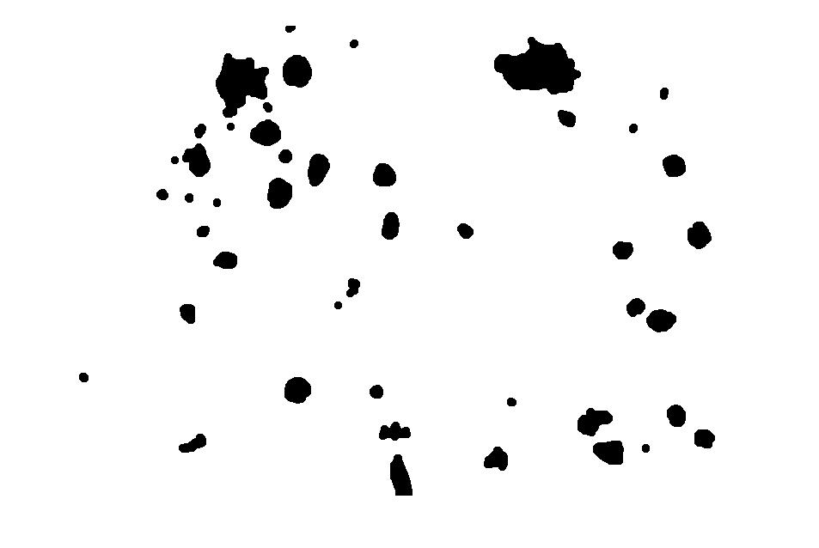

After applying close function Complemented image
Date: 12/04/2019
Group No: 39

Slide 24
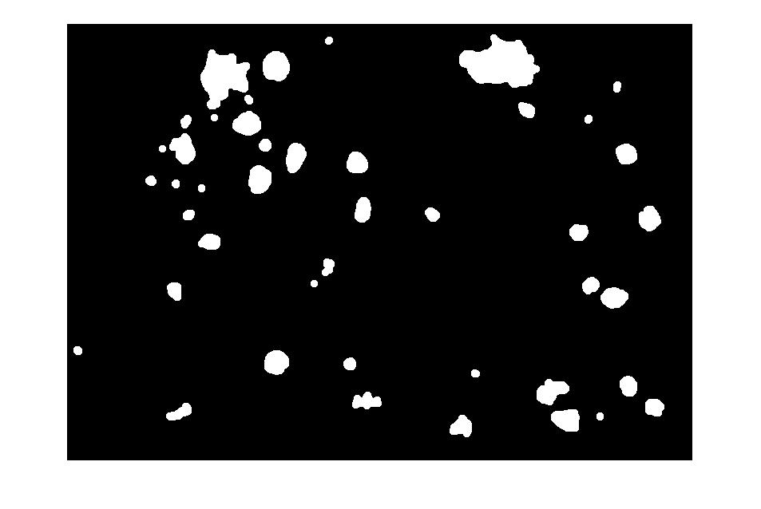
Image after clearing border .
Date: 12/04/2019
Group No: 39

Slide 25
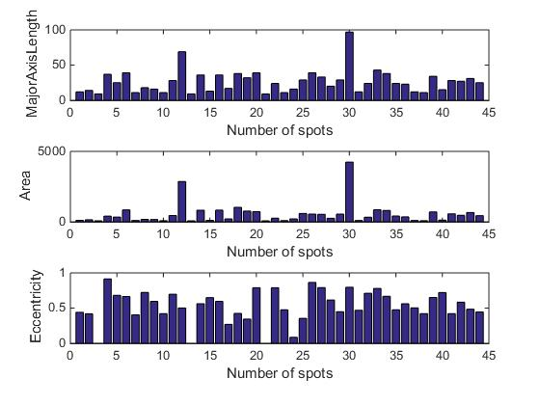
Plot between number of spots and features.
Date: 12/04/2019
Group No: 39

Slide 26
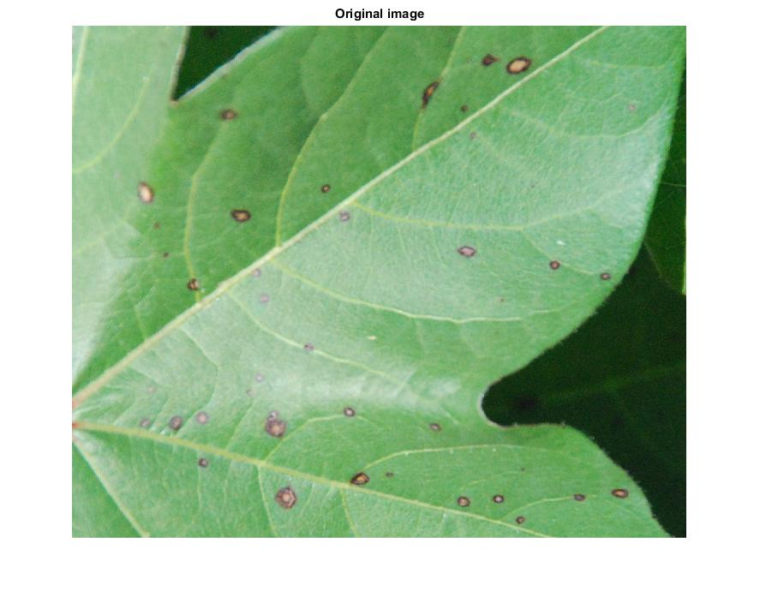

Results of alternaria leaf spot disease.
original image LAB converted image
Date: 12/04/2019
Group No: 39

Slide 27
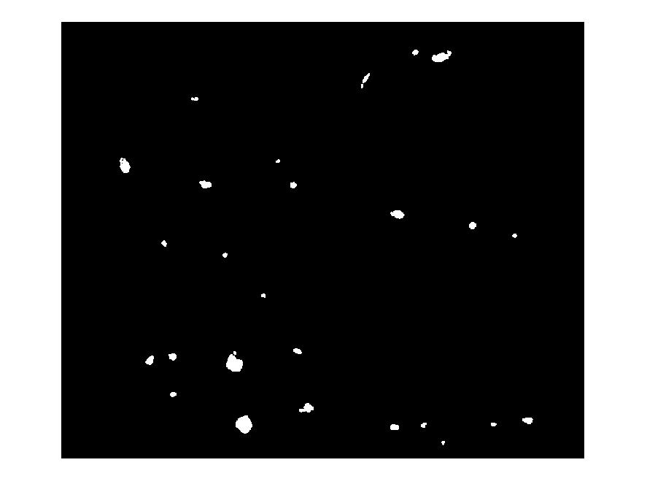
Image after clearing border.
Date: 12/04/2019
Group No: 39

Slide 28
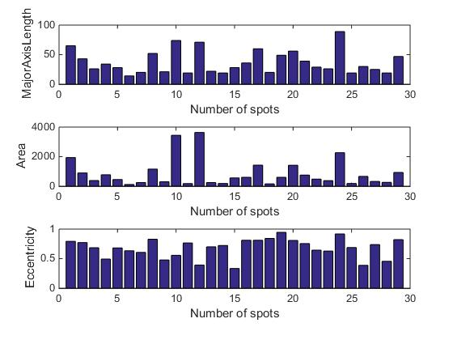
Plot between number of spots and features.
Date: 12/04/2019
Group No: 39

Slide 29
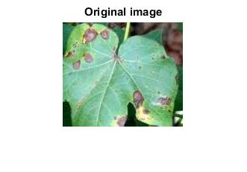
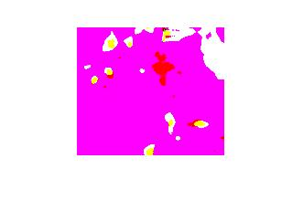
Results of myrothecium leaf spot disease.
original image LAB converted image
Date: 12/04/2019
Group No: 39

Slide 30
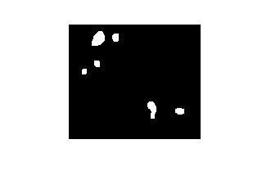
Image after clearing border.
Date: 12/04/2019
Group No: 39

Slide 31
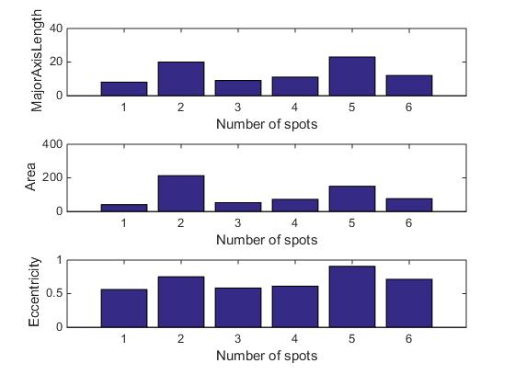
Plot between number of spots and features.
Date: 12/04/2019
Group No: 39

Slide 32
The features are extracted from the image which is obtained by multiplying HSI image and connected components image and stored as features dataset.
In features dataset 70% of the data is taken as training set and 30% of the data is taken as testing set.
Class labels a, c, m are Alternaria leaf spot, cercospora leaf spot and Myrothecium leaf spot respectively.
KNN,Naive Bayes and decision tree classifiers are applied to this dataset.
Date: 12/04/2019
Group No: 39

Slide 33
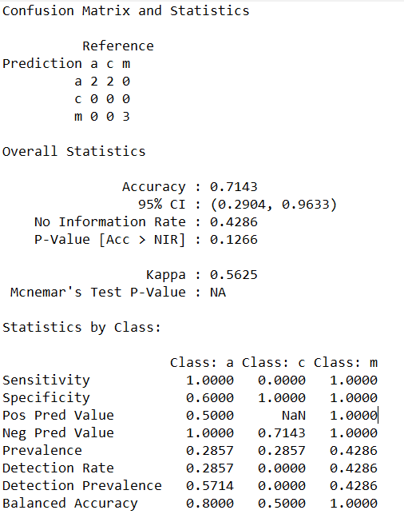
Confusion matrix obtained by applying KNN classifier to features dataset.
Date: 12/04/2019
Group No:39

Slide 34
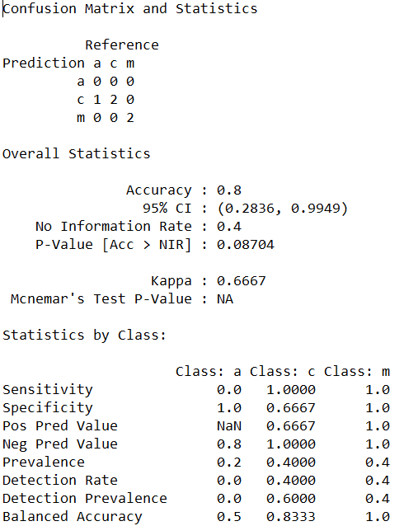
Confusion matrix obtained by applying Naive Bayes classifier to features dataset.
Date: 12/04/2019
Group No: 39

Slide 35
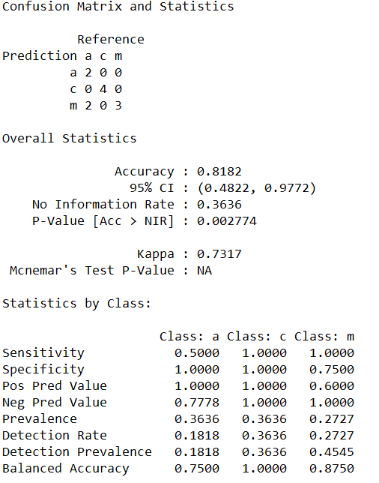
Confusion matrix obtained by applying Decision Tree classifier to features dataset.
Date: 12/04/2019
Group No:39

Slide 36
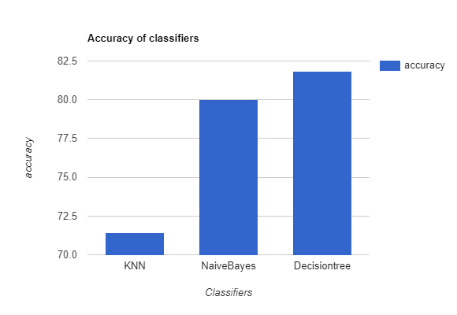
Plot between classifiers and accuracy for HSI image features dataset.
Date:12/04/2019
Group No: 39

Slide 37
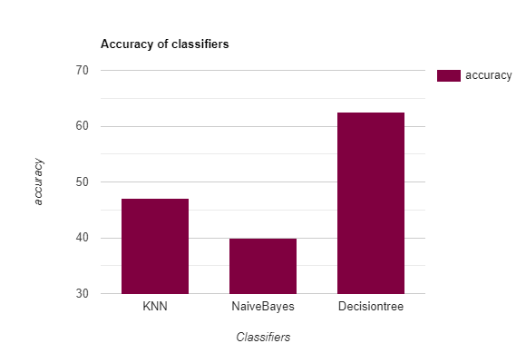
Plot between classifiers and accuracy for LAB image features dataset.
Date:12/04/2019
Group No: 39

Slide 38
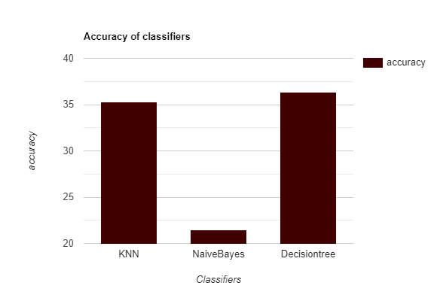
Plot between classifiers and accuracy for image pixels dataset.
Date: 12/04/2019
Group No: 39

Slide 39
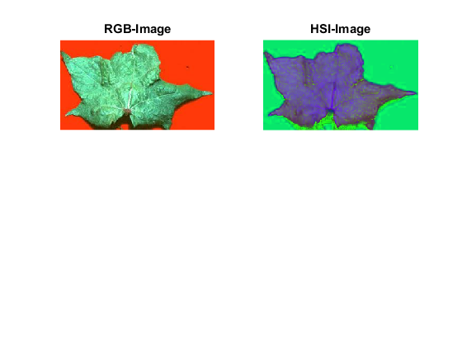
Results of Leaf crumple disease.
Date: 12/04/2019
Group No: 39

Slide 40
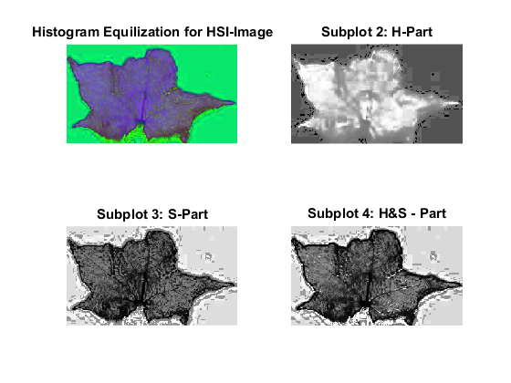
Histogram Equalisation on crumple leaf.
Date: 12/04/2019
Group No: 39

Slide 41
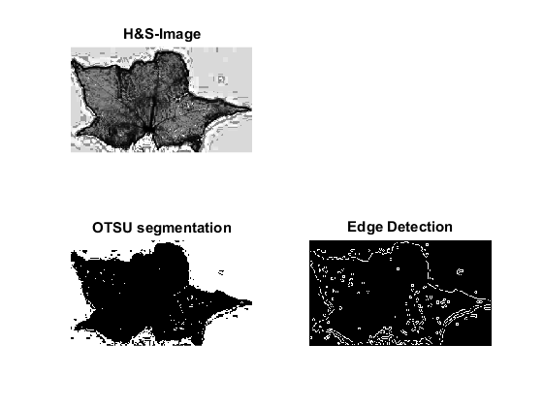
Segmentation and edge detection on crumple leaf.
Date: 12/04/2019
Group No: 39

Slide 42
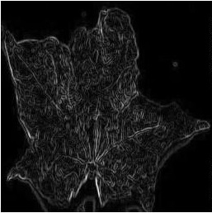
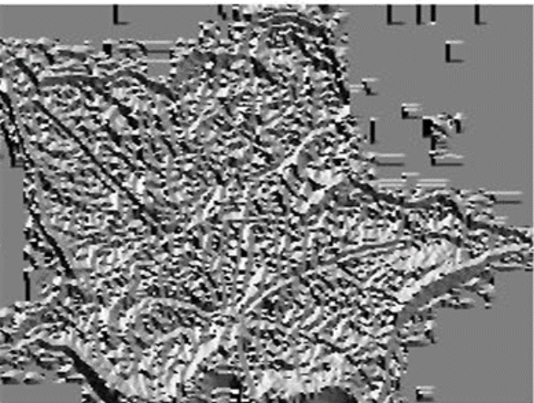
Gradient of crumple leaf is calculated.
Gradient of image Direction of image
Date: 12/04/2019
Group No: 39

Slide 43
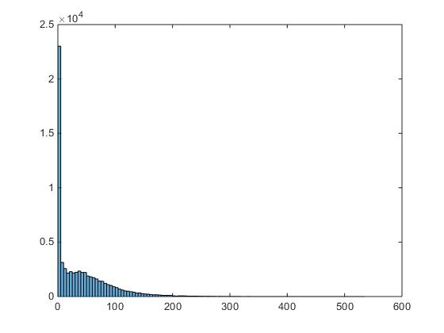
Histogram of Magnitude of crumple leaf
Date:12/04/2019
Group No:39

Slide 44
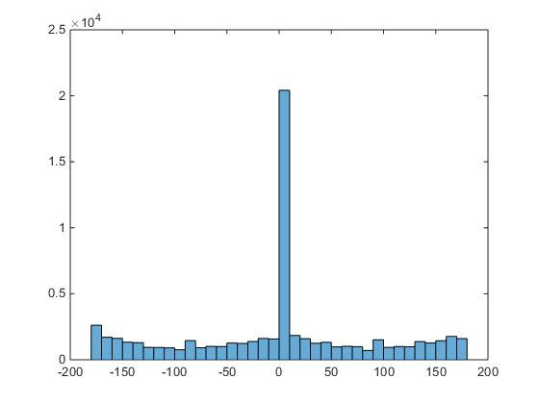
Histogram of Direction of crumple leaf
Date:12/04/2019
Group No: 39

Slide 45
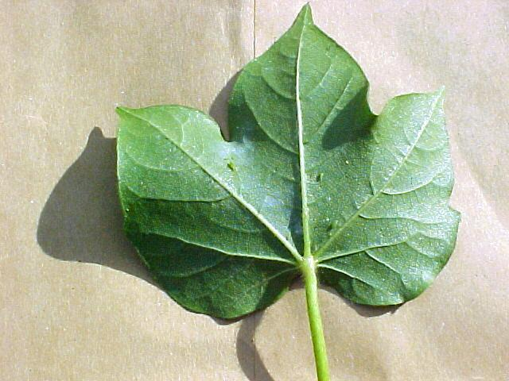
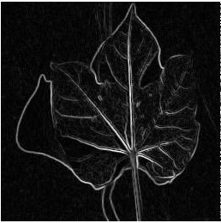
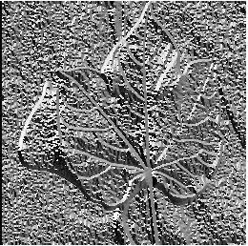
Similarly, the same process is done for normal leaf.
Normal leaf image Gradient of image Magnitude of image
Date:12/04/2019
Group No: 39

Slide 46
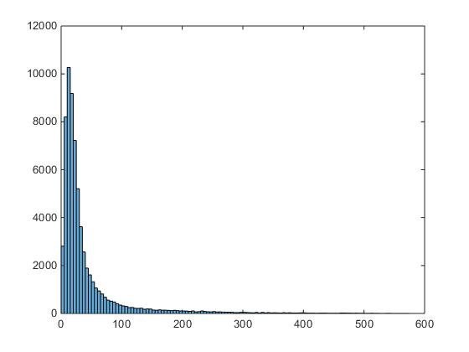
Histogram of Magnitude of Normal leaf
Date:12/04/2019
Group No: 39

Slide 47
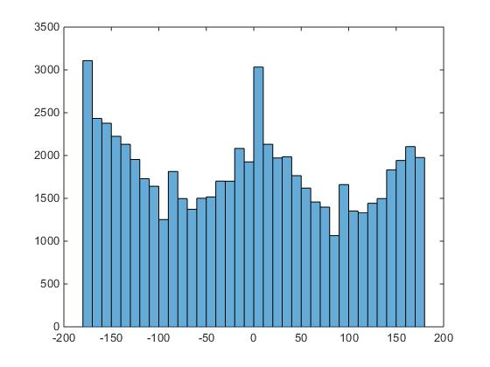
Histogram of Direction of Normal leaf
Date: 12/04/2019
Group No: 39

Slide 48
Standard deviations of magnitude and direction of crumpled and normal leaf are calculated.
 | Standard Deviation
Magnitude of Crumple leaf | 48.2
Magnitude of Normal leaf | 60.2
Direction of Crumple leaf | 91.6
Direction of Normal leaf | 107.4
Date: 12/04/2019
Group No: 39

Slide 49
Conclusion
For leaf spot diseases, it is observed that accuracy of Decision tree, Naive Bayes and KNN are 81.82%, 80% and 71.43% respectively. Naive Bayes and Decision Tree gives high accuracy.
For the crumple disease identification, the gradient of the input image is calculated. Standard deviation of gradient magnitude and gradient direction are considered as features and the leaf is classified accordingly.
Date: 12/04/2019
Group No:39

Slide 50
Future Plan
The dataset can be increased by performing image augmentation
The intensity of the disease can be calculated by using extracted features
In this project, only four major diseases are considered and in future it can be implemented for more diseases.
Date: 12/04/2019
Group No:39

Slide 51
References
[1] Shweta R. Astonkar1, Dr. V. K. Shandilya2 ,”Detection and Analysis of Plant Diseases Using Image Processing Technique ”, International Research Journal of Engineering and Technology, Volume: 05 Issue: 04 Apr-2018.
[2] Ms.Nidhi Rajesh Savaji, Vrushabh khandelwal, Kalyani Bhawar, Punam Wankhede, Ravi Kiran Rajbhure,”Plant Disease Detection Using Image Processing”,IJCESR, Volume-5, Issue-3, 2018.
[3] Rakesh Chaware, Rohit Karpe, PrithviPakhal,Prof.SmitaDesai4,”Detection and Recognition of Leaf Disease Using Image Processing ”,IJESC, Volume 7 Issue No.5 ,May-2017.
[4] Pallavi.S.Marathe,” Plant Disease Detection using Digital Image Processing and GSM ”,IJESC, Volume 7 Issue No.4 April 2017.
Date: 12/04/2019
Group No: 39

Slide 52
[5] Sujatha R, Y Sravan Kumar Garine Uma Akhil .” Leaf disease detection using image processing ”, Journal of Chemical and Pharmaceutical Sciences, Volume 10 Issue 1 January - March 2017.
[6] A.Sivasangari,K.priya,K. Indira,” Cotton Leaf Disease Detection and Recovery Using Genetic Algorithm”, International Journal of Pure and Applied Mathematics, Volume 117 No.22, 2017.
[7] Mr.Chandrakant Deelip Kokane ,Prof.N.L.Bhale,“To Detect and Identify Cotton leaf disease based on pattern recognition technique”,IJARIIE,Volume-3 Issue-4 ,2017.
[8] Supriya S. Patki, Dr. G. S. Sable,”Cotton Leaf Disease Detection & Classification using Multi SVM ”, International Journal of Advanced Research in Computer and Communication Engineering, Vol. 5, Issue 10, October 2016.
Date: 12/04/2019
Group No: 39

Slide 53
[9] Vijay S.Bhong , Prof.B.V.Pawar,”Study and Analysis of Cotton Leaf Disease Detection Using Image Processing”,IJARSET,Vol. 3, Issue 2 , February 2016.
[10]Premalatha.V, Valarmathy.S, Sumithra.M.G,“Disease Identification in Cotton Plants UsingSpatial FCM & PNN Classifier”, International Journal of Innovative Research in Computer and Communication Engineering, Vol. 3, Issue 4, April 2015.
[11] Vivek Chaudhari, C. Y. Patil,” Disease Detection of Cotton Leaves Using Advanced Image Processing ”, International Journal of Advanced Computer Research,Volume-4 Number-2 Issue-15 June-2014.
[12]Prof. Sonal P. Patil, Ms. Rupali S.Zambre,”Classification of Cotton Leaf Spot Disease Using Support Vector Machine”,IJERA,Vol. 4, Issue 5( Version 1), May 2014.
Date: 12/04/2019
Group No:39

Slide 54
Publications
Anushreddy Kommareddy,Chetansai Kurra,Mithunchandra Pokuri,Satyaanirudh Polisetty,Padmavathi S, “Image based Identification of Leaf crumple and Leaf spot diseases in Cotton plant“ International Journal of Recent Technology and Engineering (IJRTE). / Accepted /Submitted
Date: 12/04/2019
Group No:39

