Slide 1

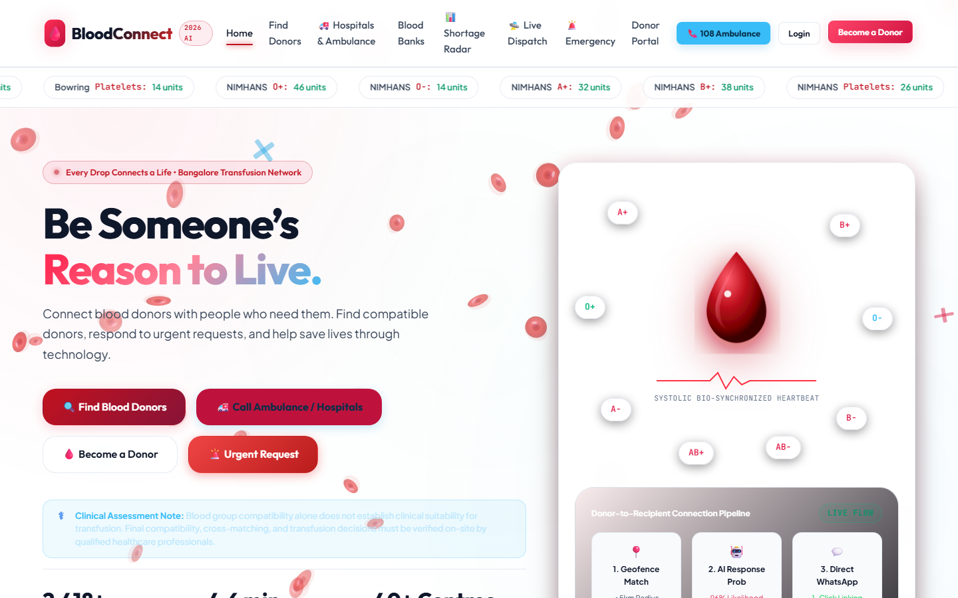
SOCIETAL PROJECT (1BSOP308) · REVIEW I
BloodConnect
Emergency Blood Donor Matching for Bengaluru
Department of Artificial Intelligence and Machine Learning
TEAM
Ranjitha
Mithun
Nikhil
Rakshitha
Compatible · Nearby · Available
Academic Year 2026 – 27

Slide 2

BMS Institute of Technology and Management
Department of Artificial Intelligence and Machine Learning | Societal Project (1BSOP308)
Roadmap
01
02
03
04
About & Review 0
Problem & need
Literature & gap
Objectives
05
06
07
08
System design
Matching logic
Team & progress
Impact & plan
BloodConnect · Review I · BMSIT&M
02

Slide 3
BMS Institute of Technology and Management
Department of Artificial Intelligence and Machine Learning | Societal Project (1BSOP308)
What Is BloodConnect?
A web app that finds compatible, available blood donors near a Bengaluru hospital — in one search.
1
Register
2
Request
3
Match
Donors add blood group, location, and availability.
Families raise an emergency request for a hospital.
The app ranks compatible donors, nearest first.
It speeds up the search. The hospital and blood bank still test and approve every unit.
BloodConnect · Review I · BMSIT&M
03

Slide 4
BMS Institute of Technology and Management
Department of Artificial Intelligence and Machine Learning | Societal Project (1BSOP308)
Since Review 0
1
Scope
2
Ownership
3
Evidence
BEFORE
BEFORE
BEFORE
General blood app
No clear owners
No user baseline
NOW
NOW
NOW
Bengaluru emergency match
Four members, four modules
Survey form only. No replies yet.
Done
Done
In progress
The 90-day rest is not a matcher rule.
Survey question 11 and the donor page mention a 90-day gap between whole-blood donations. mysql-schema.sql has no last-donation date, and MatchingService does not check one. A donor is included only when available is true.
BloodConnect · Review I · BMSIT&M
04

Slide 5
BMS Institute of Technology and Management
Department of Artificial Intelligence and Machine Learning | Societal Project (1BSOP308)
The Problem
Nearest
35 min
16%
In a shortage, find the closest available supply and raise a request [1].
Median motor trip to the nearest blood bank in India [4].
of people can walk to a blood bank within 30 minutes [4].
A centre can still be a drive away. An open request still needs a compatible donor nearby.
Local problem: families still search by phone and WhatsApp while a hospital request is open.
Patients & families
Voluntary donors
Hospital desks
Blood banks
Travel times are from Urs et al. [4], using 2024 e-RaktKosh locations. They measure centres, not a donor match.
BloodConnect · Review I · BMSIT&M
05

Slide 6
BMS Institute of Technology and Management
Department of Artificial Intelligence and Machine Learning | Societal Project (1BSOP308)
Literature Survey
STUDY
WHAT IT ACTUALLY SAYS
LIMIT OF OUR CLAIM
[1]
Ghouri et al., 2023
Nearest supply, plus an SMS request
Interview model, not our app
[2]
Shokouhifar et al., 2022
Forecasts donation and demand
A forecast, not a donor list
[3]
James et al., 2014
Area patterns guide recruitment
Recruitment, not matching
[4]
Urs et al., 2026
35 min drive; 16% within a walk
Centres, not one request
[5]
ICSSAS, 2025
A DNN predicts who may donate
Their model, not our code
We cite what each source states. We have not audited every blood-donor app in use.
BloodConnect · Review I · BMSIT&M
06

Slide 7
BMS Institute of Technology and Management
Department of Artificial Intelligence and Machine Learning | Societal Project (1BSOP308)
The Gap
✓
What these sources show
!
What we do not claim
→
What our code does
— Nearest supply in a shortage [1]
— Donation and demand forecasts [2]
— Uneven travel to Indian centres [4]
— Their forecast error as ours
— That we built their DNN [5]
— Walk time as our match rule
— Ranks available, compatible donors
— Hides the donor phone
— Status: open, fulfilled, cancelled
Built today: a ranked list for one request. Not built: a stored donor reply.
Accept and decline need the planned request_responses table. The 90-day gap is not applied.
BloodConnect · Review I · BMSIT&M
07

Slide 8
BMS Institute of Technology and Management
Department of Artificial Intelligence and Machine Learning | Societal Project (1BSOP308)
Objectives
01
Secure access
02
Donor profile
Hashed passwords, token login
Group, location, availability
03
Request lifecycle
04
Smart matching
Open, fulfilled, or cancelled
Compatibility + distance ranking
BloodConnect · Review I · BMSIT&M
08

Slide 9
BMS Institute of Technology and Management
Department of Artificial Intelligence and Machine Learning | Societal Project (1BSOP308)
System Architecture
Browser
Python
Java API
Data
HTML · CSS · JS
http.server only
Spring Boot
MySQL or H2
Ranjitha
Files, not rank
Mithun
Nikhil
INSIDE THE BACKEND
Auth
Donor API
Request API
MatchingService
JWT, BCrypt
Profile, available flag
Open / fulfilled / cancelled
Java ABO/Rh + Haversine
Python does not rank donors. Order is in MatchingService.java: available, then compatible, then nearest km, then score, then name.
If the API is down, api.js substitutes demo data. Those screens are not the Java result.
BloodConnect · Review I · BMSIT&M
09

Slide 10
BMS Institute of Technology and Management
Department of Artificial Intelligence and Machine Learning | Societal Project (1BSOP308)
How It Works
Sign in
Donor or requester
Request
Group & hospital
Match
ABO/Rh + distance
Rank
Nearest first
Update
Request status
Matching rule in Java
What is not in that sort
— Keep available donors only
— Keep ABO/Rh compatible donors
— Sort by km, then score, then name
— Python is only the file server
— Score never overtakes a nearer donor
— Phone is omitted; replies are not stored
BloodConnect · Review I · BMSIT&M
10

Slide 11
BMS Institute of Technology and Management
Department of Artificial Intelligence and Machine Learning | Societal Project (1BSOP308)
User Journeys
Requester
1
2
3
4
Register
Create request
See ranked donors
Mark fulfilled
Donor
1
2
3
4
Register
Add group & location
Set available
Phone stays hidden
BloodConnect · Review I · BMSIT&M
11

Slide 12
BMS Institute of Technology and Management
Department of Artificial Intelligence and Machine Learning | Societal Project (1BSOP308)
Blood Group Compatibility
PATIENT
PACKED RED CELLS THE PATIENT CAN RECEIVE
O−
O−
Checked in code
O+
O−, O+
A−
O−, A−
— Same 8 rows as isCompatible
— O− is on every row
— AB+ lists all 8 groups
— Rh− rows take only Rh−
— JUnit covers these pairs
A+
O−, O+, A−, A+
B−
O−, B−
B+
O−, O+, B−, B+
AB−
O−, A−, B−, AB−
AB+
O−, O+, A−, A+, B−, B+, AB−, AB+
Plasma compatibility is the reverse. It is not coded. This chart is red cells only.
BloodConnect · Review I · BMSIT&M
12

Slide 13
BMS Institute of Technology and Management
Department of Artificial Intelligence and Machine Learning | Societal Project (1BSOP308)
Ranking Example
Sample request: O+ blood · 2 units · Victoria Hospital, Bengaluru
RANK
DONOR
GROUP
DISTANCE
SCORE
RESULT
1
Meera
O+
1.9 km
98
Nearest, so first
2
Arjun
O−
2.4 km
78
Next nearest. Score loses
3
Kiran
O+
8.6 km
91
Higher score, still third
–
Priya
AB+
1.2 km
–
Skipped — not compatible
–
Ravi
O+
3.0 km
–
Skipped — not available
Order: nearest km, then higher score, then name. Score = 20 + 50 exact (30 if only compatible) + max(0, 30 − round(km)).
Worked example, not a database row. Kiran's 91 does not pass Arjun: 8.6 km is sorted before the score.
BloodConnect · Review I · BMSIT&M
13

Slide 14
BMS Institute of Technology and Management
Department of Artificial Intelligence and Machine Learning | Societal Project (1BSOP308)
Database Design
app_users
donor_profiles
blood_requests
id (key)
email
password_hash
role
phone
user_id → app_users
name, blood_group
location, lat / lng
available
requester_id → app_users
patient_name, units
blood_group, hospital
urgency, status
One user, one donor profile. One requester, many requests. A donor reply is not stored.
Planned, not in mysql-schema.sql: request_responses
request_id → blood_requests · donor_id → donor_profiles
response: accepted or declined · responded_at · today the request has only OPEN, FULFILLED, or CANCELLED
BloodConnect · Review I · BMSIT&M
14

Slide 15
BMS Institute of Technology and Management
Department of Artificial Intelligence and Machine Learning | Societal Project (1BSOP308)
Team & Roles
R
M
N
R
Ranjitha
Mithun
Nikhil
Rakshitha
Frontend & UI
Backend & Auth
Data & Matching
Research & Docs
Pages and forms
Dashboards
API connection
Login and roles
Donor & request APIs
Data security
MySQL schema
Haversine distance
Rules in Java
Survey & research
Report & diary
Presentation
HTML · CSS · JS
Spring Boot
MySQL · Java
Forms · Docs
BloodConnect · Review I · BMSIT&M
15

Slide 16
BMS Institute of Technology and Management
Department of Artificial Intelligence and Machine Learning | Societal Project (1BSOP308)
Methodology
1
2
3
4
5
6
Requirements
Design
Build
Integrate
Test
Document
Tests written in the repo
Not evidence yet
— MatchingServiceTest: 8 rows + order
— MatchingApiTest: nearer donor, no phone
— Auth, donor, request, and JWT tests
— No passing mvn test log attached
— Project target is Java 25
— No survey replies; demo fallback exists
BloodConnect · Review I · BMSIT&M
16

Slide 17
BMS Institute of Technology and Management
Department of Artificial Intelligence and Machine Learning | Societal Project (1BSOP308)
Home Screen
What a visitor sees
— Find donors, urgent request, and login
— Become a donor is on the same page
— Bengaluru is named in the banner
— Group alone does not approve a transfusion
Stock chips and the drop graphic are sample art, not a live blood-bank feed.
BloodConnect · Review I · BMSIT&M
18

Slide 18
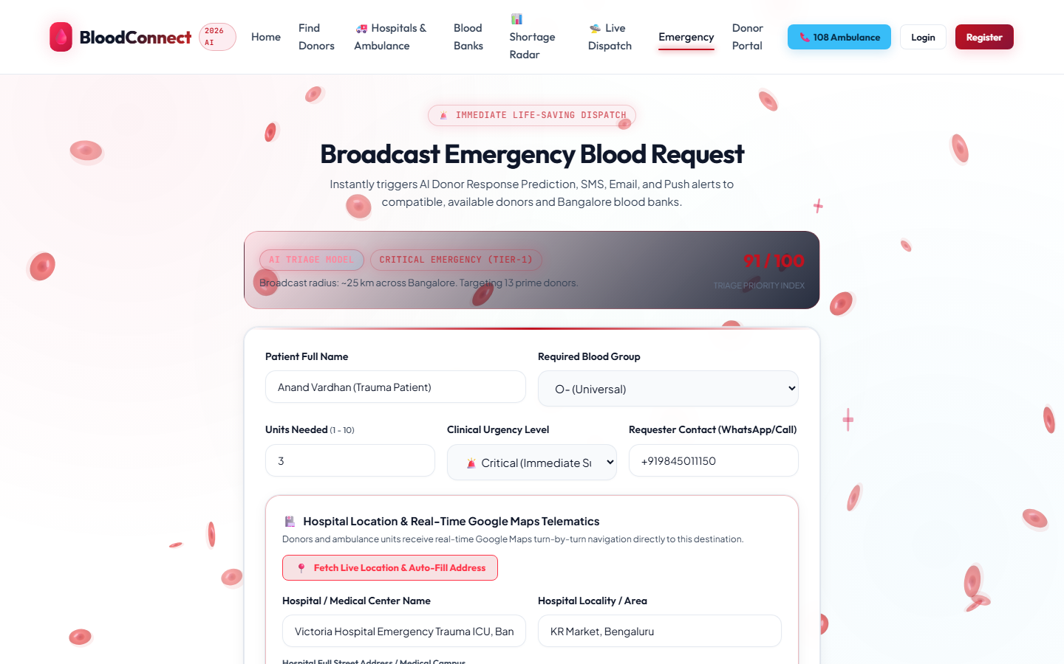
BMS Institute of Technology and Management
Department of Artificial Intelligence and Machine Learning | Societal Project (1BSOP308)
Emergency Request
What the requester fills
— Patient, blood group, units, and urgency
— Contact, hospital, and Bengaluru area
— A button can read the browser location
— Sample: Anand Vardhan, O−, Victoria Hospital
The AI alert line is page text. Ranking is done by the Java matcher.
BloodConnect · Review I · BMSIT&M
19

Slide 19
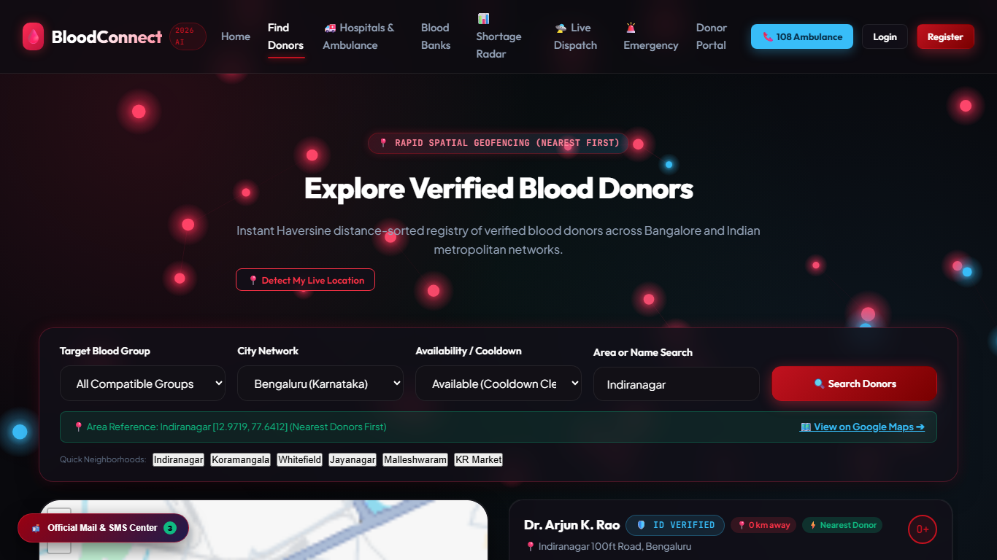
BMS Institute of Technology and Management
Department of Artificial Intelligence and Machine Learning | Societal Project (1BSOP308)
Donor Search
How a search is started
— Filter by group, city, and availability
— The city on this screen is Bengaluru
— Indiranagar, Koramangala, Whitefield
— Sample: Dr Arjun K. Rao, O+, Indiranagar
Verified and cooldown labels are sample text. The matcher uses available and distance.
BloodConnect · Review I · BMSIT&M
20

Slide 20
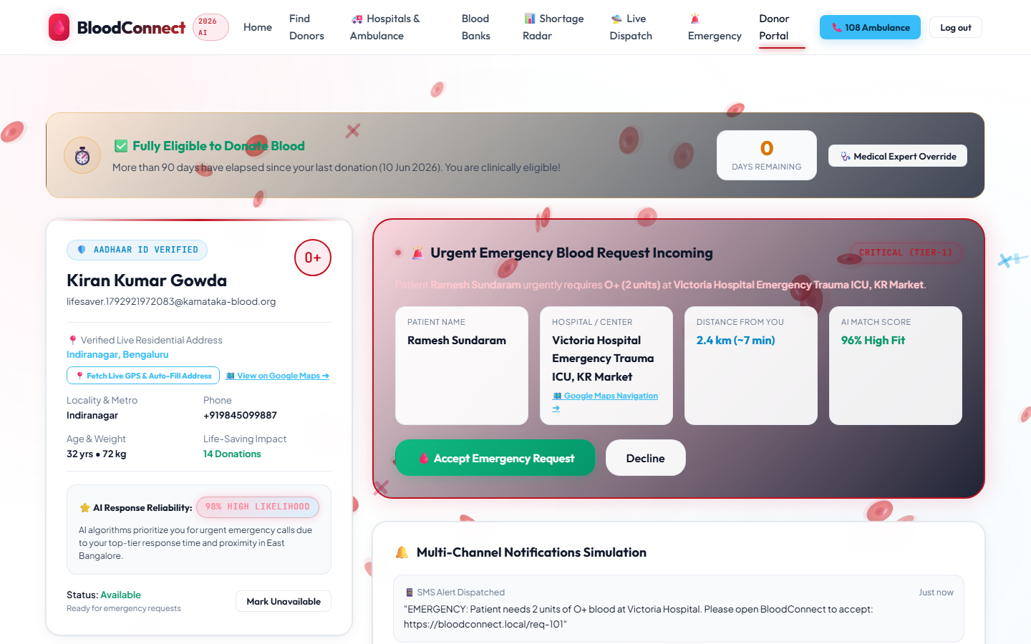
BMS Institute of Technology and Management
Department of Artificial Intelligence and Machine Learning | Societal Project (1BSOP308)
Donor Portal
What a donor is shown
— Sample: Kiran Kumar Gowda, O+, Indiranagar
— Incoming request for Victoria Hospital
— Accept and Decline are drawn here
— The banner mentions a 90-day gap
A reply is not saved. The schema has no last-donation date. Sample data only.
BloodConnect · Review I · BMSIT&M
21

Slide 21
BMS Institute of Technology and Management
Department of Artificial Intelligence and Machine Learning | Societal Project (1BSOP308)
Impact & SDG
Who benefits
We will measure
SDG 3
Good Health and Well-being
— Patients & families
— Willing donors
— Hospital desks
— Time to a ranked list
— Compatible and available only
— Survey before vs. after
Ghouri et al. [1] link emergency blood supply to SDG 3: healthy lives and well-being.
Urs et al. [4]: travel to a blood bank is uneven across India.
We do not report a measured change in a health target.
Ethics: passwords hashed · donor phone private · doctors approve every transfusion
BloodConnect · Review I · BMSIT&M
22

Slide 22
BMS Institute of Technology and Management
Department of Artificial Intelligence and Machine Learning | Societal Project (1BSOP308)
Plan to Review II
Nov
Demo on the Java API, not the fallback
Ranjitha, Mithun
RISK
Few survey replies
PLAN
Share in class; demo on sample data
Nov
Add reply table and last-donation date
Nikhil
Dec
Survey replies, diary, report
Rakshitha
Dec
Run mvn test and full demo
All four
BloodConnect · Review I · BMSIT&M
23

Slide 23
BMS Institute of Technology and Management
Department of Artificial Intelligence and Machine Learning | Societal Project (1BSOP308)
References
1
Ghouri et al., Journal of Business Research, 2023
Open source
doi.org/10.1016/j.jbusres.2023.113980
2
Shokouhifar and Ranjbarimesan, Cleaner Logistics and Supply Chain, 2022
Open source
doi.org/10.1016/j.clscn.2022.100078
3
James et al., Transfusion, vol. 54, no. 12, pp. 3051–3060, 2014
Open source
doi.org/10.1111/trf.12740
4
Urs, Miyajiwala, Raj, and Zadey, Transfusion Medicine, 2026
Open source
doi.org/10.1111/tme.70075
5
ICSSAS 2025 — DNN-autoencoder and MERN donor prediction
Open source
doi.org/10.1109/ICSSA66150.2025.11080959
BloodConnect · Review I · BMSIT&M
24

Slide 24
Thank You

