Slide 1

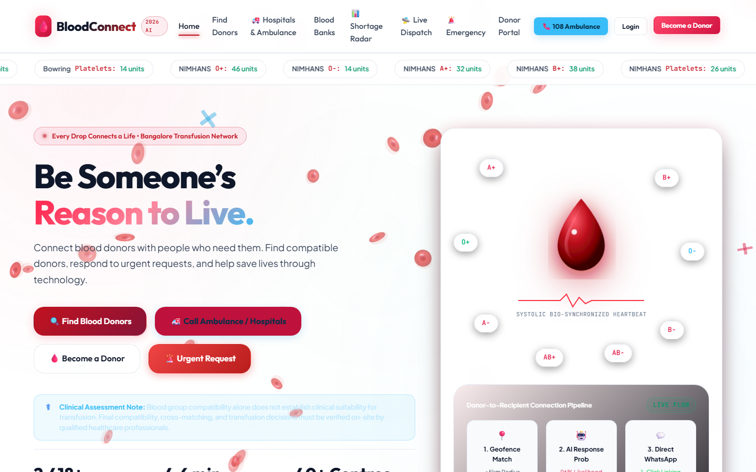
SOCIETAL PROJECT (1BSOP308) · REVIEW I
BloodConnect
Emergency Blood Donor Matching for Bengaluru
Department of Artificial Intelligence and Machine Learning
TEAM
Ranjitha
Mithun
Nikhil
Rakshitha
Compatible · Nearby · Available
Academic Year 2026 – 27

Slide 2

BMS Institute of Technology and Management
Department of Artificial Intelligence and Machine Learning | Societal Project (1BSOP308)
Roadmap
01
02
03
04
About & Review 0
Problem & need
Literature & gap
Objectives
05
06
07
08
System design
Matching logic
Team & progress
Impact & plan
BloodConnect · Review I · BMSIT&M
02

Slide 3
BMS Institute of Technology and Management
Department of Artificial Intelligence and Machine Learning | Societal Project (1BSOP308)
What Is BloodConnect?
A web app that finds compatible, available blood donors near a Bengaluru hospital — in one search.
1
Register
2
Request
3
Match
Donors add blood group, location, and availability.
Families raise an emergency request for a hospital.
The app ranks compatible donors, nearest first.
It speeds up the search. The hospital and blood bank still test and approve every unit.
BloodConnect · Review I · BMSIT&M
03

Slide 4
BMS Institute of Technology and Management
Department of Artificial Intelligence and Machine Learning | Societal Project (1BSOP308)
Since Review 0
1
Scope
2
Ownership
3
Evidence
BEFORE
BEFORE
BEFORE
General blood app
No clear owners
No user baseline
NOW
NOW
NOW
Bengaluru emergency match
Four members, four modules
Survey form only. No replies yet.
Done
Done
In progress
The 90-day rest is not a matcher rule.
Survey question 11 and the donor page mention a 90-day gap between whole-blood donations. mysql-schema.sql has no last-donation date, and MatchingService does not check one. A donor is included only when available is true.
BloodConnect · Review I · BMSIT&M
04

Slide 5
BMS Institute of Technology and Management
Department of Artificial Intelligence and Machine Learning | Societal Project (1BSOP308)
The Problem
14.6 M
~1 M
74.55%
2022 clinical demand [1]. DGHS states the same figure as the annual requirement [2].
Gap inside that 2022 study only: supply was 93% of demand [1]. Not a 2024 leftover.
Share of 2024 collection that was voluntary. Collection itself was 14.6 M units [5].
Same number, two meanings. 14.6 million is the 2022 demand estimate and the stated requirement. It is also how many units were collected in 2024. Those are not one shortfall.
Local problem: families still search by phone and WhatsApp while a hospital request is open.
Patients & families
Voluntary donors
Hospital desks
Blood banks
Read [1], [2], and [5] as separate statistics. Do not subtract 2024 collection from the 2022 gap.
BloodConnect · Review I · BMSIT&M
05

Slide 6
BMS Institute of Technology and Management
Department of Artificial Intelligence and Machine Learning | Societal Project (1BSOP308)
Literature Survey
STUDY
WHAT IT ACTUALLY SAYS
LIMIT OF OUR CLAIM
[1]
Mammen et al., 2022
Demand 14.6 M; supply 93% of it
A demand study, not an app
[2]
DGHS and e-RaktKosh
Requirement 14.6 M; public stock
Stock view, not a donor rank
[3]
Das et al., 2020
Abstract: one group, within 5 km
No interval or status in abstract
[4]
Parikh et al., 2014
Live GPS; age, weight, and Hb
A proposal. We did not run it
[5]
WHO India, 2025
2024 collection 14.6 M; 74.55%
Collection report, not a search study
We cite what each source states. We have not audited every blood-donor app in use.
BloodConnect · Review I · BMSIT&M
06

Slide 7
BMS Institute of Technology and Management
Department of Artificial Intelligence and Machine Learning | Societal Project (1BSOP308)
The Gap
✓
What these sources show
!
What we do not claim
→
What our code does
— Blood-centre stock online
— GPS search in two papers
— TTI screening at blood centres
— That no other app exists
— That Parikh skips eligibility
— That 2024 collection is the gap
— Ranks available, compatible donors
— Hides the donor phone
— Status: open, fulfilled, cancelled
Built today: a ranked list for one request. Not built: a stored donor reply.
Accept and decline need the planned request_responses table. The 90-day gap is not applied.
BloodConnect · Review I · BMSIT&M
07

Slide 8
BMS Institute of Technology and Management
Department of Artificial Intelligence and Machine Learning | Societal Project (1BSOP308)
Objectives
01
Secure access
02
Donor profile
Hashed passwords, token login
Group, location, availability
03
Request lifecycle
04
Smart matching
Open, fulfilled, or cancelled
Compatibility + distance ranking
BloodConnect · Review I · BMSIT&M
08

Slide 9
BMS Institute of Technology and Management
Department of Artificial Intelligence and Machine Learning | Societal Project (1BSOP308)
System Architecture
Browser
Python
Java API
Data
HTML · CSS · JS
http.server only
Spring Boot
MySQL or H2
Ranjitha
Files, not rank
Mithun
Nikhil
INSIDE THE BACKEND
Auth
Donor API
Request API
MatchingService
JWT, BCrypt
Profile, available flag
Open / fulfilled / cancelled
Java ABO/Rh + Haversine
Python does not rank donors. Order is in MatchingService.java: available, then compatible, then nearest km, then score, then name.
If the API is down, api.js substitutes demo data. Those screens are not the Java result.
BloodConnect · Review I · BMSIT&M
09

Slide 10
BMS Institute of Technology and Management
Department of Artificial Intelligence and Machine Learning | Societal Project (1BSOP308)
How It Works
Sign in
Donor or requester
Request
Group & hospital
Match
ABO/Rh + distance
Rank
Nearest first
Update
Request status
Matching rule in Java
What is not in that sort
— Keep available donors only
— Keep ABO/Rh compatible donors
— Sort by km, then score, then name
— Python is only the file server
— Score never overtakes a nearer donor
— Phone is omitted; replies are not stored
BloodConnect · Review I · BMSIT&M
10

Slide 11
BMS Institute of Technology and Management
Department of Artificial Intelligence and Machine Learning | Societal Project (1BSOP308)
User Journeys
Requester
1
2
3
4
Register
Create request
See ranked donors
Mark fulfilled
Donor
1
2
3
4
Register
Add group & location
Set available
Phone stays hidden
BloodConnect · Review I · BMSIT&M
11

Slide 12
BMS Institute of Technology and Management
Department of Artificial Intelligence and Machine Learning | Societal Project (1BSOP308)
Blood Group Compatibility
PATIENT
PACKED RED CELLS THE PATIENT CAN RECEIVE
O−
O−
Checked in code
O+
O−, O+
A−
O−, A−
— Same 8 rows as isCompatible
— O− is on every row
— AB+ lists all 8 groups
— Rh− rows take only Rh−
— JUnit covers these pairs
A+
O−, O+, A−, A+
B−
O−, B−
B+
O−, O+, B−, B+
AB−
O−, A−, B−, AB−
AB+
O−, O+, A−, A+, B−, B+, AB−, AB+
Plasma compatibility is the reverse. It is not coded. This chart is red cells only.
BloodConnect · Review I · BMSIT&M
12

Slide 13
BMS Institute of Technology and Management
Department of Artificial Intelligence and Machine Learning | Societal Project (1BSOP308)
Ranking Example
Sample request: O+ blood · 2 units · Victoria Hospital, Bengaluru
RANK
DONOR
GROUP
DISTANCE
SCORE
RESULT
1
Meera
O+
1.9 km
98
Nearest, so first
2
Arjun
O−
2.4 km
78
Next nearest. Score loses
3
Kiran
O+
8.6 km
91
Higher score, still third
–
Priya
AB+
1.2 km
–
Skipped — not compatible
–
Ravi
O+
3.0 km
–
Skipped — not available
Order: nearest km, then higher score, then name. Score = 20 + 50 exact (30 if only compatible) + max(0, 30 − round(km)).
Worked example, not a database row. Kiran's 91 does not pass Arjun: 8.6 km is sorted before the score.
BloodConnect · Review I · BMSIT&M
13

Slide 14
BMS Institute of Technology and Management
Department of Artificial Intelligence and Machine Learning | Societal Project (1BSOP308)
Database Design
app_users
donor_profiles
blood_requests
id (key)
email
password_hash
role
phone
user_id → app_users
name, blood_group
location, lat / lng
available
requester_id → app_users
patient_name, units
blood_group, hospital
urgency, status
One user, one donor profile. One requester, many requests. A donor reply is not stored.
Planned, not in mysql-schema.sql: request_responses
request_id → blood_requests · donor_id → donor_profiles
response: accepted or declined · responded_at · today the request has only OPEN, FULFILLED, or CANCELLED
BloodConnect · Review I · BMSIT&M
14

Slide 15
BMS Institute of Technology and Management
Department of Artificial Intelligence and Machine Learning | Societal Project (1BSOP308)
Team & Roles
R
M
N
R
Ranjitha
Mithun
Nikhil
Rakshitha
Frontend & UI
Backend & Auth
Data & Matching
Research & Docs
Pages and forms
Dashboards
API connection
Login and roles
Donor & request APIs
Data security
MySQL schema
Haversine distance
Rules in Java
Survey & research
Report & diary
Presentation
HTML · CSS · JS
Spring Boot
MySQL · Java
Forms · Docs
BloodConnect · Review I · BMSIT&M
15

Slide 16
BMS Institute of Technology and Management
Department of Artificial Intelligence and Machine Learning | Societal Project (1BSOP308)
Methodology
1
2
3
4
5
6
Requirements
Design
Build
Integrate
Test
Document
Tests written in the repo
Not evidence yet
— MatchingServiceTest: 8 rows + order
— MatchingApiTest: nearer donor, no phone
— Auth, donor, request, and JWT tests
— No passing mvn test log attached
— Project target is Java 25
— No survey replies; demo fallback exists
BloodConnect · Review I · BMSIT&M
16

Slide 17
BMS Institute of Technology and Management
Department of Artificial Intelligence and Machine Learning | Societal Project (1BSOP308)
Progress So Far
R
Ranjitha
Built
M
Mithun
Built
Frontend
Backend and auth
Home, login, register, request, and donor dashboard
Pages call the Java API when the server is running
The browser shows demo data if that API is off
Register, login, JWT, and hashed passwords
Donor profile and request status are in the API
A match result does not include the donor phone
N
Nikhil
Built
R
Rakshitha
In progress
Data and matching
Research and evidence
MySQL tables for users, profiles, and requests
All 8 packed red-cell rows are in the matcher
Order is nearest km, then score, then name
Sources [1] to [6], each with a working link
JUnit classes cover auth, matching, and requests
Survey form is ready. Replies are not in yet
Still open before Review II: last-donation date, donor reply table, survey replies, and a passing test run. Screens use sample accounts.
BloodConnect · Review I · BMSIT&M
17

Slide 18
BMS Institute of Technology and Management
Department of Artificial Intelligence and Machine Learning | Societal Project (1BSOP308)
Home Screen
What a visitor sees
— Find donors, urgent request, and login
— Become a donor is on the same page
— Bengaluru is named in the banner
— Group alone does not approve a transfusion
Stock chips and the drop graphic are sample art, not a live blood-bank feed.
BloodConnect · Review I · BMSIT&M
18

Slide 19
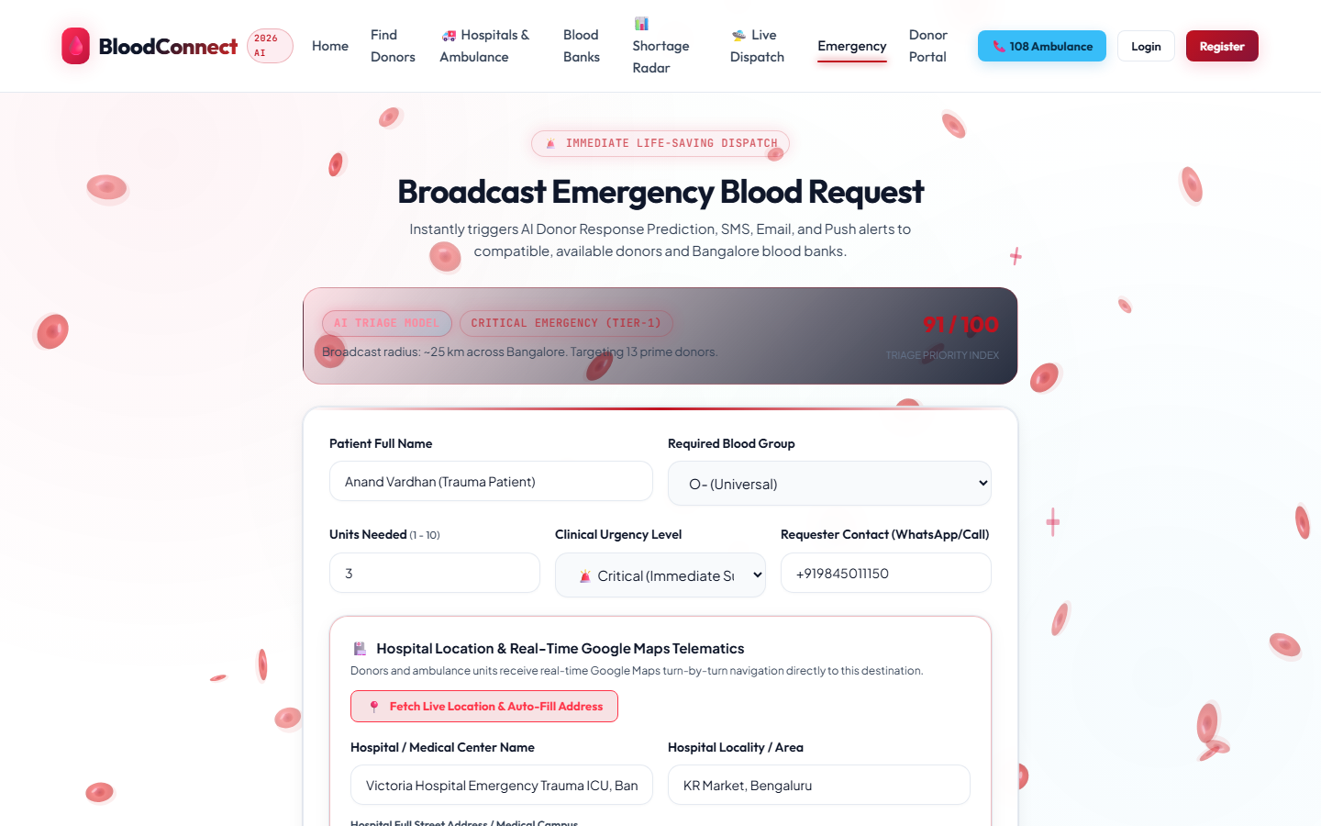
BMS Institute of Technology and Management
Department of Artificial Intelligence and Machine Learning | Societal Project (1BSOP308)
Emergency Request
What the requester fills
— Patient, blood group, units, and urgency
— Contact, hospital, and Bengaluru area
— A button can read the browser location
— Sample: Anand Vardhan, O−, Victoria Hospital
The AI alert line is page text. Ranking is done by the Java matcher.
BloodConnect · Review I · BMSIT&M
19

Slide 20
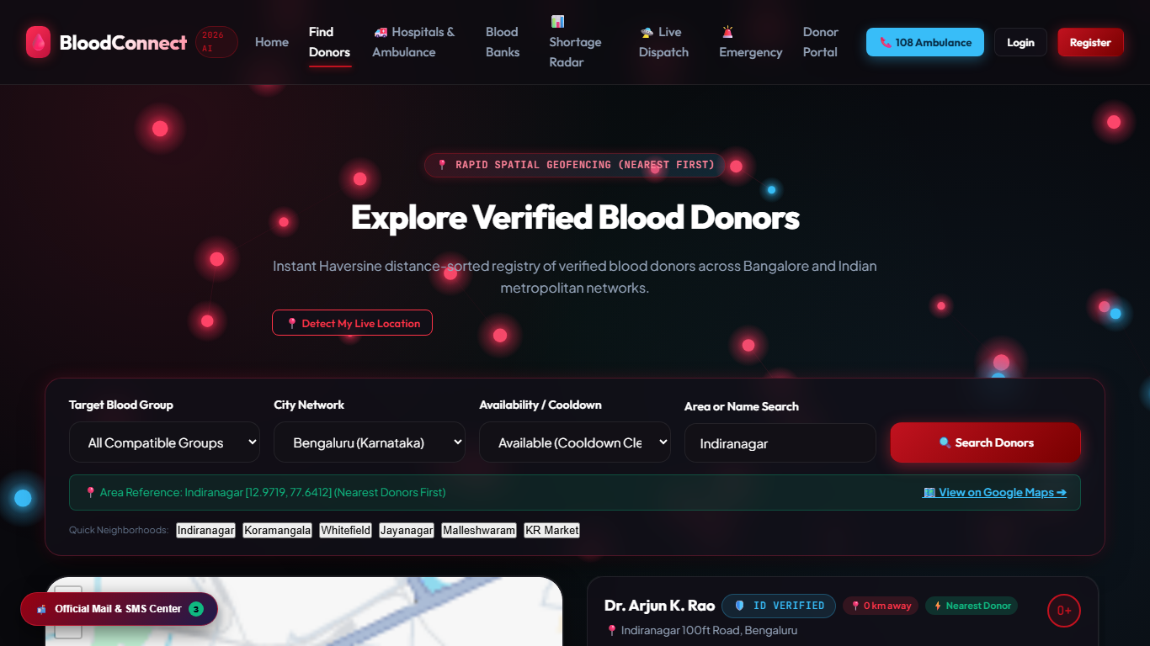
BMS Institute of Technology and Management
Department of Artificial Intelligence and Machine Learning | Societal Project (1BSOP308)
Donor Search
How a search is started
— Filter by group, city, and availability
— The city on this screen is Bengaluru
— Indiranagar, Koramangala, Whitefield
— Sample: Dr Arjun K. Rao, O+, Indiranagar
Verified and cooldown labels are sample text. The matcher uses available and distance.
BloodConnect · Review I · BMSIT&M
20

Slide 21
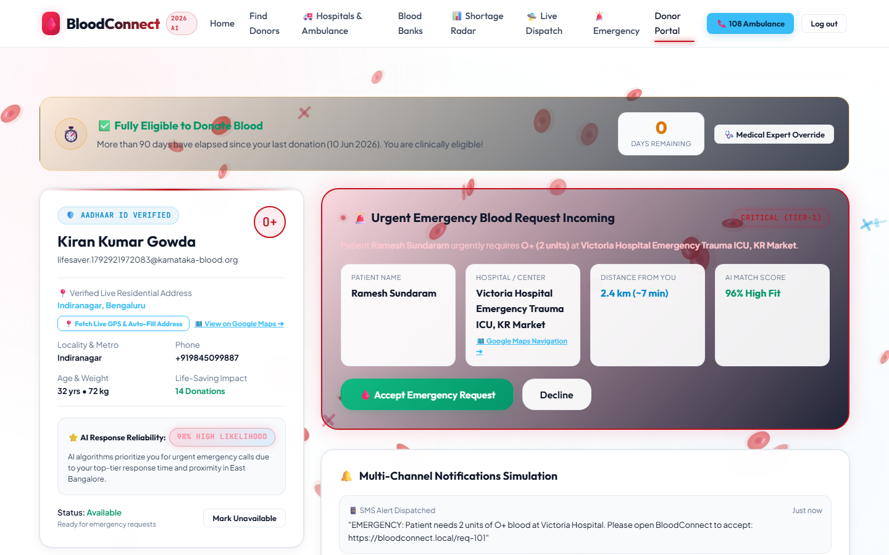
BMS Institute of Technology and Management
Department of Artificial Intelligence and Machine Learning | Societal Project (1BSOP308)
Donor Portal
What a donor is shown
— Sample: Kiran Kumar Gowda, O+, Indiranagar
— Incoming request for Victoria Hospital
— Accept and Decline are drawn here
— The banner mentions a 90-day gap
A reply is not saved. The schema has no last-donation date. Sample data only.
BloodConnect · Review I · BMSIT&M
21

Slide 22
BMS Institute of Technology and Management
Department of Artificial Intelligence and Machine Learning | Societal Project (1BSOP308)
Impact & SDG
Who benefits
We will measure
SDG 3
Good Health and Well-being
— Patients & families
— Willing donors
— Hospital desks
— Time to a ranked list
— Compatible and available only
— Survey before vs. after
3.8 UHC: WHO ties safe blood to universal health coverage [5].
3.1: 22.4% of the 2022 clinical demand is obstetrics [1].
Not 3.6. That target counts road deaths, which we do not measure.
Ethics: passwords hashed · donor phone private · doctors approve every transfusion
BloodConnect · Review I · BMSIT&M
22

Slide 23
BMS Institute of Technology and Management
Department of Artificial Intelligence and Machine Learning | Societal Project (1BSOP308)
Plan to Review II
Nov
Demo on the Java API, not the fallback
Ranjitha, Mithun
RISK
Few survey replies
PLAN
Share in class; demo on sample data
Nov
Add reply table and last-donation date
Nikhil
Dec
Survey replies, diary, report
Rakshitha
Dec
Run mvn test and full demo
All four
BloodConnect · Review I · BMSIT&M
23

Slide 24
BMS Institute of Technology and Management
Department of Artificial Intelligence and Machine Learning | Societal Project (1BSOP308)
References
1
Mammen et al., PLoS ONE, 2022 — demand 14.6 M, supply 93%
doi.org/10.1371/journal.pone.0265951
Open source
2
DGHS Blood Transfusion Services — requirement 14.6 M
dghs.mohfw.gov.in/bts.php
eraktkosh.mohfw.gov.in
Open source
3
Das et al., IEEE CSNT, 2020 — abstract: search within 5 km
ieeexplore.ieee.org/document/9115776
Open source
4
Parikh et al., IJCA, 2014 — live location; age, weight, Hb
doi.org/10.5120/15335-3669
Open source
5
WHO, 2025 — 2024 collection 14.6 M; 74.55% voluntary; UHC
who.int — India blood safety feature
Open source
6
United Nations — SDG 3, targets 3.1 and 3.8
sdgs.un.org/goals/goal3
Open source
BloodConnect · Review I · BMSIT&M
24

Slide 25
Thank You
Questions & Discussion
Ranjitha · Mithun · Nikhil · Rakshitha

