Slide 1
Predicting Cancer Relapse Through Mathematical Modelling of Tumour Dormancy
M.Sc. project: Phases 1-5 results
Proliferating-Dormant-Immune (P-D-E) ODE model, sensitivity, identifiability and METABRIC comparison

Slide 2
Background and motivation
• Breast cancer can relapse years or decades after apparently successful treatment
• Dormant (growth-arrested) cells and immune control are proposed explanations for delayed relapse
• Aim: build an interpretable mathematical model, study when relapse occurs, and check what clinical data can and cannot say
• All model parameter values are hypothetical; results are not clinical predictions

Slide 3
Research gap and questions
• Dormancy-immune ODE models are mostly analysed qualitatively; few are turned into relapse-time distributions compared with censored data
• Identifiability and endpoint mismatch (time origin, composite event) are rarely confronted explicitly
• RQ1-RQ6: immune-control bounds, role of dormancy, relapse-time control, estimating relapse likelihood, matching group-level recurrence, identifiability of the P/D split
• Negative or limiting results are treated as first-class outputs

Slide 4
The P-D-E model
• P: proliferating cells, D: dormant cells, E: effective immune activity (cell fractions of capacity K)
• dP/dt = rP(1 - N/K) - qP + aD - kEP
• dD/dt = qP - (a + δ_D)D
• dE/dt = s + ρ·P/(h+P)·E - μE - ηNE, N = P + D
• Baseline: r=0.12, q=0.04, a=0.005, δ_D=0.001, k=0.1, s=0.02, μ=0.05, ρ=0.04, h=0.02, η=0.08, K=1
• Relapse event: first upward crossing of N_detect = 0.1; horizon 240 months

Slide 5
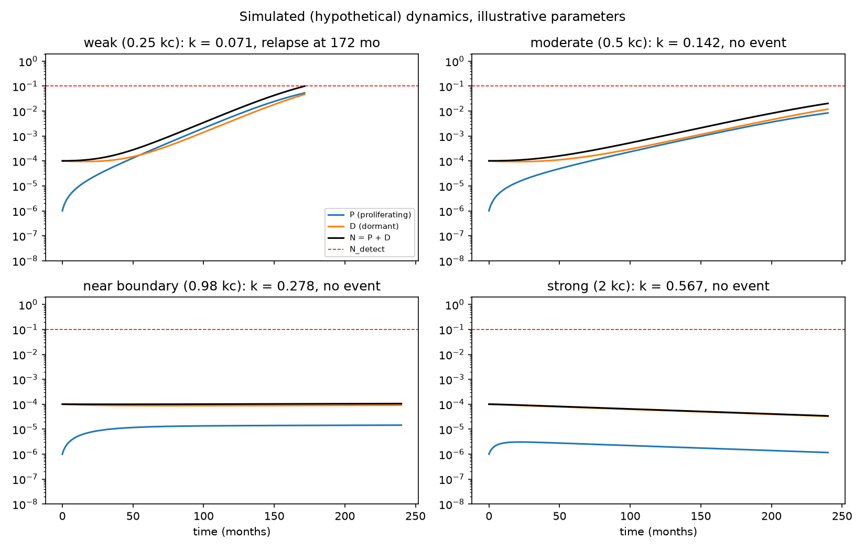
Baseline trajectories
• Deterministic solution from a small post-treatment residual burden
• Long quiescent phase, then escape: delayed relapse emerges from slow growth near the tumour-free state
• Shows the three compartments and the detection threshold

Slide 6
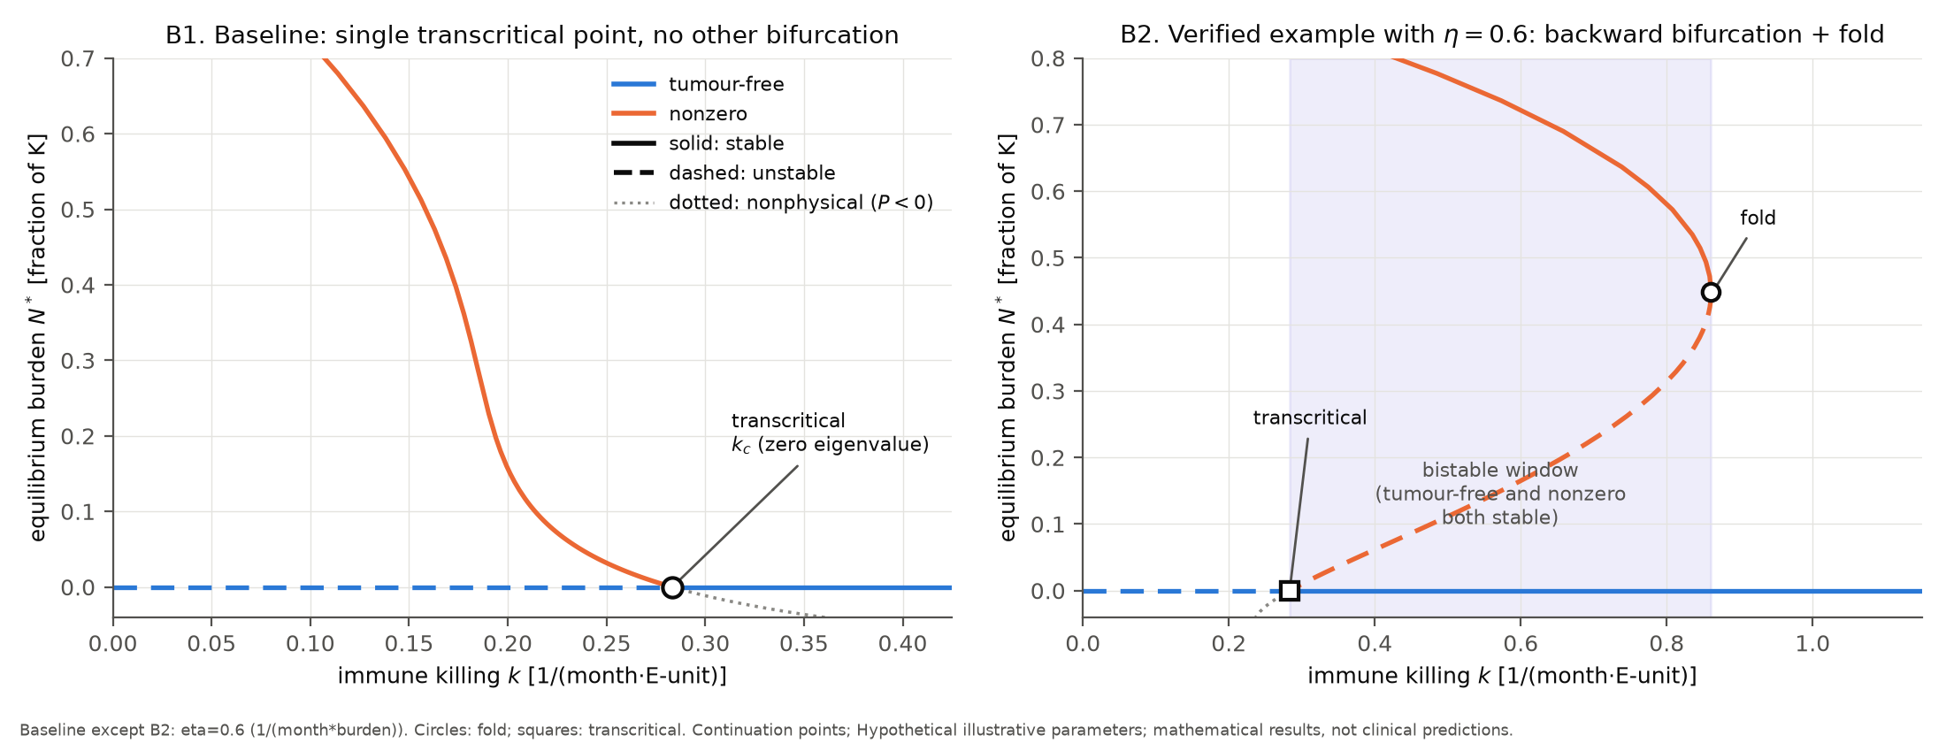
Stability and bifurcation structure
• Tumour-free state is stable iff r < ks/μ + qδ_D/(a+δ_D) (proved)
• Transcritical bifurcation at k_c = 0.28333
• Bistability (two kinds) found numerically; no Hopf bifurcation detected
• If δ_D = 0, dormancy alone does not change tumour-free stability

Slide 7
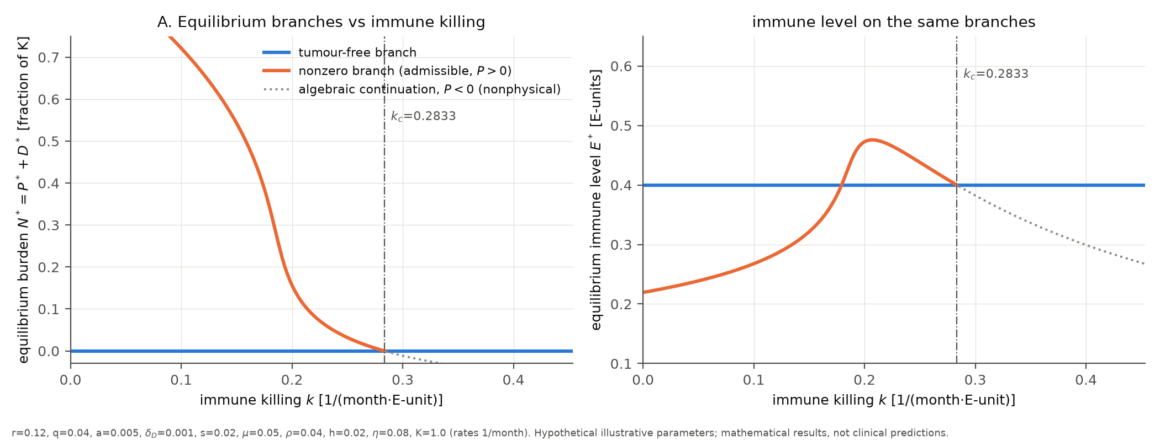
Equilibrium branches
• Nonzero equilibria obtained by reduction to one scalar equation
• Below k_c a stable nonzero equilibrium with high dormant fraction exists
• Its burden tends to 0 as k approaches k_c

Slide 8
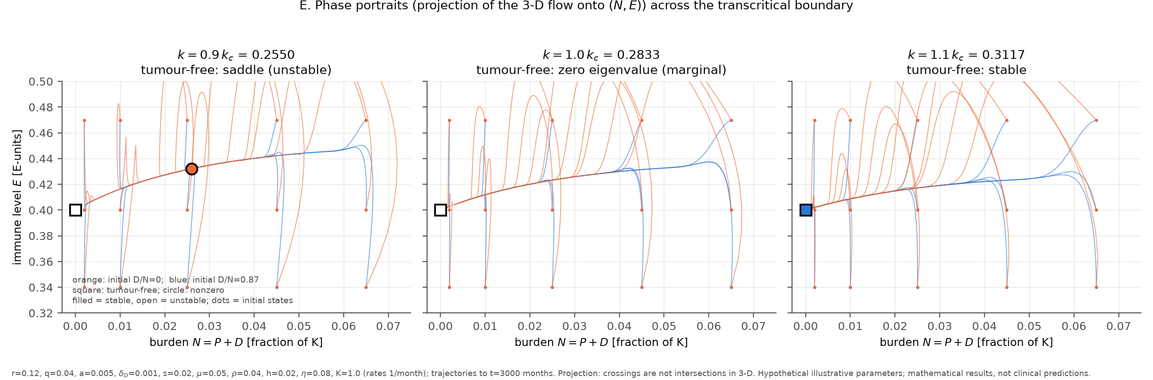
Phase portraits
• Trajectories converge to different attractors depending on initial state
• Separatrix structure explains why small residual disease can be controlled or escape

Slide 9
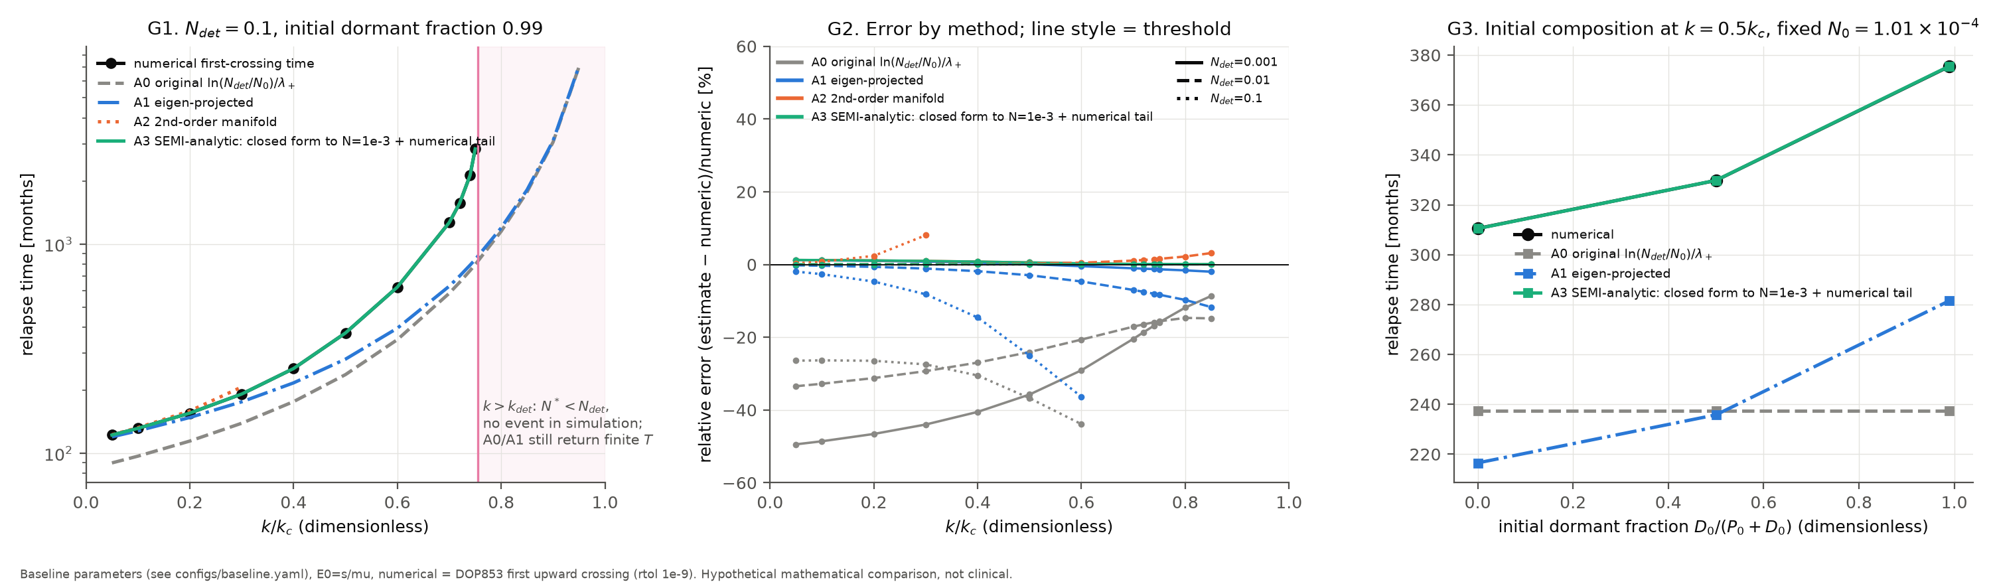
Relapse-time estimators
• Naive linear-escape estimate ln(N_detect/N0)/λ+ is not supported (about 240 vs 375 months at k = 0.5 k_c)
• Eigenvector-projection and nonlinear corrections improve the estimate
• Relapse timing is set by residual burden and proximity to the stability boundary

Slide 10
Phase 2 summary
• Closed-form tumour-free stability boundary verified against eigenvalues
• Bifurcations classified: transcritical, saddle-node, bistability; no Hopf
• M1 normalisation (e = μE/s, β = ks/μ) removes the k-s gauge redundancy
• Dormancy and relapse thresholds are illustrative; threshold sensitivity is tested in Phase 3

Slide 11
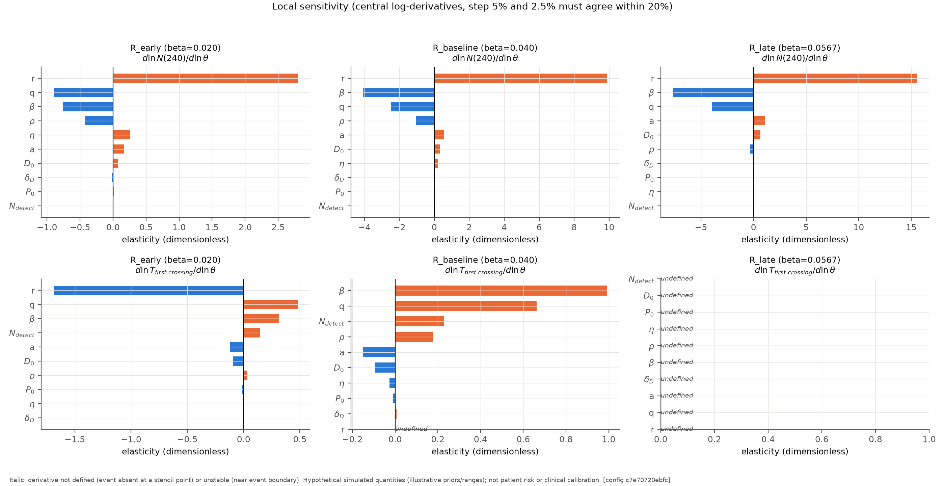
Local sensitivity (Phase 3)
• Local sensitivity of relapse outcome to each parameter around the baseline
• Parameters near the immune-control balance dominate

Slide 12
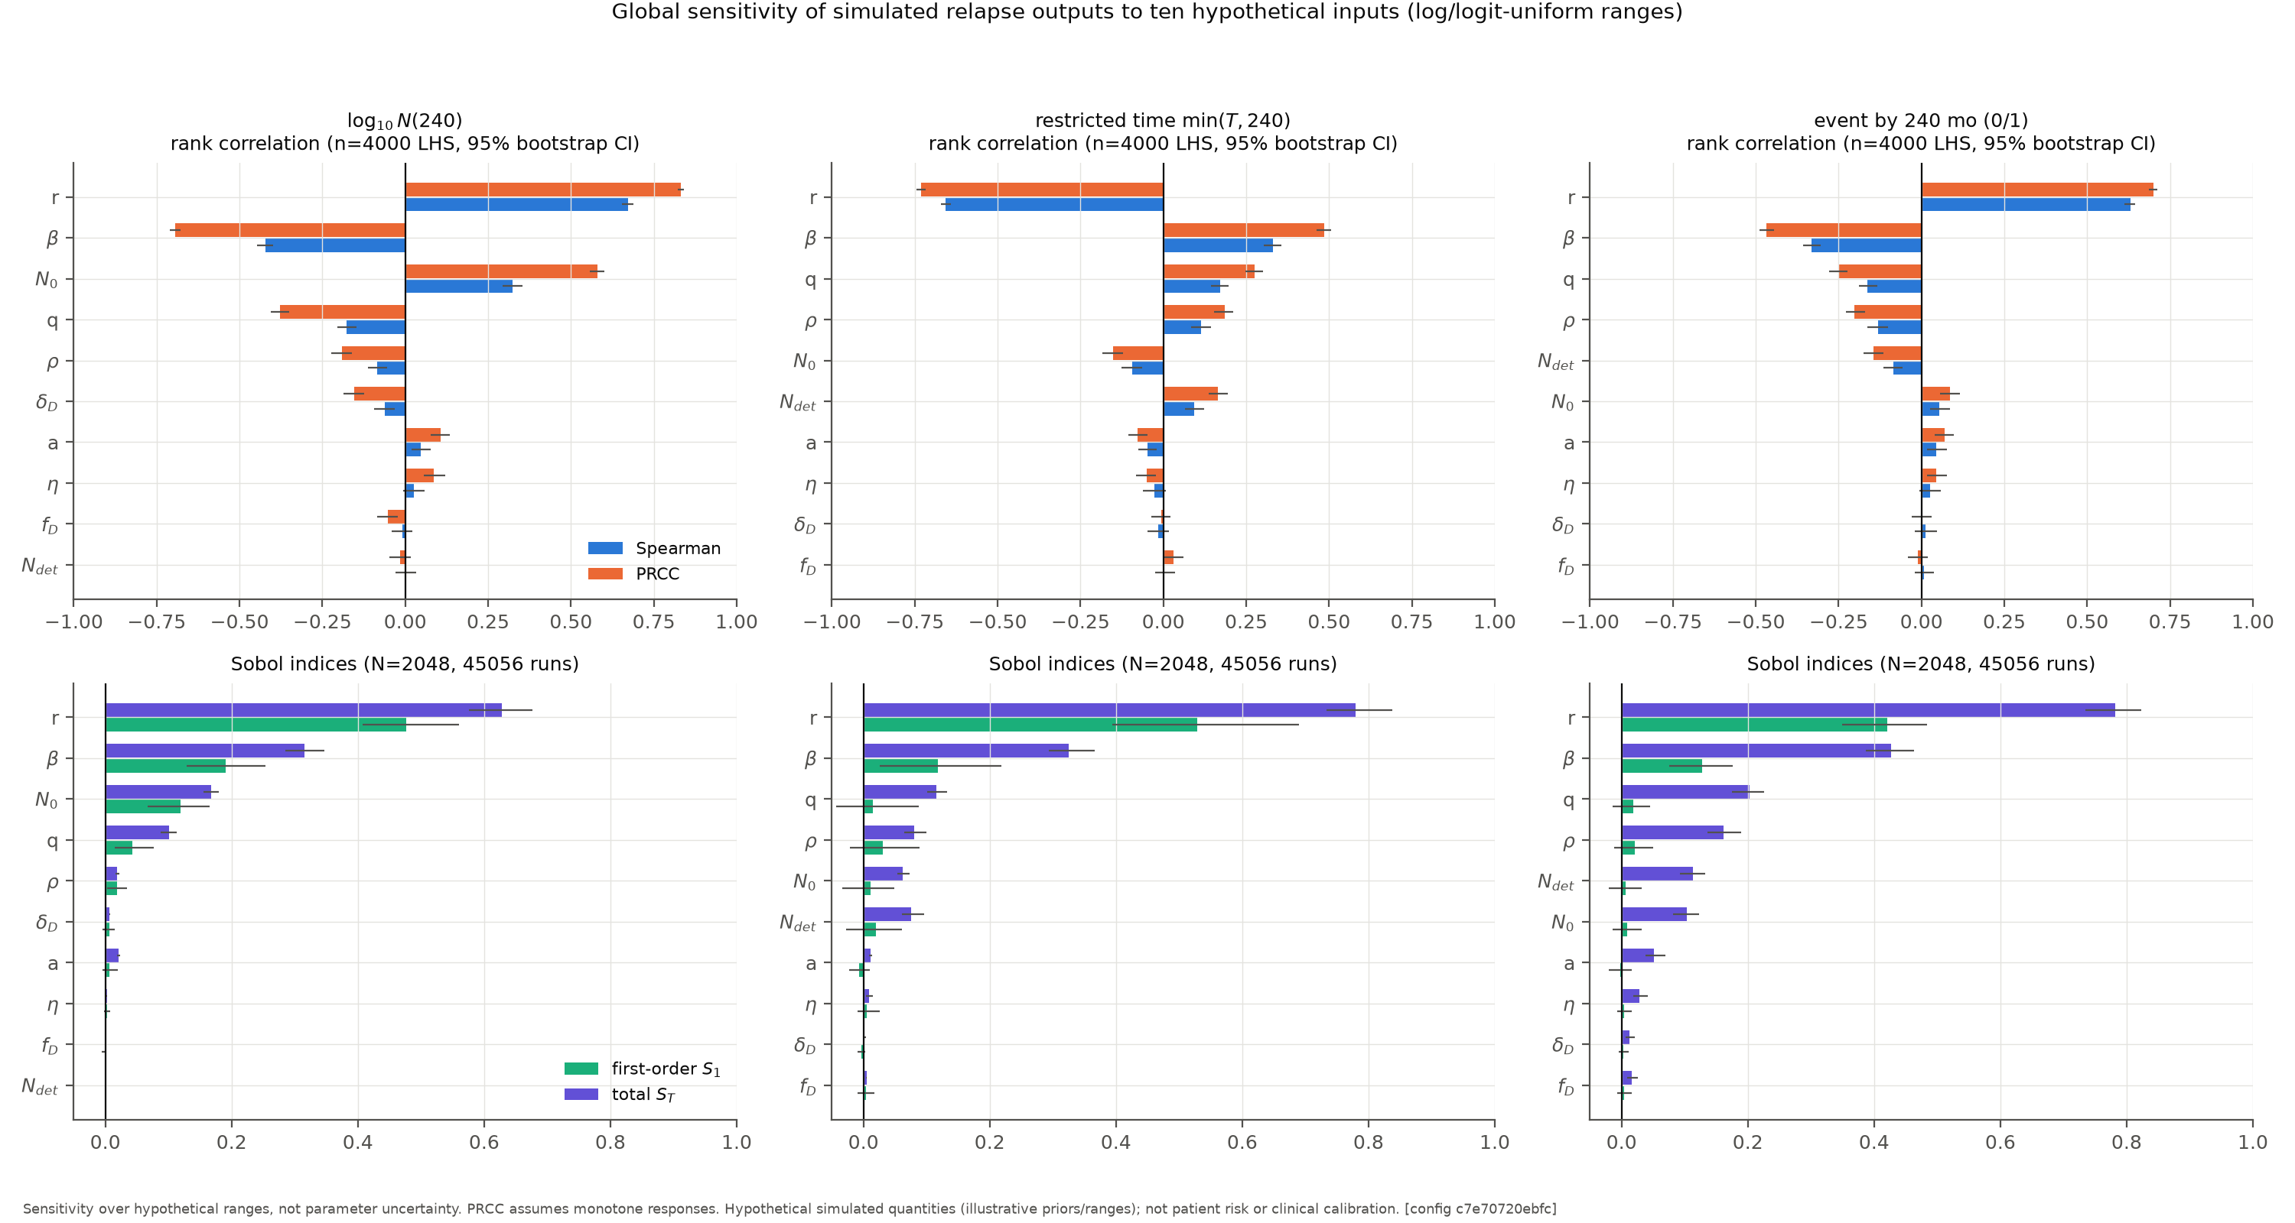
Global sensitivity (Phase 3)
• Spearman, PRCC, Morris and Sobol analyses compared
• Parameter interactions matter: effects depend on proximity to the bifurcation

Slide 13
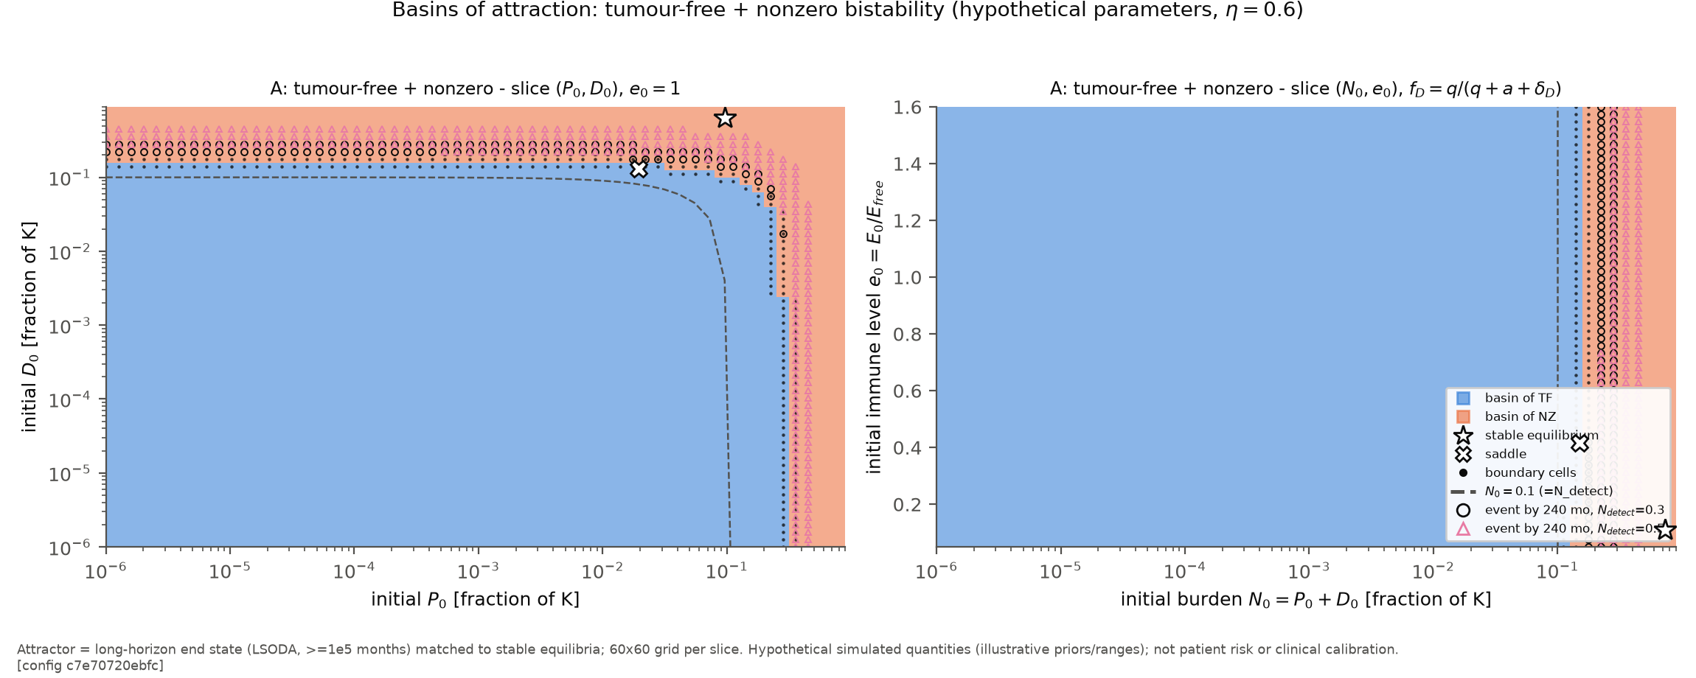
Basins of attraction
• Initial conditions partition into tumour-free and nonzero outcomes
• Event occurrence depends on both parameters and residual state

Slide 14
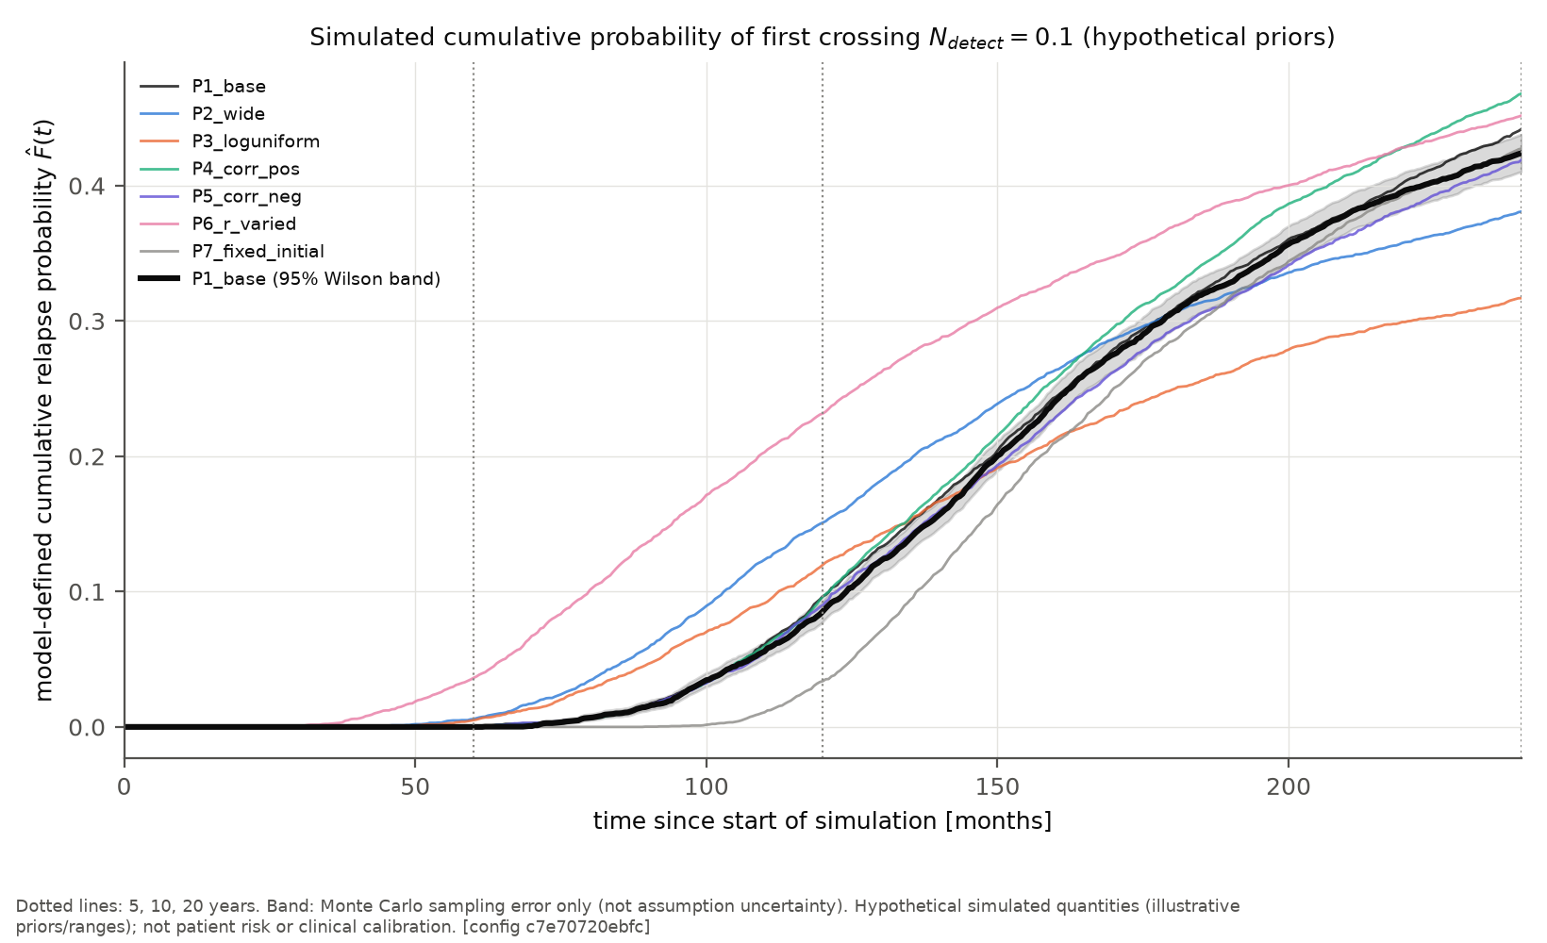
Simulated cumulative relapse probability
• Monte Carlo over priors P1-P7 gives model event curves
• Prior P1 (n = 15,000): P(5 y) = 0.0005, P(10 y) = 0.091, P(20 y) = 0.436
• Curve shape depends strongly on the prior

Slide 15
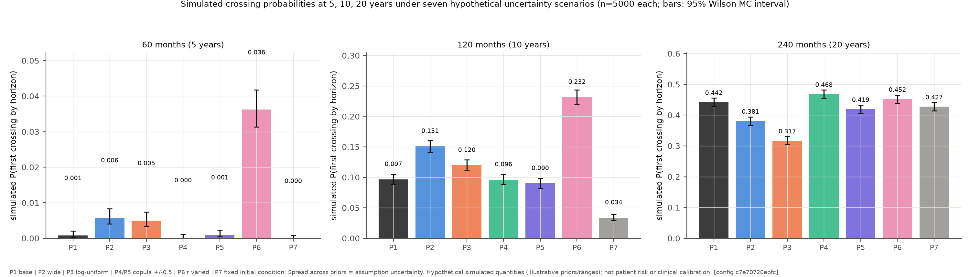
Event probabilities at 5, 10, 20 years
• Simulated event probabilities with Monte Carlo intervals across priors
• Events are strongly back-loaded: very few early, many late

Slide 16
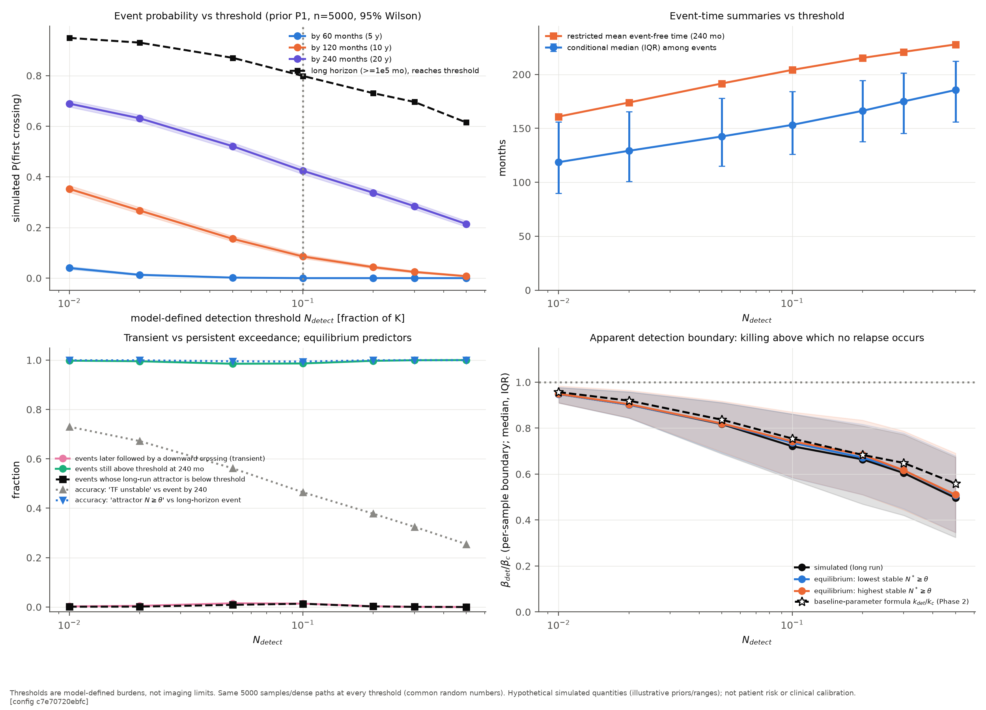
Detection threshold sensitivity
• Moving N_detect shifts the whole event-time distribution
• The threshold is a modelling convention, so absolute probabilities are threshold-dependent

Slide 17
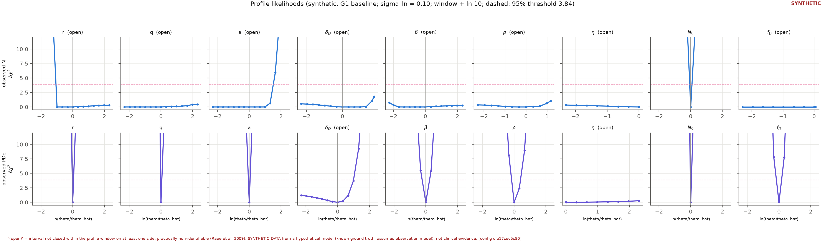
Identifiability: profile likelihoods (Phase 4)
• Some parameter combinations are well constrained; others have flat profiles
• Total-burden data alone cannot separate the P/D split

Slide 18
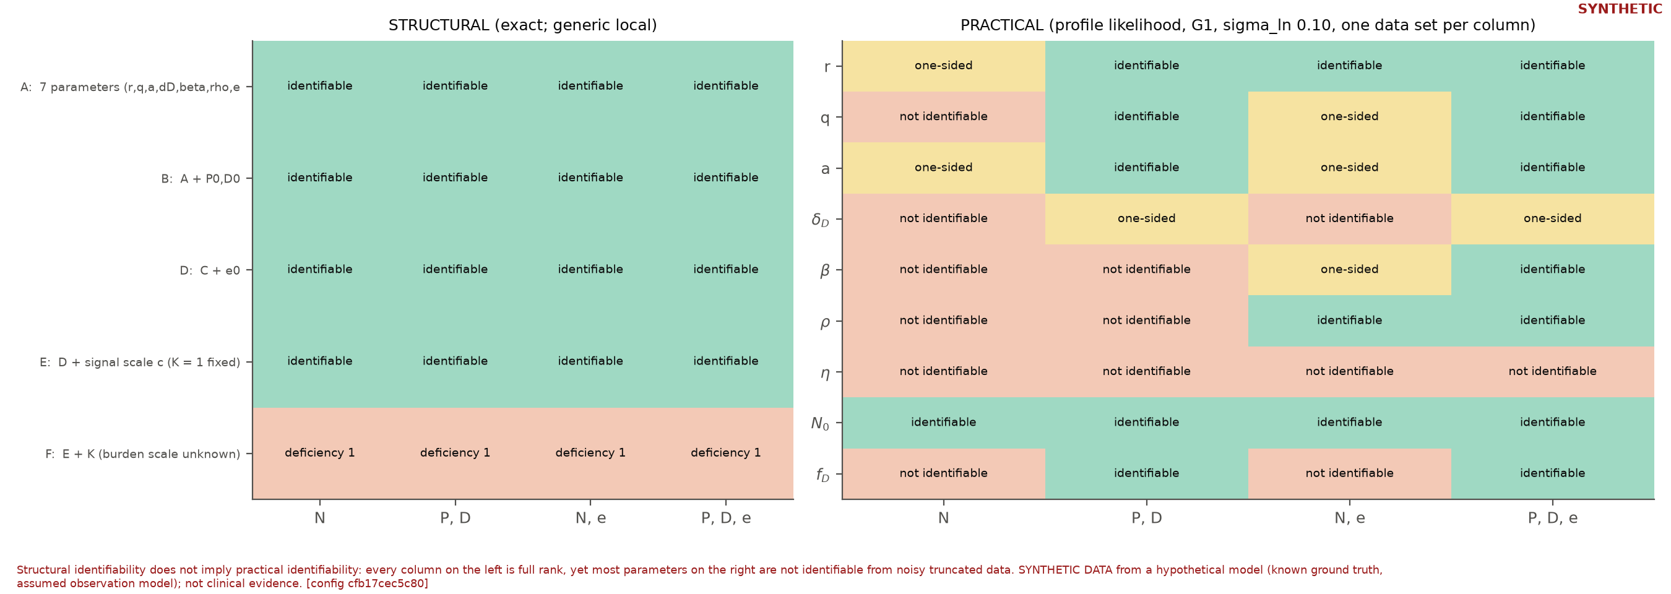
Structural vs practical identifiability
• Structural redundancy (k-s) plus practical limits from noise and sampling
• Pre-registered criteria: A (descriptive survival comparison) yes; B (mechanistic calibration) not supported; C (patient-level prediction) unsuitable

Slide 19
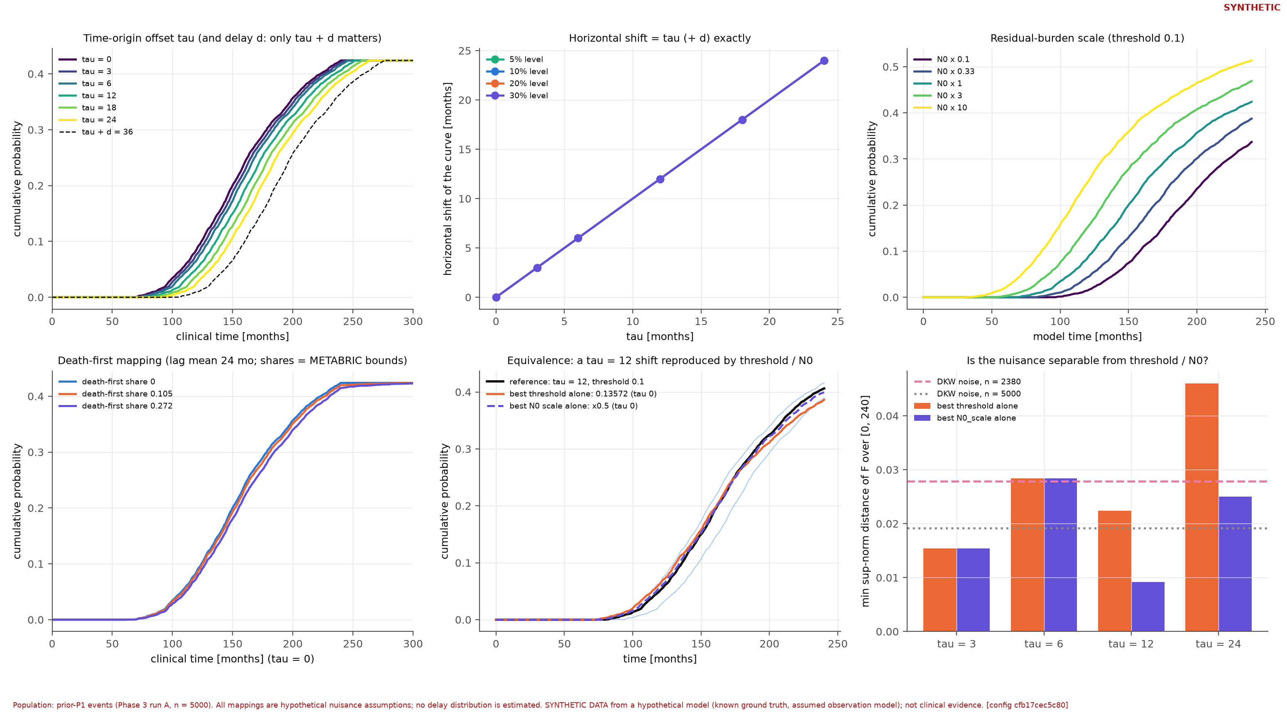
Time-origin uncertainty
• METABRIC RFS origin is not documented as treatment completion
• Offsets confound model time and clinical time, so absolute timing cannot be fitted

Slide 20
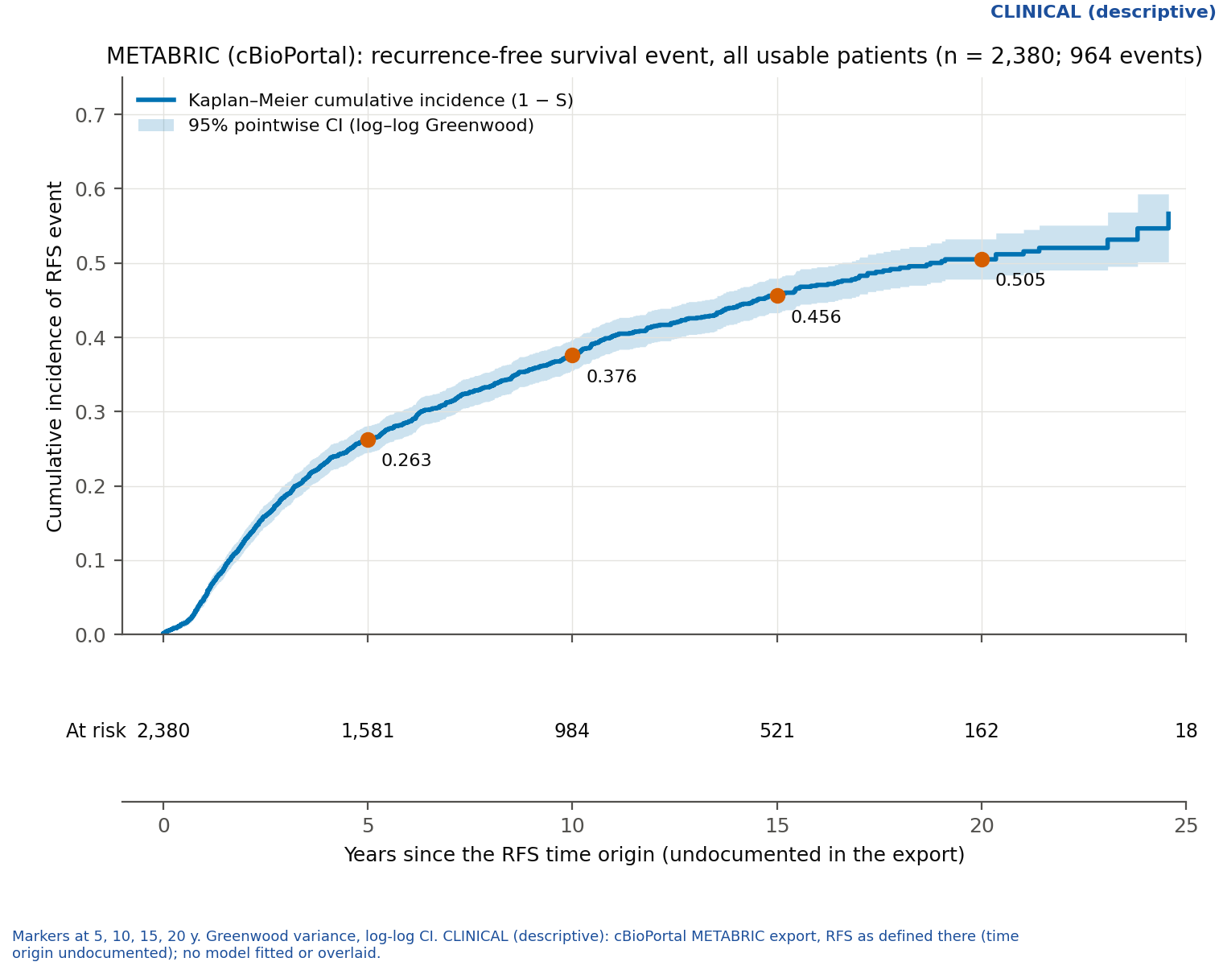
METABRIC: overall relapse-free survival
• 2,380 usable records, 964 events
• Cumulative incidence (95% CI): 5 y 0.263 (0.245-0.281); 10 y 0.376 (0.355-0.397); 15 y 0.456 (0.433-0.480); 20 y 0.505 (0.478-0.532)
• Kaplan-Meier with Greenwood log-log CI; no competing-risk analysis

Slide 21
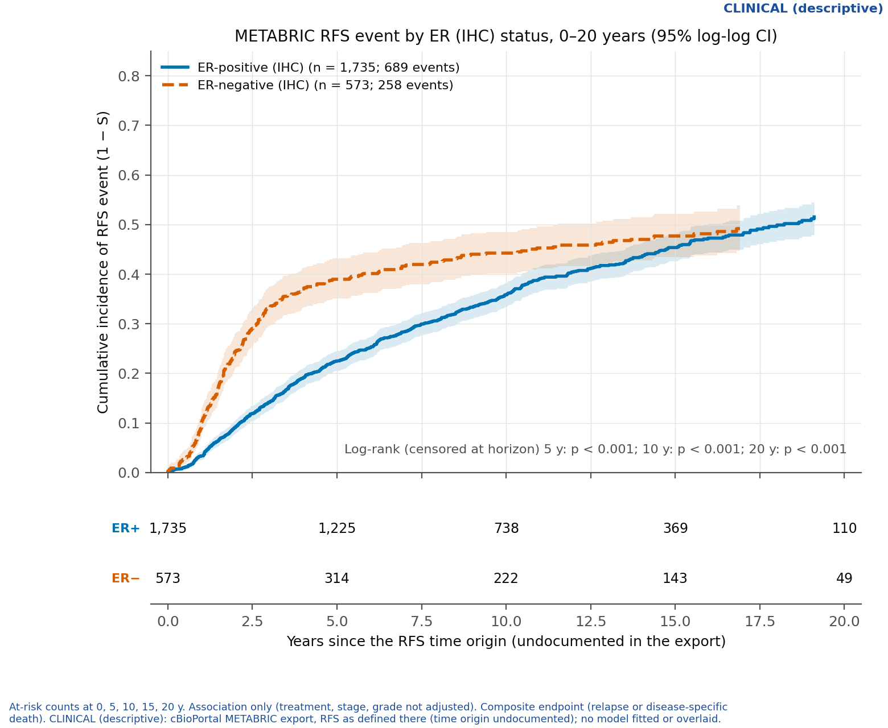
ER-positive vs ER-negative
• ER- has more early events (0.390 vs 0.225 at 5 y); curves converge by 15-20 y (0.497 vs 0.515)
• ER- interval hazard falls 10.35 to 0.91 per 100 person-years; ER+ only 5.07 to 2.61
• Log-rank p < 0.001 at 5 and 10 y

Slide 22
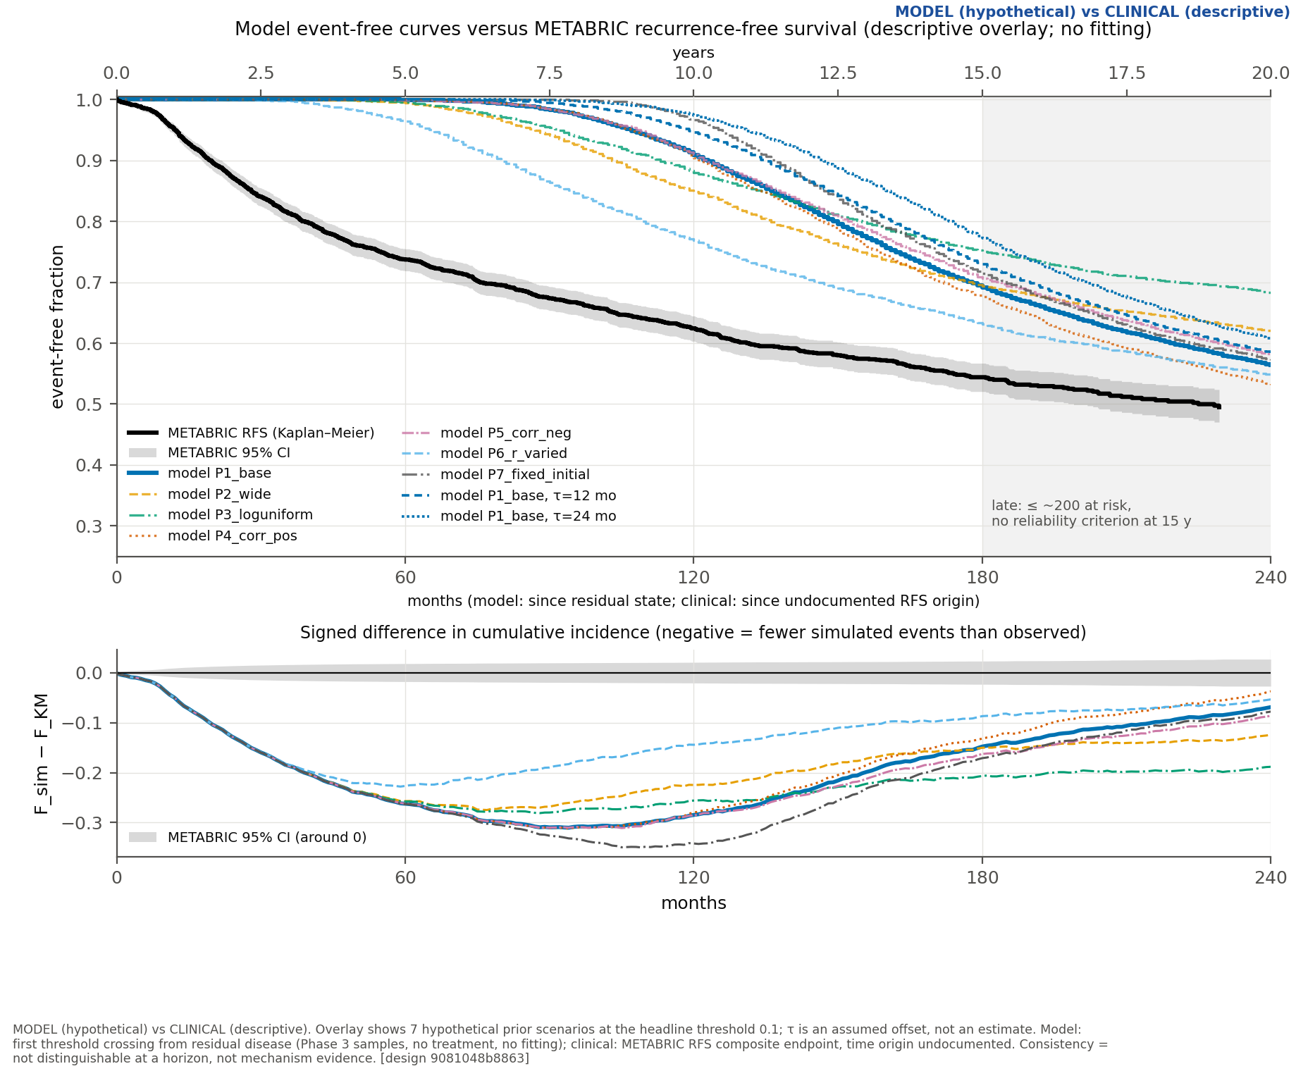
Model vs METABRIC (descriptive)
• Pre-registered grid of 1,764 scenarios; nothing fitted or tuned
• Reference scenario: simulated 0.0005 / 0.091 / 0.436 at 5 / 10 / 20 y vs METABRIC 0.263 / 0.376 / 0.505

Slide 23
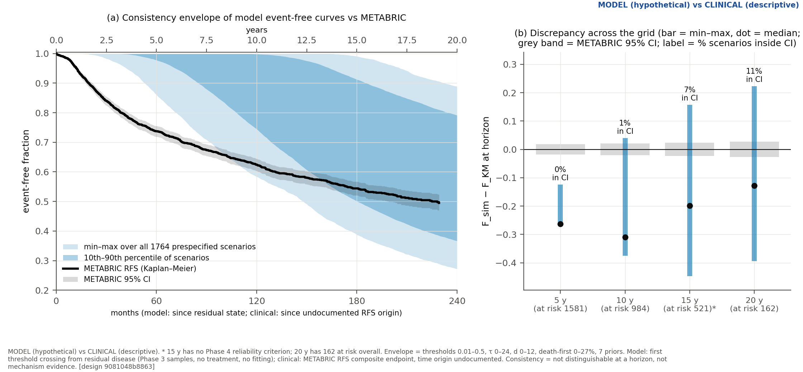
Consistency envelope
• 5 y: simulated incidence below the METABRIC CI in all 1,764 scenarios
• 10 y below in 98.8%; late events more back-loaded in all scenarios
• 20-y value inside the CI in only 11.1% of scenarios

Slide 24
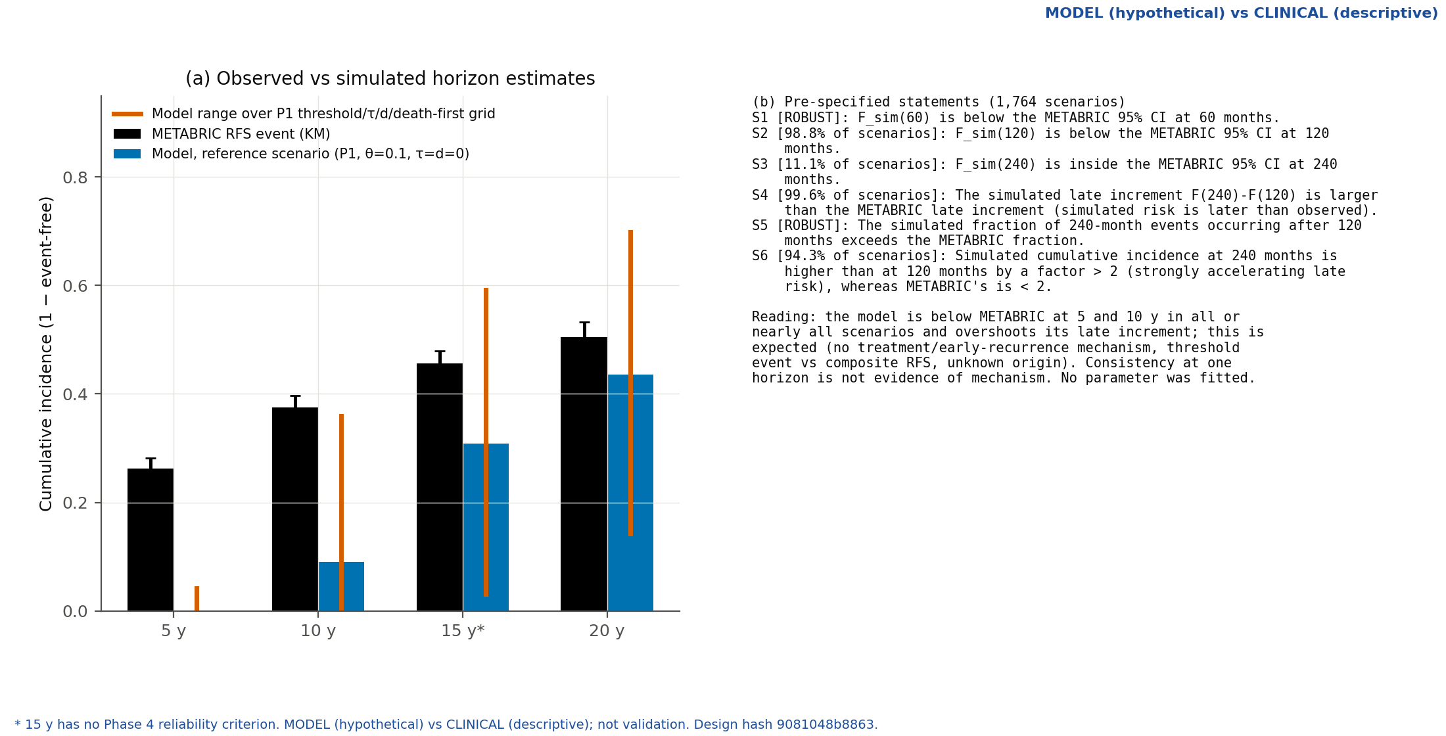
Phase 5 summary
• The model has no treatment era or early-recurrence mechanism, so early mismatch is expected
• Neither validation nor refutation of the mechanism
• Threshold and time-origin choices change magnitude but not the qualitative gaps

Slide 25
Conclusions and limitations
• Analytic stability boundary and bifurcation structure of the P-D-E model established
• Relapse-time distributions are strongly back-loaded and prior- and threshold-dependent
• Total-burden data cannot identify the P/D split; mechanistic calibration is not supported
• METABRIC comparison is descriptive: undocumented RFS origin, composite event, curve ends at about 230 months
• Future work: treatment-era and early-recurrence mechanisms, stochastic extinction, data with dormancy markers
• 164 automated tests pass; outputs reproducible from the repository

