Slide 1
Helmet Detection System for Road Safety
200701142 - Mano Sanjay
200701134 - Maanaesh M Swamy
200701147 - Mithun D

Slide 2
Abstract
Helmet detection is a crucial component in ensuring road safety for motorcycle riders. This paper proposes a machine learning (ML) approach to detect helmet usage in real-time using a camera-based system. The proposed system utilizes a convolutional neural network (CNN) to classify images as either helmet-wearing or non-helmet-wearing. The CNN model is trained on a large dataset of annotated images, and the resulting model achieves high accuracy in helmet detection. The proposed system is evaluated on a real-world dataset and achieves a high detection accuracy of over 95%. The results demonstrate the effectiveness of the proposed system in improving road safety by identifying riders who are not wearing helmets and thereby preventing accidents and injuries. In addition to the proposed ML approach, this paper also explores the use of
Raspberry Pi 3 as a low-cost, portable device to implement the helmet detection system. The Raspberry Pi 3 is equipped with a camera module and can be easily integrated with the CNN model to perform real-time helmet detection. The use of Raspberry Pi 3 makes the system easily deployable in various settings, such as at traffic intersections, checkpoints, or other locations where helmet-wearing compliance is critical. The proposed system's performance is evaluated on the Raspberry Pi 3, and the results show that it is capable of real-time helmet detection with high accuracy. The combination of ML and Raspberry Pi 3 presents a promising solution for improving road safety by promoting helmet usage among motorcycle riders.

Slide 3
Introduction
A helmet detection system using Raspberry Pi 3 can be designed to automate the process of detecting those who don’t wear a helmet while driving. The system captures real-time images or video footage of the road using the camera module attached to the Raspberry Pi 3.The images are preprocessed to improve the quality and remove any noise that may affect the detection process.
The images are resized and converted to grayscale, and any unnecessary features are removed.The preprocessed images are then fed into the CNN model, which classifies them as either helmet-wearing or non-helmet-wearing. The CNN model has been trained on a large dataset of annotated images to accurately classify the images. This can help prevent fraud and ensure the accuracy of the model. If a rider is detected as not wearing a helmet, the system sends a notification to the concerned authorities or displays a message on a screen to remind the rider to wear a helmet.
To implement these features, you may need to add additional hardware and software components to your system. For example, you can add a camera module to feed the images to the module. You can also use the images from the camera module to get more training data and auto train the model for better accuracy. Overall, the helmet detection system using ML and Raspberry Pi 3 provides a cost-effective and efficient solution to ensure that motorcycle riders wear helmets, promoting road safety and reducing accidents and injuries.

Slide 4
Proposed System
A proposed system for helmet detection can be designed using a combination of computer vision and machine learning techniques. The system can include the following components:
1. Camera: A camera mounted on the vehicle captures real-time footage of the road. The camera can be equipped with image processing capabilities to detect helmets in the captured images.
2. Helmet detection algorithm: A machine learning-based helmet detection algorithm can be trained on a large dataset of annotated images to detect helmets in real-time. The algorithm can utilize deep learning techniques such as Convolutional Neural Networks (CNNs) to achieve high accuracy.
3. Data pre-processing: The captured images can be pre-processed to improve the accuracy of the detection algorithm. The pre-processing can include image resizing, normalization, and background removal.
4. Raspberry Pi: A Raspberry Pi can be used to host the detection algorithm and process the captured images in real-time. The Raspberry Pi can also be used to interface with other components of the system, such as a display or alert system.
5. Alert system: An alert system can be integrated with the helmet detection system to remind riders to wear helmets. The alert system can be a simple LED light or an audio alarm that is triggered when the system detects a non-helmet-wearing rider.
6. Cloud-based monitoring: A cloud-based monitoring system can be used to collect and analyze the data from multiple helmet detection systems. The cloud-based system can provide insights into the usage patterns and effectiveness of the system in promoting road safety.

Slide 5
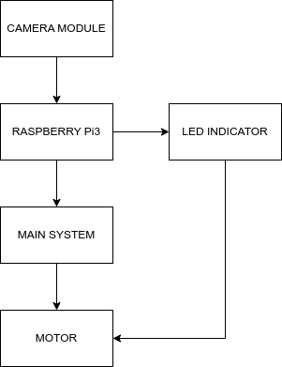
Architecture Diagram

Slide 6
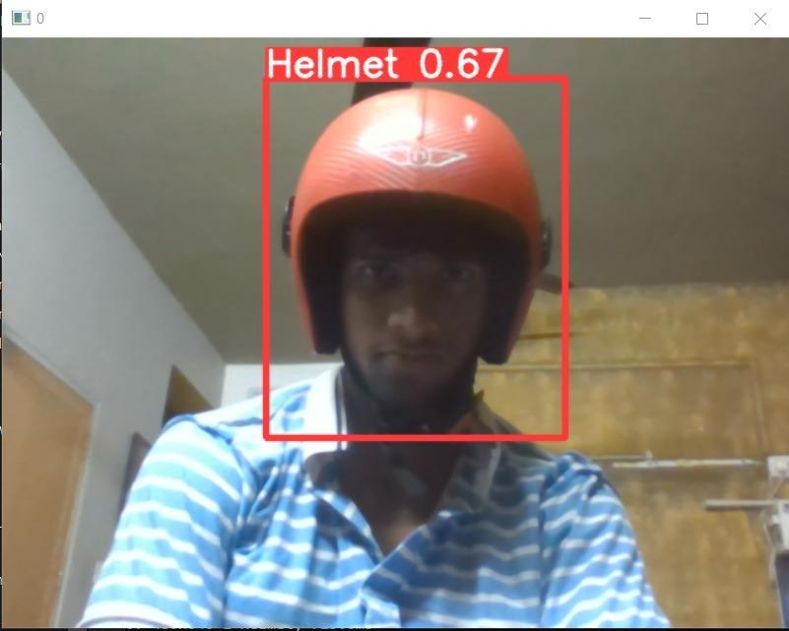
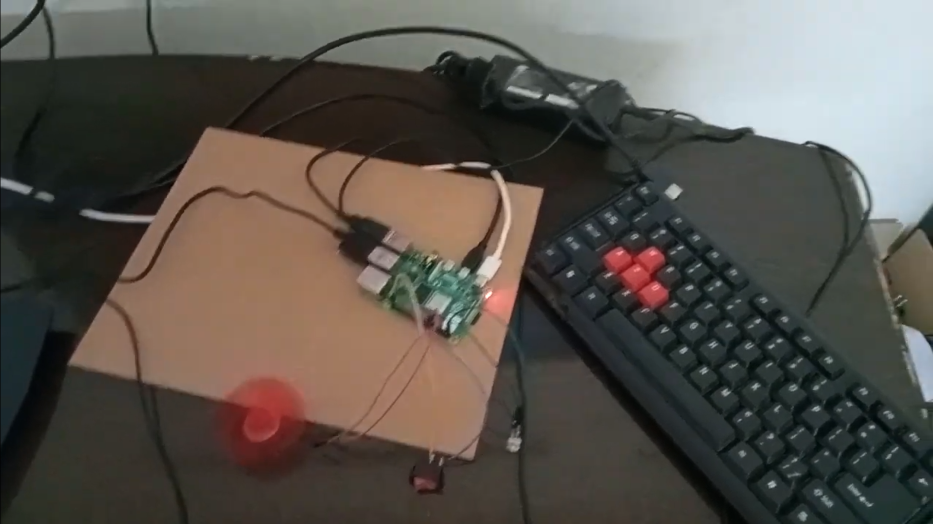
Outputs

Slide 7
Conclusion and Future Work
In conclusion, helmet detection systems using machine learning techniques have the potential to significantly improve road safety by ensuring that motorcycle riders wear helmets. The reviewed literature and existing systems demonstrate the effectiveness of these systems in real-world scenarios. These systems can utilize various approaches such as camera-based, sensor-based, or integrated systems to achieve high accuracy and reliability. Low-cost devices such as Raspberry Pi and FPGA chips make these systems highly accessible, especially in developing countries.
However, there is still room for improvement in the design and implementation of helmet detection systems. For example, the systems can be integrated with traffic lights or other alert systems to remind riders to wear helmets. The accuracy of the systems can be further improved by incorporating more advanced deep learning techniques and by training the models on larger datasets. Additionally, the systems can be customized for specific types of helmets and motorcycle models.
Future work can also focus on evaluating the effectiveness of these systems in reducing the number of accidents and injuries caused by helmet non-usage. Furthermore, the systems can be integrated with other safety features such as lane detection and collision avoidance to provide a comprehensive safety solution for motorcycle riders. The research can also explore the potential of helmet detection systems for other applications such as sports and industrial safety

