Slide 1
Concealed Object Detection
Deng-Ping Fan, Ge-Peng Ji, Ming-Ming Cheng, and Ling Shao
GNR 638: Course Project
-Mitalee Oza | 180100067
-Shubham Agrawal | 180040100
-Mithun Polamreddy | 180100081
-Tanisha jain | 200100156

Slide 2
Flow/Content
Problem Statement
Motivation for choosing SINETV2
COD10K Dataset
SinetV2 Architecture
Training
Results

Slide 3
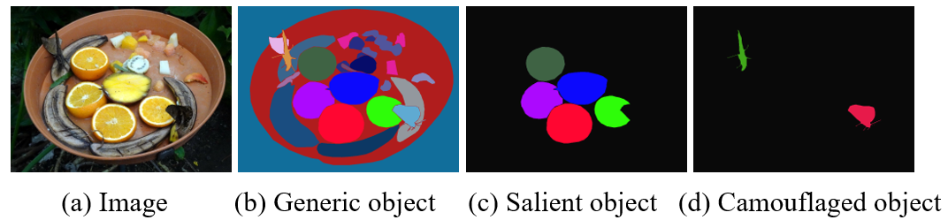
Problem Statement
SINETV2 presented the first systematic study on Concealed Object Detection (COD), which aims to identify objects that are visually embedded in their background. Primary contributions include assembly of COD10K dataset and proposal of SINet (Search Identification Net) framework.
Our work: Thoroughly understand the COD10K dataset and SINet framework. Train SINETV2 framework using COD10K dataset.
Applications: Camouflage military targets detection, Wildlife protection, Security, Search and Rescue work

Slide 4
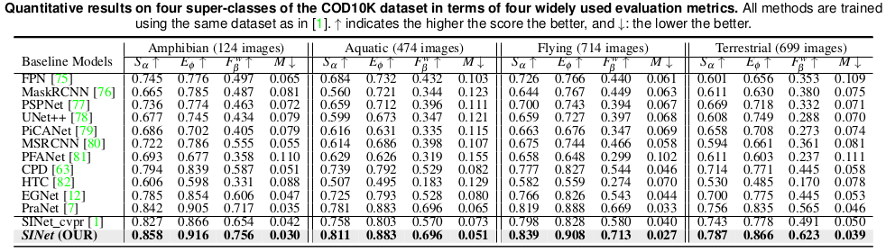
Motivation for choosing SINETV2
12 baseline-models were selected to evaluate this architecture
All the models were trained on three different dataset namely, CHAMELEON, CAMO and COD10K
This architecture achieved higher new SOTA level performance over all metrics

Slide 5
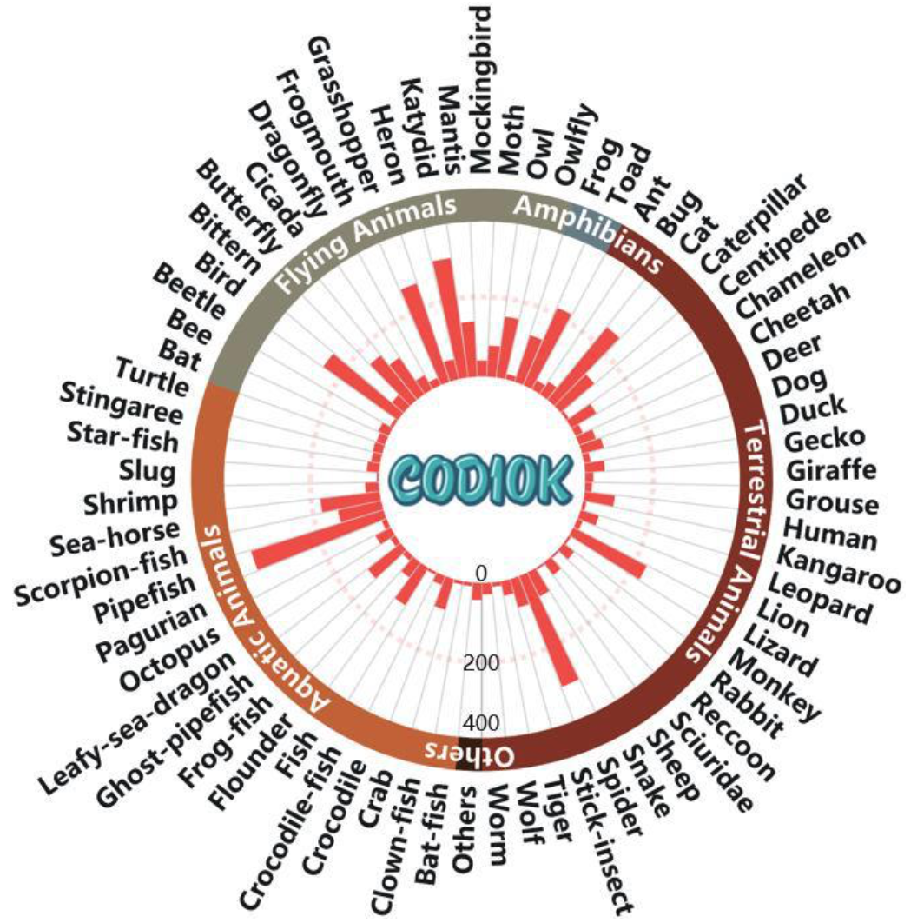
COD10K Dataset
Motivation
provide a new challenging object detection task from the concealed perspective
to promote research in several new topics
Image collection: Flickr, Visual Hunt, Pixabay, Unsplash, Free-images etc. websites
COD10K contains 10,000 images (5,066 concealed, 3,000 background and 1,934 non-concealed)
The images are divided into 10 super classes and 78 sub-classes(69-concealed and 9 non-concealed )
Each image is annotated with class, subclass, bounding box, attributes, object level annotations

Slide 6
SinetV2 Architecture
Intuition of Architecture: In biological systems, when hunting, a predator first judges if a potential prey exists, that is, it searches for a prey. Then it identifies the target animal. Similarly, the SINet model consists of 2 stages of detection: Search (outputs a coarse map indicating the rough location of concealed object) and Identification (improving the coarse map to indicate the actual location of concealed object).
The framework has four modules:
Search
Feature Extractor: Extracts features at different resolution from images using Resnet
Texture Enhancement Module: to capture fine-grained textures with the enlarged context cues
Neighbouring Connection Decoder: Provides the rough location of concealed object
Identification
Group Reversal Attention: to work collaboratively as cascaded blocks to refine prediction of location from Search stage.

Slide 7
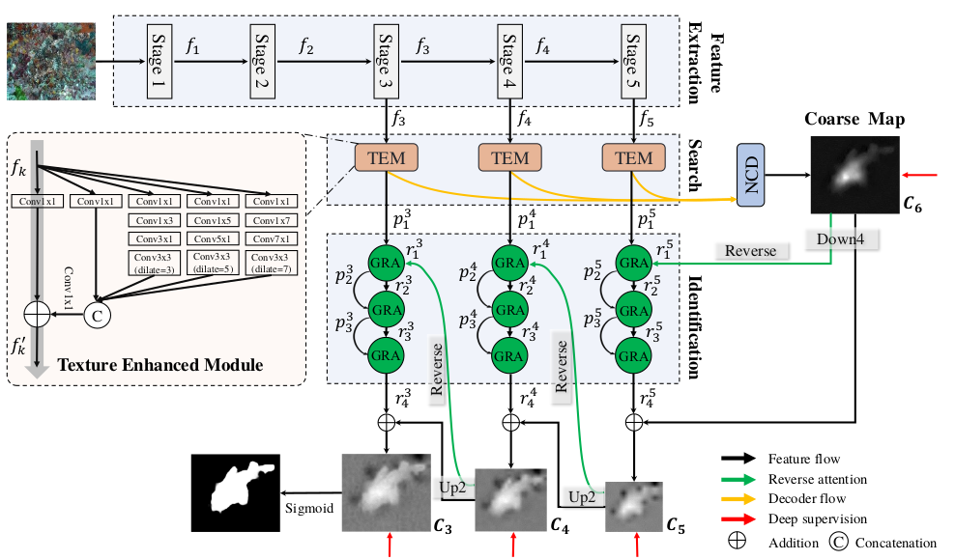

Slide 8
Feature Extraction
For an input image I(WxH) , a set of features f_k , k ∈ {1, 2, 3, 4, 5} is extracted from Res2Net
Resolution of each feature f_k is H/2^k ×W /2^k , k ∈ {1, 2, 3, 4, 5}
The purpose of this module is to cover diversified feature pyramids from high-resolution, weakly semantic to low-resolution, strongly semantic.
We consider the top-three highest-level features, as low-level feature take more compuaton due to higher spatial resolution and contribute less to performance
Notes:
To feed features into SINET architecture we use extarct the same from resent
Features have been extracted at multiple resolution to improve performance as SINET performs similar operation on feature pyramid
HIgh-level feature as low-level more time and less performance contri

Slide 10
Texture Enhancement Module (TEM)
Motivation: to incorporate more discriminative feature representations during the searching stage
Includes four parallel residual branches with different dilation rate and convolution size and a shortcut branch.
At the start of each branch we use 1x1 convolution for reducing the size of channel to 32.
Output of the four branches are concatenated followed by 1x1 convolution for channel size reduction.
The concatenated feature is added to the shortcut branch and operated with Relu to obtain f_k’
For speeding up the inference efficiency, the standard convolution operation of size (2i-1) X (2i-1) has been factored into sequence of 2 steps (2i-1) X 1 and 1 X (2i-1)
Notes:
we need better/discriminative feature to be provided to successive layers for search phase. The idea used in this block is similar to how humans view images at various population to focus on small spatial shifts.
Explain model thoda

Slide 12

Neighbouring Connection Decoder (NCD)
Motivation: to derive a coarse global location map to obtain the relatively rough location of the concealed object using the enhanced texture feature
To maintain semantic consistency within a layer and bridge the context across layers. We modify the partial decoder component (PDC) with a neighbor connection function and get three refined features f_k nc.
We feed f_k nc into the neighbor connection decoder (NCD) and generate the coarse location map C_6
𝛿²↑ denote x2 upsampling
Notes:
Motivation: once we have better discriminative feature , we need to locate the concealed object
Before feeding to the NCD function we need to operate on the enhanced feature to obtain refined feature with semantic consistency and briged context across layers
G =3 X 3 convolution followed by batch normalization
Upsampling is to match the shAPE BEFORE ELEMENT WISE MULTIPLICATION
These refined features are then passed through the NCD to generate course maps

Slide 14
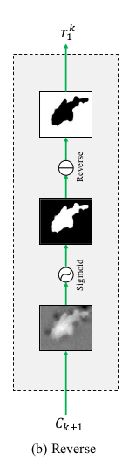
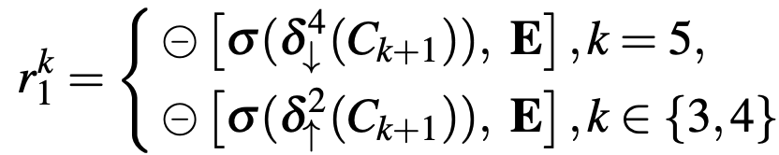
Group Reversal Attention
Reverse Guidance
Motivation: to mine discriminative concealed regions by erasing objects from the output of NCD
Output reverse guidance is obtained via sigmoid and reverse operations
𝛿⁴↓ and 𝛿²↑ denote X 4 downsampling and X2 upsampling respectively
Sigmoid operation is used to convert the mask in the interval [0,1]
Reverse operation subtracts the input from matrix E, with all elements 1
Notes:
reverse attention is used for mining complementary regions and details by erasing the existing estimated target regions from side-output features
We down sample or up sample the coarse map to match the size which is then operated with sigmoid.
This is then subtracted element wise with matrix with each element as 1 to obtain complementary region
These reverse guidance is used into GRA as feedback when it operates on the enhanced features
WHILE EXPLAINING THIS, SHOW THE OVERALL STRUCTURE TO SHOW WHERE THIS FITS IN THE OVERALL STRUCTURE

Slide 15
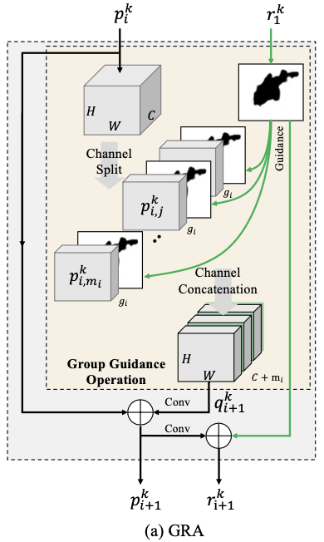

Group Reversal Attention
Group Guidance Operation (GGO)
Motivation: Novel group wise operation to utilise reverse guidance prior effectively
Consists of 2 main steps: Channel wise split(Step I) and Concatenation(Step II)
Candidate features are split into multiple groups along along channel dimension
Guidance prior is periodically interpolated among split features
Notes:
To incorporate reverse guidance prior effectively we use group wise operation
It primarily involves two steps: 1) group split 2) concatenation
The feature map P_{i}K is split into gi groups
R_{i}K is concatenated with each split group and then further all the group to concated to give a final feature with increase dimension

Slide 16
Group Reversal Attention
Group-Reversal Attention (GRA)
Motivation: Progressively refine the coarse prediction via different feature pyramids
Combination of multiple GRA blocks is used since multistage refinement improves
Performance
Refined feature map(P_{i+1}k) is obtained after a 3x3 convolution operation on the GGO of (P_{i}k and R_{i}k) for reducing the channel size
Single channel refined residual guidance R_{i+1}k is obtained as R_{i}K +(P_{i+1}k operated with 3x3 convolution for size reduction to single channel)
Finally refined guidance, serves as residual guidance, is obtained as C_{k}=R_{i+1}k+𝛿⁴↓ (C_{k+1})
Notes:
This is the main block which uses residual guidance and GGO to improve the coarse map generated by NCD for better localisation
It use different feature pyramids with multiple blocks for progressively refine the coarse prediction
P_{I+1} is obtained by 3x3 convolution of GGO for channel size reduction
R_{i+1} is obtained by element wise addition of R_{i} with P_{i+1} operated with 3x3 convolution for reduction to dingle channel
Finally the refined coarse map prediction is done by combining the reverse guidance with previous coarse map

Slide 17
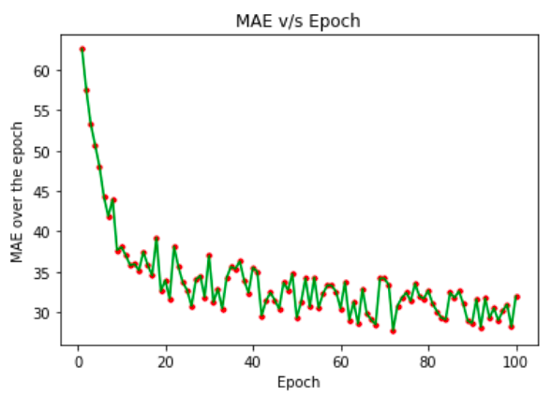
Training Process
The Model Architecture was implemented in PyTorch and trained with the Adam optimizer.
The learning rate was set to 10^ -5
Xavier initialization was used to initialize the learbale params (about 20 million)
Used Batch Normalization as the normalization method with a mini-batch size 10.
Pixel-wise cross entropy loss was used for training process
The train time observed per epoch was approximately 73 seconds and total number of epoch steps were 100.
Training was done for approximately 2 hours.

Slide 18
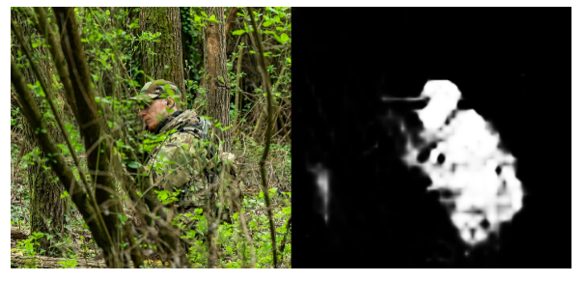
Results
COD10K result

Slide 19
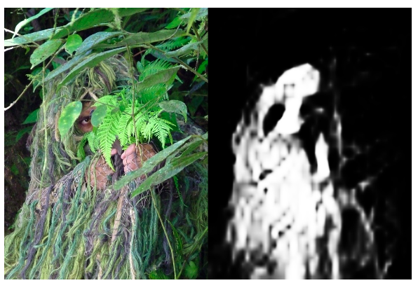
Results
COD10K result

