Slide 1
Problem Statement
Study the shear stresses distribution, axial deformations along the cross-section when a cantilevered beam is subject to torsion.
Analyse different C/S like circular , rectangular and triangular and identify regions of high stress concentration
These regions will initiate crack formation and thus , this analysis is important to figure out the weak-links and thus , improve the torsion bearing capacity of beams.

Slide 2
Problem statement
Analyse Aluminium beams with Shear Modulus about 27 GPa and find out the shear stress distribution , torsional stiffness and axial displacement across the C/S.
Use Finite-difference method to figure out the Prandlt-stress function and thus, obtain above mentioned distributions and validate the results using optimal super-position of numerical approximations that satisfy the boundary conditions but not the PDE.

Slide 3
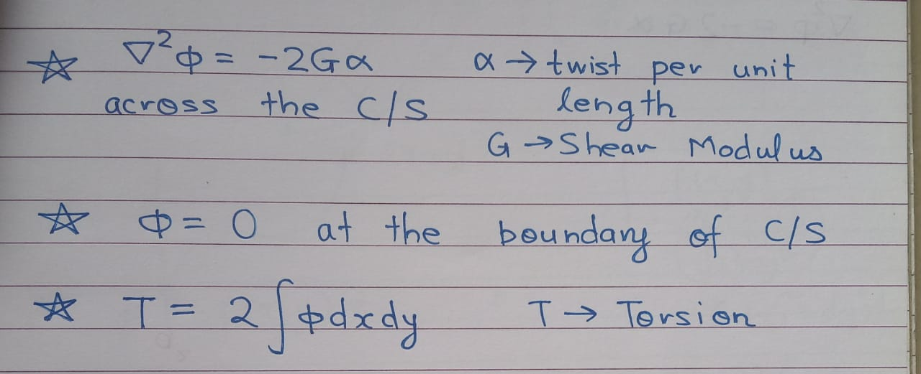
Methodology
Use FDM to solve Poisson PDE with appropriate boundary conditions for the Stress function.
All the analysis has been done with alpha=0.01 and shear modulus=27GPa but they can be changed to other values in the code.

Slide 4
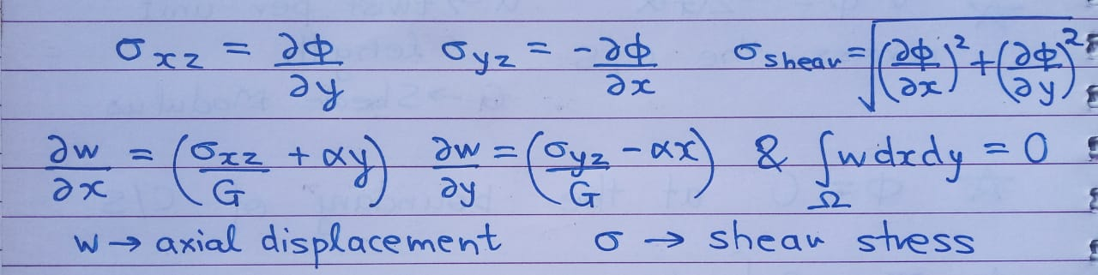
Methodology
The following are the relations to obtain shear stress , axial displacements from the stress functions:

Slide 5
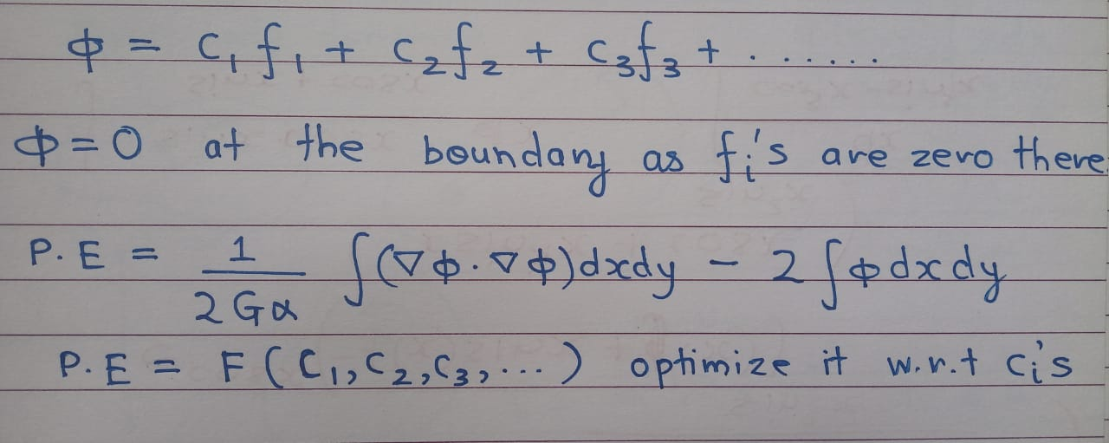
Methodology
Generate functions that vanish at the boundary like the equation of the boundary itself and find their optimal superposition which minimizes potential energy.
Used Momentum based steepest-descent to optimize the weights of those functions and thus , minimize the potential energy and obtain an approximate stress function.

Slide 6
Implementation
Initialized stress function at all points outside the C/S to zero.
Solved the system of difference equations to obtain stress function values inside the C/S
Integrated the function to obtain torque and thus , torsional stiffness.
Finally , numerically estimated the partial derivatives to obtain the stress distribution and thus ,axial displacements.
In the second method evaluated PE for various weights and optimized them using steepest descent method.

Slide 7
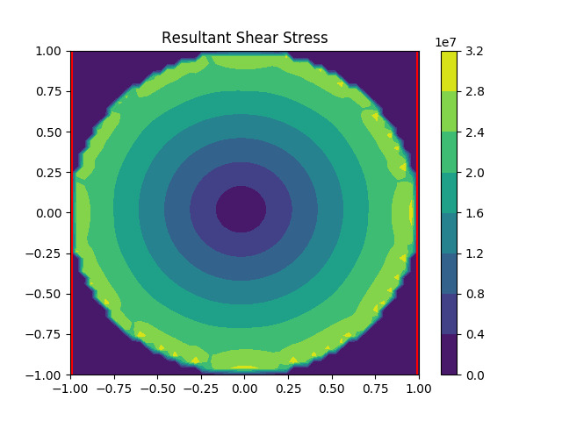
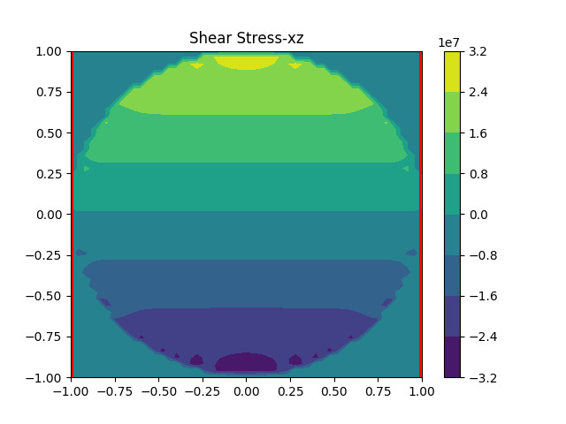
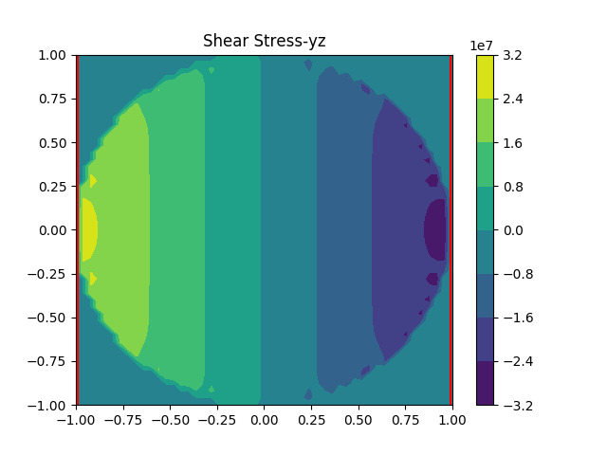
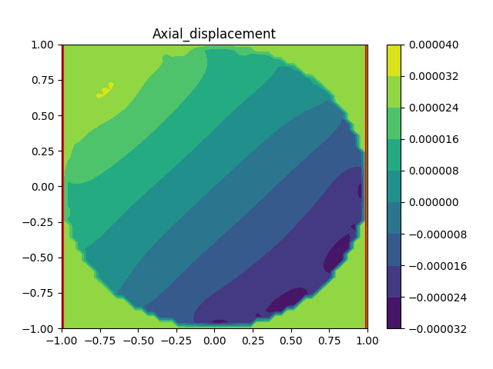
Simulations for circular C/S

Slide 8
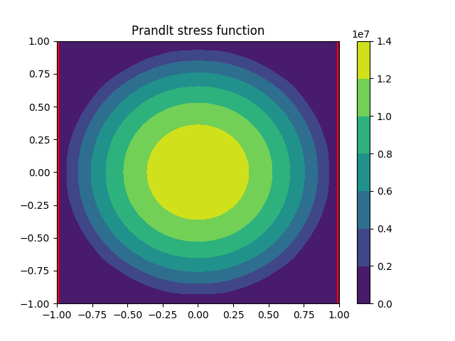
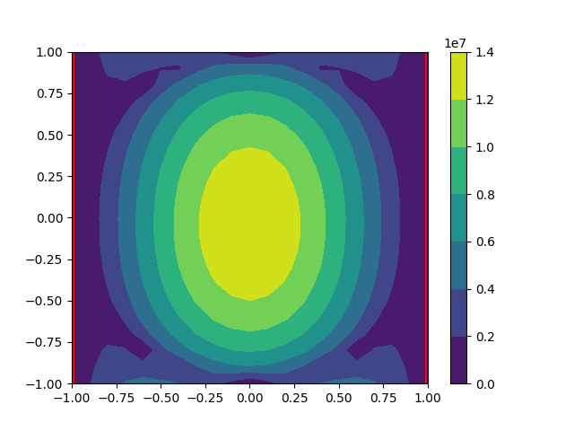
Analysis for circular C/S
Torque:44001736.442 N/m
Torsional Stiffness:44001736442
Torque:44353100.113 N/m
Torsional Stiffness:44353100113
Method 1
Method 2
Both agree well with theoritical Torque i.e.GJ*alpha=42390000 N/m

Slide 9
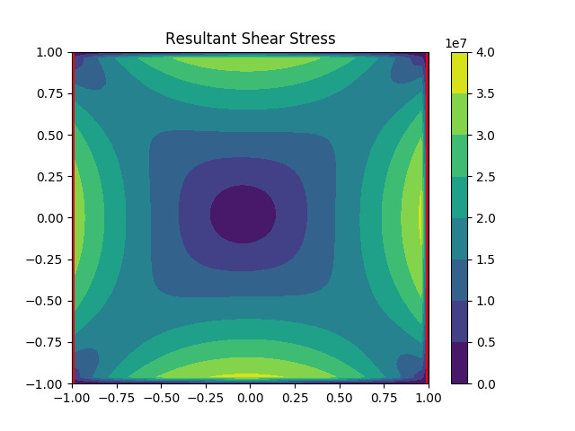
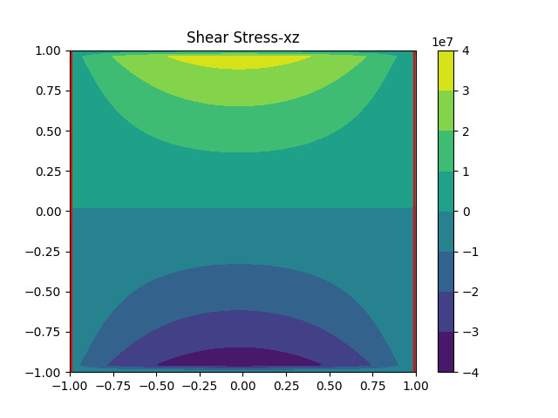
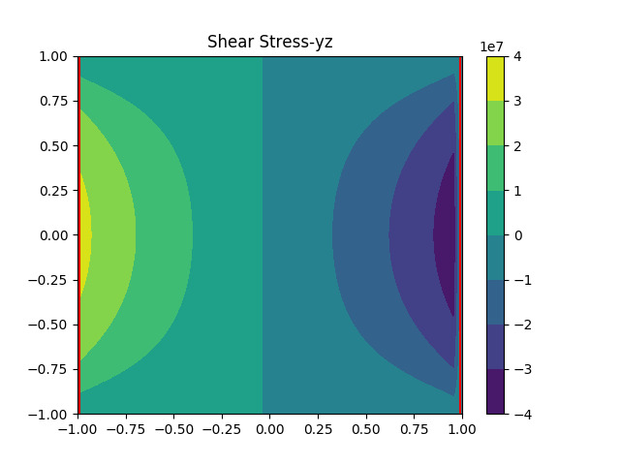
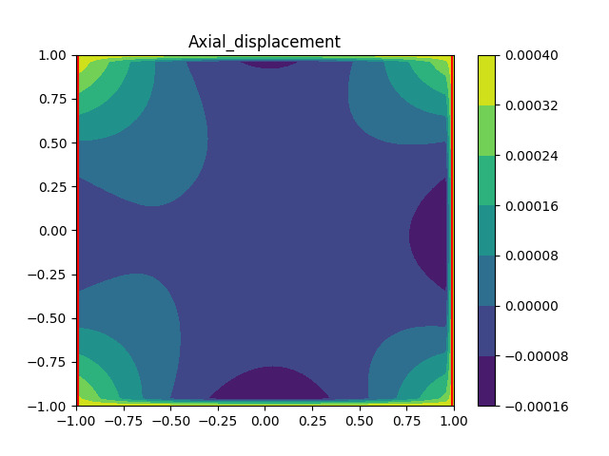
Simulations for square C/S

Slide 10
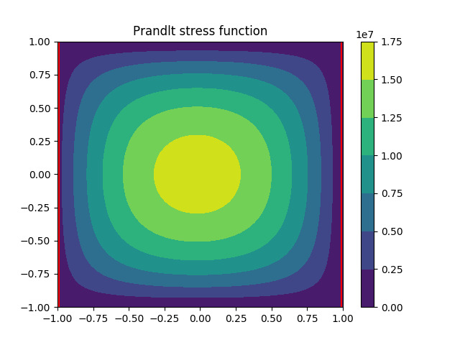
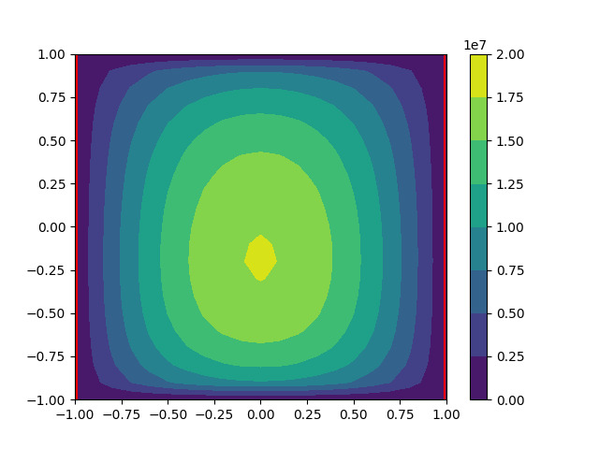
Analysis for square C/S
Torque:63090766.041 N/m
Torsional Stiffness:63090766041
Trque:74234877.972 N/m
Torsional Stiffness:74234877972
Method 1
Method 2
There is a quite a bit of error in the second method about 15%

Slide 11
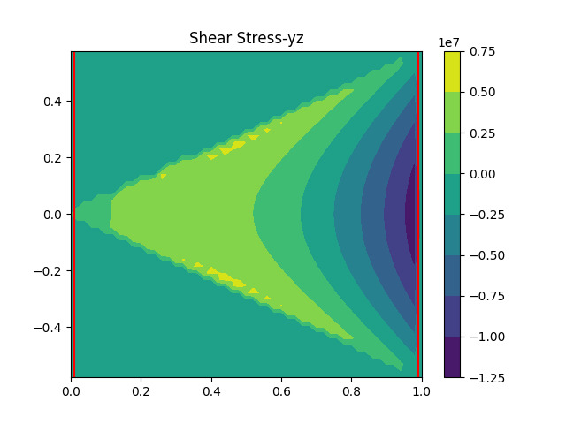
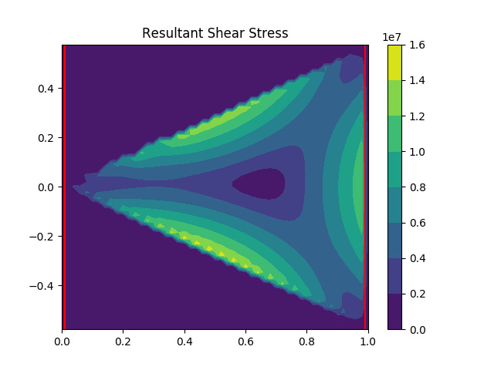
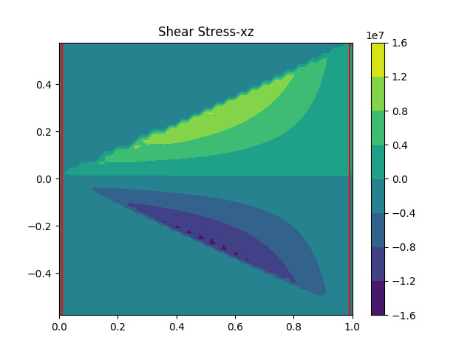
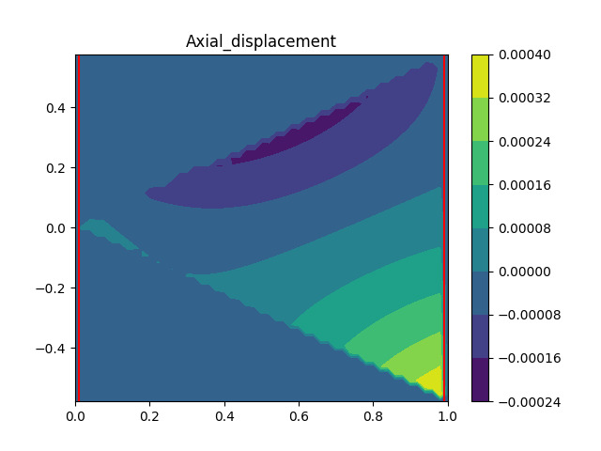
Simulations for triangular C/S

Slide 12
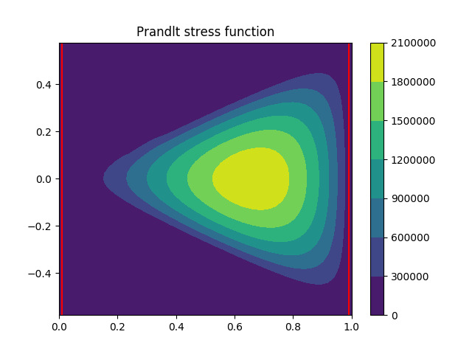
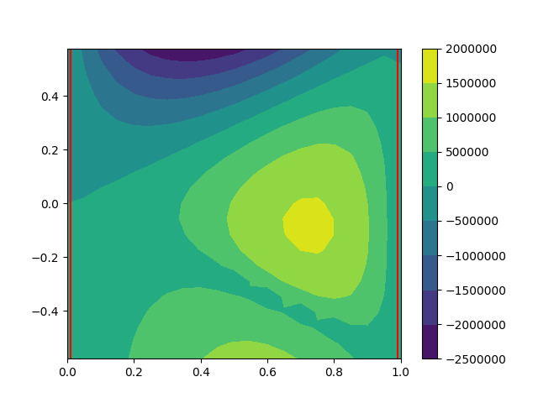
Analysis of triangular C/S
Torsion:1065740.203N/m
Torsional Stiffness:1065740203
Torsion:824501.500N/m
Torsional Stiffness:824501500
Method 1
Method 2
There is a quite a bit of error in the second method about 20%

Slide 13
Analysis
The FDM method is very accurate but the minimizing PE has some error.
The accuracy of FDM method increases by decreasing step size and increasing the number of basis functions improves the accuracy of the other method.
Torque is proportional to the angle of twist and stress builds up away from the centre but doesn’t accumulate at the corners.
The cross-section warps i.e. particles displace above and below their plane and form a non-planar surface but the average axial displacement is zero.

Slide 14
ReadMe
Inputs: G , alpha, x_start , x_end and fun_1,fun_2 are equations of C/S above and below the x-axis respectively.
eg. x_start=1,x_end=1,fun_1,fun_2=+-math.sqrt(1-x*x) for unit circle.
The poisson_pde_solver.py use FDM and pmpe.py uses numerically approximate solutions.
Outputs:Torque,Torsional stiffness and contour plots for stress function,stresses,axial displacement.

