Slide 1
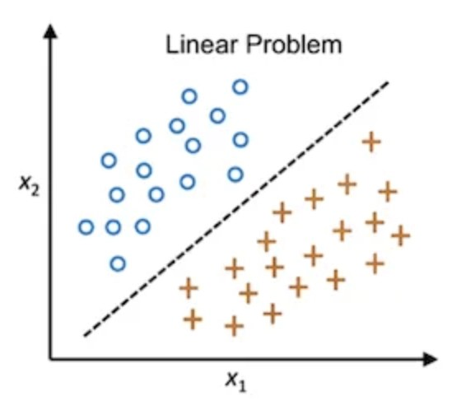
Nonlinearity
Let the feature vectors are of 2-D and of two different classes.
They may be linearly separable or nonlinearly separable.
Here, it is a linear discriminator or classifier that can separate the samples of two different classes.
For 2-D it is a straight line, for 3-D is a plane and for more dimensions it is a hyperplane.
Here, the accuracy is 100%, i.e., without any error the classifier may discriminate the samples of two different classes.

Slide 2
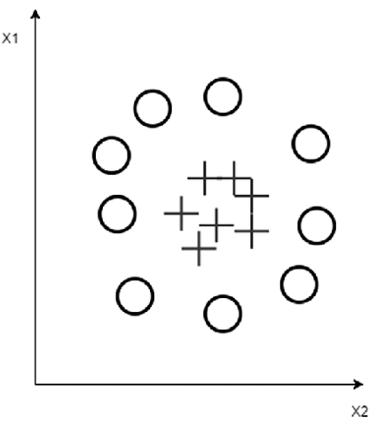
Nonlinearity
Let the feature vectors distribution is as above.
Let all the vectors of ‘+’ symbol are of one class and all other of symbols ‘-’ are of another class.
Clearly they are not linearly separable.

Slide 3
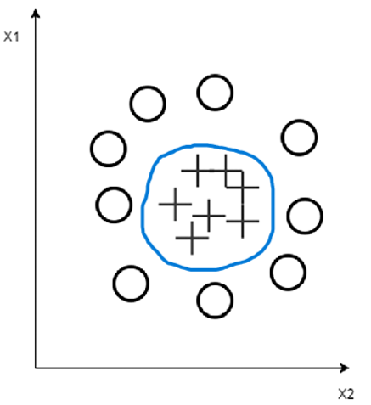
Nonlinearity
Here, all the feature vectors of class ‘+’ are within a circle and all others are outside the circle.
In case of 3-D, all samples of symbol ‘+’ are in a sphere and others are outside the sphere, and so on.
So we may have many such complicated distribution of the feature vectors.
Here, we cannot imagine any linear separator to separate the samples of one class from another.
So, if we train our linear classifier with such nonlinearly separable objects, there must be error or misclassification in the classifier.
This is known as linearly non separable problem.

Slide 4
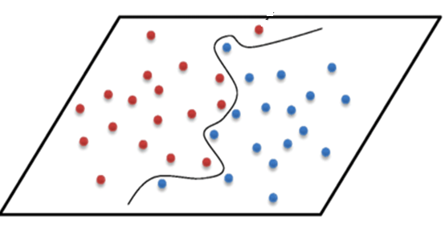
Nonlinearity
Here, we cannot separate the classes without using nonlinear functions.
What we can do in such cases?
Let us consider the 2-D features for simplicity and samples of two different classes as shown below:.

Slide 5
Nonlinearity
Let, all samples right side of the classifier are of class C1, and others are of class C2.
Here, we cannot find any linear classifier, i.e., straight line by which we can separate the samples of two classes, i.e., they are not linearly separable.
Actually, they are nonlinearly separable.

Slide 6
Nonlinearity
In fact, there is a curve (i.e., nonlinear function) by which the samples are separable.
So, it is a nonlinear problem.
But still possible to solve this problem using linear classifier – How?

Slide 7
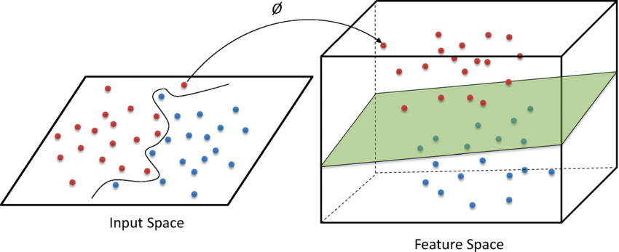
Nonlinearity
Use nonlinear mapping of the feature vectors, so that the feature vectors of 2-D are mapped into 3-D.
Here, say they mapped in such a way that the they are now separable by a plane, as shown in the right side of the figure.

Slide 8
Nonlinearity
So we are increasing the dimension of the feature vectors using nonlinear mapping.
So even though the samples of different classes are mixed with each other, still without using nonlinear classifier, it is possible to separate the samples by using the nonlinear mapping.
Nonlinear mapping maps the feature vectors or samples from lower dimensional space to higher dimensional space where they are separable by linear classifier.

Slide 9
Nonlinearity
Let us consider the previous 2-D samples.
Here, all samples within circle are of class C1 and others are of C2.
Nonlinear mapping is done using a nonlinear function, say
.
Here, we have the samples of two dimensions, X₁ and X₂.
Let, one sample is X= <x₁, x₂ >, then is defined as
So we are considering 3-Ds with a nonlinear mapping on 2-D such that:

Slide 10
Nonlinearity
Here, equation of the circle is , where R is the radius of the circle.
If a sample point (x₁, x₂) lies inside, then
If a sample point (x₁, x₂) lies outside, then
If a sample point (x₁, x₂) lies on the circle, then

Slide 11
Nonlinearity
So value of for any sample within the circle is always less than that of outside samples.
So the third coordinate of all samples outside the circle (class C2) is greater than that of all samples inside the circle (class C1).
The feature vectors in 3-D are of the form
Thus our sample points in 2-D are nonlinearly mapped to 3-D space by the nonlinear mapping:
where
, and
for any feature vector X = [X₁, X₂].
Value of the third coordinate is higher for all the samples of class C2.
So there must be a plane by which the samples of class C1 is linearly separable from samples of class C2, such that samples lower to the plane are of class C1 and upper to the plane of class C2.

Slide 12
Nonlinear to linear transformation
Thus, it is possible to transform the nonlinearly separable lower dimensional feature vectors to higher dimensional feature vectors using nonlinear mapping so that they are linearly separable by plane in 3-D, and hyperplane in higher dimensions.

Slide 13
Nonlinear to linear transformation
So this transformation is done by nonlinear mapping where X=[X₁, X₂], such that , and
Thus we map the sample X = [X₁, X₂] in 2-D to
in 3-D using the nonlinear mapping .
The hyperplane in 3-D may be written as
=> by which the feature vectors are linearly separable.

Slide 14
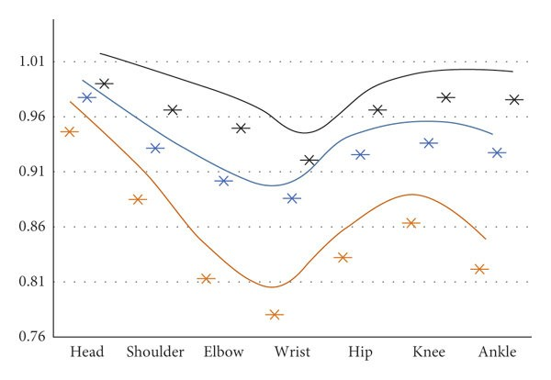
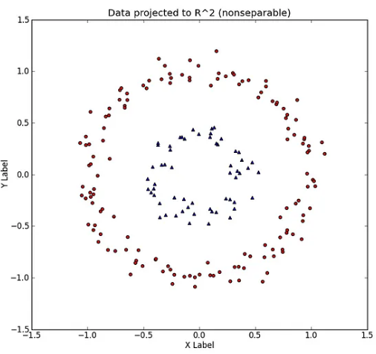
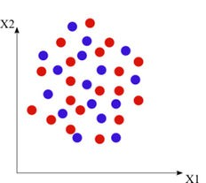
Nonlinear to linear transformation
This type nonlinearity mapping from lower dimension to higher dimension is not so simple.
But theoretically, it is proven that if we map a feature vector to a infinite dimension space then whatever be the complexity of the nonlinearity, every nonlinear problem can be solved as a linear problem. So for nonlinear mapping we need some nonlinear functions.

Slide 15
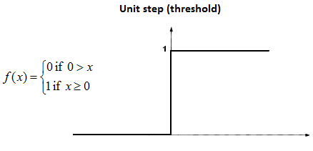
Some nonlinear functions
The nonlinear functions are also used in deep learning as activation functions to handle nonlinearity. Some of these types of nonlinear functions are:
1. Threshold Function:
This is the simplest
type of nonlinearity
function.

Slide 16
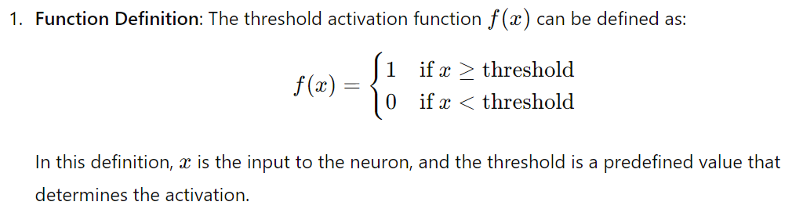
1. Threshold Function
The threshold activation function, also known as the step function, is a type of activation function used in artificial neural networks.
It's a simple function that activates a neuron only when the input exceeds a certain threshold. General definition is:

Slide 17
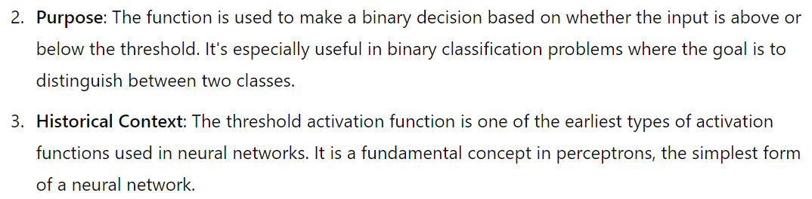
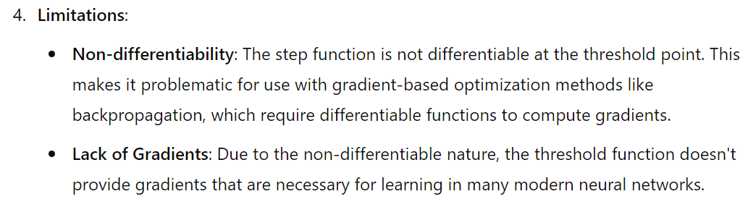
1. Threshold Function
We have used it to implement different logic gates.

Slide 18
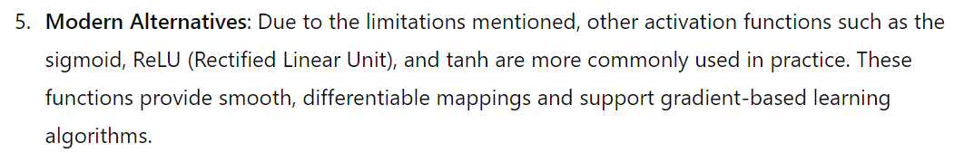
1. Threshold Function
Despite its simplicity, the threshold activation function is a foundational concept that has paved the way for more advanced and sophisticated activation functions used in contemporary neural networks.

Slide 19
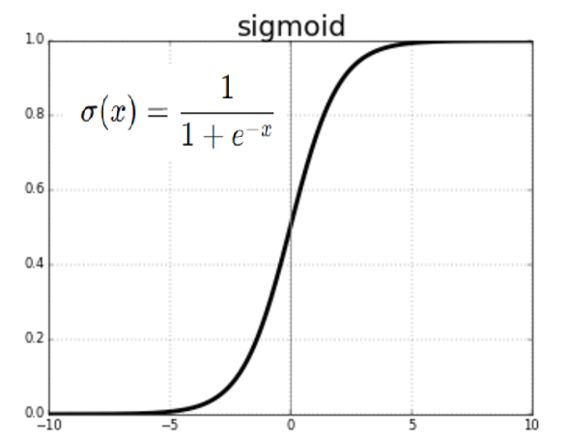
2. Sigmoid Function
We have discussed it during construction of logistic regression model.
The sigmoid activation function is a widely used activation function in neural networks, particularly in the context of binary classification problems.
It maps any real-valued number into a value between 0 and 1, which is useful for scenarios where we want to model probabilities or outcomes that need to be in this range.

Slide 20
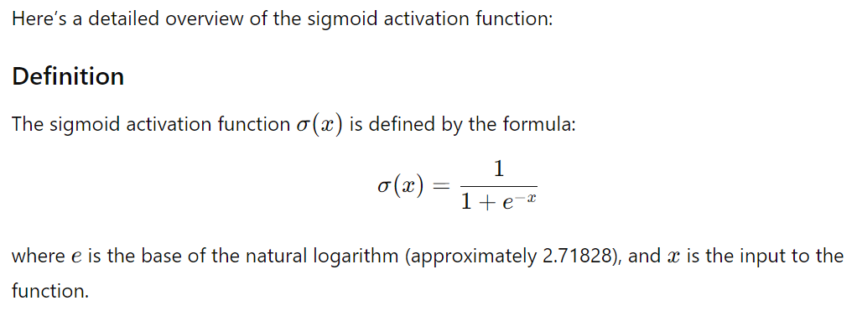
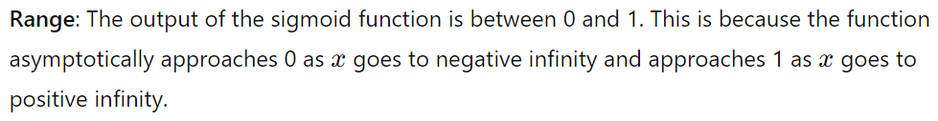
2. Sigmoid Function

Slide 21
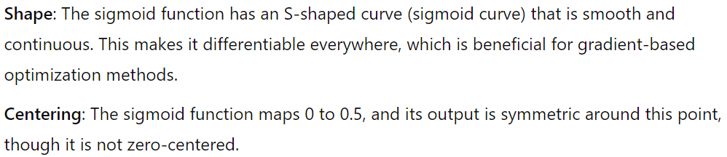
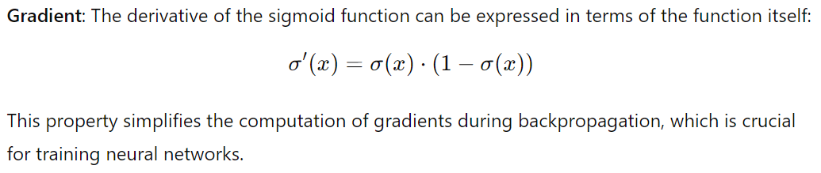
2. Sigmoid Function

Slide 22



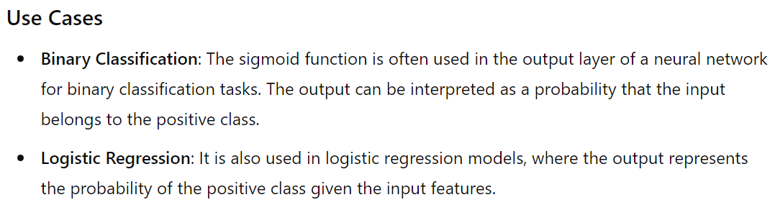
2. Sigmoid Function
Since,

Slide 23
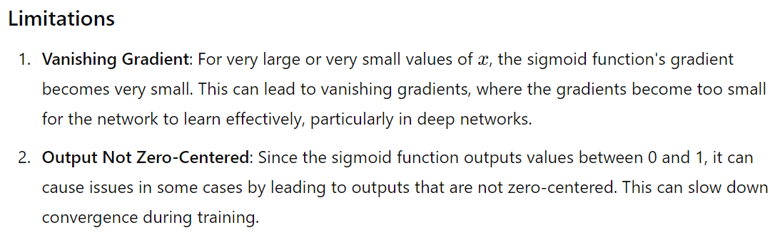
2. Sigmoid Function

Slide 24
Non-Zero-Centered Output
Non-Zero-Centered Output implies the range of values the function produces. The sigmoid function’s output is not distributed around zero. Here, the inputs map to values in the range [0,1]. This means that the function only produces positive outputs, with no values below zero. This can slow down the convergence during training.
Bias in Gradient Updates: The gradients can become skewed because the outputs are always positive. This can lead to a situation where the network’s updates are not symmetric, potentially causing inefficient learning and slower convergence.
Example: Consider a simple neural network with sigmoid activation functions in its hidden layers. The activations will be in the range of 0 to 1, meaning that any neuron output will be positive. If you have a large number of neurons in the network, the activations can become biased towards higher values, and the gradients may not be centered around zero, leading to less effective gradient updates.

Slide 25
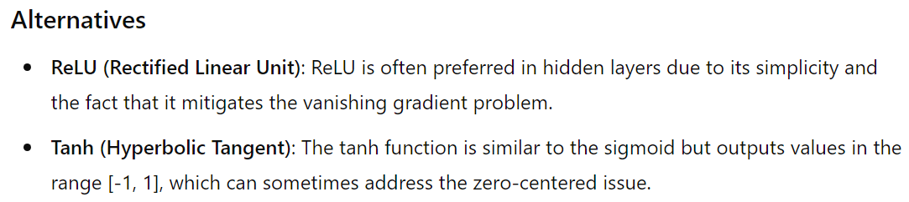
2. Sigmoid Function
Conclusion: The sigmoid function is a fundamental concept in neural network design and provides a good starting point for understanding activation functions and their role in network training.

Slide 26
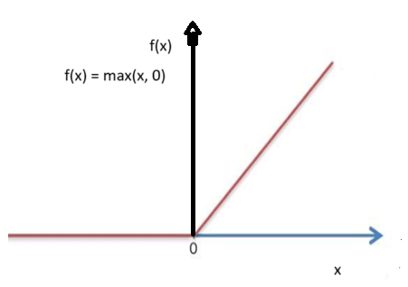
3. Rectifier Function
Rectifier functions are often called Rectified Linear Unit activation functions, or ReLUs for short.
A Rectified Linear Unit (ReLU) is a widely used activation function in neural networks.
It helps introduce non-linearity into the model, allowing it to learn complex patterns in data.
The ReLU function is defined
mathematically as:
f(x) = max(0, x)
This means that if the input x is
positive, the output is x. If x is
negative, the output is 0.

Slide 27
Key Features of ReLU:
Non-linearity: Despite being a simple piecewise linear function, ReLU introduces non-linearity, which is crucial for learning complex patterns.
Sparsity: It leads to sparse activation. For any given input, a significant portion of neurons will be inactive (outputting zero), which can help with efficient computation and reduce overfitting.
Computational Efficiency: ReLU is computationally efficient because it only involves a simple comparison operation.
But the disadvantage of ReLU is that it can lead to "dying ReLU" problem where neurons output zero and stop learning. Variants like Leaky ReLU or ELU can help mitigate this issue.

Slide 28
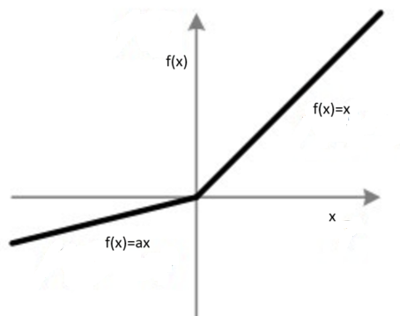
Leaky ReLU
Leaky ReLU is a variant of the standard ReLU activation function designed to address the "dying ReLU" problem, where neurons can become inactive and stop learning if their outputs are zero.
Leaky ReLU introduces a small, non-zero slope for negative inputs, which helps keep the neurons active during training.
It is defined mathematically as:
f(x)=max(a*x , x)
It returns x if it receives any positive input, but for any negative value of x, it returns a really small value which is ’a’ times x.
Thus it gives an output for negative values as well.

Slide 29
Leaky ReLU
Thus, Leaky ReLU has a small slope for negative values instead of a flat slope.
The slope coefficient (a) is determined before training, i.e. it is not learnt during training.
This type of activation function is popular in tasks where we may suffer from sparse gradients, for example training generative adversarial networks.

Slide 30
What is Sparse Gradient?
Gradient: In the context of machine learning and neural networks, the gradient of a function (such as a loss function) with respect to a model's parameters indicates how much the function would change if the parameters were adjusted. The gradient is used to update the parameters during training.
Sparsity: Sparse gradients are those where many of the gradient values are zero or very small. This often means that only a few parameters are actively contributing to the loss, and the rest do not change significantly in response to small variations in the parameters.

Slide 31
How Sparse Gradients Arise?
Activation Functions: Activation function like ReLU can lead to sparse gradients. For example, ReLU outputs zero for all negative inputs, which can cause gradients to be zero for neurons with negative activations.
Feature Selection: In models where feature selection or sparsity is encouraged (e.g., through L1 regularization), some parameters or features may end up with gradients of zero, reflecting that they do not contribute to the loss function.
Optimization Algorithms: Algorithms like stochastic gradient descent (SGD) might result in sparse gradients due to the nature of the data batches used for updates.

Slide 32
Advantages of Sparse Gradient
Computational Efficiency: Sparse gradients can lead to more efficient computations and updates since fewer parameters need to be adjusted. This can be beneficial in high-dimensional spaces where only a small subset of parameters are active.
Reduced Overfitting: Sparse gradients might help with model generalization by focusing the learning process on a smaller number of important parameters, potentially reducing overfitting.

Slide 33
Disadvantages of Sparse Gradient
Learning Dynamics: If too many parameters have sparse gradients, the model might learn slowly or inadequately if the gradients are not informative enough about the loss function.
Gradient Noise: Sparse gradients can introduce noise into the training process, particularly if the gradients are zero for many parameters, making the optimization process less stable.

Slide 34
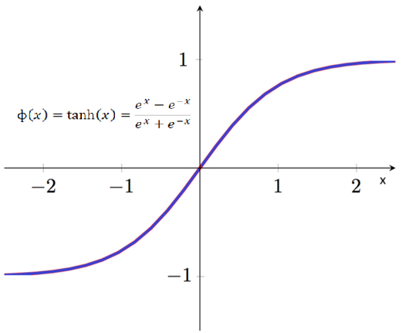


The Hyperbolic Tangent Function
The hyperbolic tangent function, often abbreviated as tanh, is a mathematical function used as an activation function in neural networks and other applications.
It is defined as follows:
Alternatively, it can also be expressed in terms of exponential functions:

Slide 35
Key Properties of tanh
Range: The output of the tanh function ranges between -1 and 1. This is in contrast to the sigmoid function, which ranges between 0 and 1.
Non-linearity: The tanh function introduces non-linearity into the model, allowing it to learn complex patterns in the data.
Odd Function: The tanh function is odd, meaning that tanh⁡(−x)=−tanh⁡(x). This symmetry around the origin can help in learning representations that are centered around zero.
Smooth Gradient: The gradient of the tanh function is smooth and continuous, which can help with gradient-based optimization methods.

Slide 36
Key Properties of tanh
Gradient Descent and Symmetry: In tanh, outputs range from -1 to 1, which helps in keeping gradients symmetric around zero. This symmetry can lead to more efficient learning as the gradient steps are balanced in all directions.
tanh functions produce outputs in the range [−1,1]. This zero-centered nature helps maintain a balanced gradient flow, making the learning process more stable and often faster.

Slide 37
Mathematical Behavior of tanh
For large positive inputs: tanh(x) approaches 1.
For large negative inputs: tanh(x) approaches -1.
For inputs around zero: tanh(x) behaves approximately like the input x, which makes it approximately linear in the small input region.

Slide 38
Advantages
Zero-Centered Output: Unlike the sigmoid function, which outputs values between 0 and 1, tanh outputs values between -1 and 1. This can help in centering the data and speeding up learning because the activations are zero-centered, reducing bias in gradients.
Non-saturation in the Middle Region: The tanh function is less likely to saturate around zero compared to the sigmoid function, making it less prone to the vanishing gradient problem in the central part of its domain.

Slide 39
Disadvantages
Vanishing Gradient Problem: For very large or very small inputs, the gradient of the tanh function can become very small, leading to the vanishing gradient problem where the model learns very slowly. This can hinder training, particularly in deep networks.
Computational Complexity: While tanh is more complex to compute than simpler functions like ReLU, modern computational libraries and hardware optimizations typically make this a minor issue.

Slide 40
Use in Neural Networks
Activation Function: Tanh is often used as an activation function in the hidden layers of neural networks. It can help in ensuring that activations have zero mean and maintain some level of gradient flow.
Recurrent Neural Networks (RNNs): Tanh is particularly popular in RNNs, including Long Short-Term Memory (LSTM) and Gated Recurrent Unit (GRU) networks, where its ability to manage gradients and zero-centered output is beneficial for learning temporal sequences.

Slide 41
Thank You

