Slide 1
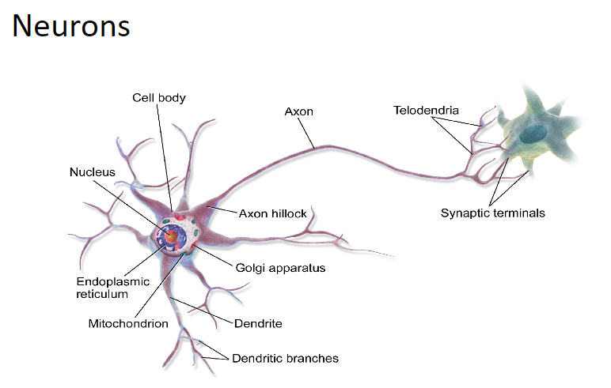
Biological Neuron
The Nervous system helps us to sense and respond to our environment and it is divided into two parts: Central nervous system and Peripheral nervous system.
Central nervous system consists of the brain and spinal cord.
Peripheral nervous system consists of sensory and motor nerve cells that runs throughout the rest of the body.
All cells of the nervous system are comprised of neurons. Neurons are the basic unit of the nervous system and nervous tissue.

Slide 2
Biological Neuron
A human brain consists of approximately 10¹¹ neurons communicating with each other with the help of electrical impulses. Each neuron is approximately 10 micron in length.
The neurons in brain help the human being to think, remember and solve the problem.
There is a chemical called neurotransmitter in each neuron by which signal (sense) transmitted.

Slide 3
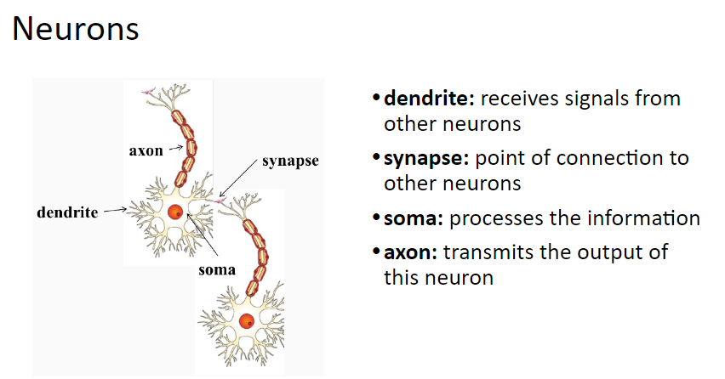
Biological Neuron
Neurons communicate with each other with the help of electrical impulses.
Neurons carry electrical impulses from one part to another part of the body.
Neurons are responsible for sending, receiving, and interpreting information from all parts of the body.

Slide 4
Biological Neuron
All inputs (signal) from one neuron arrive to another neuron through dendrites.
Then the input signals are accumulated and processed at soma.
The processed signal is transmitted as output from the axon to the other neuron through synapse.

Slide 5
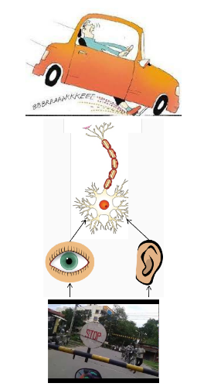
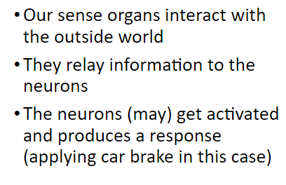
Biological Neuron

Slide 6
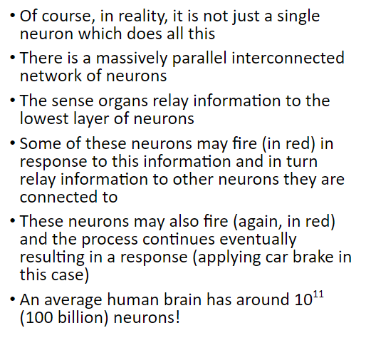
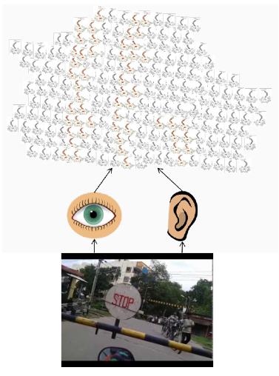
Biological Neuron

Slide 7
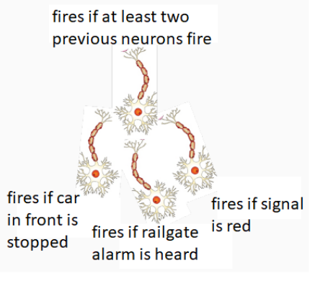
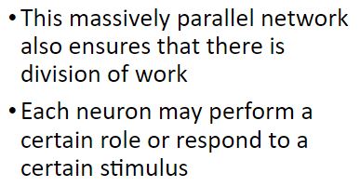
Biological Neuron
An action (like when a mosquito bites, car comes in front of your car) may produce an electrical impulses, which usually lasts for about a millisecond.
This pulse is created due to an incoming signal and all signals may not produce pulses in axon unless it crosses a threshold value (i.e., signal strength > threshold).
The impulse in Axon of a neuron is collective signals arrive at dendrites which summed up at Soma (nucleus).

Slide 8
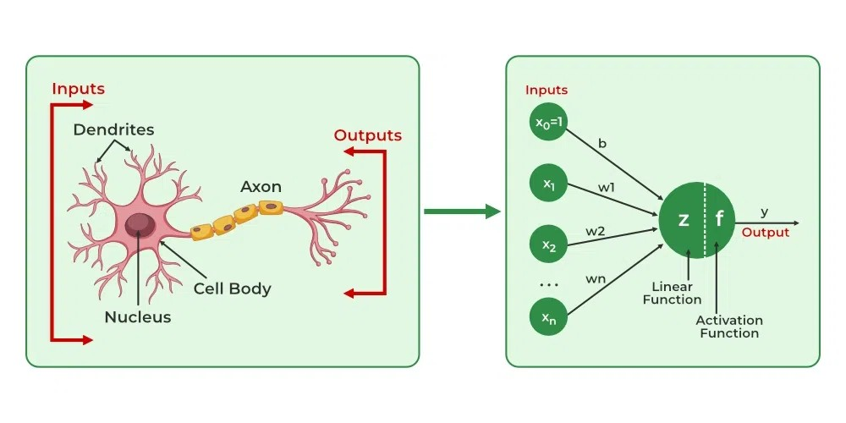
Biological Neuron to Artificial Neuron
An artificial neural network is inspired by the way the human brain processes information.
It is just the mimic or simulation of our biological nervous system.
Biological Neuron | Dendrite | Cell nucleus or Soma | Synapses | Axon
Artificial Neuron | Inputs | Nodes | Weights | Output

Slide 9
Biological Neuron to Artificial Neuron
Understanding the parallels between biological neurons and artificial neurons helps in grasping how artificial neural networks are inspired by the human brain's neural structures. Here's a detailed comparison of the specific parts of biological neurons and their counterparts in artificial neurons:
Biological Neuron:
1. Dendrites
Function: Dendrites are branch-like extensions from the neuron's cell body (soma) that receive incoming signals (neurotransmitters) from the synapses of other neurons.
Role: Act as receivers, collecting electrical signals from other neurons and conveying them toward the cell body.
Artificial Neuron: Equivalent Part: Inputs
Function: The artificial neuron receives inputs, which can be data features or outputs from other neurons in previous layers.
Role: Serve as the input channels through which the neuron receives information to process.
Similarity:
Both dendrites and inputs are responsible for receiving signals from external sources or other neurons, serving as the initial point of data reception in their respective systems.

Slide 10
Biological Neuron to Artificial Neuron
Biological Neuron:
2. Synapses
Function: Synapses are the junctions where the axon terminals of one neuron connect with the dendrites of another. They transmit signals via neurotransmitters.
Role: Facilitate the communication between neurons by modulating the strength of the signal through synaptic weights (efficacy).
Artificial Neuron: Equivalent Part: Weights
Function: Each input to an artificial neuron is associated with a weight that determines its influence on the neuron's output.
Role: Weights adjust the significance of each input during processing, similar to how synaptic strengths modulate signal transmission.
Similarity: Both synapses and weights control the influence of incoming signals on the neuron's activation, effectively modulating the strength of connections between neurons.

Slide 11
Biological Neuron to Artificial Neuron
Biological Neuron:
3. Cell Body (Soma) Biological Neuron:
Function: The soma integrates incoming signals from the dendrites and determines whether the neuron should initiate an action potential.
Role: Acts as the processing center, summing up the electrical signals and making the "decision" to fire or not.
Artificial Neuron:
Equivalent Part: Summation Function (Weighted Sum)
Function: Calculates the weighted sum of all inputs (inputs multiplied by their corresponding weights).
Role: Aggregates the information received to produce a single value that represents the total input signal to the neuron.
Similarity:
Both the soma and the summation function are responsible for integrating incoming signals to determine the neuron's level of activation.

Slide 12
Biological Neuron to Artificial Neuron
Biological Neuron:
4. Axon Hillock
Function: The region where the soma transitions to the axon; it's the site where the action potential is initiated if the combined signal exceeds a certain threshold.
Role: Acts as a trigger point for generating the action potential based on the integrated signal.
Artificial Neuron:
Equivalent Part: Activation Function Threshold
Function: Applies a threshold (or activation function) to the weighted sum to decide whether to activate the neuron.
Role: Determines if the neuron's output should be generated based on the input exceeding a certain value.
Similarity: Both the axon hillock and the activation function threshold serve as decision points that determine whether the neuron will produce an output signal.

Slide 13
Biological Neuron to Artificial Neuron
5. Axon
Biological Neuron:
Function: A long, slender projection that conducts electrical impulses (action potentials) away from the cell body toward other neurons or effector cells.
Role: Transmits the neuron's output signal to other neurons via synapses.
Artificial Neuron:
Equivalent Part: Output Signal
Function: The result of the activation function is sent as an output to other neurons in the next layer or as the final output.
Role: Propagates the neuron's processed information forward through the network.
Similarity:
Both the axon and the output signal are responsible for transmitting the neuron's response to subsequent neurons or systems, enabling communication within the network.

Slide 14
Biological Neuron to Artificial Neuron
6. Activation Function
Biological Neuron:
Function: The neuron's activation depends on whether the integrated signal exceeds a threshold, leading to the generation of an action potential.
Role: Introduces non-linearity by producing an all-or-none response (fires or doesn't fire).
Artificial Neuron:
Equivalent Part: Activation Function (e.g., Sigmoid, ReLU, Tanh)
Function: Applies a mathematical function to the weighted sum to introduce non-linearity and determine the neuron's output value.
Role: Decides the level of activation and allows the network to model complex, non-linear relationships.
Similarity:
Both systems use an activation mechanism to process the summed inputs and produce an output that is not a simple linear function of the inputs, enabling complex signal processing.

Slide 15
Biological Neuron to Artificial Neuron
7. Neurotransmitters
Biological Neuron:
Function: Chemical messengers released at synapses that transmit signals across the synaptic gap to the dendrites of neighboring neurons.
Role: Facilitate or inhibit the firing of the receiving neuron, influencing the signal transmission.
Artificial Neuron:
Equivalent Part: Weighted Inputs and Bias
Function: The weights (and bias) adjust the influence of each input on the neuron's activation, similar to how neurotransmitters can be excitatory or inhibitory.
Role: Modulate the input signals to control the neuron's response.
Similarity:
Both neurotransmitters and weighted inputs/biases modulate signal transmission, affecting whether the next neuron will activate.

Slide 16
Biological Neuron to Artificial Neuron
8. Plasticity (Synaptic Plasticity)
Biological Neuron:
Function: The ability of synapses to strengthen or weaken over time in response to increases or decreases in activity.
Role: Enables learning and memory formation by adjusting the strength of connections between neurons.
Artificial Neuron:
Equivalent Part: Weight Updates during Learning
Function: Weights are adjusted during the training process using algorithms like backpropagation to minimize errors.
Role: Allows the network to learn from data by updating connection strengths based on the error between predicted and actual outputs.
Similarity:
Both systems adjust the strength of connections between neurons to learn from experience, improving performance over time.

Slide 17
Biological Neuron to Artificial Neuron
9. Refractory Period
Biological Neuron:
Function: A period after firing during which the neuron is less excitable and cannot fire again immediately.
Role: Prevents the neuron from overreacting to stimuli and ensures directional signal propagation.
Artificial Neuron:
Equivalent Part: Not Directly Represented, but Similar Concepts Exist
Function: While artificial neurons don't have a refractory period, mechanisms like dropout during training temporarily deactivate neurons to prevent overfitting.
Role: Dropout helps in regularization by preventing neurons from becoming too reliant on specific inputs.
Similarity:
Both mechanisms serve to regulate neuron activity, though the refractory period is biological and dropout is an artificial training technique.

Slide 18
Biological Neuron to Artificial Neuron
10. Membrane Potential
Biological Neuron:
Function: The voltage difference across the neuron's membrane, which changes in response to incoming signals and determines whether the neuron will fire.
Role: Integral in the generation and propagation of action potentials.
Artificial Neuron:
Equivalent Part: Weighted Sum Before Activation Function
Function: The calculated weighted sum represents the neuron's "potential" before applying the activation function.
Role: Determines the level of activation, similar to how membrane potential influences firing.
Similarity:
Both the membrane potential and the weighted sum are critical in determining whether the neuron reaches the threshold to produce an output.

Slide 19
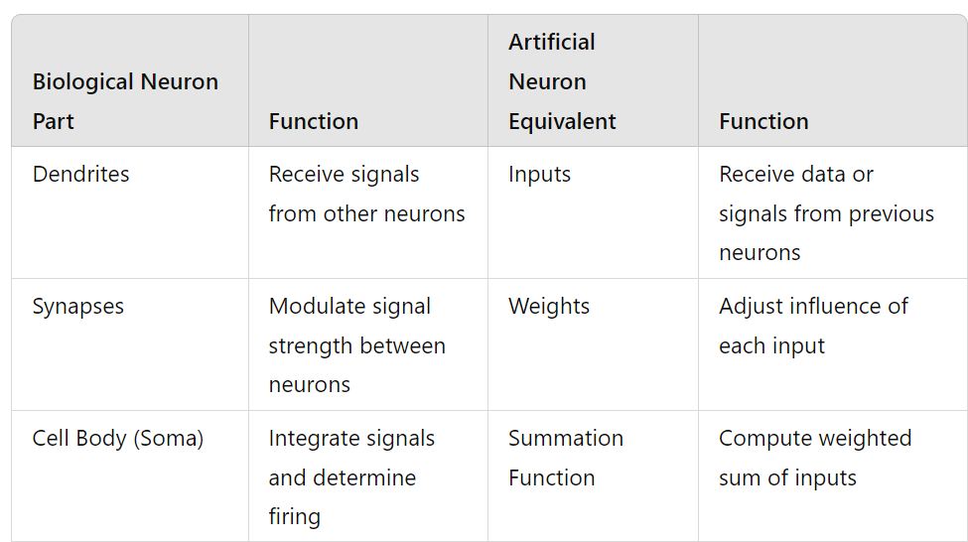
Biological Neuron to Artificial Neuron

Slide 20
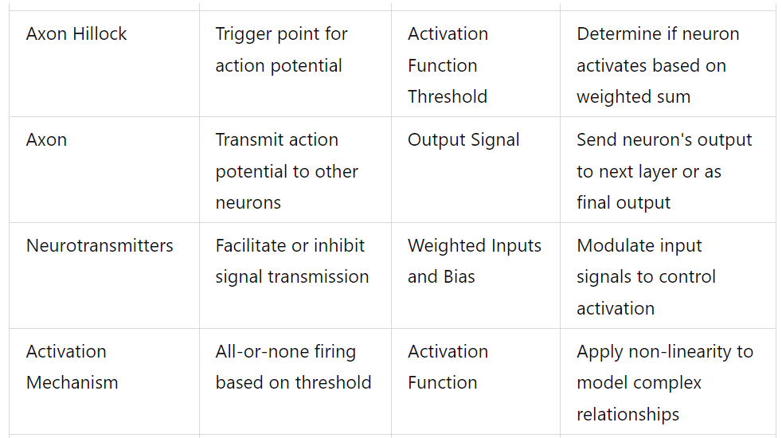
Biological Neuron to Artificial Neuron

Slide 21
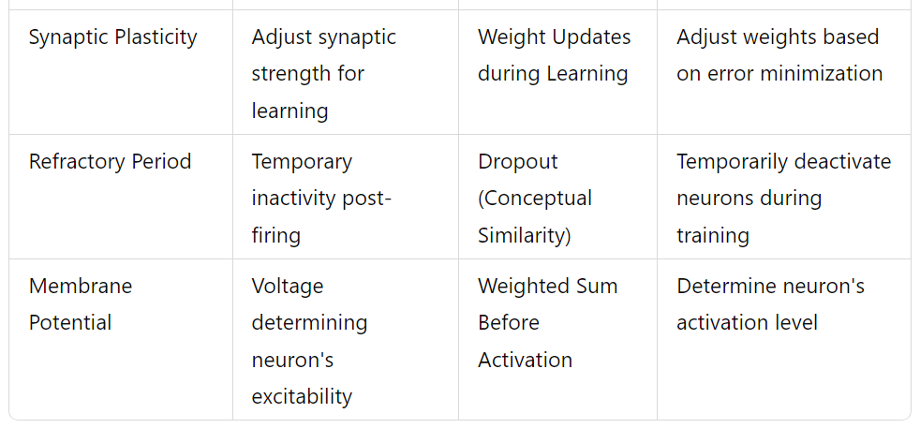
Biological Neuron to Artificial Neuron

Slide 22
Conclusion
The parts of biological neurons have functional counterparts in artificial neurons:
Dendrites ↔ Inputs: Both receive signals from other sources.
Synapses ↔ Weights: Both modulate the strength of incoming signals.
Cell Body (Soma) ↔ Summation Function: Both integrate incoming signals.
Axon Hillock ↔ Activation Threshold: Both decide whether to transmit a signal based on a threshold.
Axon ↔ Output Signal: Both transmit the neuron's response to other neurons.
Neurotransmitters ↔ Weights/Biases: Both influence whether the next neuron will activate.
Activation Mechanism ↔ Activation Function: Both introduce non-linearity into signal processing.
Synaptic Plasticity ↔ Weight Updates: Both adjust connection strengths for learning.
Membrane Potential ↔ Weighted Sum: Both determine the neuron's readiness to activate.

Slide 23
Conclusion
Understanding these parallels highlights how artificial neural networks are designed to mimic the fundamental principles of biological neural processing, enabling machines to perform complex tasks inspired by human cognition.

Slide 24
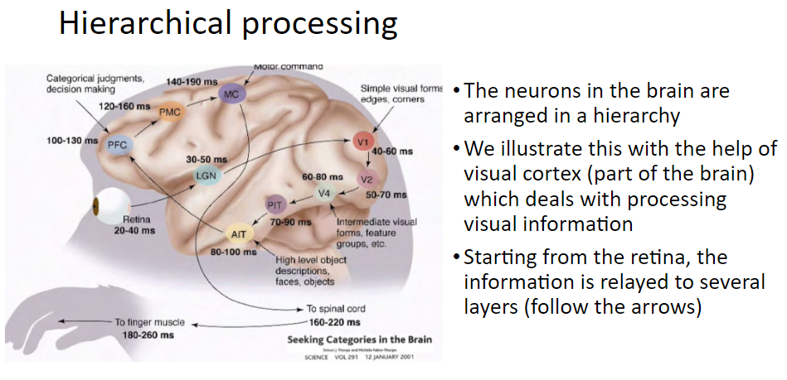
Biological Neural Network

Slide 25
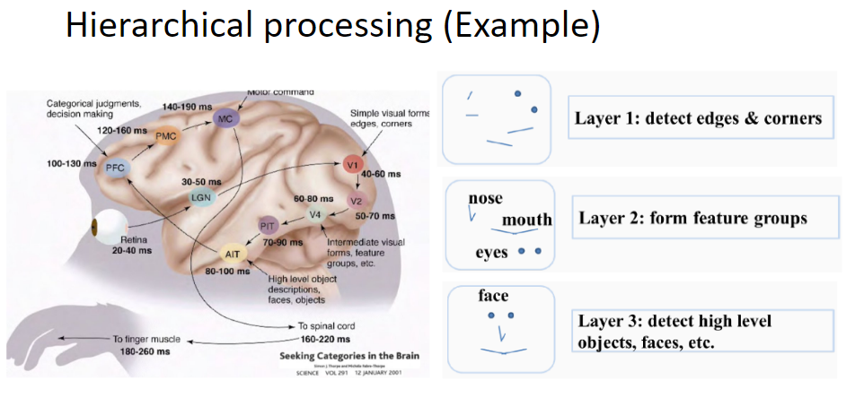
Biological Neural Network

Slide 26
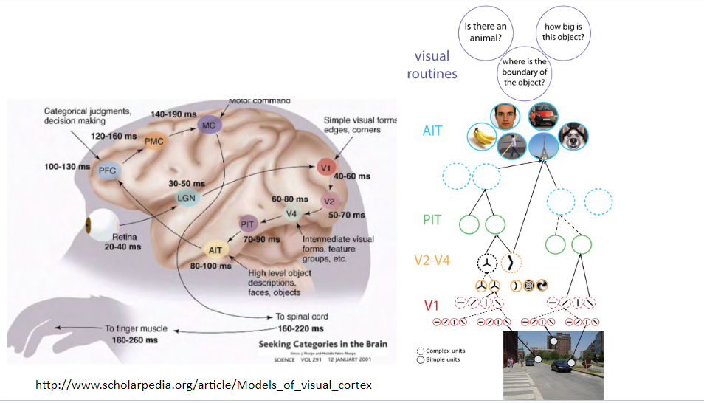
Biological Neural Network

Slide 27
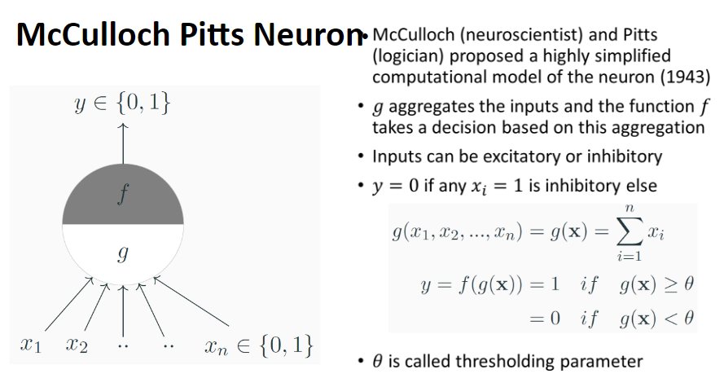
Artificial Neuron

Slide 28
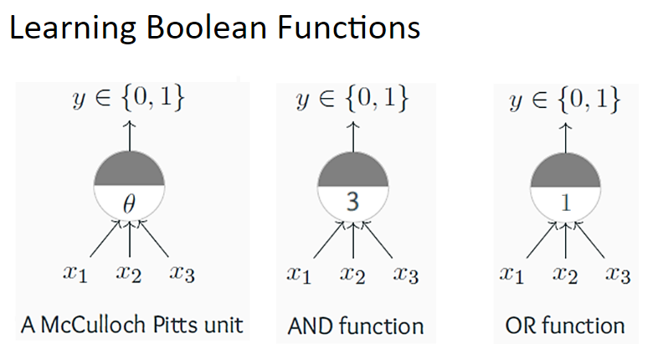
Boolean Function

Slide 29
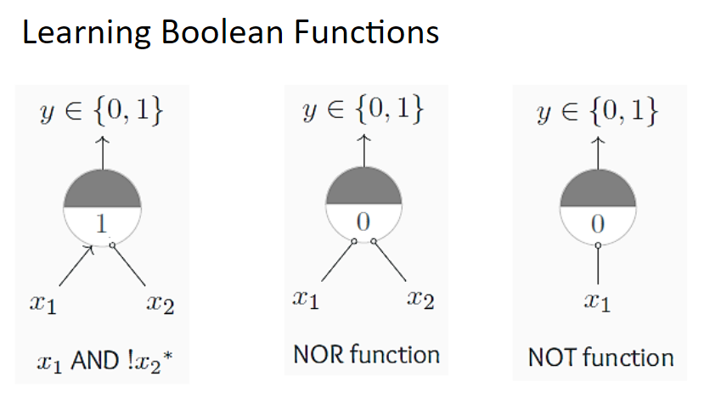
Boolean Function

Slide 30
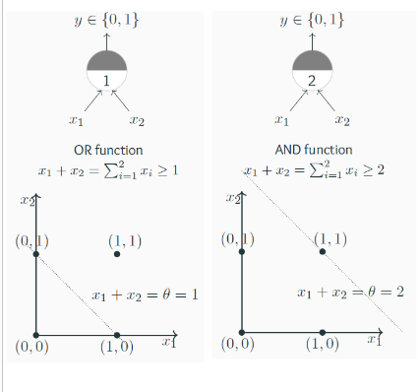
Geometric Interpretation

Slide 31
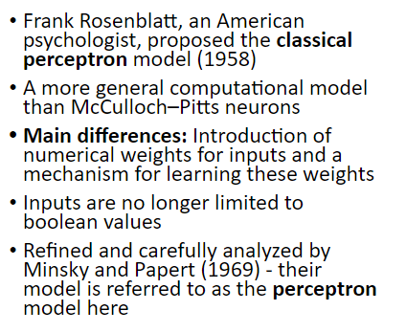
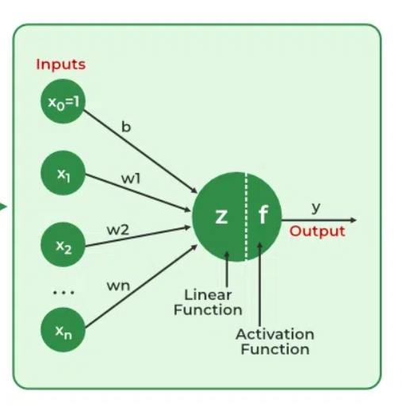
Perceptron
Perceptron

Slide 32
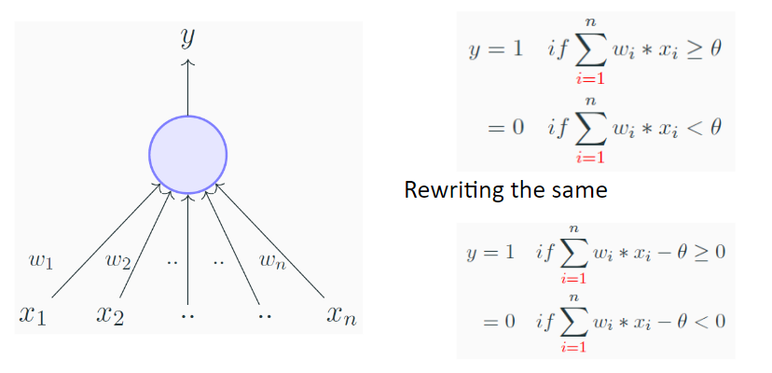
Perceptron

Slide 33
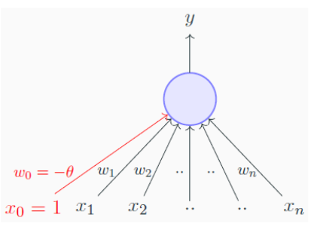
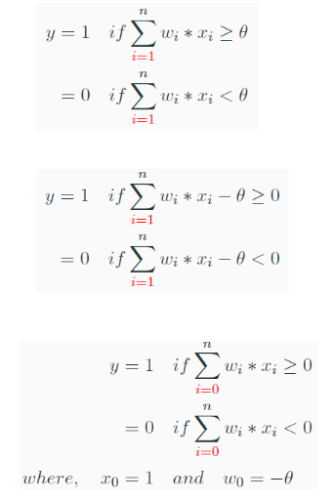
Perceptron
Bias, b is used to adjust the output along with the weighted sum of the inputs to the neuron. It allows to shift the activation function to either left or right to fit the model better.
High bias means the model is not fitting well on the training set => training error is large.
High variance means model is not able to make accurate prediction on the validation set => validation error is large.

Slide 34
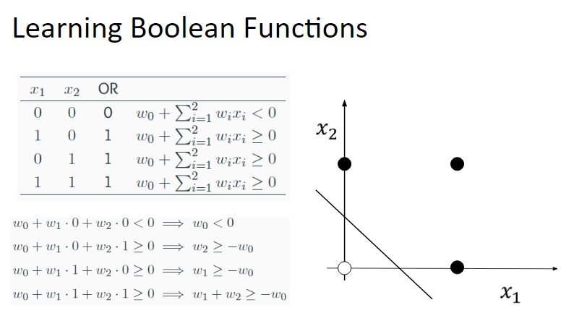

Slide 35
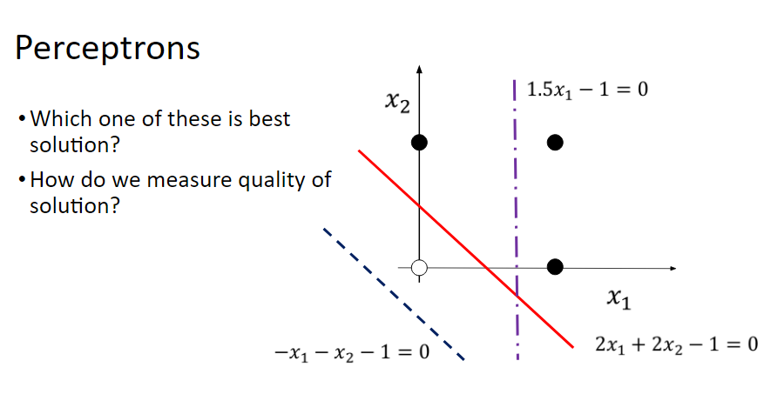
Learning Boolean Function

Slide 36
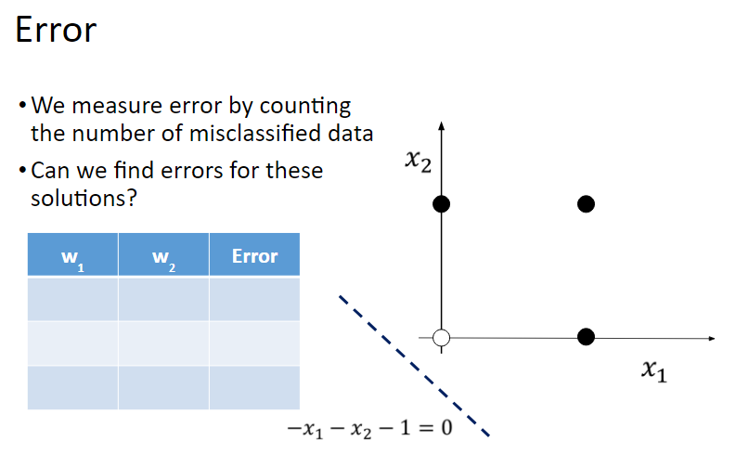
Learning Boolean Function

Slide 37

Learning Boolean Function

Slide 38
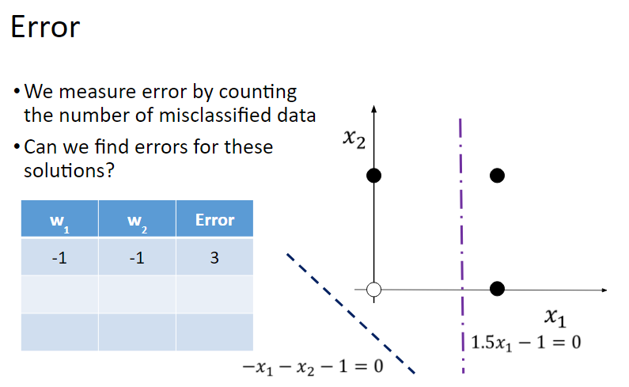
Learning Boolean Function

Slide 39
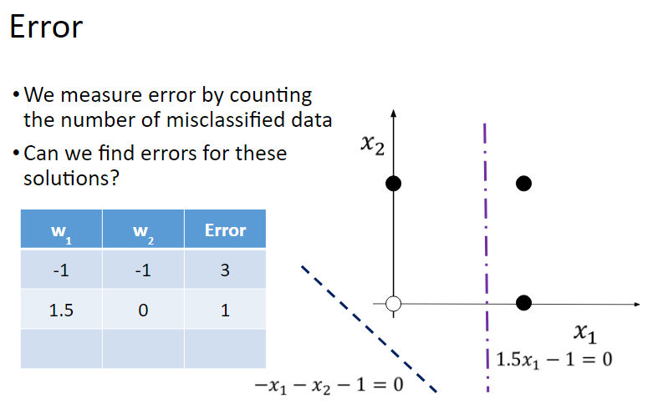
Learning Boolean Function

Slide 40
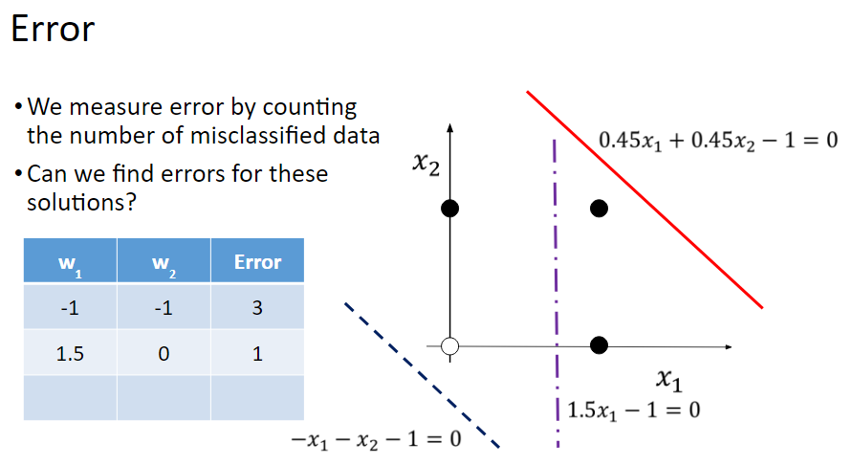
Learning Boolean Function

Slide 41
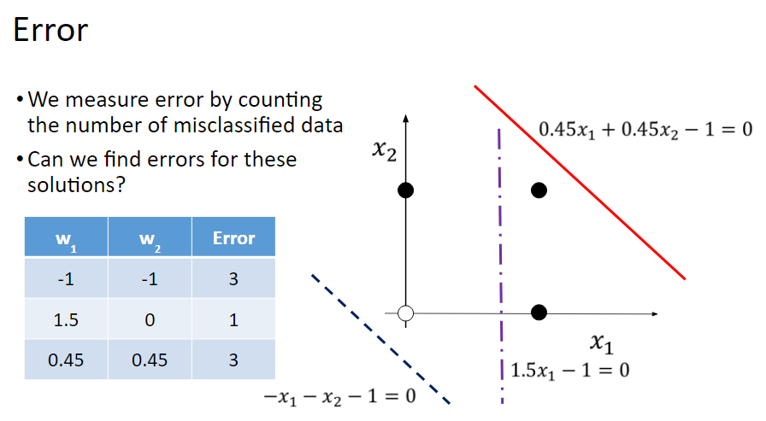
Learning Boolean Function

Slide 42
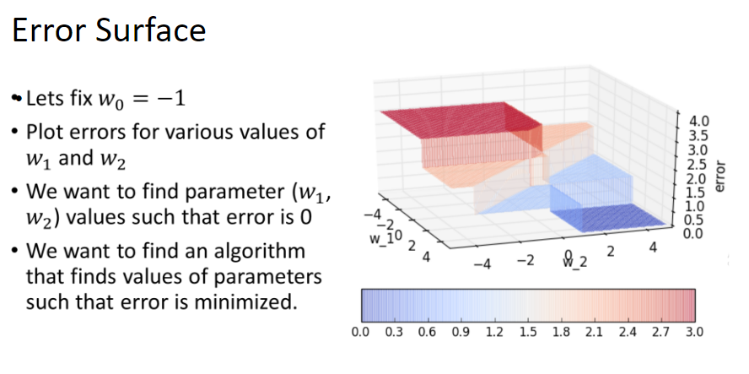
Error Minimization Algorithm

Slide 43
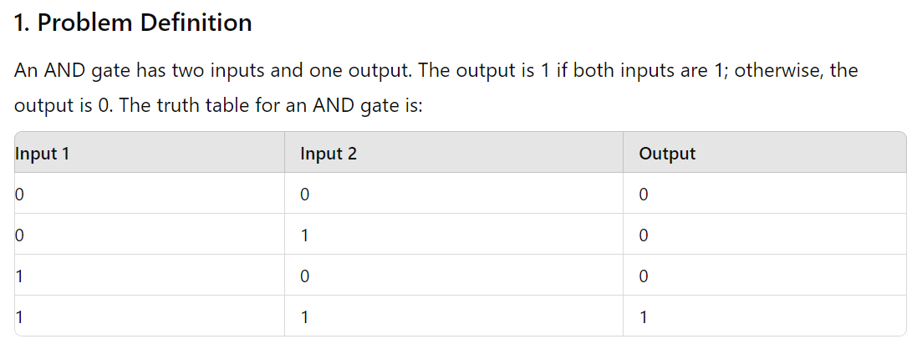
Implementation of AND gate using Neural Network

Slide 44
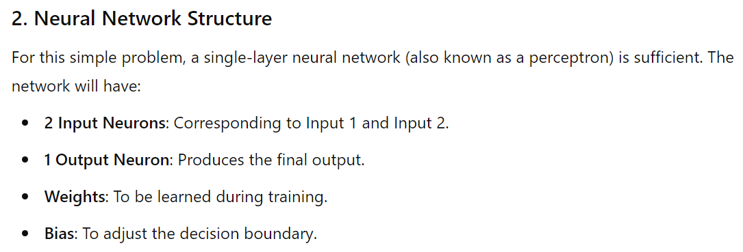
AND gate using Neural Network

Slide 45
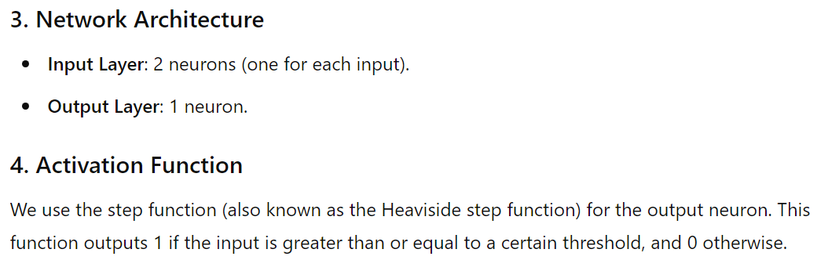
AND gate using Neural Network

Slide 46
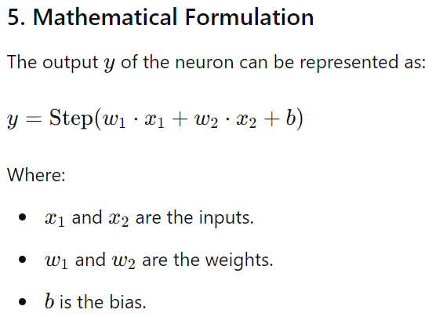
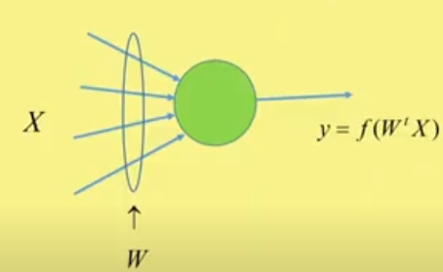
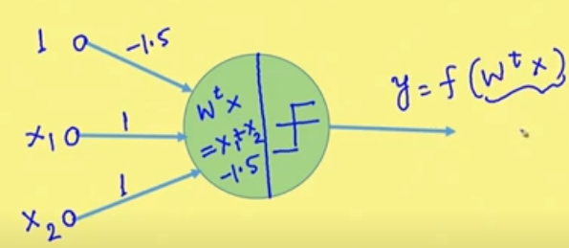
AND gate using Neural Network

Slide 47



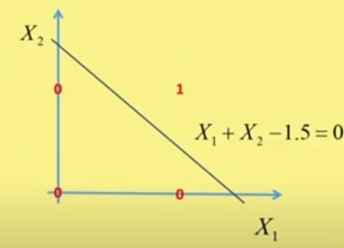
AND gate using Neural Network
The step function can be defined as:
If y =1 if value of step function is ≥ 0
= 0 otherwise.
Training For the AND gate, we need to find suitable values for w₁, w₂, and b such that the network's output matches the AND gate’s truth table.
After training:

Slide 48
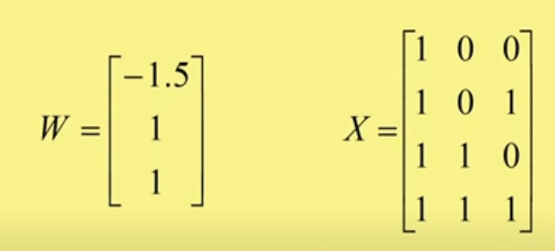
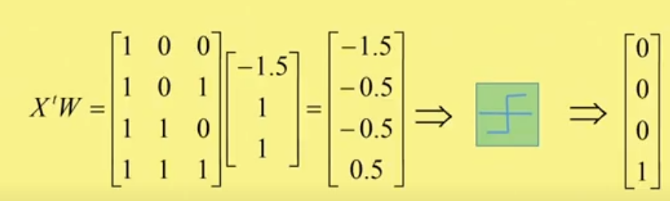
Matrix for of AND gate implementation
Including the bias, the feature vectors are represented by matrix X, and weight vector is W
t
To capture Nonlinearity, use step function

Slide 49
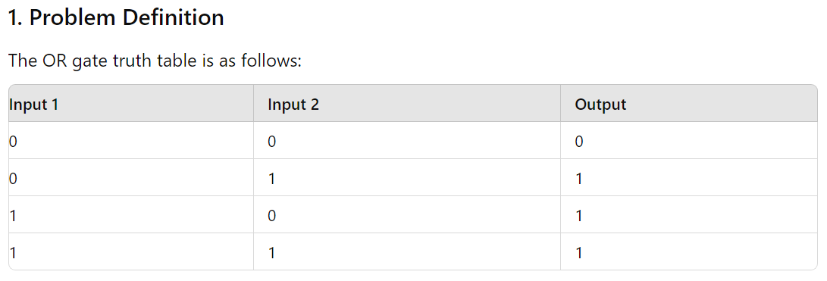
Implementation of OR gate using Neural Network

Slide 50
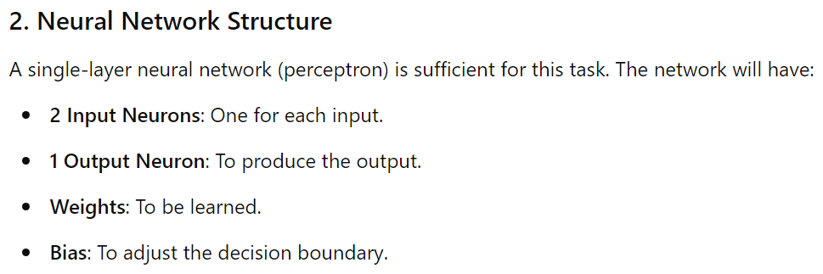
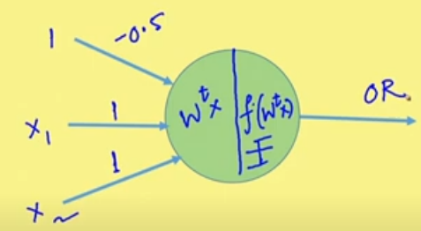
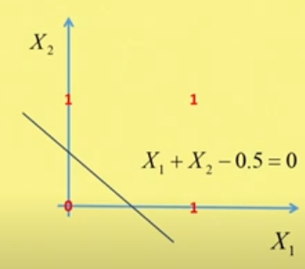

OR gate using Neural Network
Here,
, and after training :

Slide 51
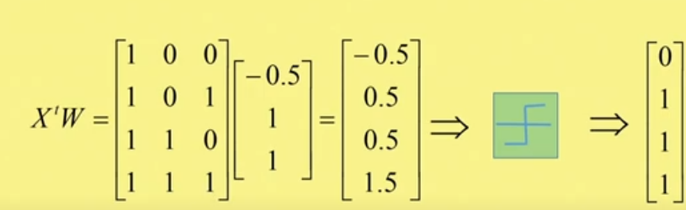
OR Gate Implementation

Slide 52
Perceptron Learning Algorithm
Both AND and OR gates are implemented by a single neuron or perceptron, because the input features of two different classes are linearly separable.
Here, output layer is the only layer and the information pass in forward direction only, i.e., from inputs (also called Input layer) to the output layer.
If there are multiple classes (i.e., more than two) than there will be m neurons in the output layer to classify m classes. Here also information pass in forward direction only, i.e., from input layer to the output layer.
This network is called Single Layer Feed Forward Neural Network (SLFFNN).
We estimate the parameters of the perceptron by using perceptron learning algorithm.

Slide 53
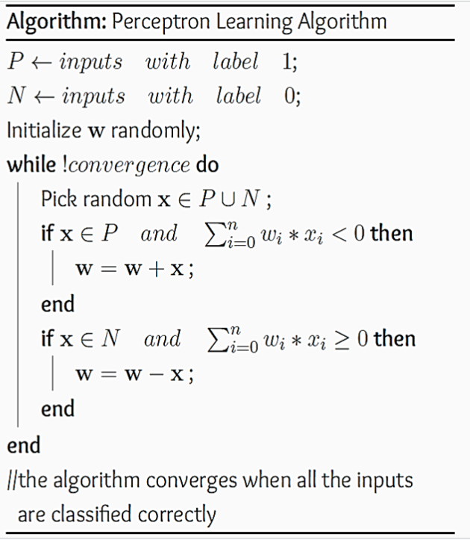
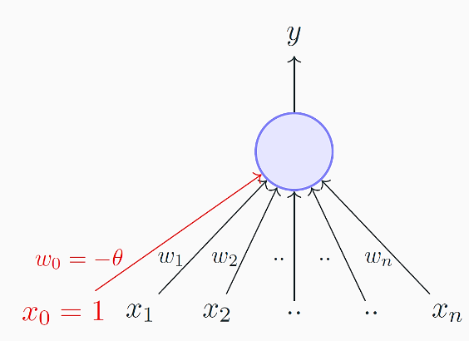
Perceptron Learning Algorithm
If there are 10 neurons in the SLFFNN, we need to iterate the algorithm 10 times.

Slide 54
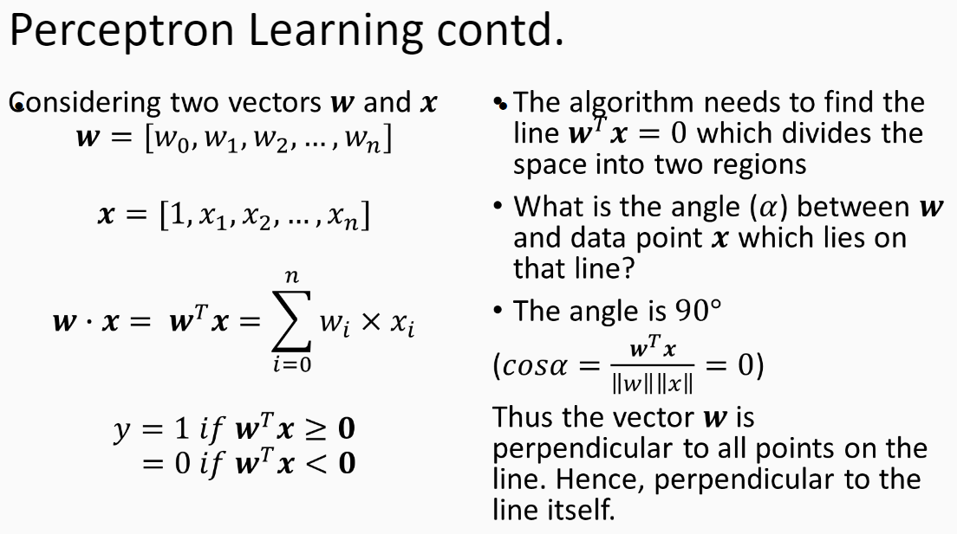

Slide 55
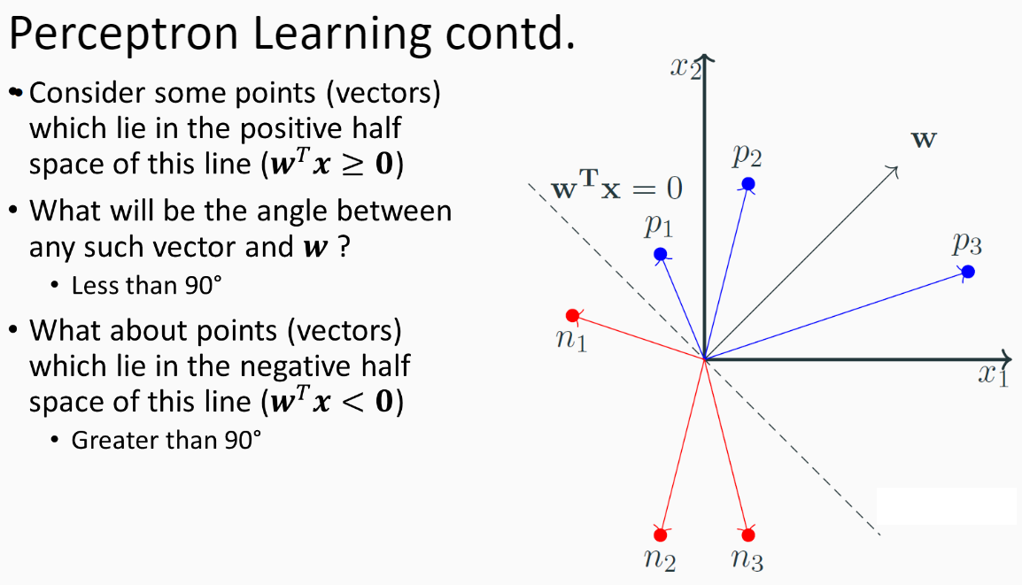

Slide 56

Perceptron Learning Algorithm

Slide 57

Perceptron Learning Algorithm

Slide 58

Perceptron Learning Algorithm

Slide 59

Perceptron Learning Algorithm

Slide 60

Perceptron Learning Algorithm Convergence Proof

Slide 61

Implementation of XOR gate using Neural Network
X1 | X2 | Y
0 | 0 | 0
0 | 1 | 1
1 | 0 | 1
1 | 1 | 0
The outputs of AND and OR gates are linearly separable. So single layer perceptron can implement them.
But the outputs of XOR is not linearly separable.
This means a single-layer perceptron cannot solve it.
Instead, we need a neural network with at least one hidden layer to solve the XOR problem.

Slide 62

XOR gate using Neural Network

Slide 63
XOR gate using Neural Network
3. Mathematical Formulation
For a neural network with one hidden layer, the computations are as follows:
i) Hidden Layer:
  Compute the weighted sum for each hidden neuron.
  Apply the activation function (e.g., sigmoid, or ReLU) to capture non-linearity.
ii) Output Layer:
  Compute the weighted sum from hidden layer outputs.
  Apply the activation function (e.g., sigmoid).

Slide 64
XOR gate using Neural Network
  Loss Function: Binary cross entropy may be used for binary classification.
  Optimizer: Stochastic Gradient Descent (SGD) may be used to optimize the weights.
Training:
  Epochs: Number of iterations over the entire dataset.
Evaluation and Prediction:
  After training, the model's accuracy is evaluated, and predictions are made on the XOR inputs.
This simple neural network will be able to learn the XOR function effectively, demonstrating the power of neural networks to solve problems that are not linearly separable.

Slide 65

XOR Gate
We compute OR operation and NAND operation on X₁ and X₂, and finally AND operation on h₁ and h₂ gives the XOR operation.
As for AND operation, the weight vector is [-1.5, 1,1] so for NAND gate it is: [1.5, -1, -1].

Slide 66

XOR Gate
So, two operations OR and NAND transform the input vectors to an intermediate vectors.
Initial feature space was 2-D in form of [X₁, X₂] and the intermediate feature space is [h₁, h₂].
In intermediate feature space, the feature vectors are linearly separable.
The XOR gate is implemented
by the AND operation of h₁
h₂.

Slide 67

XOR gate using Neural Network

Slide 68


XOR Gate
It is an example of Multi Layer Feed Forward Neural Network.
For XOR, we need 3 neurons of which two neurons are at hidden layer and one neuron at output layer.
One neuron at hidden layer computes OR operation and other computes NAND operation.

Slide 69

Some key points of neural networks
Structure: A neural network consists of layers of interconnected nodes (or neurons).
These layers include:
  Input Layer: Receives the initial data.
  Hidden Layers: Perform intermediate processing. There can be one or more hidden layers.
  Output Layer: Produces the final prediction or classification.
Weights and Biases: Each connection between nodes has an associated weight that is adjusted during training. Biases are added to the weighted sum of inputs to help the model fit the data better.
Activation Functions: These functions determine if a neuron should be activated or not. Common activation functions include ReLU (Rectified Linear Unit), sigmoid, and tanh.

Slide 70
Some key points of neural networks
Training: Neural networks learn by adjusting weights and biases based on the errors of their predictions. This process is often done using algorithms like backpropagation combined with optimization techniques like gradient descent.
Applications: Neural networks are used in various applications such as image and speech recognition, natural language processing, and game playing. They are especially powerful in tasks where patterns and relationships in data are complex and not easily defined by traditional algorithms.

Slide 71
Some key points of neural networks
Types: There are different types of neural networks tailored to specific tasks:
  Feedforward Neural Networks: The simplest type, where information moves in one direction—from input to output.
  Convolutional Neural Networks (CNNs): Effective for image processing tasks.
  Recurrent Neural Networks (RNNs): Suitable for sequential data like time series or text.
Neural networks have become a foundational technology in modern AI, enabling many of the advanced applications we see today.

Slide 72

Multi Layer Feed Forward Neural Network
Here, for 2 classes, we have two neurons at the output layer. For m-class problem, the output layer consists of m number of neurons.
There will be at least one hidden layer.

Slide 73



Neural Network Function
Each layer of the neural network computes a non-linear function of the input feature vector inputted to that particular layer of neurons.
The output of that layer of neurons is an intermediate feature vector (may be of same or different dimension depending on how many neurons we have considered).
In every layer, the neurons compute a non-linear function.

Slide 74
Neural Network Function
The i-th layer neurons computes a non-linear function, say f^{i} on the feature vectors which are computed by the previous layer given by the function f^{i-1} and each of these are non-linear function.
If input vector is X, the first layer computes f¹(X), which is inputted to the next layer. It computes f²(f¹(X)), and this way it continues and finally, we get output f^{k}.

Slide 75
Neural Network Function
Thus the input feature vector is non-linearly mapped to intermediate feature vector, which is again non-linearly mapped to another representation, and so on. And finally, the last representation of the feature vectors are separable by the linear classifier.
This is the working principle of multi layer feed forward neural network. It is feed forward because information is always flowing from input to output. The information does not flow in the reverse direction.
K indicates the number of hidden layers. If K is very high then the neural network is called Deep neural Network.

Slide 76
ANN with one hidden layer using ReLU activation to classify the Iris dataset
Steps required:
Loads the Iris dataset (4 features, 3 classes).
Splits into train (80%) and test (20%).
Normalizes features using StandardScaler.
Defines a neural network:
  Input: 4 features
  Hidden layer: 10 neurons, ReLU activation
  Output layer: 3 neurons, Softmax activation
Compiles with Adam optimizer and categorical cross-entropy loss.
Trains for 100 epochs.
Reports test accuracy.

Slide 77
ANN with one hidden layer using ReLU activation to classify the Iris dataset
Python Code using scikit-learn + TensorFlow/Keras:
import numpy as np
from sklearn.datasets import load_iris
from sklearn.model_selection import train_test_split
from sklearn.preprocessing import StandardScaler
from tensorflow.keras.models import Sequential
from tensorflow.keras.layers import Dense
from tensorflow.keras.utils import to_categorical

Slide 78
Python Code using scikit-learn + TensorFlow/Keras: Cont..
# Load Iris dataset
iris = load_iris()
X = iris.data
y = iris.target
# Train-test split
X_train, X_test, y_train, y_test = train_test_split( X, y, test_size=0.2, random_state=42, stratify=y)

Slide 79
Python Code using scikit-learn + TensorFlow/Keras: Cont..
# Standardize features
scaler = StandardScaler()
X_train = scaler.fit_transform(X_train)
X_test = scaler.transform(X_test)
# One-hot encode labels
y_train = to_categorical(y_train, num_classes=3)
y_test = to_categorical(y_test, num_classes=3)

Slide 80
Python Code using scikit-learn + TensorFlow/Keras: Cont..
# Build neural network (1 hidden layer with ReLU)
model = Sequential()
model.add(Dense(10, input_dim=4, activation='relu'))
# hidden layer with 10 neurons
model.add(Dense(3, activation='softmax'))
# output layer (3 classes)
# Compile model
model.compile(optimizer='adam', loss='categorical_crossentropy', metrics=['accuracy'])
# Train model
model.fit(X_train, y_train, epochs=100, batch_size=8, verbose=0)
# Evaluate on test set
loss, accuracy = model.evaluate(X_test, y_test, verbose=0)
print(f"Test Accuracy: {accuracy * 100:.2f}%")

Slide 81
Non-linear Classifier
To implement a non-linear classifier, we try to map the input vectors to intermediate feature space using non-linear mapping.
The intermediate feature vectors may be again mapped to another intermediate feature space using non-linear mapping, and so on.
Final intermediate feature vectors are linearly separable. So, at the, say, K-th layer we may use a linear classifier.
Here, we observe that information always flows in the forward direction, and so called feed forward.
There are some networks where information may feed back to the previous layer. Example, Recurrent Neural Network (RNN).
Training of the neural network means estimation of the parameters, like weights and bias.
We give learning or training to the neural networks using back propagation algorithm, where error is propagated in the backward direction. This is because, only at the output layer, we can compute the error or loss function.
Before discussing the training of the neural networks, we will discuss different types of non-linear functions (in the next class).

Slide 82
Thank You!

