Slide 1
VGG-16
The VGG-16 model is a CNN architecture that was proposed by the Visual Geometry Group (VGG) at the University of Oxford.
It is characterized by its depth, consisting of 16 layers (i.e., these layers have tunable parameters), including 13 convolutional layers and 3 fully connected layers. Other layers are pooling layers which have no tunable parameters.
VGG-16 is renowned for its simplicity and effectiveness, as well as its ability to achieve strong performance on various computer vision tasks, including image classification and object recognition.
The model’s architecture features a stack of convolutional layers followed by max-pooling layers, with progressively increasing depth.

Slide 2
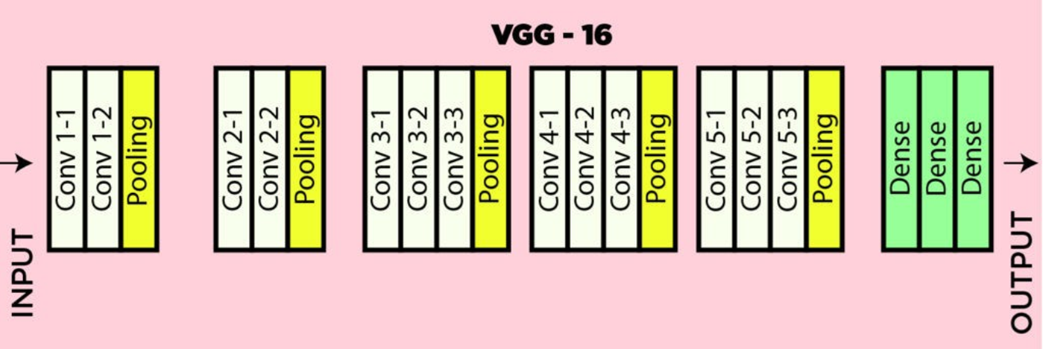
VGG16
This design enables the model to learn intricate hierarchical representations of visual features, leading to robust and accurate predictions.
VGG16, proposed by Karen Simonyan and Andrew Zisserman in 2014, and this architecture was the first runners up in ImageNet Large Scale Visual Recognition Challenge (ILSVRC).
This model achieves 92.7% top-5 test accuracy on the ImageNet dataset which contains 14 million images belonging to 1000 classes.
It means for every 100 images it was tested on, it got the answer right within its top 5 guesses about 93 times. This is an exceptionally high score, indicating a very powerful and accurate model, especially given the difficulty of the dataset.

Slide 3
The Detailed Breakdown (ILSVRC)
The standard split for the ImageNet Large Scale Visual Recognition Challenge (ILSVRC), for "92.7% top-5 accuracy," is as follows:
Training Images: ~1.28 million (There are roughly 1,281,167 training images, with about 1,000 images per of the 1,000 classes.)
Validation Images: 50,000 (It contains 50,000 images, with 50 images per class, for hyperparameters tuning)
Test Images: 100,000 (The labels for this set are kept secret. It contains 100,000 images, with 100 images per class.)
So, the total volume for the ILSVRC benchmark is roughly 1.28M + 50k + 100k = ~1.43 million images.

Slide 4
ImageNet dataset
The "ImageNet dataset" is a much larger project than just the ILSVRC challenge.
The full ImageNet database indeed contains over 14 million images organized according to the WordNet hierarchy.
However, these 14+ million images are spread across more than 20,000 categories (called "synsets").
The ILSVRC Subset: The ILSVRC uses a curated subset of this vast database. It takes a manageable number of images (the ~1.43 million mentioned above) from 1,000 of the most common object categories.

Slide 5
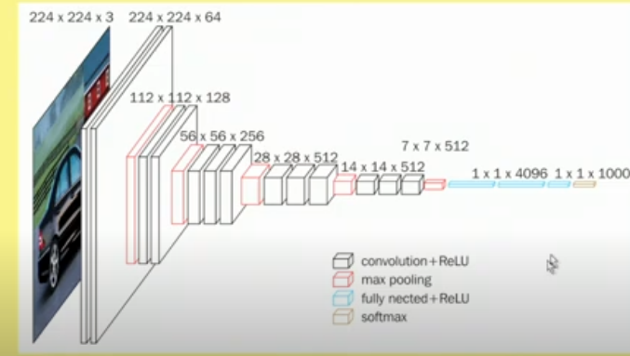
Architecture of VGG16

Slide 6
VGG16
It accepts color images (i.e., 3 channels) of size 224 × 224
Image is passed through a stack of convolutional layers
Every convolutional filter is of size 3×3, and convolution is carried out with stride = 1
Use row and column padding to maintain spatial resolution after convolution, i.e., the size of input feature map and the size of the output feature map are same.
  ReLU activation function is used for nonlinearity, after convolution operation in every convolution layer.
There are 13 convolution layers and 5 max-pool layers, so every convolution layer is not followed by a max-pool layer.
Max-pooling window size 2 × 2, stride 2; i.e., max-pool windows are non-overlapping windows.
There are 3 Fully connected layers.

Slide 7
VGG16
Here’s a breakdown of the VGG-16 architecture based on the provided details:
1. Input Layer: It accepts color images of size 224 × 224
  Input dimensions: (224, 224, 3)
2. Convolutional Layers (64 filters, 3×3 filters, same padding):
  Two consecutive convolutional layers with 64 filters each and a filter size of 3×3.
  Same padding is applied to maintain spatial dimensions.
3. Max Pooling Layer (2×2, stride 2):
  Max-pooling layer with a pool size of 2×2 and a stride of 2.

Slide 8
VGG16
4. Convolutional Layers (128 filters, 3×3 filters, same padding):
  Two consecutive convolutional layers with 128 filters each and a filter size of 3×3.
5. Max Pooling Layer (2×2, stride 2):
  Max-pooling layer with a pool size of 2×2 and a stride of 2.
6. Convolutional Layers (256 filters, 3×3 filters, same padding):
  Three consecutive convolutional layers with 256 filters each and a filter size of 3×3.

Slide 9
VGG16
7. Convolutional Layers (512 filters, 3×3 filters, same padding):
  Three consecutive convolutional layers with 512 filters each and a filter size of 3×3.
8. Max Pooling Layer (2×2, stride 2):
  Max-pooling layer with a pool size of 2×2 and a stride of 2.
9. Convolutional Layers and Max Pooling:
  Three consecutive convolutional layers with 512 filters each and a filter size of 3×3.
  Max-pooling layer with a pool size of 2×2 and a stride of 2.
10. Flattening:
  Flatten the output feature map (7x7x512) into a vector of size 25088.

Slide 10
VGG16
11. Fully Connected Layers:
  Three fully connected layers with ReLU activation.
  First layer with input size 25088 and output size 4096.
  Second layer with input size 4096 and output size 4096.
  Third layer with input size 4096 and output size 1000, corresponding to the 1000 classes in the ILSVRC challenge.
  Softmax activation is applied to the output of the third fully connected layer for classification.

Slide 11
VGG16
This architecture follows the specifications provided, including the use of ReLU activation function and the final fully connected layer outputting probabilities for 1000 classes using softmax activation.
VGG-16 was one of the best performing architectures in the ILSVRC challenge 2014.
It was the runner up in the classification task with a top-5 classification error of 7.32% (only behind GoogLeNet with a classification error of 6.66%).
It was also the winner of localization task with 25.32% localization error.

Slide 12
VGG16
Limitations Of VGG 16:
It is very slow to train (the original VGG model was trained on Nvidia Titan GPU for 2-3 weeks).
The size of VGG-16 trained imageNet weights is 528 MB. So, it takes quite a lot of disk space and bandwidth which makes it inefficient.
138 million parameters lead to exploding gradients problem.

Slide 13
Advantages over AlexNet
VGG16 and AlexNet are both convolutional neural network architectures designed for image classification, but VGG16 is considered a more advanced and effective model in many respects.
Here are the key advantages of VGG16 over AlexNet:

Slide 14
Advantages over AlexNet
1. Deeper Architecture
VGG16: Has 16 layers of weights (13 convolutional layers + 3 fully connected layers), allowing it to capture more complex features from input images.
AlexNet: Contains only 8 layers (5 convolutional layers + 3 fully connected layers), which limits its capacity to learn hierarchical features.
Advantage: The deeper architecture of VGG16 enables it to model more intricate patterns and achieve higher accuracy on complex datasets.

Slide 15
Advantages over AlexNet
2. Smaller Filter Sizes
VGG16: Uses 3×3 convolutional filters consistently across all layers.
AlexNet: Uses larger 11×11filters in the first layer and 5×5 filters in subsequent layers.
Advantage: Smaller filters allow VGG16 to stack more layers while maintaining the same receptive field. This increases the model's depth and the granularity of feature extraction without a significant increase in computational cost.

Slide 16
Advantages over AlexNet
3. Uniform Architecture
VGG16: Has a uniform architecture throughout, with all convolutional layers using the same filter size and consistent stride/padding settings.
AlexNet: Features varying filter sizes, strides, and complexities across different layers.
Advantage: The uniform design of VGG16 makes it easier to understand, implement, and extend for different use cases.

Slide 17
Advantages over AlexNet
4. Better Generalization
The deeper structure and smaller filters of VGG16 help it learn richer and more generalized feature representations.
This often translates to better performance on unseen data compared to AlexNet.
5. Improved Accuracy
VGG16 achieved significantly higher accuracy in image classification benchmarks like ImageNet compared to AlexNet.
VGG16's top-5 error rate on ImageNet was approximately 7.4%, whereas AlexNet's was around 16.4%.

Slide 18
Advantages over AlexNet
6. Regularization via Depth
The deeper architecture of VGG16 naturally acts as a form of regularization, as the increased depth forces the network to extract only the most relevant features to pass through the layers.
7. Wider Adoption and Pre-trained Models
VGG16 became more popular for transfer learning because its pre-trained weights generalize well to other tasks, while AlexNet is less commonly used today.

Slide 19
Trade-offs
While VGG16 has clear advantages, it also comes with trade-offs:
Increased Computational Cost: VGG16 has significantly more parameters (138M) compared to AlexNet (60M), leading to higher memory and computation requirements.
Slower Training and Inference: The deeper network requires more time for both training and inference.

Slide 20
Conclusion
VGG16 is superior to AlexNet in terms of accuracy, depth, and feature extraction capabilities, making it a more powerful model for complex image recognition tasks.
However, these improvements come at the cost of increased computational demand.

Slide 21
Testing Strategy
K-fold cross-validation (e.g., 5-fold or 10-fold), train the model K separate times.
  Example: If one training run takes 5 days and $1,000, a 5-fold cross-validation would take 25 days and $5,000.
This cost is simply too high for most research labs and companies, especially when the benefit is often marginal for large datasets.
A Single Training Run is Extremely Expensive:
Training a modern model like VGG, ResNet or Vision Transformer on ImageNet can take days or even weeks on a powerful, multi-GPU server, costing thousands of dollars in cloud computing.

Slide 22
The Dataset is Already Massive and Stable
The statistical advantages of K-fold are less critical with huge datasets.
Reduces Variance: K-fold is brilliant for small datasets (e.g., 1,000 images) because it maximizes the use of limited data and reduces the variance in performance estimation that can come from a single, unlucky random split.
Large Datasets are Inherently Stable: With over 1.2 million training images, a single, large, random split is already a very robust and representative sample of the underlying data distribution. The performance metric on a validation set of 50,000 images is already a highly stable estimate with low variance. The extra stability gained from K-fold isn't worth the 5x-10x computational cost.

Slide 23
Thank You!

