Slide 1
Machine Learning Based Yoga Pose Correction

Slide 2
Under the guidance of:
Meghana H J
Guest Faculty,
DoS in Computer Science,
MGM
Presented By:
MithunKaveriappa M K
IInd MCA (P01ZZ22S126041)
DoS in Computer Science,
MGM

Slide 3
Contents
Problem Statement
Introduction
Literature Survey
Dataset
Proposed Methodology
Results
Conclusion
Future Work
References

Slide 4
Problem Statement
Yoga practice demands precise body alignment and positioning to ensure optimal benefits and prevent injuries.
However, achieving and maintaining correct form can be challenging, especially for individuals practicing without the guidance of an instructor.
Incorrect self-correction of yoga poses can lead to suboptimal results or even physical strain.

Slide 5
Introduction
Proper alignment in yoga is essential for gaining the full benefits of each pose and avoiding injuries.
However, it can be difficult to achieve the correct form, especially when practicing without an instructor.
This study looks at how machine learning-based systems can transform yoga practice by offering real-time feedback on pose accuracy, helping practitioners maintain proper alignment and improve their yoga experience.

Slide 6
Literature Survey
Paper | Dataset | Methods | Results
“Yoga Pose Estimation and Feedback Generation Using Deep Learning" by Vivek Anand Thoutam. | 300 recordings of 12 yoga stances from 5 yoga pose with each present performed on five events. | They propose a three-step methodology involving feature extraction, classification and feedback generation. The system uses Keras multi-person pose estimation for feature extraction and Multilayer Perceptron (MLP) for pose classification. | The proposed method achieved an impressive accuracy of 0.9958, outperforming other models like SVM, CNN and CNN+LSTM.
"Yoga Pose Estimation Using Angle-Based Feature Extraction" by Debanjan Borthakur, Arindam Paul, Dev Kapil and Manob Jyoti Saikia published in Healthcare 2023. | Yoga-82 Dataset. | Presents a novel approach to detecting correct yoga poses and providing real-time feedback using computer vision and machine learning techniques. | Achieving a prediction accuracy of 91% on the test dataset and 92% in a fivefold cross-validation experiment.
"Deep Learning Models for Yoga Pose Monitoring" by Swain D, Satapathy S, Acharya B, Shukla M. Gerogiannis V.C, Kanavos A, Giakovis published in the journal Algorithms in 2022. | Real-time Monitored Videos. | The authors propose a self-guidance practice framework that uses a combination of Convolutional Neural Network (CNN) and Long Short-Term Memory (LSTM) for yoga pose recognition through real-time monitored videos. | The system achieved an accuracy of 99.53% on the test dataset.
Deepak Kumar, Anurag Sinha discusses the application of deep learning in yoga pose detection and classification. | Yoga-82 Dataset. | The paper explores keypoints detection methods such as OpenPose, PoseNet and PIFPAF and their role in pose estimation. | The document also highlights the health benefits of yoga and its increasing significance in the medical community.

Slide 7
Dataset
Dataset used is Yoga-82.
The Yoga-82 dataset, which contains images of various yoga postures, was utilized for the collection of data.
This dataset is well-suited for tasks involving image classification, particularly in the context of yoga posture recognition.

Slide 8
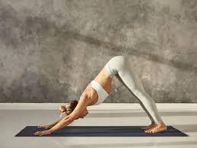
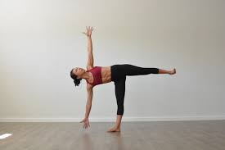
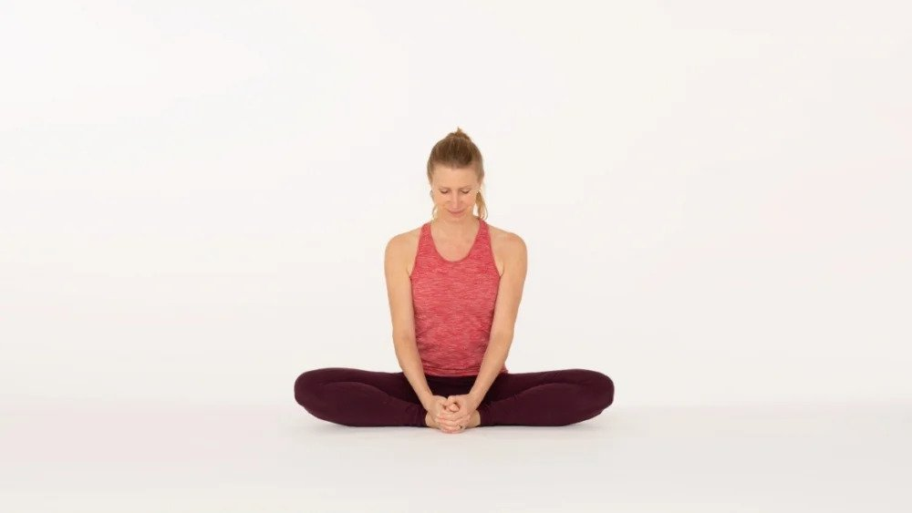
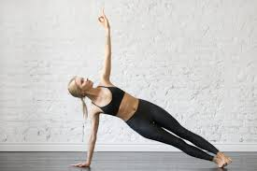
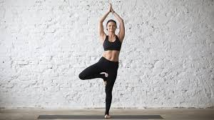
Dataset
Adho Mukha Svanasana
Ardha Chandrasana
Baddha-Konasana
Vasisthasana
Vrakshasana

Slide 9
Proposed Methodology
start
User select asana from available list of poses
System displays information for the selected asana ,user begins performing it
System checks if position is achieved, calculate and compares the angle of major body parts
no
Angles are within acceptable range
yes
Generate alignment, feedback and generate
Heat map
Give positive feedback and generate heat map
End

Slide 10
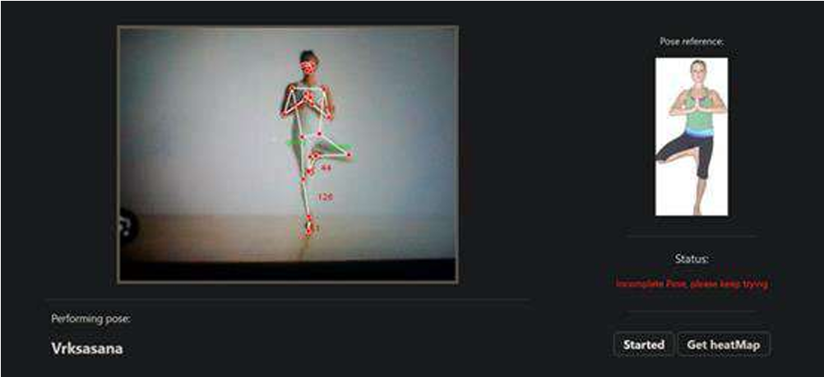
Results

Slide 11
Results
Asana Name | Absolute Angle Value ["Left Elbow", "Right Elbow", "Right Knee", "Left Knee", "Right Shoulder", "Left Shoulder", "Left Hip", "Right Hip"] | Observed Angle Value ["Left Elbow", "Right Elbow", "Right Knee", "Left Knee", "Right Shoulder", "Left Shoulder", "Left Hip", "Right Hip"]
Vrksasana | [33.61999404146039, 29.540970853085263, 13.974997526266186,188.79726109968368, 66.44447374046031,72.24049417901529, 173.7480281550308,260.5400365119113] | [39.61999404146039, 19.540970853085263, 14.974997526266186, 186.79726109968368, 72.44447374046031, 76.24049417901529, 177.7480281550308, 259.5400365119113]

Slide 12
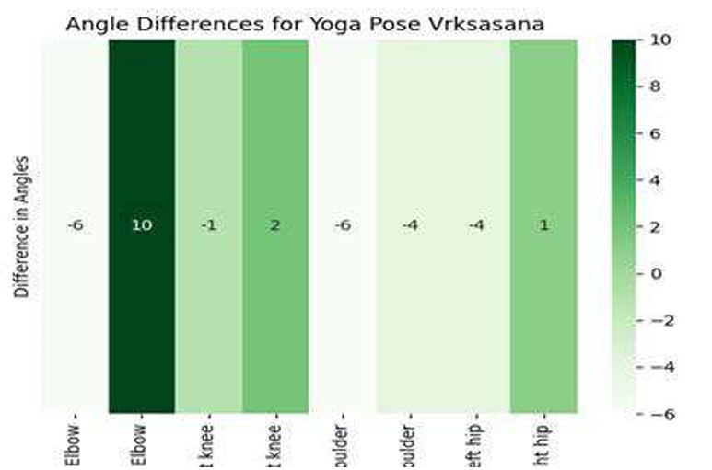
Results

Slide 13
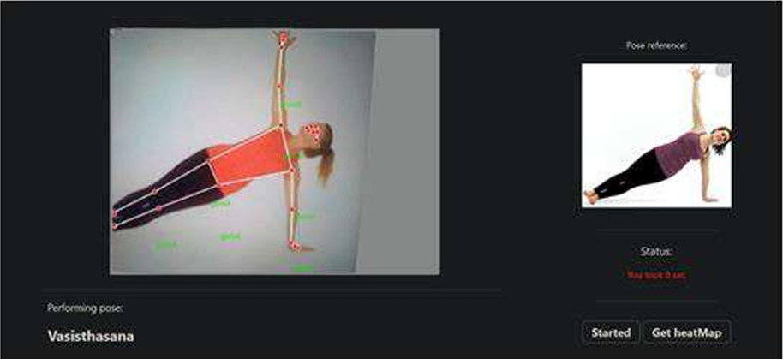
Results

Slide 14
Results
Asana Name | Absolute Angle Value ["Left Elbow", "Right Elbow", "Right Knee", "Left Knee", "Right Shoulder", "Left Shoulder", "Left Hip", "Right Hip"] | Observed Angle Value ["Left Elbow", "Right Elbow", "Right Knee", "Left Knee", "Right Shoulder", "Left Shoulder", "Left Hip", "Right Hip"]
Vasisthasana | [181.4614160981745, 172.91858871891495, 186.1289051547743, 178.84621319352848, 241.8804761270079, 69.29282517447515, 179.8449862361831, 180.70760289867388] | [187.4614160981745, 175.91858871891495, 192.1289051547743, 186.84621319352848, 237.8804761270079, 61.292825174475155, 174.8449862361831, 180.70760289867388]

Slide 15
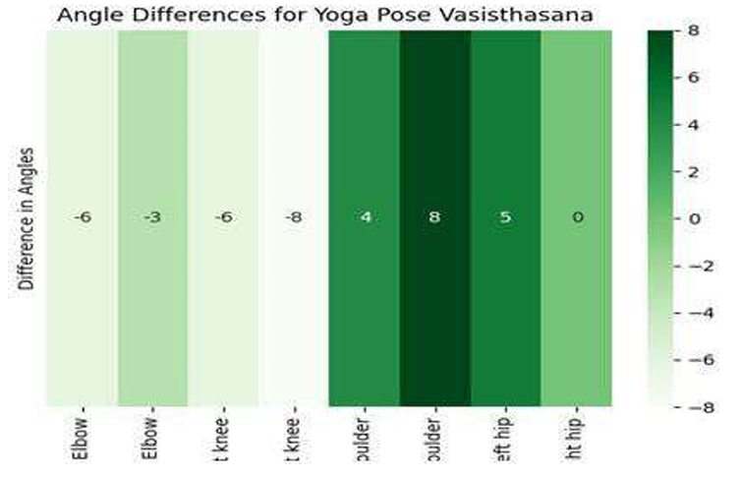
Results

Slide 16
Conclusion
In summary, the Yoga Pose correction mechanism offers a revolutionary way to improve yoga practice.
It gives users the ability to acquire proper posture securely and effectively with its unique technique of taking into account the angles between body parts, real-time feedback via a TTS engine, and visual assistance like heat maps.
It encourages thoughtful practice and lowers the chance of injury by including user-friendly features like posture selection.

Slide 17
Future Work
Progress Tracking: Introduce features that track user progress over time and adjust the difficulty of poses or correction suggestions accordingly.
Multiview Analysis: Implement multi-camera or depth-sensing technology to improve the accuracy of pose detection and correction from various angles.

Slide 18
References
Vivek Anand Thoutam (2023): Developed a pose estimation system using Keras and MLP, achieving 99.58% accuracy, outperforming SVM and CNN.
Debanjan Borthakur et al. (2023): Proposed angle-based feature extraction, achieving 91% accuracy with the Yoga-82 Dataset for real-time feedback.
Swain et al. (2022): Combined CNN and LSTM in a self-guidance framework, achieving 99.53% accuracy on real-time videos.
These studies collectively contribute to significant advancements in yoga pose correction, focusing on accuracy, real-time feedback and health benefits.

Slide 19
Thank You…

