Slide 1

Project Title:Seasonal Agriculture Performance Analysis
Student Name: Mithun Kumar Rajak
College Name: Jagran Lakecity University, Bhopal
AICTE STU ID : STU693712de6ea801765216990

Slide 2

PROBLEM STATEMENT
Agricultural activities are influenced by seasonal variations in environmental conditions, farming practices, resource availability and market conditions. As a result, agricultural performance may differ from one season to another.
However, raw agricultural data does not clearly explain how agricultural performance changes across seasons or what patterns can be observed in different seasonal conditions.
The problem is to analyze the given agricultural dataset and investigate seasonal differences in agricultural performance by identifying meaningful patterns, trends, relationships and variations within the available data.

Slide 3
Project Description
Dataset Overview: 4,000 farm records across 8 major Indian states covering 8 crops (Rice, Wheat, Maize, Cotton, Pulses, Groundnut, Chilli, Sugarcane) across Kharif, Rabi, and Zaid seasons.
Data Quality & Preprocessing:
100% data completeness achieved with deterministic yield calculation and hierarchical seasonal-regional median imputation.
Feature Engineering:
Formulated key performance metrics: Profit Margin (%), ROI (%), Cost/Ha, Profit/Ha, Water Productivity, Total NPK, and categorical Pest Risk.
Analytical Architecture:
Exploratory Data Analysis: Environmental profiles, crop mix, and yield/profit distributions.
Statistical Rigor: Kruskal-Wallis, Chi-Square, and Mann-Whitney U hypothesis tests.
Machine Learning: Random Forest Regressors for Yield and Profit.
Unsupervised Clustering: K-Means ($K=2$) identifying distinct commercial vs. smallholder farm typologies

Slide 4

WHO ARE THE END USERS?
Farmers & Farmer Producer Organizations (FPOs):
  Make informed decisions on seasonal crop selection, water-efficient irrigation (drip over furrow), and off-season risk mitigation.
Ministry of Agriculture & Policy Makers:
  Design targeted summer (Zaid) subsidies, formulate groundwater extraction limits, and restructure PMFBY crop insurance.
Agricultural Extension Workers & Agronomists:
  Provide early pre-monsoon pest advisories (Kharif) and promote precision NPK application.
Agri-Fintech & Crop Insurance Companies:
  Model seasonal default risks, establish accurate credit ratings, and underwrite climate-indexed crop policies.

Slide 5

Technology Used
Programming Language: Python 3.11+
Data Manipulation & Preprocessing:
  pandas (grouping, crosstabs, feature engineering)
  numpy (array calculations, vectorization)
Data Visualization & Analytics:
  matplotlib.pyplot (violin plots, multi-panel boxplots, bar charts)
  seaborn (heatmaps, correlation matrices, styling)
Machine Learning & Statistical Testing:
  Scikit- learn (RandomForestRegressor, KMeans, PCA, StandardScaler, LabelEncoder)
  scipy.stats (kruskal, mannwhitneyu, chi2_contingency, f_oneway)
Environment & Tools: Jupyter Notebook, Git & GitHub

Slide 6
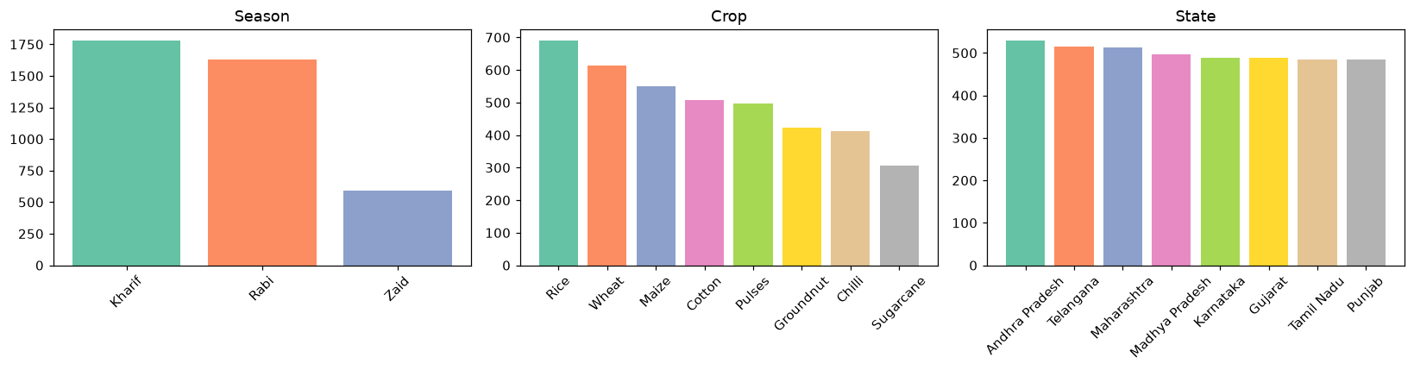
RESULTS
Dataset Overview
4,000 Farm Records | 8 Indian States | 3 Seasons (Kharif, Rabi, Zaid) | 8 Crops
Geographic representation is evenly distributed across all 8 states

Slide 7
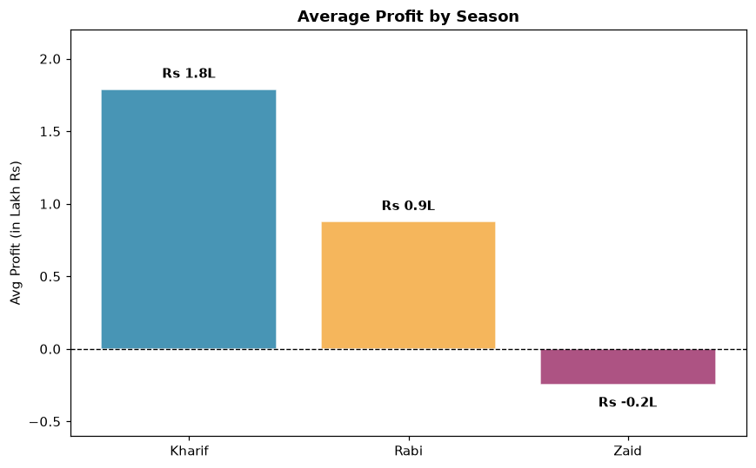
RESULTS
Code:
Seasonal Economic Performance
# bar chart of average profit with data labels
fig, ax = plt.subplots(figsize=(8, 5))
seasons = SEASON_ORDER
profits = [df[df['Season'] == s]['Profit_INR'].mean() / 1e5 for s in seasons]
bars = ax.bar(seasons, profits, color=[SEASON_COLORS[s] for s in seasons],
edgecolor='white', alpha=0.88)
ax.axhline(0, color='black', linewidth=0.9, linestyle='--')
ax.set_ylabel('Avg Profit (in Lakh Rs)')
ax.set_title('Average Profit by Season', fontweight='bold')
ax.set_ylim(-0.6, 2.2)
for bar, val in zip(bars, profits):
y = val + 0.08 if val >= 0 else val - 0.15
ax.text(bar.get_x() + bar.get_width() / 2, y,
f'Rs {val:.1f}L', ha='center', fontsize=10, fontweight='bold')
plt.tight_layout()
plt.show()
Note: Kharif is the only strongly lucrative season with 57.8% profitable farms (avg profit Rs. 1.8 Lakh), whereas 64.5% of Zaid farms operate at a net loss (avg loss -Rs. 24.8k) due to high irrigation and input costs.

Slide 8
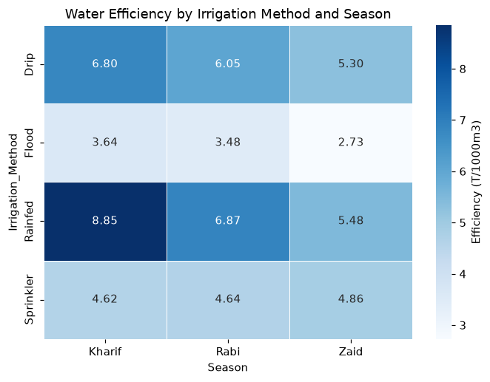
RESULTS
Water & Fertilizer Usage
Finding: Drip irrigation delivers the highest water productivity across all seasons (~6.8 T/1000m3), substantially outperforming furrow and canal irrigation, while pesticide application rates remain uniform (~5.1 L/Ha).

Slide 9
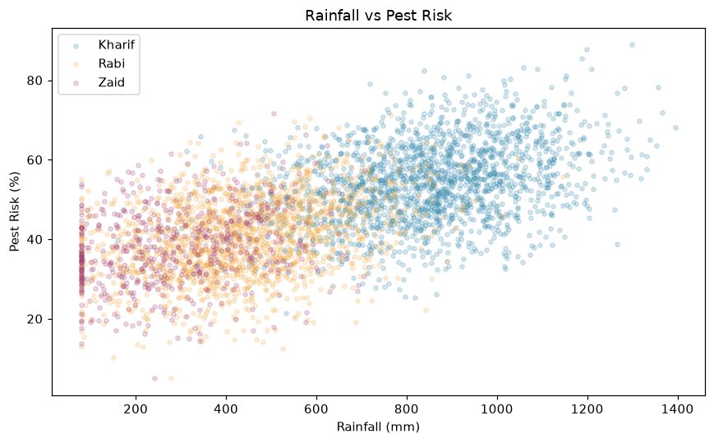
RESULTS
Disease & Pest Risk Analysis
Insight: Pest risk is strongly positively correlated with Rainfall ($r = 0.62$) and
Humidity ($r = 0.55$), confirming that monsoon warmth and moisture create optimal breeding conditions for agricultural pests.

Slide 10
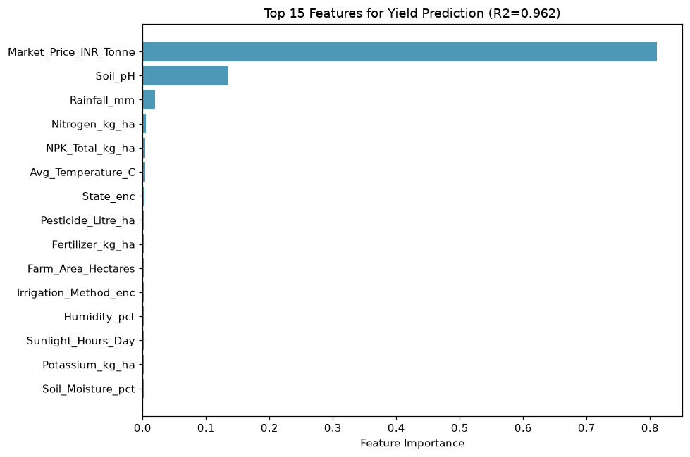
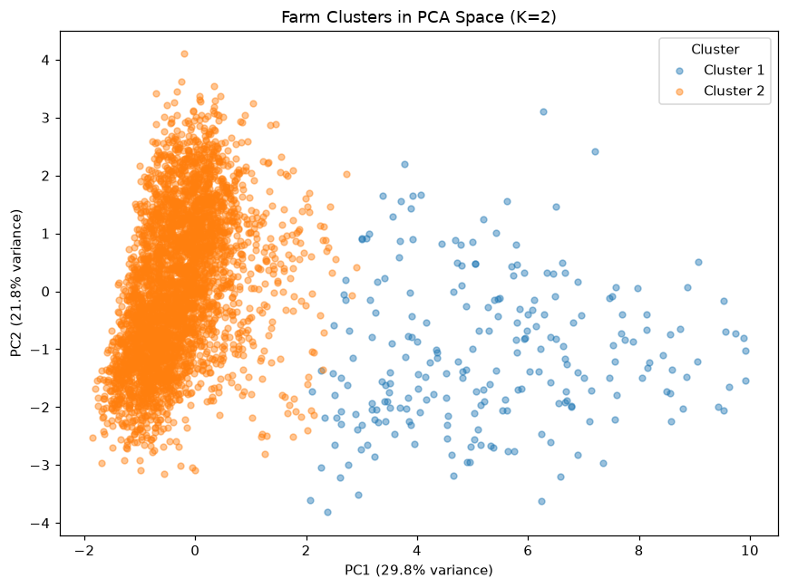
RESULTS
Predicting Yield & Profit + Farm Clustering
Yield Prediction — R² = 0.962 (Random Forest)
Farm Clusters (K-Means)
Profit prediction R² = 0.869 - farms cluster into 2 archetypes: high-input/high-output vs low-input

Slide 11
Future scope
Incorporate real-time weather & satellite data (IMD, remote sensing) for dynamic seasonal forecasts
Build a farmer-facing dashboard / mobile app for season-wise crop and irrigation advice
Extend the analysis to district/block-level granularity for hyper-local recommendations
Add multi-year time-series data to capture inter-annual climate variability
Integrate market-price forecasting to strengthen the profit-prediction model
Deploy the Random Forest models as an API for real-time yield/profit prediction

Slide 12
GitHub Link
https://github.com/MithunKumarRajak/Seasonal-Agriculture-Performance-Analysis

Slide 13

VOIS Course completion certificate:
Course name- Data Visualization

Slide 14
Thank you
.
.

