Slide 1



Slide 2
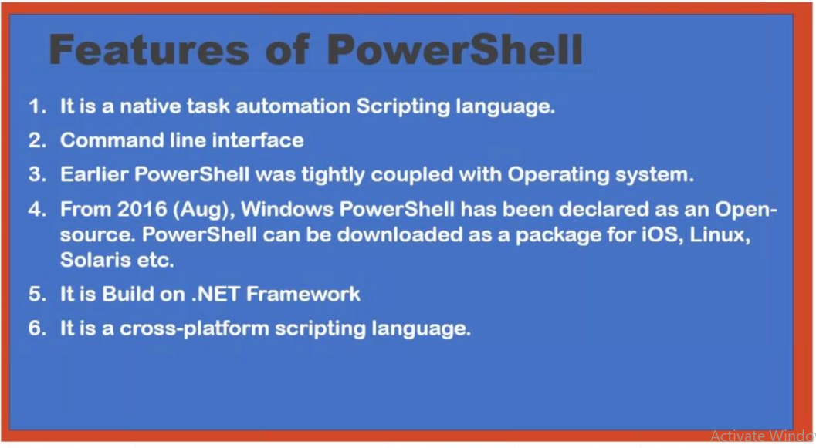

Slide 3
Get-Command
1. Get-Command
ctrl+c abnormal termination
2.Get-Command | more
2.Get-Command | measure
Feature | Description
Alias | A shortcut or alternate name for a command or cmdlet. Provides a convenient way to use familiar names.
Cmdlet | Lightweight commands in PowerShell that perform specific actions or operations.
Function | A block of reusable code that encapsulates a series of commands to perform a specific task.

Slide 4

cmdlet
A cmdlet (pronounced "command-let") is a lightweight command used in PowerShell. It is a single-function command that follows a verb-noun naming convention, such as
        Get-Process,
        remove-Item
        New-Service.

Slide 5
Wild character search &
File operations
Get-Command *csv*
Get-Command *Service*
Get-Command *az* > G:\comm.txt
Get-Command *az* | Export-Csv G:\comm.csv

Slide 6
On-Prem Operations
Get-Service
Get-Service | more
Get-Service | measure
Get-Service *AnyDesk*
Stop-Service -Name "AnyDesk"
Help & parameter
Get-Help Get-Service
-parameter
      Get-Service -DependentServices

Slide 7
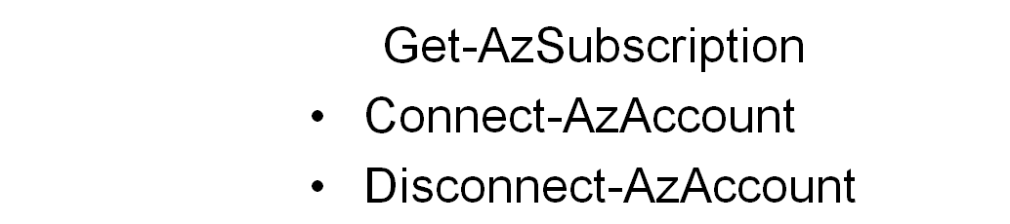
Azure Powershell
Install-Module -Name az –AllowClobber
Import-Module Az
Connect-AzAccount
    Version -1 : AzureVM
    Version : AzureRMVM
    Version : az

Slide 8
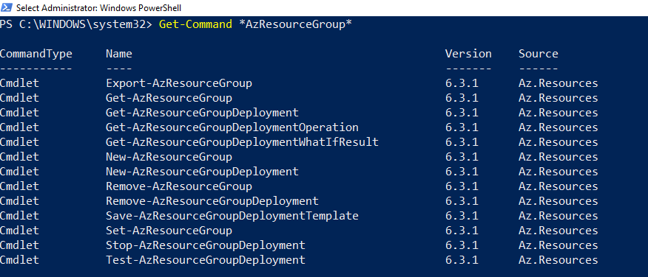
Azure Powershell Commands
Get-command *resourcegroup*
Get-Command *resourcegroup* | Export-csv g:\b.csv
Get-Command *resourcegroup* > g:\c.csv

Slide 9
Get azure resources
1.Get-AzResourceGroup
Get-AzResourceGroup | ft (Table Format)
Get-AzResourceGroup | Export-csv g:\b.csv
Get-AzResourceGroup > g:\c.csv

Slide 10
Resource Group
Create Resource Group
New-AzResourceGroup -ResourceGroupName testrg -Location EastUS
Remove ResourceGroup
Remove-AzResourceGroup testrg -Force -Verbose

Slide 11
vNet/subnet
vnet Creation
$MyvNet01 = New-AzVirtualNetwork -ResourceGroupName testrg -Location EastUS -Name myvnet01 -AddressPrefix 172.168.0.0/16
To see vnet
Get-AzVirtualNetwork -Name myvnet01
To Create Subnet
$Mysubnet01 = Add-AzVirtualNetworkSubnetConfig -Name mysubnet01 -AddressPrefix 172.168.0.0/24 -VirtualNetwork $myvnet01
$Mysubnet01 | Set-AzVirtualNetwork
$Mysubnet02 = Add-AzVirtualNetworkSubnetConfig -Name mysubnet02 -AddressPrefix 172.168.1.0/24 -VirtualNetwork $myvnet01
$Mysubnet01 | Set-AzVirtualNetwork
To Delete vnet
Remove-AzVirtualNetwork -Name myvnet01
Remove-AzVirtualNetwork -Name myvnet01 -Force -Verbose

Slide 12

VM

