Slide 1
CAPSTONE PROJECT - 4 AIRBNB ANALYSIS – EDA AND TABLEAU
MITHUNA K N
DTM2 BATCH

Slide 2


AIRBNB
Airbnb is an online marketplace that connects people who want to rent out their property with people who are looking for accommodations in specific locales.
Airbnb offers people an easy, relatively stress-free way to earn some income from their property.

Slide 3
APPROACH
MongoDB connection & data retrieval
Data Cleaning and Preparation
Analysis – Prices, Availability
Dashboard – Tableau or Power BI

Slide 4
LIBRARIES USED
Pymongo.MongoClient – For MongoDB connection
Pandas – To create dataframe, data cleaning
Seaborn, plotly – data visualization

Slide 5
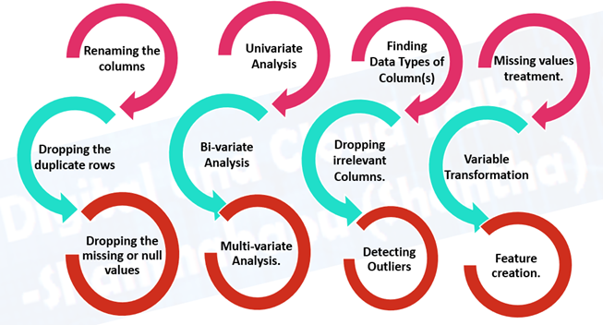
EXPLORATORY DATA ANALYSIS (EDA)
It is a process to understand the data in depth and learn the different data characteristics, often with visual means.
It helps you gather insights and make better sense of the data, and removes irregularities and unnecessary values from data.
Helps you prepare your dataset for analysis.
Allows a machine learning model to predict our dataset better.
Gives you more accurate results.
It also helps us to choose a better machine learning model.

Slide 6
DATA CLEANING AND PREPROCESSING
Handling missing values
Removing duplicates
Transforming data types as necessary
Renaming columns
Detecting outliers

Slide 7
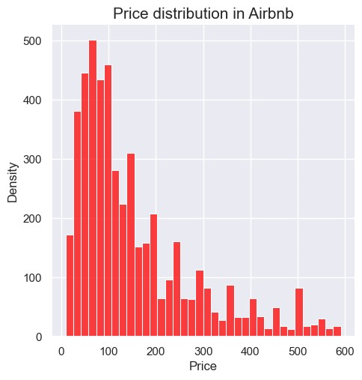
PRICE DISTRIBUTION
This chart shows the price distribution in Airbnb.
Ranges from approx. $20 to $600
Shows the density of each prices listed in Airbnb.

Slide 8
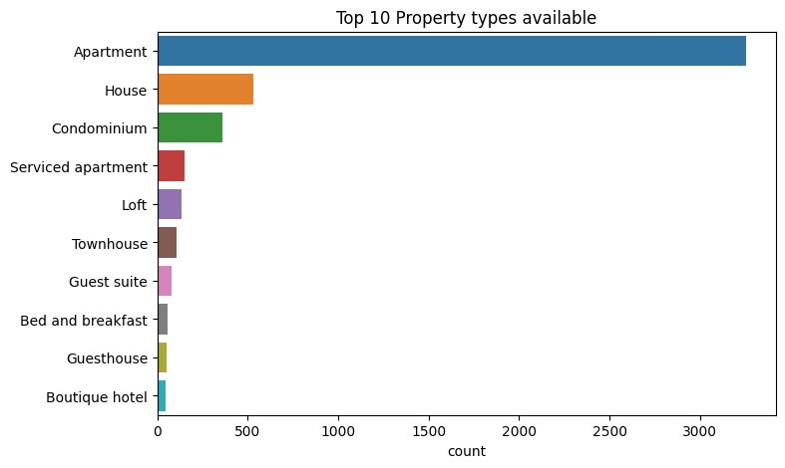
TOP 10 PROPERTY TYPES AVAILABLE

Slide 9
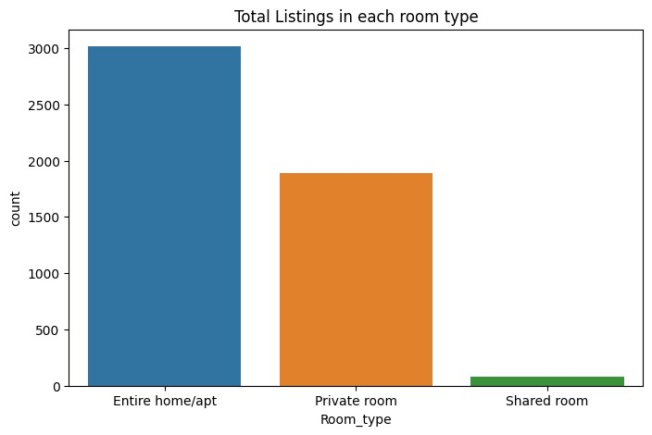
TOTAL LISTINGS IN EACH ROOM TYPE

Slide 10
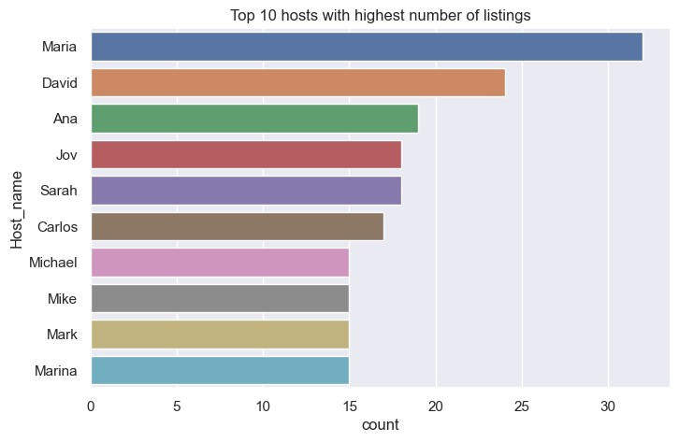
TOP 10 HOSTS WITH HIGHEST LISTINGS

Slide 11
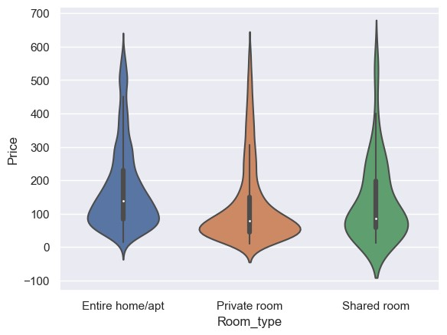
PRICES FOR EACH ROOM TYPE

Slide 12
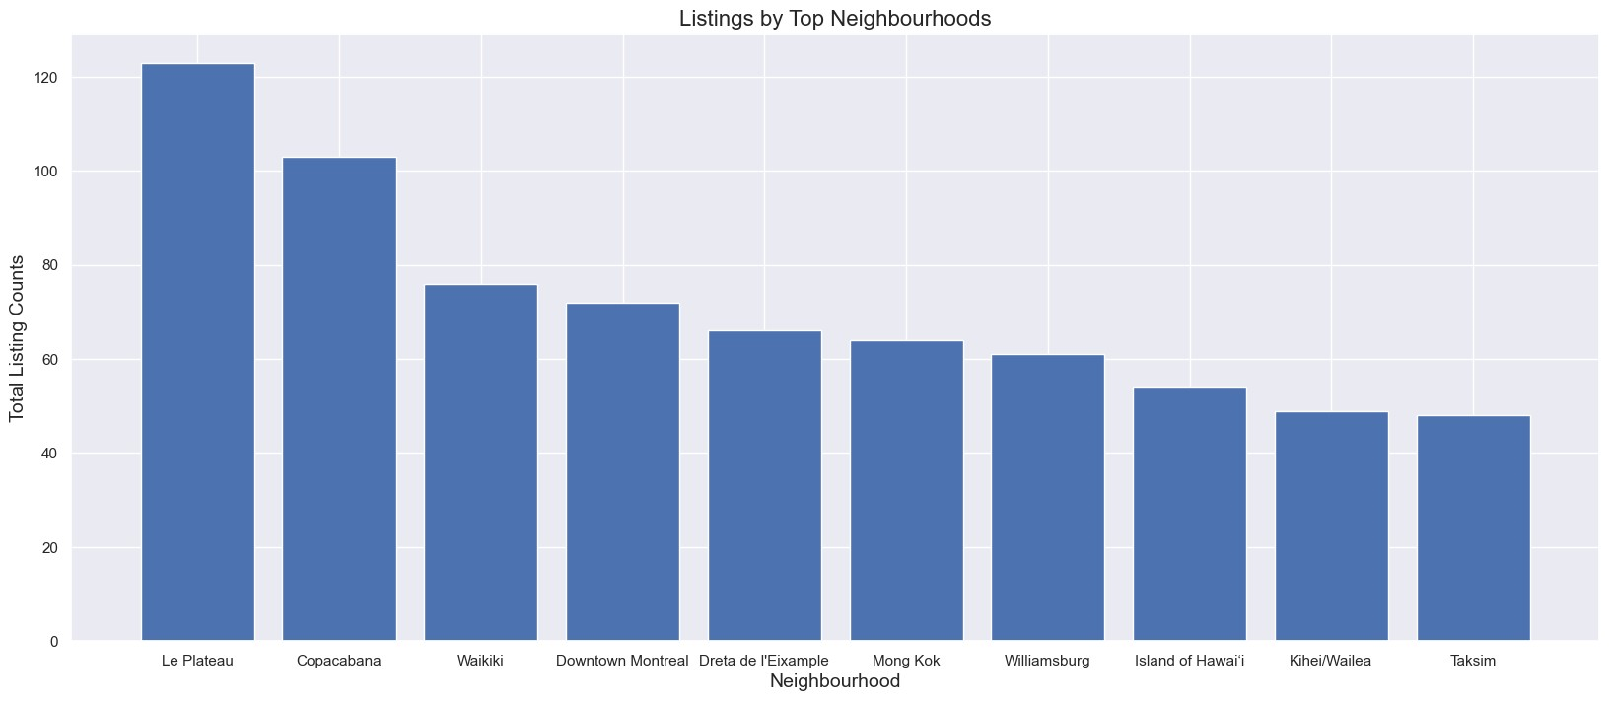
TOTAL LISTINGS IN NEIGHBOURHOOD

Slide 13
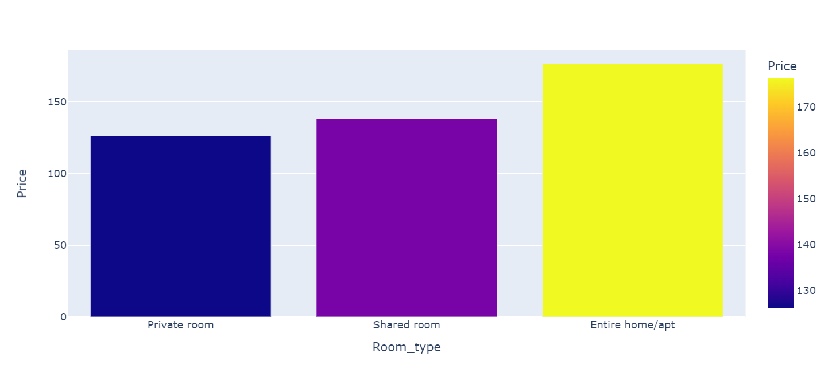
AVERAGE PRICES FOR EACH ROOM TYPE

Slide 14
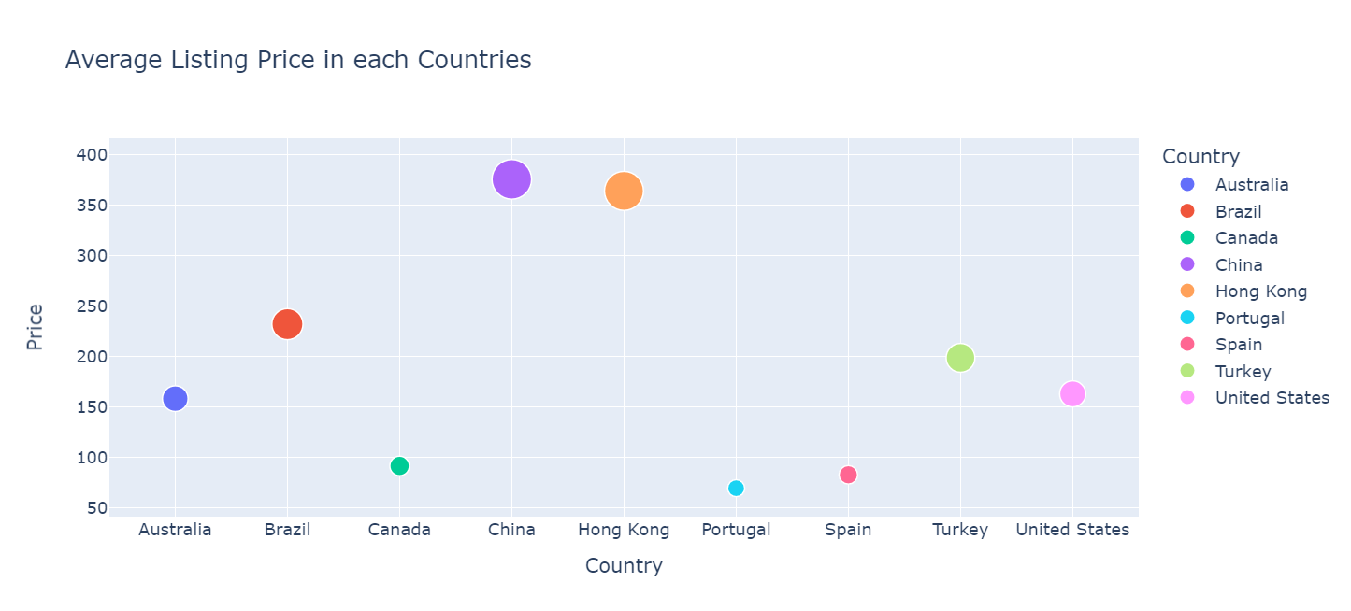
AVERAGE LISTING PRICE IN EACH COUNTRY

Slide 15
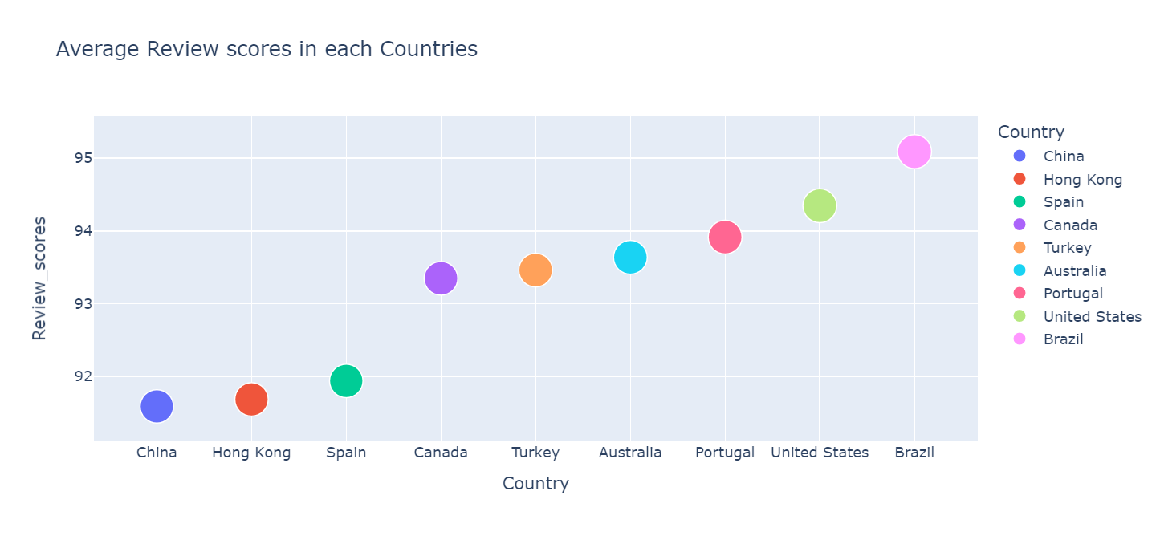
AVERAGE REVIEW SCORE IN EACH COUNTRY

Slide 16
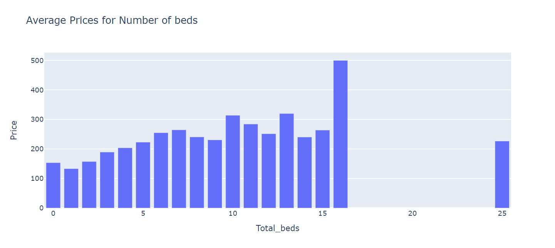
AVERAGE PRICES FOR NUMBER OF BEDS

Slide 17
TABLEAU DASHBOARD
https://public.tableau.com/app/profile/mithuna.k.n/viz/Capstone-AirbnbAnalysis/Dashboard1?publish=yes

