Slide 1


Slide 2
All java applications are compiled and interpreted.
It generates byte codes rather than object code.
Bytecode is a highly optimized set of instructions designed to be executed by the Java run-time system, which is called the Java Virtual Machine (JVM).
This provides greater level of flexibility for the developers to implement the logic specific to JVM rather to any platform or device.
Prof.Mithuna H.R,Dept of ISE,AcIT

Slide 3
JVM is an interpreter for bytecode.
The fact that a Java program is executed by JVM helps solve the major problems associated with downloading programs over the Internet.
Translating a Java program into bytecode helps makes it much easier to run a program in a wide variety of environments.
Prof.Mithuna H.R,Dept of ISE,AcIT

Slide 4
This is because only the JVM needs to be implemented for each platform.
Sun provides a facility called Just In Time (JIT) compiler for byte code.
Prof.Mithuna H.R,Dept of ISE,AcIT

Slide 5
JIT compiles the code.
Job of JVM is to read this bytecode and convert into machine dependent instructions.
JVM’s needs to be platform specific but not the developer’s code. JVM is an interpreter for Bytecode
Prof.Mithuna H.R,Dept of ISE,AcIT

Slide 6
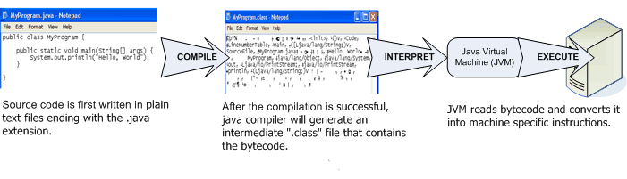
Prof.Mithuna H.R,Dept of ISE,AcIT

Slide 7
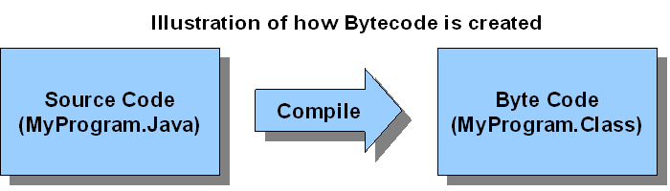
Prof.Mithuna H.R,Dept of ISE,AcIT

Slide 8
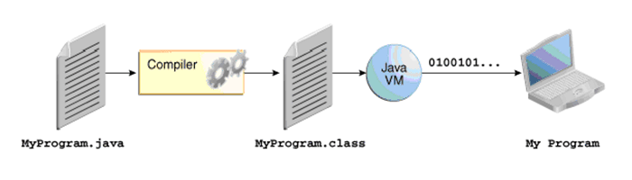
Bytecode generated after compiling in Mac, Windows, Linux or Unix will be same which makes Bytecode platform independent.So, Bytecode compiled in one platform can be executed into another platform.
Prof.Mithuna H.R,Dept of ISE,AcIT

Slide 9
Java’s magic: Java Virtual Machine(JVM)
The Java Virtual Machine (JVM) is an abstract computer, on which the byte code can be executed.
Java Virtual Machine (JVM) interprets the byte code into the machine code depending upon the underlying operating system and hardware combination.
JVM does not know anything about Java program rather it reads the bytecode, interprets the code and executes the code.
Prof.Mithuna H.R,Dept of ISE,AcIT

Slide 10
JVM is platform dependent that means there are different implementation of JVM on different OS.
Java code / Bytecode is always the same on different OS. That makes java program as platform independent.
Prof.Mithuna H.R,Dept of ISE,AcIT

Slide 11
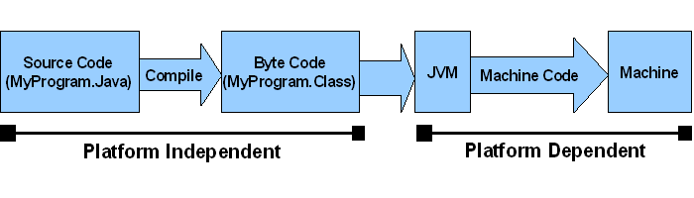
Prof.Mithuna H.R,Dept of ISE,AcIT

Slide 12
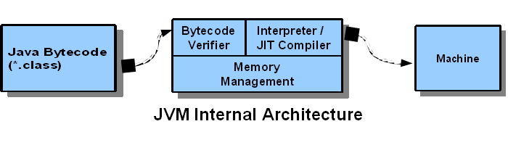
Java’s Magic – Just in Time (JIT):
Just in time (JIT) is a part of Java Virtual Machine (JVM) architecture.
The job of JIT inside JVM is to compile bytecode into machine executable code in real time, on a piece-by-piece, demand basis.
Prof.Mithuna H.R,Dept of ISE,AcIT

Slide 13
Just in time (JIT) helps to compile code that is only needed and at the same time boost the program performance.
Prof.Mithuna H.R,Dept of ISE,AcIT

Slide 14
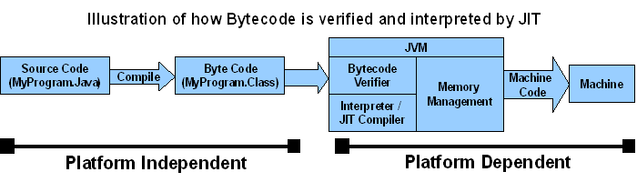
Prof.Mithuna H.R,Dept of ISE,AcIT

Slide 15
Java’s Magic – Java Runtime Environment (JRE):
Java programs cannot be executed on machine without the JVM installed on machine.
Java Runtime Environment (JRE) is software which we can download and install on the any operating system like Windows, Mac or Linux.
Prof.Mithuna H.R,Dept of ISE,AcIT

Slide 16
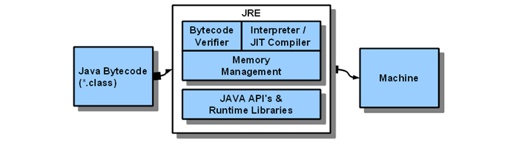
Prof.Mithuna H.R,Dept of ISE,AcIT

Slide 17
JRE is combination of JVM and Java Application Programming Interface (Java API).
Java API is set of tools and libraries that are required by the JVM to execute the java programs. Java Runtime Environment provides an environment to execute java programs on the computer.
JRE = JVM + Java API’s (like util, math, lang, awt, swing etc) + Runtime libraries.
Prof.Mithuna H.R,Dept of ISE,AcIT

Slide 18
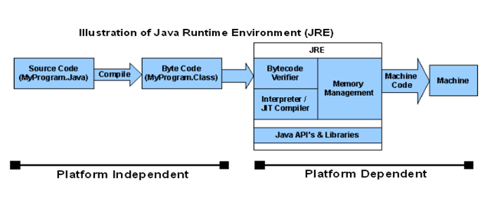
JRE does NOT contain any development tools such as compiler, debugger, etc. and it is NOT for development purpose.
Prof.Mithuna H.R,Dept of ISE,AcIT

Slide 19
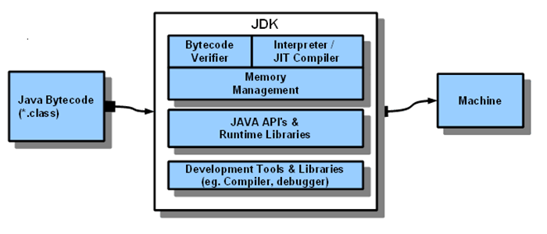
Java’s Magic – Java Development Kit (JDK)
Java Development Kit (JDK) is a set of development tools installed on the local machine to write and compile Java programs.
JDK = JRE + Java Development Tools + Libraries
Prof.Mithuna H.R,Dept of ISE,AcIT

Slide 20
Application of Java
Desktop Applications such as acrobat reader, media player, antivirus, etc.
Web Applications such as irctc.co.in
Enterprise Applications such as banking applications.
Mobile
Embedded System
Smart Card
Robotics
Games, etc.
Prof.Mithuna H.R,Dept of ISE,AcIT

Slide 21
Types of Java Applications
Standalone Application
Web Application
Enterprise Application
Mobile Application
Prof.Mithuna H.R,Dept of ISE,AcIT

Slide 22
The simple java program creation
We can write a simple hello java program easily after installing the JDK.
To create a simple java program, you need to create a class that contains main method. Let's understand the requirement first.
Requirement for Hello Java Example
For executing any java program, you need to
Install the JDK
set path of the jdk/bin directory.
create the java program
compile and run the java program
Prof.Mithuna H.R,Dept of ISE,AcIT

Slide 23
Java Version History
JDK Alpha and Beta (1995)
JDK 1.0 (23rd Jan 1996)
JDK 1.1 (19th Feb 1997)
J2SE 1.2 (8th Dec 1998)
J2SE 1.3 (8th May 2000)
J2SE 1.4 (6th Feb 2002)
J2SE 5.0 (30th Sep 2004)
Java SE 6 (11th Dec 2006)
Java SE 7 (28th July 2011)
Java SE 8 (18th Mar 2014)
Java SE 9 (21st Sep 2017)
Java SE 10 (20th Mar 2018)
Prof.Mithuna H.R,Dept of ISE,AcIT

Slide 24
Java Platforms / Editions
Java SE (Java Standard Edition)
We can develop stand-alone applications. This provides the different packages like java.lang,java.util etc.
Java EE (Java Enterprise Edition)
we can develop Enterprise applications. This includes API’s like Servlets, WebSocket, JavaServerFaces, Unified Expression Language.
Java ME (Java Micro Edition)
we can develop applications that run on small scale devices like mobile phones.
Prof.Mithuna H.R,Dept of ISE,AcIT

Slide 25

Prof.Mithuna H.R,Dept of ISE,AcIT

Slide 26
Java Program structure:
Java program structure contains six stages. They are:
Documentation Section: The documentation section contains a set of comment lines describing about the program.// or /* */
Package statement: The first statement allowed in a Java file is a package statement. This statement declares a package name and informs the compiler that the class defined here belong to the package.
Package student;
Import statements: Import statements instruct the compiler to load the specific class belongs to the mentioned package.
import student.test;
Prof.Mithuna H.R,Dept of ISE,AcIT

Slide 27
Interface statements: An interface is like a class but includes a group of method deceleration. This is an optional statement.
Class definition: A Java program may contain multiple class definition The class are used to map the real world object.
Main method class: The main method creates objects of various classes and establish communication between them. On reaching to the end of main the program terminates and the control goes back to operating system.
Prof.Mithuna H.R,Dept of ISE,AcIT

Slide 28
Creating Hello World Example
class Simple{
public static void main(String args[]){
System.out.println("Hello Java");
}
}
Prof.Mithuna H.R,Dept of ISE,AcIT

Slide 29
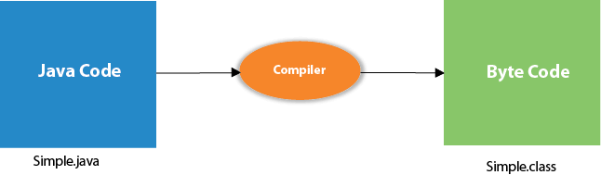
Compilation Flow
To compile: | javac Simple.java
To execute: | java Simple
Output: Hello Java
Prof.Mithuna H.R,Dept of ISE,AcIT

Slide 30
Understanding first java program
Let's see what is the meaning of class, public, static, void, main, String[], System.out.println().
class keyword is used to declare a class in java.
public keyword is an access modifier which represents visibility, it means it is visible to all.
static is a keyword, if we declare any method as static, it is known as static method. The core advantage of static method is that there is no need to create object to invoke the static method. The main method is executed by the JVM, so it doesn't require creating object to invoke the main method. So it saves memory.
Prof.Mithuna H.R,Dept of ISE,AcIT

Slide 31
void is the return type of the method, it means it doesn't return any value.
main represents startup of the program.
String[] args is used for command line argument.
System.out.println() is used print statement.
To write the simple program, open notepad by start menu -> All Programs -> Accessories -> notepad and write simple program as displayed below:
Prof.Mithuna H.R,Dept of ISE,AcIT

Slide 32
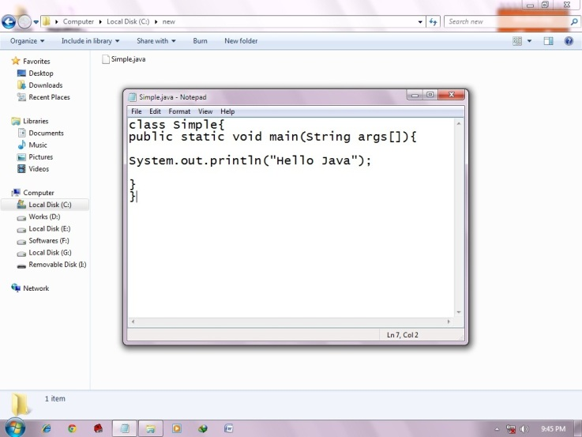
As displayed in the above diagram, write the simple program of java in notepad and saved it as Simple.java.
To compile and run this program, you need to open command prompt by
start menu -> All Programs -> Accessories -> command prompt.
Prof.Mithuna H.R,Dept of ISE,AcIT

Slide 33
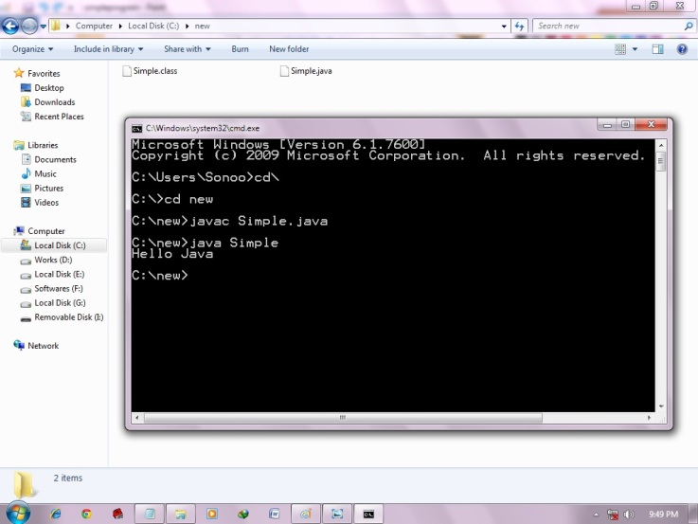
Prof.Mithuna H.R,Dept of ISE,AcIT

Slide 34
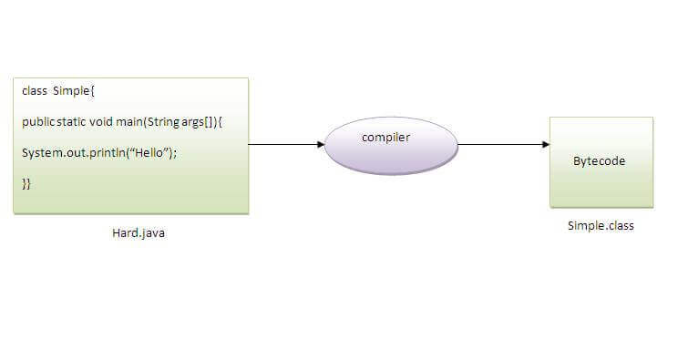
Can you save a java source file by other name than the class name?
To compile: | javac Hard.java
To execute: | java Simple
Prof.Mithuna H.R,Dept of ISE,AcIT

Slide 35
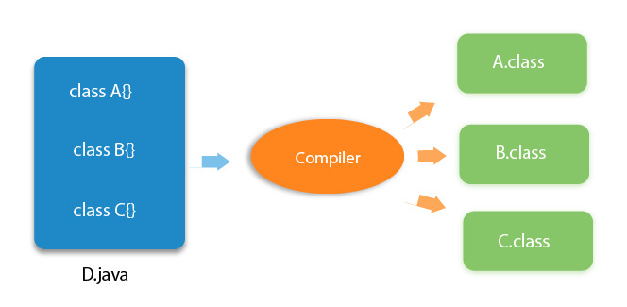
Can you have multiple classes in a java source file?
Prof.Mithuna H.R,Dept of ISE,AcIT

Slide 36
OOPs (Object-Oriented Programming System)
Object
Class
Inheritance
Polymorphism
Abstraction
Encapsulation
Prof.Mithuna H.R,Dept of ISE,AcIT

Slide 37
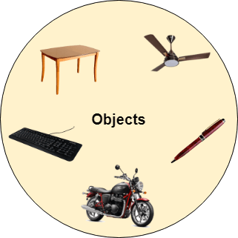
Object
Any entity that has state and behavior is known as an object.
Prof.Mithuna H.R,Dept of ISE,AcIT

Slide 38
Class
Collection of objects is called class. It is a logical entity.
A class can also be defined as a blueprint from which you can create an individual object. Class doesn't consume any space.
Prof.Mithuna H.R,Dept of ISE,AcIT

Slide 39
Inheritance
When one object acquires all the properties and behaviors of a parent object, it is known as inheritance.
It provides code reusability.
It is used to achieve runtime polymorphism.
Prof.Mithuna H.R,Dept of ISE,AcIT

Slide 40
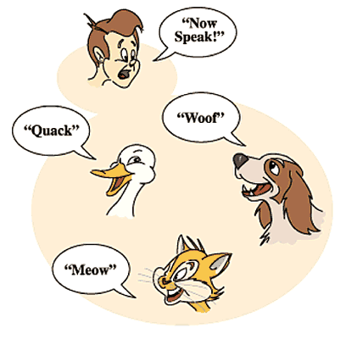
Polymorphism
If one task is performed in different ways, it is known as polymorphism
Prof.Mithuna H.R,Dept of ISE,AcIT

Slide 41
Abstraction
Hiding internal details and showing functionality is known as abstraction.
For example phone call, we don't know the internal processing.
In Java, we use abstract class and interface to achieve abstraction.
Prof.Mithuna H.R,Dept of ISE,AcIT

Slide 42

Encapsulation
Binding (or wrapping) code and data together into a single unit are known as encapsulation.
A java class is the example of encapsulation because all the data members are private here.
Prof.Mithuna H.R,Dept of ISE,AcIT

Slide 43
What is a class in Java
A class is a group of objects which have common properties. It is a template or blueprint from which objects are created. It is a logical entity. It can't be physical.
A class in Java can contain:
Fields
Methods
Constructors
Blocks
Nested class and interface
Prof.Mithuna H.R,Dept of ISE,AcIT

Slide 44
Creating an Object
In Java, the new keyword is used to create new objects.
There are three steps when creating an object from a class −
Declaration − A variable declaration with a variable name with an object type.
Instantiation − The 'new' keyword is used to create the object.
Initialization − The 'new' keyword is followed by a call to a constructor. This call initializes the new object.
Prof.Mithuna H.R,Dept of ISE,AcIT

Slide 45
Accessing Instance Variables and Methods
Instance variables and methods are accessed via created objects. To access an instance variable, following is the fully qualified path −
/* First create an object */
Datatype ObjectReference = new Constructor();
Example: A a=new A();
/* Now call a variable as follows */ ObjectReference.variableName;
/* Now you can call a class method as follows */ ObjectReference.MethodName();
Prof.Mithuna H.R,Dept of ISE,AcIT

Slide 46
//Java Program to illustrate how to define a class and fields
//Defining a Student class.
class Student{
  //defining fields
  int id;//field or data member or instance variable
  String name;
  //creating main method inside the Student class
  public static void main(String args[]){
  //Creating an object or instance
  Student s1=new Student();//creating an object of Student
  //Printing values of the object
  System.out.println(s1.id);//accessing member through reference variable
  System.out.println(s1.name);
  }
}
Output:
0
null
Prof.Mithuna H.R,Dept of ISE,AcIT

Slide 47
Java command line arguments:
Command line arguments are the parameters that are supplied to the application program at the time when they are invoked.
The main() method of Java program will take the command line arguments as the parameter of the args[ ] variable which is a string array.
Prof.Mithuna H.R,Dept of ISE,AcIT

Slide 48
Example:
Class Comlinetest
  {
  public static void main(String args[ ] )
  {
      int count, n = 0; string str;
      count = args.length;
      System.out.println ( “ Number of arguments :” + count);
    while ( n < count )
    {
      str = args[ n ]; n = n + 1;
      System.out.println( n + “ : “ + str);
    }
  }
}
Prof.Mithuna H.R,Dept of ISE,AcIT

Slide 49
Run/Calling the program:
javac Comlinetest.java
java Comlinetest Java c cpp fortran
Output:
    1: Java
    2: c
    3: cpp
    4: fortran
Prof.Mithuna H.R,Dept of ISE,AcIT

Slide 50
Java API
Java standard library includes hundreds of classes and methods grouped into several functional packages. Most commonly used packages are:
  Language support Package.
  Utilities packages.
  Input/output packages
  Networking packages
  AWT packages.
  Applet packages.
Prof.Mithuna H.R,Dept of ISE,AcIT

Slide 51
Java User Input (Scanner)
The Scanner class is used to get user input, and it is found in the java.util package.
create an object of the class and use any of the available methods found in the Scanner class documentation.
Scanner is a class in java.util package used for obtaining the input of the primitive types like int, double, etc. and strings.
It is the easiest way to read input in a Java program, though not very efficient if you want an input method for scenarios where time is a constraint like in competitive programming.
Prof.Mithuna H.R,Dept of ISE,AcIT

Slide 52
To create an object of Scanner class, we usually pass the predefined object System.in, which represents the standard input stream. We may pass an object of class File if we want to read input from a file.
To read numerical values of a certain data type XYZ, the function to use is nextXYZ(). For example, to read a value of type short, we can use nextShort()
To read strings, we use nextLine().
To read a single character, we use next().charAt(0). next() function returns the next token/word in the input as a string and charAt(0) function returns the first character in that string.
Prof.Mithuna H.R,Dept of ISE,AcIT

Slide 53
User Input from Keyboard
Accepting keyboard input in Java is done using a Scanner object.
Consider the following statement
Scanner console = new Scanner(System.in);
This statement declares a reference variable named console. The Scanner object is associated with standard input device (System.in).
To get input from keyboard, you can call methods of Scanner class. For example in following statment nextInt() method of Scanner takes an integer and returns to variable x :
int x = console.nextInt();
Prof.Mithuna H.R,Dept of ISE,AcIT

Slide 54
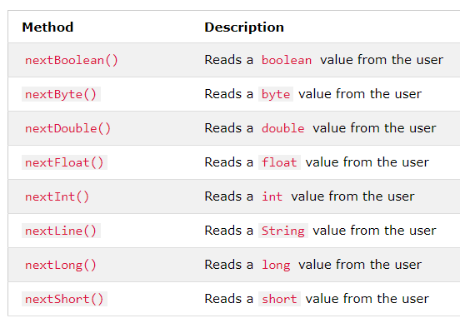
Input Types
Prof.Mithuna H.R,Dept of ISE,AcIT

Slide 55
Data Types, Variables, Operators, Control Statements in Java
Data types:
There are two data types available in Java
Primitive Data Types
Non Primitive Data Types
Reference/Object Data Types
Prof.Mithuna H.R,Dept of ISE,AcIT

Slide 56

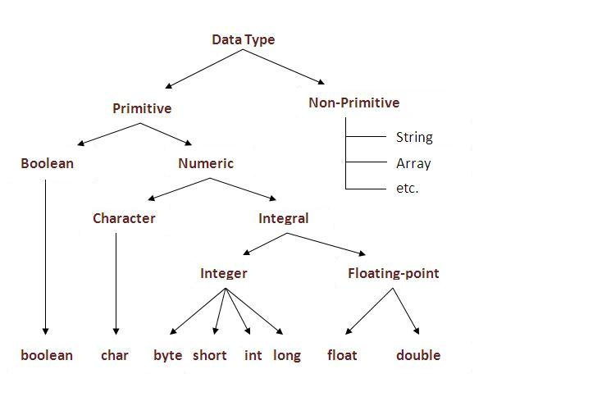
Prof.Mithuna H.R,Dept of ISE,AcIT

Slide 57
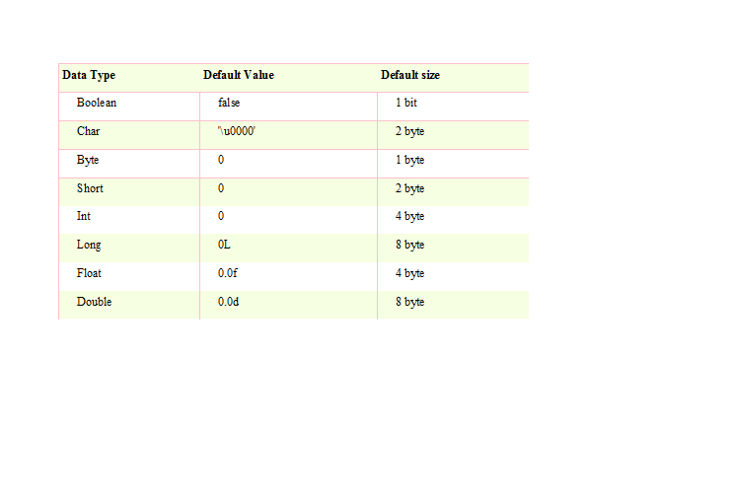
Prof.Mithuna H.R,Dept of ISE,AcIT

Slide 58
Reference Data types:
Reference variables are created using defined constructors of the classes.
They are used to access objects. These variables are declared to be of a specific type that cannot be changed. For example, Employee, Students etc.
Class objects and various types of array variables come under reference data type.
Default value of any reference variable is null.
A reference variable can be used to refer any object of the declared type or any compatible type.
Example: Animal animal = new Animal("giraffe");
Prof.Mithuna H.R,Dept of ISE,AcIT

Slide 59
Variables
Variable is a name of memory location.
There are three types of variables in java: local, instance and static.
Variable is name of reserved area allocated in memory. In other words, it is a name of memory location. It is a combination of "vary + able" that means its value can be changed.
To declare one identifier as a variable there are certain rules. They are:
They must not begin with a digit.
Uppercase and lowercase are distinct.
It should not be a keyword.
White space is not allowed.
Prof.Mithuna H.R,Dept of ISE,AcIT

Slide 60
Types of Variable
There are three types of variables in java:
  local variable
  instance variable
  static variable
Prof.Mithuna H.R,Dept of ISE,AcIT

Slide 61
Local Variable
A variable which is declared inside the method is called local variable.
Instance Variable
A variable which is declared inside the class but outside the method, is called instance variable.
It is not declared as static.
Static variable
A variable that is declared as static is called static variable.
It cannot be local.
Prof.Mithuna H.R,Dept of ISE,AcIT

Slide 62
Example to understand the types of variables in java
class A{
    int data=50;//instance variable
    static int m=100;//static variable
    void method()
    {
    int n=90;//local variable
    }
}//end of class
Prof.Mithuna H.R,Dept of ISE,AcIT

Slide 63
Operators:
Operator in java is a symbol that is used to perform operations.
For example: +, -, *, / etc.
There are many types of operators in java which are given below:
Unary Operator,
Arithmetic Operator,
shift Operator,
Relational Operator,
Bitwise Operator,
Logical Operator,
Ternary Operator and
Assignment Operator.
Prof.Mithuna H.R,Dept of ISE,AcIT

Slide 64
Instanceof Operator
This operator is used only for object reference variables.
The operator checks whether the object is of a particular type (class type or interface type). instanceof operator is written as
( Object reference variable ) instanceof (class/interface type)
If the object referred by the variable on the left side of the operator passes the IS-A check for the class/interface type on the right side, then the result will be true.
Prof.Mithuna H.R,Dept of ISE,AcIT

Slide 65
class Test
{
      public static void main(String args[])
      {
      String name ="James";
      // following will return true since name is type of String
      boolean result = name instanceof String;
      System.out.println( result );
      }
}
Class A
A obj=new A();
boolean result=obj instanceof A
Output
true
Prof.Mithuna H.R,Dept of ISE,AcIT

Slide 66
Arrays:
Array is a collection of similar type of elements that have contiguous memory location.
Java array is an object the contains elements of similar data type.
It is a data structure where we store similar elements.
We can store only fixed set of elements in a java array.
Array in java is index based, first element of the array is stored at 0 index.
Prof.Mithuna H.R,Dept of ISE,AcIT

Slide 67
Advantage of Java Array
    Code Optimization: It makes the code optimized, we can retrieve or sort the data easily.
    Random access: We can get any data located at any index position.
Disadvantage of Java Array
    Size Limit: We can store only fixed size of elements in the array. It doesn't grow its size at runtime. To solve this problem, collection framework is used in java.
Prof.Mithuna H.R,Dept of ISE,AcIT

Slide 68
Types of Array in java
There are two types of array.
    Single Dimensional Array.
    Multidimensional Array
  Single Dimensional Array in java
    Syntax to Declare an Array in java
    To use an array in a program, you must declare a variable to reference the array, and you must specify the type of array the variable can reference.
Prof.Mithuna H.R,Dept of ISE,AcIT

Slide 69
syntax for declaring an array variable
Here is the syntax for declaring an array variable:
int a[4];
dataType[] arrayRefVar; (or) int[] a;
dataType []arrayRefVar; (or)
dataType arrayRefVar[];
Prof.Mithuna H.R,Dept of ISE,AcIT

Slide 70
The following code snippets are examples of this syntax:
int[] myList;
(or)
int []myList;
(or)
int myList[];
Prof.Mithuna H.R,Dept of ISE,AcIT

Slide 71
Creating Arrays:
You can create an array by using the new operator with the following syntax:
arrayRefVar = new dataType[arraySize];
The above statement does two things:
  It creates an array using new dataType[arraySize];
  It assigns the reference of the newly created array to the variable arrayRefVar.
Prof.Mithuna H.R,Dept of ISE,AcIT

Slide 72
Declaring an array variable, creating an array, and assigning the reference of the array to the variable can be combined in one statement, as shown below:
dataType[] arrayRefVar = new dataType[arraySize];
Alternatively you can create arrays as follows:
dataType[] arrayRefVar = {value0, value1, ..., valuek};
The array elements are accessed through the index. Array indices are 0-based; that is, they start from 0 to arrayRefVar.length-1.
Prof.Mithuna H.R,Dept of ISE,AcIT

Slide 73
Example:
Following statement declares an array variable, myList, creates an array of 10 elements of double type and assigns its reference to myList:
double[] myList = new double[10];
Following picture represents array myList. Here, myList holds ten double values and the indices are from 0 to 9
Prof.Mithuna H.R,Dept of ISE,AcIT

Slide 74
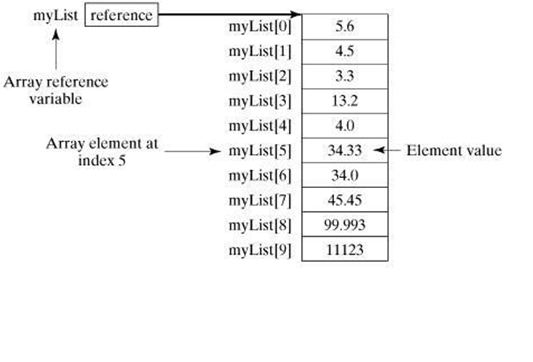
Prof.Mithuna H.R,Dept of ISE,AcIT

Slide 75
Example of single dimensional java array
class Testarray
{
public static void main(String args[])
{
int a[]=new int[5];//declaration and instantiation
a[0]=10;//initialization
a[1]=20;
a[2]=70;
a[3]=40;
a[4]=50;
//printing array
for(int i=0;i<a.length;i++)//length is the property of array
System.out.println(a[i]);
}
}
  Output: 10
  20
  70
  40
  50
Prof.Mithuna H.R,Dept of ISE,AcIT

Slide 76
Declaration, Instantiation and Initialization of Java Array
We can declare, instantiate and initialize the java array together by: int a[]={33,3,4,5};//declaration, instantiation and initialization
Let's see the simple example to print this array.
class Testarray1
{
  public static void main(String args[])
  {
  int a[]={33,3,4,5};//declaration, instantiation and initialization
  //printing array
  for(int i=0;i<a.length;i++)//length is the property of array
  System.out.println(a[i]);
  }
}
Prof.Mithuna H.R,Dept of ISE,AcIT

Slide 77
Passing Array to method in java
We can pass the java array to method so that we can reuse the same logic on any array.
class Testarray2
{
static void min(int arr[])
{
int min=arr[0]; //33
for(int i=1;i<arr.length;i++)
if(min>arr[i])// 33>3
min=arr[i];// 3
System.out.println(min);
}
public static void main(String args[])
{
int a[]={33,3,4,5};
min(a);//passing array to method
}
}
Output:3
Prof.Mithuna H.R,Dept of ISE,AcIT

Slide 78
Multidimensional array in java
In such case, data is stored in row and column based index (also known as matrix form).
Syntax to Declare Multidimensional Array in java
dataType[][] arrayRefVar; (or)
dataType [][]arrayRefVar; (or)
dataType arrayRefVar[][]; (or)
dataType []arrayRefVar[];
Prof.Mithuna H.R,Dept of ISE,AcIT

Slide 79
Example to instantiate Multidimensional Array in java
int[][] arr=new int[3][3];//3 row and 3 column
Example to initialize Multidimensional Array in java
      arr[0][0]=1;
      arr[0][1]=2;
      arr[0][2]=3;
      arr[1][0]=4;
      arr[1][1]=5;
      arr[1][2]=6;
      arr[2][0]=7;
      arr[2][1]=8;
      arr[2][2]=9;
Prof.Mithuna H.R,Dept of ISE,AcIT

Slide 80
Example of Multidimensional java array
Let's see the simple example to declare, instantiate, initialize and print the 2Dimensional array.
class Testarray3
{
public static void main(String args[])
{ //declaring and initializing 2D array
int arr[][]={{1,2,3},{2,4,5},{4,4,5}};
//printing 2D array
for(int i=0;i<3;i++)
{ for(int j=0;j<3;j++)
{
System.out.print(arr[i][j]+" ");
}
System.out.println();
}
}}
Output:
1 2 3
2 4 5
4 4 5
Prof.Mithuna H.R,Dept of ISE,AcIT

Slide 81
Addition of 2 matrices in java
class Testarray5{
      public static void main(String args[])
      {
        //creating two matrices
        int a[][]={{1,3,4},{3,4,5}};
        int b[][]={{1,3,4},{3,4,5}};
        //creating another matrix to store the sum of two matrices
        int c[][]=new int[2][3];
        //adding and printing addition of 2 matrices
        for(int i=0;i<2;i++)
        {
        for(int j=0;j<3;j++)
        {
        c[i][j]=a[i][j]+b[i][j];
        System.out.print (c[i][j]+" ");
} System.out.println ();//new line
} }}
Output:2 6 8
6 8 10
Prof.Mithuna H.R,Dept of ISE,AcIT

Slide 82
Control Statements:
A program executes from top to bottom except when we use control statements, we can control the order of execution of the program, based on logic and values.
In Java, control statements can be divided into the following three categories:
Selection Statements
Iteration Statements
Jump Statements
Prof.Mithuna H.R,Dept of ISE,AcIT

Slide 83
Selection Statements
Selection statements allow you to control the flow of program execution on the basis of the outcome of an expression or state of a variable known during runtime.
Selection statements can be divided into the following categories:
The if and if-else statements
The if-else statements
The if-else-if statements
The switch statements
Prof.Mithuna H.R,Dept of ISE,AcIT

Slide 84
If Statements
The first contained statement (that can be a block) of an if statement only executes when the specified condition is true.
If the condition is false and there is not else keyword then the first contained statement will be skipped and execution continues with the rest of the program.
The condition is an expression that returns a boolean value.
Prof.Mithuna H.R,Dept of ISE,AcIT

Slide 85
Example
import java.util.Scanner;
public class IfDemo
{
public static void main(String[] args) {
int age;
Scanner inputDevice = new Scanner(System.in);
System.out.print("Please enter Age: ");
age = inputDevice.nextInt();
if(age > 18)
System.out.println("above 18 ");
}
Prof.Mithuna H.R,Dept of ISE,AcIT

Slide 86
The if-else statements
In if-else statements, if the specified condition in the if statement is false, then the statement after the else keyword (that can be a block) will execute.
Prof.Mithuna H.R,Dept of ISE,AcIT

Slide 87
Example
import java.util.Scanner;
public class IfElseDemo
{
public static void main( String[] args )
{
int age;
Scanner inputDevice = new Scanner( System.in );
System.out.print( "Please enter Age: " );
age = inputDevice.nextInt();
if ( age >= 18 )
System.out.println( "above 18 " );
else
System.out.println( "below 18" );
}
}
Prof.Mithuna H.R,Dept of ISE,AcIT

Slide 88
The if-else-if statements
This statement following the else keyword can be another if or if-else statement.
That would looks like this:
if(condition)
statements;
else if (condition)
statements;
else if(condition)
statement;
else
statements;
Whenever the condition is true, the associated statement will be executed and the remaining conditions will be bypassed. If none of the conditions are true then the else block will execute.
Prof.Mithuna H.R,Dept of ISE,AcIT

Slide 89
Example
import java.util.Scanner;
public class IfElseIfDemo
{
public static void main( String[] args )
{
int age;
Scanner inputDevice = new Scanner( System.in );
System.out.print( "Please enter Age: " );
age = inputDevice.nextInt();
if ( age >= 18 && age <=35 )
System.out.println( "between 18-35 " );
else if(age >35 && age <=60)
System.out.println("between 36-60");
else
System.out.println( "not matched" );
}
}
Prof.Mithuna H.R,Dept of ISE,AcIT

Slide 90
The Switch Statements
The switch statement is a multi-way branch statement.
The switch statement of Java is another selection statement that defines multiple paths of execution of a program.
It provides a better alternative than a large series of if-else-if statements.
Prof.Mithuna H.R,Dept of ISE,AcIT

Slide 91
import java.util.Scanner;
public class SwitchDemo
{
public static void main( String[] args )
{
int age;
Scanner inputDevice = new Scanner( System.in );
System.out.print( "Please enter Age: " );
age = inputDevice.nextInt();
switch ( age )
{
case 18:
System.out.println( "age 18" );
break;
case 19:
System.out.println( "age 19" );
break;
default:
System.out.println( "not matched" );
break;
} } }
Prof.Mithuna H.R,Dept of ISE,AcIT

Slide 92
Each of the values specified in the case statement must be of a type compatible with the expression.
Duplicate case values are not allowed.
The break statement is used inside the switch to terminate a statement sequence.
The break statement is optional in the switch statement.
Prof.Mithuna H.R,Dept of ISE,AcIT

Slide 93
Iteration Statements
Repeating the same code fragment several times until a specified condition is satisfied is called iteration.
Iteration statements execute the same set of instructions until a termination condition is met.
Java provides the following loop for iteration statements:
The while loop
The for loop
The do-while loop
The for each loop
Prof.Mithuna H.R,Dept of ISE,AcIT

Slide 94
The while loop
It continually executes a statement (that is usually be a block) while a condition is true. The condition must return a Boolean value.
Prof.Mithuna H.R,Dept of ISE,AcIT

Slide 95
  Example:
  public class WhileDemo
  {
  public static void main( String[] args )
  {
  int i = 0;
  while ( i < 5 )
  {
  System.out.println( "Value :: " + i );
  i++;
  }
  }
  }
OUTPUT:
Value::0
Value::1
Value::2
Value::3
Value::4
Prof.Mithuna H.R,Dept of ISE,AcIT

Slide 96
The do-while loop
The only difference between a while and a do-while loop is that do-while evaluates its expression at the bottom of the loop instead of the top. The do-while loop executes at least one time then it will check the expression prior to the next iteration.
Prof.Mithuna H.R,Dept of ISE,AcIT

Slide 97
  Example:
  public class DoWhileDemo
  {
    public static void main( String[] args )
    {
      int i = 0;
        do
        {
        System.out.println( "value :: " + i );
        i++;
        }
      while ( i < 5);
    }
  }
OUTPUT:
Value::0
Value::1
Value::2
Value::3
Value::4
Prof.Mithuna H.R,Dept of ISE,AcIT

Slide 98
The for loop
A for loop executes a statement (that is usually a block) as long as the Boolean condition evaluates to true. A for loop is a combination of the three elements initialization statement, Boolean expression and increment or decrement statement.
Syntax:
for(<initialization>;<condition>;<increment or decrement statement>)
{
<block of code>
}
Prof.Mithuna H.R,Dept of ISE,AcIT

Slide 99
The initialization block executes first before the loop starts. It is used to initialize the loop variable.
The condition statement evaluates every time prior to when the statement (that is usually be a block) executes, if the condition is true then only the statement (that is usually a block) will execute.
The increment or decrement statement executes every time after the statement (that is usually a block).
Prof.Mithuna H.R,Dept of ISE,AcIT

Slide 100
Example
public class WhileDemo
{
public static void main( String[] args )
{
for (int i = 0; i < 5;i++ )
{
System.out.println( "Value :: " + i );
}
} }
OUTPUT:
Value::0
Value::1
Value::2
Value::3
Value::4
Prof.Mithuna H.R,Dept of ISE,AcIT

Slide 101
The For each loop
The Java for-each loop or enhanced for loop is introduced since J2SE 5.0. It provides an alternative approach to traverse the array or collection in Java. It is mainly used to traverse the array or collection elements.
For-each is another array traversing technique like for loop, while loop, do-while loop introduced in Java5.
Prof.Mithuna H.R,Dept of ISE,AcIT

Slide 102
It starts with the keyword for like a normal for-loop.
Instead of declaring and initializing a loop counter variable, you declare a variable that is the same type as the base type of the array, followed by a colon, which is then followed by the array name.
In the loop body, you can use the loop variable you created rather than using an indexed array element.
It’s commonly used to iterate over an array or a Collections class (eg, ArrayList)
Prof.Mithuna H.R,Dept of ISE,AcIT

Slide 103
syntax:
for (type var : array)
{
statements using var;
}
is equivalent to:
for (int i=0; i<arr.length; i++)
{
type var = arr[i];
statements using var;
}
Prof.Mithuna H.R,Dept of ISE,AcIT

Slide 104
Example
class ForEachExample1
{
  public static void main(String args[])
      {
      int arr[]={12,13,14,44};
      for(int i:arr)
      {
      System.out.println(i);
      }
  } }
Prof.Mithuna H.R,Dept of ISE,AcIT

Slide 105
Compile by: javac ForEachExample1.java
Run by: java ForEachExample1
ouput:
  12
  13
  14
  44
Prof.Mithuna H.R,Dept of ISE,AcIT

Slide 106
Advantages
It makes the code more readable.
It eliminates the possibility of programming errors.
It is known as the for-each loop because it traverses each element one by one.
Prof.Mithuna H.R,Dept of ISE,AcIT

Slide 107
Drawback of the enhanced for loop
It cannot traverse the elements in reverse order.
we do not have the option to skip any element because it does not work on an index basis. Moreover, we cannot traverse the odd or even elements only.
But, it is recommended to use the Java for-each loop for traversing the elements of array and collection because it makes the code readable.
Prof.Mithuna H.R,Dept of ISE,AcIT

Slide 108
Example:
  class ForEachExample1
  {
    public static void main(String args[])
    {
    int arr[]={12,13,14,44};
    int total=0;
      for(int i:arr)
      {
      total=total+i;
      }
    System.out.println("Total: "+total); }}
Prof.Mithuna H.R,Dept of ISE,AcIT
Notes:
output:83

Slide 109
Jump Statements
Jump statements are used to unconditionally transfer the program control to another part of the program.
Java provides the following jump statements:
break statement
continue statement
return statement
Prof.Mithuna H.R,Dept of ISE,AcIT

Slide 110
Break Statement
The break statement immediately quits the current iteration and goes to the first statement following the loop. Another form of break is used in the switch statement.
The break statement has the following two forms:
Labeled Break Statement
Unlabeled Break Statement
Prof.Mithuna H.R,Dept of ISE,AcIT

Slide 111
Unlabeled Break Statement:
This is used to jump program control out of the specific loop on the specific condition.
Prof.Mithuna H.R,Dept of ISE,AcIT

Slide 112
Example
  public class UnLabeledBreakDemo
  {
    public static void main( String[] args )
    {
      for ( int var = 0; var < 5; var++ )
      {
      System.out.println( "Var is : " + var );
      if ( var == 3 )
      break;
      }
    } }
Prof.Mithuna H.R,Dept of ISE,AcIT

Slide 113
CHOOSE CORRECT OUTPUT
A)0,1,2,3
B)0,1,2,3,4
C)0,1,2,3,4,5
D)0,1,2
Prof.Mithuna H.R,Dept of ISE,AcIT

Slide 114
Labeled Break Statement:
This is used for when we want to jump the program control out of nested loops or multiple loops.
Prof.Mithuna H.R,Dept of ISE,AcIT

Slide 115
Example
public class LabeledBreakDemo
{
  public static void main( String[] args )
  {
    Outer: for ( int var1 = 0; var1 < 5; var1++ )
    {
      for ( int var2 = 1; var2 < 5; var2++ )
      {
      System.out.println( "var1:" + var1 + ", var2:" + var2 );
      if ( var1 == 3 )
      break Outer;
      }
    }
  }
}
Prof.Mithuna H.R,Dept of ISE,AcIT

Slide 116
Find total number of iterations
A)10
B)12
C)13
D)16
Prof.Mithuna H.R,Dept of ISE,AcIT

Slide 117
continue statement
The continue statement is used when you want to continue running the loop with the next iteration and want to skip the rest of the statements of the body for the current iteration.
The continue statement has the following two forms:
Labeled Continue Statement
Unlabeled Continue Statement
Unlabeled Continue Statement: This statement skips the current iteration of the innermost for, while and do-while loop.
Prof.Mithuna H.R,Dept of ISE,AcIT

Slide 118
Example
public class UnlabeledContinueDemo
{
public static void main( String[] args )
{
for ( int var1 = 0; var1 < 4; var1++ )
{
for ( int var2 = 0; var2 < 4; var2++ )
{
if ( var2 == 2 )
continue;
System.out.println( "var1:" + var1 + ", var2:" + var2 );
}
}
}
}
Prof.Mithuna H.R,Dept of ISE,AcIT

Slide 119
Find total number of iterations
A)10
B)12
C)14
D)16
Prof.Mithuna H.R,Dept of ISE,AcIT

Slide 120
Labeled Continue Statement:
This statement skips the current iteration of the loop with the specified label.
Prof.Mithuna H.R,Dept of ISE,AcIT

Slide 121
Example
public class LabeledContinueDemo
{
public static void main( String[] args )
{
Outer: for ( int var1 = 0; var1 < 5; var1++ )
{
for ( int var2 = 0; var2 < 5; var2++ )
{
if ( var2 == 2 )
continue Outer;
System.out.println( "var1:" + var1 + ", var2:" + var2 );
}
}
}
}
Prof.Mithuna H.R,Dept of ISE,AcIT

Slide 122
Find total number of iterations
A)10
B)12
C)13
D)15
Prof.Mithuna H.R,Dept of ISE,AcIT

Slide 123
Return Statement
The return statement is used to immediately quit the current method and return to the calling method. It is mandatory to use a return statement for non-void methods to return a value.
Prof.Mithuna H.R,Dept of ISE,AcIT

Slide 124
Example
public class ReturnDemo
{
public static void main( String[] args )
{
ReturnDemo returnDemo = new ReturnDemo();
System.out.println( "No : " + returnDemo.returnCall() );
}
int returnCall()
{
return 5;
}
}
Prof.Mithuna H.R,Dept of ISE,AcIT

Slide 125
Type Casting in Java
Assigning a value of one type to a variable of another type is known as Type Casting.
Java object typecasting one object reference can be type cast into another object reference.
The cast can be to its own class type or to one of its subclass or superclass types or interfaces.
There are compile-time rules and runtime rules for casting in java.
Prof.Mithuna H.R,Dept of ISE,AcIT

Slide 126
Example in Java
int x = 10;
byte y = (byte)x;
Prof.Mithuna H.R,Dept of ISE,AcIT

Slide 127
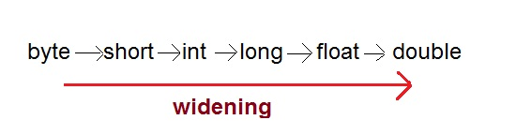
In Java, type casting is classified into two types,
1)Widening Casting(Implicit)
Prof.Mithuna H.R,Dept of ISE,AcIT

Slide 128
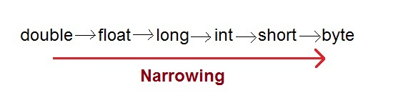
2) Narrowing Casting(Explicitly done)
Prof.Mithuna H.R,Dept of ISE,AcIT

Slide 129
Widening or Automatic type conversion
Automatic Type casting take place when,
the two types are compatible
the target type is larger than the source type
Prof.Mithuna H.R,Dept of ISE,AcIT

Slide 130
Example :
public class Test
{
public static void main(String[] args)
  {
  int i = 100;
  long l = i; //no explicit type casting required
  float f = l; //no explicit type casting required
  System.out.println("Int value "+i);
  System.out.println("Long value "+l);
  System.out.println("Float value "+f);
  }
}
Prof.Mithuna H.R,Dept of ISE,AcIT

Slide 131
Output :
Int value 100
Long value 100
Float value 100.0
Prof.Mithuna H.R,Dept of ISE,AcIT

Slide 132
Narrowing or Explicit type conversion
When you are assigning a larger type value to a variable of smaller type, then you need to perform explicit type casting.
Prof.Mithuna H.R,Dept of ISE,AcIT

Slide 133
Example :
public class Test
{
  public static void main(String[] args)
  {
  double d = 100.04;
  long l = (long)d; //explicit type casting required
  int i = (int)l; //explicit type casting required
  System.out.println("Double value "+d);
  System.out.println("Long value "+l);
  System.out.println("Int value "+i);
  }
}
Prof.Mithuna H.R,Dept of ISE,AcIT

Slide 134
Output :
Double value 100.04
Long value 100
Int value 100
Prof.Mithuna H.R,Dept of ISE,AcIT

Slide 135
Java Access Specifiers/Modifiers
Private Access Modifier - private:
Methods, Variables and Constructors that are declared private can only be accessed within the declared class itself.
Private access modifier is the most restrictive access level. Class and interfaces cannot be private.
Using the private modifier is the main way that an object encapsulates itself and hides data from the outside world.
Prof.Mithuna H.R,Dept of ISE,AcIT

Slide 136
Public Access Modifier - public:
A class, method, constructor, interface etc declared public can be accessed from any other class. Therefore fields, methods, blocks declared inside a public class can be accessed from any class belonging to the Java Universe.
However if the public class we are trying to access is in a different package, then the public class still need to be imported.
Because of class inheritance, all public methods and variables of a class are inherited by its subclasses.
Prof.Mithuna H.R,Dept of ISE,AcIT

Slide 137
Protected Access Modifier - protected:
Variables, methods and constructors which are declared protected in a superclass can be accessed only by the subclasses in other package or any class within the package of the protected members' class.
The protected access modifier cannot be applied to class and interfaces. Methods, fields can be declared protected, however methods and fields in a interface cannot be declared protected.
Prof.Mithuna H.R,Dept of ISE,AcIT

Slide 138
Default Access Modifier - No keyword:
Default access modifier means we do not explicitly declare an access modifier for a class, field, method, etc.A variable or method declared without any access control
Prof.Mithuna H.R,Dept of ISE,AcIT

Slide 139
Advantages of JAVA:
•It is an open source, so users do not have to struggle with heavy license fees each year.
•Platform independent.
•Java API's can easily be accessed by developers.
•Java perform supports garbage collection, so memory management is automatic.
•Java always allocates objects on the stack.
•Java embraced the concept of exception specification.
•Multi-platform support language and support for web-services.
•Using JAVA we can develop dynamic web applications.
•It allows you to create modular programs and reusable codes.
Prof.Mithuna H.R,Dept of ISE,AcIT

