Slide 1
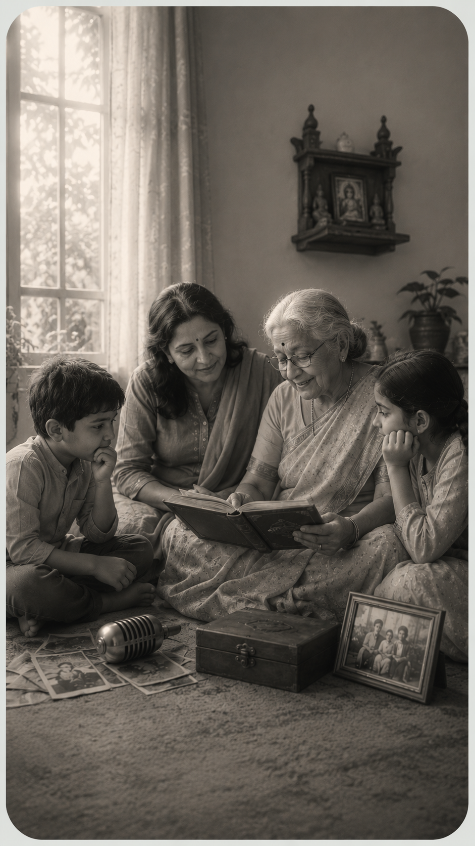
ಅಕ್ಕ · AKKAVERSE
ಅಕ್ಕ
AKKA
Preserve. Teach. Celebrate.
A bilingual (English + ಕನ್ನಡ) local-first platform that keeps Kannada language, family memory and heritage alive — one voice at a time.
by Mithun R
Three generations, one voice — preserved.
akkaverse.vercel.app · github.com/Mithuncoding/akkaverse

Slide 2
01 · THE PROBLEM
Culture doesn't vanish overnight. It fades one generation at a time.
ಅಜ್ಜಿ
Parent
Child
Grandparent
Understands
A few words
Speaks Kannada fluently
But rarely speaks it
The thread is breaking
When an elder is gone, their voice, blessings, proverbs, recipes and stories go too. Existing heritage apps are static encyclopedias — they store facts, not living family memory.
ಅಕ್ಕ Akkaverse
Built by Mithun R
02 / 10

Slide 3
02 · THE SOLUTION
Start with your family — not a textbook.
Preserve
Capture an elder's words (blessing, story, song, recipe, advice) in Kannada + English, with their original recording.
1
Teach
Akkaverse auto-generates a bilingual micro-lesson — a phrase to repeat, key vocabulary and a meaning check for the next generation.
2
Celebrate
Explore the wider culture with a grounded AI guide, an interactive map, a cinematic timeline, festivals, stories and quizzes.
3
ಅಕ್ಕ Akkaverse
Built by Mithun R
03 / 10

Slide 4
03 · PRODUCT DEMO
Four surfaces. One heritage universe.
Ask Akka
Voice Legacy
AI guide with cited Wikipedia answers in EN / ಕನ್ನಡ.
Preserve a voice → auto bilingual lesson → pass it on.
Explore Map
Timeline
Interactive Karnataka district map + photos.
Cinematic scroll through 2,500 years of history.
Fully bilingual · no login · works offline (PWA)
ಅಕ್ಕ Akkaverse
Built by Mithun R
04 / 10

Slide 5
04 · HOW IT WORKS
Grounded AI — not a chatbot wrapper.
User asks
Retrieve
Ground
NVIDIA NIM
Cited answer
→
→
→
→
EN or ಕನ್ನಡ
Wikipedia REST + PageImages
Inject context + citations
Llama 3.1 8B → Nemotron 49B
Streamed with sources
Server-only API key — never shipped to the browser. Local-first storage: family data in localStorage, original audio in IndexedDB. Nothing is uploaded. If the key or network is missing, curated fallbacks still answer.
ಅಕ್ಕ Akkaverse
Built by Mithun R
05 / 10

Slide 6
05 · TECH STACK & TRUST
Lean stack. Serious guarantees.
Frontend
Next.js (App Router), React, TypeScript, Tailwind, shadcn/ui
AI / LLMs
NVIDIA NIM — Llama 3.1 8B → Nemotron Super 49B (language-aware)
Grounding
Wikipedia REST + PageImages retrieval with citations
Voice & OCR
Keyless Kannada TTS + browser fallback; Tesseract.js in-browser
Storage
localStorage + IndexedDB — local-first, no login, offline PWA
Deploy
Vercel — single deployment, one free NIM key, no database
ಅಕ್ಕ Akkaverse
Built by Mithun R
06 / 10

Slide 7
06 · WHY IT'S DIFFERENT
Not another encyclopedia app.
Family-first
Shows its sources
Begins with your elder's voice, not a textbook.
Grounded AI cites Wikipedia — no invented history.
Private by design
Truly bilingual
No account, no upload; data stays on your device.
Every string in EN, ಕನ್ನಡ, or both at once.
Works offline
Zero-friction demo
Core pages run without a network (PWA).
No login — judges use every feature instantly.
ಅಕ್ಕ Akkaverse
Built by Mithun R
07 / 10

Slide 8
07 · BUSINESS VIABILITY & SCALE
High margin. Real Karnataka impact.
Scale path: Diaspora families → Kannada schools & cultural associations → other Indian languages (same engine, swap datasets)
Karnataka angle
Cost model
Revenue
Tourism via the district Explore layer; a discovery surface for local MSMEs & artisans through festivals and stories.
Near-zero infra — one Vercel deploy + free NIM tier, no database. High margin by construction.
School / institution licences and an optional opt-in cloud-sync tier for families across devices.
ಅಕ್ಕ Akkaverse
Built by Mithun R
08 / 10

Slide 9
08 · IMPACT & FEEDBACK
Every preserved voice becomes a lesson.
1 min
0
EN + ಕನ್ನಡ
to preserve a voice and auto-build a lesson
logins, uploads, or credentials required
every screen, fully bilingual
Inclusive by design — usable by non-technical elders on any device. The preserve-and-teach loop turns a passive “someday I'll record grandpa” intention into a finished, shareable bilingual lesson.
Add tester quotes / feedback gathered during the build phase here.
ಅಕ್ಕ Akkaverse
Built by Mithun R
09 / 10

Slide 10
09 · 6-MONTH ROADMAP & THE ASK
ಅಕ್ಕ
If we had six more months…
AKKA
Opt-in cloud sync
RLS-protected accounts + cross-device audio.
Voice-cloning narration
Preserved recordings speak new text in the elder's own voice (with consent).
Community oral-history wall
A moderated public archive of shared voices.
School mode
Teacher dashboards + assignments from Voice Legacy lessons.
Kannada literary retrieval
Grounding beyond Wikipedia into curated Kannada sources.
Thank you.
Let's keep every family's voice alive.
Live akkaverse.vercel.app · Code github.com/Mithuncoding/akkaverse · Video youtu.be/lXtAyZyDumM
ಅಕ್ಕ Akkaverse · Built by Mithun R

