Slide 1

Cargo Management System

Slide 2
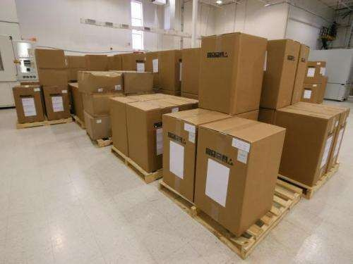
Cargo Logistics Management intends to meet the logistics management and
provide sourcing around
professional transportation,
and information the world.
service

Slide 3

Objective:
Cargo Logistics Management aims at providing needs of International Freight Forwarding, Warehousing & Logistics, Customs Clearance, Nation-wide distribution and transport.

Slide 4

Mode of Transportation
Cargo service
within country- land(truck)and air(aero plane )
outside country- Air and water(ship)

Slide 5



Charges
Depends upon the types of cargo
o General-General Cargo is the term used for
shipments of durable goods that do not require special treatment. Within this category are shoes, textiles, and spare parts, among others.

Slide 6

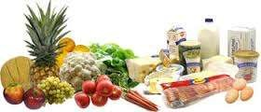
oDangerous goods-chemicals , nuclear weapons
oPerishable-fruits, flowers, vegetables, meats, eggs, medicines and transplants, organs, fish, etc.

Slide 7
SOFTWARE REQUIREMENTS OS: WINDOWS OR UBUNTU FRONT END:PYTHON WITH TKINTER BACKEND: MYSQL SERVER:LOCALHOST
.

Slide 8
PYTHON MODULES USED MYSQL-CONNECTOR RE PILL TKINTER
.

Slide 9
SQL QUERY USED: FOR LOGGING:SELECT INSERTING DATA: INSERT DISPLAYING DATA:SELECT WITH WHERE CLAUSE
.

Slide 10
THANK YOU
.

