Slide 1
Predictive Modeling of the salary dataset
Mithun Ghosh

Slide 2
Predictive Modeling
The Purpose
To build a classification predictive model, with the response being whether the salary is in the top quartile or not.

Slide 3
Steps in Model building
Descriptive Analysis
Data Visualization
Data Preprocessing
Inferential Analysis : Modeling

Slide 4
quantitative variables: 1. nine-month salary 2. years since Ph.D. 3. years of service

Slide 5
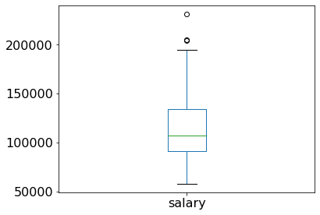
Quartiles of the Nine Month Salary Data
Quartile | value
min | 57800
25% | 91000
50% | 107300
75% | 134185
max | 231545
According to Broadband salary structure, We can consider the top quartile salary range as the salaries which are greater then 75% quartile value.

Slide 6
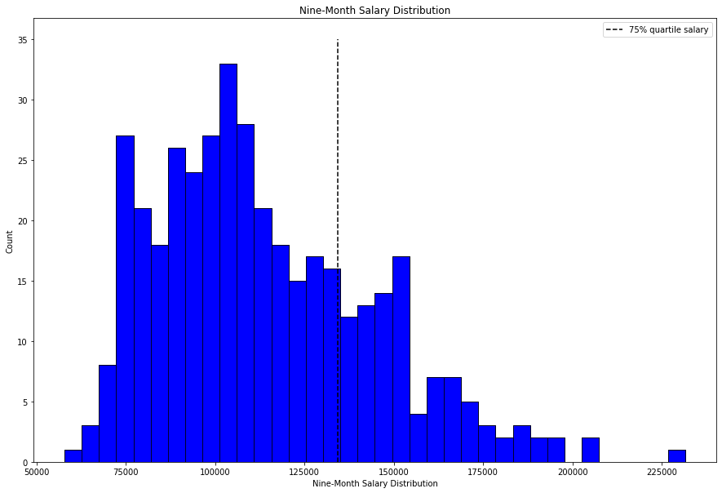
The distributions of Nine Months Salary is shown below.
Dashed line represents the 75% quartile salary
The distribution for the nine-month salary variable above seems to be skewed right. As shown from the histogram, most of the salary data are not in the top quartile range.

Slide 7
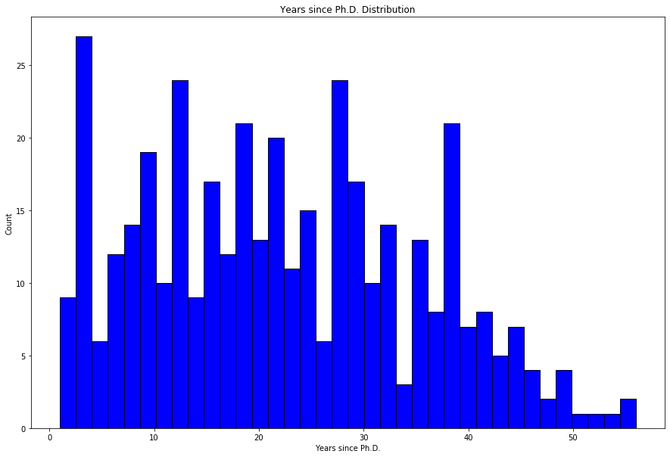
Years since Ph.D. Distribution
The years since obtaining a Ph.D. variable seems to take on a relatively normal distribution, perhaps showing slight skewness to the right. The median number of years since receiving a Ph.D. for faculty members is 21 years whereas the mean is ~22 years (rounded from the estimate of 22.31 years). Thus 50% of the faculty members received their Ph.D. between 1-21 years ago whereas the other 50% received their Ph.D. between 21-56 years ago.

Slide 8
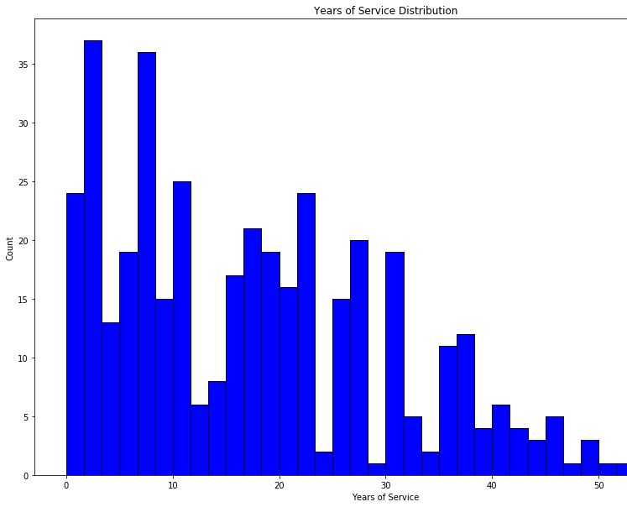
Years of Service Distribution
The distribution of years of service seems to be slightly skewed right, similar to the distribution of years since Ph.D. The median number of years that faculty members have served is 16 years whereas the mean is ~17 years (rounded from the estimate 17.61 years.

Slide 9
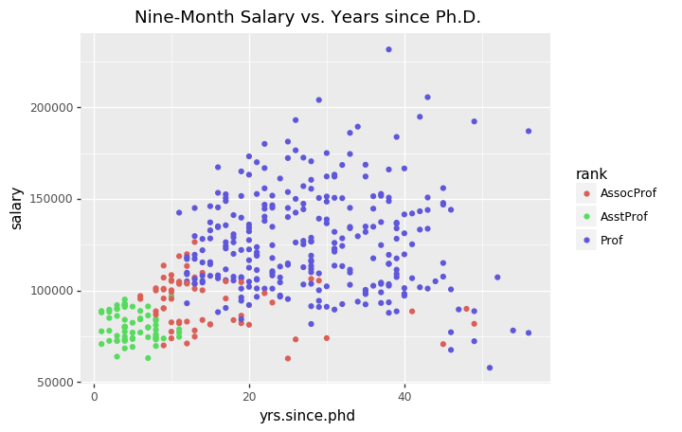
Assessing Years since Ph.D., Salary, and Rank
Generally, as the number of years since a faculty member received their Ph.D. increases, their salary increases as well.
Furthermore, it appears that rank is also somewhat positively correlated with years since Ph.D. and salary as well. Assistant Professors appear to have the lowest nine-month salaries and Professors tend to have the highest range in nine-month salaries based on the graph.

Slide 10
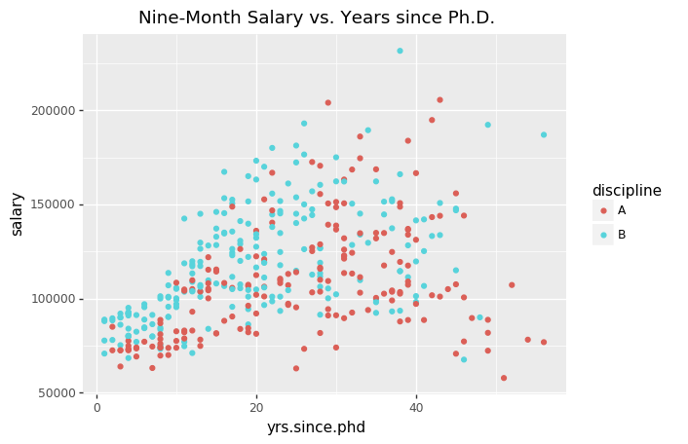
Assessing Years since Ph.D., Salary, and Discipline
There does not appear to be a strong relationship between salary and discipline or even between discipline and years since Ph.D. However, it does appear that the data points from faculty members in applied departments are situated higher than data points from faculty members in theoretical departments.

Slide 11
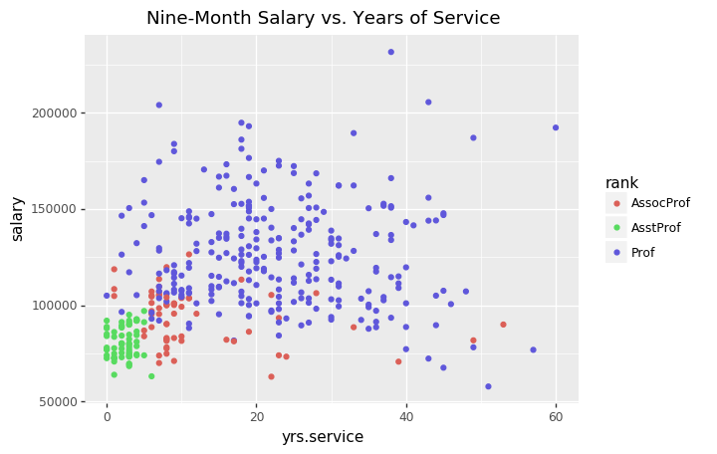
Assessing Salary, Years of Service, and Rank
There does not appear to be a strong relationship between nine-month salary and years of service, but there is somewhat a relationship between rank and years of service as expected. Faculty members that are Professors or Associate Professors tend to have served longer in departments and therefore hold higher positions and get paid more compared to Assistant Professors.

Slide 12
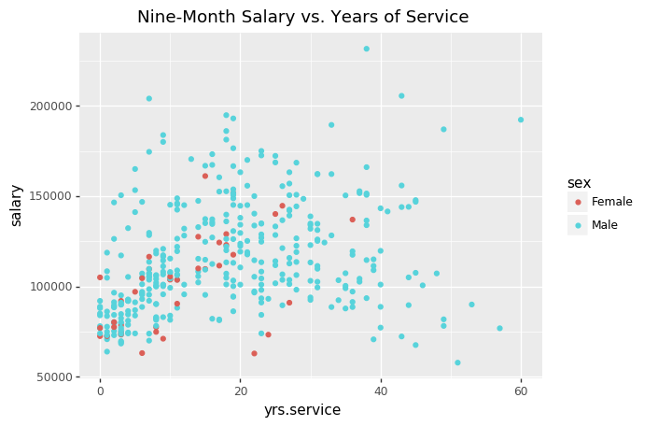
Assessing Salary, Sex, Years of Service
There does not appear to be a strong relationship between nine-month salary and sex or between sex and years of service. However, as noted previously, more observations in this dataset are from male faculty members (n = 358) compared to female faculty members (n = 39 ).

Slide 13
Data Preprocessing Converting categorical and Continuous variables into integer
We need to convert the categorical features and continuous output into binary values in the following way:
rank: ‘Prof’=1, ‘AssocProf’=2 and ‘AsstProf’=3
discipline: ‘A’=1 and ‘B’=0
sex: ‘male’=1 and ‘female’=0
salary: if: salary> 75% quartile value, salary = 1;
else: salary=0.

Slide 14
Data Preprocessing Converting categorical and Continuous variables into integer
 | rank | discipline | yrs.since.phd | yrs.service | sex | salary
0 | Prof | B | 19 | 18 | Male | 139750
1 | Prof | B | 20 | 16 | Male | 173200
2 | AsstProf | B | 4 | 3 | Male | 79750
3 | Prof | B | 45 | 39 | Male | 115000
4 | Prof | B | 40 | 41 | Male | 141500
5 | AssocProf | B | 6 | 6 | Male | 97000
 | rank | discipline | yrs.since.phd | yrs.service | sex | salary
0 | 1 | 0 | 19 | 18 | 1 | 1
1 | 1 | 0 | 20 | 16 | 1 | 1
2 | 3 | 0 | 4 | 3 | 1 | 0
3 | 1 | 0 | 45 | 39 | 1 | 0
4 | 1 | 0 | 40 | 41 | 1 | 1
5 | 2 | 0 | 6 | 6 | 1 | 0

Slide 15
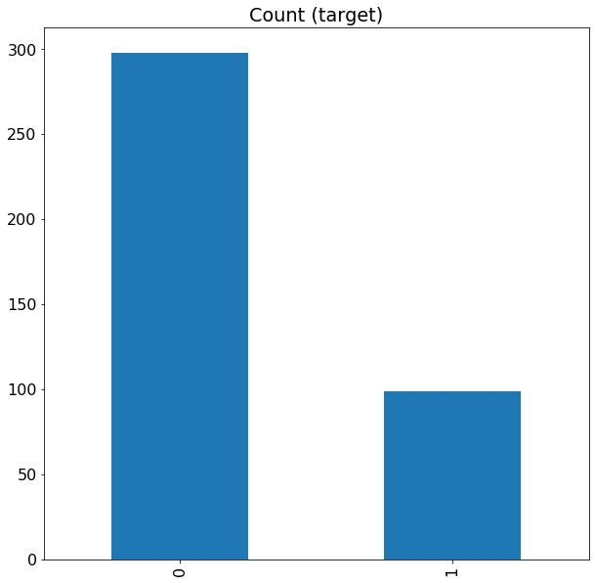
Imbalance Class Problem
We need to deal with this imbalance class problem. Some of the ways are:
Up-sample Minority Class
Down-sample Majority Class
Penalize Algorithms (Cost-Sensitive Training)
Change Your Performance Metric
After experimenting, I am considering Up-sample of the minority class method for this Dataset.
Imbalanced classes in the salary output

Slide 16
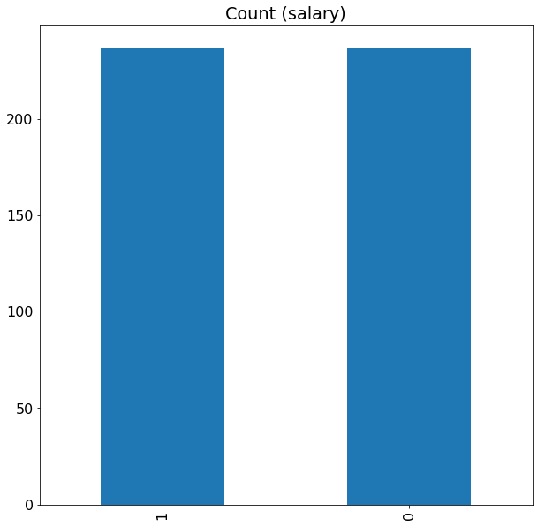
Up-sample Minority Class
Up-sampling : Randomly duplicating observations from the minority class in order to reinforce its signal. The steps are:
First, we'll separate observations from each class into different DataFrames.
Next, we'll resample the minority class with replacement, setting the number of samples to match that of the majority class.
Finally, we'll combine the up-sampled minority class DataFrame with the original majority class DataFrame.
Thus both classes are balanced now in the salary output

Slide 17
Standardize the data & Split
Standardization gives both a data point and full data set greater meaning.
Also making sure that data is internally consistent; that is, each data type has the same content and format.
We split the data as a rule of thumb into 80/20% criteria. Thus, 80% data are in training set and 20% are in test set.

Slide 18
Spot-Check Algorithm
For the spot-check, we are considering popular Classification algorithms to see which will be suitable for the dataset. We used the following algorithms:
Neural Network (NN)
Logistic Regression (LR)
Linear Discriminant Analysis (LDA)
K-nearest neighbors (KNN)
Decision Trees (CART)
Naïve Bayes (NB)
SVM (SVM)

Slide 19
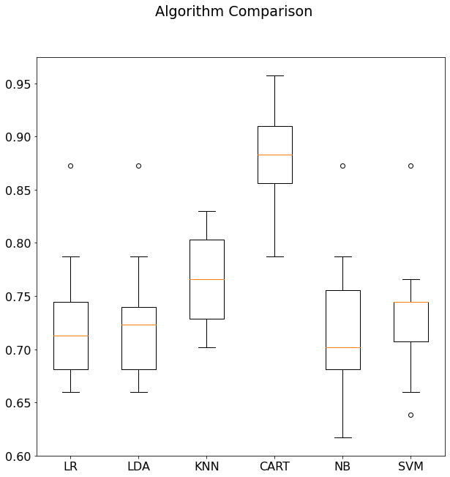
K-fold cross-validation Score
By taking K=10, the 10-fold cross validation score for each algorithm is shown here. We used F1 score as the CV scoring criteria, as it’s an imbalanced class problem.
Decision Tree(CART) outperformed every other algorithms by some distance.
Alogorithm | mean of CV error | variance of CV error
NN | 0.725532 | 0.066911
LR | 0.734043 | 0.058074
LDA | 0.734043 | 0.049671
KNN | 0.793617 | 0.047623
CART | 0.861702 | 0.058074
NB | 0.719149 | 0.036606
SVM | 0.753191 | 0.046809
The box and whisker plot showing the spread of the accuracy scores across each cross validation fold for each algorithm.

Slide 20
Ensembles of Decision Tree
One disadvantage of decision tree is it’s tendency to overfit. There are some strong modeling ensembles techniques and much more robust than a single decision tree. They aggregate many decision trees to limit overfitting as well as error due to bias and therefore yield useful results
Some of the popular Ensembles techniques for Decision Trees are:
AdaBoost
Random Forest
Extra Tree Classifiers
XGBoost
Stochastic Gradient Boosting

Slide 21
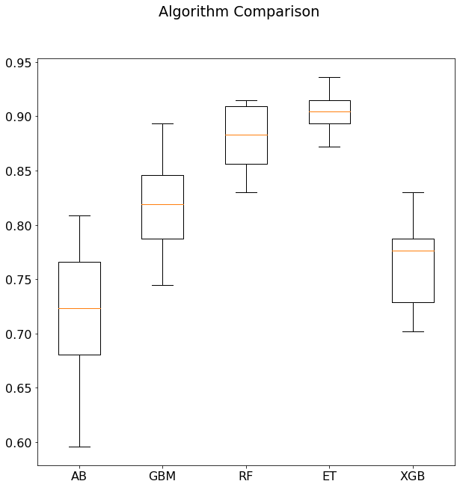
10-fold CV error for the decision tree ensembles
From the CV error, we can see that Random Forest and Extra Tree Classifiers have higher performance than other ensembles. We will take Random Forest as our final algorithms for the predictive modeling.
The box and whisker plot showing the spread of the accuracy scores across each cross validation fold for each algorithm.

Slide 22
Feature Selection
Extra features can decrease performance because they may “confuse” the model by giving it irrelevant data that prevents it from learning the actual relationships. The random forest performs implicit feature selections because it splits nodes on the most important variables. From the analysis, we can get the most important features in the dataset.

Slide 23
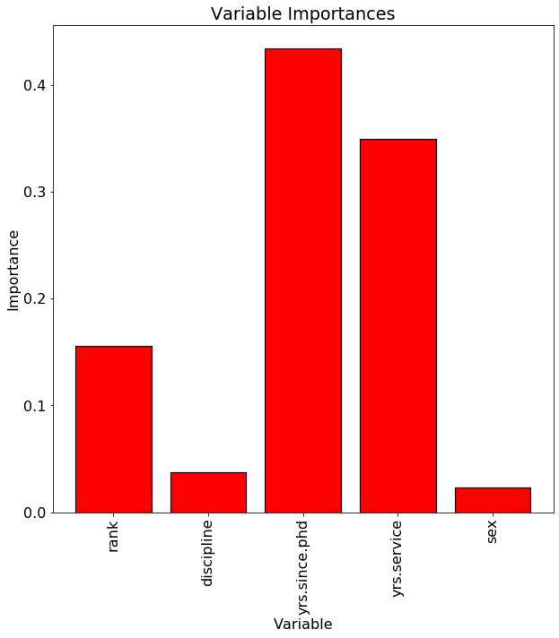
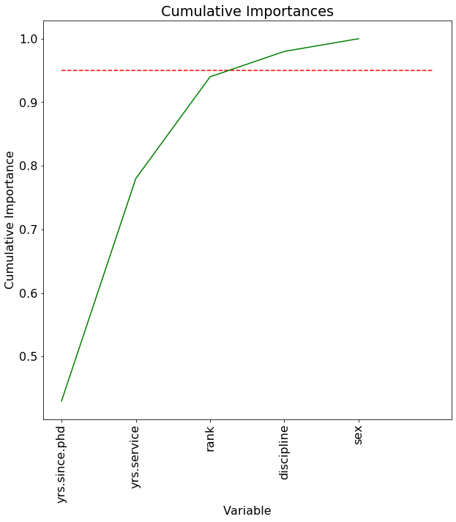
Feature Selection

Slide 24
Feature Selection
From the Previous slide results, we can see than sex and discipline have minimum impact on Random Forest algorithm. Although they are less important, they have a positive impact on the Random Forest performance. Thus, we are not removing these from the model.

Slide 25
Hyperparameter tuning by Random search
There are lots of hyperparameters in the Random Forest that need to be tuned. We can use random search technique with 5-fold cross validation to tune the parameters in the Random Forest. Most notable hyperparameter of the Random Forest are:
Number of trees
Depth of the tree
Minimum leaf size in splitting criteria
Maximum features to split in a tree

Slide 26
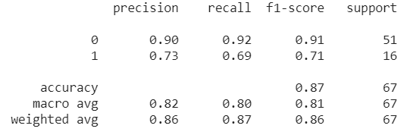
Classification Reports based on the test data
Random Forest have high precision and recall for each class.
The algorithm has also high F1 score on both class.
The confusion matrix:
[[47 4]
[ 5 11]]

Slide 27
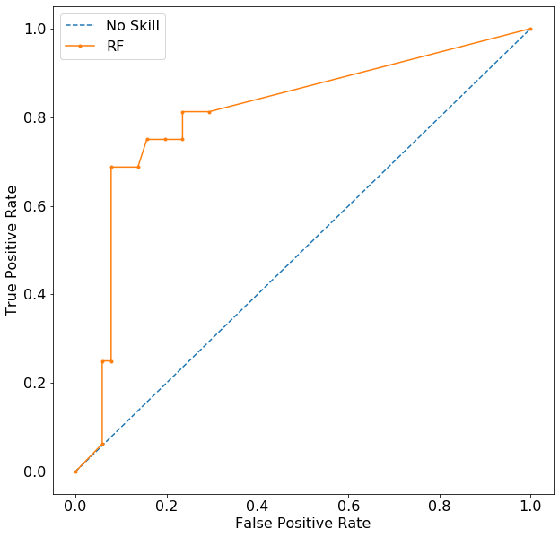
Analysis of the result
Finally, we showed the Receiver Operating Characteristic (ROC) curve, which plots model specificity against sensitivity. The model outputs the probability of abnormality in the study, and the ROC curve is generated by varying the thresholds used for the classification boundary. The area under the ROC curve (AUROC) of the model is 0.808. Using a threshold of 0.5, the model achieves a sensitivity of 0.92 and a specificity of 0.69. Thus, this is a good prediction model.
ROC Curve Plot for a No Skill Classifier and a Random Forest Classifier Model

Slide 28
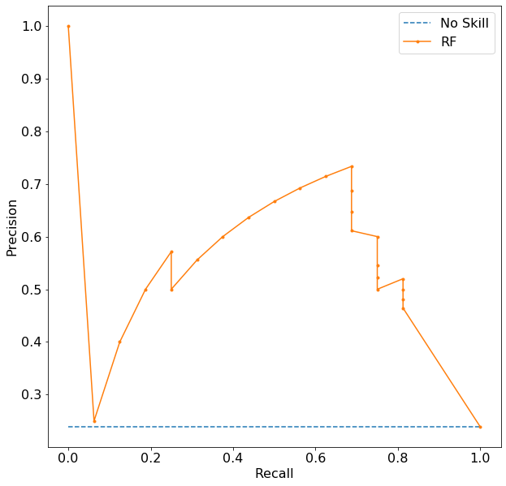
Precision-Recall Curves
The Precision-Recall Plot Is more Informative than the ROC Plot when evaluating Binary Classifiers on imbalanced Datasets. The precision-recall curve plot is created showing the precision/recall for each threshold for a Random Forest model (orange) compared to a no skill model (blue). The plot of the precision-recall curve highlights that the model prediction power is above the no skill line for most thresholds.

Slide 29


