Slide 1

Capgemini South Central Europe(SCE) Case Study Presentation of Hotel Management System
GET THE FUTURE YOU WANT

Slide 2
List of Stack Holders
S.NO | Name | Emai.Id | Role
1 | Amit Bhave | amit.bhave@capgemini.com | CG Mentor
2 | Gaurav Pednekar | gaurav.p@capgemini.com | CG Mentor
3 | Reena Sarathe | reena.sarathe@technocratsgroup.edu.in | TIT Mentor
4 | Dr Manoj Tyagi | hodtitcse@technocratsgroup.edu.in | TIT Mentor
5 | Akshat Sharma | sharmaakshat0707@gmail.com | TIT Student
6 | Isha Agrawal | asthaagrawal1312@gmail.com | TIT Student
7 | Miti Parashar | mitiparashar2@gmail.com | TIT Student

Slide 3
ABSTRACT
The Hotel Management System (HMS) is a comprehensive software solution designed to optimize and
automate various aspects of hotel operations. With the advancement of technology and the increasing
demand for seamless guest experiences, hotel management systems have become indispensable tools
for efficient and effective hotel management. The HMS encompasses a wide range of functionalities
including reservation management, guest check-in and check-out, room management, e-mail
generation billing and invoicing . By centralizing and digitizing these processes, hotel staff can save
time, eliminate manual errors, and enhance productivity .
The reservation management module of the HMS enables guests to make online bookings, check room
availability in real-time, and select preferred amenities. This feature ensures that guests can easily
make reservations from anywhere at any time, leading to increased occupancy rates and improved
revenue streams.

Slide 4
APPLICATION FEATURES
User Sign in/Login : Allow users to create accounts and manage their personal information.
Search Rooms : Enable users to search for rooms according to the check-in, check-out and number of guests .
Book Rooms : Enable users to book rooms according to the available rooms.
User Details : Enable users to fill up the user personal details.
Bill and invoice : Give the details about the total amount for the bookings.
Payment integration : Facilitate secure online payments for ticket bookings.
Email notification : Provides email to the user after registration and successful booking.
Owner dashboard : Enable owner to see all the functionalities .
Receptionist dashboard : Enable receptionist to see booking and guest details.
Manager dashboard : Enable manager to do room and staff management.

Slide 5
Tools
The following tools are used to make services of Hotel management system.
Spring tool suite
Postgres SQL
VS Code
Postman

Slide 6
Technology stack
Front end
HTML&CSS
React.js
Back end
Spring Boot
Java
Spring Security(JWT)
Data Base
Postgres SQL

Slide 7
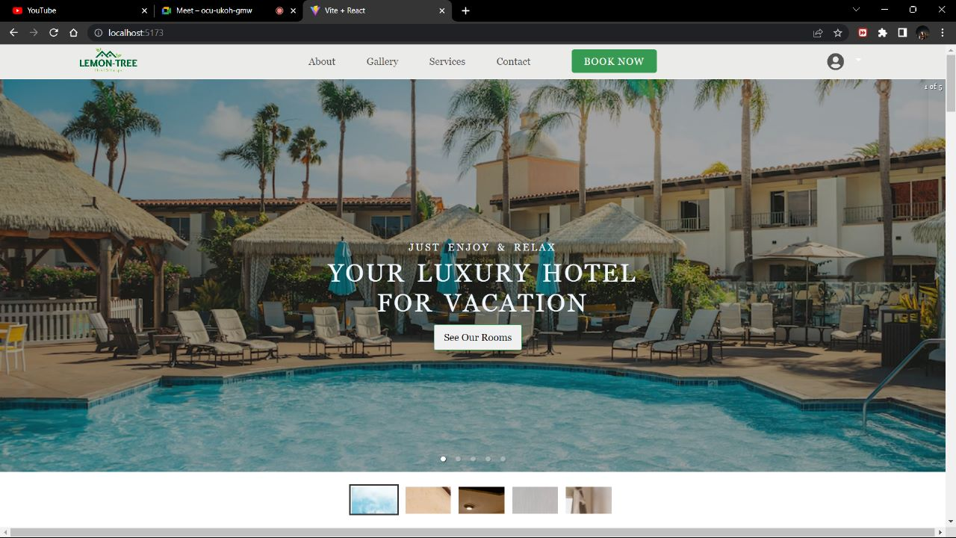

Slide 8
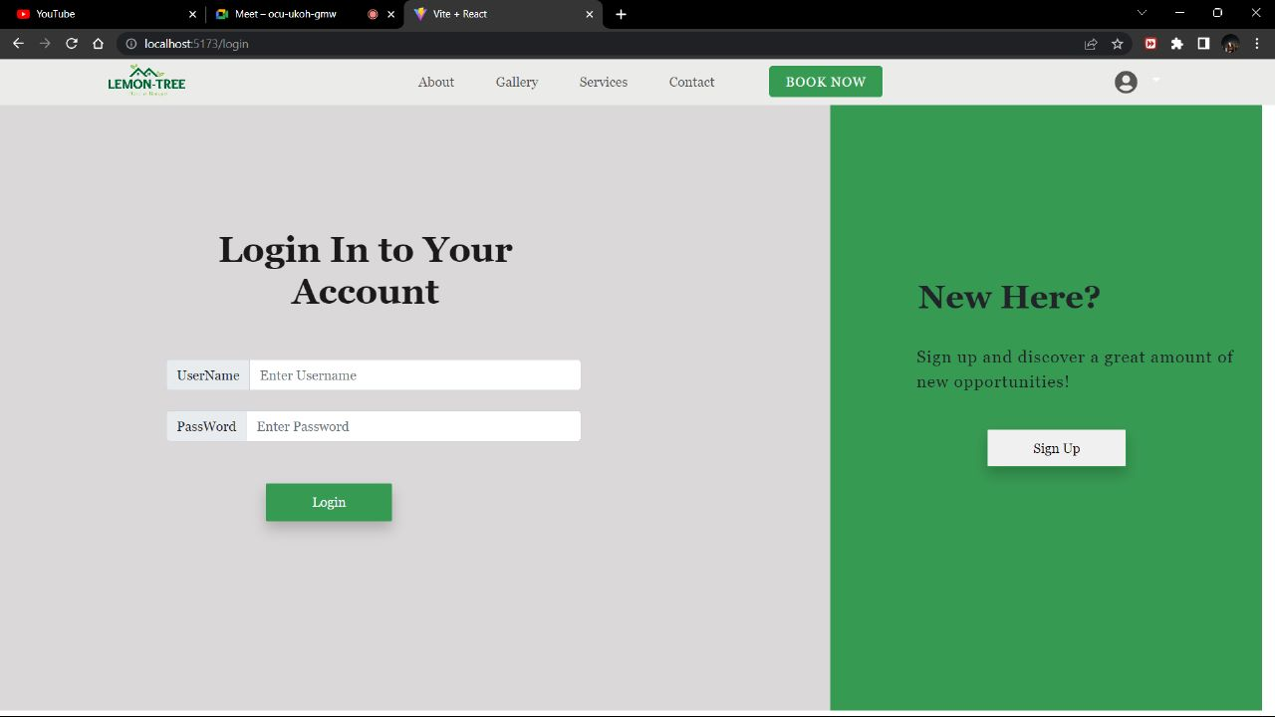

Slide 9
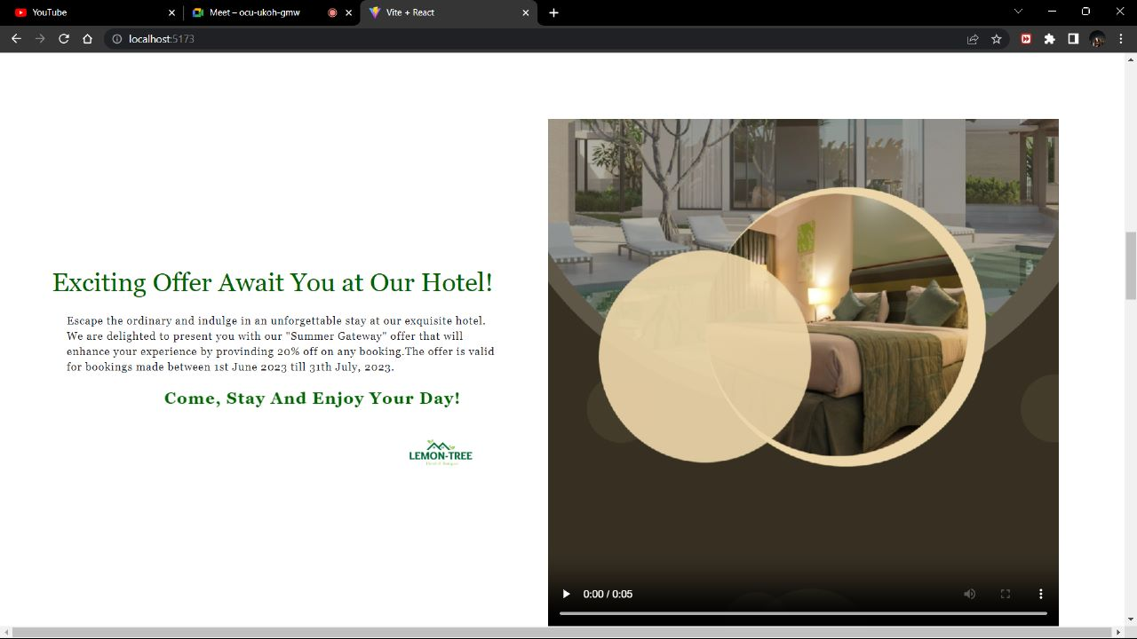

Slide 10
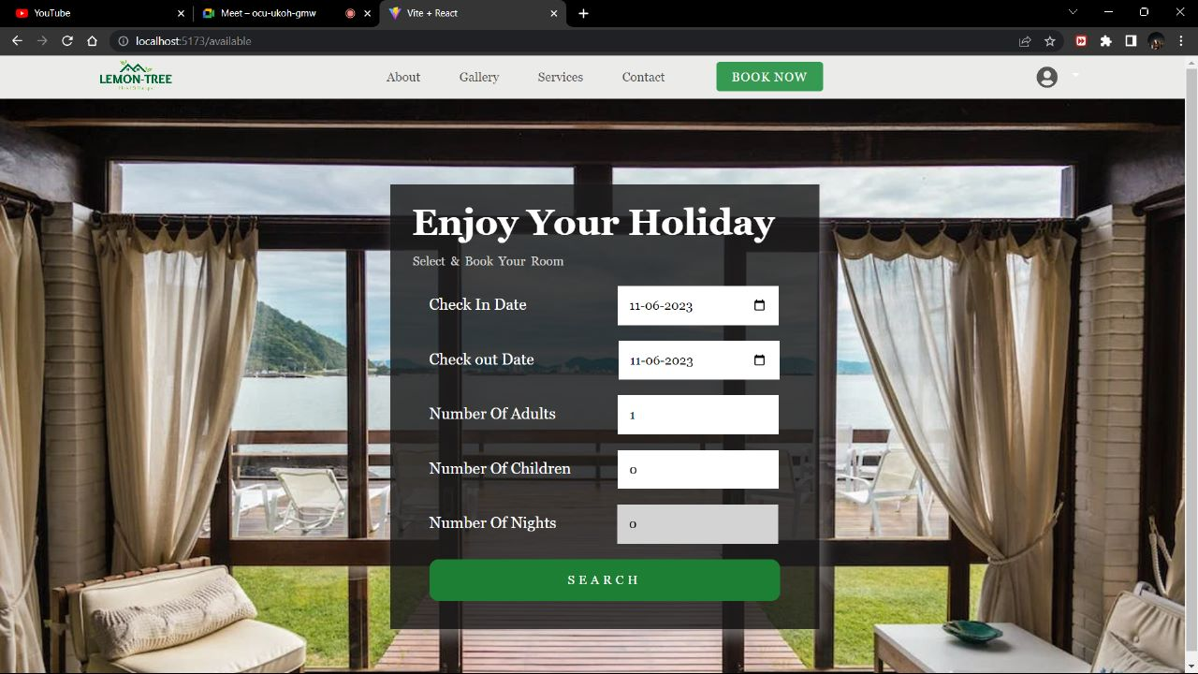

Slide 11
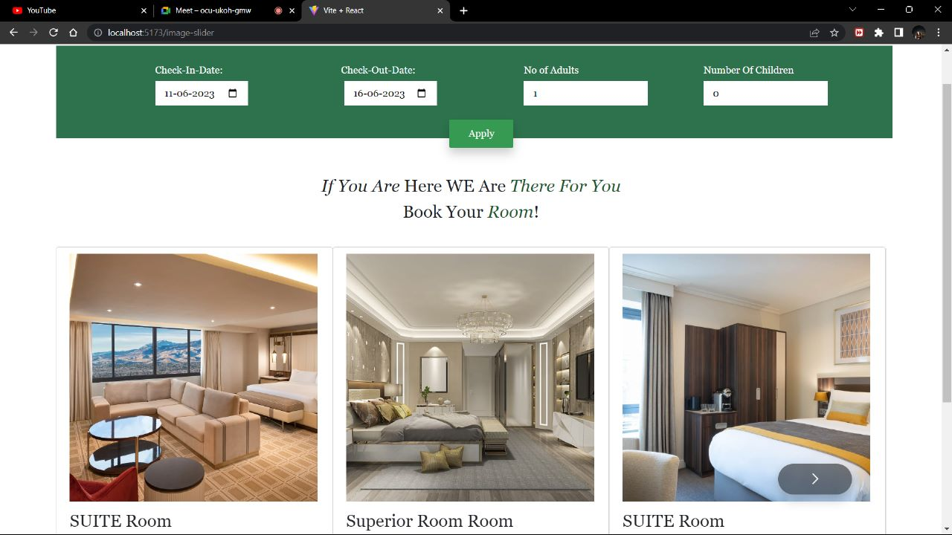

Slide 12
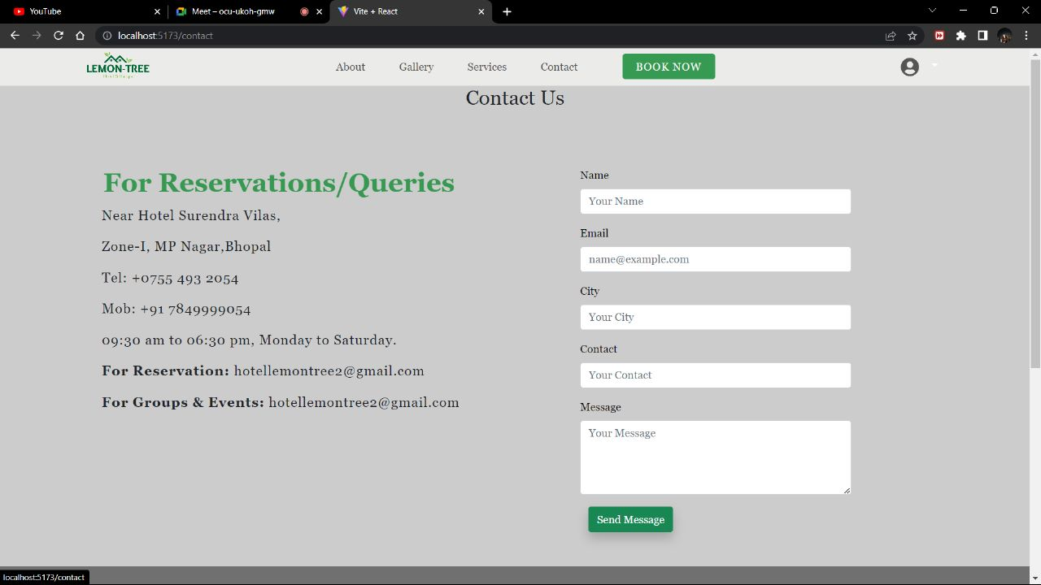

Slide 13
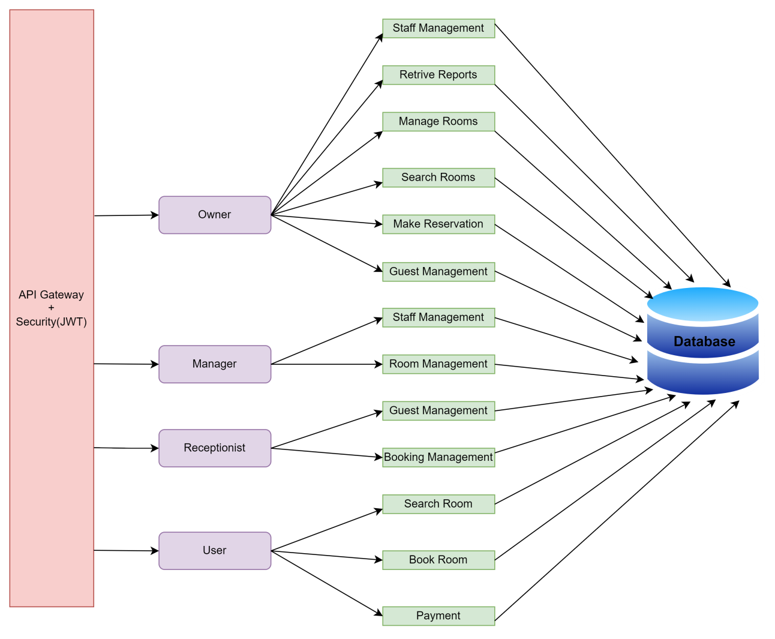
ARCHITECTURE

Slide 14
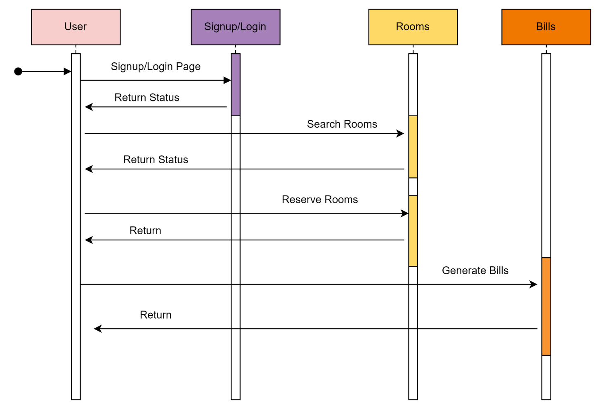

Sequence Diagram

Slide 15
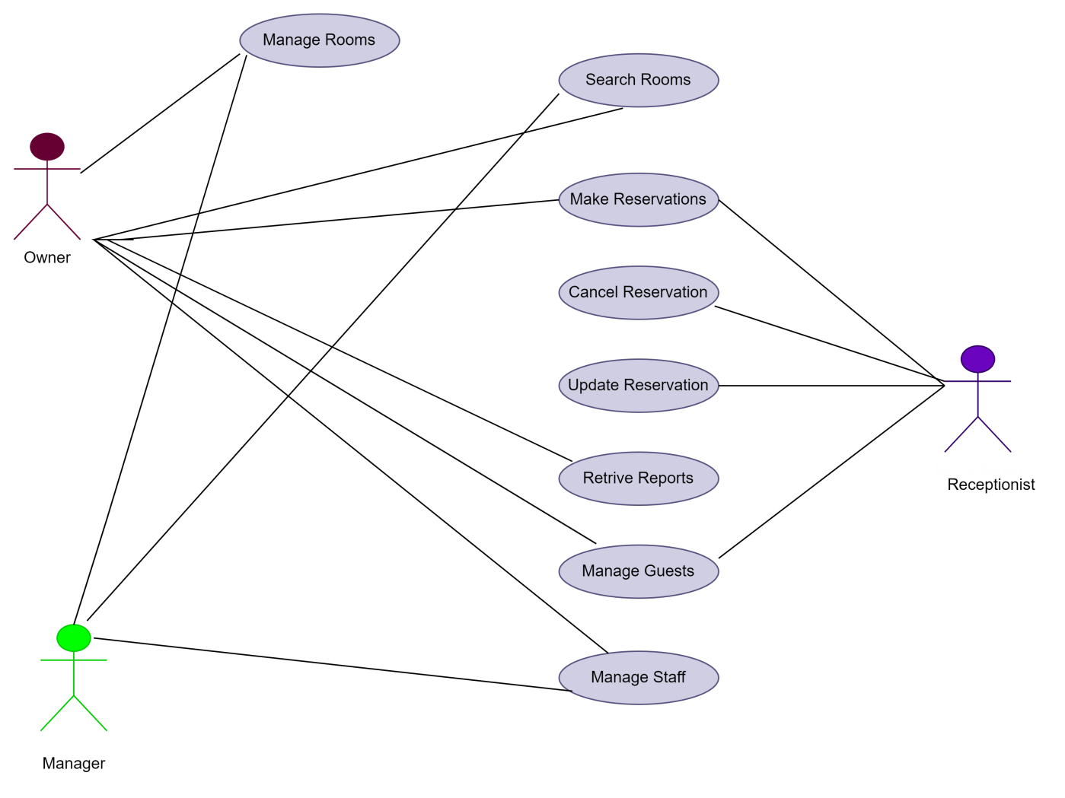
USE CASE Diagram

Slide 16

….AND INSPIRED BY OUR
PROMISE
GET THE FUTURE YOU WANT

