Slide 1

Functional Annotation Lesson 3
Inferring function from position-sensitive models
HMMER

Slide 2
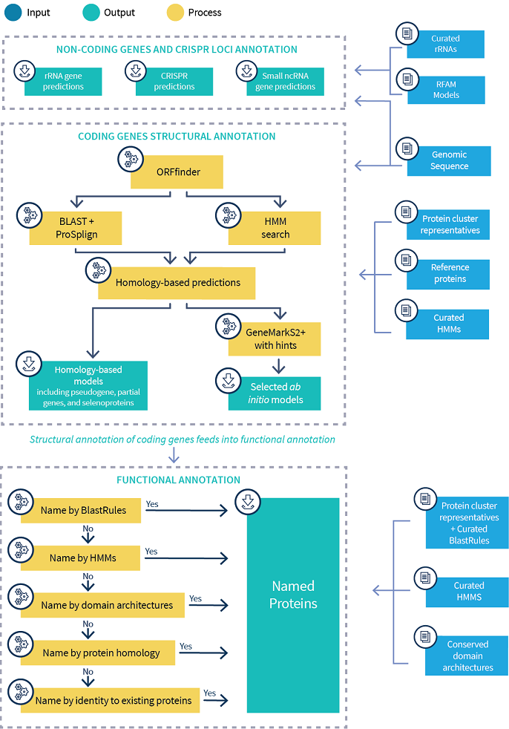
NCBI PGAP Prokaryotic Genome Annotation Pipeline

Slide 3
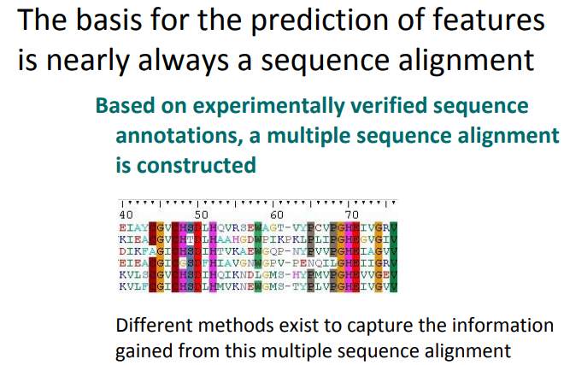

Slide 4
PROBABILISTIC APPROACHES to Homology
BLAST is computationally greedy, alternative annotation options can use a probabilistic approach
Probabilistic approach – incorporate random variables and probability distributions into the model of an event or phenomenon
hidden Markov model - HMM
HMMs require building a profile based on a training data set
Like other “machine learning” approaches.
More Sensitive

Slide 5
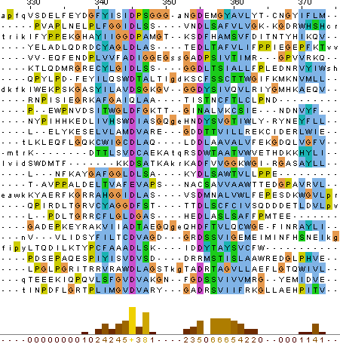
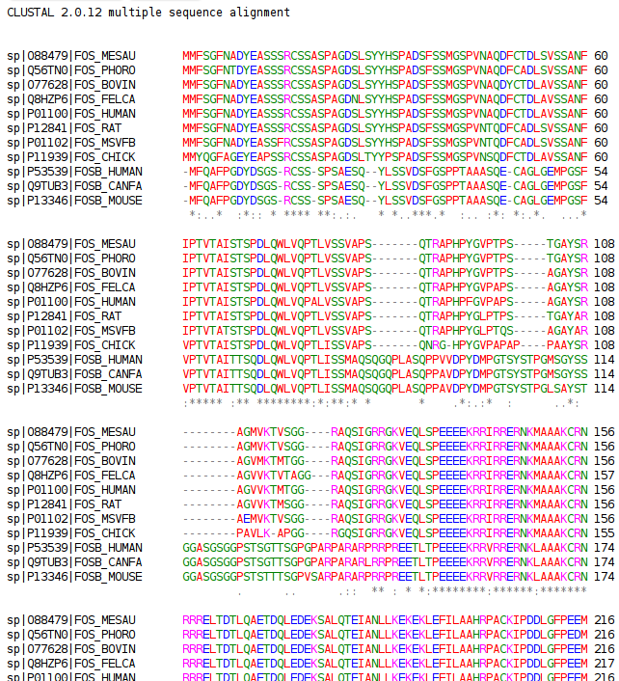
HMM starts with a Multiple Sequence Alignment
Use structural and mechanistic information (e.g., catalytic sites)
More sensitive than pairwise – detect distant relationships

Slide 6
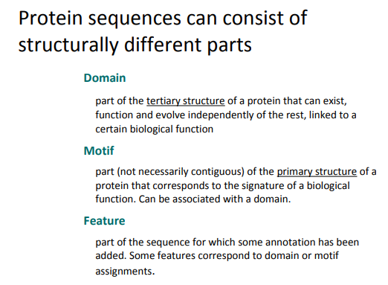
EXAMPLE
ATP-binding domain
Heme motif CHXXH

Slide 7
MSA to HMM or PSSM profile
Collect “seed” proteins
Generate & Trim Alignment
Generate Profile with HMM or PSSM
Search New Model against all proteins
Region of good alignment and closest similarity
Compute statistical probabilities for amino acid patterns in the seed
Choose “noise” and “trusted” cutoff scores based on “known” versus “unknown” protein scores

Slide 8
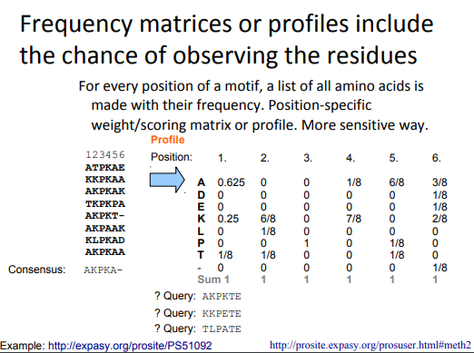

Slide 9
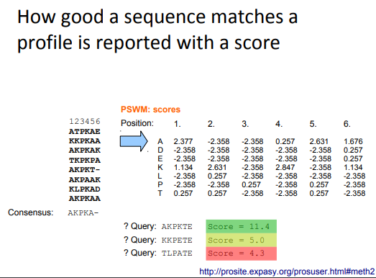


Slide 10
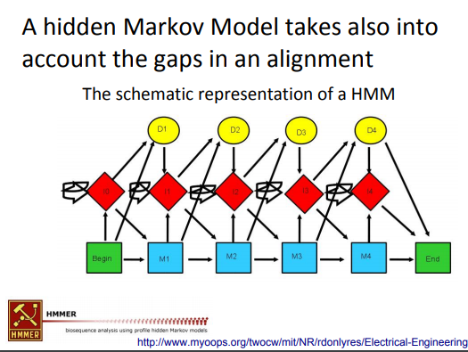

Slide 11
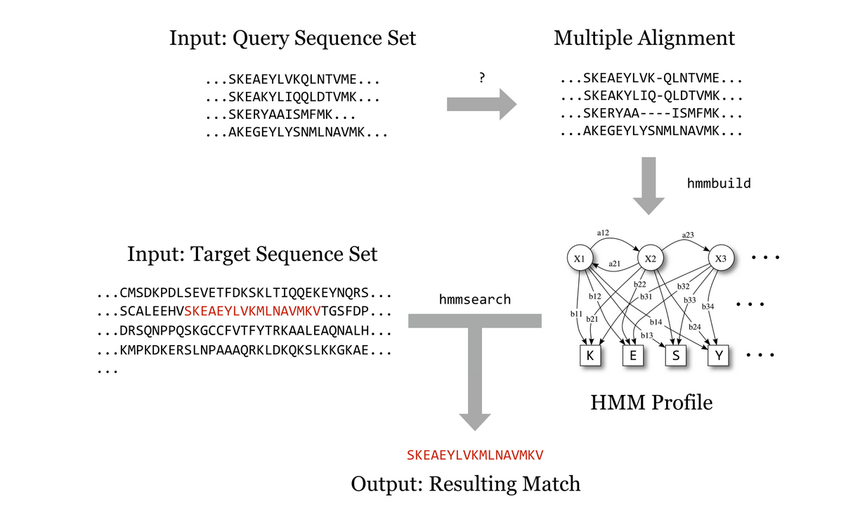
MSA to HMM profile using HMMER

Slide 12
HMMER
Program | Task
hmmalign | build an MSA from sequences
hmmbuild | convert MSA to HMM
phmmer | single protein vs protein DB (like-BLAST)
hmmscan | protein sequence vs HMM database
hmmsearch | HMM database vs protein sequence
hmmconvert | convert HMM profile formats
hmmfetch | grab a single HMM from a database
hmmpress | compress HMM into binary format for hmmscan
HMMER is used for searching sequence databases for sequence homologs and for making sequence alignments.

Slide 13
Difference between hmmscan and hmmsearch
hmmscan and hmmsearch are doing exactly the same compute
comparing one profile to one sequence at a time
bit score results are identical
save both in tabular output files
hmmscan needs to read in all HMM profiles in a database for each query protein being searched → compute time << I/O time
hmmpress solves some of this issue
hmmsearch reads in the HMM profile database so the search is now per query protein

Slide 14
PSI-BLAST & RPS-BLAST (NCBI)
PSI-BLAST
RPS-BLAST
Position-Specific Iterated BLAST
finds sequences significantly similar to the query in a database search
Significant matches are used to make an alignment
MSA used to build a Position-Specific Score Matrix (PSSM) for the query
The new PSSM is searched against the same database again to pull in more significant hits based on conserved features
Can be used to further refine the scoring model
Reverse Position-Specific BLAST
query sequence to search a database of pre-calculated PSSMs
reports significant hits in a single pass
The PSSM has changed from "query" to "subject”
Commonly used to search the NCBI CDD (Conserved Domain Database)

Slide 15
Lesson 4
Reference databases – series of lectures and examples about databases with a variety of functions
Pfam
KEGG
eggNOG
Reference databases – lectures and examples about databases for specific functions
CAZy
anitSMASH

