Slide 1
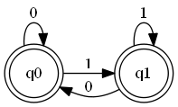
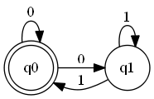

Reverse
Powerset
Construction
Reverse
Powerset
Construction

