Slide 1
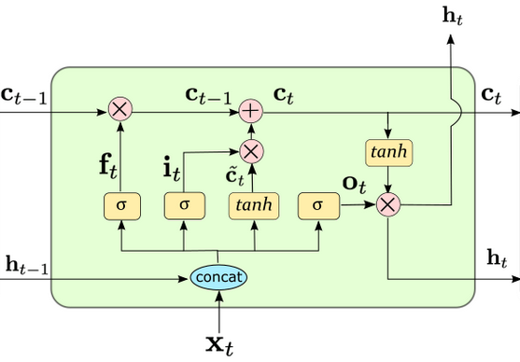
index=1
数据文本如train.txt
data (35,20)
每个batch
index=36
target (20,1)
(700,33278)
tokenizer
decoded
# 减1主要是最后一批量data需要留一行给target
seq_len = min(seq_len, len(source) - 1 - i)
data = source[i:i+seq_len]
target = source[i+1:i+1+seq_len].view(-1)
view(-1, 33278)
与词表映射的一维向量，值为词表对应的下标，shape=(1,200w)
(35,20,33278)
batchify
decoded
batch_size = 20
decoder
nn.Linear
(200, 33278)
batch_size = 20
seq_len = 35
get_batch
train
.
.
.
embedding
(vocab_size, nhidden)
(35,20,200)
(35,20,33278)
vocab_size = 33278
nhidden = 200
embedding
(emsize, nhidden, nlayers)
(200, 200, 2)
output
shape=(10w,20)
每个句子都是竖着放置
每个batch: shape=(35,20)
hidden tuple(
)
(2, 20, 200)
(2, 20, 200)

