Slide 1
GuestWave
Hotel Operations Suite
Driving Guest Experience & Operational Excellence

Slide 2



The Problem
02
No real-time visibility
Delayed service handling
Inefficient staff coordination
Front office teams operate blind - room status, service requests, and SLA breaches are scattered across disconnected systems.
Without a unified view, service requests pile up unnoticed. Staff are reactive, not proactive, leading to guest dissatisfaction.
Task assignment is manual and ad-hoc. No visibility into staff workload means uneven distribution and missed follow-ups.

Slide 3
Solution Overview
03
A unified operations suite built for hotel teams.
Web
Mobile
Front Office Control Panel
Housekeeping Staff App
A live operations dashboard for front office teams. Complete visibility into 100+ rooms, real-time SLA alerts, staff assignment, and check-in/out - all in a single screen.
A field-first mobile app for housekeeping and service staff. Task-first interface with door verification, before/after media capture, and structured room documentation.
Live room grid (floor × type)
SLA breach detection
Staff workload management
Check-in / check-out flows
Task inbox sorted by urgency
3-step task execution flow
Per-section media capture

Slide 4
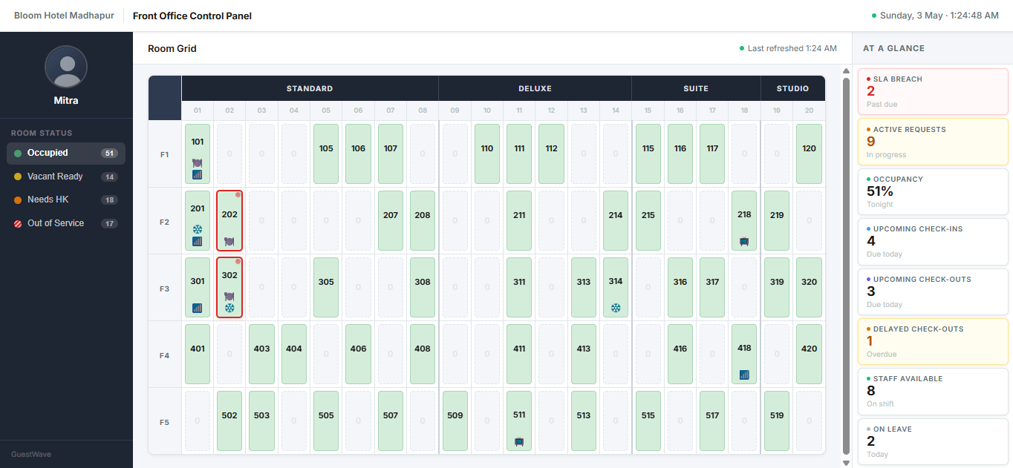
Hotel Operations Control Panel
04

Slide 5
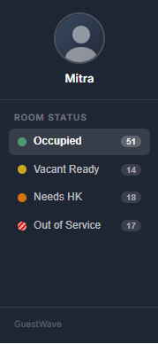



Left Panel — Control
05
Design Decisions
Single-select filter
One status at a time prevents cognitive overload. Staff see exactly what they need — nothing more.
Profile always visible
Staff identity is always on screen. Reduces errors, increases accountability.
Color-coded status
Four distinct colors map directly to operational states — scannable in under a second.

Slide 6
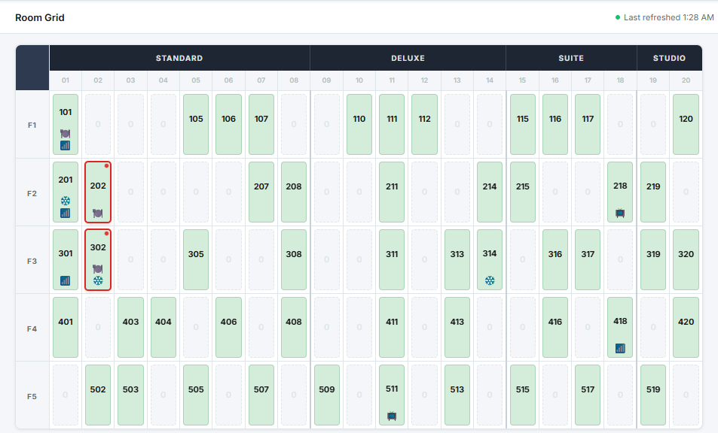
Center Grid — Core Experience
06
Design Decisions
Floor × Type structure
Y-axis = floors, X-axis = room types. No infinite scroll — every room visible at once.
Status-coded cards
Color, border, and icon communicate status instantly. No labels needed.
SLA pulse indicator
Red border + animated dot draws attention to breaching rooms. Priority is self-evident.
Click-to-action
Any card opens a contextual action modal. Check-in, assign staff, mark done — 2 clicks max.

Slide 7
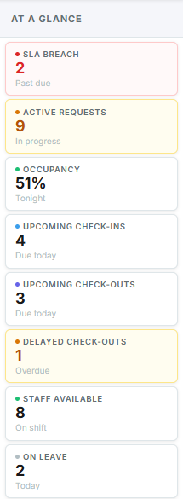



Right Panel — Awareness
07
Design Decisions
Proactive SLA alerts
Breaching rooms are surfaced before they become complaints. Staff act before guests escalate.
Live KPI cards
Occupancy, requests, check-ins/outs — always visible. No report, no refresh needed.
Clickable for depth
Every KPI card opens a detailed modal. Summary by default, drill-down on demand.

Slide 8
Data Model Overview
08
How operations are structured behind the interface
Room
room_id
stays in
floor
type
status
has
Guest
Tasks
Staff
guest_id
task_id
staff_id
name
type (HK/Service)
assigned to
name
check_in
status
role
check_out
sla_time
task_count

Slide 9


Dashboard Impact
09
Operational Excellence
Guest Experience
Reduced SLA breaches through proactive alerts
Better workload distribution across staff
Improved staff utilisation and accountability
Faster decision-making with a single-screen view
Faster service response with real-time assignment
Fewer delays through live room status visibility
Smoother stay from check-in to check-out

Slide 10
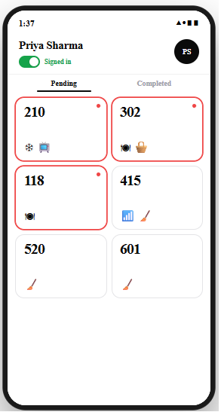
Housekeeping App — Home Screen
10
Name & sign-in toggle
Pending / Completed tabs
Red pulse = SLA breach
2×5 square card grid
(sorted by SLA urgency)

Slide 11
App in Action — Task Execution Flow
11
Service task example: Room 302 · Food Delivery
1
2
3
4
🟡
📷
📋
✅
Select Task
Verify Room
Pre-condition
Complete
Staff taps urgent room card (red pulse). Opens task detail with SLA timer.
→
Camera opens. Staff captures door plate. Timestamp auto-stamped.
→
Before photos captured across 3 sections: Room, Bathroom, Amenities.
→
After photos captured. Staff confirms. Task marked done. Card moves to Completed.
Repair tasks (AC, TV, Plumbing) include an additional After Documentation step before completion.

Slide 12
Mobile App Impact
12
Operational Excellence
Guest Experience
Quick task access — no navigation overhead
Reduced errors through structured documentation
Real-time task status visible to front office
Proof of work ensures quality at every room
Consistent experience via streamlined task flow
Fewer service gaps through photo documentation

Slide 13
"From reactive operations
to real-time control"
Thank You

